Slide 2
PERIODONTAL CONSIDERATION, BIOLOGICAL WIDTH, ANTE’^{S} LAW & JAPSEN RULE IN FPD ALONG WITH CASE SELECTION FOR FPD (DIAGNOSIS AND TREATMENT PLANNING).
Presented by:
DR. Astha Khurana

Slide 3
CONTENT
Introduction
Periodontal considerations
Biologic width
Ante’s law
Japsen’s rule in FPD
Introduction to FPD
Components of FPD
Diagnosis and treatment planning
Diagnostic aids
Personal information
Patient evaluation
Medical history
Past dental history
--Clinical examination
Extra oral examination
Intraoral examination
Radiographic examination

Slide 4
Selection of articulator
Consideration of occlusion
Treatment plan
Conclusion
References

Slide 5
INTRODUCTION TO FPD
Successful management of cases begin with a thorough assessment of the patient’s physical and psychological condition and determining a treatment that will satisfy the realistic expectations of the patient.

Slide 6
Definition “ A partial denture that is luted or otherwise securely retained to natural teeth, tooth roots and/or dental implant abutments that furnish the primary support to the prosthesis”- GPT

Slide 7
COMPONENTS OF FPD
DEFINITIONS:
Crown: an artificial replacement that restores missing tooth structure by surrounding part or all of the remaining structure with a material such as cast metal alloy, metal-ceramics, ceramics, resin, or a combination of materials
Abutment: a tooth, a portion of a tooth, or that portion of a dental implant that serves to support and/or retain a prosthesis

Slide 8
Retainer: the part of a fixed partial denture or fixed complete denture that unites the abutment(s) to the remainder of the restoration
Pontic: an artificial tooth on a fixed partial denture that replaces a missing natural tooth, restores its function, and usually restores the space previously occupied by the clinical crown

Slide 9
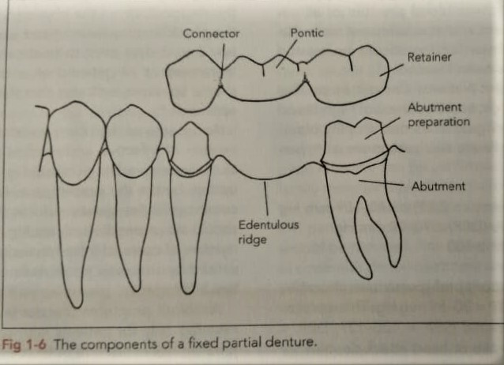
Connector: the portion of a fixed partial denture that unites the retainer(s) and pontic(s)

Slide 10
TYPES OF FPD
Simple fixed bridge
Traditional FPD
FPD with stress breaker
Cantilever
Maryland bridge
Rochette bridge
Virginia bridge
Compound fixed bridge

Slide 11
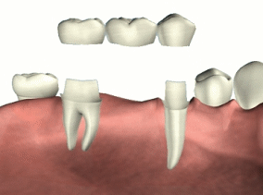
Traditional FPD

Slide 12
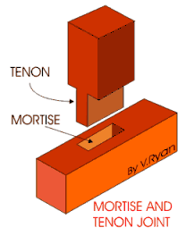
FPD with stress breaker

Slide 13
Cantilever bridge

Slide 14
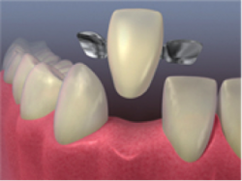
Maryland Bridge

Slide 15
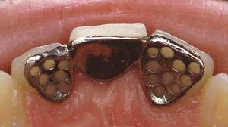
Rochette bridge

Slide 16
Virginia bridge

Slide 17
Compound PFD

Slide 18
PERIODONTAL CONSIDERATIONS
In the fabrication of any fixed prosthesis, the practitioner must determine the periodontal status of the involved abutment teeth. This allows a reliable and accurate prognosis for the restoration.
Peri = around, odontos = tooth
Functional unit of tissues supporting the tooth
Tooth + periodontium = DENTOPERIODONTAL UNIT
Comprises of
Gingiva, PDL,Alveolar bone,Root Cementum

Slide 19
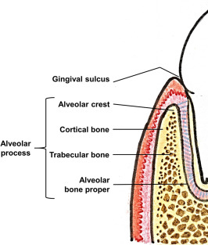
CLINICAL LANDMARKS
ALVEOLAR BONE
The bony portion of the mandible or the maxillae in which the roots of the teeth are held by the fibres of the periodontal ligament, also called as dental alveolus

Slide 20
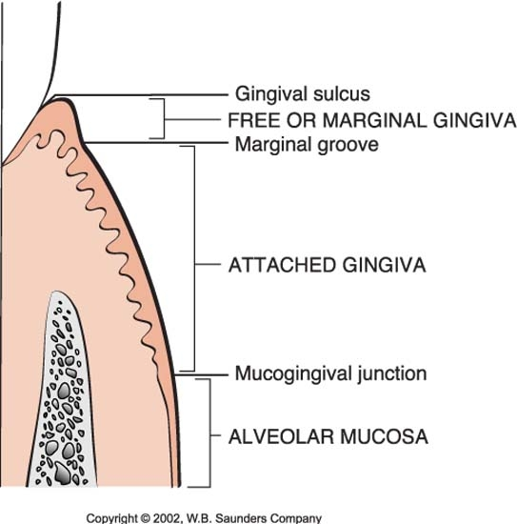
GINGIVA
The gingiva or gums, consists of the mucosal tissue that lays over the jawbone.
Normal gingiva exhibiting no fluid exudates or inflammation due to bacterial plaque-is pink and stippled

Slide 21
Gingival sulcus
It is defined as the space or shallow crevice between the tooth and the free gingiva, which extends apical to the junctional epithelium.
It is V- shaped and barely permits the enterance of periodental probe
Under normal or ideal conditions it is about 0 mm (very rare)
The so-called probing depth of a clinically-normal gingical sulcus in humans is about 2-3 mm.

Slide 22
Measurement of gingival sulcus depth :
UNC-15 periodontal probe.
The probe is inserted parallel to the long axis to the tooth and walked along the tooth. The probing depth is measured from the free gingival margin to the deepest penetration of periodontal probe.
Notes:
1, 2, 3, 4
5 missing

Slide 24
CEMENTUM
Cementum is the calcified mesenchymal tissue that forms the outer covering of the anatomical root.
PERIODONTAL LIGAMENT
It’s the connective tissue that surrounds the root and connects it to the bone
Its mainly made of collagen fibers - principle fibers

Slide 25
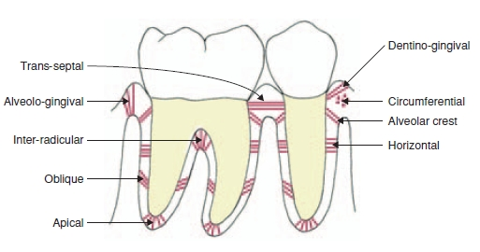

Slide 26
Margin placement
Preparation margin can be supragingival, at the crest, or subgingival.
A supragingival margin location allows healthiest gingival response.
Periodontally, subgingival margins results in a gingival inflammatory response.
Inflammatory response may range from subclinical inflammation to an overt inflammatory response with swelling, redness, tenderness, bleeding, and possibly bone loss.

Slide 27
GUIDELINES FOR SUBGINGIVAL MARGIN PLACEMENT:
A general guideline is that subgingival margins should be placed not more than half the depth of sulcus.
Restorative considerations that dictate the placement of margins below the gingiva include:
Creating adequate resistance and retention form
Allowing the margin to be placed on sound tooth structure below any decay or existing restoration
Esthetics in anterior region

Slide 28
BIOLOGIC WIDTH
Biological width is the natural distance between the base of the gingival sulcus and the height of the alveolar bone. The gingival sulcus is a little crevice that lies between the enamel of the tooth crown and the sulcular epithelium.
Mean values
junctional epithelium: 0.97mm
connective tissue attachment: 1.07mm
biological width: 0.97mm+1.07mm = 2.04mm

Slide 30
The biologic width can be identified by probing under local anesthesia to the bone level (referred to as "sounding to bone") and subtracting the sulcus depth from the resulting measurement.
If this distance is less than 2 mm at one or more locations, a diagnosis of biologic width violation can be confirmed
Tooth preparation margins that are within the attachment create a biologic width violation.

Slide 31
It frequently occur at the Mesiofacial or the distofacial line angles of maxillary anterior teeth treated with fixed restoration.
It can be corrected either by surgical removal of bone from below the restorative margin and movement of attachment apically, or by orthodontic movement of the coronally away from the attachment.

Slide 32
ANTE’S LAW
The root surface area of potential abutment teeth must be assessed when planning treatment for fixed prosthodontics. ‘Ante suggested in 1926’ that it was unwise to provide a fixed partial denture when the root surface area of the abutment was less than the root surface area of the teeth being replaced.

Slide 33
ANTE'S law sated that ‘ the combined root surface area of the abutment teeth should be equal to or greater than the root surface area of the tooth or teeth to be replaced.

Slide 35
Jepsen table: root surface area for abutment teeth
Notes:
To make ANTE'S law a mathematical calculation, average values for root surface area of permanent teeth were given by Jepson.

Slide 36
DIAGNOSIS

Slide 37
DIAGNOSIS AND TREATMENT PLANNING
Diagnosis
The determination of the nature of a disease.
Treatment plan
The sequence of procedures planned for the treatment of a patient after diagnosis.
Making the correct diagnosis is prerequisite to formulating an appropriate treatment plan.

Slide 38
HISTORY
All pertinent information concerning the reasons seeking treatment, along with any personal information, including relevant medical and dental experiences.
The chief complaint should be recorded preferably in patient’s own words.

Slide 39
CHIEF COMPLAINT
The accuracy and significance of the patient’s primary reason or reasons for seeking treatment should be analyzed first.
The complaints usually belong to one of the following four categories:
COMFORT (pain, sensitivity, swelling)
FUNCTION (Difficulty in mastication or speech)
SOCIAL (Bad taste or odor )
APPEAREANCE (Fractured or unattractive teeth or restorations , discoloration)

Slide 40
PERSONAL DETAILS
The patient's name
Address
Phone number
Gender
Occupation
Work schedule.

Slide 41
MEDICAL HISTORY
Accurate and current general medical history should include
Any medication the patient is taking as well as all relevant medical conditions
If necessary the patients physician(s) can be contacted for clarification.
The following classification may be helpful:
Conditions affecting the treatment methodology e.g., any disorders that necessitate the use of antibiotic premedication, any use of steroids or anticoagulants, and any previous allergic responses to medication or dental materials.

Slide 42
Conditions affecting the treatment plan (e.g., previous radiation therapy, hemorrhagic disorders, extremes of age, and terminal illness).
Systemic conditions with oral manifestations.
Possible risk factors to the dentist and auxiliary personnel (e.g., patients who are suspected or confirmed carriers of hepatitis B, acquired immunodeficiency syndrome, or syphilis).

Slide 43
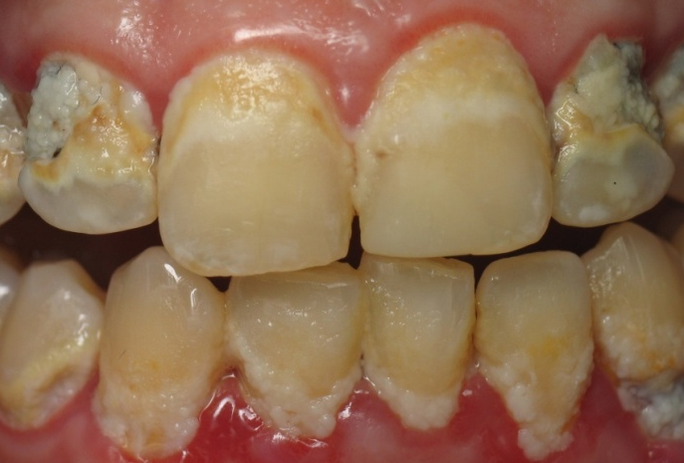
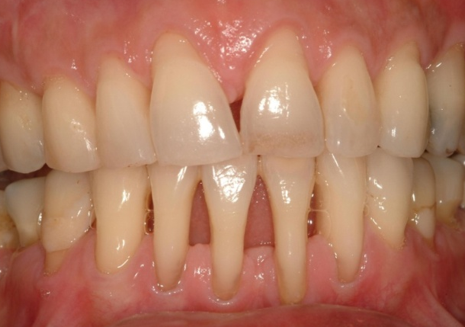
DENTAL HISTORY
Periodontal history
The patients oral hygiene is assessed
The frequency of any previous debridement should be recorded
Dates & nature of any previous periodontal surgery should be noted.

Slide 44
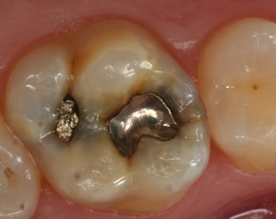
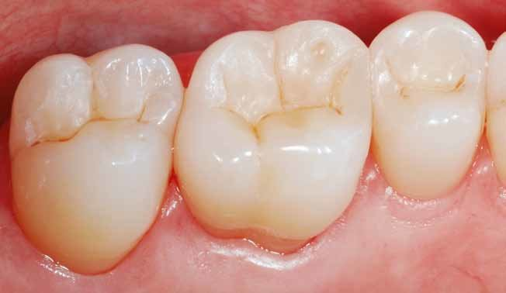
Restorative history
Simple composite resin or dental amalgam fillings or may involve crowns and extensive fixed partial dentures.
The age of previous existing restorations can help the prognosis and probable longevity of any future fixed prosthesis.

Slide 45
Endodontic history
Readily identified with radiographs.
The findings should be reviewed periodically so that peri-apical health can be monitored, and any recurring lesions are promptly detected

Slide 46
Orthodontic history
On occasion, root resorption (detected on radiograph) may be attributable to previous orthodontic treatment. As the crown/root ratio is affected, future prosthodontic treatment and its prognosis may also be affected.

Slide 47
Removable prosthodontic history
The patients experiences with removable prosthesis must be carefully evaluated.
Listening to the patient’s comments about previously unsuccessful prosthesis can be helpful in assessing whether future treatment will be more successful.

Slide 48
Oral surgical history
Information about missing teeth and any complications that may have occurred during tooth removal is obtained.
Special evaluation and data collection procedures are necessary for patients who require prosthodontic care after orthognathic surgery.
Before any treatment is undertaken, the prosthodontic component of the proposed treatment must be fully coordinated with surgical component.

Slide 49
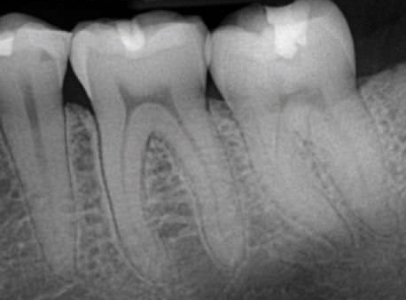
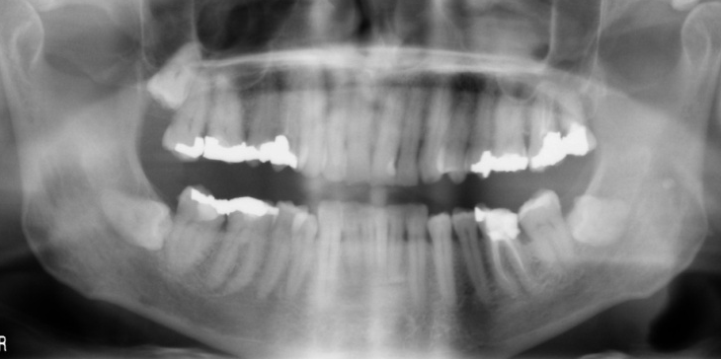
Radiographic history
Previous radiographs may prove helpful in judging the progress of dental disease.
In most instances , however , a current diagnostic radiographic series is essential and should be obtained as a part of examination.

Slide 50
TMJ dysfunction history
A history of pain or clicking in the TMJ or neuromuscular systems, such as abnormal muscle tone or tenderness to palpation, should normally be treated and resolved before fixed prosthodontic treatment begins.

Slide 51
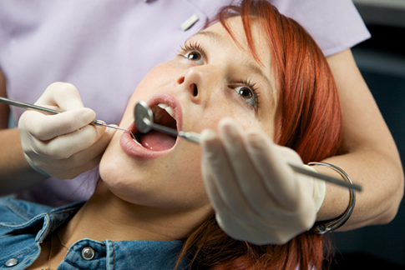
EXAMINATION
An examination consist of the clinician’s use of sight, touch , and hearing to detect abnormal conditions.

Slide 52
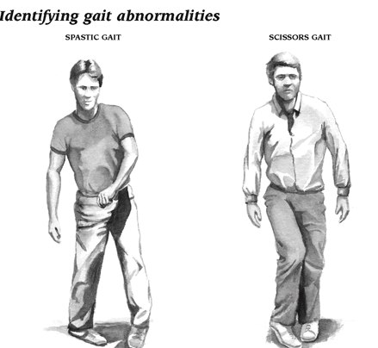
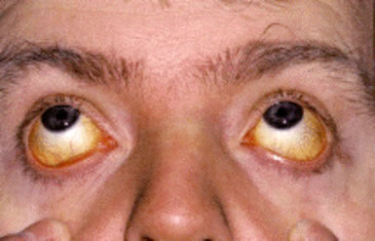
General examination
General appearance: Gait and weight are assessed.
Skin color : For signs of Anemia or jaundice.
Vital signs: Respiration, pulse, temperature and blood pressure are measured and recorded.

Slide 53
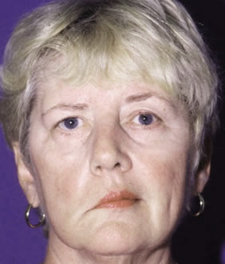
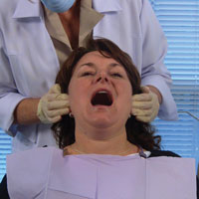
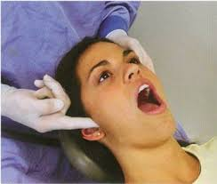
Extraoral examination
Facial asymmetry
Cervical lymph nodes
TMJ
Muscles of mastication(Palpated)

Slide 54
Temperomandibular joint
The clinician locates the TMJs by palpating bilaterally just anterior to the auricular tragi while having the patient open and close the mouth.
Permits a comparison between the relative timing of left and right condylar movements during the opening stroke

Slide 55
ASYNCHRONOUS MOVEMENT indicates anterior disk displacement that prevents one of the condyles from making a normal translatory movements.
Auricular palpation with light anterior pressure helps identify potential disorders in the posterior attachment of the disk.
Tenderness or pain on movement, can be indicative of inflammatory changes in the retrodiscal tissues ,which are highly vascular and innervated.

Slide 56
Mouth opening
Average opening >50mm
Restricted opening <35mm (intracapsular changes in the joints).
Similarly, any midline deviation on opening and/or closing is recorded. The maximum lateral movements of the patient can be measured (normal is about 12 mm).

Slide 57
Muscles of mastication
Masseter ,Temporalis and other postural muscles are palpated for signs of tenderness.
light pressure
In TMJ dysfunction , a systematic sequence of muscle palpation should be followed

Slide 59
Lips
Visibility during normal and exaggerated smiling is observed. This can be critical during Fixed Prosthodontic Treatment Planning.

Slide 60
“NEGATIVE SPACE”:- When the patient laughs, the jaws open slightly and a dark space is often visible between the maxillary and mandibular teeth.
Missing teeth, diastemas and fractured or poorly restored teeth disrupts harmony of negative space and require correction.

Slide 62
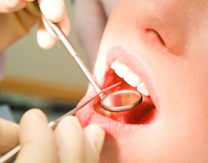
Intraoral examination
Condition of the soft tissues, teeth and supporting structures, tongue, floor of the mouth, palate are examined

Slide 63
Periodontal examination
Should provide information regarding status of bacterial accumulation.
The response of the host tissues and the degree of reversible & irreversible damage.
Long term periodontal health is essential to successful fixed prosthodontic treatment.

Slide 64
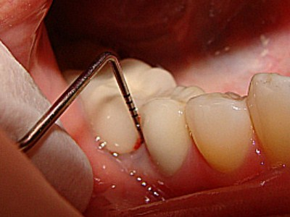
Gingiva: color,texture,position,contour, consistency.
Periodontium: With the help of periodontal probe. We measure the pocket depth, any tooth mobility, open contacts, furcation involvement, frenal attachment.

Slide 65
Clinical attachment level
It determines amount of periodontal destruction and is essential in rendering a diagnosis of periodontitis (loss of connective tissue attachment).
It is determined by measuring distance between apical extent of probing depth and a fixed reference point on the tooth.

Slide 66
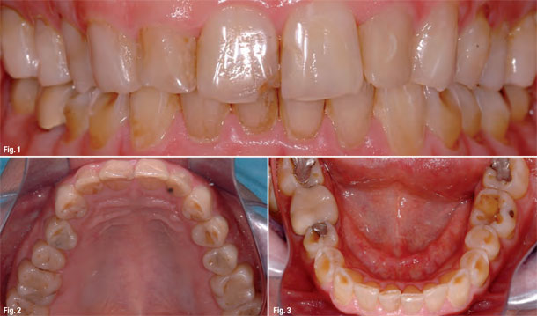
Occlusal examination
The initial clinical examination starts with the clinician asking the patient to make a few simple opening and closing movements while carefully observing the opening and closing strokes.
Special attention is given to Initial tooth contact, Tooth alignment, and eccentric contacts

Slide 67
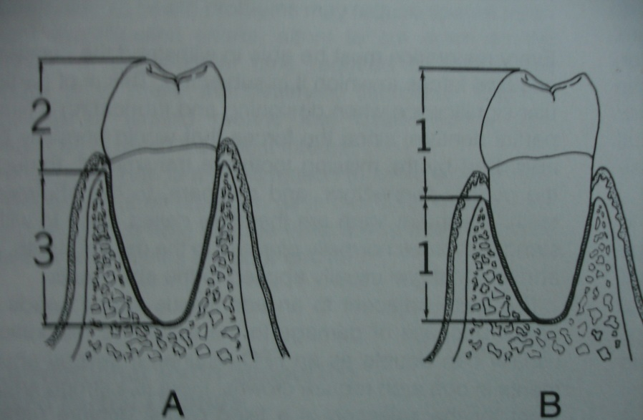
CROWN ROOT RATIO
Optimum -2:3
Minimum -1:1 (acceptable)

Slide 68
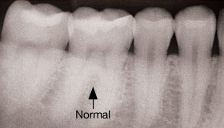
FURCATION
Furcation is the area located between individual root of the multirooted teeth.

Slide 69
Furcation involvement
It refers to the invasion of the bifurcation and trifuraction of the multirooted teeth by periodontal disease.
Mandibular first molars are most commonly involved.
Maxillary premolars are least common.

Slide 70
Furcation classification
Acc. to glickmann- 1953
Grade 1- Incipient or early stage of furcation invovement, radiographically no changes are seen.
Grade 2- Can involve one or more of the furcation of the same tooth, lesion is cul- de- sac ,radiograph may or may not depict furcation invovlement.

Slide 71
Grade 3- Interdental bone is not attached to furcation but there is presence of soft tissue.
Grade 4- Inderdental bone along with soft tissue is destroyed, through and through lesion and visible clinically.

Slide 72
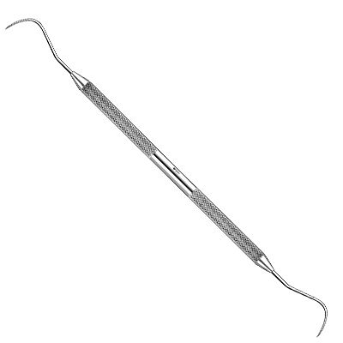
Assessed by Naber’s probe

Slide 73
DIAGNOSTIC AIDS
Radiographs
Vitality test
Diagnostic casts
Periodontal probe.

Slide 74
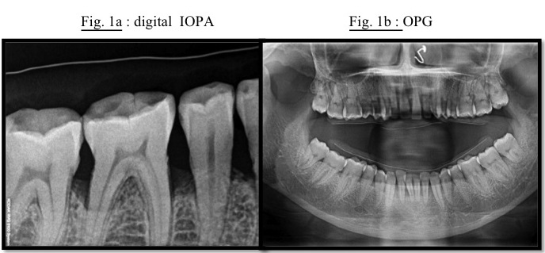
Radiographic examination
Provides essential information to supplement clinical examination.
Extent of bone support

Slide 75
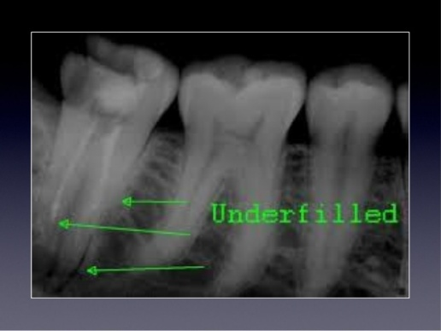
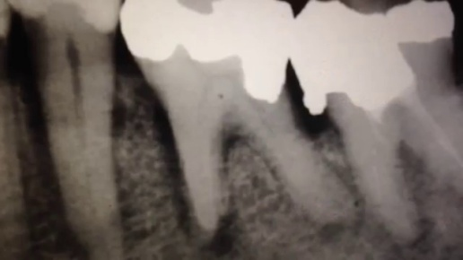
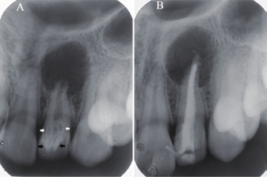
Existing restoration
Peri apical pathology

Slide 76
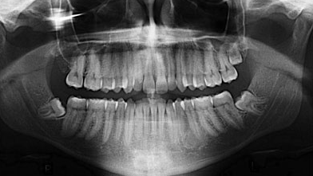
Panoramic radiographs
Presence or absence of teeth
Assessing third molars impactions,
Evaluating the bone before implant placement.
Screening edentulous arches for buried root tips.

Slide 77
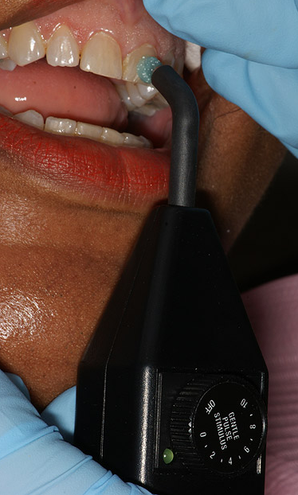
VITALITY TEST
Pulpal health must be measured before any restorative treatment usually by-
percussion and
thermal stimulation
Non vitality -Test cavity without L.A

Slide 78
DIAGNOSIS AND PROGNOSIS
Not all the patients seeking fixed prosthodontic treatment have diagnostic problems.
Nevertheless ,diagnostic errors are possible, especially when a patient complains of pain or symptoms of occlusal dysfunction.
A logical and systematic approach to diagnosis will help avoid mistakes.

Slide 79
PROGNOSIS
The prognosis is an estimation of the likely course of a disease.
The prognosis of dental disorders is influenced by-
GENERAL FACTORS (age of patient, lowered resistance of the oral environment)
LOCAL FACTORS (Forces applied to a given tooth , access for oral hygiene measures).

Slide 80
Prosthodontic Diagnostic Index PDI(For partially edentulous and completely dentate patients)
Classification is based on four criteria, Each class is differentiated by-
Location and extent of edentulous area or areas
Condition of abutment teeth
occlusal scheme
Residual ridge

Slide 81
Class I
Ideal or minimal compromise in the location of edentulous areas( which is confined to single arch)
Abutment condition is ideal or minimally compromised
Occlusion is ideal with no need for pre prosthetic therapy and class 1 molar relationship
Residual ridge conforms class I complete edentulism description.

Slide 82
Class I

Slide 83
Class II
Location and extent of edentulous area are moderately compromised
Edentulous area may exist in one or both arches
It may include any anterior maxillary span not exceeding 2 incisors.
In mandible anterior span - not exceeding four incisors
Posterior maxilla and mandible- that does not exceed 2 premolar or 1 premolar and 1 molar.
Any missing canine(max. or mand)

Slide 84
Abutment
In 1 or 2 sextants have sufficient structure to retain or support intra or extra coronal restoration and requires localized adjunctive therapy.
Occlusion
Occlusion correction requires localized adjunctive therapy (enameloplasty of premature contacts)
Class I molar relationship
Residual ridge - conforms to class II complete edentulism description

Slide 85
Class II

Slide 86
Class III
Characterized by substantially compromised location and extent of edentulous area in both arches.
It may include- Posterior maxillary or mandibular edentulous area greater than 3 teeth or two molars or anterior and posterior edentulous areas of 3 or more teeth.

Slide 87
Abutments : have insufficient tooth structure
Requires more substantial localized adjunctive therapy but have fair prognosis.
Occlusion
Requires establishment of entire occlusal scheme without accompanying changes in OVD.
Molar relationship- class II

Slide 88
Class III

Slide 89
Class IV
Edentulous areas- may be extensive and may occur in both arches
Abutments: severely compromised, in 4 or more sextants have insufficient tooth structure.
Occlusion: Severely compromised
Re-establishment of entire occlusal scheme including changes in OVD is necessary.

Slide 90
Class IV

Slide 91
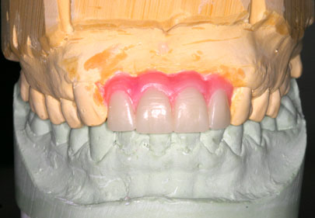
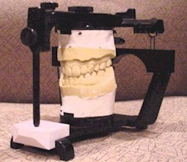
DIAGNOSTIC CASTS
A life size reproduction of the parts of the oral cavity and or facial structures for the purpose of study and treatment planning.
Diagnostic casts are the integral part of the diagnostic procedures necessary to give the dentist a complete perspective as possible of the patients dental needs.

Slide 92
SEMIADJUSTABLE ARTICULATOR with a FACE BOW TRANSFER.
Articulated diagnostic casts permits a detailed analysis of occlusal plane and the occlusion for a better diagnosis and treatment plan in fixed prosthodontic treatment.
Tooth preparations can be “rehearsed “ on the casts and diagnostic waxing procedures allow evaluation of the eventual outcome of proposed treatment .

Slide 93
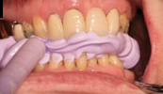
INTEROCCLUSAL RECORDS
CENTRIC RELATION RECORDS are used to replicate on the articulator.
Identify the deflective contacts.

Slide 94
SELECTION OF ARTICULATOR

Slide 95
Articulators can simulate the movement of the condyles in their corresponding fossae.
If an articulator closely reproduces the actual border movements of a given patient, this will significantly reduce chair time because the dental laboratory can then design the prosthesis to be in functional harmony with the patient's movements.

Slide 96
Instrument selection depends on the type and complexity of treatment needs, the demands for procedural accuracy, and general expediency.
Use of the proper instrument for a given procedure can translate into significant timesaving during subsequent stages of treatment.

Slide 97
Small nonadjustable articulators
Many cast restorations are made on small nonadjustable articulators
Their use often leads to restorations with occlusal discrepancies, because these instruments do not have the capacity to reproduce the full range of mandibular movement.

Slide 98
Some discrepancies can be corrected intraorally, but this is often time consuming, leading to increased inaccuracy.
If discrepancies are left uncorrected, occlusal interferences and associated neuromuscular disorders may result.

Slide 99
Semiadjustable articulators
For most routine fixed prostheses, the use of a semiadjustable articulator (Fig. 2-7) is a practical approach to providing the necessary diagnostic information while minimizing the need for clinical adjustment during treatment.
There are two basic designs of the semiadjustable articulator:
the arcon and the nonarcon

Slide 101
Nonarcon instruments gained considerable popularity in complete denture prosthodontics because the upper and lower members are rigidly attached, permitting easier control when positioning artificial teeth.
In an arcon articulator, the condylar spheres are attached to the lower component of the articulator, and the mechanical fossae are attached to the upper member of the instrument.

Slide 102
Fully adjustable articulators
A fully (or highly) adjustable articulator has a wide range of positions and can be set to follow a patient's border movements.

Slide 103
The accuracy of reproduction of movement depends on the care and skill of the operator, the errors inherent in the articulator and recording device, and any malalignments due to slight flexing of the mandible and the nonrigid nature of the TMJs.

Slide 105
Whip Mix articulators
are designed to enable the user to quickly and easily mount casts of a patient’s dentition on a mechanical device that will reproduce their natural relationship and movements with an acceptable degree of accuracy.

Slide 106
Articulator Manipulations
To attach or remove the incisal guide pin, loosen or tighten the incisal guide pin screw.
The upper and lower frames are made parallel by aligning the top of the pin with the dark line which completely encircles the pin.

Slide 107
Spring Latch Operation
To engage the spring latch, pull down on the spring and slide into the latch bracket. To remove the upper member, slide the spring latch out of the latch bracket.

Slide 108
Adjust Intercondylar Distance
The lower frame of the articulator has the letters L, M, and S engraved on each of its top corners.
Each of the two condylar elements should slide to one of the settings to correspond with the patient’s intercondylar width as recorded on the facebow.

Slide 109
Maxillary Fork Support
The adjustable “T” supports the bitefork and maxillary cast when mounting the facebow record on the articulator.

Slide 110
Dual-End Incisal Pin
Has a chisel end for use with an adjustable incisal guide table and a spherical end for use with a flat anterior guide table. Both ends are calibrated for vertical adjustments.

Slide 111
Facebow transfer
Whip Mix Quick Mount arbitrary hinge axis facebows.
Note the nasion relator as the third reference point.

Slide 112
Facebow Registration
Items needed for a facebow registration
1. Facebow with nasion relator assembly, transfer jig, and bitefork
2. Wax or bite registration material
3. Rubber band (optional)

Slide 113
Preparing the Face-Bow
Cleanse the plastic ear pieces thoroughly

Slide 114
2. Preparing Face-Bow Fork
Apply an elastomeric registration material to the top surface of the bite fork (capture the cusp tips of the maxillary teeth)
Remove the fork from the mouth and trim away any excess compound or wax.
Cover the lower surface of the fork with firm wax to provide more comfort for the patient.
It is now positioned in the patient’s mouth and held in place by closing the mandible against it.

Slide 115
3. Positioning the Face-Bow on the Patient
Ask the patient to grasp both arms of the face-bow and help guide the plastic ear pieces into the external auditory meatus.
Tighten the 3 thumb screws and center the nose piece on the nasion and tighten it into place.

Slide 116
The patient’s condylar width is determined by referring to the markings on the front of the face-bow. Three graduations are marked (S,M,L) on the upper arm corresponding to condylar widths of Small, Medium and Large. The single line on the lower arm is the indicator.

Slide 117
4. Preparing Articulator for Mounting Casts
The lower frame of the articulator has the letters L,M and S engraved on each of its corners on the back side.

Slide 118
Then set the upper frame of the articulator to the same width by removing or adding the correct number of spacers on the shafts of the condylar guides.
Use two spacers on each shaft for Large, one on each shaft for Medium and none for Small.

Slide 119
Be sure that the horizontal line on each spacer aligns with that on the back of the condylar guide.
The condylar guides should now be set at 30° angulation in preparation for attaching the face-bow assembly.

Slide 120
5. Placing Face-Bow Registration on Articulator
Slide the nasion relator assembly away from the center of the cross bar of the face-bow and loosen the 3 thumb screws slightly.
To secure the face-bow in place, hold it in one hand and with the other lift off the upper member of the articulator.

Slide 121
Allow the anterior end of the upper frame of the articulator to rest on the cross bar of the face-bow, then tighten the 3 thumb screws

Slide 122
Now replace the upper frame with the attached face-bow onto the lower frame allowing the fork toggle of the face-bow to rest on the plastic incisal guide block.

Slide 123
6. Mounting Maxillary Cast

Slide 124
7. Mounting Mandibular Cast

Slide 125
Custom Acrylic Anterior Guidance Table
This simple device is used for accurately transferring to an articulator the contacts of anterior teeth when determining their influence on border movements of the mandible.
Acrylic resin is used to record and preserve this information, even after the natural lingual contours of the teeth have been altered during preparation for complete coverage restorations.

