Slide 1
COVID 19
DR A NIKHIL SINGH
MDS PG 3rd yr
Guided: MK SINGHAL

Slide 2
INTRODUCTION
Coronavirus disease 2019 (COVID-19) is a respiratory tract infection caused by a newly emergent corona-virus (SARS-COV-2), that was first recognized in Wuhan, China, in December 2019.
Genetic sequencing of the virus suggests that it is a beta-coronavirus closely linked to the SARS virus.
Incubation period : appearance of symptoms after infection is usually 5-14 days.

Slide 3
MODE OF TRANSMISSION
Highly infectious viral disease of respiratory system and spreads by
•Droplets-when an infected person coughs,sneezes or talks,or during certain procedures.
•infectiousparticles >5micronsinsize.
•droplet distribution range is limited by the force of expulsion and gravity and is usually <1metre.
•Droplets can also be transmitted indirectly to mucosal surfaces(e.g.viahands) or contact of hands with surfaces contaminated by droplet and by touching the face,nose and mouth with hands.
•Contact of hands with contaminated surfaces.

Slide 5
CURRENT SITUATION AS OF 01/5/2020
Total cases worldwide: 33,03,850
Deaths 2,33,813
Recovered : 10,39,055
Top 5 worst hit countries USA 10,94,730 Spain 2,39,639 Italy 2,05,463 UK 1,71,253 France 1,67,178
China 11th worst hit country 82,862 with 41 active

Slide 6
SITUATION IN INDIA as of 01/05/2020
India 16th worst hit country
Total cases: 34,863
Active 24,647
Recovered 9,059
Death 1,154
UTTAR PRADESH 2,211 77^ updated 12 hrs ago (from 10:00 am) Agra 468 38^ Kanpur 210 3^ Lucknow 206 1^ Saharanpur 187 5^ GB Nagar 141 4^
Bareilly 8

Slide 7
CLINICAL PROFILE
Most people infected with COVID-19 virus (SARS-COV2) develop only mild illness
Approximately 14% develop severe disease, which requires hospitalization and oxygen support
Less than 5% may require admission to an intensive care unit (ICU) with ventilator support
The severe cases can be complicated as severe pneumonia, acute respiratory distress syndrome (ARDS),, sepsis, multi -organ failure and shock.
Patients above 60 years of age or with co-morbidities like Diabetes Mellitus, Hypertension and COPD have higher mortality

Slide 8
CASE DEFINITION OF A SUSPECT, PROBABLE CASE AND CONFIRMED CASE

Slide 9
CASE DEFINITION:SUSPECT
History of foreign travel during the 14 days prior to symptom onset AND Any of the following:
•Fever
•Cough
•Respiratory distress
OR
•A patient/Health care worker with any acute respiratory illness AND having been in contact with a confirmed COVID-19 case in the last 14 days prior to onset of symptoms;
OR
•A patient with severe acute respiratory infection {fever and at least one sign/symptom of respiratory disease (e.g., cough, shortness breath)} AND requiring hospitalization AND with no other etiology that fully explains the clinical presentation;
OR
•A case for whom testing for COVID-19 is inconclusive.

Slide 10
CASE DEFINITION:PROBABLE
A person with acute respiratory illness of any degree of severity who, within 14 days before onset of illness, had any of the following exposures:
a. close physical contact with a confirmed case of COVID19 infection, while that patient was symptomatic;
Or
b. a healthcare facility in a country where hospital associated COVID19 infections have been reported

Slide 11
CASE DEFINITION:LAB
Patients that meet the case definition and tested positive with Specific Real time RT-PCR test for COVID 19

Slide 12
HIGH RISK CONTACTS vs LOW RISK CONTACTS

Slide 22
LEVELS OF FACILITIES
L1, L2 ,L3

Slide 28
PATHOGENESIS
Much is known about the mortality of the clinical disease, however much less is known about its pathology.
Although details of the cellular responses to this virus are not known, a probable course of events can be postulated
Based on the cells that are likely infected, COVID-19 can be divided into three phases that correspond to different clinical stages of the disease

Slide 29
Stage 1: Asymptomatic state (initial 1–2 days of infection)
The inhaled virus likely binds to epithelial cells in the nasal cavity and starts replicating.
ACE2(Angiotensin converting enzyme 2) is the main receptor
In vitro data with the virus indicate that the ciliated cells are primary cells infected
There is local propagation of the virus but a limited innate immune response.
At this stage the virus can be detected by nasal swabs.
Although the viral burden may be low, these individuals are infectious.
The RT-PCR value for the viral RNA might be useful to predict the viral load

Slide 30
Stage 2: Upper airway and conducting airway response (next few days)
The virus propagates and migrates down the respiratory tract along the conducting airways, and a more robust innate immune response is triggered.
Nasal swabs or sputum should yield the virus as well as early markers of the innate immune response.
At this time, the disease COVID-19 is clinically manifest
The level of innate response cytokine may be predictive of the subsequent clinical
For about 80% of the infected patients, the disease will be mild

Slide 31
Stage 3: Hypoxia, ground glass infiltrates, and progression to ARDS
Unfortunately, about 20% of the infected patients will progress to stage 3 disease and will develop pulmonary infiltrates and some of these will develop very severe disease.
Initial estimates of the fatality rate are around 2%, but this varies markedly with age .
The virus now reaches the gas exchange units of the lung and infects alveolar type II cells, propagates within type II cells, release large number of viral particles, and the cells undergo apoptosis and die .
The end result is likely a self-replicating pulmonary toxin as the released viral particles infect type II cells in adjacent units
Recovery will require a vigorous innate and acquired immune response and epithelial regeneration
Elderly individuals are particularly at risk because of their diminished immune response and reduced ability to repair the damaged epithelium.

Slide 32
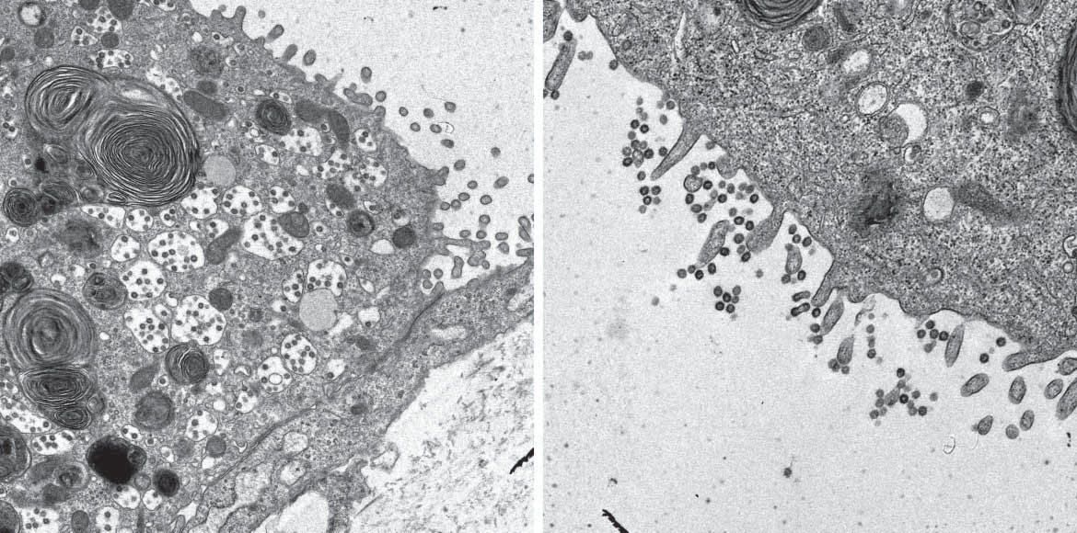
Human alveolar type II cells infected with SARS-CoV. Human type II cells were isolated, cultured in vitro, and then infected with SARS-CoV. Viral particles are seen in double membrane vesicles in the type II cells (a) and along the apical microvilli (b).

Slide 33
COMPARISON TO PAST OUT BREAKS

Slide 34
DISEASE and Mortality | 1st DETECTION | GLOBAL CASES | DEATHS | TRANSMISISON | T/t | VACCINE | END
Influenza/ Spanish flu | 1918 | 500 million | 50 million | Respiratory droplets | None (no ab or av) | X | 1919
Common flu (0.1%) |  | 9% population (1 billion) | 2.9-6.5k | Respiratory droplet (1.3 ) | symptomatic | X
SARS (15%) | 2002 CHINA | 8,098 | 774 (^60yrs) | Respiratory droplets and contaminated surface | Antivirals and steroids | At end | July 2003
H1N1 (0.2%) | 2009 Mexico | 60.8 million | 2.84K (children 5-19) | Respiratory droplets | Oseltamavir | Dec 20009 | Aug 2010
Ebola (50%) | 2013 GUinea | 28,652 | 11,325 | Bodily fluid | supportive | X | March 2016

Slide 35
SAFETY MEASURES

Slide 43
All Dental Colleges should provide general as well as specific information to all visiting the Dental Colleges

Slide 44
GENERAL INFORMATION:
1. Appeal to non-emergency patients to postpone their treatment plans to avoid cross-infection caused by clustering in Dental Colleges.
2. In case of any dental emergency; patients should wear masks for protection and minimize the number of accompanying persons as much as possible.
3. Patients should be encouraged to take appointments or register online or telephonically in all outpatient clinics to reduce gathering of people;
4. Enhance oral health education through the different media like internet, newspapers and social media.
5. The body temperature of all employees must be taken before entering the workplace, and it is forbidden to work with illness.
6. Strengthen training of faculty and staff in infection control, and equip dental teams with sufficient protective equipment which strictly complies with the protection requirements.
7. Display of posters of hand hygiene, infection control and other preventive strategies should be displayed at different and important locations of the dental colleges.
8. In wake of COVID-19 outbreak going on in the country, the Dental Colleges shall not hold any workshops, conferences, dental screening camps etc.

Slide 45
SPECIFIC INFORMATION:
1. Upon arrival, all patients in Pre-screening area, will be screened for signs and symptoms of COVID-19 and current dental complain.
2. Every patient who upon screening further classified as Emergency or Non-emergency. Emergency dental problems can be into severe dental pain, trauma, swelling, excessive bleeding and any other condition that is deemed appropriate.
3. Develop a standard reporting system with
a. Patient contact details,
b. History of fever, cold/cough and
c. Shortness of breath etc to report the same as per standard Government guidelines.
4. Dental Colleges should have a protocol for referral for patients and employees to fever clinic either in the attached Medical College or Affiliated Hospital.
5. Patient classified as emergency and non-emergency/elective procedures have to be managed accordingly.
6. Medical management of patients should be promoted until dental procedures are unwarranted.

Slide 46
Pre-viewing and triage area
Pre-viewing and triage dental team should wear adequate personal protective equipment.
Prepare thermometers/thermal scanners (forehead or ear thermometer) for temperature measurement, and ask patients regarding their epidemiological contact history, fever, and respiratory symptoms.
3. If the following conditions are encountered during triage, advise patients to leave and instruct them to go to the government hospital or designated hospital, and clean and disinfect the pre-screening triage area as soon as possible.
4. Maintain at least a 1 metre (3 feet) distance between yourself and anyone who is coughing or sneezing.
5. Patients with body temperature ≥37.3 ℃, with symptoms of a cough, runny nose, fatigue, etc may be referred to fever clinic and follow protocol.
6. A history of travel or local contact with somebody who has a fever may be identified, referred to fever clinic and follow protocol.
7. The patient’s living or working area has confirmed cluster cases of SARS-CoV-2 infection may be identified, referred to fever clinic and follow protocol.

Slide 47
DENTAL TREATMENT CONSIDERATIONS:
1. Carry out only emergency dental treatments in a single treatment room. Preferably designate separate clinical areas for Aerosol and Non-aerosol Control dental treatments.
2. Use 1.5% hydrogen peroxide or 0.2% povidine as a pre-procedural mouth rinse.
3. Wherever warranted, use extraoral dental radiographs such as panaromic radiographs as alternatives to intra oral radiographs during the outbreak of COVID-19, as the latter can stimulate saliva secretion and coughing.
4. Reduce aerosol production as much as possible, as the transmission of COVID-19 occurs via droplets or aerosols, and dentists should prioritize the use of hand instrumentation.
5. Dental teams should use rubber dams if an aerosol-producing procedure is being performed to help minimize aerosol or spatter.

Slide 48
6. Dentist may use a 4-handed technique for controlling infection.
7. Most of the Dental care should be performed with the use of high-volume suction or saliva ejectors mainly aerosol based procedures.
8. Dental care teams should “minimize the use of a 3-in-1 syringe as this may create droplets due to forcible ejection of water/air.”
9. Restrict the number of para-dental staff and patients who enter the clinical as well as waiting area of the clinics.
10. Pre-operative and Post operative Infection Control protocols should be followed and regular fumigation of clinics should be carried out.

Slide 50
THANK YOU

