Slide 1


Slide 2
DIABETES MELLITUS
PRESENTED BY:
satyaki verma
Mds I yr.
Dept. of periodontology and implantology

Slide 3

CONTENTS
INTRODUCTION
CLASSIFICATION
TYPES OF DIABETES MELLITUS(DM)
DIFFERENCE BETWEEN TYPE 1 & TYPE 2 DM
SYMPTOMS AND FEATURES OF DM
SIGNIFICANCE OF DIABETIC HISTORY & DIAGNOSTIC CRITERIA FOR DM
COMPLICATIONS OF DM
RELATIONSHIP B/W DIABETES AND PERIODONTAL DISEASE
  MECHANISM LINKING DIABETES AND PERIODONTITIS
  EFFECT OF DIABETES ON PERIODONTAL DISEASE AND TREATMENT
  EFFECT OF PERIODONTAL DISEASE AND TREATMENT ON DIABETES
  EFFECT OF NSPT ON DIABETES GLYCEMIC CONTROL
  EFFECT OF NSPT WITH ANTIMICROBIALS ON DIABETES GLYCEMIC CONTROL
  EFFECT OF SURGICAL PERIODONTAL THERAPY ON DIABETES GLYCEMIC CONTROL
CONCLUSION

Slide 4
INTRODUCTION
Diabetes is a chronic, metabolic disease characterized by elevated levels of blood glucose (or blood sugar), which leads over time to serious damage to the heart, blood vessels, eyes, kidneys and nerves.
World Health Organisation(WHO)
Diabetes is a group of metabolic diseases characterized by hyperglycemia resulting from defects in insulin secretion, insulin action, or both.
American Diabetes Association(ADA)
Diabetes is a Greek word meaning ‘a passer through; a siphon’, and mellitus derives from the Greek word for ‘sweet’.
Notes:
The study of metabolism began as long ago as the fifteenth century BC, with the first description of diabetes in the Ebers Papyrus.
3)The Greeks named it thus due to the excessive amounts of urine produced by sufferers which attracted insects because of its glucose content. The ancient Chinese tested for diabetes by observing whether ants were attracted to a person’s urine.

Slide 5
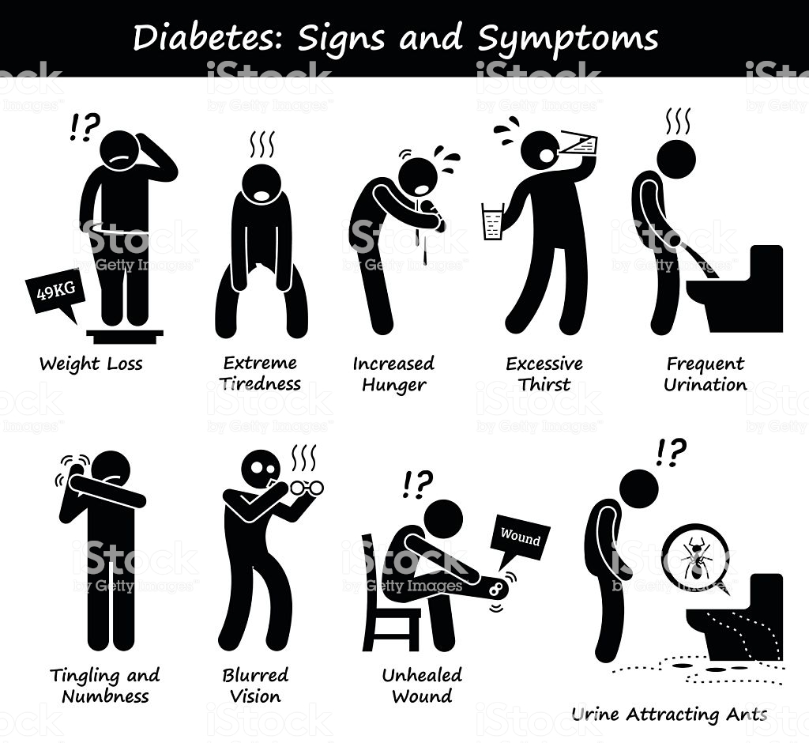
Metabolic diseases such as diabetes were deemed diseases of the rich, in developed countries but they are now frequently diseases of lower social class, as access to healthier foods may be expensive and difficult.
Diabetes mellitus is characterized by abnormal carbohydrate and lipid homoeostasis, leading to elevation in plasma glucose, or hyperglycaemia, and abnormality of serum lipids, or dyslipidaemia.
Diabetes develops as a result of a variable combination of absolute insulin deficiency as a result of pancreatic islet cell dysfunction and tissue insulin resistance due to reduced cellular responsiveness to insulin.
Notes:
1)Diabetes has become more prevalent in both developed and developing countries, leading to a significant burden of chronic disease and complications related to those diseases
3)Glucose homoeostasis is modulated mainly by the release of insulin from the islet cells (β cells) of the pancreas.

Slide 6
CLASSIFICATION
The World Health Organization (WHO) has developed a classification of diabetes mellitus based on its pathogenesis

Slide 7
HUTCHINSONS CLINICAL METHODS- AN INTEGRATED APPROACH 23RD ED.
Notes:
Assigning a type of diabetes to an individual often depends on the circumstances present at the time of diagnosis, and many diabetic individuals do not easily fit into a single class.

Slide 8
American Diabetes Association(ADA) Has classified diabetes on basis of etiology

Slide 10
TYPES OF DM
Type I diabetes(Beta Cell destruction usually leading to absolute insulin deficiency):
  Previously known as Insulin Dependant Diabetes or Juvenile Onset Diabetes.
  Markers of the immune destruction of the beta-cell include islet cell autoantibodies, autoantibodies to insulin, autoantibodies to Glutamic Acid Decarboxylase (GAD65), and autoantibodies to the tyrosine phosphatases IA-2 and IA-2beta.
  It has strong Human Leucocyte Antigen(HLA) associations.
Notes:
1)Accounts for 5-10% of those with diabetes.
2)Results from cellular mediated auto immune destruction of Beta Cells of pancreas.
3)One or more of these autoantibodies are present in 85–90% of individuals when fasting hyperglycemia is initially detected.

Slide 11
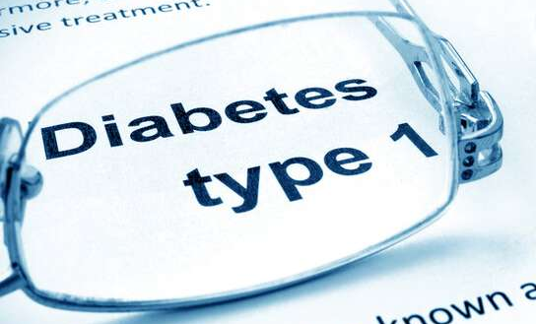
  Adults sometimes retain residual Beta-cell function sufficient to prevent ketoacidosis for many years, such individuals eventually become dependent on insulin for survival and are at risk for ketoacidosis.
  Patients are rarely obese and the presence of obesity is not incompatible with the diagnosis.
Notes:
2)Immune mediated diabetes commonly occurs in childhood and adolescence, but can occur at any age, even in the 8th and 9th decades of life.
4)Patients are also prone to other autoimmune disorders such as Graves’ disease, Hashimoto’s thyroiditis, Addison’s disease, vitiligo, celiac sprue, autoimmune hepatitis, myasthenia gravis, and pernicious anemia.

Slide 12
  IDIOPATHIC DIABETES
    This form of type 1 diabetes have no known etiologies.
    Only a minority of patients with type 1 diabetes fall into this category.
    Racial predilection for African or Asian ancestry is seen.
    This form of diabetes is strongly inherited, lacks immunological evidence for Beta–cell autoimmunity, and is not HLA associated.
Notes:
2)Patients have permanent insulinopenia and are prone to ketoacidosis, but have no evidence of autoimmunity.
5)An absolute requirement for insulin replacement therapy in affected patients may come and go.

Slide 13
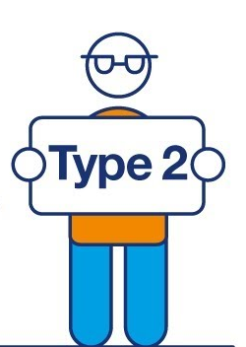
Type 2 diabetes (from predominantly insulin resistance with relative insulin deficiency to predominantly an insulin secretory defect with insulin resistance):
  Previously referred to as non–insulin dependent diabetes or adult-onset diabetes.
  Patients have insulin resistance and usually have relative (rather than absolute) insulin deficiency initially.
  Specific etiologies are not known as autoimmune destruction of beta-cells does not occur, and patients do not have any of the other causes of diabetes.
Notes:
Accounts for 90–95% of those with diabetes.
In the initial stages insulin resistance leads to increased insulin secretion which compensates for the insulin resistance leading to relative insulin deficiency. In later stages the islet cells of pancreas decreases production of insulin as they are exhausted leading to insulin secretory defect.
These individuals do not need insulin treatment to survive often throughout their lifetime.

Slide 14
  Patients with this form of diabetes are obese, and obesity itself causes some degree of insulin resistance.
  Patients are at increased risk of developing macrovascular and microvascular complications.
  Insulin resistance may improve with weight reduction or pharmacological treatment of hyperglycemia and is seldom restored to normal.
Notes:
1)Ketoacidosis seldom occurs spontaneously in this type of diabetes.
2)insulin secretion is defective in these patients and insufficient to compensate for insulin resistance.
3)This form of diabetes frequently goes undiagnosed for many years because the hyperglycemia develops gradually and at earlier stages is often not severe enough for the patient to notice any classical symptoms of diabetes.

Slide 15
  The risk of developing this form of diabetes increases with age, obesity, and lack of physical activity.
  It occurs more frequently in women with prior Gestational DM(GDM) and in individuals with hypertension or dyslipidemia.
  It is often associated with a strong genetic predisposition, than type 1 diabetes.

Slide 16

Other Specific Types of Diabetes:
  Genetic Defects of Beta Cell:
    They are referred to as Maturity Onset Diabetes Of The Young (MODY).
    Characterized by impaired insulin secretion with minimal or no defects in insulin action.
    Most common form is associated with mutations on chromosome 12 in a hepatic transcription factor referred to as hepatocyte nuclear factor (HNF)-1 alpha.
Notes:
2)These forms of diabetes are frequently characterized by onset of hyperglycemia at an early age (generally before age 25 years).
3)…………………………They are inherited in an autosomal dominant pattern.

Slide 17
    A second form is associated with mutations in the glucokinase gene on chromosome 7p and results in a defective glucokinase molecule.
    The less common forms result from mutations in other transcription factors, including HNF-4 alpha, HNF-1 beta, insulin promoter factor (IPF)-1, and NeuroD1.
    Point mutations in mitochondrial DNA have been found to be associated with diabetes and deafness.
    Genetic abnormalities that result in the inability to convert proinsulin to insulin have also been identified and the resultant glucose intolerance is mild.
Notes:
2) Glucokinase converts glucose to glucose-6-phosphate, the metabolism stimulates insulin secretion by the -cell. Thus, glucokinase serves as the “glucose sensor” for the -cell. Because of defects in the glucokinase gene, increased plasma levels of glucose are necessary to elicit normal levels of insulin secretion.
4)……………….The most common mutation occurs at position 3,243 in the tRNA leucine gene, leading to an A-to-G transition.

Slide 18

Genetic defects in insulin action.
  Mutations of the insulin receptor may range from hyperinsulinemia and modest hyperglycemia to severe diabetes.
  In the past, this syndrome was termed type A insulin resistance.
  Leprechaunism and the Rabson-Mendenhall syndrome are two pediatric syndromes that have mutations in the insulin receptor gene with subsequent alterations in insulin receptor function and extreme insulin resistance.

Slide 19
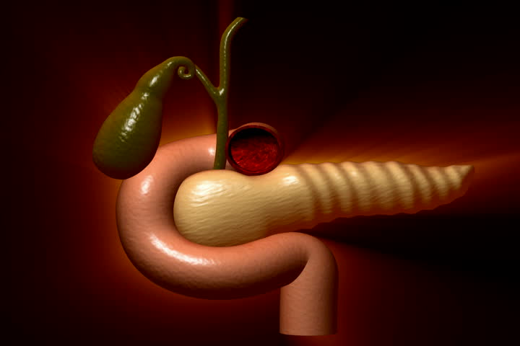
Diseases of the exocrine pancreas.
  Process that diffusely injures the pancreas can cause diabetes.
  Acquired processes include pancreatitis, trauma, infection, pancreatectomy, and pancreatic carcinoma. Damage to the pancreas must be extensive for diabetes to occur.
  Adrenocarcinomas that involve only a small portion of the pancreas have been associated with diabetes.
Notes:
3)This implies a mechanism other than simple reduction in beta-cell mass. If extensive enough, cystic fibrosis and hemochromatosis will also damage beta-cells and impair insulin secretion.

Slide 20
Endocrinopathies.
  Several hormones such as growth hormone, cortisol, glucagon, epinephrine antagonize insulin action.
  This generally occurs in individuals with preexisting defects in insulin secretion, and hyperglycemia typically resolves when the hormone excess is resolved.
Notes:
2)Excess amounts of these hormones (e.g., acromegaly, Cushing’s syndrome, glucagonoma, pheochromocytoma, respectively) can cause diabetes.
4)Somatostatinoma- and aldosteronoma- induced hypokalemia can cause diabetes, at least in part, by inhibiting insulin secretion.

Slide 21

Drug- or chemical-induced diabetes.
  These drugs may not cause diabetes by themselves, but they may precipitate diabetes in individuals with insulin resistance and can impair insulin action.
  Examples include nicotinic acid and glucocorticoids. Patients receiving alpha-interferon have been reported to develop diabetes associated with islet cell antibodies and severe insulin deficiency.
Notes:
1)Many drugs can impair insulin secretion.

Slide 22
Infections.
  Diabetes occurs in patients with congenital rubella, although most of these patients have HLA and immune markers characteristic of type 1 diabetes.
  In addition, coxsackievirus B, cytomegalovirus, adenovirus, and mumps have been implicated in inducing certain cases of the disease.
Notes:
Certain viruses have been associated with beta-cell destruction.

Slide 23
Uncommon forms of immune-mediated diabetes.
  The stiff-man syndrome is an autoimmune disorder of the central nervous system characterized by stiffness of the axial muscles with painful spasms and approximately one-third will develop diabetes.
  Anti-insulin receptor antibodies can cause diabetes by binding to the insulin receptor, thereby blocking the binding of insulin to its receptor in target tissues. In the past, this syndrome was termed type B insulin resistance.
Notes:
3)in some cases, these antibodies can act as an insulin agonist after binding to the receptor and can thereby cause hypoglycemia. Anti-insulin receptor antibodies are occasionally found in patients with systemic lupus erythematosus and other autoimmune diseases.

Slide 24

Gestational Diabetes Mellitus(GDM):
  GDM has been defined as any degree of glucose intolerance with onset or first recognition during pregnancy.
  Most cases resolve with delivery.
  The definition includes whether or not the condition persisted after pregnancy and does not exclude the possibility that unrecognized glucose intolerance may have begun simultaneously with the pregnancy.

Slide 25
DIFFERENCE B/W TYPE 1 AND TYPE 2 DIABETES

Slide 27
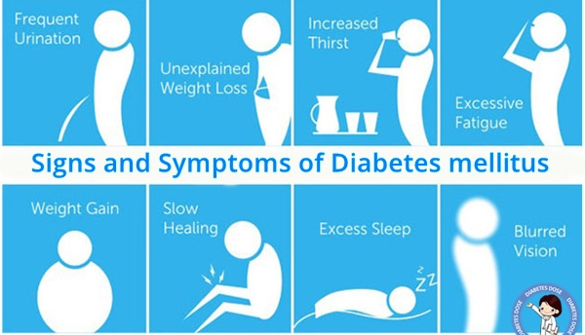
SYMPTOMS AND FEATURES OF DM
Symptoms of Diabetes Mellitus include:
  Polyuria
  Polydipsia
  Nocturia
  Weight Loss
  Lethargy
  Skin Problems
  Visual Disturbance

Slide 28
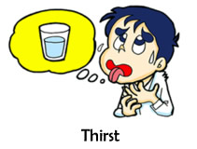
POLYURIA, POLYDIPSIA & NOCTURIA
Acute hyperglycaemia causes increased urine excretion (polyuria) and, as a result, excessive thirst and water ingestion (polydipsia).
Raised plasma glucose leads to increased renal tubular delivery of glucose, which then exceeds the resorptive capacity of the renal tubule, leading to glycosuria.
Nocturia is also common in patients presenting with osmotic symptoms of diabetes.
Notes:
3) despite hyperglycaemia people with an increased renal threshold for glucose may have no osmotic symptoms. Conversely, people with a low renal threshold for glucose may have glycosuria despite being normoglycaemic. It is for this reason that glycosuria is an unreliable feature in the diagnosis of diabetes mellitus.

Slide 29

WEIGHT LOSS & LETHARGY
Loss of more than 5% of total body weight should be considered clinically important in a subject not deliberately attempting to lose weight.
Weight loss is a common presenting symptom in people with type 1 diabetes, and occasionally in type 2 diabetes with marked hyperglycaemia.
Loss of weight in diabetes is predominantly due to renal glucose loss as a result of lack of insulin to enable cellular uptake of glucose.
Notes:
4)The weight loss usually occurs despite a normal appetite and dietary intake.

Slide 30
SKIN PROBLEMS
Skin infections, such as staphylococcal infection leading to boils, carbuncles or abscesses, which are often recurrent, may occur.
Dermatological manifestations are common in patients with poor glycaemic control.
Severe infections itself can lead to hyperglycaemia, and a new diagnosis of diabetes should be reconsidered once the acute infection has cleared.
Genital candidiasis in women leads to a thick white discharge and vaginal soreness. Similarly, in men it can lead to a severe balanitis (inflammation of the glans penis).

Slide 31
ORAL MANIFESTATIONS
Oral candidiasis can also be presenting features of diabetes mellitus.
The presence of the characteristic white plaques on the tongue and oropharynx in a previously healthy person not on antibiotic therapy should indicate the possibility of diabetes mellitus.
Diminished salivary flow and burning mouth are other oral characteristics in diabetic patients with poor glycemic control.
Different oral pathologies such as, lichen planus, leukoplakia and lichenoid reactions are associated to diabetic subjects due to immunosuppression.

Slide 32
VISUAL DISTURBANCES
Hyperglycaemia can lead to blurred vision, owing to osmotic changes within the aqueous humour of the lens of the eye.
This can also occur when chronic hyperglycaemia is treated, causing further osmotic shifts in the lens. The symptom usually settles once normoglycaemia is achieved.

Slide 33
SIGNIFICANCE OF DIABETIC HISTORY
Patients with diabetes are at risk of cardiovascular disease, and this risk is increased when there is a family history of vascular disease in fathers or brothers aged less than 55 years, or mothers or sisters aged under 65.
Any history of hypertension, hyperlipidaemia or previous vascular disease (cerebro-, cardio- or peripheral vascular) should be noted.
Notes:
1)Type 2 diabetes appears to have a stronger genetic component than type 1, with around a third of patients having a positive family history compared to around 10% of type 1 diabetic patients.

Slide 34
DIAGNOSIS OF DM
AMERICAN DIABETES ASSOCIATION
Notes:
the diagnosis of diabetes was previously based on glucose criteria, either the FPG or the 75-g OGTT. In 1997, the first Expert Committee on the Diagnosis and Classification of Diabetes Mellitus revised the diagnostic criteria, using the observed association between FPG levels and presence of retinopathy as the key factor with which to identify threshold glucose level.
The Committee examined data from three cross-sectional epidemiologic studies that assessed retinopathy. These studies demonstrated glycemic levels below which there was little prevalent retinopathy and above which the prevalence of retinopathy increased in an apparently linear fashion

Slide 35
Notes:
Although clinically it is relatively simple to distinguish between type 1 and type 2 diabetes, occasionally the diagnosis is not clear, especially in younger-onset type 2 diabetes without a family history. In these circumstances, the use of immunological tests such as anti-islet cell (ICA) or antiglutamic acid decarboxylase (GAD) antibody may be helpful.
In order to reduce the risk of chronic complications, it is important to ensure a full biochemical assessment is undertaken yearly as part of an annual diabetic review.

Slide 36
A1C is a widely used marker of chronic glycemia, as it reflects average blood glucose levels over a 2- to 3-month period of time.
The diagnostic A1C cut point of 6.5% is associated with an inflection point for retinopathy prevalence as are the diagnostic thresholds for FPG and 2-h PG.
The A1C has several advantages to the FPG, since fasting is not required,, evidence to suggest greater preanalytical stability, and less day-to-day perturbations during periods of stress and illness.
Notes:
2)The test plays a critical role in the management of the patient with diabetes, since it correlates well with both microvascular and, to a lesser extent, macrovascular complications and is widely used as the standard biomarker for the adequacy of glycemic management
4)In practice, a large portion of the population with type 2 diabetes remains unaware of their condition. Thus, it is conceivable that the lower sensitivity of A1C at the designated cut point will be offset by the test’s greater practicality, and that wider application of a more convenient test (A1C) may actually increase the number of diagnoses made.

Slide 37
Patients with severe hyperglycemia such as those who present with severe classic hyperglycemic symptoms or hyperglycemic crisis can continue to be diagnosed when a random plasma glucose of 200 mg/dl is found.
Notes:
The decision about which test to use to assess a specific patient for diabetes should be at the discretion of the health care professional, taking into account the availability and practicality of testing an individual patient or groups of patients.

Slide 38
COMPLICATIONS OF DM

Slide 39
Notes:
Chronic complications of diabetes mellitus can be usefully subdivided into large blood vessels (macrovascular), small blood vessels (microvascular) and others

Slide 40
MACROVASCLAR DISEASES
People with diabetes have fewer, less severe symptomatic chest pains, possibly due to autonomic neuropathy leading to reduced deep pain sensation – so-called silent ischaemia. The only symptom of ischaemic heart disease in a diabetic subject may be breathlessness.
In patients with diabetes, a combination of peripheral neuropathy and peripheral vascular disease can lead to foot ulceration, particularly at sites of pressure

Slide 41
MICROVASCULAR DISEASES
Diabetic retinopathy
  It is frequently asymptomatic until it causes significant visual loss.
  It may be acute in onset (e.g. owing to a sudden retinal haemorrhage) or insidious (e.g. owing to cataract or maculopathy).
  External examination may indicate signs of dyslipidaemia(corneal arcus and xanthelasmata).

Slide 42
  A reduced pupillary response to light may indicate autonomic neuropathy.
  Loss of the red reflex on funduscopy may indicate cataract formation, and the lens should be assessed for opacities.

Slide 43
Diabetic Neuropathy
Chronic peripheral sensory neuropathy
  is the commonest form and Symptoms varying from numbness, a feeling of ‘walking on cotton wool’ and paraesthesiae (pins and needles) to burning, sharp and shooting pains are seen.
  Proximal motor neuropathy (diabetic amyotrophy, or femoral neuropathy)
  is uncommon, seen predominantly in middle-aged men with type 2 diabetes. The condition is characterized by severe, deep pain and paraesthesiae in the upper anterior thigh, followed by weakness and wasting of the quadriceps muscle.
Notes:
1…The latter is a feature of selective involvement of small pain fibres. Symptoms are characteristically worse at night, frequently leading to insomnia.
2…The condition is often unilateral, generally short-lived (around 3 months) and usually resolves spontaneously.
Diabetes can cause autonomic neuropathy, the symptoms of which can be very troublesome. They include impotence, gustatory sweating (severe facial sweating on tasting food), urinary retention or incontinence, dizziness or syncope due to postural hypotension, constipation or diarrhoea (so called diabetic diarrhoea) and recurrent nausea and vomiting due to diabetic gastroparesis

Slide 44
Mononeuropathies, particularly affecting the median nerve of the hand are common in patients with diabetes. This frequently presents with paraesthesiae and numbness in the median nerve distribution of the hand (lateral two-and-half digits) and is again worse at night.
Similar symptoms may occur in the foot (tarsal tunnel syndrome).
Notes:
3)Cranial mononeuropathies are rare, but palsies of cranial nerves III, VI and VII are seen in patients with diabetes, leading to blurred or double vision due to ophthalmoplegia, or a lower motor neurone facial palsy. The pupillomotor fibres are usually spared in diabetic third nerve palsy.

Slide 45
Diabetic Nephropathy
  is similarly asymptomatic until renal dysfunction becomes so severe that uraemia ensues.
  Uraemic symptoms include fatigue, breathlessness and tachypnoea, pleuritic chest pain due to pericarditis and pruritus. Heavy proteinuria may lead to the development of a nephrotic syndrome.
.

Slide 46


Slide 49
RELATIONSHIP B/W DIABETES AND PERIODONTAL DISEASE
Periodontitis is defined as “an inflammatory disease of the supporting tissues of the teeth caused by specific microorganisms or groups of specific microorganisms, resulting in progressive destruction of the periodontal ligament and alveolar bone with increased probing depth formation, recession, or both.”
CARRANZA’S CLINICAL PERIODONTOLOGY
Notes:
Periodontal diseases include two major entities, gingivitis and periodontitis. Gingivitis is characterized by reversible inflammation of periodontal tissues whereas periodontitis also presents destruction of tooth supporting structures, and may lead to tooth loss.

Slide 50
Epidemiological data confirm that diabetes is a major risk factor for periodontitis.
Susceptibility to periodontitis is increased by approximately threefold in people with diabetes. But the mechanisms that links between these two conditions are not completely understood.
There is emerging evidence to support the existence of a two-way relationship between diabetes and periodontitis, with more severe periodontal tissue destruction in diabetic patients and poorer glycemic control in diabetic subjects with periodontal disease.
Notes:
4)Furthermore, the risk of cardiorenal mortality (ischaemic heart disease and diabetic nephropathy combined) is three times higher in diabetic people with severe periodontitis than in diabetic people without severe periodontitis.

Slide 51
MECHANISM LINKING DIABETES AND PERIODONTITIS
Inflammation is a central feature of the pathogenesis of diabetes and periodontitis & sum total of the inflammatory response in the periodontal tissues determines the pattern and rate of disease progression.
Hyperglycaemia can result in the activation of pathways that increase inflammation, oxidative stress and apoptosis. Elevated serum levels of IL-6 and TNF-α have been demonstrated in diabetes and obesity, and serum levels of IL-6 and C-reactive protein (CRP) have been shown to predict future occurrence of type 2 diabetes mellitus.
Serum levels of IL-6 and CRP are also raised in patients with periodontitis, with IL-6 levels correlating with the extent of disease [46, 47]. The systemic inflammation that is associated with periodontal disease may therefore enhance the diabetic state.
Notes:
2)Both type 1 and type 2 diabetes mellitus are associated with elevated levels of systemic markers of inflammation [40].
3)Elevated levels of CRP are also associated with insulin resistance, type 2 diabetes mellitus and cardiovascular disease [43].

Slide 52
Diabetic patients with severe periodontitis have depressed PMN chemotaxis and apoptosis compared with diabetics with mild periodontitis, which may lead to increased retention of PMNs in the periodontal tissue.
Diabetes also prolongs the inflammatory response to Porphyromonas gingivalis with increased production of TNF-α [56].
Accumulation of Advanced Glycosylation End products(AGE) in the periodontal tissues upregulates periodontal inflammation in diabetics.
Binding of AGE to its receptor (RAGE) results in the upregulated production of inflammatory mediators such as IL-1β, TNF-α and IL-6.
Notes:
2)This leads to more tissue destruction by continued release of MMPs and reactive oxygen species (ROS).
4)Diabetes increases inflammation in the periodontal tissues. For example, gingival crevicular fluid (GCF; a fluid exudate that flows from the gingival margins) levels of PGE2 and IL-1β are higher in type 1 diabetic patients with either gingivitis or periodontitis compared with those in non-diabetic individuals with the same level of periodontal disease [49]. In a study of type 2 diabetic patients, those with HbA1c >8% had a significantly higher GCF IL-1β level compared with patients with HbA1c <8%, and both HbA1c and random glucose were independent predictors of an elevated GCF IL-1β level [50].
5) AGE formation results in the production of ROS and enhances oxidant stress, and the subsequent endothelial cell changes that occur contribute to the vascular injury implicated in many diabetes complications [62].

Slide 53
Notes:
Exacerbated and dysregulated inflammatory responses are at the heart of the proposed two-way interaction between diabetes and periodontitis (purple box), and the hyperglycaemic state results in various proinflammatory effects that impact on multiple body systems, including the periodontal tissues. Adipokines produced by adipose tissue include proinflammatory mediators such as TNF-α, IL-6 and leptin. The hyperglycaemic state results in deposition of AGEs in the periodontal tissues binding of the receptor for AGE (RAGE) results in local cytokine release and altered inflammatory responses.
Neutrophil function is also altered in the diabetic state, resulting in enhancement of the respiratory burst and delayed apoptosis (leading to increased periodontal tissue destruction). Local production of cytokines in the periodontal tissues may, in turn, affect glycaemic control through systemic exposure and an impact on insulin signalling (dotted arrow). All of these factors combine to contribute to dysregulated inflammatory responses that develop in the periodontal tissues in response to the chronic challenge by bacteria in the subgingival biofilm, and which are further exacerbated by smoking.

Slide 54
Effect of diabetes on periodontal disease and periodontal treatment and Health:
Lalla et al determined the prevalence of periodontitis in different age cohorts. They found that it was 4.8 times higher among diabetics compared to non diabetics when the 15 to 24-year age cohort was considered, and 2.3 higher in the 25-34 year group. Also, CAL was higher in diabetic patients when the 15 to 55-year age cohort was considered.
The risk of periodontitis is 3-fold times higher among diabetics, being its prevalence and severity even greater in diabetic patients presenting elevated HbA1c levels.
Notes:
2)Xerostomia is a frequent symptom found in diabetic patients on oral hypoglycemic agents, and it may facilitate the onset of some fungal opportunistic infection.

Slide 55
Notes:
Chronic hyperglycemia produces AGEs that can bind to specific receptors (RAGE) on different cells such as fibroblast, endothelial cells and macrophages. Thereby, macrophages are transformed into hypereactive cells that produce pro-inflammatory cytokines such as interleukins 1β and 6 (IL-1β, IL-6) and TNF-α.
AGEs can also alter endothelial cells which will become hyperpermeable and hyperexpressive for adhesion molecules, while fibroblasts will show decreased collagen production.

Slide 58
Effect of periodontal disease and its treatment on diabetes:
Many longitudinal studies have demonstrated that severe periodontitis is associated with poorly controlled hyperglycemia, higher HbA1c levels and development of diabetic systemic complications.
Studies assumed that periodontal infection may impair glycemic control by increasing insulin tissue resistance. This assumption is based on studies that observed an improvement in diabetes glycemic control following periodontal therapy.
The first clear evidence to support this hypothesis came from investigations of individuals in the Gila River Indian community. Severe periodontitis at baseline was associated with an increased risk of poor glycaemic control (HbA1c>9.0%) at follow-up (minimum 2 years), suggesting that severe periodontitis was a risk factor for compromised diabetes management.
Notes:
The National Health and Nutrition Examination Survey 2009-2010 reported that prevalence of diabetes was 12.5% among periodontal patients, but only 6.3% in subjects without periodontitis[48].

Slide 59
Further studies of the Indian Community investigated the effect of periodontitis on the development of overt nephropathy in type 2 diabetes mellitus.
The incidences of macroalbuminuria were 2.0, 2.1 and 2.6 times as high In those with moderate periodontitis, severe periodontitis, or who were edentulous, respectively, compared with those with no/mild periodontitis (p<0.05).
The incidences of endstage renal disease (ESRD) were 2.3, 3.5 and 4.9 times as high for those with moderate or severe periodontitis or who were edentulous, respectively (p<0.05).

Slide 60
Researchers also investigated the effect of periodontitis on deaths from cardiovascular disease and found out that diabetic individuals with severe periodontitis had 3.2 times the risk of cardiorenal mortality (ischaemic heart disease and diabetic nephropathy combined) compared with the reference group (no/mild periodontitis and moderate periodontitis combined).

Slide 61
Effect of Non-Surgical Periodontal Therapy(NSPT) on glycemic control
Notes:
Faria-Almeida et al reported that non-surgical periodontal therapy significantly reduce HbA1c levels about 5.7% in type 2 diabetics, while Dağ et al[56] and Auyeung et al[57] reported that this therapy alone significantly reduced HbA1c levels only in well-controlled diabetics. Smith et al[47] reported that mechanical periodontal therapy alone did not produce a significant change in glycemic control in diabetic patients..

Slide 62
Effect of NSPT with antimicrobials on glycemic control
Christgau et al demonstrated that NSPT in combination with subgingival irrigation of 0.2% chlorhexidine did not improve HbA1c levels. The same results were achieved when 0.12% chlorhexidine was considered.
Iwamoto et al demonstrated a 0.8% reduction in HbA1c in type 2 diabetics after NSPT and subgingival use of minocycline gel.
Studies in which systemic antibiotics were used along with mechanical therapy showed a significant improvement in glycemic control in diabetic patients. This may be due to the additional benefits of systemic antibiotics, such as their antimicrobial and host modulation effects, as well as their inhibition of non-enzymatic glycosylation.

Slide 63
Effect of surgical periodontal therapy on diabetes glycemic control
Diabetic patients usually show improved periodontitis after surgical periodontal treatment. However, if poor diabetic control is present more recurrence of periodontal pockets and unfavorable long term response is expected after surgical treatment.
Effects of surgical periodontal treatment on HbA1c are currently unknown.

Slide 64
CONCLUSION
Diabetes has been associated to different oral diseases such as: xerostomia, neuro-sensory disorders, several oral mucosa diseases, tooth decay and periodontal disease. It is well documented in the literature that periodontal disease is more prevalent and severe in diabetic individuals than in healthy subjects.
Periodontal treatment is effective in diabetic patients, but more long-term recurrence can be expected when diabetes is not well controlled.
Controlling diabetes (i.e. improving glycaemic control) is likely to reduce the risk and severity of periodontitis. Furthermore, evidence suggests that resolution of periodontal inflammation can improve metabolic control (with reported HbA1c reductions of approximately 0.4%), though large, multi-centre, randomised controlled trials are needed to further validate these findings.

Slide 65
REFERENCES

