Slide 1
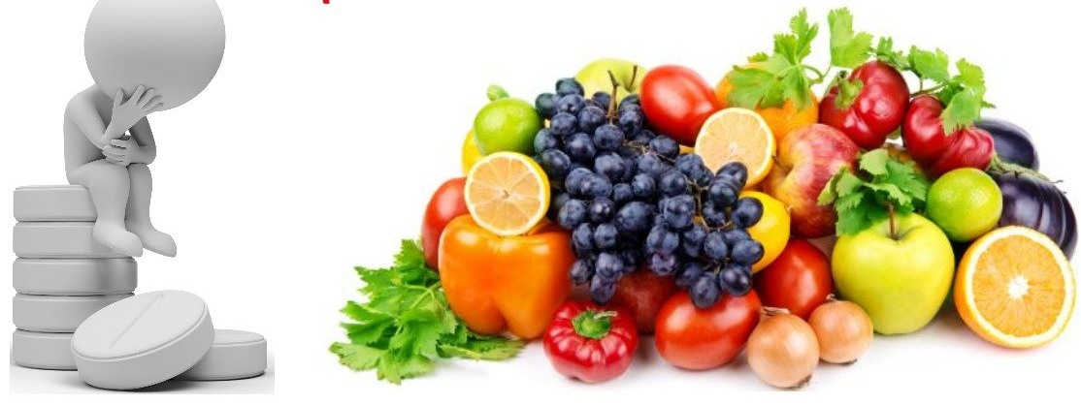
EFFECT OF NUTRITIONAL DEFICIENCY ON PERIODONTIUM
NIDHI PANDEY
MDS 1ST YEAR

Slide 2
CONTENTS
DEFINITIONS
NUTRITION
NUTRITIONAL DEFICIENCIES
TYPES OF NUTRIENTS
SOURCES OF NUTRIENTS
EFFECTS ON VARIOUS NUTRIENTS ON PERIODONTIUM
CONCLUSION

Slide 3
NUTRITION
“Utilization of food by living organism.”
Nutrition is the science that interprets the nutrients and other substances in food in relation to maintenance, growth, reproduction, health and disease of an organism. It includes food intake, absorption, assimilation, biosynthesis, catabolism and excretion.

Slide 4
NUTRITIONAL DEFICIENCY
A nutritional deficiency occurs when the body doesn't absorb or get from food the necessary amount of a nutrient.
Deficiencies can lead to a variety of health problems.

Slide 5
Periodontitis is a highly prevalent and complex disease, initiated by a dysbiotic plaque biofilm but progressed largely by an exaggerated host immune-inflammatory response.
A periodontal lesion is essentially a wound, and sufficient host resources must be available for optimal healing to take place.

Slide 6
The diet plays primarily a modifying role in the progression of periodontal disease.
The effect of nutrition on the immune system and its role in periodontal disease has been reviewed by various authors.

Slide 7
TYPES OF NUTRIENTS
Macronutrients-
Carbohydrates
Proteins
Fat
Micronutrients-
Vitamins
Fat soluble
Water soluble
Minerals
Major minerals
Trace elements

Slide 8
MACRONUTRIENTS

Slide 9
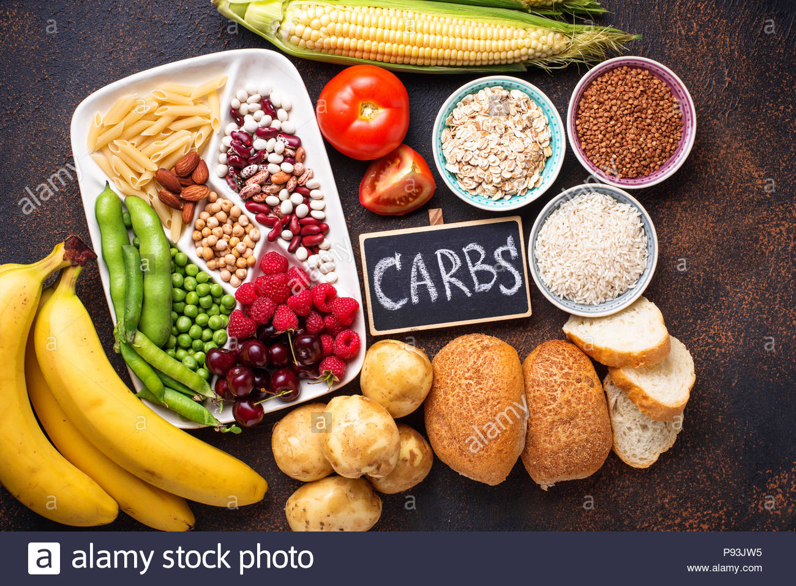
Carbohydrates
Source –
RDA- 130 gm/day
The primary role of carbohydrate is to provide energy to the body.
Protein sparing action.
Helps in fat metabolism.

Slide 10
Carbohydrates are needed for the synthesis of chondroitin, keratin and dermatan sulfates, which are present in the ground substance of the connective tissues.

Slide 11
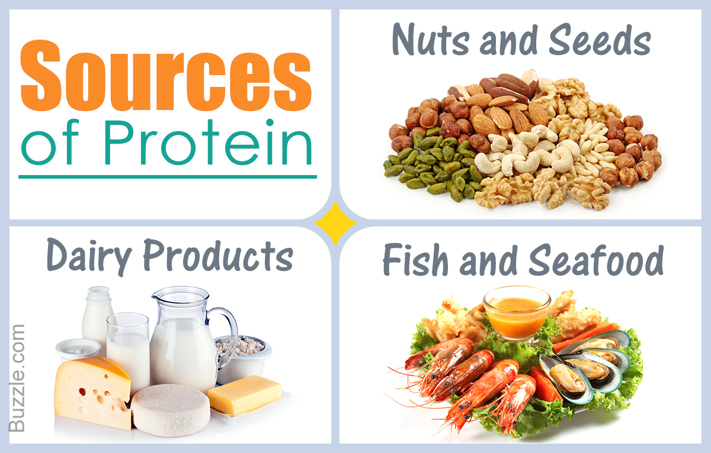
Proteins-
Source-
RDA- 0.8 g/kg of body wt
Most common substance in the body after water, making up about 50% of the body’s dry weight.
Provides amino acids, the building blocks of protein.
Its deficiency in body leads to occurence of PEM- Marasmus & Kwashiorkar.

Slide 12
Other types of proteins, such as enzymes, are used to support bodily functions.
Some proteins, for example, collagen, which is a major organic component of bone, teeth, periodontal ligament and muscle, provide structure in the body.
Proteins are components of defensive molecules and barriers that help to control the disease process.

Slide 13
The crevicular and junctional epithelia provide an epithelial barrier function. This epithelial surface provides a major defensive barrier to invasion by antigens, noxious products and bacteria, and undergoes a rapid turnover.
It is therefore dependent on sufficient protein, zinc, folic acid, iron, vitamin A and vitamin C. If the patient is undernourished, their nutritionally deficient status could result in a reversible loss of barrier function and diminished resistance to disease.

Slide 14
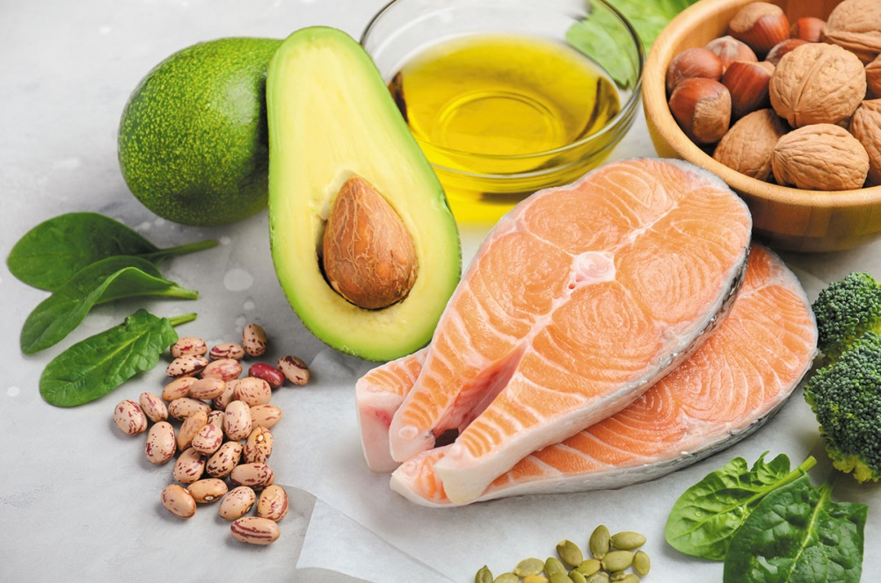
Lipids-
Source-
Two essential fatty acids (linoleic acid and linolenic acid) are required in our diet.
Lipids are a more concentrated source of energy than carbohydrates or proteins, providing 9 kcal of energy per gram.

Slide 15
Omega-3 fatty acids have anti inflammatory properties and their addition to our diet may help to reduce the inflammation associated with periodontal disease.
Study was done on rats for omega 3 fatty acid:
-Kesavalu L(2007)
These results suggest that omega-3 fatty acids help to modulate the inflammatory response, and in turn reduce the alveolar bone loss associated with infection by P. gingivalis in rats.

Slide 16
But excess of fat leads to obesity!
Obesity is a risk factor for periodontal disease, probably through the secretion of pro-inflammatory cytokines by adipocytes.
In a study in NHANES III—
It was observed that Overweight individuals (body mass index ‡27) with high levels of insulin resistance exhibited an odds ratio of 1.48 for severe periodontal disease by comparison with overweight subjects who had a low insulin resistance.
-Genco RJ(2005)

Slide 17
MICRONUTRIENTS
VITAMINS

Slide 19
Vitamins are organic substances that are present in food in small quantities.
They are utilized in metabolic reactions in the body. Vitamins are either not made by the body or are made in inadequate amounts.
Therefore, they must be supplied by food or made from a provitamin.

Slide 20
Vitamin A-
A fat-soluble vitamin
vitamin A is collectively used to represent many structurally related and biologically active molecules.
The term retinoids is often used to include the natural and synthetic forms of vitamin A.
Retinol, retinal and retinoic acid are regarded as vitamers of vitamin A.
Needed for the maturation of epithelial tissues and is required for vision, being a component of visual purple (essential for night vision).

Slide 21
Retinol and retinoic acid function almost like steroid hormones. They regulate the protein synthesis and thus are involved in the cell growth and differentiation.
Vitamin A is essential to maintain healthy epithelial tissue. This is due to the fact that retinol and retinoic acid are required to prevent keratin synthesis (responsible for horny surface).

Slide 22
Retinyl phosphate synthesized from retinol is necessary for the synthesis of certain glycoproteins, and mucopolysaccharides which are required for growth and mucus secretion.
Vitamin A is considered to be essential for the maintenance of proper immune system to fight against various infections.

Slide 23
Vitamin D-
Fat soluble vitamin.
Regulates plasma levels of calcium & phosphate in body.
Well known for its effect on bone metabolism, but it also has a strong impact on the innate as well as adaptive immune inflammatory response.
Deficiency is reatively less common.

Slide 24
Deficiency occurs due to-
Insufficient exposure to sunlight.
In strict vegetarian.
In chronic alcoholics.
Patient with liver & kidney diseases.
Deficiency disorders-
Rickets (osteomalacia in adults)
Renal rickets

Slide 25
The first study to report an association between serum vitamin D levels and periodontitis, as well as gingivitis, was carried out by Dietrich et al.
The authors found less alveolar bone loss in both men and women over the age of 50 who had the highest quartile of serum 25-hydroxy vitamin D vs those with the lowest quartile, with a higher protective effect in men.
Here the effect was independent of bone mineral density, which was not associated with periodontal disease, indicating the potential importance of the anti-inflammatory properties of vitamin D, rather than the osteogenic properties.

Slide 26
In innate inflammation, vitamin D exhibits an antibacterial response by strongly inducing the antibacterial peptide cathelicidin to form LL-37.
Vitamin D also effects macrophage phenotypes. It has the capacity to switch the macrophage phenotype from M1 to M2.
Vitamin D effects both B- and T-cell function, as well as proliferation, in an anti-inflammatory manner.
Although Well-designed, randomized, placebo-controlled trials on vitamin D and periodontitis are still needed to correlate the periodontal therapy and vit D.

Slide 27
Vitamin E
A naturally occurring antioxidant. It is essential for normal reproduction in many animals, hence known as anti-sterility vitamin.
Vitamin E is the name given to a group of tocopherols and tocotrienols. About eight tocopherols (vitamin E vitamers) have been identified–D, E, J, G etc.
prevents the nonenzymatic oxidations of various cell components (e.g. unsaturated fatty acids) by molecular oxygen and free radicals.

Slide 28
Vitamin E is essential for the membrane structure and integrity of the cell, hence it is regarded as a membrane antioxidant.
Vitamin E prevents the oxidation of vitamin A and carotenes.
The relationship between vitamin E and periodontitis has been studied for decades.
It inhibits cyclooxygenase, lipoxygenase, and phospholipase A2 (resulting in decreased synthesis of prostaglandin E2, leukotriene B4, and thromboxane A2); inhibits protein kinase C activity (resulting in decreased leukocyte adhesion and reactive oxygen species formation) and tumor necrosis factor-alpha formation by the redox-sensitive transcription factor, nuclear factor-kappa B; and reduces synthesis of C-reactive protein and thus has an anti-inflammatory and an anti-thrombotic effect.

Slide 29
Panjamurthy et al confirmed, in a case-control study, the results from the literature that periodontitis patients exhibit a higher level of oxidative stress.
The vitamin E concentration was significantly reduced in plasma and erythrocyte membranes of periodontitis patients verses controls.
Cerna et al reported a reduction in periodontal inflammation as a result of vitamin E supplementation for 12 weeks in female patients with periodontitis.
And Higher dietary intakes of alpha-tocopherol (≥5.9 mg/d) may have a beneficial effect on periodontal healing following scaling and root planing.

Slide 30
but many vitamin E supplementation trials demonstrate a lack of efficacy, which may be explained by absence of data on vitamin levels at baseline or on biomarkers of oxidative stress and lipid peroxidation, and by several other factors.

Slide 31
Vitamin C-
Ascorbic acid is a hexose (6 carbon) derivative and closely resembles monosaccharides in structure.
Most of the functions of vitamin C are related to its property to undergo reversible oxidation-reduction i.e., interconversion of ascorbic acid and dehydroascorbic acid.
Function in body:
collagen synthesis
bone formation
Iron and hemoglobin metabolism
Folic acid metabolism
Immunological function

Slide 32
The relationship between the consumption of vitamin C-rich vegetables/fruits and periodontal pathology has been described historically.
In the 18th century, during maritime trading and exploratory seafaring, sailors suffered from SCURVY, a vitamin C deficiency disease associated with gingival bleeding and tooth mobility55 that was caused by altered collagen formation.
scurvy is diagnosed when serum ascorbate levels fall below 11 microM, whereas the normal range is presently 23-50 microM.

Slide 33
During inflammation, histamine is an important mediator responsible for regional blood flow regulation, resulting in redness, swelling, and edema.
Vitamin C exhibits antihistamine properties by direct detoxification of histamine and, in the gingival tissue, a sufficient vitamin C level may contribute to a healthy gingival homeostasis, despite bacterial challenge.

Slide 34
B Vitamins-
For periodontium folate and cobalamine are of more importance.

Slide 35
Following supplementation with the vitamin B complex containing capsule, it was demonstrated that patients exhibited improved clinical attachment level compared with patients who received placebo. -Study by Neiva et al 2005
The connection between low serum levels of vitamin B12 and periodontitis was reviewed by Hujael (2017).
Increased clinical attachment loss, as well as a higher risk for tooth loss, were associated with low serum levels (152 mol/L) of vitamin B12.

Slide 36
Here The fact that Porphyromonas gingivalis may utilize vitamin B12 for its metabolic flexibility may partly explain a potential alteration in vitamin B12 levels in patients with periodontitis
-o flynn (2015)
To date, there is only limited knowledge regarding the purposeful supplementation of vitamin B12 and folate.
Overall, more studies are needed to elucidate the role of vitamin B12, as well as that of folate, during the development of periodontitis, and also as a potential treatment strategy for periodontitis.

Slide 39
Calcium-
Over 99% of the total calcium in the body is located in the bones and teeth, mostly as hydroxyapatite, and <1% is located in soft tissues and body fluids.
Low dietary intake of calcium, along with low vitamin D, results in a low serum calcium level that stimulates the parathyroid gland to produce parathyroid hormone, which results in osteoclastogenesis and bone resorption to prevent hypocalcemia.

Slide 40
It has been suggested that alveolar bone in patients with periodontal disease and low levels of vitamin D and calcium should be under a heavier osteoclastic load than the long bones, and that the effect of vitamin D and calcium on alveolar bone may be more pronounced than its effects in the spine and hip.

Slide 41
In some studies
Dietary intake of calcium below the levels recommended almost tripled the risk of losing 10% or more of natural teeth in male participants. It was demonstrated that dietary calcium intake, particularly calcium from dairy products, seems to protect against loss of teeth in adult men and women in the.
The intake of calcium from nondairy sources had no appreciable association with the risk of tooth loss, neither in men nor in women.

Slide 42
It was proposed that inadequate calcium intake may lead to an imbalance of the calcium/phosphorus concentrations in the blood, promoting secretion of parathyroid hormone and the mobilization of calcium from the skeleton, including alveolar bone, which may result in bone resorption and increased risk of periodontal disease.

Slide 43
Magnesium-
Manganese derives its name from the Greek work ‘mangania’, meaning magic. The name is appropriate as research is still being conducted on its biological functions.
Manganese is known to be essential for certain metalloproteins, such as manganese superoxide dismutase, and is involved in gluconeogenesis.
In a study there was significant inverse association between plasma levels of manganese and periodontal status in a representative sample.
Not much studies are done for this element in respect to its effect on periodontium.

Slide 44
Iron-
essential trace element which plays a crucial role in metabolic processes, not only for humans but for almost every other living organism.
major function is oxygen transport by hemoglobin.
Iron deficiency is thought to be the most common cause of anemia.

Slide 45
Patients with chronic periodontitis have a lower number of erythrocytes and a lower hemoglobin level than healthy controls.
Gokhle SR (2010)
Yamamotto et al confirmed that, after adjusting for age, the progression of periodontal disease is associated with a decrease in erythrocyte counts.
It was proposed that chronic periodontitis can lead to anemia of chronic disease, which may be explained by a depressed erythropoiesis resulting from the systemic effect of the proinflammatory cytokines in response to periodontal pathogens and their products.

Slide 46
Patients with iron deficiency anemia and comorbid chronic periodontitis exhibited a higher incidence of bleeding on probing, a higher percentage of sites with clinical attachment loss of ≥ 6 mm, as well as deeper periodontal pocket depths, than patients with chronic periodontitis only.
-Chakraborty S et al (2014)
Currently, there is insufficient evidence that iron deficiency may be causally related to periodontitis. The available literature supports rather the reverse association, that chronic inflammatory periodontitis can result in anemia of chronic disease. However, disturbances in iron homeostasis may also affect the periodontium by influencing periodontal pathogens and host defense reactions.

Slide 47
Zinc-
It has various biological functions:- it plays an essential role in human growth, development, wound healing, cell proliferation and differentiation, gene expression, integrity and stabilization of biomembranes and the cytoskeleton, antioxidant functions, immune competence, and metabolism.
In addition, zinc is essential for intracellular binding of tyrosine kinase to the T-cell receptors, CD4 and CD8a, which are required for T-lymphocyte development and activation.
-National Academies Press (US);2001.

Slide 48
In a study by weden by Frithiof et al Patients with decreased zinc levels showed increased alveolar bone resorption. The authors proposed that the physiological functions of zinc may have an influence on periodontal disease.

Slide 49
Potassium-
Potassium is the most abundant intracellular cation and is required for many normal cellular functions, including metabolism and growth, cell division, optimal enzyme function, protein and DNA synthesis, cell volume regulation, and intracellular acid-base balance.
Nutritional factors, particularly potassium intake, were associated with periodontitis but not with tooth loss. They concluded that low potassium intake in the diet mostly accompanied by low dietary fiber intake may increase blood pressure as well as periodontal inflammation.
-Yamori et al 2011

Slide 50
Selenium-
Selenium is essential for human well-being, largely because of its potent antioxidant, anti-inflammatory, and antiviral properties.
The significant inverse association found between serum selenium concentration and periodontitis prevalence in a basic model adjusting only for age, gender, race, or ethnicity was markedly attenuated after full multivariate adjustment, indicating the presence of substantial confounding.

Slide 51
The biological effects of selenium are mainly exerted through its incorporation into selenoproteins in the form of selenocysteine, a selenium-containing homolog of cysteine. They are involved in the activation, proliferation, and differentiation of cells that drive innate and adaptive immune responses.
At a cellular level, dietary selenium may influence various leukocytic effector functions, including adherence, migration, phagocytosis, and cytokine secretion.
-Huang Z 2010

Slide 52
Conclusion
It is reasonable to consume a nutritionally adequate diet to help maintain host resistance and to maintain the integrity of the periodontal tissues. A good diet contributes to both good general health and good oral health.
Moreover, the data available suggest that micronutrients are important in the prevention and treatment of periodontal disease but further research is required to define mechanisms, risk groups, and potential intervention strategies.

Slide 53
References
Textbook of biochemistry – by U Satyanarayana
Periodontology 2000 – vol 78, vol 50,vol 58

