Slide 1
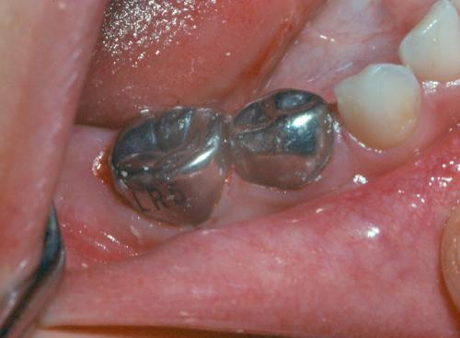
STAINLESS STEEL CROWNS (SSC)
Dr. SHIVANGI SHRMA

Slide 2

IMPORTANCE OF PRIMARY TEETH???…

Slide 3
VARIOUS RESTORATIONS IN PRIMARY TEETH…
Silver amalgam
Glass ionomer cements
Composite resins
Semi-permanent restorations
Semi permanent restorations are those which last for months or years preserving the function of primary teeth until their normal exfoliation . (Braff 1982)
Notes:
Semi permanent restorations are those which last for months or years preserving the function of primary teeth until their normal exfoliation . (Braff 1982)

Slide 4

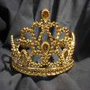
History
Humphrey in 1950 – use of chrome steel in pediatric dentistry in form of crowns
Mink & Bennett in 1968 – basics in crown preparation
Rapp & Castaldi – recommendations for preparation of tooth, manipulations of crown, type of crown to be used & methods of cementation

Slide 5
More frequent in deciduous dentition:-
  Relatively small deciduous teeth
  Deciduous teeth pulp is larger than permanent in relation to dentin and enamel envelope. Thus it is difficult to make dentinal stump for a gold casting or to use a pin system of retention for more extensive amalgam restoration
Notes:
Relatively small deciduous teeth: neglected caries can destroy the tooth’s integrity faster than larger permanent teeth
Deciduous teeth pulp is larger than permanent in relation to dentin and enamel envelope. Thus it is difficult to make dentinal stump for a gold casting or to use a pin system of retention for more extensive amalgam restoration

Slide 6
Advantages (Braff ,1982)
These are far superior to multi-surface amalgam restorations with respect to both life span and replacement
Most advantageous system of restoration because of its retention and resistance
Acceptable to both the patient and dentist
More cost effective because of comparatively simple procedures involved in the restoration
Notes:
Low cost
Durability
Resistant in oral environment
Tarnish resistant
Reduction in operating time
One appointment

Slide 7
Objectives of using stainless steel crowns
To achieve biologically compatible masticatory component & clinically acceptable restorations.
Maintain form & function of teeth, with vitality of tooth where possible.

Slide 8
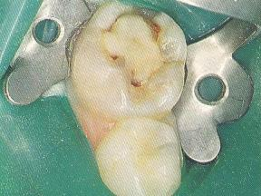
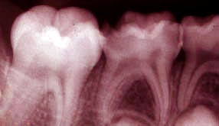
INDICATIONS
Extensive decay

Slide 9
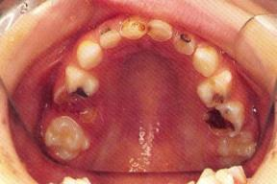
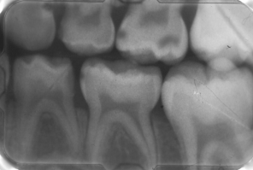
Rampant caries

Slide 10
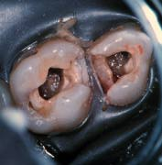
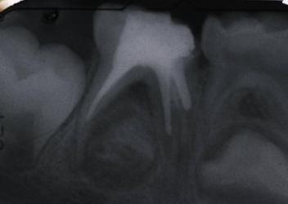
FOLLOWING PULP THERAPY
Notes:
Compensate for the wear & to reduce masticatory forces on the erupting permanent molars
Restore vertical dimension & prevent traumatic exposure

Slide 11
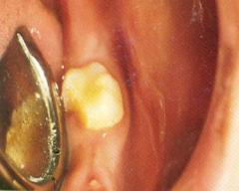
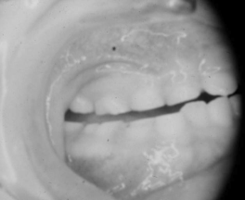
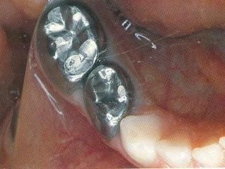
TEMPORARY RESTORATION FOR FRACTURED TOOTH
Retains the sedative dressing over the exposed dentin
  BRUXISM
Notes:
Compensate for the wear & to reduce masticatory forces on the erupting permanent molars
Restore vertical dimension & prevent traumatic exposure

Slide 12
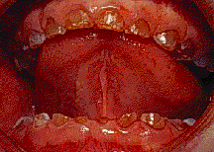
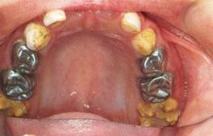
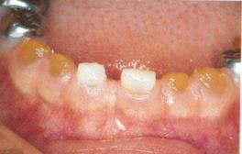
  FOR TEETH WITH DEVELOPMENTAL DEFECTS
Hypoplastic teeth
Amelogenesis imperfecta
Dentinogenesis imperfecta
Notes:
Amelogenesis imperfecta dentinogenesis imperfecta, enamel Hypoplasia – enamel chipped or worn off Exposing the underlying dentine & reduction in vertical height of crown

Slide 13
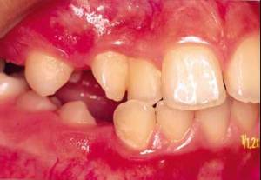
Single teeth cross bite

Slide 14

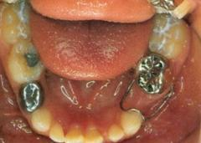
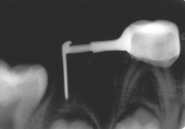
AS AN ABUTMENT(NASH)
  Crown & loop - for first primary molar
  Distal shoe

Slide 15
Indication for permanent tooth
Full coverage in partially erupted (Rapp,1966)
Interim restoration of a broken down or traumatized tooth (Croll 1978, Brook 1982)
When financial consideration are concern (Gordan 1979, Croll 1987, Murray,1997)
Severely periodontally involved teeth that need a cast restoration ,but supporting structure and patient finances limit the treatment options.(Murray ,1996)

Slide 16
AAPD (Amer Assoc Pediatric Dentists)Consensus on Use of SSCs
Children at high risk exhibiting anterior tooth decay and/or molar caries may be treated with SSCs to protect remaining at-risk surfaces.
Extensive decay, large lesions or multiple surface lesions in primary molars should be treated with SSCs.
Strong consideration for use of SSCs in children who require GA

Slide 17
Contraindications
Esthetics
Teeth that are nearing exfoliation
With in 6-12 months (Nash,1981)

Slide 18
Types of crowns
Manufacturers
Unitek corporation
Rocky mountain corporation
3M company
Ion
Ormaco

Slide 19
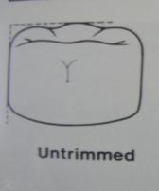
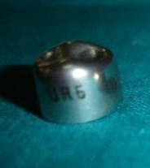
Shape
Untrimmed (Rocky Mountain )
Made of 18-8 steel
Not prefestooned & requires trimming at the gingival margins
Occlusal table is small buccolingually
Can be easily dislodged if there is any interference
Notes:
ROCKY MOUNTAIN:
Made of 18-8 steel
Not prefestooned & requires trimming at the gingival margins
Occlusal table is small buccolingually
Can be easily dislodged if there is any interference

Slide 20
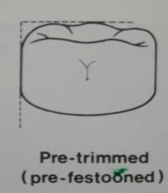
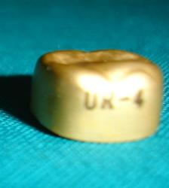
Pre-trimmed (unitek,3M. Denovo )
Prefestooned
Broader occlusal table
Long gingival occlusal height
Provide excellent restoration if properly belled & trimmed

Slide 21
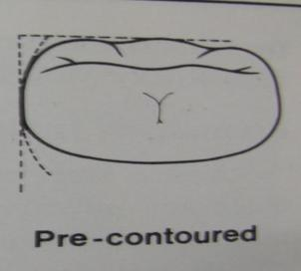
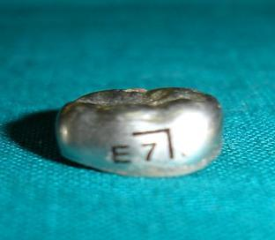
Pre-contoured (Nichro ion crown )

Slide 22
BASED ON COMPOSITION
Stainless steel(18:8) Austenitic
17-19% Cr
10-13% Ni
67% Fe
0.08-0.15% C
Examples :Rocky Mountain ,unitek
Notes:
Strength 211-1760 Mpa
Austenitic type provides best corrosion resistance

Slide 23
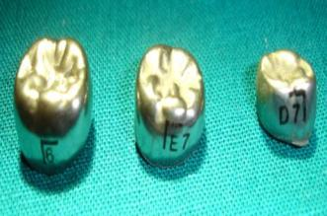
Ni-based crowns
72% Ni
14% Cr
6-10% Fe
Example: Iconel 600

Slide 24
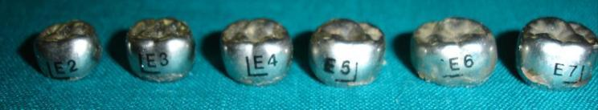
size
Crown shape | Number of sizes available | Width range (mm)
Upper 1st primary molar | 6 | 7.2 to 9.2
Upper 2nd primary molar | 6 | 9.2 to 11.2
Lower 1st primary molar | 6 | 7.4 to 9.4
Lower 2nd primary molar | 6 | 9.4 to 11.4

Slide 25
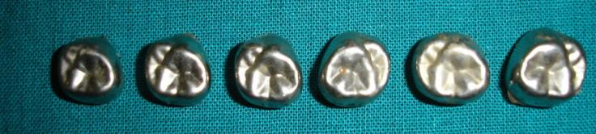
Crown shape | Number of sizes available | Width range (mm)
Upper 1st permanent molar | 6 | 10.7 to 12.8
Lower 1st permanent molar | 6 | 10.8 to 12.8

Slide 26
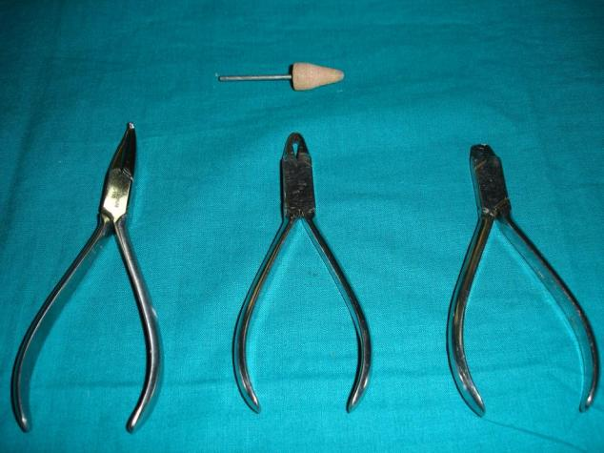
ARMAMENTARIUM

Slide 27
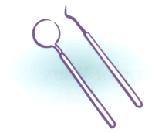


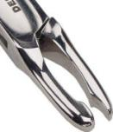
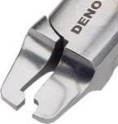
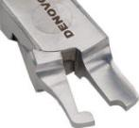
Armamentarium
MIRROR
LARGE SPOON EXCAVATOR
CROWN TRIMMING SCISSORS (Curved & straight)
CROWN CONTOURING PLIERS 800-114 (Johnson pliers)
CROWN CONTOURING PLIERS #137 (Gordon pliers)
BALL & SOCKET PLIERS (contouring)
CROWN CRIMPING PLIERS 800-417
CROWN CRIMPING PLIERS (spring back) 800-421

Slide 28
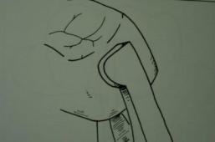
HOWE PLIERS #110 (flattening of contacts)
HEATLESS STONE
BURLEW WHEEL
FINISHING STONE
STAINLESS STEEL CROWN KIT
GLASS SLAB
CEMENTING MEDIA
DENTAL FLOSS

Slide 29
Burs and stones
Pliers
Scissors
Cement medium
Miscellaneous
Rubber dam
Polishing wheel
Crown seater or tongue depressor
Articulation paper

Slide 30
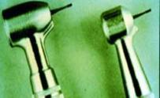
Burs:
No 699 tapered fissure bur
No. 169L or 69L bur
Half round bur – for making crown margins
6 No. round - for caries removal

Slide 31
Pliers used
Plier name | No. of plier | Use of plier
Johnson plier | no 114 | Contouring occlusal & middle third of crown
Gordon plier | no 137 | Contouring gingival third of crown
Crimping plier | no 800-417 | Marked gingival crimping
Ball & socket plier | no 112 | Exaggerating interproximal contour in open contacts
Howe plier | no 110 | Flattening interproximal contour of crown
Crown & bridge scissor |  | Cutting excess material

Slide 32
PRE-OPERATIVE EVALUATION OF THE PATIENT…
Dental age of the patient
Co-operation of the patient
Motivation of the patient
Medically compromised / disabled children
Notes:
Dental age of the patient
Co-operation of the patient
Motivation of the patient
Medical history :antibiotic prophylaxsis
Nickel allergy (Feasby,1988

Slide 33
STEP – BY – STEP PROCEDURE
Preoperative cast
Check occlusion
Notes:
Local anesthesia
Rubber dam application (wedges/ interproximal dam cutting/ slip over posterior & anterior tooth)
Caries removal (pulpectomy / pulpotomy)
M-D width of the tooth
Crown selection

Slide 34
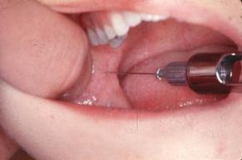
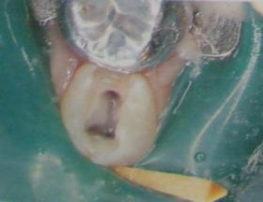
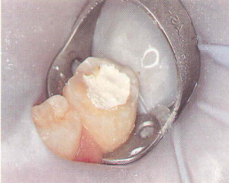
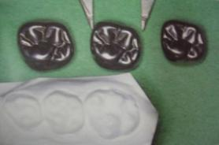
Local anesthesia
Rubber dam application
Pulp therapy
Crown selection

Slide 35

Crown selection:
Factors to be considered
MD width of the tooth
Measured with calipers & matched with the SSC
Height of crown:
Same as that of the uncut tooth with cervical margin not more than 1 mm below & parallel to the gingival margin
Notes:
Measurement of appropriate size crown:
Boley guage (Tandon et al 2001)
Dividers (Forrester et al 1981)
Perioprobe
Gingival marginal contour:
Differ from I to II molar as well as buccal to lingual to proximal aspect

Slide 36
Tooth preparation
Aims of tooth preparation -
Prepare tooth to receive crown.
Remove all gross caries & irregularities.
Keep sufficient tooth structure to support steel crown.

Slide 37
Tooth Preparation
OCCLUSAL OR PROXIMAL FIRST???
Occlusal reduction 1st: Mink & Bennet 1968
Proximal reduction 1st: Mathewson et al 1974, Welburry 1980, Forrester et al 1981, Brook et al 1982

Slide 38
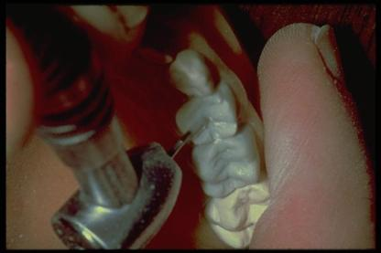
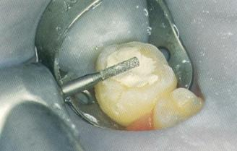
Occlusal Reduction
Rapp, 1966: preparation height 4mm from gingival margin
Mink & Bennet, 1968: uniform reduction, 1-1.5mm
Mathewson et al 1974: 1-1.5mm
Troutman, 1976: 1mm
Kennedy, 1976: 1.5-2mm

Slide 39
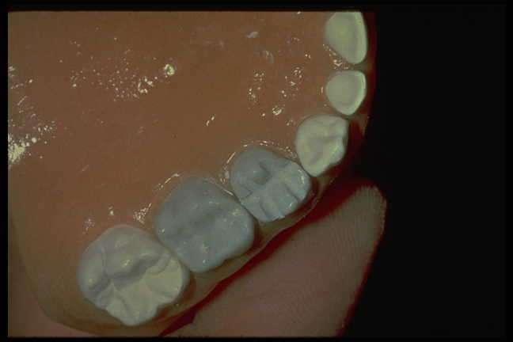
Occlusal depth grooves:
Mink & Bennet

Slide 40
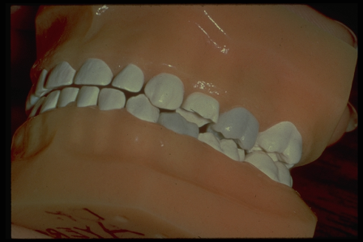
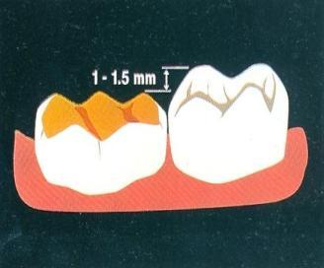
Completed Occlusal Reduction- Check reduction with opposing arch
Wax sheet (Forrester et al 1981)
Visual

Slide 41
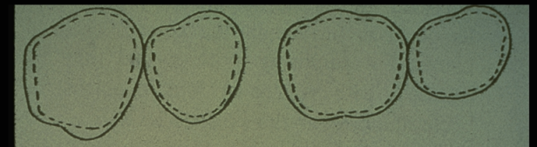
Preserving Occlusal Outline
Maxillary molars
Mandibular molars
Crown retentive potential
Less chances of pulp exposure
Preservation of tooth structure

Slide 42
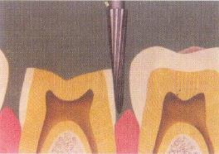
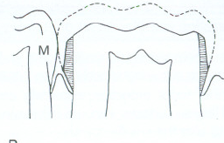
Proximal reduction
Bur is preferred compare to disc
Feather edge finish line

Slide 43
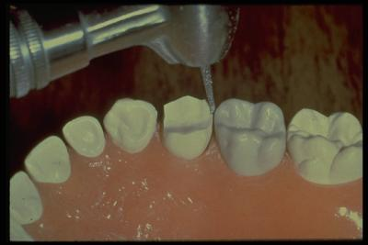
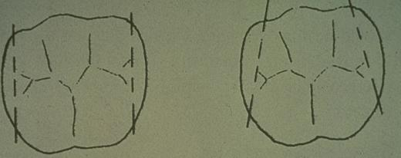
Proximal Slices
Angulation of Slices
Proper slice
Improper slice
Notes:
proximal slices converge slightly toward the occlusal and lingual (Meyers et al 1976)

Slide 44
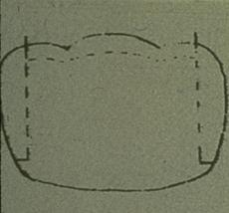
Ledging- Proximal slice must be extended below gingival crest to avoid leaving a ledge
Obstructed crown placement
Popping out of crown
Stress area

Slide 45
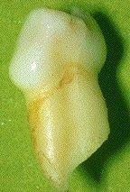
Buccal-Lingual Reduction
Optional
Not done for retention (Mink & Bennet 1968)
Undertaken only if the buccal or lingual bulges obstruct crown placement (Mink & Bennet 1968, Mathewson et al 1974, Andlaw & rock, 1984)
  when required, no more than 0.5-1mm should be removed
  feather edge finish line

Slide 46
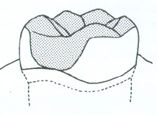
Only on occlusion third (Mink, Hill& Bennett,1971)
Oval rhomboid preparation

Slide 47
Beveling
Bevel at an angle of 30-45 degrees
Removes sharp cusp tips
Unobstructed crown placement
Creates a gentle slope in the occlusal third of the lingual and buccal surfaces

Slide 48
Round Sharp Line Angles
The buccal and lingual proximal line angles are rounded
Hold bur parallel to the tooth’s long axis and blend surfaces together
The finished contour should conform to the internal contour of the stainless steel crown (ovoid/ rhomboidal)

Slide 49
Evaluation criteria (Stewart)
Occlusion clearance
Proximal slice convergence
Explorer can pass between prepared tooth and proximal tooth
Feather edge 0.5-1mm
Bucco-lingual convergence
Round point and line angles
Occlusal third rounded

Slide 50

Crown selection
Trial & error
Snap fit
Direction : lingual to buccal
Criteria: M-D width, occlusal height, light seating
After tooth preparation: Forrester et al 1981, Andlaw & Rock, 1984

Slide 51

Crown Trimming
Notes:
Mark gingival line with a scaler & trim 1mm beneath the mark using scissors
Margins lie parallel with the contour of the gingival tissue and consist of a series of curves without sharp angles
Scissors or heatless wheel
At 45 degrees
Towards inner surface of crown

Slide 52

Gingival Contours
Buccal gingival contour of second primary molar – Smile
Buccal gingival contour of first primary molar-- stretched-out S
Proximal gingival contour of primary molars – frown
Lingual gingival contour of all molars – Smile

Slide 53
Welbury et al 1980:
Small holes made on approximal surfaces of crown:
Benefits to adjacent teeth from fluoride release by GIC

Slide 54

Crown Contouring
Contouring pliers
# 114 ball & socket pliers
# 137 Gordon pliers
# 800-114 Johnson pliers
More &pink (1973): contouring is primary retention factor
Notes:
Bending the gingival third of the crown’s margins inward
Restores anatomic margins and reduce the marginal circumference
Ensures good fit

Slide 55


Crown Crimping
Inward movement of cervical margin
Replace crown on tooth and check margins with an explorer
# 137 pliers
# 800-417 Unitek pliers
Notes:
Crown crimping
Crimping done at cervical 1/3rd of crown with a No. 800-412 plier to aid in tight marginal fit
This aids in:-
- mechanical retention of the
crown
- protection of cement from
exposure to oral fluids
- maintenance of gingival
health

Slide 56





Slide 57

Checking of gingival margins:
Explorer
Blanching (Johnsen et al 1987: some amount inevitable)
Bitewing radiograph (More & Pink 1973)
Henderson et al 1973:
Soft tissue adapt to rough & unpolished crown surfaces, plaque accumulation is main cause for gingival inflammation
Notes:
Need for good fit:
Mechanical retention
Cement protection
Gingival health

Slide 58
Guidelines for Final trial
Resistance in seating without tissue blanching. Check for
  ledges
Resistance in seating with tissue blanching. Check for
  crown too wide (preliminary contouring)
  crown too long
  tissue caught in margin

Slide 59
Adaptation Criteria
Snap fit
No rocking on tooth
Not rotated
Marginal height
No high points
Close tooth adaptation
No gingival blanching
1-1.5mm high in occlusion is acceptable (Fayle,1999)

Slide 60


Finishing and Polishing
Notes:
Heatless stone (green stone):
Smooth jagged edges
Towards inside of crown
Use rubber wheel:
Remove small scratches and smooth
Polish surface of crown to a high shine with rouge & fine polishing material

Slide 61
Crown finishing and polishing
Wearhaug (1960) : Gingival inflammation due to plaque
Henderson (1973): Tissue adaptaion is fast but inflammation due to plaque retention
Myers (1975): Lower incidence of gingivitis around crown without defect

Slide 62
Cementation
Zinc oxide eugenol
Zinc phosphate
Zinc silicophosphate
Polycarboxylate
Glass ionomer
Resin modified glass ionomer
Acrylic resin
Composite resin
ACP resin

Slide 63
Studies ..
Myers et al(1970) proved that zinc phosphate and polycarboxylate had significant better crown retention then those of zinc oxide and eugenol

Slide 64
Karatoprak (1997) luting GIC , polycarboxylate cement , zinc phosphate .GIC cement to be most effective cement for retaining preformed crown on primary molars.
Resin modified GIC: Croll (1996), Nicholson &Croll (1997)
Yilmaz (2006) : luting GIC (Meron) and Resin modified GIC (Vitremar). No significant difference was found between the mean retentive force of Meron and Vitremar

Slide 65

Cementation procedure
Remove the rubber dam
Verify the occlusion , contacts
Topical ointment
Isolation
Mixing of cement
Cementation

Slide 66

Cementation
Clean crown and tooth
Meyers et al 1983: varnish on vital teeth
Fill 2/3rd of crown with cement
Seat crown (lingual to buccal)expressing cement form all margins
Press into occlusion: handle of mirror, flat end of band pusher, tongue blade
Notes:
Remove excess cement when partially set (interproximally: floss)
Cements used: GIC, zinc phosphate, zinc polycarboxylate
Mathewson et al 1974: zinc phosphate for cementation

Slide 67



Removal of excess RMGIC with ultrasonic scalars (Croll,1997)
Notes:
Remove excess cement with scaler or explorer
Remove excess from interdental areas using floss
Make the final check of restoration for occlusion
Polish the crown with acidulated phosphate fluoride prophylaxis paste

Slide 68

Post-op instructions
Patients and parents warned of possibility of dislogement of crown
Avoid for atleast 1 hr:
Sticky foods like caramel, gum, taffy
Hard candy
Chewing on ice

Slide 69
Retention of Stainless steel crowns
Mathewson et al 1974: cementing medium for retention
Savide et al, 1979: compared 5 preparations to check for crown retention:
Type A: Mink & Bennet, 1968: only occlusal 1/3rd reduction
Type B: inluding class II with type A
Type C: supragingival reduction of B & L surfaces
Type D: Troutman, 1976: 0.5 mm subgingival reduction of B & L surfaces
Type E: grossly destructed tooth

Slide 70





Savied et al – to compare retention capabilities of five different preparations

Slide 71
Results:
Type A: Preparation for vital teeth
Type B: Not acceptable, highest retention values, pulp exposure
Type C: Useful for Rocky Mountain crowns (softer metal)
Type D: Best preparation, healthy cervical adaptation, for Ion crowns
Type E: High retentive values
Pre cementation retention due to undercuts, post cementation retention due to cement

Slide 72

Modifications of SSC
Occlusal reduction one tooth should be done first
Contact point between adj tooth should be broken producing 1.5mm space at gingival level
Both crown should be trimmed, contoured & prepared for cementation simultaneously
Distal tooth should be cemented first

Slide 73
Undersized crown:( Mink & Hill- 1971)
Vertical cut is made on the buccal surface
Margins are pulled apart
Additional piece of steel band is spot welded
After contouring crown is soldered, polished & cemented

Slide 74
Oversized crown:
Cut along the buccal surface
Free margins are appx & overlapped over each other and spot welded
After contouring, the cut & relocated area is soldered and polished

Slide 75
Deep subgingival caries
Unfestooned crowns or prefestooned crowns
Amalgam
Extension soldered/ weld to crown

Slide 76


Open contact (except primate spaces):
Larger crowns, taking care not disturbing path of eruption of the erupting adj tooth
Anterior teeth:
Removing the labial surface of the crown & replacing with composite resin
Bruxism:
Thickness of the occlusal surface is increased – Croll’s technique

Slide 77




Clinical modifications…
STAINLESS STEEL CROWN IN SPACE LOSS (Mc Evoy 1977):
Loss of space:- due to proximal caries and movement of tooth into the space
In this situation a crown that will fit on buccolingually is too large mesiodistally
  Crown is rotated slightly mesiobuccaly
  so that it is slightly out of the arch
  Crown is squeezed mesiodistally with
  Adams plier to reduce dimension

Slide 78
Clinical Variations
Space Loss (Mc Evoy 1977):
More tooth reduction
Smaller crown
Opposite side maxillary crown
Flattening contacts with Hoe pliers

Slide 79
Adjacent Crown and class II amalgam:
SS crown cemented 1st

Slide 80
Anterior teeth
Stainless steel crown
Open face stainless steel crowns
Preveneered crowns

Slide 81


Clinical modifications…
  OPEN FACED CROWNS :
Complain of appearance of metal crowns as being ugly
The labial surface of steel crown is trimmed away to leave the crown perimeter
Then restored with a resin veneering – Roberts 1983

Slide 82



Anterior Stainless steel crown
More durability
Aesthetics problem
ANTERIOR STAINLESS STEEL CROWNS (DENOVO CO)

Slide 83
Open face stainless steel crowns
Technique suggested by : Helping (1983)
Adv: retention, durable (bruxism, accident prone children), gingival hemorrhage.
Disadv: more tooth reduction, two-step procedure,
Indication: decayed canines, mandibular anteriors
Technique: like post. SSC, ovoid crowns with less faciolingual dimension: open the crown (Howe pliers), cement the crown, cut labial window (#330/35 bur)

Slide 84

Window: incisally: just short of incisal edge, gingivally: gingival crest, proximally: line angles.
Remove facial cement for 1mm
Undercuts at each margin (#35 bur): mechanical retention (little enamel)
Apply DBA, Composite
Finishing: abrasive disc moved from composite margin to metal (prevent discoloration)

Slide 85

Pre veneered Stainless Steel crown
Example : NuSmile crowns
(Orthodontics Technologies , Houston Texas. US)
Resin based composite bonded to the occlusal and buccal surface in a Laboratory process to create a more aesthetic posterior crown
Disadvantages:
More expensive
More tooth reduction
Only minimal crimping for crown adaptation.
Notes:
Adv: aesthetics, durability, moisture sensitive,
Disadv: cost, more tooth reduction (B,L,I), minimum crimping (lingually), no close adaptation, few available data for durability
Design: composite bonded to incisal and labial surface
Technique: little recontouing & reshaping (adjust tooth to fit the crown), no snap fit (# of veneer), “snug-sleeve” like fit,

Slide 86
Preveneered Crowns
Commercials:
Kinder Krowns, Mayclin Dental Studios, Minneapolis
Dura Crowns, Space Maintainers Laboratory, Van Nuys, California
NuSmile Primary Crowns, Houston, Texas
Cheng Crowns, Peter Cheng Orthodontic Laboratories, Philadelphia

Slide 87

Hall technique :Halls et,al(2005)

Slide 88
Hall technique
Novel way of placing preformed metal crown involving no local anaesthesia, no caries removal and no preparation of tooth. Halls et,al(2005). A retrospective analysis was done from 1988 to 2001 . The majority of the 978 PMC fitted on 279 children when there was clinical evidence of approximal caries into dentin . The probability of surviving three years without being extracted or lost was 73.4%and for 5 year 67.6%

Slide 89
Biological considerations
Myers criteria(1975)
Length
Crimp
Contour
Contact
Position
Polish
Cement

Slide 90


Slide 91


Slide 92





Slide 93




Slide 94
Causes of SS crown failures
Inadequate tooth reduction
Inadequate crown contouring and crimping
Inappropriately established occlusion
Inappropriate cementation methods (frequent decementation)
Pulp treatment failure
Recurrent caries (improper contact)
Crown abrasion (occlusal surface)

Slide 95
Complications
Crown tilt :
Destruction of complete lingual or buccal wall by caries or over instrumentation may result in crown tilting towards deficient side
Placement of an amalgam alloy or GIC restoration prior to crowning provides support to prevent crown tilt

Slide 96

Inter proximal ledge :
Incorrect angulation of the tapered fissure bur can produce a ledge instead of a shoulder free interproximal slice
Failure to remove the ledge result in inability to seat the crown

Slide 97

Ingestion / inhalation of crown :
Square piece of gauze as throat screen or by rubber dam
PA chest radiograph is mandatory & pt is referred to physician

Slide 98
Poor margins :
When imperfectly adapted- marginal integrity reduced
Marginal discrepancy – recurrent caries, gingivitis, chronic inflammation of supporting structures, early exfoliation

Slide 99
Stainless Steel Crown Technique
Recap……..

Slide 100

Anatomical Differences
Primary vs. Permanent
Enamel Thickness
Dentin Thickness
Pulpal Size
Gingival Bulge

Slide 101

View of Buccal Cervical Bulge: This is what retains an SSC

Slide 102

Buccal Cervical “Sweetspot”: This is the critical area for retention

Slide 103

Prep (L) vs. No Prep (R): “Sweetspot” Remains

Slide 104


SSC Technique
Proper Crown Fit: There are no crown margins
The SSC fits over the remaining crown and adapts with a crimped contour.

Slide 105

Proximal Contacts Must be Well Broken
Ledges prevent SSC from telescoping over the tooth

Slide 106

Rubber Dam “Slit Technique”

Slide 107


Slide 108


Slide 109


Slide 110
The “Sloppy Box” Technique
Stainless Steel Crown Preparation

Slide 111

Cut an MOD Prep #330 Bur

Slide 112

Reduce Occlusal 45 Degrees 1/8 A Diamond Bur

Slide 113

Lingual Cusp Reduction-Use Base of MOD Prep as Guide

Slide 114

1-1.5 mm Buccal Counterbevel

Slide 115

Lingual Counterbevel

Slide 116

Round Proximal Box From Line Angle to Line Angle

Slide 117

Mesial Prep Complete/Distal Not Complete

Slide 118
Note: No Gingival Seat Ledge Remains on Mesial!

Slide 119

Distal Prepped: No Ledges

Slide 120

SSC Technique

Slide 121

Note: Rounded Line Angles

Slide 122

Occlusal Reduction: Adequate for Height of SSC ~1-1.5 mm

Slide 123

Select SSC for Mesial-Distal Space: Usually Rocks on From Lingual to Buccal

Slide 124

Should “Snap” into Place Over Cervical Bulge

Slide 125

Check for Open Margins

Slide 126

Remove With Sturdy Instrument

Slide 127

Crimping To Adapt Margins

Slide 128

Band Contouring Plier

Slide 129

Note: Adapted Margins

Slide 130

Uncrimped vs. Crimped

Slide 131

Patient Bites Into Occlusion

Slide 132

Confirm Occlsion

Slide 133




“Depth Groove” Technique

Slide 134

Depth Groove Technique #K

Slide 135

Cut Occlusal Guides #330 Bur

Slide 136

Occlusal Depth Grooves

Slide 137

Connect Depth Grooves

Slide 138

Connecting Depth Grooves

Slide 139

Placing Counterbevel

Slide 140

Counterbevels Complete

Slide 141

Slicing Proximals

Slide 142

Prep Complete

Slide 143
Finishing Steps The Same

Slide 144

conclusion
…no other restoration has the flexibility of
use like a stainless steel crown

Slide 145

  REFERENCES…
Fundamentals of Pediatric dentistry : Mathewson
Pediatric dentistry : Stephan Wei
Pediatric operative dentistry : Kennedy
Textbook of pediatric dent. – Braham Morris
Pediatric dentistry : Pinkham
Pediatric dentistry : Ray E Stewart
Clinical considerations in Pediatric dentistry : Duggal

Slide 146
Pediatric Dent 1988
Pediatric Dent 1996
Pediatric Dent 2002
JDC 1977
JDC 1979
JDC 1980
JDC 1983
JADA 1981
JADA 1992

Slide 147

T
H
A
N
K
Y
O
U

