Slide 1
GOOD AFTERNOON

Slide 2
XENOGRAFTS
BY
G SHIVA SHANKAR
JR III DEPT OF PERIODONTOLOGY AND IMPLANTOLOGY

Slide 3
CONTENTS:
INTRODUCTION
HISTORIC PERPESPECTIVE- BRIEF
OBJECIVES FOR BONE GRAFTING
IDEAL PROPERTIES OF GRAFTS
CLASSIFICATION IN BRIEF
XENOGRAFTS
CONCLUSION

Slide 4
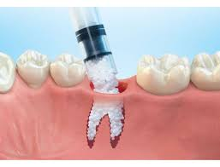
INTRODUCTION

Slide 5
HISTORICAL PERSPECTIVE- EVOLUTION
AUTOGENOUS- HEGDUS 1923- PERIODONTAL APPLICATION
AUTOGENOUS- INTRA ORAL- NABERS AND OLEARY-1965
ALLOGENIC FREEZE DRIED BONE-1970’S
DFDBA-URIST-1980’S
NEW BONE GRAFTS AND ALLOPLASTS- 1990’S
XENOGRAFTS- FORSBERG 1956, MELCHER 1962

Slide 6
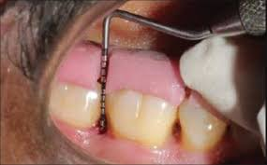
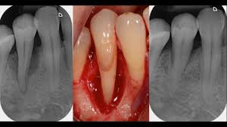
CLINICAL OBJECTIVES OF BONE GRAFTING
MELLONIG ET AL

Slide 7
IDEAL PROPERTIES OF BONE GRAFT
Non- toxic, Non- antigenic
Patient acceptance
Resistant infection
No root resorption or ankylosis
Strong and resistant
Stimulate osteoinduction and frame work for osteoconduction
Easily adaptable
Readily and sufficiently available
Predictability
Minimal surgical procedure
Complete replacement of new bone
Induce and enhance cementogenesis

Slide 8
INDICATIONS OF PERIODONTAL BONE GRAFT
Deep intra bony defects
Tooth retention
Defects associated with aggressive periodontitis
Furcation
Ridge preservation

Slide 9
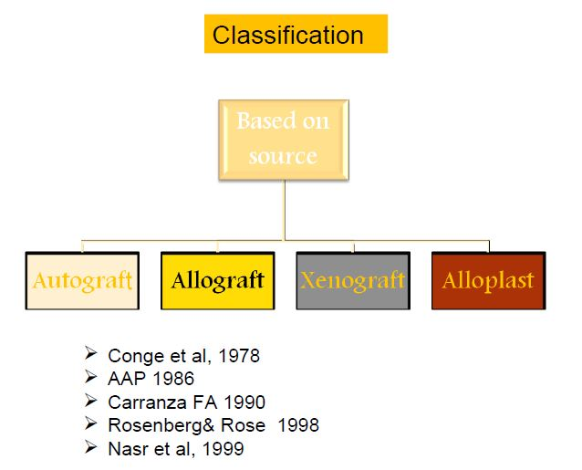

Slide 10
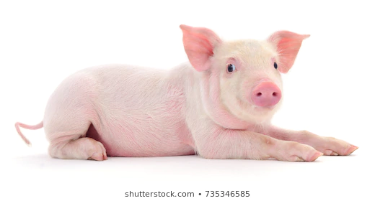
XENOGRAFTS
BOVINE DERIVED
PORCINE DERIVED
NATURAL CORAL
BIO-OSS
BIO-OSS COLLAGEN
OSSEOGRAF
PEP GEN-15
CORALLINE CALCIUM PHOSPHATE
OSTEOBIOL

Slide 11
XENOGRAFTS
CALF BONE- BOPLANT (AROCCA R 1968 and SCOOP 1966A, B)
KIEL BONE-CALF OR OX BONE
ANORGANIC BONE-

Slide 12
Nielsen et al 1981 treated 46 intabony defects with Kielbone® (i.e. defatted and deproteinized ox bone) and another 46 defects with intra oral autogenous bone grafts. The results showed no differences between the amount of clinical gain of attachment and bone fill obtained between in two categories of defects.
Histologic features showed isolated bone particles surrounded by a cementum like substances.

Slide 13
BOVINE DERIVED XENOGRAFTS
ANORGANIC BOVINE BONE (ABB):
Recently, new processing and purification methods have been utilized which make it possible to remove all organic components from a bovine bone source and leaving behind a non-organic bone matrix in an unchanged inorganic form. e.g.,
Bio-Oss Granules, Bio-Oss Collagen, and Bio-Oss Blocks.
Endobone®
Ladec®
Bon-Apatite®
OsteoGuide TM Anorganic Bone Mineral.
OsteoGuide Collagen TM Anorganic Bone Mineral with Collagen.
Osteograf/N.
PROCEDURE

Slide 14
BIO-OSS
Bio-Oss®
Approved in Europe (CE certificate) and in the USA (FDA notification).
Synonyms
Deproteinized bovine bone mineral
Porous Bone Mineral.
Natural Bone Mineral
Particle size- 100x200x500A⁰

Slide 15
Remodeling to lamellar bone occurs after approximately 6 months. Gradual replacements of Bio-Oss by host bone as the particles are resorbed.
It is biocompatible, amalgamate, and incorporates well within the newly formed regenerated hard tissue, with almost no clinical postoperative complications. Clinically the presence of ABB particles does not interfere with the wound healing process.

Slide 16
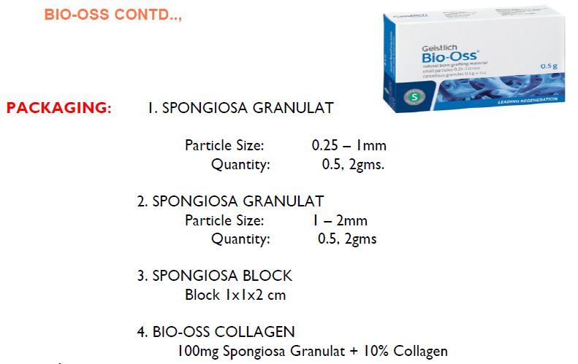
Schmitt et al 1997 compared bone regeneration promoted by porous bone mineral and biologically active glass in a critically sized defect (CSDs) in rabbits.
Porous bone mineral was significantly more radiopaque and more new bone was formed than biologically active glass-treated sites at both 4 and 8 weeks. This shows that Porous bone mineral appears to be more effective than biologically active glass in regenerating bone.

Slide 17
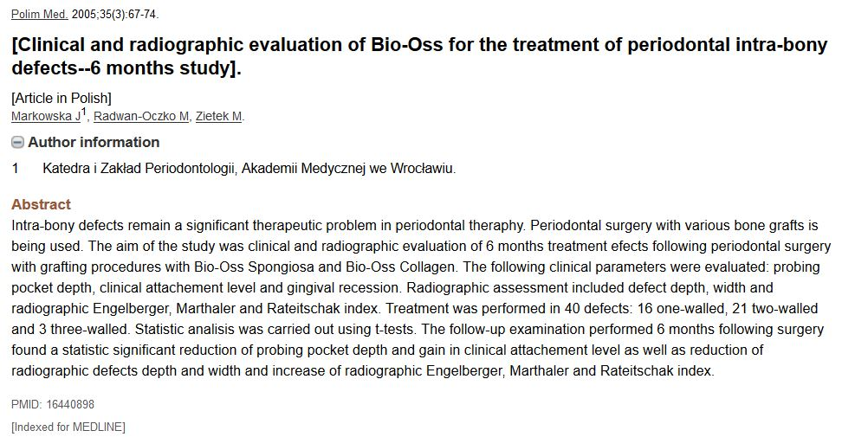
When ABB compared with DFDBA…
When ABB used alone or in combination with GTR and observed histologically
Richardson et al 1999

Slide 18
BIO-OSS COLLAGEN

Slide 19
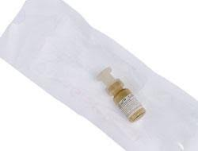
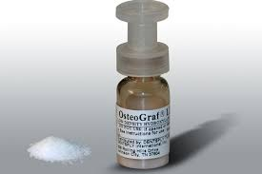
OSTEOGRAF
It is a natural anorganic bovine bone derived from microporous HA
Only xenograft that meets all standards of ASTM
Achieves a hydrophilic- cohesive consistency when hydrated
It remodels to vital bone at the same rate as natural bone
Osteograf N-300
Osteograf N-700

Slide 20
Pep Gen-15
Tissue engineered bone replacement graft which mimics inorganic and organic component of autogenous bone
It consists of uniquely designed p-15 peptide a synthetic biomimetic of 15 amino acid sequence of collagen type-1 that involves binding of cells particularly fibroblasts and osteoblasts.
Size 250-420μ
Available as Particulate, Putty and FLowable

Slide 21
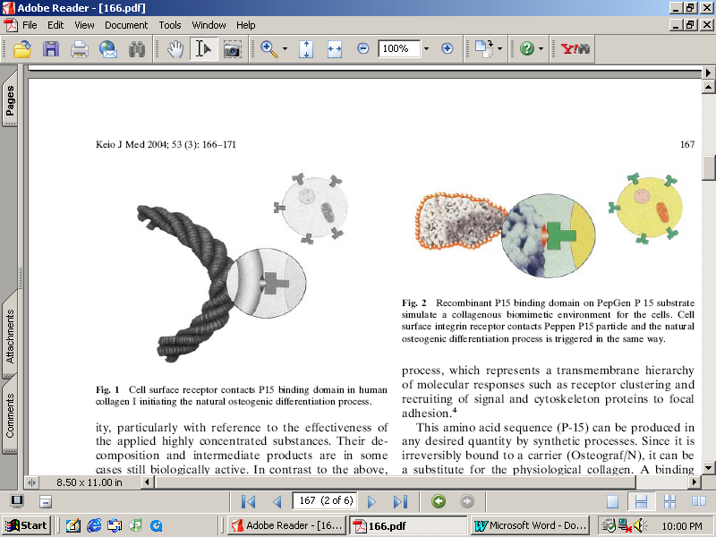
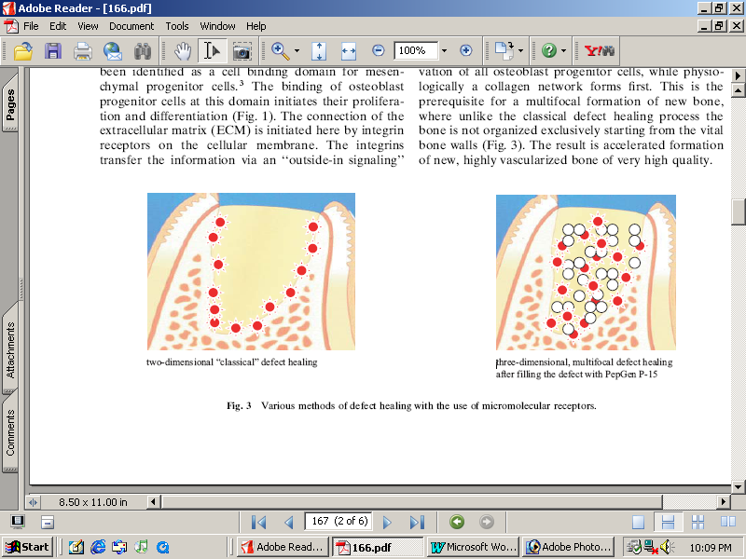
Mechanism of bone formation using Pep Gen 15
P-15 is a short (766-GTPGPQGIAGQRGVV-780) sequence of Type I collagen,
PepGen P15 simulates a biomimetic cell-attractive environment for osteogenic cells and controls the stoechiometric processes of the bone regeneration cascades

Slide 22
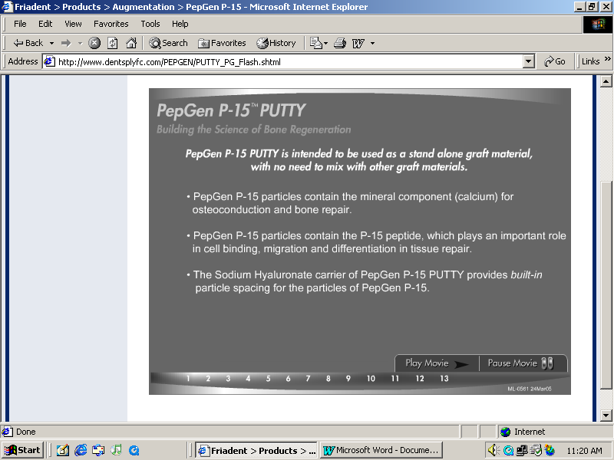

Slide 23
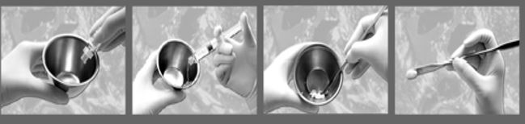

Slide 24
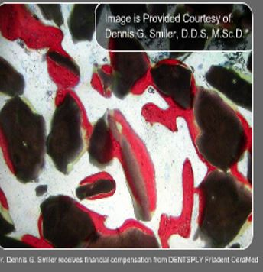
Sodium hyaluronate plays an important role in number of physiologic functions
1. Cell protection and lubrication.
2. Maintenance of structural integrity of tissues.
3. Transport of molecules.
4. Fluid retention and regulation.
5. Increases migration and proliferation of endothelial cells and ultimately angiogenesis.
6. It also allows adhesion and proliferation of osteoblastic progenitor cells and allows to even potentiate the effects of local growth factors.
7. Increases viscosity and allows more easy manageable product for the clinician to work intraoperatively and a more stable graft in its recipient site.

Slide 25
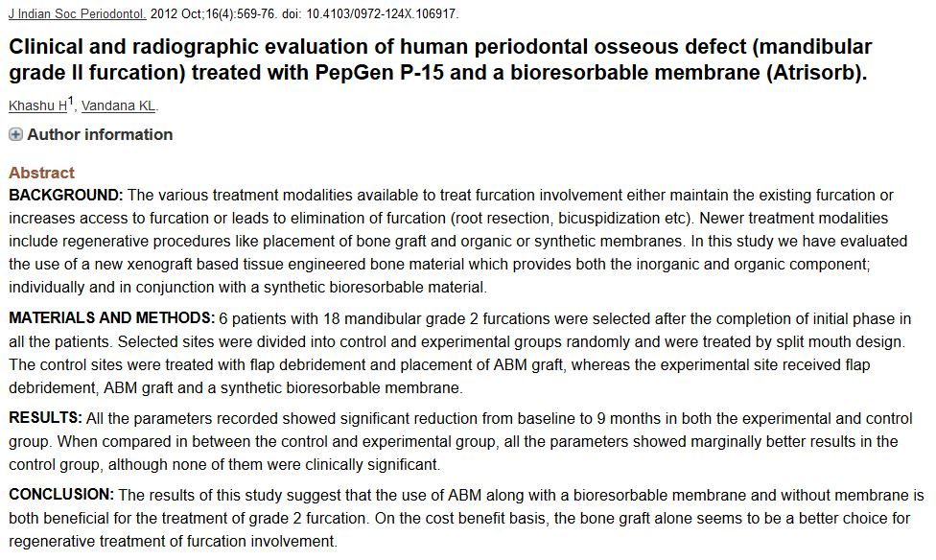

Slide 26
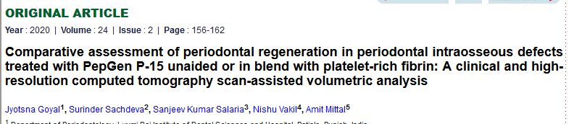
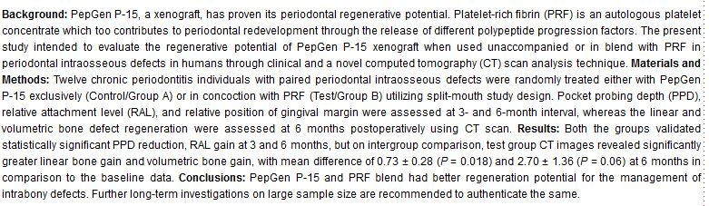

Slide 27
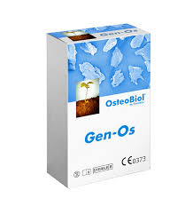
PORCINE DERIVED BONE GRAFTS
These are derived from porcine cortical and cancellous bone
These are also developed and used as bone substitutes
OSTEOBIOL GEN OS (TECHNOSS TURIN ITALY)
Commercially available
Heterogenous graft
Hydrated before use
Acts as carrier for drugs
Collagen facilitates blood clot stability, cohesive environment
Particle size 250-1000μ

Slide 28
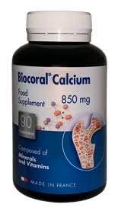
CORALLINE CALCIUM CARBONATE
BIOCORAL is a calcium carbonate derived from natural coral and purely composed of > 98% CaCO₃
Bio compatible and resorbable similar to spongy bone size is about 100-200μm
porosity provide a large surface area- Yukna et al 1994
Does not require surface transformation
Osteoconductive
Kim et al 1996; Gao et al 1997

Slide 29
COMBINATION PROCEDURES
Systematic review done by Merkx et al 2003 stated that 1:2 ratio of autogenous bone and bone substitutes were used in oral surgery procedures
Zafiropoulos et al 2007 used autogenous bone and de-proteinized bovine bone in intrabony defects- 12 month follow up

Slide 30
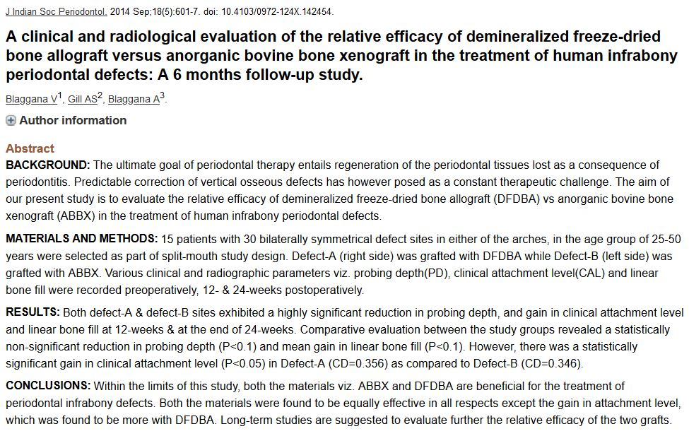

Slide 31
RISK OF DISEASE TRANSMISSION
PRION mediated diseases- Bovine Spongiform Encephalopathy
Humans- Creutzfeldt – Jakob disease
WHO- stated this bone as type-IV
Segal &Tofe 1999….. Extensive review on BSE

Slide 32
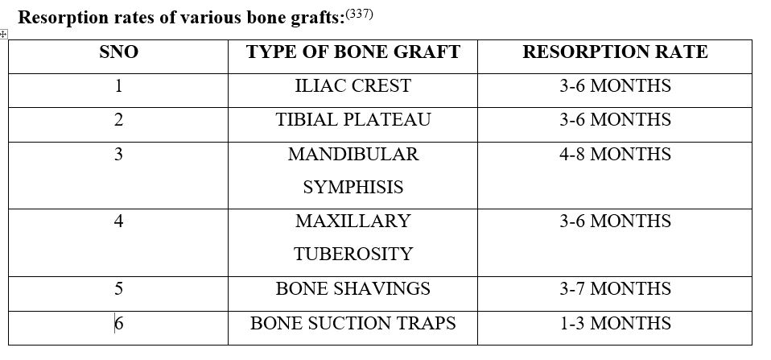

Slide 33
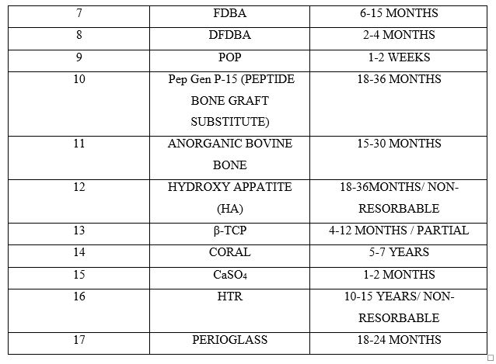

Slide 34
CONCLUSION

Slide 35
REFERENCES
AlGhamdi AS, Shibly O, Ciancio SG. Osseous grafting part II: xenografts and alloplasts for periodontal regeneration--a literature review. Journal of the International Academy of Periodontology. 2010 Apr;12(2):39-44.
Nasr HF, Reidy AME, Yukna RA. Bone and bone substitutes. Periodontology 2000, 1999; 19: 74-86.
Carranza FA, Takei HH, Cochran DL. Chapter-67, Reconstructive Periodontal Surgery. Carranza's Clinical Periodontology, 10th edition: 968-969.
Reynolds MA, Reidy AME, Branch-May GL, Gunsolley JC. The efficacy of bone replacement grafts in the treatment of periodontal osseous defects. Ann Periodontol 2003; 8(1): 227-265.
Dental & Medical Device. Product information on Osteo-Biol ®, 2008.
Dentsply-Friadent. Product information on PepGen P-15®, 2008

Slide 36
Rita Singh, Lanka Mahesh. Infections Resulting from Bone Grafting Biomaterials. International Journal of Oral Implantology and Clinical Research, May-August 2013;4(2):68-71
A.L. Dumitrescu, Chemicals in Surgical Periodontal Therapy, Bone Grafts and Bone Graft Substitutes in Periodontal Therapy.
Garg AK. Bone biology, harvesting, grafting for dental implants: rationale and clinical applications. Quintessence Publishing Company; 2004.

