Slide 1
TRACHEA & LUNG
SURESH BABU K

Slide 2
INTRODUCTION
Lungs have “Four” main components:
Airways (Bronchi – Bronchioles)
Alveoli
Vessels (Arteries – Veins – Lymphatics)
Interstitium & Pleura
should be examined in every slide

Slide 3
GENERAL
The main role of airways is to conduct the air to the alveoli for gas exchange
Trachea → main bronchi → lobar bronchi → segmental bronchi → small bronchi → bronchioles → respiratory bronchioles → alveolar ducts → alveoli
Respiratory bronchioles and alveolar ducts are not only conduct air but also participate in gas exchange with the alveoli

Slide 4
GENERAL
The delivered air should be:
Warm
By the airways blood vessels
Moisten
By watery secretion released by submucosal seromucinous glands
Clean
By Ciliary movements (located at apical portions of mucosal epithelium)
By Mucous secretion (released by mucosal goblet cells and submucosal seromucinous glands)

Slide 5
TRACHEA
Mucosa
Respiratory epithelium
Pseudostratified Ciliated Columnar Epithelium
Other cells
Goblet cells
Basal cells
Brush cells
Neuroendocrine cells (Kulchitsky)
Basement membrane
Lamina Propria
– Connective tissue + elastic fibers
stratified appearance of the mucosa is because their nuclei are located on different levels, even though the cells are anchored on the same basement membrane

Slide 6
TRACHEA
Wall
Tracheal Seromucinous glands
Tracheal cartilage
C-shaped rings of hyaline cartilages
Number: 16 - 20
Incomplete posteriorly (gap)
Trachealis muscle
Filling the posterior cartilaginous gap
Also connective tissue + elastic fibers

Slide 7
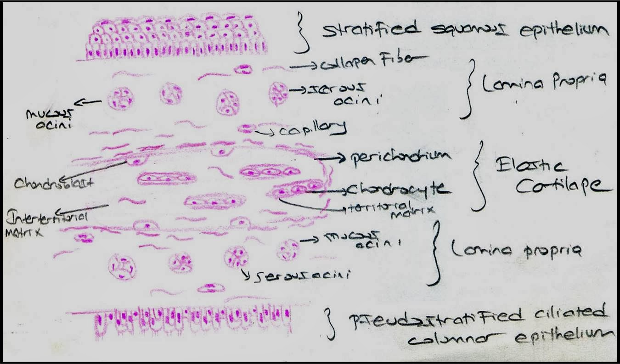

Slide 9
BRONCHI
Mucosa
Respiratory epithelium
Pseudostratified Ciliated Columnar Epithelium
Other cells
Goblet cells
Basal cells
Brush cells
Neuroendocrine cells (Kulchitsky)
Basement membrane
Lamina Propria
Connective tissue + elastic fibers
stratified appearance of the mucosa is because their nuclei are located on different levels, even though the cells are anchored on the same basement membrane

Slide 10
BRONCHI
Wall
Smooth muscle layer
Just below mucosa
Bronchial seromucinous glands
Bronchial cartilage
Incomplete plates
Also connective tissue + elastic fibers
Also bronchus-associated lymphoid tissue (BALT)
Similar to (MALT) of GIT

Slide 11
BRONCHIOLES
Mucosa
Bronchiolar epithelium
Less pseudostratified to simple, Columnar Ciliated epithelium
Other cells
Clara cells
Basement membrane
Lamina propria
Connective tissue + elastic fibers
In more distal airways, there are:
fewer goblet cells
more Clara cells

Slide 12
BRONCHIOLES
Wall
Smooth muscle layer
– Relatively thicker than bronchi
No glands
No cartilage
Also connective tissue + elastic fibers

Slide 13
TERMINAL BRONCHIOLES
The last generation of conductive airways
Then divide into respiratory bronchioles (gas exchange system)
Have thinner mucosa than other bronchioles
Simple, Low columnar – Cuboidal epithelium
Few ciliated cells
Clara cells
No Goblet cells
Have thinner wall than other bronchioles
– Thin smooth muscle and connective tissue
TB

Slide 14
RESPIRATORY BRONCHIOLES
The beginning of gas exchange compartment
Lined by simple cuboidal – flat epithelium
Non-ciliated
Alveoli budding along their thin walls
In 2D longitudinal sections of glass slides, respiratory bronchiole lined on one side by simple cuboidal – flat epithelium and alveolar spaces on the other side

Slide 15
ALVEOLAR DUCTS
Straight tubular spaces
Bounded entirely by alveoli
– Alveoli protrude from their lumens

Slide 16
BRONCHI V.S. BRONCHIOLES
 | Bronchi | Bronchioles
Diameter | > 1 mm | < 1 mm
Mucosa:
Lining | Pseudostratified | Simple
Clara cells | Rare | Present
Goblet cells | Present | Rare
Wall:
Bronchial glands | Present | Absent
Cartilage plates | Present | Absent
Smooth Muscle | Thin layer | Thicker layer

Slide 17
MUCOSA
Large Bronchi
increase
Pseudo-stratification, columnar
Mucosal Height
decrease
Simple, cuboidal
Terminal Bronchioles
increase
Mucosal Cilia
decrease/absent
increase
Goblet Cells
decrease/absent
decrease/absent
Clara Cells
increase

Slide 19
GOBLET CELLS
Non-ciliated, Columnar cells
Goblet = drinking glass with stem
Wide apex “cytoplasm filled with mucin”
Narrow base “nucleus”
Secretory cells
Apical mucin vacuoles (PAS, Alcian-Blue)
Bronchi > bronchioles

Slide 20
CLARA CELLS
Non-ciliated Columnar cells
Dome-shaped apical ends
Secretory cells
Apical secretory granules (PAS + diastase resistant)
Produce components of surfactants
Also Reserve cells
Replace bronchiolar epithelium after injury
Bronchioles > Bronchi

Slide 21
NEUROENDOCRINE CELLS
Also known as “Kulchitsky cells”
Scattered within airways epithelium
More evident in neonates
Rarely seen in adults
Secretory cells
Contain neurosecretory granules by E/M

Slide 22
GENERAL
Alveoli are sac-like spaces arising from:
Respiratory bronchioles
Alveolar ducts
Alveolar sacs
It provides a tremendous surface area for gas exchange between inhaled air and alveolar capillaries
The alveoli are protected from collapse during expiration by the action of
surfactant
Mixture of phospholipids that reduce alveolar surface tension

Slide 23
LUNG ACINUS
A functional unit (for gas exchange) composed of the structures distal to
a single terminal bronchiole
Respiratory bronchioles
Alveolar ducts
Alveoli

Slide 24
LUNG LOBULE
An anatomic unit consisting of the acini of 3 to 10 terminal bronchioles
that are bounded together by the interlobular septum

Slide 26
ALVEOLI
Lining (pneumocytes)
Type I
Squamous “flat” epithelial cells
Cover 90% of total alveolar surface area
Very thin cytoplasm (to permit gas exchange)
Incapable of division

Slide 27
ALVEOLI
Lining (pneumocytes)
Type II
Cuboidal epithelial cells
More numerous than type I
But cover only 10% of total alveolar surface area
Capable of division
Reserve cells for type I pneumocytes
Alveolar damage/repair → type II hyperplasia
Also produce surfactant
Lamellar bodies by E/M

Slide 28
ALVEOLI
Wall
Very thin
Connective tissue + elastic & reticular fibers
Contains many types of cells (nuclei):
– Pneumocytes nuclei
Capillary endothelial nuclei
Macrophages nuclei
Fibroblasts nuclei
Alveolar macrophages help removing the
dust and foreign materials
They have the same role as airways cilia

Slide 29
AIR-BLOOD BARRIER
Very thin to facilitate gas exchange
Formed of:
Alveolar Epithelium (Type I Pneumocytes)
Fused basement membranes
Of both alveoli and pulmonary capillaries
Capillary Endothelium

Slide 30
COLLATERAL VENTILATION
Means the ventilation of alveolar structures through passages or
channels that bypass the normal airways
Normally they are Non-functioning
They play an important role in cases of airways obstruction “to ventilate the collapsed area”
Also they may permit passage of bacteria and exudate between alveoli and bronchioles during pneumonia

Slide 31
COLLATERAL VENTILATION
K → two alveoli
L → one bronchiole + one alveolus
M → two bronchioles
Three main routes
Channels of Martin:
Communication between two adjacent bronchioles
Channels of Lambert:
Communication between non-respiratory bronchiole and adjacent alveolus
Pores of Kohn:
Communication between two adjacent alveoli through perforations in their walls

Slide 32
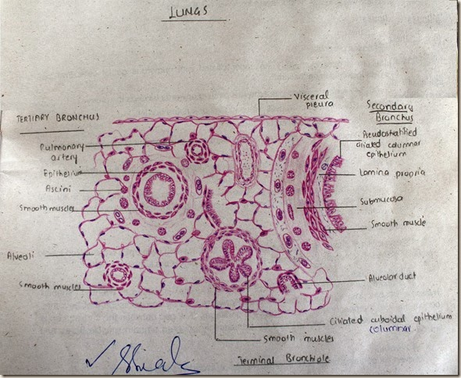

Slide 33
GENERAL
The lungs receive dual vascular supply
 | Pulmonary | Bronchial “Systemic”
Aim | Gas exchange “at alveolar capillaries” | Supply bronchi with O2 and nutrition
Arterial side | Low O2 High CO2 | High O2 Low CO2
Venous side | High O2 Low CO2 | Low O2 High CO2

