Slide 1
POLYMERS: Denture base, Flexible denture

Slide 2
CONTENTS
Definitions
Application in dentistry
Classification
Ideal requirements
General properties
Stages of polymerisations
Acrylic resins
Denture base fabrication techniques
Flexible denture
Conclusion

Slide 3
Monomer
A Chemical compound capable of reacting to form a polymer.(GPT-8)
Polymer
Chemical compound consisting of large organic molecules formed by the union of many repeating smaller monomer units. (GPT-8)
Notes:
Starting with some basic terminologies

Slide 4
Polymerization
Chemical reaction in which monomers of a low molecular weight are converted into chains of polymers with a high molecular weight.
Monomer + Monomer
+ Monomer + Monomer
Polymerization
- Mer - Mer - Mer - Mer -

Slide 5
APPLICATION OF RESINS IN DENTISTRY
Dentures
Cavity-filling materials
Sealants
Impression materials
Custom impression trays
Cements
Dies
Splints
Post and core
Notes:
Dentures (bases, liners and artificial teeth)
Cavity-filling materials (“composites”)
Sealants
Impression materials(polyether, polysulphide,silicone)
Cements (resin-based)
Dies – epoxy resin

Slide 6
CLASSIFICATION
Based on thermal behavior:
1) Thermoplastic polymers
2) Thermosetting polymers
Based on mode of polymerization:
1) Heat-activated polymers
2) Auto, self or chemically activated polymers
3) Light-activate polymers
4) Microwave-cured polymers
Notes:
Thermoplastic resins that can be repeatedly softened and molded under heat and pressure without any chemical change occurring. Eg GP, PMMA polyethylene polystyrene
Thermosetting resins which can be molded only once. They set when heated. E.g-corss linked PMMA, silicones, bisphenol.

Slide 7
IDEAL REQUIREMENTS OF DENTAL RESINS
Be tasteless, odorless, non-toxic and non-irritant to oral tissues.
Be esthetically satisfactory
Be dimensionally stable.
Have enough strength, resilience and abrasion resistance.
Be insoluble and impermeable to oral fluids.
Notes:
2.- Be esthetically satisfactory, i.e. it can easily tinted.
3.- Be dimensionally stable. Means it should not expand, contract or warp during processing and subsequent use by the patient.
6.- Have a low specific gravity (light in weight).

Slide 8
Have a low specific gravity.
Tolerate temperatures well above the temperature of any hot foods or liquids taken in the mouth without undue distortion.
Be easy to fabricate and repair.
Have good thermal conductivity.
Be radiopaque.

Slide 9
When used as a filling material it should bond chemically with the tooth.
Have coefficient of thermal expansion which match that of tooth structure.
Be economical.
Notes:
9. radiopaque- so that fragments can be easily detected by x-rays if accidentally aspirated or swallowed.
Cofficient of thermal expansion-Fractional change in size per degree change in temp.

Slide 10
GENERAL PROPERTIES AND NATURE OF POLYMERS

Slide 11
CHAIN BRANCHING AND CROSSLINKING
Notes:
Branches increases the physical entanglement or connections between the chains, n increases the ability to resist distortion.
However requires low energy to break but crosslinking are chemical bonds hence require more energy to break down
Cross linking increases the molecular weight, as they form bridges between the chains
Cross linking of polymer increases rigidity, resistance to solvent and increases the softening or glass transition temperature

Slide 12
MOLECULAR WEIGHT & CAHIN LENGTH
Notes:
Strength, rigidity n melting range are directly proportional to chain length
Molecular weight: 8000 to 39000
Longer the chain the more difficult it is to distort the polymer material AS greater number of entanglements can be seen

Slide 13
COPOLYMERES STRUCTURES
Random polymer - No sequential order exist among the two or more mer units along the polymer chain.
… ABBABABABAABAB BABABABABBA…
Block polymer- Identical monomer units occur in relatively long sequences (blocks) along the main polymer chain.
…AAAABBBBBAAAABBBBBAAAABBBBB…

Slide 14
Graph or branched polymers- Sequence of one type of mer units (B) are grafted onto a backbone chain of a second (A) type of mer unit to form branched configuration.

Slide 15
MOLECULAR ORGANISTAION
Notes:
When the chains are randomly coiled and entangled in disorderly fashion they are arranged in amorphus pattern.
But when the chains are aligned in a highly ordered fashion they are arranged in crastaline pattern
Most dental polymers are predominenty amorphus with very little crystalline pattern.
Polymer crystallinity increase strength, rigidity, hardness, n MP n brittelness BUT decrease ductility

Slide 16
STAGES OF POLYMERIZATION
Four stages:
Induction
Propagation
Termination
Chain transfer
Notes:
This occurs in four stages:

Slide 17
INDUCTION
Molecules of the initiator becomes energized or activated and start to transfer the energy to the monomer.
First step involves formation of free-radical.
This free-radicals initiates polymerization reaction.
Notes:
The induction of the polymer chain occurs in two steps
1 activation
And the it is followed by initiation

Slide 18
Activation
Notes:
Can occur by chemical, heat, visible light, UV light or energy transfer from other compounds.
On the basis of activation process dental polymers can be:
1) Heat-activated polymers
2) Auto, self or chemically activated polymers
3) Light-activate polymers
Presence of an unsaturated group that is double bond is required as a source of free radicle.(having an unpaired electron)
It is not a catalyst as it enters the chemical reaction.

Slide 19
Initiation
Notes:
Initiation is the period during these free radicals reacting with monomer molecules to initiate or start the chain growth
Higher the temperature more rapid is the formation of free radicals and consequently shorter the induction period.

Slide 20
Induction systems for dental resins:
Heat activation- e.g. benzoyl peroxide for polymerization of methyl methacrylate monomer.
Chemical activation- e.g. the use of benzoyl peroxide and an aromatic amine (dimethyl-p-toluidine) in self-cured dental resins.
Notes:
As suggested by the name they are activated by increase in temperature
Benzoyl peoxide provide 2 free radicles per molecule at about 50-100 degrees of temp
Uses two reagents that chemically react with each other to give a free radicle

Slide 21
Light activation- e.g. camphorquinone and amine will react to form free radicals, when irradiated with visible light.
Notes:
Light activation- In this system, photons of light energy activate the initiator to generate free radicals,
visible light-380-700
Uv light- 100-400

Slide 22
PROPAGATION
Once the growth has started, the process continues rapidly and is accompanied by evolution of heat.
Theoretically, the chain reactions should continue with evolution of heat until all the monomer has been changed to polymer but in reality the polymerization is never complete.

Slide 24
CHAIN TRANSFER
The chain termination results from chain transfer.
Activated radical is converted to an inactive molecule and a new nucleus of growth is created.
An already terminated chain can be reactivated by chain transfer resulting in continued growth.

Slide 26
TERMINATION
The chain reactions can be terminated either by direct coupling of two chain ends
or
By exchange of a hydrogen atom from the growing chain to another.

Slide 28
INHIBITION OF POLYMERIZATION
Such reactions are inhibited by:
Inhibitors – These react with the activated initiator or with an activated growing chain to prevent further growth.
e.g. Hydroquinone is added to prevent polymerization of the monomer during storage.
Oxygen – Presence of oxygen (air) also inhibit polymerization.

Slide 29
ACRYLIC RESINS
The acrylic resins are the derivatives of ethylene and contain a vinyl group in their structural formula.
The acrylic resins used in dentistry are the esters of:
1. Acrylic acid, CH2=CHCOOH
2. Methacrylic acid, CH2=C(CH3)COOH

Slide 30
POLY METHYL METHACRYLATE RESINS
Widely used in dentistry to fabricate denture base.
It is a transparent resin of remarkable clarity.
Knoop hardness number of 18 to 20
Tensile strength - 60 Mpa
Density of 1.13 g/cm³
Modulus of elasticity - 2400 Mpa
Usually supplied as powder liquid system.
Notes:
One of the reasons for its wide popularity is the ease with which it can be processed.

Slide 31
TYPES
Based on the method used for its activation
Heat activated resins
Chemically activated resins 
Light activated resins

Slide 32
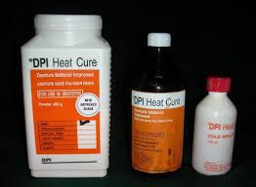
HEAT-ACTIVATED DENTURE BASE RESINS
The thermal energy required for polymerization of such materials can be provided using a water bath or microwave oven.
Notes:
It is the most commonly used for the fabrication of denture bases.

Slide 33
COMPOSITION
POWDER | LIQUID
Polymethyl methacrylate | Methyl methacrylate
Benzoyl peroxide | Glycol dimethacrylate
Ethyl or butyl methacrylate | Hydroquinone
Compounds of mercuric sulfide, cadmium sulfide,etc | Dibutyl pthalate
Zinc or Titanium oxide
Dibutyl phthalate
Fillers like glass fibers, alumina
Notes:
2 Initiator,
3 co-polymer to improve properties,
4 5 dyes, opacifier, plasticiser, improves physical properties like stiffness etc
6 Crosslinking agent,
7plasticizer
,
3 inhibitor-prevent premature polymerization
4 plasticizer

Slide 34
STORAGE
Manufacturers generally recommend specific temperature and time limits for storage.
If recommendations are not followed, components may undergo changes that can affect properties of these resins.
Liquid is supplied in tightly sealed amber coloured bottles to prevent premature polymerization by light.
Notes:
Pyrax- keep away from moisture, keep away from direct sunlight, & temp not less than 5 and not more than 30.
Liqid- temp not less than 10 and not more than 30

Slide 35
PHYSICAL PROPERTIES OF DENTURE BASE RESINS

Slide 36
POLYMERIZATION SHRINKAGE
When methyl methacrylate monomer is polymerized to form polymethyl methacrylate, the density of the mass changes from 0.94 to 1.19 g/cm3.
The volumetric shrinkage exhibited by the polymerized mass is approximately 7%.

Slide 37
LINEAR SHRINKAGE
Exerts significant effects upon denture base adaptation and cuspal interdigitation.
Greater the linear shrinkage, greater is the discrepancy observed in the initial fit of a denture.

Slide 38
Material | Linear shrinkage(%)
Chemically activated resin | 0.26
Conventional heat cured acrylic resin | 0.43
Pour-type acrylic resin | 0.48
Rapid heat cured acrylic resin | 0.97

Slide 39
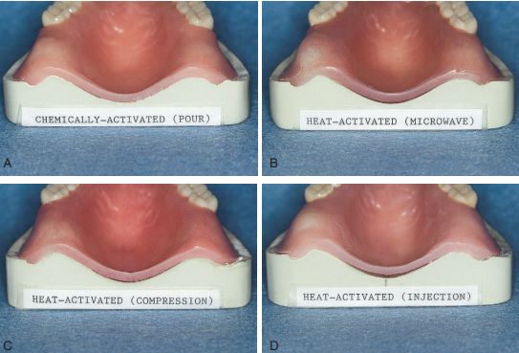
Dimensional changes resulting from polymerization.
Notes:
Complete dentures constructed using chemically activated resins generally display better adaptation than those constructed using heat-activated resins. This phenomenon can be attributed to the negligible thermal shrinkage displayed by chemically activated resins.
Processing shrinkage has been measured as 0.26% for chemically activated resin, compared with 0.53% for a representative heat-activated resin.

Slide 40
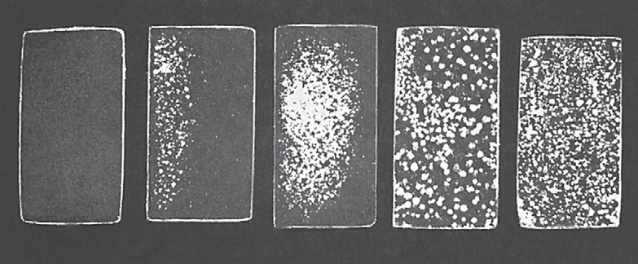
POROSITY
A B C D E
Notes:
Heat activated denture base resin exhibiting different types and degree of porosity.
A- Properly polymerized; no porosity.
B and C- Rapid heating, relatively small subsurface voids.
D- Insufficient mixing of monomer and polymer; large voids resulting from localized polymerization shrinkage.
E- Insufficient pressure & material during polymerization; relatively large, irregular voids.

Slide 41
Viscoelastic property
Notes:
Elastic property- exhibited when crystalline entanglements are present

Slide 42
Notes:
Viscoelastic property- partial elastic recovery bcz more amorphus.

Slide 43
PLASTICIZATION PROPERTY
The solvent particles penetrates polymer chains and facilitates slipping of chains.
It is of two types:
INTERNAL- Copolymerization
EXTERNAL- Solvent penetration
It reduces strength, hardness and softening temperatures.
Facilitates cushioning linear polymer for dentures.

Slide 44
WATER ABSORPTION
Polymethyl methacrylate exhibits a water absorption value of 0.69 mg/cm2.
It has been estimated that for each 1% increase in weight produced by water absorption, acrylic resin exhibits a linear expansion of 0.23%.
Notes:
Diffusion mechn.

Slide 45
SOLUBILITY
Non-cross-linked polymethyl methacrylate dentures made in the 1940s swelled and warped when exposed to ethanol in the diet.
Addition of cross-linking agents to the resin composition has solved this problem.

Slide 46
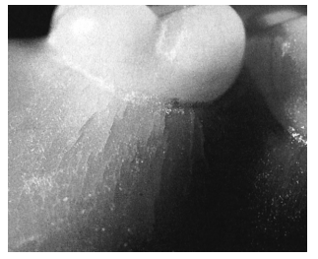
CRAZING
Release of stress can produce small surface flaws that may adversely affect the esthetic and physical properties of a denture. The production of such flaws, or microcracks, is termed crazing.
Notes:
Tensile stresses are most often responsible for crazing in denture base Applications.

Slide 47
Crazing in a transparent resin -- a “hazy” or “foggy” appearance.
In a tinted resin -- a whitish appearance.
Crazing may result from stress application or from partial dissolution by a solvent.
Crazing generally begins at the surface of a resin and is oriented at right angles to tensile forces.

Slide 48
STRENGTH
As the degree of polymerization increases, the strength of the resin also increases.
The factors on which strength depends are:
composition of the resin,
processing technique
Compressive strength: 85 and 110 MPa
Tensile strength: 30 and 50 MPa
Notes:
chemically-activated resins exhibit increased levels of residual monomer as well as decrease strength and decreased stiffness.

Slide 49
DENTURE FABRICATION TECHNIQUES
Compression molding technique
Injection molding technique
Fluid resin technique
Visible light curing technique
Notes:
Compression molding technique uses usually heat activated resins
Injection molding technique (heat activated resins)
Fluid resin technique (chemically activated resins).
Visible light curing technique (VLC resins).

Slide 50
Compression molding technique
Heat-activated denture base resins are shaped using compression molding.

Slide 51
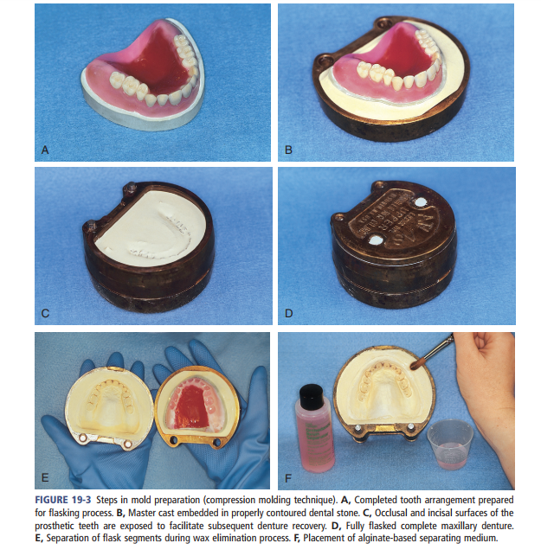
1. PREPARATION OF THE MOLD:
Notes:
A- shows the waxed denture
B - The lower portion of a denture flask is filled with freshly mixed dental plaster, and the waxed denture is placed into this mixture.
Upon reaching its initial set, the waxed denture is coated with a thin layer of separator e.g sodium alginate to prevent adherence of dental plaster to the master cast during the flasking process.
C-Plaster is added until all surfaces of the tooth arrangement and denture base are completely covered.
D-Then an additional increment of dental plaster is poured and lid of the flask is gently seated and allowed to harden.
Then denture flask is immersed in boiling water for 4 min. Residual wax is removed from the mold cavity with clean hot water.

Slide 52
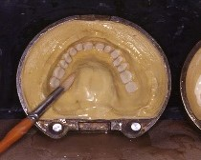
2. APPLICATION OF A SEPARATING MEDIUM
Notes:
When applied to dental plaster surfaces, produce thin, insoluble calcium alginate film.
These films prevent direct contact of denture base resins to dental plaster, thereby eliminating undesirable interactions
Chemical bonding.

Slide 53
3. POLYMER-TO-MONOMER RATIO
3 : 1 by volume.
2 : 1 by weight
Using a 3 : 1 ratio, the volumetric shrinkage can be limited to approximately 7%.
Notes:
Each molecule possesses an electrical field that repels nearby molecules. Consequently, the distance between molecules is significantly greater than the length of a representative carbon-to-carbon bond. When the methyl methacrylate molecules are chemically bonded, a new carbon-to-carbon linkage is formed. This produces a net decrease in the space occupied by the components. the polymerization of methyl methacrylate to form polymethyl methacrylate yields a 21% decrease in the volume of material. As might be expected, a volumetric shrinkage of 21% would create significant difficulties in denture base fabrication. To minimize dimensional changes, resin manufacturers prepolymerize a significant fraction of the denture base material. This can be thought of as “preshrinking” the selected resin fraction.pre polymerized fraction- powder, non polymerized- liquid.

Slide 54
4. POLYMER-MONOMER INTERACTION
These stages can be described as:
Sandy
Stringy
Dough-like
Rubbery or elastic
Stiff.
Notes:
1.-sandy stage, little or no interaction occurs on a molecular level. Polymer beads remain unaltered, and the consistency of the mixture is described as “coarse” or “grainy.”
2.- During this stage, the monomer attacks the surfaces of individual polymer beads and is absorbed into the beads thereby increasing the viscosity of the mix.
3.- in this stage an polymerisation begins and maximum number of monomer unit enters into the reaction Ideal stage
4.- Following the doughlike stage, the mixture enters a rubbery or elastic stage. This is because monomer is dissipated by evaporation and by further penetration into remaining polymer beads.
The mass rebounds when compressed or stretched
5.- in this the mass is totally unworkable.

Slide 55
DOUGH-FORMING TIME
The time required for the resin mixture to reach a dough-like stage is termed the dough-forming time.
(ANSI / ADA) Specification No. 12
less than 40 min from the start of the mixing process.
In clinical use less than 10 min.
Notes:
American national standards institute
American dental association

Slide 56
WORKING TIME
Working time is defined as the time a denture base material remains in the dough-like stage.
ADA Specification No.12 5 minutes
The ambient temperature affects the working time. Hence the working time of a denture resin can be extended via refrigeration. Moisture contamination can be avoided by storing the resin in an airtight container.
Notes:
A significant drawback associated with this technique is that moisture may condense on the resin when it is removed from the refrigerator, which may degrade the physical and esthetic properties of a processed resin.
Following removal from the refrigerator, the container should not be opened until it reaches room temperature.

Slide 57
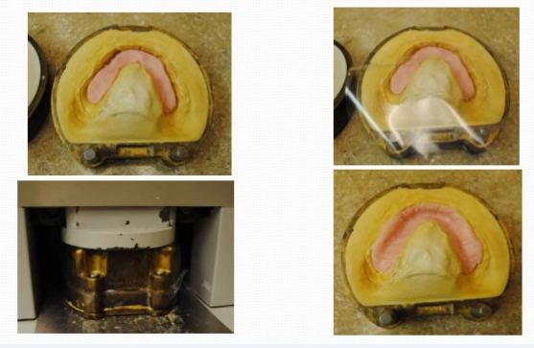
5. PACKING: The placement and adaptation of denture base resin within the mould cavity.
Notes:
The resin is removed from its mixing container and rolled into a ropelike form for mandible and horse-shoe shaped for maxilla and placed in mould cavity.
A thin polyethylene separator sheet is placed over it and flask is assembled.
Then flask is opened and the polyethylene packing sheet is removed from the surface of the resin, flash is removed gently with instrument

Slide 58
The placement of too much material yields a denture base that exhibits excessive thickness and resultant mal-positioning of prosthetic teeth.
Use of too little material leads to noticeable denture base voids or porosity.

Slide 59
Slow application of pressure permits the resin dough to flow uniformly throughout the mold space.
Excess resin will be found on the relatively flat areas surrounding the mold cavity. This excess resin is called flash.

Slide 60
When flash is no longer apparent, the mold is closed for the last time with no polyethylene sheet interposed. The mold sections are properly aligned and placed in the flask press.

Slide 61
Notes:
Then the flask is left for 60-90 min for bench curing.

Slide 62
INJECTION MOLDING TECHNIQUE

Slide 63
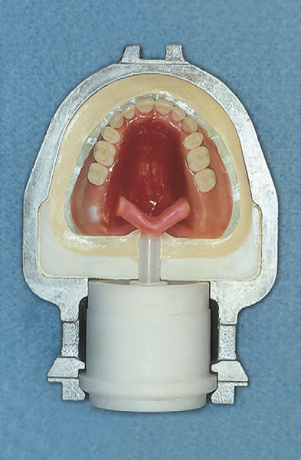
Denture bases can be fabricated via injection molding using specially designed flasks.
One half of the flask is filled with freshly mixed dental stone, and the master cast is settled into this mixture.

Slide 64
The dental stone is appropriately contoured and permitted to set.
Subsequently, sprues are attached to the wax denture base, which lead to an inlet or pressure port.

Slide 65
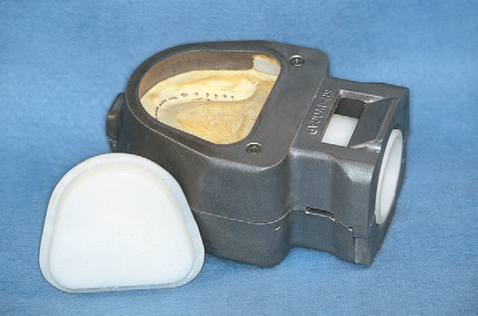
The remaining half of the flask is positioned, and the investment process is completed.

Slide 66
WAX ELIMINATION

Slide 67
Injection of resin is done into the mold cavity through sprue channels that were placed.
Notes:
Then the assemble is place for 60 min for bench curing.
Both compression moulding and injection moulding techniques uses heat cure resin .

Slide 68
CURING CYCLE
Processing in a constant temperature water bath at 74 °C for 8 hour or longer, with no terminal boiling treatment.
Processing in a 74 °C water bath for 8 hours and then increasing the temperature to 100 °C for 1 hour.
Processing at 74 °C for approximately 2 hour and then increasing the temperature to 100 °C and processing for 1 hour.

Slide 69
Following completion of the chosen polymerization cycle, the denture flask should be cooled slowly to room temperature.
Overnight bench cooling is recommended.
To decrease the probability of unfavorable dimensional changes, the denture should be stored in water until it is placed in the oral cavity.

Slide 70
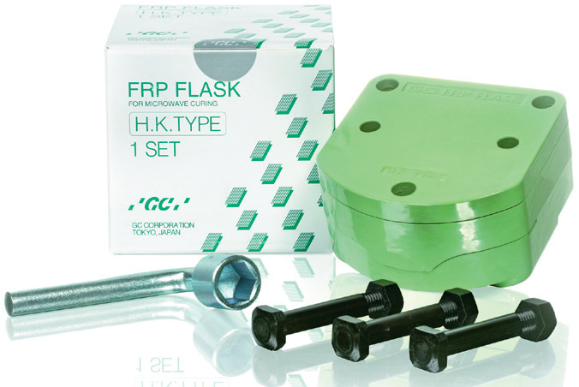
POLYMERIZATION VIA MICROWAVE ENERGY
Polymethyl methacrylate resin can also polymerized using microwave energy.
This technique employs a specially formulated resin and a nonmetallic flask.
Notes:
Nature cryl MC

Slide 71
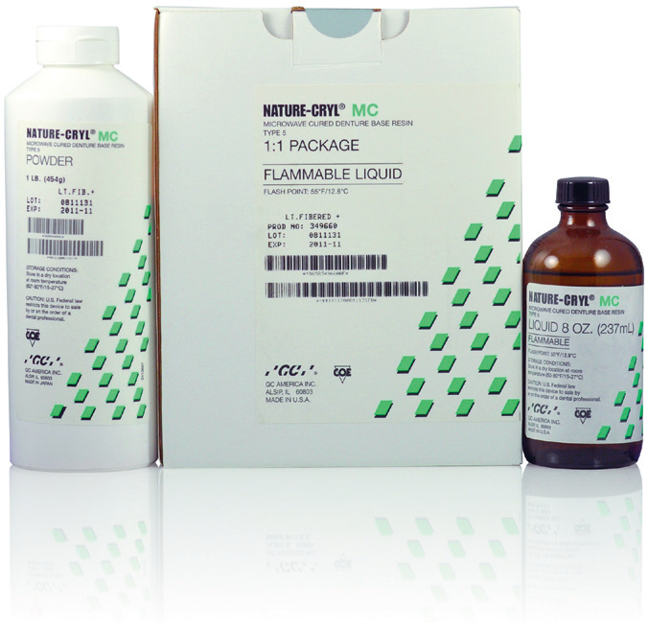
A conventional microwave oven is used to supply the thermal energy required for polymerization.

Slide 72
Advantage- polymerization can be accomplished faster than the convention water bath method.
Disadvantage- Overheating can occur in thick sections, causing the monomer to boil and produce porosity.
Physical properties and fit of microwave resins are comparable to those processed via conventional compression moulding techniques.

Slide 73
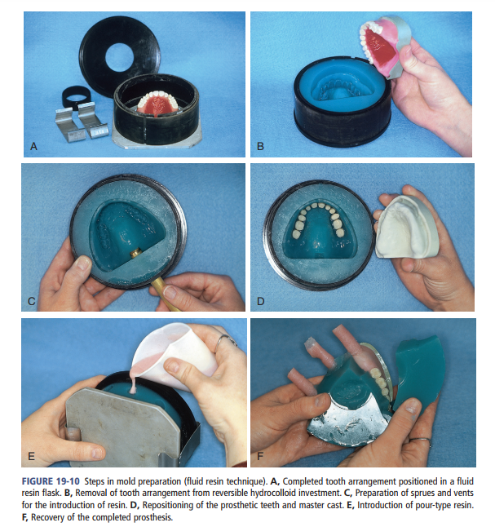
FLUID RESIN TECHNIQUE
Notes:
A, Completed tooth arrangement positioned in a fluid resin flask. And reversible hydrocolloid is poured into it.
B, Removal of tooth arrangement from reversible hydrocolloid investment.
C, Preparation of sprues and vents for the introduction of resin.
D, Repositioning of the prosthetic teeth and master cast.
E, Introduction of pour-type resin. FLASK IS THEN PLACED IN THE PRESSURIZED CHAMBER (PRESSURE POT) AT ROOM TEMP AND THE RESIN IS PERMITTED TO POLYMERIZE (30-45 MINS)
F, Recovery of the completed prosthesis

Slide 74
Advantages:
Improved adaptation to underlying soft tissues.
Decreased probability of damage to prosthetic teeth and denture bases during deflasking.
Reduced material costs.
Simplification of flasking, deflasking, and finishing procedure.

Slide 75
Disadvantages:
Noticeable shifting of prosthetic teeth during processing.
Air entrapment within the denture base material.
Poor bonding between the denture base material and acrylic resin teeth.

Slide 76
LIGHT-ACTIVATED DENTURE BASE RESINS
These materials have been described as composites having matrices of urethane dimethacrylate, microfine silica, and high-molecular-weight acrylic resin monomers.
Acrylic resin beads are included as organic fillers.

Slide 77
Visible light is the activator.
A photosensitizing agent such as camphorquinone serves as the initiator for polymerization.
A light-activated resin cannot be flasked in a conventional manner since the opaque investing media prevent the penetration of light.

Slide 78
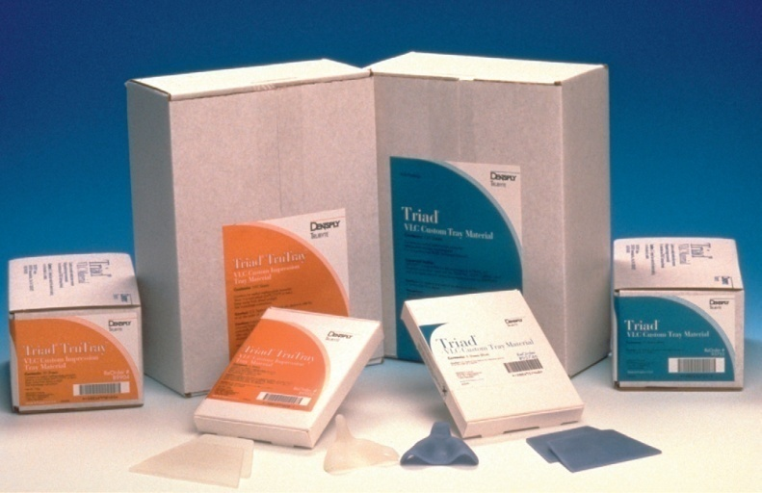
Single component denture base resins are supplied in sheet and rope forms .

Slide 79
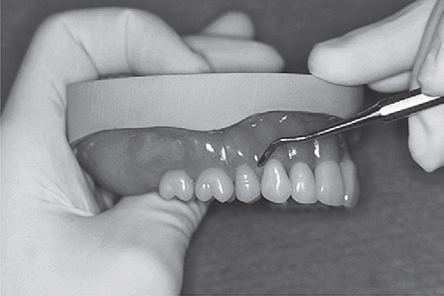
Denture base is molded on an accurate cast and subsequently the teeth are positioned.

Slide 80
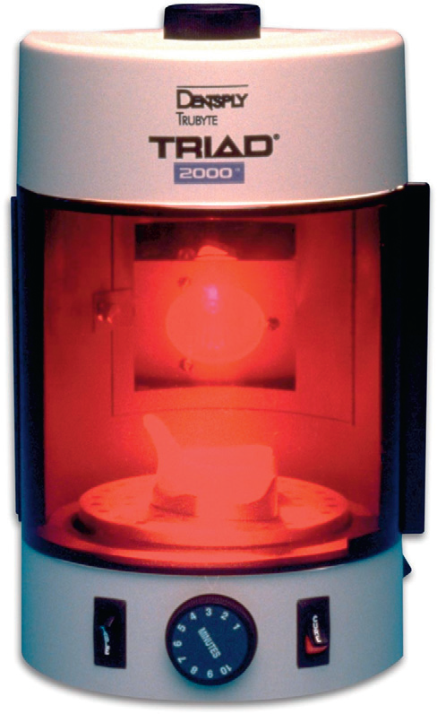
The denture base is exposed to a high intensity visible light source for an appropriate period.
Following polymerization, the denture is removed from the cast, finished, and polished in a conventional manner.

Slide 81
The most recent generation of light-activated denture base resins consists of three resins.
a base forming resin,
a tooth-setting resin, and
a contouring resin.
Notes:
The base-forming resin is adapted to the dental cast. The cast and denture base are placed into a high-intensity light chamber to induce polymerization.
The tooth-setting resin is used to attach the prosthetic teeth to the polymerized base. A high-intensity light source is used to polymerize the tooth-setting resin, thereby maintaining prosthetic teeth in the desired positions.
A contouring resin is used to generate the desired final surface form. The resultant prosthesis is placed into the light chamber to complete the denture base fabrication process. The denture is then removed from the cast, finished, and polished in a conventional manner.

Slide 82
The base-forming resin is adapted to the dental cast.
The cast and denture base are placed into a high-intensity light chamber to induce polymerization.

Slide 83
The tooth-setting resin is used to attach the prosthetic teeth to the polymerized base.
A high-intensity light source is used to polymerize the tooth-setting resin, thereby maintaining prosthetic teeth in the desired positions.

Slide 84
A contouring resin is used to generate the desired final surface form.
The resultant prosthesis is placed into the light chamber to complete the denture base fabrication process. The denture is then removed from the cast, finished, and polished in a conventional manner.

Slide 85
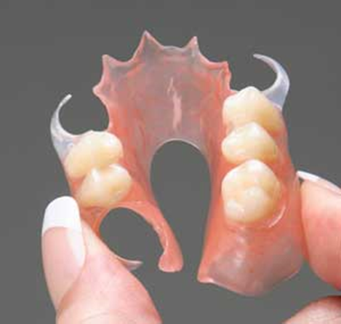
FLEXIBLE DENTURES
It is nylon based thermoplastic material that does not sacrifice function and preserves aesthetics.

Slide 86
Soft dentures are an excellent alternative to traditional hard-fitted dentures.
Some of the commercially available products are - Valplast, Duraflex, Flexite, Proflex, Lucitone, Impak.

Slide 87
Unique features-the semi-crystalline nylon composition provides:
Strength,
Flexibility,
Transparency,
High impact resistance,
Colour stability,
High creep resistance,
High fatigue endurance,
Excellent wear characteristics,

Slide 88
Good solvent resistance,
No porosity ,
No odours or stains,
Low water sorption and good dimensional stability,
The microcrystalline structure is easy to finish and polish like acrylic.

Slide 89
PHYSICAL PROPERTIES
Nylon is the most suitable material available for flexible RPDs.
The specific gravity- 1.14.
The tensile strength is 11000 psi
The flexural strength is 16000 psi
When compared with PMMA, valplast has higher transverse strength (117.22 ± 37.80 MPa) as well as impact strength (0.76 ± 0.03 kN).

Slide 90
FABRICATION
INJECTION MOULDING TECHNIQUE
Make an impression with hydrocolloids or elastomeric impression material and obtain a master cast. Duplicate the master cast in any suitable duplicating material. Make wax occlusal rim, record jaw relations and mount the casts on the articulator.

Slide 91
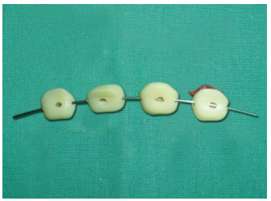
Make ‘T’ shape holes (diatorics) in teeth of selected shade.
This technique of retention of acrylic teeth with flexible denture base is known as RETENTO-GRIP TISSUE BEARING TECHNIQUE.
Notes:
The holes are made for mechanical retention of acrylic teeth to flexible denture base.
The wax should be completely removed from the holes in the teeth. If wax is not completely removed from holes, flexible material may not flow properly into holes from the cartridge thereby affecting the retention of teeth with denture base.

Slide 92
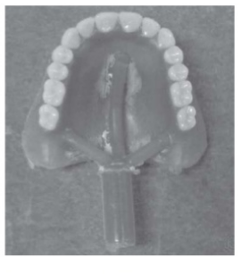
Arrange the teeth, do the try in and wax up and attach the sprue formers to make the channels for flowing of fluid resin into mold.

Slide 93
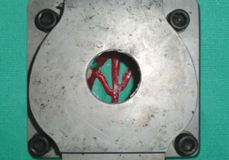
After investing in a special flask designed for injection molding technique dewaxing is done by placing flasks in boiling water for 3 to 5 minutes to soften the wax. Open the flask and flush with clean boiling water to remove all the residue of wax.
Notes:
Apply a thin coat of separating agent to model and allow the model to dry completely.

Slide 94
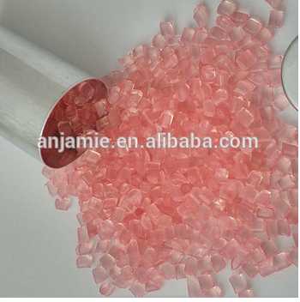
Opened flask is placed in a pre heated oven.
Flask halves are reassembled with brackets and cartridge containing melted nylon.
Placed onto injection unit
Pressure maintained
Notes:
At 65 to 80 degree celcius and timer of 17 minutes is set.

Slide 95
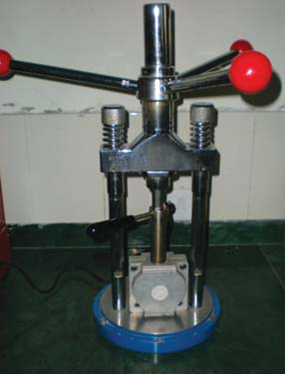
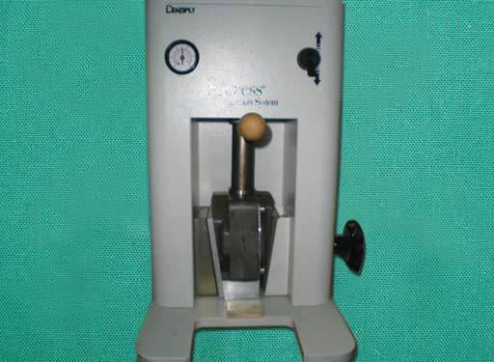
MANUAL COMPRESSION UNIT
Notes:
Manual compression unit-uniform pressure is applied and pressure should be maintained for 3 to 5 minutes. bench cool for at least 15 to 20 minutes before opening
Pressure compression unit-the injection pressure should be 100 psi (minimum 75 psi) and injection time should be 1 minute.
Pound per square inch

Slide 96
Finishing- The sprue formers are cut with special type of knife or disk and finishing is done with valcinate burs and green and pink mounted stones, usually used for porcelain finishing, using a rapid and light shaving motion.
Polishing-
Pumice
Polishing cake
Notes:
high luster shine is achieved by polishing with polishing cake.

Slide 97
ADVANTAGES
1.Translucency
2. No clasps are visible
3. The material is exceptionally strong and flexible.
4. Free movement is allowed by the overall flexibility
5. Complete biocompatibility
Notes:
1. the material picks up underlying tissue tones, making it almost impossible to detect in the mouth.
2. on tooth surfaces (when used in manufacturing of clear clasps), improving aesthetics.
5. is achieved because the material is free of monomer and metal, these being the principle causes of allergic reactions in conventional denture materials.

Slide 98
DISADVANTAGS
The acrylic teeth are mechanically bonded to thermoplastic nylon.
Chairside techniques for insertion and adjustment are different so need to be learnt.
The elastic modulus of flexible nylon (valplast) is lesser than that of PMMA.
Notes:
1. Hence the teeth can come out of the prosthesis
2. Flexible partial dentures might fail if not inserted properly
Also, one has to purchase separate instruments to adjust/ trim the flexible denture so it might add to the cost.

Slide 99
The valplast shows clinically significant chromatic instability.
As flexible dentures flex under occlusal load so these can not maintain the vertical dimension.

Slide 100
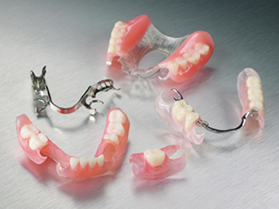
CONTRAINDICATION
This prosthesis is contraindicated in patients where interarch space is less than 4 mm (insufficient space for placing diatorics)
Notes:
and is intended only for provisional or temporary applications.

Slide 101
Flexible RPDs versus Cast partial dentures
TIME CONSUMING
COST FACTOR
WEIGHT
ESTHETICS
Notes:
1 If we compare the both from the viewpoint of a dentist, time consuming mouth preparations are needed followed by some high skilled surveying techniques in the fabrication of cast partial dentures but still flexible are less time consuming as no mouth preparation is done
2 .On the part of patients, he/she finds the cast partial dentures much expensive than the FRPDs.
3 the cast partial dentures are quite heavy as compared to the FRPDs and hence relatively uneasy to wear.
4 The thermoplastic nylons are translucent material that allow the underlying tissue to be seen resulting in excellent esthetics. Moreover in FRPDs there are no metal clasps at all. Clasps are also made up of thermoplastic nylons.
So clasps can be given on canines without compromising esthetics which is not possible in cast partial dentures.

Slide 102
PRECAUTIONS
When grinding these prosthesis, proper ventilation, masks, and vacuum systems should be used.
Store at 16°C-­32°C, away from moisture and direct sunlight.
Notes:
1Excessive mois­ture content may cause voids (porosity) in processed dentures.
2Always store the cartridges in their foil bags until ready for use.

Slide 103
Accurate denture base shade is achieved only when processing, and heating times are followed.
For finishing the acrylic instruments should not be used because they generate heat and cause fiber formation and roughness of the prosthesis. Being thermoplastic material, the high heat generated while finishing with acrylic trimmers may soften and distort the prosthesis.

Slide 104
PATIENT INSTRUCTIONS
Clean the appliance regularly with a commercially available denture cleanser at least 2- 3 times in a week.
Use a denture cleansing toothpaste or low abrasive toothpaste with a soft brush or denture brush.
The denture is not unbreakable so be careful not to drop the appliance on hard floors avoid excessive flexing.

Slide 105
CONCLUSION
Acrylic resin polymethyl methacrylate is the most extensively used material in fabrication of dentures.
Proper handling of powder and liquid along with technique is necessary for yeilding good prosthetic results.

Slide 106
Flexible removable partial dentures are better than other available options especially when there are bilateral undercuts or high esthetic requirements.
Proper diagnosis, treatment planning followed by proper insertion techniques can yield good long term results.

Slide 107
REFERENCES
Phillip’s Science of Dental material- 11th edition
Basic Dental Materials, JOHN J MANAPPALLIL- 4th edition
Singh J P, Dhiman R K, Bedi R, Girish S H. Flexible denture base material: A viable alternative to conventional acrylic denture base material. Contemp Clin Dent 2011;2:313-7.

Slide 108
Singh K, Aeran H, Kumar N, Gupta N.Fexible Thermoplastic Denture Base Materials for Aesthetical Removable Partial Denture Framework .2021;7(10):2372-2373.
Singh K & Gupta N. Injection Molding Technique for Fabrication of Flexible Prosthesis from Flexible Thermoplastic Denture base Materials. World J Dent 2012;3(4):303-307.

