Slide 1
GYPSUM PRODUCTS

Slide 2
CONTENTS
INTRODUCTION
PRODUCTION OF GYPSUM PRODUCTS
SETTING OF GYPSUM PRODUCTS
SETTING REACTIONS
PROPERTIES
CARE OF CAST
TYPES OF GYPSUM MATERIALS
INFECTION CONTROL
SPECIALISED GYPSUM
CONCLUSION
REFERENCES

Slide 3
INTRODUCTION
Gypsum (CaSO₄.2H₂O) is a mineral mined in various parts of the world.
ADA Specification no. 25
ISO Specification no. 6873:1998

Slide 4
USES
Building construction
Soil conditioning
Food additives
Pharmaceuticals
Medical devices
Dental Applications

Slide 5
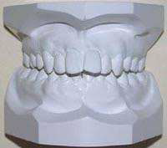
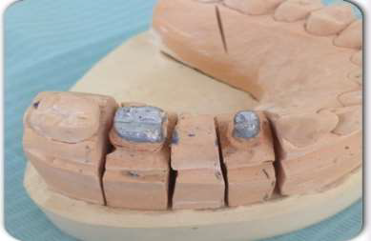
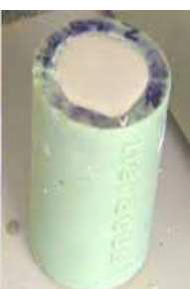
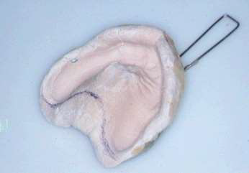
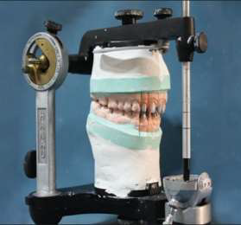
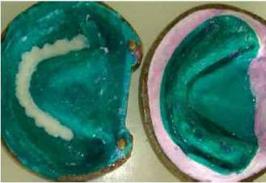
APPLICATION IN DENTISTRY
For cast preparation.
Models and dies.
Impression Material
As Investment Material
Mounting of Casts
As a mould material for processing of complete dentures

Slide 6
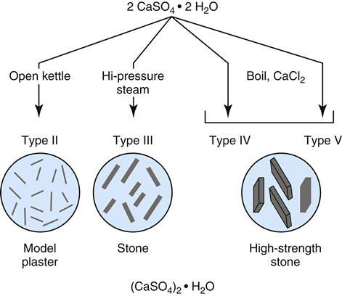
PRODUCTION OF GYPSUM PRODUCTS
Depending on method of calcination it can be :-
α-Hemihydrate
β-Hemihydrate
Modified α-Hemihydrate
Notes:
Gypsum is ground heated in an open kettle on kiln at temp of 110 to 130◦C.

Slide 7
α-Hemihydrate
Produced by Wet Calcination.
Examples- Die Stone, Artificial Stone, Improved Stone.
Consists of smaller, regularly shaped crystalline particles in form of rods or prisms.

Slide 8
β-Hemihydrate
Produced by Dry Calcination.
Example- Dental Plaster.
Consists of large, irregularly shaped orthorhombic crystal particles with capillary pores.

Slide 9
Modified α-Hemihydrate
Produced by boiling with chemicals.
Smoothest and most dense, used for dies.

Slide 10
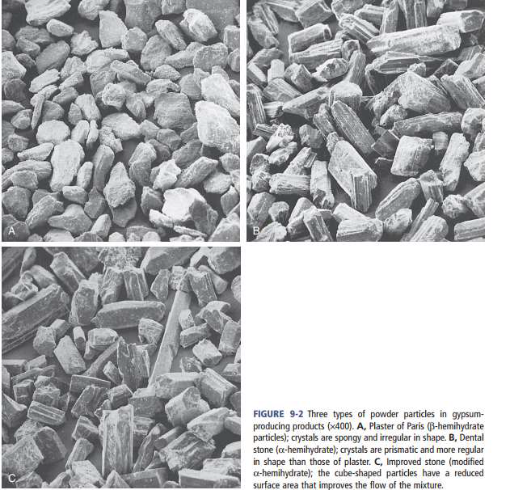

Slide 11
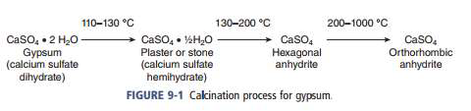
Calcination: The process of heating gypsum to manufacture plaster and stone products is known as calcination.
i) Dry Calcination
ii) wet Calcination
iii) Dehydration by boiling with chemicals
iv) Synthetic method

Slide 12
SETTING REACTIONS
There are three theories of gypsum setting.
Colloidal Theory
This theory was put forward by Mahaelis in 1893.
The gypsum product when mixed with water enters into a colloidal stage through a sol-gel mechanism.
In the sol state, hemihydrate particles combines with water to form dihydrate.
As the water is consumed, the mass turns to a solid gel.

Slide 13
Hydration Theory:
Suggest that the hemihydrate undergoes hydration.
These rehydrated crystals are joined together through hydrogen bond to the sulfate groups forming a set solid mass.

Slide 14
Dissolution-precipitation theory:
The theory put forth by the French chemist
Henry Louis Le Chatelier in 1887
Widely accepted theory, based on the principle of gradual dissolution of hemihydrate and instant crystallization of dihydrate with inter locking of crystals forming a set mass.
Hemihydrate is four times more soluble than dihydrate.
Notes:
Most widely accepted,

Slide 15
SELECTION
Based on the desired properties and dental application. e.g.:
For a diagnostic cast plaster can be used.
For a working cast, strength and accuracy is required, dental stone is the gypsum product of choice
Working models for cast restorations require die stone.
For casting procedures dental investment is required.

Slide 16
Manipulation
PROPORTIONING & W:P Ratio
The properties of the material depend upon the accurate proportioning of water and powder and its proper manipulation.
Graduated cylinder
Weighing balance

Slide 17
W:P is usually expressed by the quotient obtained when weight or volume of water is divided by weight of powder.
Higher the water powder ratio longer is the setting time.
Notes:
Increased w/p – inc st, dec strength , dec setting expansion

Slide 18
Factors determining water for reaction:-
Particle size
Shape of particle
Total surface area
Adhesion between hemihydrate particles
Addition of surface active materials.

Slide 19
MIXING & MIXING TIME
Mixing:-
Manual-
Bowl
Spatula
Place measured amount of water in bowl.
Then, weighed powder is sifted into water and initial mixing is performed.

Slide 20
Then, stir the mixture vigorously, periodically wiping inside of the bowl with spatula.
Wetting of all powder particles with water must be ensured
Mixing is done until uniform mix is obtained.

Slide 21
Mechanical mixing-
Initial 15 sec of hand mixing followed by 20-30 secs of mechanical mixing under vacuum.
Better strength and hardness as compared to manual.
Mixing Time:-
Time from addition of water until mixing is completed.
Mechanical- 15 and 20-30 sec.
Manual- approx. 1 min.

Slide 22
Working Time
Time available to use a workable mix, one that maintains a uniform consistency to perform task. Measured from start of mixing to point when consistency is no longer acceptable for handling.
Generally, 3 mins is adequate.

Slide 23
Setting Time
Time elapsed from beginning of mixing until the material hardens is k/a Setting Time.
Usually, measured by some type of penetration tests.

Slide 24
TESTS FOR SETTING TIME
Loss of Gloss for Initial Set
As the reaction proceeds, some excess water is taken up in forming the dihydrate so that mix loses its gloss.
No measurable compressive strength is attained.

Slide 25
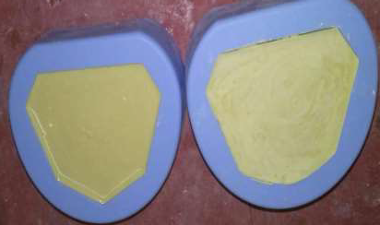

Slide 26
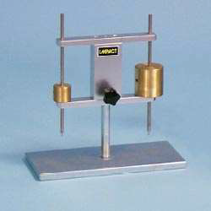
Initial Gillmore Test for initial set
Smaller Gillmore needle is used.
Mixture is spread out, and the needle is lowered onto the surface. Time at which it no longer leaves an impression is called initial set.
Marked by definite increase in strength.

Slide 27
Vicat Test for Setting Time
Instrument used: Vicat Penetrometer
The needle is held just in contact with the mix. Soon after the gloss is lost, the plunger is released.
Time elapsed from start of mixing till the needle no longer penetrates to bottom of mix is k/a setting time.

Slide 28
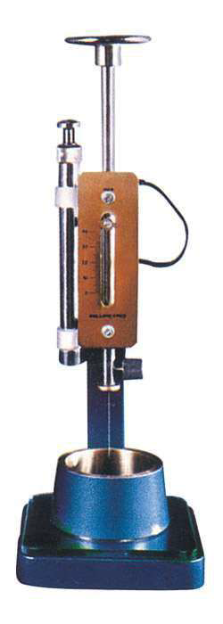

Slide 29
Gilmore test for final setting time
The heavier one amongst the Gilmore needles is used.
Time elapsed at which this needle leaves only a barely perceptible mark on the surface is known as final setting time.

Slide 30
Weight And Diameter Of Vicat And
Gillmore Needle
Vicat needle : Weight - 300gm
Diameter – 1mm
Gillmore needle :
I)Small : Weight - ¼ lb
Diameter - 1/12’’(2.12mm)
II)Large : Weight - 1lb
Diameter – 1/24’’(1.06mm)

Slide 31
Ready for Use Criterion
It is a subjective measure of the time at which the set material may be safely handled in the usual manner.
Compressive strength 80% at approximately 1 hr.

Slide 32
How to Control Setting time?
Theoretically there are 3 methods
Solubility of hemihydrates can be increased or decreased
Solubility
Supersaturation of calcium sulfate
Setting

Slide 33
Number of nuclei of crystallization can be increased or decreased.
Nuclei of crystallization
Faster Gypsum crystal formation
Faster Setting

Slide 34
By increasing or decreasing the rate of crystal growth, setting time can be accelerated or retarded respectively.

Slide 35
IMPURITIES
Insufficient calcination leaved gypsum particles that leads to shortened setting time.
FINE-NESS
Finer the particle size of hemihydrate, faster the mix hardens. Fineness increases both dissolution as well as number of nuclei of crystallization.

Slide 36
W/P Ratio
More the water used for mixing → Fewer nuclei available per unit volume
Consequently setting time is prolonged.
Mixing
Longer and rapid mixing → Shorter the setting time
Notes:
AS THE MIXING BEGINS FORMATION OF CRYSTALS INC, AT THE SAME TIME CRYSTALS ARE BROKEN UP BY SPATULA AND ARE DISTRIBUTED THROUGHOUT MIX RESULTING IN MORE NUCLEI OF CRYSTALLISATION.

Slide 37
TEMPERATURE
Varies from plaster to plaster.
Temperature of mix above 50˚C, gradual retardation occurs.
Reaction halts at 100˚C of mix.

Slide 38
HUMIDITY
Gypsum products left open for days
Increased Setting Time

Slide 39
Modifiers: Retarders and Accelerators
RETARDER | ACCELERATOR
Chemical added to increase setting time | Chemical added to decrease setting time
Organic materials: Glue, Gelatin and gums. Act by forming adsorbed layer | Potassium sulfate (>2%) NaCl (<2%), Sodium sulfate ( <3.4%), Slurry water (gypsum 0.5-1%)
Salts: Borax(2%), Potassium Citrate, NaCl(>2%). Form a layer of calcium salt.
Blood, saliva, alginate act as retarders.

Slide 40
PROPERTIES
OF
GYPSUM PRODUCTS

Slide 41
SETTING-EXPANSION
Range from 0.06% - 0.5%.
Mechanical mixing decreases the setting expansion.
Setting expansion that occurs after initial set is only of importance.
Measured using an extensometer.
Notes:
Regardless of gypsum product used there is s e ,shrinkage occurs when sol is converted into gel

Slide 42
Setting expansion is of two types
1)Normal setting expansion
2) Hygroscopic setting expansion

Slide 43
NORMAL EXPANSION
All gypsum products show expansion during setting, due to the outward growth of crystals during setting.
In dentistry increased setting expansion is desirable in case of investment material as it help to compensate the shrinkage of metal during casting. It is undesirable in dental plaster and stone

Slide 44
HYGROSCOPIC EXPANSION
Instead of air setting is allowed to occur in water.
Due to additional crystal growth permitted by allowing the crystals to grow freely, rather than being constrained by surface tension when crystals forms in air.

Slide 45
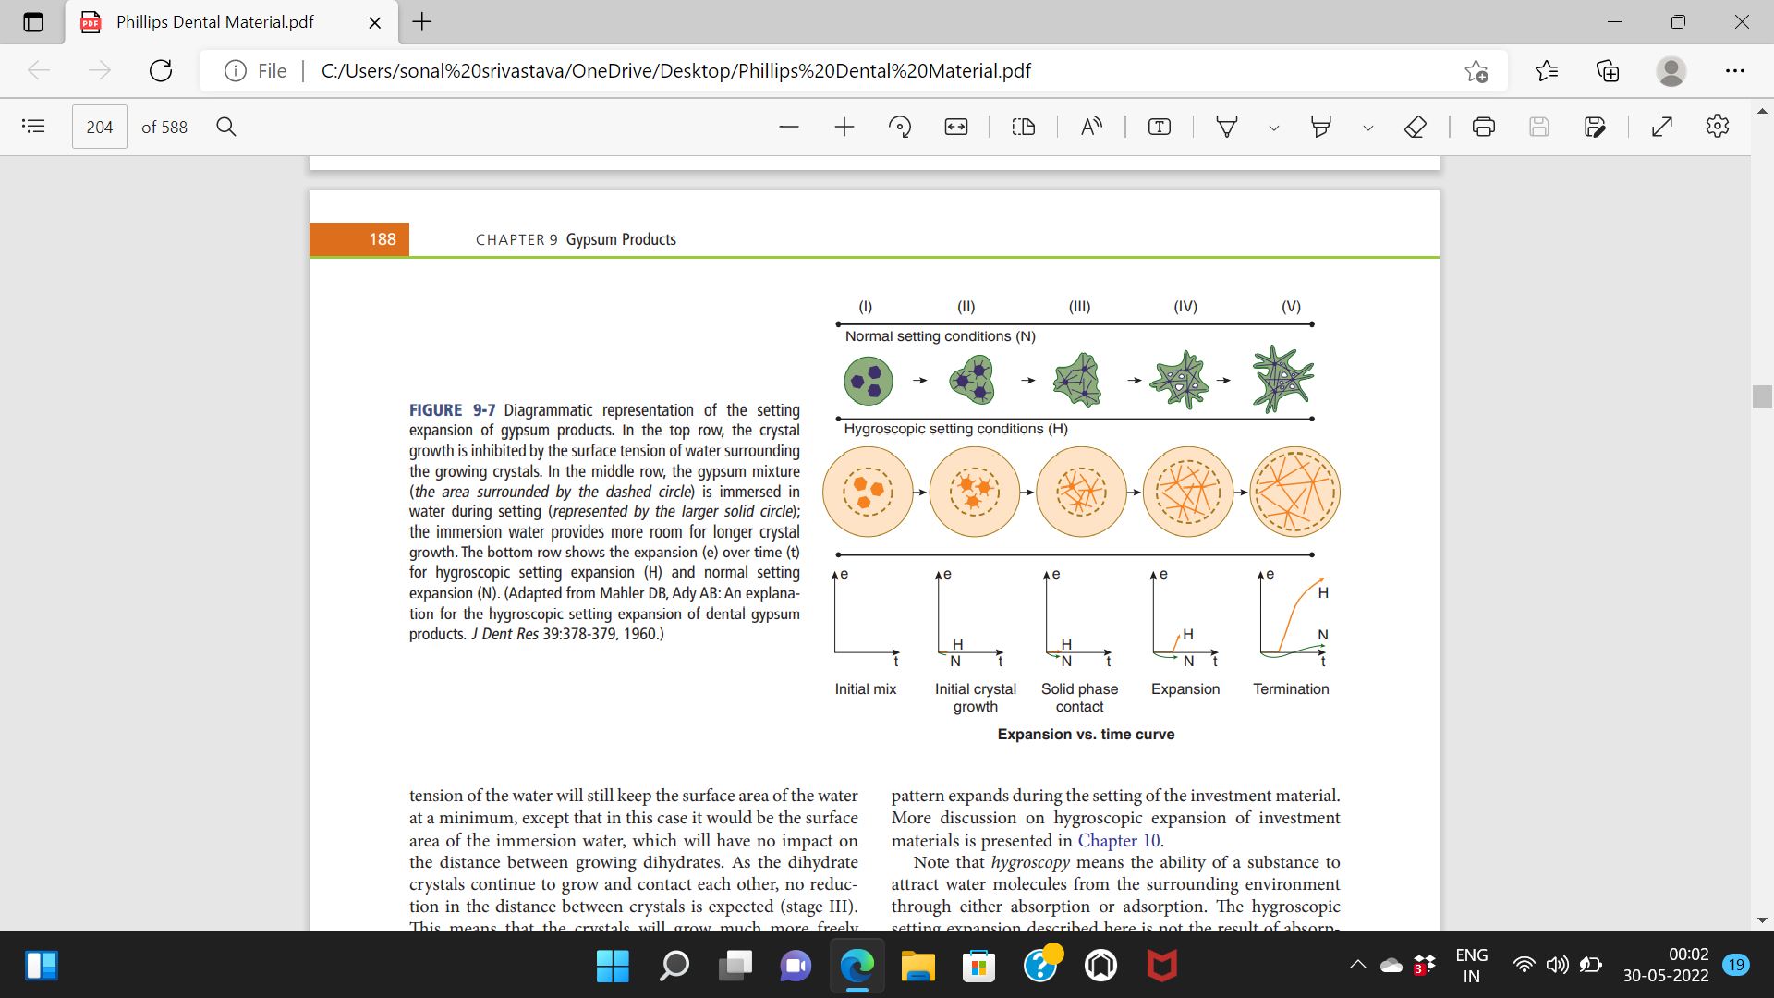
Notes:
In the top row the crystal growth is inhibited by the surface tension of water surrounding the growing crystals in second row the gypsum immersed in water during seting.the immersion water provides more room for longer crystal growth

Slide 46
CONTROL OF SETTING EXPANSION
# Lower W/P Ratio.
# Longer mixing time.
# Chemical modifiers.
Notes:
POTASSIUM SULFATE BORAX NACL wp inc- expansion decr, spatulation incr- expansion incr, add of nacl- incr expansion

Slide 47
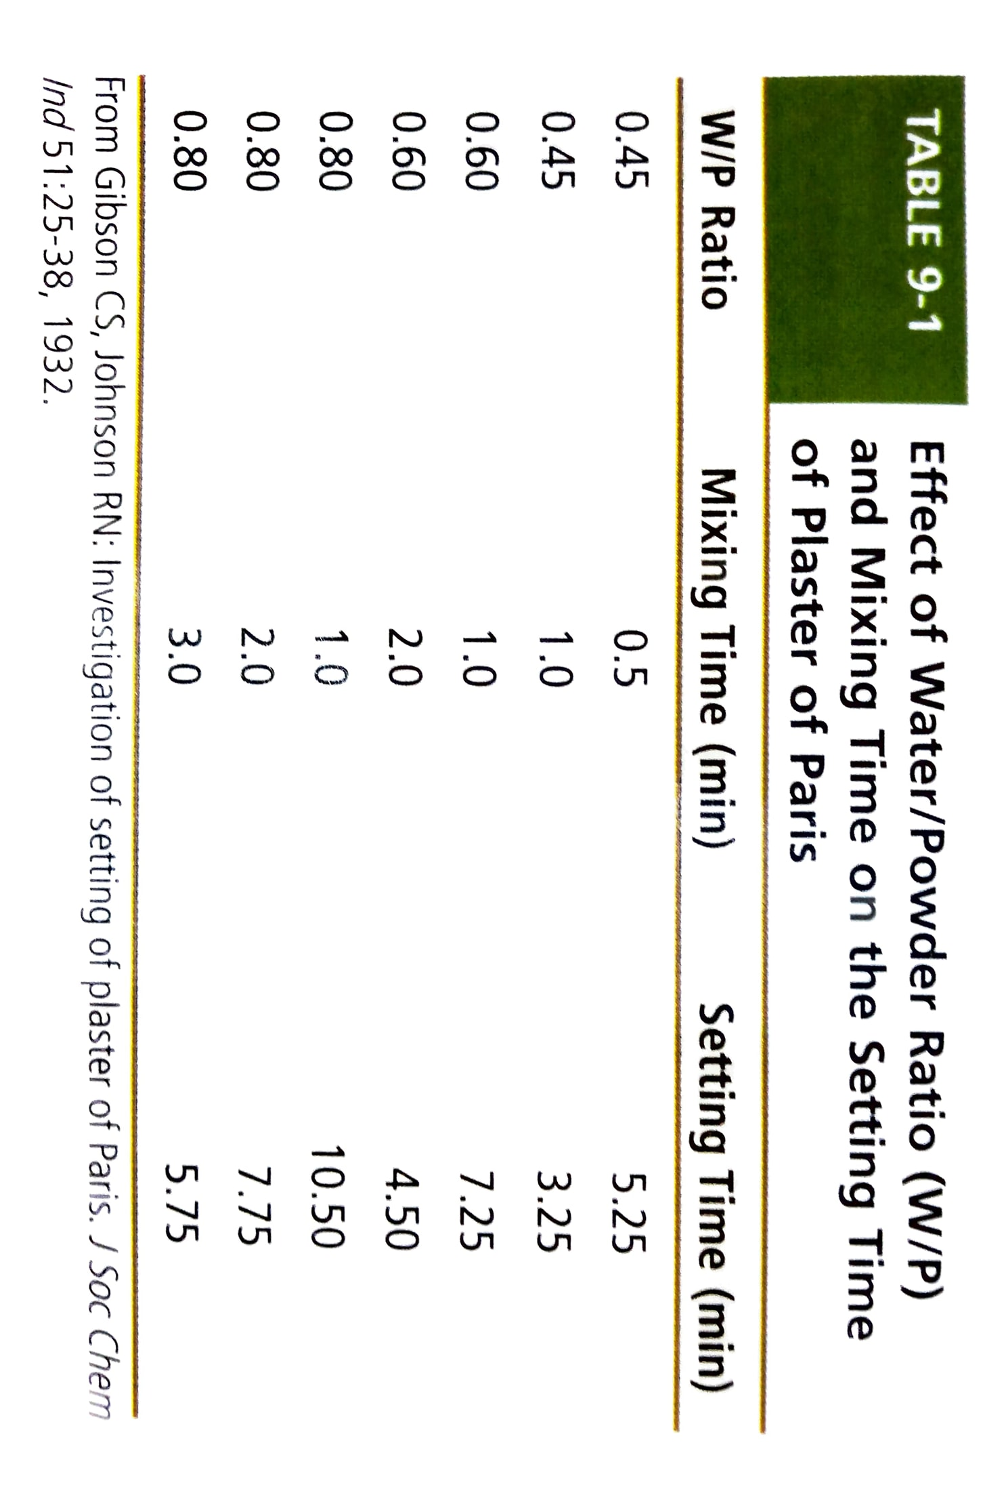
Effect of W/P Ratio:-
Effect of Manipulation and additives.

Slide 48
Strength of Gypsum Products
Strength of set Gypsum Products is expressed in terms of compressive strength, although tensile strength can also be considered.
Wet Strength or Green Strength
It is the strength of gypsum material with some or all of the excess water present in the specimen.

Slide 49
DRY STRENGTH
It is the strength of gypsum material with all of its excess water driven out.
The dry compressive strength is usually about twice that of the wet strength.
Theoretically, about 8.8 % of excess water is in the hardened mass of stone.

Slide 50
As the mass loses up to the 7% of the water, no appreciable change develops in the compressive strength of the material
When the mass loses 7.5% of the excess water, however the strength increases sharply, and when all of the excess (8.8%) is lost, the strength of the material is over 55 Mpa.
At room temp and avg humidity, about 7 days are necessary for an avg dental flask filled with gypsum material to lose the excess water.

Slide 51
Tensile Strength
The tensile strength of model plaster and dental stone is important in structures in which bending tends to occur because of lateral force application, such as removal of casts from flexible impressions.
Because of the brittle nature of gypsum materials the teeth on the cast may fracture rather than bend.

Slide 52
1 hour wet tensile strength of model plaster, 2.3 MPa is about one half the dry tensile strength, 4.1 MPa, after 40 hours at 45◦ C.
The tensile strength of the model plaster in either the wet or dry condition is about one half that of high-strength dental stone in comparable condition.

Slide 53
REPRODUCTION OF DETAILS
Factors which affect detail reproduction include
- trapped air bubbles in the mix.
- surface contaminants like saliva and blood.
Rinsing the impression and blowing away excess water can improve the detail recorded by the gypsum die material

Slide 54
Use of mechanical vibrator and proper technique considerably improve detail reproduction.
Type 1 and 2 reproduce a groove 75 µm in
width where as types 3, 4, and 5 reproduce
a groove 50 µm in width.

Slide 55
HARDNESS & ABRASION RESISTANCE
Directly proportional to compressive strength.
The higher the compressive strength of the hardening mass the higher the surface hardness.
Can be improved by hardening solutions.
Mixing the high strength dental stone with a commercial hardening solution containing colloidal silica improves the surface hardness.

Slide 56
The Knoop hardness of two commercial high strength dental stones were 54 and 77kg/mm² when mixed with water.
When hardening solution used these values increased to 62 and 79 kg/mm²

Slide 57
Care of the cast
Once the setting reaction of cast have been completed, its dimensions will be relatively constant under ordinary conditions of room temp and humidity.
The safest method of soaking the cast in water is to immerse the cast in water bath that contain plaster debris at the bottom of the container. This is known as slurry water.
Shrinks at higher temperature.
Notes:
Immersion in running water and

Slide 58
Types of Gypsum Products
According to ADA Specification no. 25 there are 5 types of Gypsum Products
Type 1- Plaster impression
Type 2- Plaster model
Type 3- Dental stone
Type 4- Dental stone high strength
Type 5- Dental stone High strength high expansion

Slide 59
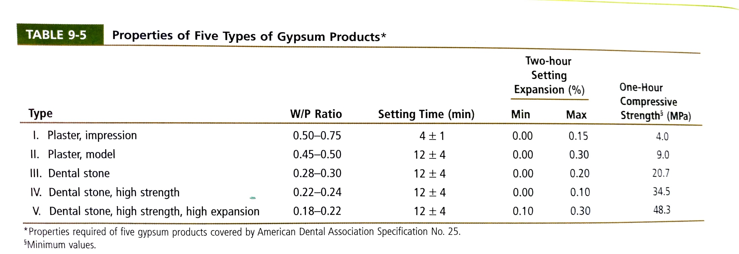

Slide 60
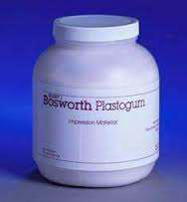
Type I: Impression Plaster
Plaster of Paris is called so because it was obtained by burning gypsum from deposits near Paris.
Seldom used as replaced by less rigid materials like hydrocolloids and elastomers.
Currently it is more useful as a bite registration material

Slide 61
Composition:
Dental plaster
K₂SO₄(Potassium sulphate)
Borax
Colouring and flavouring agent
Uses:
For making impression in complete denture and maxillofacial prosthetics.
Bite registration material

Slide 62
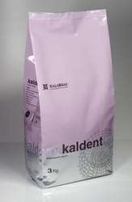
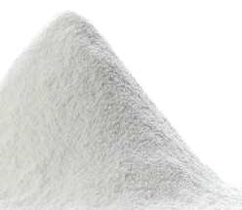
Type II: Model Plaster
Used for
Diagnostic cast
Articulation of stone cast
Art portion of working cast
Flasking procedure for acrylic dentures
Composition
Βeta hemihydrate + Modifiers

Slide 63
Requirement of an ideal cast material
It should set rapidly but give adequate time for manipulation.
It should set to a very hard and strong mass.
It should not lose its strength when subjected to moulding and curing procedures.
It should neither contract nor expand while setting

Slide 64
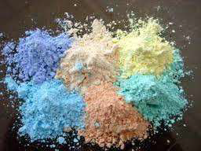
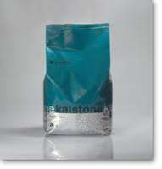
Type III: Dental Stone
Also known as Class I stone or Hydrocal.
Used for
complete or partial denture models
Orthodontic models
It requires less water and is stronger than plaster
Compressive strength varies from3000 to 5000 psi
Hardness : 82 RHN

Slide 65
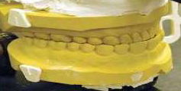
Composition:
Alpha hemihydrate + 2 to 3% coloring agent+ K₂SO₄ (accelerator) + borax (retarder)
Uses:
Used for preparing master cast and to make molds

Slide 66
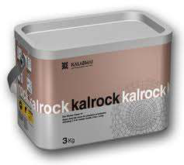
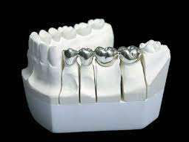
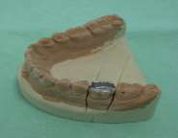
Type IV: Dental Stone high strength
Also called as Class II Stone or die stone or densite or improved stone.
Die stone is strongest and hardest variety of gypsum product.
Uses-
Used when high strength and surface hardness is required.
Dies for fabricating inlay, crown and bridge wax patterns.

Slide 67
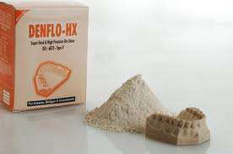
Type V: Dental Stone high strength high Expansion
E.g: Hard rock, Jade rock, Resinrock XL5, Denflo HX
Has higher compressive strength than type IV which is attained by lower W/P ratio.

Slide 68
Setting expansion has been increased from a maximum of 0.10% to 0.30% to compensate for the solidification shrinkage of some alloys used as base metals used for dental casting.
Most recent gypsum product.
Most costly of all gypsum materials.
Should be avoided in production of dies for inlays as higher expansion may lead to tight fits.

Slide 69
If materials used during the casting process didn’t shrink or expand, the size of the final cast restoration would be the same as the original wax pattern.
However dimensional change occur in most of the steps in casting and, in practice, the final restoration may not be exactly same size as the pattern.
The management of these dimensional changes is complex, but can be summarized by equation.
Notes:
1.25 to 1.65 h
Gold shrinkage

Slide 70
Wax shrinkage + metal shrinkage = wax expansion + setting expansion + hygroscopic expansion + thermal expansion
This equation balances the shrinkage against the expansion that occurs during the casting process.
If the final restoration is to fit the die , the shrinkage and expansion during the process must be equal.
Notes:
Coefficient of thermal expansion=how the size of an object changes with a change in temperature.

Slide 71
Infection Control
There are chances of cross infection of HBV, HIV etc on clinicians due to impression which has lead to the idea of disinfection sprays and immersion techniques to disinfect the impressions.
If the impression is not disinfected then the cast should be disinfected using disinfectant solutions . Alternatively dental stone containing disinfectant can be used.

Slide 72
Commonly used stone disinfectants are spray disinfectants, iodophors and glutaraldehyde.
Can be immersed in 1:10 dilution of sodium hypochlorite for 30 min.
Addition of disinfectant into the stone

Slide 73
Specialized Gypsum Products
Dental Casting Investments:
Gypsum bonded investment
Phosphate bonded investement
Ethyl silicate bonded investment
Silica + dental plaster/stone.
Capable of withstanding high temperatures.
Used to prepare refractory molds for casting.

Slide 74
Divestments:
To make refractory dies.
Combination of die stone and gypsum bonded investment mixed with colloidal silica.
Orthodontic Stone
Orthodontists prefer to use white stone or plaster
Have longer working time for pouring multiple models and ease of trimming.
Treated with (model glow) soap for an added sheen.

Slide 75
Resin modified stones
They are resin fortified.
Less brittle, improved surface smoothness, increased resistance to abrasion.
Mounting Plasters
Used for attaching casts to the articulators
Fast setting
Low setting expansion
Low strength

Slide 76
Mounting Plasters
Used for attaching casts to the articulators
Fast setting
Low setting expansion
Low strength

Slide 77
CONCLUSION
A wide choice of Gypsum Products is available so we should choose the one or a combination which is most suitable for our desired requirements.

Slide 78
References
Philips’ Science of Dental Materials, 11th ed.
John J Manappallil Basic Dental Materials, 4th ed.
Restorative Dental materials. Robert G. Craig,11th ed.

Slide 79
THANK YOU

