Slide 1
DRUG INDUCED GINGIVAL ENLARGEMENT

Slide 2
HISTORICAL PERSPECTIVE
Drug-induced gingival enlargement (DIGE) associated with chronic use of the anti-epileptic drug phenytoin was first reported in 1939 by Kimball.
In the same year, Faurbye and in 1959, Strean and Leoni suggested that the alkalinity of phenytoin might be the cause of the gingival side effect.
In 1948, Brandon hypothesized that phenytoin had a direct action on the gingival tissues

Slide 3
In 1975, Angelopoulos argued that phenytoin induced degranulation of mast cells which resulted in the generation of a substance that increased collagen formation.
Larmas, in 1976, suggested that phenytoin had a proliferating effect primarily on the basal cell layer of the oral epithelium thus increasing the epithelium-connective tissue interface area, which was confirmed by Hassel et al.
In 1977,Vogel speculated that phenytoin induced gingival enlargement was due to an end-organ folic acid deficiency, which could lead the gingival tissues susceptible to inflammation by causing degenerative changes in the gingival sulcular epithelium.

Slide 4
NOMENCLATURE
In the past, DIGO had been known as either drug-induced gingival hypertrophy or drug-induced gingival hyperplasia.
Currently its name has been changed to gingival enlargement/overgrowth because the prior classifications indicated a histologic characterization, not a clinical diagnosis.
The past nomenclature is somewhat misleading because today it is well understood that the reason for the proliferating increase in gingival tissue is an exponential increase in the extracellular matrix, not because of cell hyperplasia or hypertrophy
Wright G,Welbury RR, Hosey MT. Cyclosporin-induced gingival overgrowth in children.
Int J Paediatr Dent 2005;15(6):403–411

Slide 5


CATEGORY | DRUGS | INDIAN BRAND NAMES
ANTIEPILEPTICS | Phenytoin Phenobarbitone Primidone Valproic acid | Epileptin,Celetoin,Episol Fenobarb,Epitan,Gardenal Mysoline Epilex chrono
CALCIUM CHANNEL BLOCKERS Dihydropyridines Phenylalkylamine Benzodiazepine | Nifedipine Amlodipine Felodipine Diltiazem Bepridilhydrochlo ride | AdalatRetard,Angiblock,Angi fine Acedip,Amlogard,Acord Felogard-ER,Plendil,Renedil Cardem,Angizem,Channel Vascor
IMMUNOSUPRESSANT | Cyclosporine | Arpimune-ME,Cyclomune
MISCHELLANOUS | Erythromycin Sertraline | Althrocin,Lymphocin,Emthro cin Daxid,Alwel Plus

Slide 6
PREVALENCE
50% of dentate patients on phenytoin experience gingival changes.
30% of hospital based patients on cyclosporine are affected by gingival overgrowth
10% of hospital based patients on calcium channel blockers also experience gingival enlargement
ROBIN A. SEYMOUR Effects of medications on the periodontal tissues in health and disease Periodontology 2000,Vol. 40, 2006, 120–129

Slide 7
RISK FACTORS
Age and Demographic variables
Drug Variables
Concomitant Medications
Periodontal variables
Genetic factors

Slide 8
Age & Demographic variables
Children and teenagers are affected by Phenytoin and cyclosporine induced gingival enlargement whereas age is not important in patients who are on calcium channel blockers as they would be middle aged and elderly.
A Hormonal component may thus contribute to sensitising the fibroblasts to the antiepileptic and imunosupressant drugs.

Slide 9
Phenytoin enhances the ability of fibroblasts to metabolize the testosterone to the more active 5α dihydrotestosterone. (Suryamoorthy et al 1988)
Higher levels of circulating androgens in adolescents could stimulate the fibroblasts to produce more collagen thus inhibiting collagenase activity.
Sex hormone levels are also increased in teenagers which correlate with the gingival inflammation leading to gingival enlargement.

Slide 10
Gender
Not applicable in patients on phenytoin, as both males and females are equally affected. (Ellis JS et al 1999)
Relevant in cyclosporine and nifedipine users.
ROBIN A. SEYMOUR Effects of medications on the periodontal tissues in health and disease Periodontology 2000,Vol. 40, 2006, 120–129

Slide 11
Concomitant medications
Some Patients on cyclosporine are also administered nifidepine which increases the prevalence but not the severity of gingival overgrowth.
 Phenobarbitone, primidone and carbamazepine induce the hepatic cells to release cytochrome 450 which has a stimulatory effect on fibroblasts, thus explaining the excessive overgrowth in patients on multiple antiepileptic drugs.

Slide 12
Prednisalone and azathioprine used in organ transplant patients offer protection against gingival overgrowth due to their anti- inflammatory properties.

Slide 13
Periodontal Variables
Plaque induced inflammatory changes in the tissues exacerbates the gingival overgrowth.(Ellis JS 1999,Thomason JM, Seymour RA 1995)
The extent of gingival inflammation prior to medication plays a major role in causing gingival overgrowth.
Patients on nefidipine for cardiovascular reasons exhibit more overgrowth than for other reasons due to the impact of the other cardiovascular drugs on the gingival vasculature.

Slide 14
Genetic factors
Phenytoin,cyclosporine and nifedipine are metabolised by the hepatic enzyme cytochrome P450.
Cytochrome P450 Exhibits genetic polymorphisms causing variation in the levels of the drug in the body thus contributing to gingival overgrowth.
Patients expressing HLA-DR1 have some degree of protection against GO compared to patients who express HLA-DR2 who are more susceptible. (Cebeci I, Kantarci A et al 1996)
HLA A19 increases susceptibility and HLA B 37 is a risk factor for GO. (Thomason JM, Seymour RA 1996)

Slide 15
Although they are chemically unrelated, the anticonvulsants, immunosuppressants, and calcium antagonists act as inhibitors of the drug transporter permeability glycoprotein (P-gp) .
The gene product of multidrug resistance 1 (MDR1), and inflammation may modify P-gp expression.
It has been observed in patients on calcium blockers that they are associated with the MDR1 G2677T/A polymorphism. The MDR1 genotype may modify the inflammatory response to the drugs.
Meisel P, Giebel J, Kunert-Keil C, Dazert P, Kroemer HK, Kocher T. MDR1 gene polymorphisms
and risk of gingival hyperplasia induced by calcium antagonists. Clin Pharmacol Ther 2006;79(1):62– 71

Slide 16
Hereditary Gingival Fibromatosis | Lysosomal Storage Disorders | Vascular Disorders | DisordersAssociated with Dental Abnormalities
Gingival fibromatosis (isolated) | Hurler syndrome | Sturge Weber syndrome | Wilson syndrome
Zimmerman – Laband syndrome | Maroteaux-Lamy syndrome | KlippelTrenaunay syndrome | Goltz syndrome
Ramon syndrome | Scheie syndrome |  | Regional Odontodysplasia
Systemic hyalinosis | Hurler/ scheie
Jones syndrome | Hunter syndrome
Rutherfurd syndrome Cross Syndrome | Sly syndrome I- Cell disease
Gingival fibromatosis, hypertrichosis and mental retardation | Aspartylglucosaminuria
Neurofibromatosis type I | Alpha Mannosidosis
Mostafa Ibrahim, Maha Abouzaid, Mennat Mehrez, Heba Gamal El Din and Ghada El Kamah (2011). Genetic Disorders Associated with Gingival Enlargement, Gingival Diseases - Their Aetiology, Prevention and Treatment, Dr. Fotinos Panagakos (Ed.), ISBN: 978-953-307-376-7, InTech

Slide 17
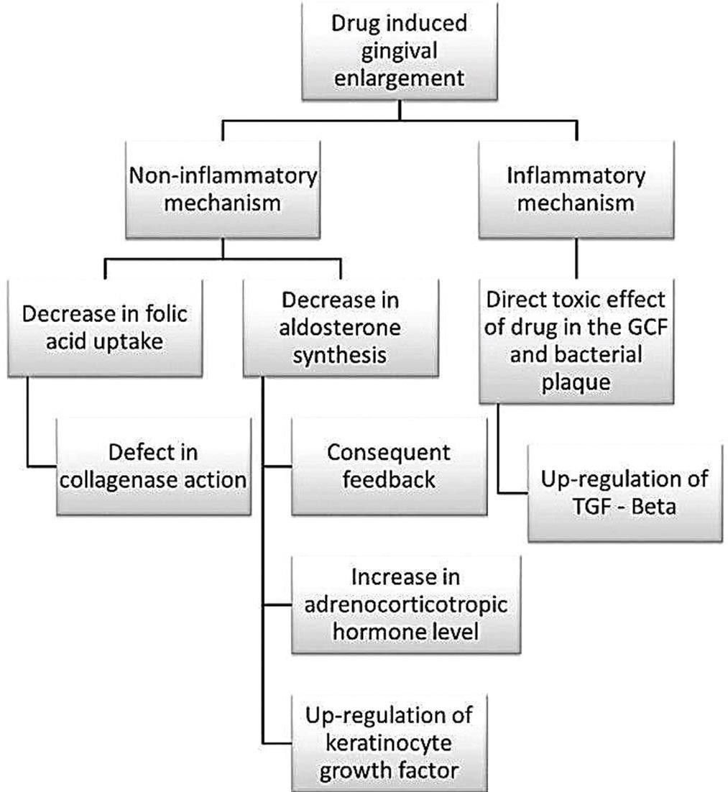
Bajoria AA, Asha ML, Babshet M, Patil P, Sukhija P. Gingival enlargement: Revisited - A case series. IJSS Case Reports & Reviews2014;1(3):20-25

Slide 18
PHENYTOIN INDUCED GINGIVAL OVERGROWTH

Slide 19
Phenytoin
Introduced by Merritt & Putnam in 1938
Used to control seizures in patients with epilepsy
Most commonly used because of low cost ,easy availability & effectiveness.

Slide 20
Mechanism of action:
Selectively depress the motor cortex of CNS
Blocks voltage dependent Na & Ca channels Limit the progression of neuronal excitation
Blocks high frequency firing seen in seizures

Slide 21
PATHOGENESIS

Slide 22



JohnsonBD, Narayana AS,
reported that synthesis of fibroblasts decreased with age in normal gingiva but this was not seen in phenytoin affected gingiva, perhaps due to the unique phenotype
Shafer WG observed that the Optimal rate of cell growth occurred at phenytoin concentration of 5µg/ml compared to nonphenytoin controls
HasselT and Page R demonstrated that the active metabolite of Phenytoin was 5 - para hydroxyphenyl 5phenylhydantoin

Slide 23



Dill RE documented that phenytoin induced GO is associated with specific macrophage phenotypes that express PDGFβ in the overgrown tissue and IL-1β in the inflammed tissue
Pagliarini observed that Proportion of intracellular GAG was increased in attached gingival fibroblasts whereas extracellular GAG was increased in free gingival fibroblasts.
Liu TZ, Bhatnegar RS stated that phenytoin diminishes the activity of prolyhydroxylase and inhibits activation of collagenase

Slide 24
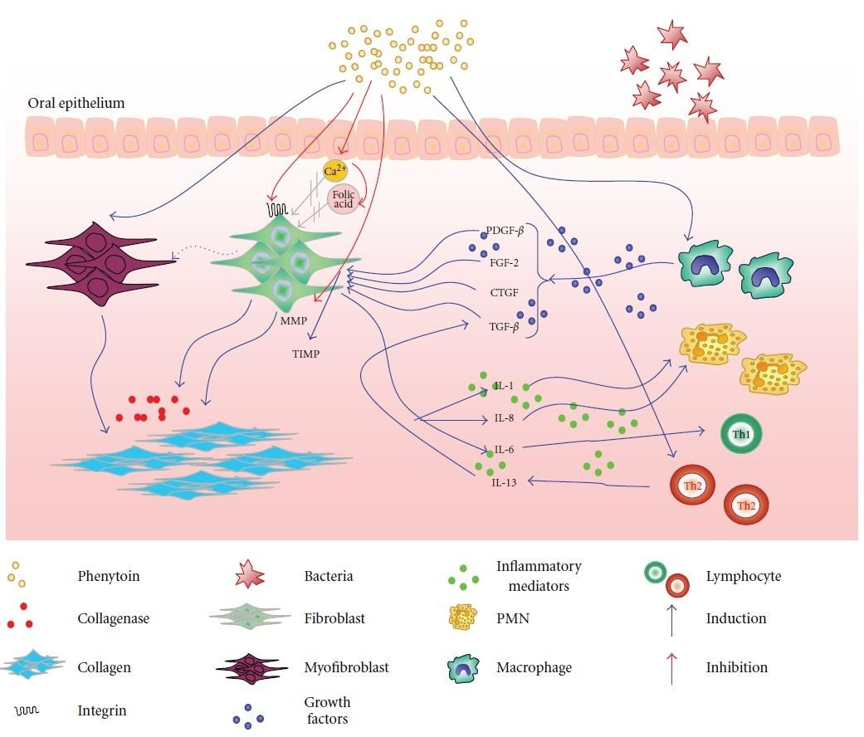

Slide 25
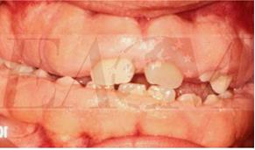
CLINICAL PRESENTATION
Characterized by initial enlargement of the interdental papillae.
Less frequently accompanied by the increased thickening of the marginal tissue.
Affected tissues present a granular or pebbly surface with the enlarged papilla extending facially or lingually
Facial gingiva of the anterior segment most commonly involved resulting in aesthetic disfigurement.

Slide 26
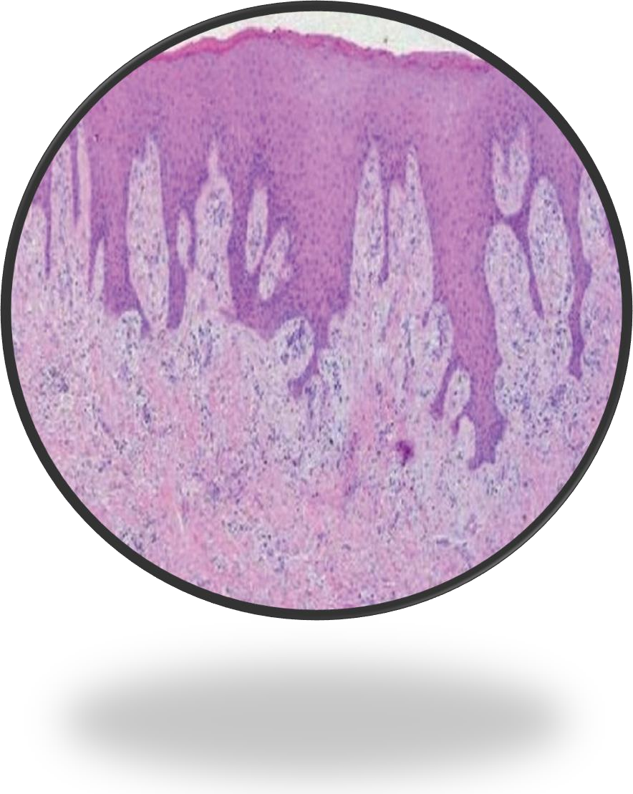
HISTOPATHOLOGY
Thick stratified squamous epithelium With long thin retepegs which are acanthotic and extend into the lamina propria.
Lamina propria characterized by proliferation of fibroblasts and increased collagen formation accompanied by an increase in the noncollagenous proteins.

Slide 27
CYCLOSPORINE INDUCED GINGIVAL OVERGROWTH

Slide 28
Cyclosporin A was first isolated in Switzerland in 1970 as a metabolite of the fungus species Tolypocladium
inflatum Gams but proved to have little value as an antifungal antibiotic
Discovered by Jean Borel
It was first administered to renal transplant patients by Calne et al
The first case of gingival overgrowth due to cyclosporine was reported by Ratieitschak-Pluss et al in 1983

Slide 29
MECHANISM OF ACTION

Slide 30
It inhibits the action of imunocompetent lymphocytes.
It also inhibits IL -2 Synthesis when administered orally at a dose of 10-20 mg/kg body weight
It produces imunosupression by inhibiting the action of macrophages and preventing the production of IL-1 Receptors on the surface of T Helper cells.
Drug is metabolized in the liver through Cytochrome 450 monooxygenase enzyme system and peak plasma levels occur 3-4 hrs after administration and its serum half life is 17-40 hrs. (Beveridge T 1981)

Slide 31
Cyclosporine is widely used for prevention of organ transplant rejection either as a primary imunosupresant or in combination with steroids.
It also plays a role in reducing the morbidity in graft-host reaction in bone marrow transplants.
It is used in imuno-compromised conditions like insulin dependant diabetes mellitus, Bechets disease, Rheumatoid and Psoriatic arthritis, ulcerative colitis, Crohns disease to name a few.

Slide 32
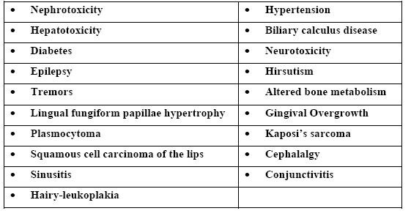
ADVERSE EFFECTS OF CYCLOSPORINE

Slide 33
PATHOGENESIS

Slide 34
Wysocki et al stated that Cyclosporine and its active metabolite OL-17 react with phenotypically distinct subpopulation of fibroblasts,causing increase in protein synthesis and rate of cell proliferation.
Pernu HE et al observed that Patients expressing HLA-DRI had a protective role against GO,whereas those expressing HLA- DR2 showed an increased risk for overgrowth.
Kataoka M, Seto H documented that CsA-treated fibroblasts had 28% lower expression of α2 integrin than that of control. Thus they concluded that inhibition of collagen phagocytosis by reduced α2 integrin expression may cause GO.

Slide 35
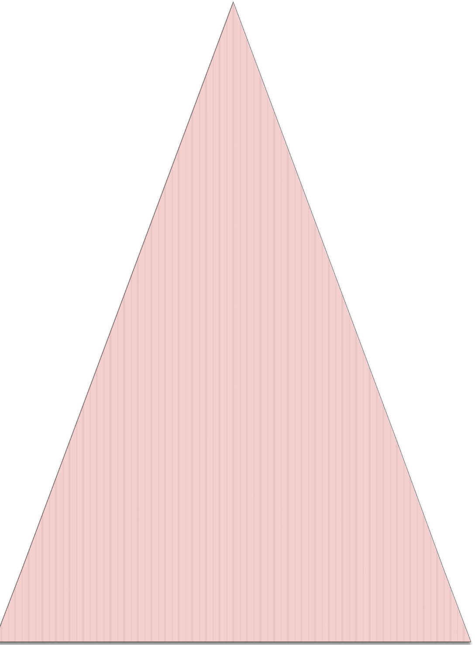
Iacopino AM, et al reported that Platelet-derived growth factor- B messenger RNA is significantly increased in cyclosporine A gingival overgrowth tissue relative to normal controls
Slavin J ,Taylor J. Observed an increased rate of gingival overgrowth in patients taking both drugs nefidipine & Cyclosporine A, compared with those on cyclosporine A alone
Zebrowski EJ, Pylpas SP, Odlum 0, Johnson RB, suggested that increased tissue levels of non-sulfated glycosaminoglycans can occur with cyclosporin A exposure, possibly contributing to the occurrence of increased connective tissue matrix

Slide 36
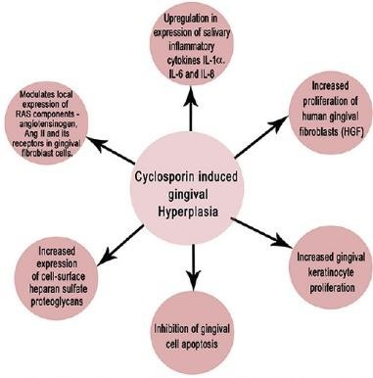

Slide 37
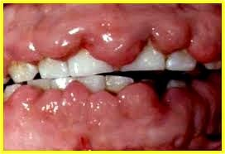
CLINICAL
PRESENTATION
This type of overgrowth is more pronounced On the labial aspect of the gingiva which bleeds considerably when surgically removed.
Friskopp and Klintmalm observed that the GO was restricted to the keratinised gingiva but sometimes extended coronally to interfere
with oclusion, mastication and speech
GO more likely to occur when plasma concentrations of cyclosporine> 400ng/ml (Seymour RA, Heasman P 1988)

Slide 38
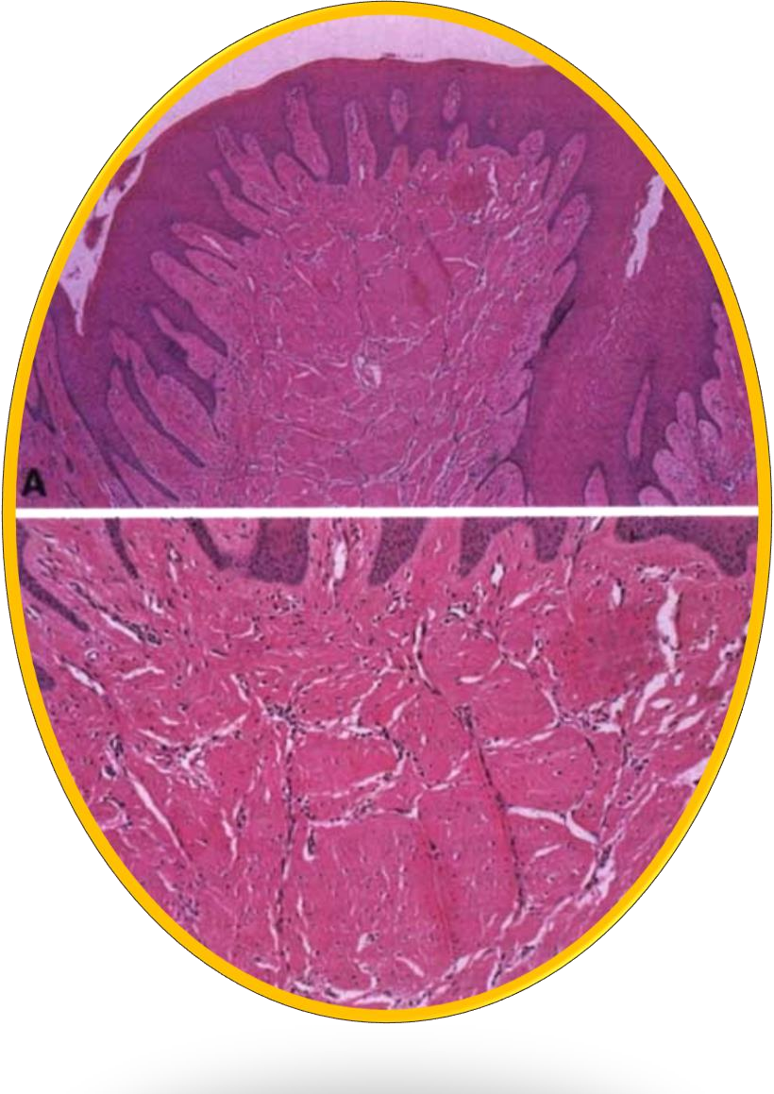
HISTOPATHOLOGY
Epithelial ridges penetrate deep into the connective tissue creating irregularly arranged collagen fibre bundles.
Higher power of the same specimen showing highly vascularized connective tissue with an inflammatory infiltrate
(Plasma cells)and abundant amorphous ground substance

Slide 39

CALCIUM CHANNEL BLOCKERS AND GINGIVAL
OVERGROWTH

Slide 40
Calcium channel blockers may be classified on the basis of their chemical composition as:
Benzothiazepine derivatives (diltiazem),
Phenylalkylamine derivatives (verapamil) or
Substituted dihydropyridines (amlopidine, felodipine, isradipine, nicardipine,nifedipine, nitrendipine, oxodipine, nimodipine and nisoldipine)

Slide 41
MECHANISM OF ACTION

Slide 42
Calcium channel blockers act by inhibiting calcium ion influx across the cell membrane of cardiac and
smooth muscle cells, thereby interfering or blocking mobilization of calcium intracellularly (Rees TD, Seymour RA)
Depending on the specific agent, this results in dilatation of coronary arteries and arterioles, as well as decreased myocardial contractility and oxygen demand.
Since 1978, the substituted dihydropyridines have been used to treat angina pectoris, postmyocardial syndrome and hypertension.

Slide 43
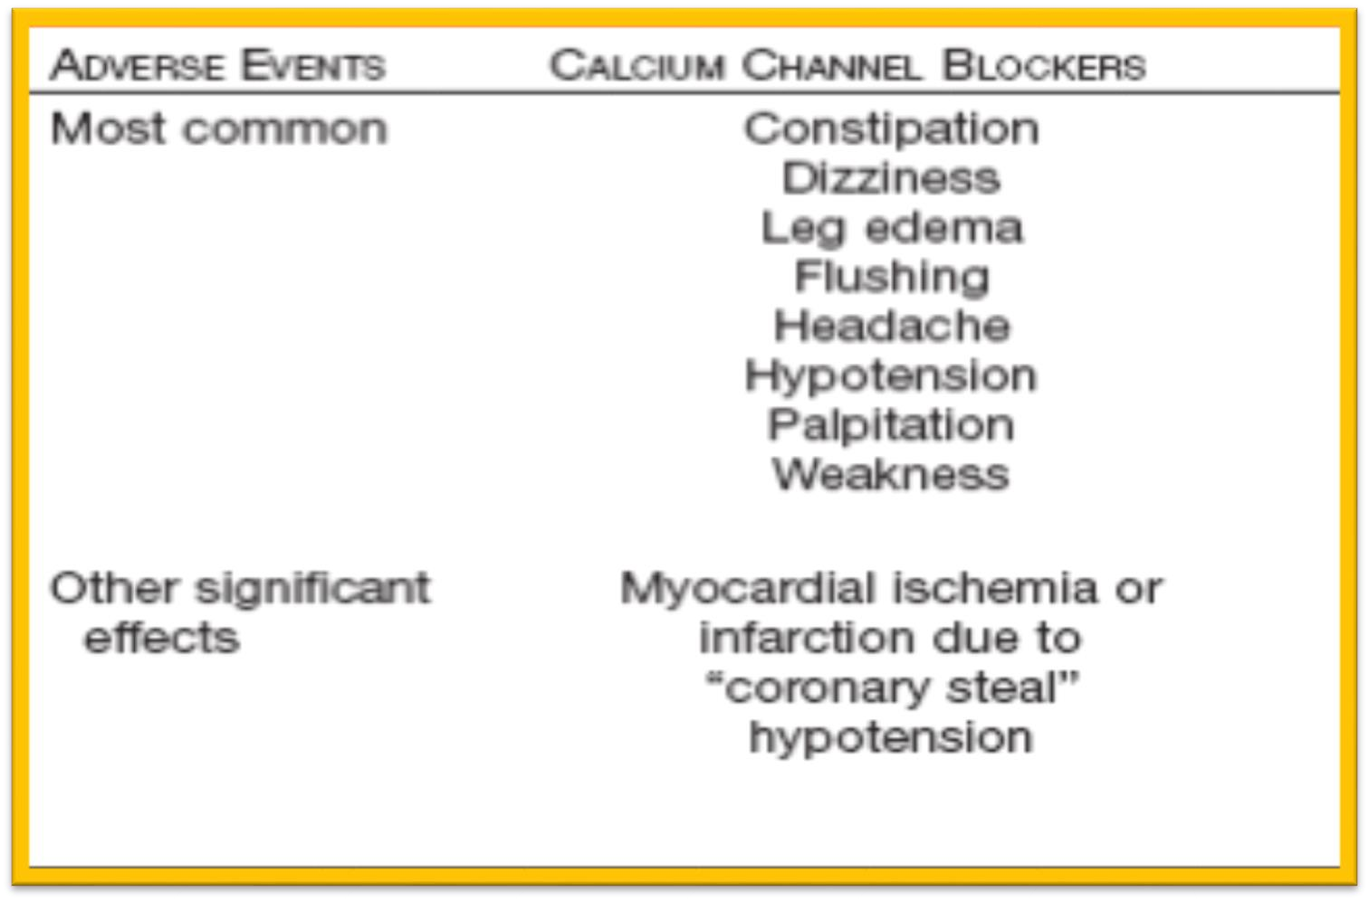
ADVERSE EFFECTS

Slide 44
Ramon et al, published the first report in the scientific literature that associated a calcium channel blocker (nifedipine) with the occurrence of gingival overgrowth in 1984
WILLIAM W HALLMON & JEFFREY A. ROSSMANN The role of drugs in the pathogenesis of gingival overgrowth A collective review of current concepts. Periodontology 2000,Vol. 21, 1999, 176-196

Slide 45
PATHOGENESIS

Slide 46



Ishida H, et al have reported that a Minimum blood level of 800 ng/ml of nefidipine resulted in gingival overgrowth in a rat model and the degree of overgrowth depended on increased concentrations above this threshold value
Bullon P et al said that human studies have not supported a relationship between dose or plasma levels of these agents and gingival overgrowth
Lucas RM et al Observed that gingival overgrowth results from overproduction of extracellular ground substance characterized by increased presence of sulphated- mucopolysaccharides(glycosaminoglycan) and collagen, and abundant active fibroblasts

Slide 47
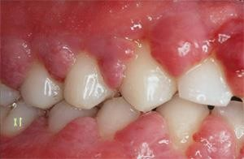
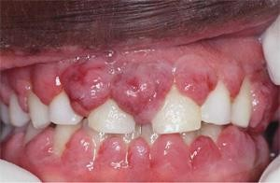
CLINICAL PRESENTATION
The interdental papillae are initially affected,
becoming enlarged and resulting in a lobulated or
nodular morphology.
These effects are limited to the attached and marginal gingiva, and are more frequently observed anteriorly, especially on the facial Surfaces.(Seymour RA 1991)

Slide 48
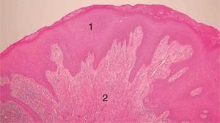
HISTOPATHOLOGY
Hyperkeratotic epithelium that is characterized by long, thin, often interlacing rete pegs.
The epithelial
rete pegs extend deep into the lamina propria, which manifests collagenous and non-
collagenous elements, numerous fibroblasts, vessels, and a foci of inflammatory
cells deep within the specimen

Slide 49
Measurement
Bokenkamp A. Bohnhoest B
Grade 0
Grade 1
Grade 2 gingiva
Grade 3
of crown.
-No signs of gingival enlargement
-Enlargement confined the IDP
-Enlargement involves papilla and marginal
-Enlargement covers three quarters or more

Slide 50
According to the amount of gingiva covering anatomic crown
Angel poulus and Goaz –1972
Grade 0 – No hyperplasia
Grade 1 – Hyperplasia covering cervical 3rd of ant. Crown
Grade2 – Hyperplastic gingiva extending the middle 3rd of anatomic crown of Ant.Teeth
Grade 3 – Hyperplastic gingiva covering > 2/3rd of crown of anterior tooth.
Nery et al (1995) modified by adding interproximal area

Slide 51
McGaw et al (1987)
Degree of gingival enlargement can be scored as
Grade 0: No signs of inflammation
Grade 1: GE confined to interdental papilla
Grade 2: Enlargement involves papilla &marginal gingiva.
Grade 3: Enlargement covers three quarters or more of crown.

Slide 52
Based on assessment of plaster study cast
Seymour et al –1985
Included both thickening and encroachment.
GO assessed on a plaster model in upper and lower segments. Grade o – Normal
Grade 1- Thickening from normal upto 2mm, Grade 2 – Thickening >2mm

Slide 53
Miranda and Brunet –2001
Measured GO in buccolingual direction both for buccal and lingual/palatal papilla.
0 – papillary thickness < 1 mm 1 – papillary thickness 1-2 mm
2 – papillary thickness > 2 mm

Slide 54

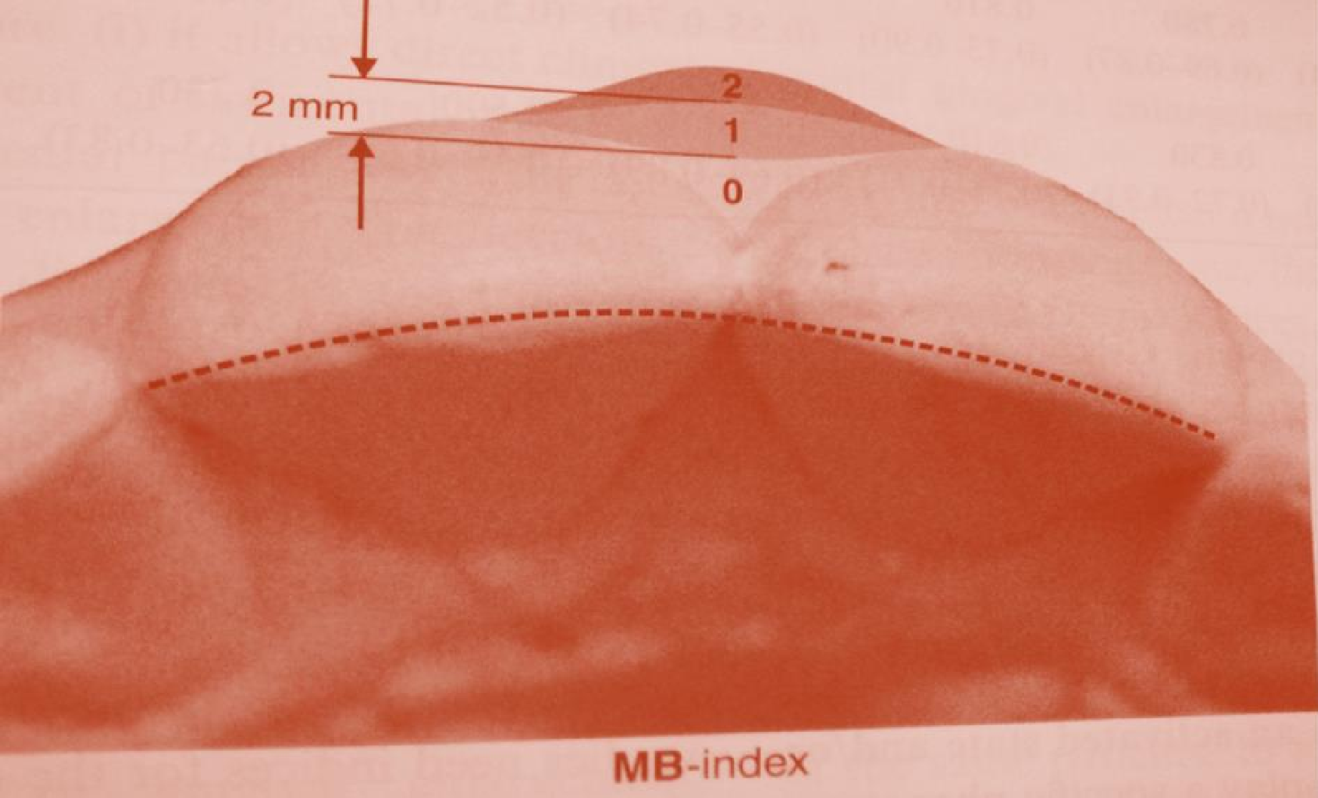
Miranda and brunet index

Slide 55
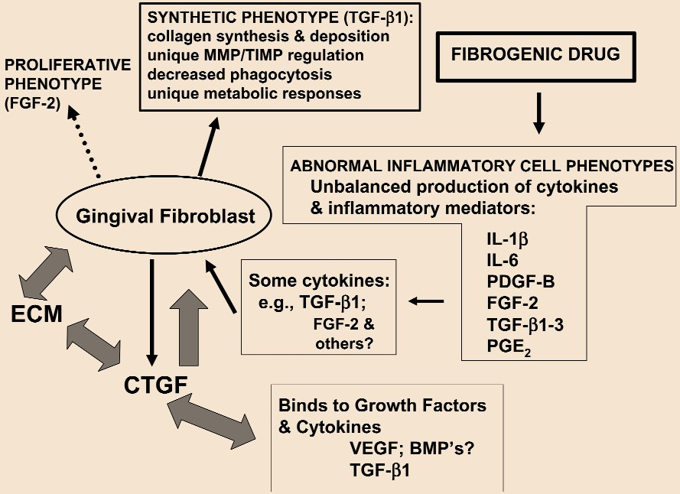
P. C.Trackman*A. Kantarci Connective Tissue Metabolism and Gingival Overgrowth Crit Rev Oral Biol Med 15(3):165-175 (2004)

Slide 56
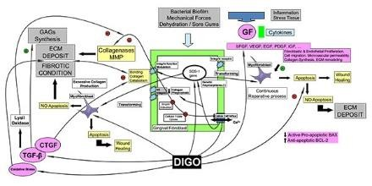
Albert Ramírez-Rámiz, Lluís Brunet-LLobet, Eduard Lahor-Soler and Jaume Miranda-Rius.
On the Cellular and Molecular Mechanisms of Drug-Induced Gingival Overgrowth .The Open Dentistry Journal, 2017,
Volume 11 421

Slide 57
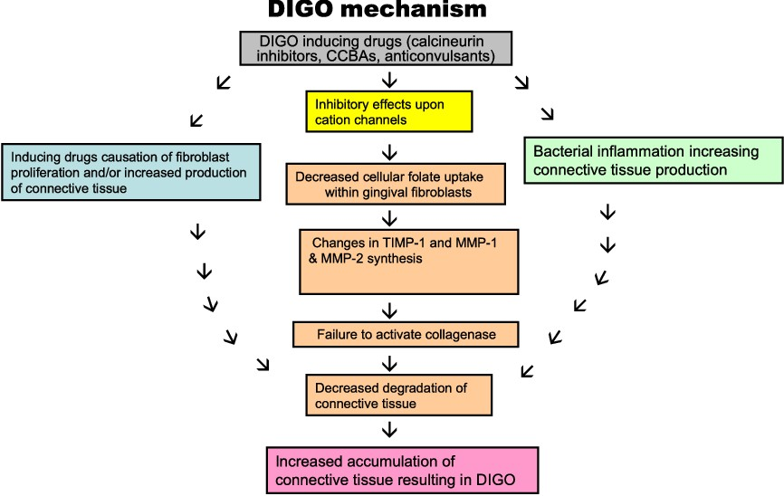
Brown, R.S., & Arany, P.R. (2015). Mechanism of drug-induced gingival overgrowth revisited: a unifying hypothesis. Oral diseases, 21 1, e51-61 .

Slide 58
TREATMENT

Slide 59
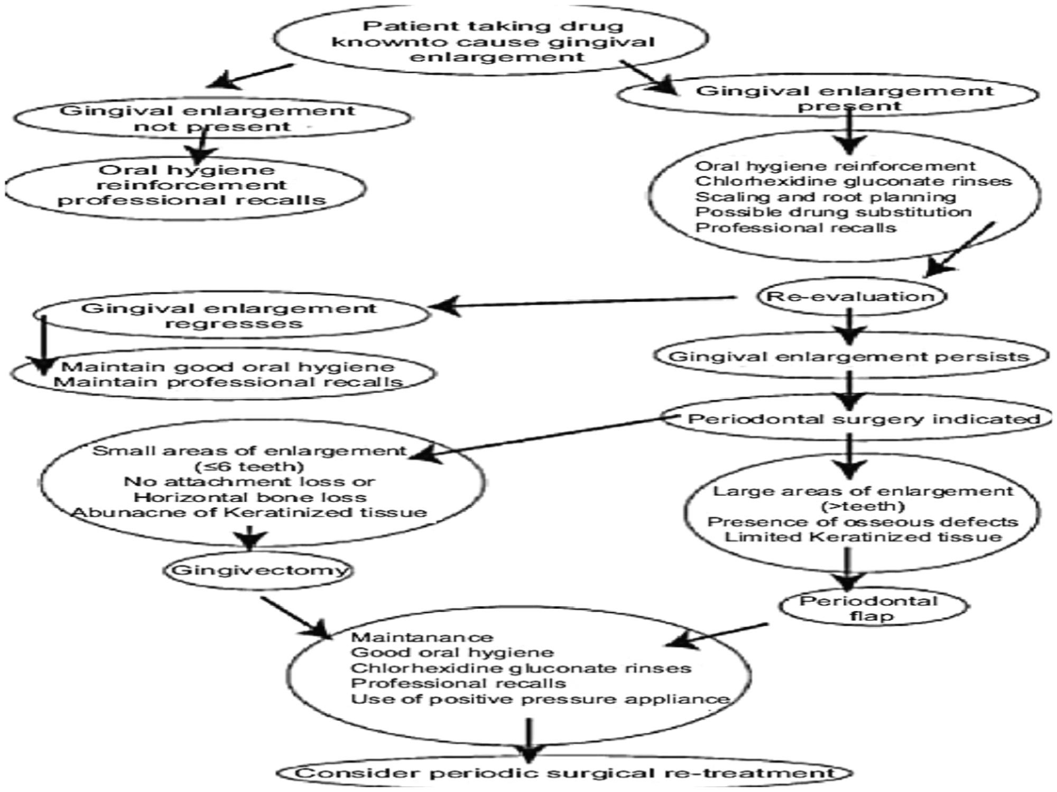

Slide 60
Management
 Key strategies in gingival enlargement.
Periodontal surgical procedures
Multidisciplinary dental care
Plaque control
Medical management
Mavrogiannis M, Ellis JS,Thomason JM, Seymour RA. The management of drug induced gingival overgrowth. J Clin Periodontol 2006; 33: 434–439

Slide 61
Drug substitution
CCB’s : Nifedipine with Isradipine ( 20 mg BD)
ACE Inhibitors like Captopril (12.5 to 50mgBD),
Enalapril (2.5to20 mg OD) to control hypertension
Phenytoin with Phenobarbital(60 mg TDS),
Primidone ( 100mg TDS)
Carbamezepine (200-400mg TDS) Valproic acid (200-500mg TDS)
Cyclosporin A with Tacrolimus (0.15 to 0.20/kg/d)
Rapamycin

Slide 62
NONSURGICAL MANAGEMENT OF DIGO

Slide 63



Seymour, R. A. & Smith, D. G. (1991)
studying the effect
of plaque control programme concluded that Oral hygiene therapy, while of some benefit to the patients, failed to completely prevent the development of overgrowth.
Pilatti, G. L. & Sampaio, J. E. (1997 observed that regular application of a chlorhexidine solution to rats medicated with cyclosporin resulted in significantly less overgrowth than in control animals
Wong,W. et al (1994) reported that Complete remission of cyclosporin induced gingival overgrowth occured in four renal transplant patients after a
7-day course of metronidazole

Slide 64
Strachan, D., Burton, I. & Pearson, G. J. (2003) studying the effects of oral azithromycin concluded that Systemic administration of the drug appears more effective in reducing overgrowth than a local delivery preparation
Drew, H. J.,
Vogel, R. I.(1987)
stated that patients with low plasma and redblood cell folate levels show a greater gingival response to topical folic acid than patients with normal levels.
Puolijoki et al. 1988 observed that there was a reduction in GO when a different calcium channel blocker such as angiotensin- converting enzyme inhibitor,enalapr il was administered.

Slide 65
Surgical Treatment of gingival enlargement
 Gingivectomy
Excision of gingiva.
Simple & quick technique

Slide 66
Gingivectomy by Electro surgery
Advantages
Permits an adequate contouring of the tissue
Controls hemorrhage
Disadvantages
Unpleasant odour
Irreparable damage to bone
Use limited to superficial procedures
Heat generated can cause tissue damage & loss of periodontal support.

Slide 67
Laser gingivectomy
Co₂ lasers used for excision of gingiva Advantages
Excellent soft tissue ablation
Haemostatic characteristic Disadvantages
Healing is delayed
Requires precautionary measures
Application to root surface or alveolar bone causes carbonization & major thermal damage

Slide 68
RECURRENCE OF DIGO AFTER SURGERY
Recurrence of GO is commonly reported.
Meticulous home care, Chlorhexidine gluconate rinses and regular professional cleaning can decrease the speed and degree of recurrence
A hard rubber fitted bite guard worn at night (Positive pressure appliance) may help to control recurrence of gingival overgrowth.
Paulo M Camargo, Fermin A.Carranza, and Henry H.Takei.Treatment of gingival
enlargement.Carranza’s Clinical Periodontology.10th edition 918-25.

Slide 69
Summary of Current Understanding
Molecular markers and clinical features of gingival overgrowth differ depending on the responsible medication.
Multiple different genetic loci have been
linked to inherited forms of gingival overgrowth, implying that the biological origins for gingival overgrowth are complex.
Cytokine and growth factor balances are
altered in gingival overgrowth tissues, including CTGF, a member of the interesting CCN family

Slide 70
Cytokine dependent alterations in extracellular matrix metabolism appear to be of functional importance to gingival overgrowth.
Abnormal differentiation of cells, resulting in accumulation of fibroblasts with a pathologic range of proliferative and synthetic phenotypes, could result from deregulated cytokines.
Gingival fibroblast extracellular matrix metabolism are unique, and may help to explain the tissue specificity of gingival overgrowth.

Slide 71
 Further studies are required to define unique metabolic aspects of gingival extracellular matrix metabolism;
 A greater understanding of interactions between and among medications, the innate and acquired immune response, cytokines and growth factors, and gingival epithelial and connective tissue cells will provide more detailed molecular and mechanistic information that will help in the prevention and treatment of gingival overgrowth.
 The accomplishment of these objectives will contribute to the improvement of oral and systemic health
P. C.Trackman*A. Kantarci Connective Tissue Metabolism and Gingival Overgrowth Crit Rev Oral Biol Med 15(3):165-175 (2004)

Slide 72


