Slide 1
Cephalometrics in Orthodontics

Slide 2
INTRODUCTION
Cephalic pertains to the head;
Metric means measurement.
Cephalometric roentgenography thus means head measurement with the x-ray.

Slide 3
HISTORICAL DEVELOPMENT
Discovery of x-rays by ROENTGEN in 1895.
Pacini and Carrera in 1922 first introduced radiographic technique for producing lateral radiographs.
BROADBENT and HOFRATH (1931) simultaneously presented a standardised cephalometric technique.

Slide 4
USES OF CEPHALOMETRICS
Helps in orthodontic diagnosis.
Helps in classification of malocclusion.
Helps in treatment planning.
Evaluation of treatment results.
Helps in predicting growth related change.
It is also valuable aid in research work involving the cranio-dento facial region .

Slide 5
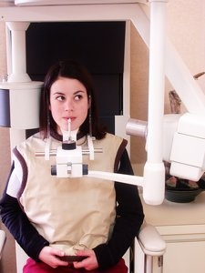
Evolution of cephalostat

Slide 6
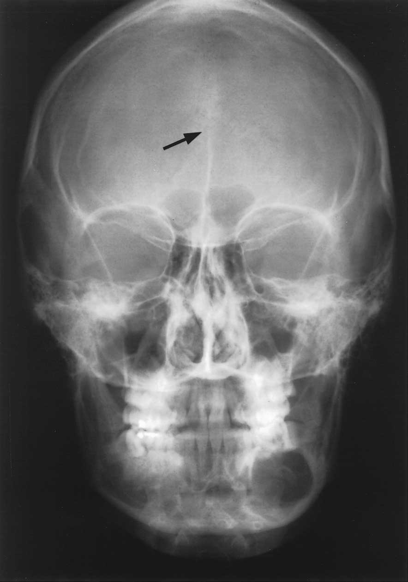
TYPES OF CEPHALOGRMS
LATERAL CEPHALOGRAM
FRONTAL CEPHALOGRAM

Slide 7
STANDARDIZATION
The cephalometric radiographs are taken by a machine that consists of an X-Ray source & a head holding device called cephalostat.
It consist of two ear rods that prevent the movement of head in horizontal plane and an orbital pointer for vertical stabilization. The upper part of the forehead is supported by forehead clamp above the region of nasal bridge .

Slide 9
The distance between the X-Ray source and the mid-sagittal plane of the patient is fixed at 5 feet. Thus the equipment helps in standardizing the radiographs by use of constant head position and source film distance so that serial radiographs can be compared

Slide 10
CEPHALOMETRIC LANDMARKS
Cephalometrics makes use of certain landmarks or points on the skull which are used for analysis and measurements.
The cephalometric landmarks can be classified as:
Anatomic landmarks – these landmarks represent actual anatomic structures of the skull.
Derived landmarks – these are landmarks that have been obtained secondarily from anatomic structures in a cephalogram.

Slide 11
Soft tissue /
Hard tissue landmark.
Unilateral /
Bilateral landmark.

Slide 12
LANDMARKS
Nasion : the most anterior point midway between the frontal & nasal bone on the fronto-nasal suture.
Orbitale : the lowest point on the inferior margin of the orbit.
Porion : the highest bony point on the upper margin of the external auditory meatus.

Slide 13
Sella : the point represting the midpoint of the pituitary fossa.
Point A: it’s a deepest point in the midline between ANS & alveolar crest between two central incisors.
Point B: it’s a deepest point in the midline between alveolar crest of the mandible & the mental process.
Basion: it’s the median point of the anterior margin of foramen magnum

Slide 14
ANS: it’s the anterior tip of the sharp bony process of the maxilla in the midline of the lower margin of anterior nasal spine.
Gonion: it is at the junction of the ramal plane & mandibular plane.
Pogonion: it’s the anterior most point of the bony chin in the medial plane.

Slide 15
Menton: Most inferior midline point on the mandibular symphysis.
Gnathion: Most antero-inferior point on the symphysis of the chin.
Articulare: point at the junction of the posterior border of ramus & the inferior border of the basilar part of occipital bone.
Condylion: most superior point on the head of condyle.

Slide 16
Prosthion/ supradentale: the lowest & most anterior point on the alveolar bone in the midline, between the upper central incisors.
Infradentale: highest & most anterior point of the alveolar process, between the lower central incisors.

Slide 17
PNS: The intersection of a continuation of the anterior wall of the pterygopalatine fossa & floor of the nose, marking the distal limit of maxilla.
Ptm point: The intersection of inferior border of foramen rotundum with the posterior wall of pterygo-maxillary fissure.

Slide 18
Glabella: It is most prominent point of the forehead in the mid sagittal plane.
Subnasale: The point where the lowest border of nose meets the outer contour of the upper lip.

Slide 20
PLANES IN CEPHALOMETRICS
Horizontal planes :
S.N. plane: It’s a line between sella & nasion represents anterior cranial base.
FH plane: Plane between orbitale & porion.
Palatal plane: Plane between ANS & PNS.
Occlusal plane: Plane bisecting the posterior occlusion of permanent premolars & molars.

Slide 22
Mandibular planes:
Tangent to lower border of mandible (Tweed).
A line connecting Go to Gn (Steiner).
A line connecting Go to Me (Downs).
Basion –Nasion Plane: Line connecting the basion & nasion representing cranial base.

Slide 24
Vertical plane:
A-Pog line: Line from point A to pogonion.
Facial plane : Line from from nasion to pogonion
Facial axis: A line from Ptm point to cephalometric gnathion.
E. plane : Also called Esthetic plane is a line between most anterior point of the soft tissue nose & soft tissue chin.

Slide 26
Steiner analysis
Steiner elected to use the anterior cranial base (sella –nasion ) as the line of reference to which the jaws would be related. The advantage of these to midline point is that they are moved only a minimal amount whenever the head deviates from the true profile position.
The skeletal analysis
Dental analysis
Soft tissue analysis

Slide 27
PARAMETER | NORMAL VALUE | INFERENCE
SKELETAL PARAMETERS
SNA | 82±2° | Prognathic/retrognathic maxilla
SNB | 80±2° | Prognathic/retrognathic mandible
ANB | 2° | ClassI/II/III
Mandibular plane angle | 32° | Vertical / Horizontal Growth Pattern
DENTAL PARAMETERS
U1-A | 25° | Proclined/Retroclined maxillary incisor
L1-B | 4 mm | Proclined/Retroclined mandibular incisor
Inter Incisial Angle | 22° | Proclined/Retroclined incisors
Lower Incisior to chin | 4 mm | Proclined/ retroclined mandibular incisor

Slide 28
THE SKELETAL ANALYSIS
Maxilla - SNA
If the angular reading is greater than 82⁰, it would indicate a relative forward positioning of mandible.

Slide 29
Mandible - SNB
To assess whether the mandible is protrusive or recessive to the cranial base, the SNB angle is read.
An angle less than 80⁰ indicates the retrusive mandible.

Slide 30
Relationship of maxilla to mandible - ANB
By noting the SNA & SNB readings the offending jaw can usually be pinpointed. The more significant reading, however, is the ANB reading, which provides the relative position of the jaws to each other.

Slide 31
Occlusal plane
The occlusal plane is drawn through the region of the overlapping cusps of the first premolars& first molars.
The angle between occlusal plane to S-N is measured.
The mean reading for normal occlusion is 14⁰.

Slide 32
Mandibular plane
Is drawn between gonion & gnathion. The mandibular plane angle is formed by relating it to the anterior cranial base.
Mean reading 32⁰.
Excessive high or low mandibular plane angles suggest unfavorable growth pattern.

Slide 33
DENTAL ANALYSIS
Maxillary incisor position
The upper incisor to N –A reading in degrees indicates the relative angular relationship of the upper incisor teeth, where as the upper incisor to N –A reading in the millimeter provides information on the relative forward or backward position of the incisor teeth to the N-A line.

Slide 34
Mandibular incisor position
The lower incisor to N-B measurement in millimeters shows the relative forward or backward positioning of these teeth to the N-B line, in degrees indicate the relative axial inclination of these teeth to the N-B line

Slide 35
Interincisal angle
130⁰

Slide 36
Lower incisor to chin
The degree of prominence of the chin contributes to the determination of the placement of the teeth in the arch.
Ideally according to Holdaway, the distance between the labial surface of the lower incisor to the N-B line should be equal i.e., 4mm.

Slide 37
SOFT TISSUE ANALYSIS (Steiner’s)
The soft tissue analysis is basically a graphic record of the visual observations made in the clinical examination of the patient. The soft tissue analysis includes an appraisal of the adaptation of the soft tissue to the bony profile with consideration to the size, shape, & posture of the lips as seen on the lateral head film.

Slide 38
According to Steiner the lips in well balanced faces, should touch a line extending from the soft tissue contour of the chin to the middle of an S formed by the lower border of the nose. This line is referred as S line.
Lips located beyond this line tend to be protrusive, in which case the teeth &/or jaws usually require orthodontic correction.

Slide 39
TWEED’S ANALYSIS
PARAMETER | NORMAL VALUE | INFERENCE
FMA | 25 | Vertical / Horizontal Growth Pattern
FMIA | 65 | Proclined/ retroclined mandibular incisor
IMPA | 90 | Proclined/ retroclined mandibular incisor

Slide 40
SEMINAR TOPICS
DEVELOPMENT OF DENTITION – Part 1
DEVELOPMENT OF DENTITION – PART 2
CLASSIFICATION OF MALOCCLUSION – PART 1
CLASSIFICATION OF MALOCCLUSION – PART 2
ETIOLOGY OF MALOCCLUSION – PART 1
ETIOLOGY OF MALOCCLUSION – PART 2

Slide 41
Down’s analysis
.

Slide 42
Downs used Frankfort horizontal plane as the reference plane to determine the degree of retrognathism, orthognathism or prognathism.
FH is a horizontal plane running through the cephalometric porion and orbitale.
SKELETAL PATTERN
Facial angle (87.8⁰)
Angle of convexity (0⁰)
A-B plane (-4.6⁰)
Mandibular plane angle (21.9⁰)
Y-(growth) axis (59.4⁰)
DENTAL PATTERN
Cant of occlusal plane.
Interincisal angle (135.4⁰)
Incisor occlusal plane angle (14.5⁰)
Incisor mandibular plane angle (1.4⁰)
The protrusion of maxillary incisors (+2.7mm)

Slide 43
PARAMETERS | RANGE | INFERENCE
SKELETAL PARAMETERS
Facial angle | 82-95 (87.8) | Protrusive/retrusive chin
Angle of convexity | -8.5 - +10 (0) | Convex/concave/straight facial profile
A-B plane | -4.6 | Class I/II/III skeletal bases
Mandibular plane angle | 17-28 (21.9) | Vertical/average/horizontal growth pattern
Y-(growth) axis | 53-66 (59.4) | Vertical/average/horizontal growth pattern

Slide 44
DENTAL PARAMETERS
Cant of Occlusal Plane |  | Vertical/average/horizontal growth pattern
Interincisal angle |  | Proclined/retroclined incisors
Incisor occlusal plane angle |  | Proclined/retroclined mandibular incisors
Incisor mandibular plane angle |  | Proclined/retroclined mandibular incisors
Protrusion of maxillary incisors |  | Proclined/retroclined maxillary incisors

Slide 45
Facial angle
This is the inferior inside angle in which the facial line (nasion pogonion) intersect the FH plane.
It is used to measure the degree of retrusion or protrusion of the lower jaw.
Mean reading: 87.8⁰ S.D. 3.6
Range: 82 to 95 degrees

Slide 46
Angle of convexity
Formed by the intersection of the line N - point A to point A - pogonion.
This angle measures the degree of maxillary basal arch at its anterior limit (point A) relative to the total facial profile (nasion-pogonion).
A positive angle suggests prominence of the maxillary base relative to the mandible. A negative angle in prognathic profile
Mean reading: 0⁰
Range: -8.5 to +10 degrees

Slide 47
A-B plane
Points A and B are joined and when the line is extended , the angle formed with the line N-pog is read.
Is the measure of the relation of the anterior limit of the apical bases to each other relative to the facial line.
Mean reading: - 4.6 degrees
Range: -8.5 to +10 degrees

Slide 48
Mandibular plane angle
Downs considered mandibular plane as tangent to the gonial angle & the lowest point of the symphysis.
The Mandibular plane angle is established by relating the MP to FH plane.
High Mandibular plane angle occurs in both retrusive & protrusive faces & are suggestive of hyperdivergent facial patterns.
Mean reading: 21.9⁰
Range: 17 to 28degrees

Slide 49
Y-(growth) axis
is the measure of the acute angle formed by the intersection of a line from the sella turcica to gnathion with the FH plane.
A decrease in Y-(growth) axis in serial radiographs may be interpreted as a greater horizontal than vertical growth pattern.
Mean reading: 59.4⁰
Range: 53 to 66 degrees

Slide 50
DENTAL PATTERN
Cant of occlusal plane.
Downs originally defined the occlusal plane as that line bisecting the overlapping cusps of the first molars & incisor overbite.
The cant of occlusal plane is measure of the slope of the occlusal plane to the FH.
Mean reading: 9.34⁰
Range: +1.3 to +14 degrees

Slide 51
Interincisal angle
Is established by passing a line through the incisal edge & apex of the root of the maxillary & mandibular central incisors.
This angle is relatively small in individuals whose anteriors are tipped forward on the denture base.
Mean reading: 135.4⁰
Range: 130 to 150 degrees

Slide 52
Incisor occlusal plane angle
relates the lower incisor to their functional surface at the occlusal plane. The inferior inside angle is read as either positive or negative deviation from a right angle.
The positive angle increases if these teeth are inclined forward.
Mean reading: 14.5⁰
Range: 3.5 to 20 degrees

Slide 53
Incisor mandibular plane angle
is formed by the intersection of the mandibular plane with a line passing through the long axis of the incisor.
Mean reading: 91.4⁰
Range: 81.5 to 97 degrees

Slide 54
The protrusion of maxillary incisors
is measured as the distance between the incisal edges of the maxillary central incisor to the line from point A- pogonion line & indicates the maxillary dental protrusion.
This distance is positive if the incisal head is ahead of the point A-pogonion line. Indicates the amount of maxillary dental protrusion.
The reading is negative if the maxillary incisal edge lies behind the point A-pogonion line and suggests a retruded position of the maxillary incisors.
Mean reading: 2.7mm
Range: -1 to +5mm

