Slide 1
SEMINAR
CLASSIFICATION
OF
MALOCCLUSION

Slide 2
CONTENTS
  ANGLE SYSTEM
  DEWEY’S MODIFICATION
  LISCHER’S MODIFICATION
  SIMON’S CLASSIFICATION
  BENNET’S CLASSIFICATION
  ACKERMAN – PROFFIT SYSTEM
  INCISOR CLASSIFICATION
  BRITISH STANDARDS CLASSIFICATION
  BALLERD CLASSIFICATION
  WHO CLASSIFICATION
  BAUME CLASSIFICATION
  SKELETAL CLASSIFICATION
LIMITATIONS OF CLASSIFICATION SYSTEMS
CONCLUSION
REFERENCES

Slide 3

CLASSIFICATION OF MALOCCLUSION
CLASSIFICATION SYSTEM
-IS A GROUPING OF CLINICAL CASES OF SIMILAR APPEARANCE FOR EASE IN HANDLING AND DISCUSSION
-IT IS NOT A SYSTEM FOR DIAGNOSIS ,METHOD FOR DETERMINING PROGNOSIS OR A WAY OF DEFINING TREATMENT

Slide 4
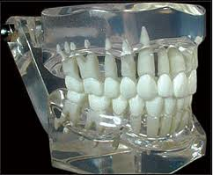
OCCLUSION
OC - UP
CLUSION - CLOSING
“CLOSING UP”
DEF.-
THE RELATIONSHIP OF THE MAXILLARY AND MANDIBULAR TEETH WHEN THE JAWS ARE CLOSED IN CENTRIC RELATION WITHOUT STRAIN OF MUSCULATURE OR DISPLACEMENT OF CONDYLES IN THEIR FOSSAE.(GRABER)

Slide 5
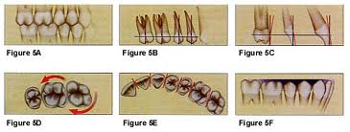
SIX KEYS OF NORMAL OCCLUSION
(BY ANDREWS LF-Am J Orthod 1972:63:296)
1.MOLAR INTER-ARCH RELATIONSHIP
2.MESIODISTAL CROWN ANGULATION
3.LABIOLINGUAL CROWN INCLINATION
Notes:
1-mesiobuccal cusp of max 1st molar occludes in groove b/w the mesial and medial buccal cusp of lower 1st molar. 2 -GOD-gingival part of long axis of crown is always distal to occlusal part . 3-tell crown inclination. +crown inclination-ging area of crown is more lingual then occlusal area.vice versa.max inc have a +crown incl. And mand inc have mild –ve crwn inclination .max and mand posteriors hv a –ve crwn incl.

Slide 6
4.ABSENCE OF ROTATION
5.TIGHT CONTACTS
6.CURVE OF SPEE
Notes:
4 . Rotated posterior teeth occupies more space and rotated incisors occupy less space in arch.
6 . Cos shud be flat not exceeding then 1.5mm

Slide 7
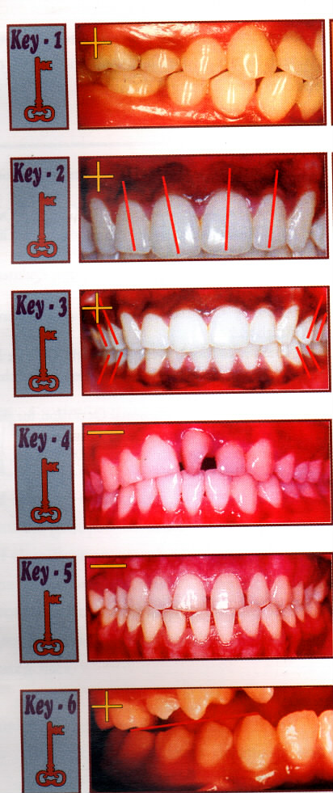

Slide 8
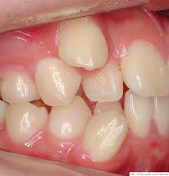
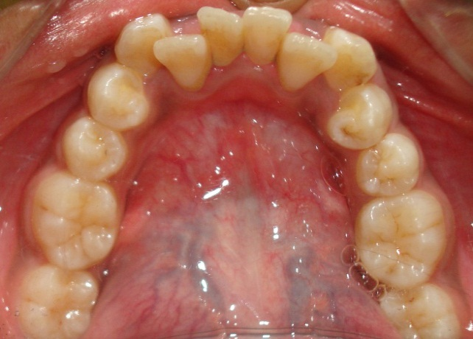
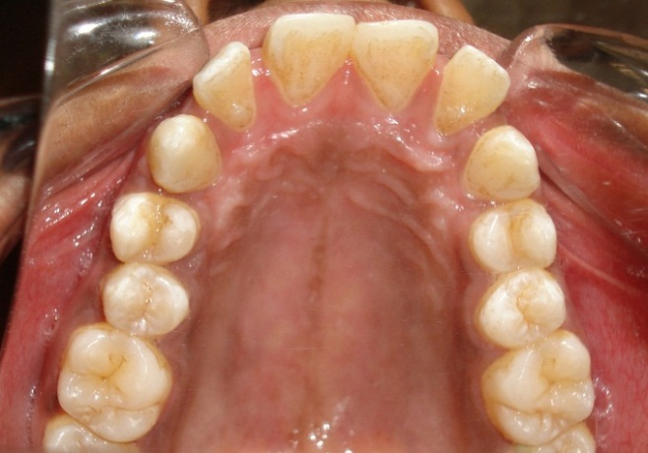
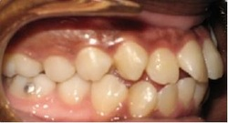
MALOCCLUSION
Malocclusion is a problem in the way the upper and lower teeth fit together in biting or chewing.
The word malocclusion literally means "bad bite’’.

Slide 9
-ANGLE’S CLASSIFICATION & ITS MODIFICATION
-SIMONS SYSTEM
-BJORK’S CLASSIFICATION
-BENNETT’S CLASSIFICATION
-SKELETAL CLASSIFICATION
-ACKERMANN AND PROFITT CLASSIFICATION
-AETIOLOGICAL CLASSIFICATION
-WHO / FDI CLASSIFICATION
-BALLARDS CLASSIFICATION
-BAUME CLASSIFICATION OF PRIMARY TEETH
-INCISOR CLASSIFICATION

Slide 10
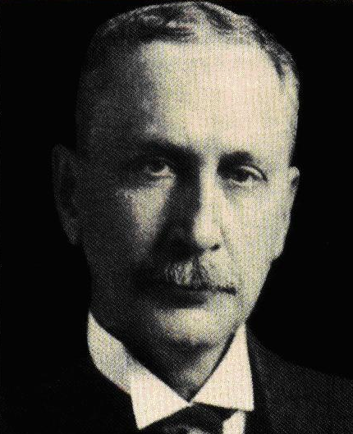
ANGLE'S SYSTEM OF CLASSIFICATION
BY EDWARD HARTLEY ANGLE
Published in 1899 in the periodical
-DENTAL COSMOS
Based on
-- KEY of occlusion-
Maxillary first permanent molars
--Antero posterior relationship of the Jaws with each other
Notes:
It is a smooth curve passing through central fossa of each upper molar and across cingulum of upper canine and incisor teeth.
The same line runs along the buccal cusps & incisal edges of lower teeth.

Slide 11
KEY of occlusion
Maxillary first molars considered to be the key to occlusion.
According to angle ,
-Key Ridge/Angle’s point is normal anatomical landmark to which mesiobuccal cusp tip is related.
According to Angle,mesiobuccal root tip is in line with key ridge in normally positioned teeth in maxillary arch and
He considered this point as the most stable point in maxillary arch and considered mandibular arch with this position.

Slide 12
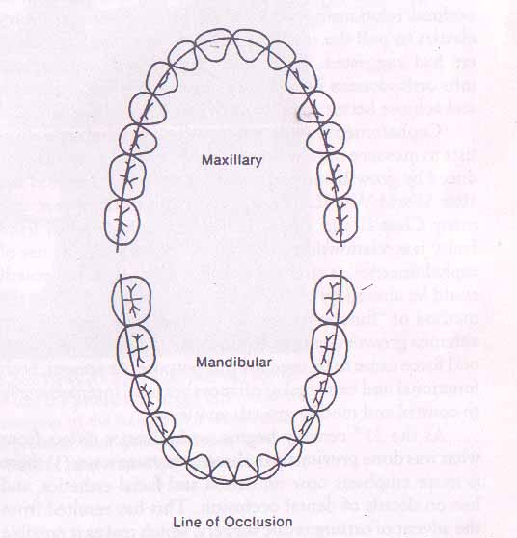
LINE of occlusion
-It is a smooth curve passing through central fossa of each upper molar and across cingulum of upper canine and incisor teeth.
-The same line runs along the buccal cusps & incisal edges of lower teeth.

Slide 13
Normal occlusion.
-Normal (class I) molar relation.
-The line of occlusion is not altered.
It means that if buccal occlusal line of mandibular dental arch was coincident with central fossa line of maxillary arch & teeth were well aligned,ideal occlusion will result.
Notes:
Edward Angle, in his classification of malocclusions, never depicted Class I as “IDEAL”,but as a range of abnormality b/w extremes of full Class II & Class III.
According to angle – In Ideal occlusion every tooth (except lower centrals & upper third molars) should have two antagonists alongwith having class I molar relation
According to angle
“ALL IDEAL OCCLUSIONS ARE CLASS I , BUT NOT ALL CLASS I OCCLUSIONS ARE IDEAL”

Slide 14
ANGLE'S SYSTEM OF CLASSIFICATION
CLASS I
CLASS II
DIVISION I
DIVISION II
CLASS II SUB DIV
TRUE
PSUEDO
CLASS III
CLASS III SUB DIV

Slide 16
Angle's Class I
-NEUTROCCLUSION
MOLAR RELATION-
The mesio-buccal cusp of the maxillary first permanent molar occludes in the mesiobuccal groove of mandibular first permanent molar.
CANINE RELATION-
The mesial slope of upper canine occludes with distal slope of lower canine whereas distal slope of upper canine occlude with mesial slope of lower 1st premolar.
Normal skeletal relation
Normal muscle function.

Slide 17
CLASS I BIMAXILLARY PROTRUSION
Condition where -key of occlusion and line of occlusion are not altered.
Both upper and lower anteriors are proclined and exist usually in edge to edge relationship.
As well as upper and lower anteriors are forwardly placed in
relation to the facial profile

Slide 18
Angle's Class II
DISTOCCLUSION
MOLAR RELATION
Disto buccal cusp of the upper first permanent molar occludes in the buccal groove of the lower first permanent molar
CANINE RELATION-
The distal slope of upper canine occludes with mesial slope of lower canine.
LINE OF OCCLUSION-
It will be altered in upper and lower arches.
Above feautures are common in both div 1 & div 2 malocclusions.

Slide 19
Class II, division 1
Characteristics—
-Proclined upper incisors
-Increase in overjet
-A deep incisor overbite
-The upper lip is usually hypotonic, short and fails to form a lip seal.
-The lower lip cushions the palatal aspect of the upper teeth referred to as 'lip trap'.

Slide 20
-V-shaped upper arch or constricted maxilla because the tongue occupies a lower posture thereby failing to counteract the buccinator activity, which results in narrowing of the upper arch at the premolar and canine regions
-Hyperactive mentalis and buccinator
-Normal path of closure.
-SUNDAY BITE-
It is the bite achieved the patient by deliberately bringing mandible forward in class II division 1 cases,for improving their esthetics.

Slide 21
Class II, division 2
Characteristics—
-There is 3 types of relations of Incisors
# I – only upper central incisor is lingually inclined and laterals
are labially inclined
#II – upper central and lateral incisors are lingually inclined while
canines are labially inclined
#III – upper central incisor,lateral incisor and canines are lingually inclined

Slide 22
-Deep anterior overbite is present
-Arch has a squarish appearance-due to lingually inclined central incisors
-The mandibular labial gingival tissue is often traumatized.
-Patient exhibits normal perioral muscle activity.
-An abnormal backward path of closure may also be present due to the excessively tipped central incisors.

Slide 23
Class II, Subdivision
Class II molar relation exists on one side and a Class I relation on the other.
Based on whether it is a division 1 or division2 it can be called
-Class II division 1, subdivision or
- Class II, division 2,subdivision.

Slide 24
Comparision b/w angle’s class ii div 1 & 2
FEATURE | DIVISION 1 | DIVISION 2
OVERJET | INCREASED | DECREASED
PROFILE | CONVEX | STRAIGHT/MILD CONVEX
LIPS | LOWER LIP-MORE ACTIVE & UPPER LIP IS HYPOTONIC | NORMAL
ARCH FORM | V SHAPE & NARROW | U/SQUARE
PALATE | DEEP | NORMAL
MUSCLE ACTIVITY | INCREASED MENTALIS & BUCCINATOR | NORMAL
PATH OF CLOSURE | NORMAL | BACKWARD
LOWER FACIAL HEIGHT | NORMAL/INCREASED | DECREASED
DEEP BITE | INCREASED | INCREASED
Notes:
DEEP BITE INCREASES IN BOTH CLASS II DIV 1 & DIV 2 AS LOWER INCISAL EDGES R PLACED DISTALLY TO CINGULUM OF UPPER INCISORS AND THEREFORE THEY GROWS UNOBSTRUCTEDLY.

Slide 25
Class III malocclusion
MESIOCCLUSION
MOLAR RELATION-
Class III molar relation with the mesio-buccal cusp of the maxillary first permanent molar occluding in the interdental space between the mandibular first and second molars.
CANINE RELATION-
The upper canine occludes with INTERDENTAL SPACE B/W lower 1st and 2nd premolars
LINE OF OCCLUSION-
It may or may not be altered.
-

Slide 26
Other characteristic features are-
-Reverse overjet or Edge to Edge incisor relationship.
-Maxillary anterior crowding
-Hyperactive upper lip
-Posterior crossbite
-Narrow upper arch-because tongue occupies a lower position as space available for tongue is very large.
Class III, Subdivision
This is a condition characterized by a Class III molar relation on one side and a Class I relation on the other side

Slide 27
True Class III | Pseudo Class III
Skeletal malocclusion | Postural/Habitual malocclusion
Causes are- Retrognathic maxilla -Excessively small maxilla -Prognathic mandible -Excessive large mandible | Causes- Occlusal prematurities -Premature loss of decidious teeth -Enlarged adenoids
CLASS III molar relation exists both in centric Relation and centric occlusion | CLASS III molar relation exists in centric occlusion only
Retrusion of mandible is not possible | Retrusion of mandible is possible
T/T— Orthopedic or surgical | T/T— Elimination of prematurities, replacement of lost posterior teeth
If left untreated-No further changes | If left untreated,it becomes established into true class III
Notes:
Pseudo class III if left untreated vl develop into TRUE class III due to unhindered growth of mandible..therefore,crossbite should be treated as early as possible

Slide 28
SHORT COMINGS OF ANGLE’S
CLASSIFICATION
DOES NOT CONSIDER MALOCCLUSION IN VERTICAL AND TRANSVERSE PLANE.
CANNOT BE APPLIED IF FIRST PERMANENT MOLARS ARE MISSING.
CANNOT BE USED IN DECIDUOUS DENTITION.
DOES NOT INDICATE THE ETIOLOGY OF MALOCCLUSION.
NO SKELETAL RELATIONSHIP IS CONSIDERED
MALFUNCTIONS OF MUSCLES AND BONES ARE OVERLOOKED.
DOES NOT INDICATE THE COMPLEXITY OF THE PROBLEM.

Slide 29
Drawbacks of Angle's classification
DOES NOT CONSIDER MALOCCLUSION IN VERTICAL AND TRANSVERSE PLANE.
CANNOT BE APPLIED IF FIRST PERMANENT MOLARS ARE MISSING.
CANNOT BE USED IN DECIDUOUS DENTITION.
DOES NOT INDICATE THE ETIOLOGY OF MALOCCLUSION.
NO SKELETAL RELATIONSHIP IS CONSIDERED
MALFUNCTIONS OF MUSCLES AND BONES ARE OVERLOOKED.
DOES NOT INDICATE THE COMPLEXITY OF THE PROBLEM
BUT
Then also Angle's classification is still in use after almost 100 years of its introduction due to its simplicity in application & communication

Slide 30
MODIFICATIONS
LISCHERS modification
DEWEYS modification
HOWARDS modification
TAYALORS modification

Slide 31
LISCHER'S MODIFICATIONS OF
ANGLE'S CLASSIFICATION
1933
-Neutrocclusion : Synonymous with Angle's ClassI malocclusion.
-Distocclusion : Synonymous with Angle's ClassII malocclusion.
-Mesioclusion: Synonymous with Angle's ClassIII malocclusion.
Notes:
Lischer

Slide 33
He added suffix ‘VERSION’ to describe malposition of individual teeth.It indicates direction of deviation from normal position
Mesioversion : Mesial to the normal position.
Distoversion: Distal to the normal position.
Buccoversion: towards lip or cheek.
Linguoversion : Lingual to normal position.
Supraversion: erupted beyond normal level.
Infraversion : not erupted to normal level.
Transversion:Transposition of two teeth. . .
Axiversion : Abnormal axial inclination of a tooth
Torsiversion: Rotation of a tooth around its long axis.

Slide 34

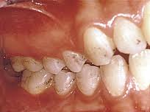
INTRA-ARCH MALOCCLUSIONS
Intra-arch malocclusions -variations in individual tooth position and malocclusions affecting a group of teeth within an arch.
They have 5 types -
1. Saggital problems
LABIOVERSION
LINGUOVERSION
MESIOVERSION

Slide 36
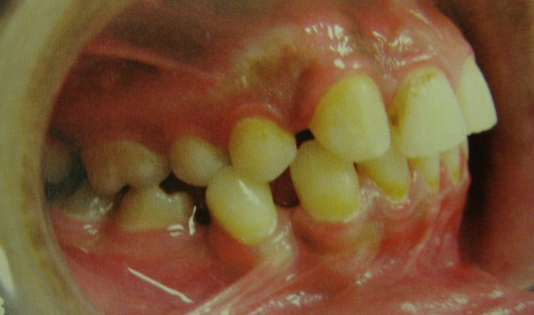
DISTOVERSION

Slide 37
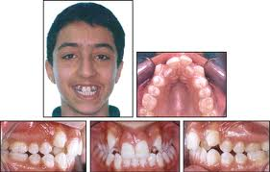
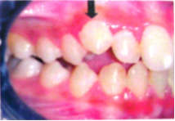
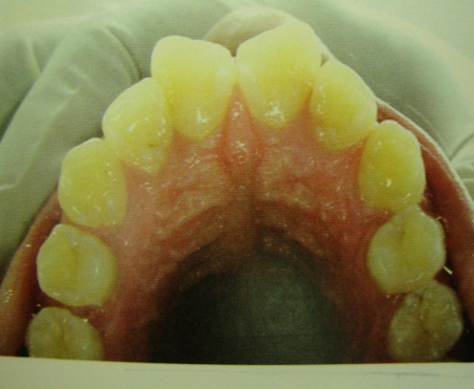
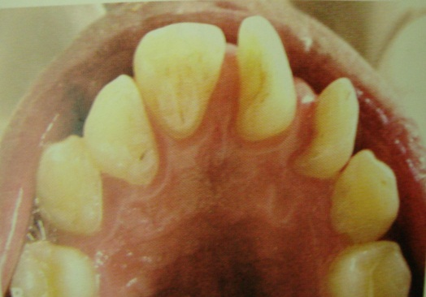
SUPRAVERSION
INFRAVERSION
Mesiolingual Distolingual

Slide 38
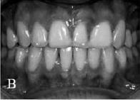
TRANSPOSITION OF TEETH
This term is used in cases where two teeth exchange places,
e.g. a lateral incisor in place of the central incisor.

Slide 39
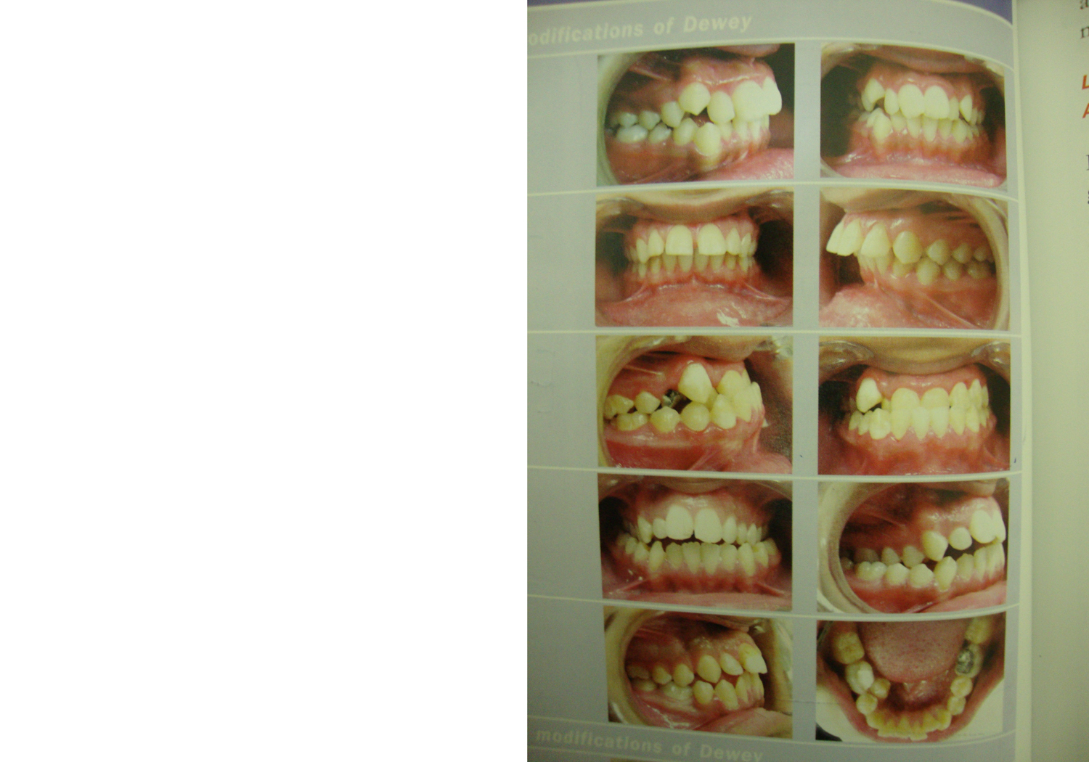
DEWEY'S MODIFICATION
MARTIN DEWEY Divided Angle’s Class I & III into further types
ANGLES CLASS I
TYPE I CROWDED MAXILLARY ANTERIORS
TYPE 2 MAXILLARY INCISORS ARE PROCLINED AND SPACED
TYPE 3 ANTERIOR CROSS BITE
TYPE 4 POSTERIOR CROSSBITE
TYPE 5 DRIFTING OF MOLARS MESIALLYDUE TO EARLY LOSS OF DECIDUOUS 2ND MOLAR

Slide 40
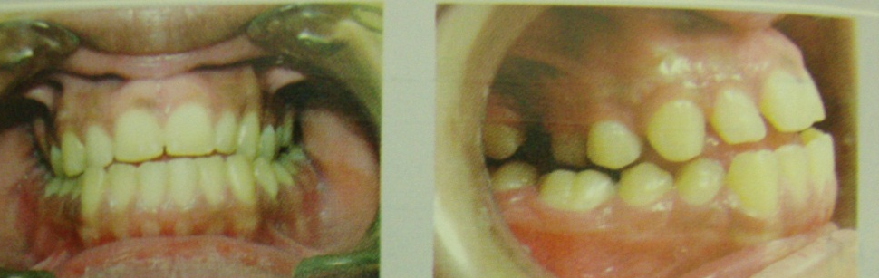


ANGLES CLASS III
TYPE 1 EDGE TO EDGE INCISOR RELATION
TYPE 2 CROWDED LOWER ANTERIORS
TYPE 3 CROWDED LOWER INCISORS WITH
ANTERIOR CROSS BITE

Slide 41
MODIFIED ANGLE CLASSIFICATION
Morton I. Katz
(AJO Aug&Sep `92)

Slide 42
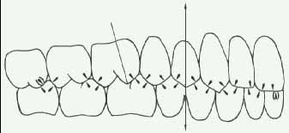
Edward Angle, in his classification of malocclusions, appears to have made Class I a range of abnormality, not a point of ideal occlusion.He never depicted Class I as a treatment goal or “IDEAL”,but as a range of abnormality b/w extremes of full Class II & Class III.
According to angle – In Ideal occlusion every tooth (except lower centrals & upper third molars) should have two antagonists alongwith having class I molar relation

Slide 43
-According to angle
“ALL IDEAL OCCLUSIONS ARE CLASS I , BUT NOT ALL CLASS I OCCLUSIONS ARE IDEAL”
- Unfortunately, many modern orthodontists use the Class I designation as a goal of successful treatment.
Therefore, to more closely match current use, it is necessary to redefine Class I for the purpose of this modified Angle classification as the point of ideal intermeshing.
IN THIS MODIFIED CLASSIFICATION -ANGLE’S CONCEPT OF IDEAL OCCLUSION REMAINS THE SAME

Slide 44
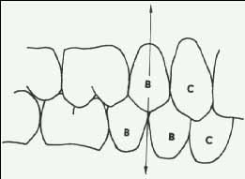
MODIFIED ANGLE CLASSIFICATION
-It is a PREMOLAR DERIVED CLASSIFICATION AND IS UNCONCERNED ABOUT MOLAR RELATION.
-Class I, in the modified Angle classification is defined:
The most anterior upper premolar fits exactly into the embrasure created by the distal contact of the most anterior lower premolar.
This definition applies whether a full complement of premolars are present,
whether -one upper premolar opposes two lower premolarslower premolars,hether one upper premolar opposes two lower premolars,
Traditional angle only classifies molars & wud call this excellent occlusion as CLASS II

Slide 45
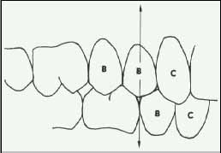
whether two upper premolars oppose one
lower premolar,
Traditional angle only classifies molars & wud call this excellent occlusion as CLASS III

Slide 46
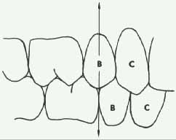
or whether only one premolar is present in each quadrant.
.

Slide 47
Modern orthodontists do extract teeth, whereas Angle did not, and we need to have an occlusion classification that works when teeth are extracted in only one arch.
In the rare instance where no premolar exists in a quadrant, then the center axis of the upper canine crown (not the cusp tip) should be used as a reference to the distal contact of the lower canine.

Slide 48
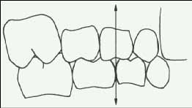
Deciduous and mixed dentition classification
The deciduous or mixed dentition was not directly addressed by Angle in his classification.
In the modified classification, the center axis of the upper first deciduous molar should split the embrasure between both lower deciduous molars in MODIFIED CLASS I in mixed dentition.

Slide 49
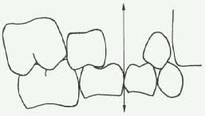
However, in the event that an upper first deciduous molar is prematurely lost, a line drawn through the center axis of the edentulous space should bisect the embrasure between the two lower deciduous molars.

Slide 50
Advantages of the modified Angle classification
-It establishes a specific cusp-embrasure point as a t/t goal rather than a range of 7 mm (half of a cusp each way) as in the traditional Angle classification of malocclusion.
-It quantifies the degree of occlusion error of a malocclusion precisely in millimeters and for each side separately i.e tells degree of CLASS II OR CLASS III .
-It designates ideal cusp embrasure occlusion as described by angle as 0. A plus (+) sign shows class II
direction & negative (-) sign shows class III direction

Slide 51
-This method allows the orthodontist to classify those patients who have Class II tendency on one side and Class III tendency on the other side.
-This numerical system allows computer input to the facilitated and the severity of the malocclusion to be easily rated and compared for statistical and research purposes.
-This new system addresses the need for deciduous and mixed dentition classification to assist early treatment analysis.

Slide 52
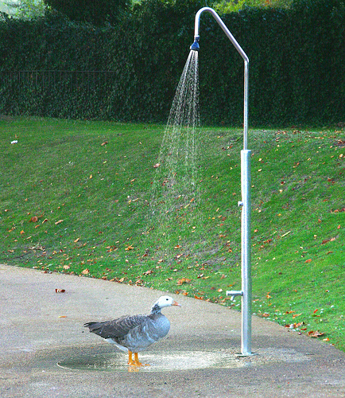
BREAK

Slide 53
BAUME CLASSIFICATION OF PRIMARY TEETH
CLASS I
OR
CLASS II
STRAIGHT OR FLUSH TERMINAL PLANE
CLASS I
OR
CLASS III
MESIAL STEP
DISTAL STEP
CLASS II

Slide 55

BAUME CLASSIFICATION OF PRIMARY TEETH
A normal relationship of the
primary molar teeth is
FLUSH TERMINAL PLANE.
The primary dentition equivalent of Angle’s CLASS II is the
DISTAL STEP.
A MESIAL STEP relationship corresponds to Angle’s Class I.
An equivalent of CLASS III is almost never seen in the primary dentition becoz of normal pattern of craniofacial growth in which mandible lags behind the maxilla.

Slide 56
CLASS I
OR
END ON
FLUSH TERMINAL PLANE
CLASS I
OR
CLASS III
MESIAL STEP
DISTAL STEP
CLASS II
OR
END ON
Only 55% of the children have flush terminal plane relationship,
26% of the children have distal step
and 4% of children have mesial step relation.
In the remaining cases the relation was different on either
side of the arches.
Notes:
LOWER PERMANENT MOLAR SHFTS MESIALLY MORE THAN PERMANENT UPPER MOLAR BCOZ OF-
=LEEWAY SPACE ALLOWS MORE MAND MOLAR MOVEMENT
=DIFERENTL GRWTH OF LOWER JAW CARRYNG LWR MLR WITH IT

Slide 57
THE PSEUDO-CLASS I- A NEWLY DEFINED TYPE OF MALOCCLUSION
(Jan De Baets and Martin Chiarini)
Pseudo-Class I is an apparent Class I molar and canine relationship that has developed too mesially because of a combination of lower anterior crowding, mesial rotation of the upper first molars, and lack of space for the erupting lower canines.
The Class I intercuspation in fact masks a mild dental Class II.
Most mature P-Cl.I malocclusions also have overerupted lower second molars and anterior deep bites. (jco 95 Feb)

Slide 58
Development of pseudo class 1
Because of lower incisor crowding and lack of space for erupting lower canine, lower canine erupts too mesially. Lower 1 st premolar also erupts too mesially & there class I occlusion with antagonist hinders spontaneous distal migration of lower canine-Lower canine remains blocked.
Despite available leeway space ,2nd bicuspid tends to erupt in class I relation which is also too mesial and erupting lower 2nd molar closes leeway space.
Mesially rotated upper 1st molar rotates further into space left by 2nd dec molar
Until late teens ,occlusion matures and settles under influence of occlusal interferences into stable PSEUDO CLASS I RELATION.

Slide 59
#THEREFORE,
BY INTERCEPTING THE DEVELOPMENT OF PSEUDO CLASS I EARLIER, OR BY TREATING THIS MALOCCLUSION CORRECTLY ORTHODONTISTS MAY BE ABLE TO IMPROVE THE STABILITY.
#T/T-DONE BY- PASSIVE LINGUAL ARCH
-DISTAL MOVEMENT OF
UPPER & LOWER BUCCAL
SEGMENT.

Slide 60
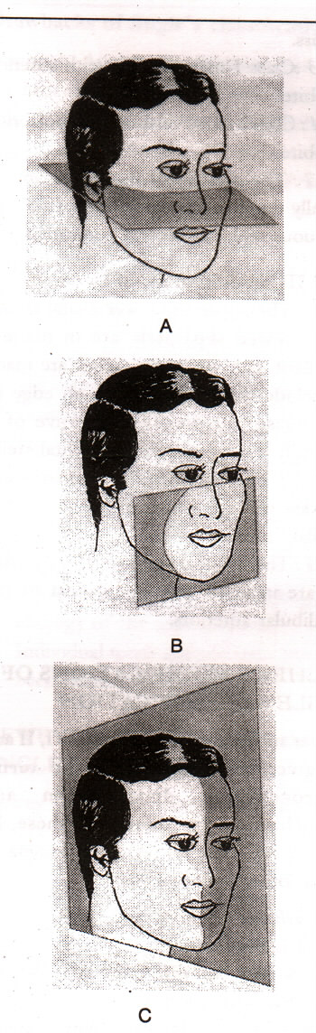
SIMON CLASSIFICATION
ATTRACTION
FRANKFORT HORIZONTAL PLANE
ABSTRACTION
PROTRACTION
ORBITAL PLANE
RETRACTION
CONTRACTION
MID SAGITAL PLANE
DISTRACTION
Notes:
FH- STRAIGHT LINE THRUGH BONY MARGIN OF ORBIT DIRECTLY UNDER PUPIL OF EYE TO UPR MARGINS OF EXTRNL AUDITORY MEATUS.
OP-IT IS DRWN PERPNDCULR TO FH AT BOTH BONY MARGIN OF ORBIT DIRECTLY UNDER PUPIL OF EYE
MSP –PASSES THRUGH MID PALATAL RAPHE AT RGHT ANGL TO FHP

Slide 61
Simon’s law of canine
According to SIMON, it tells normal position of maxillary canine
LAW OF CANINE- Orbital plane passes through distal 3rd of upper canine in class I cases
In class II cases- Orbital plane passes DISTAL to
canine
In class III cases- Orbital plane passes MESIAL to canine

Slide 62
SKELETAL CLASSIFICATION
Salzmann in 1950 was the first to classify the underlying skeletal structures.
-Malocclusion may or may not be associated with facial dysplasia.
Dental malocclusion may be present in an otherwise orthognathic face. However, normal occlusion may also be present in a face which is not orthognathic.
Facial skeletal patterns are divided into
Class 1, in which the profile is orthognathic
Class 2, where the mandible is retrognathic, and
Class 3, in which the mandible is prognathic.

Slide 63
ADVANTAGES
1 . 3 DIMENSIONAL - MORE PRECISE
2. LAYS EMPHASIS ON THE ORIENTATION OF DENTAL ARCHES TO THE FACIAL SKELETON
DISADVANTAGES
IT IS TIME CONSUMING AND CUMBERSOME

Slide 64
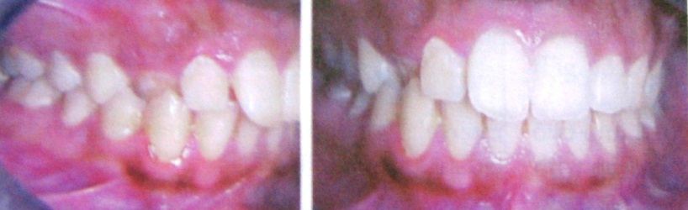

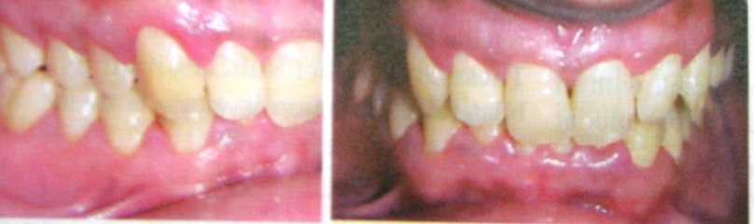

SKELETAL CLASS I
-These malocclusions were purely dental with the bones of the face and jaws being in harmony with one another and with the rest of the head.
-The maxilla is slightly ahead of the mandible.
-The profile is orthognathic
Division 1- Malposition of incisors,
canine and premolars
Division 2-Maxillary incisor protrusion
Division 3-Maxillary incisors in
linguoversion .
Division 4-Bimaxillary protrusion

Slide 65
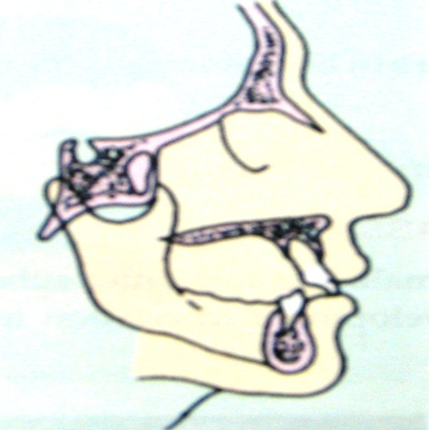
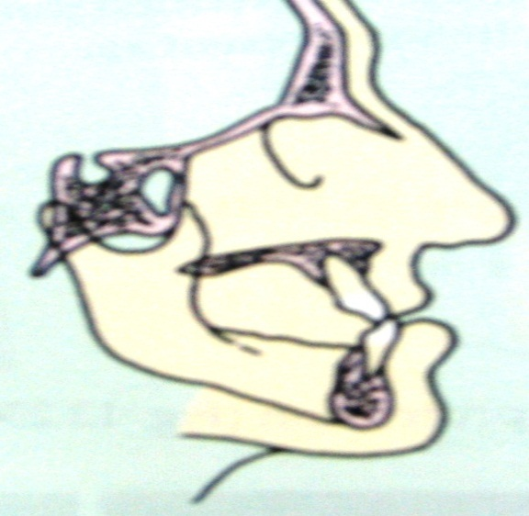
SKELETAL CLASS II
These included malocclusion with a subnormal distal mandibular development in relation to the maxilla
The skeletal class 2 was further divided -
Division 1
The maxillary dental arch is narrower with crowding in the canine region.The maxillary anterior teeth are protruded and the profile is retrognathic.
Division 2
The maxillary incisors are lingually inclined, the lateral incisors may be normal or in labio-version.
SKELETAL CLASS III
Here there is an over growth of the mandible with an obtuse mandibular angle. The profile is prognathic at the mandible .

Slide 66
-Skeletal pattern can also be classified using measurements obtained from lateral skull radiographs.
Assessment is made using the angle ANB
#ANB angle of 2 to 4° - skeletal class I pattern
# greater than 4° - class II
# less than 2° - class III
Within the class II and class III skeletal categories the severity of the discrepancy can be described further as mild, moderate and severe, adding further emphasis to the potential mechanism for treatment.

Slide 67
BALLARD’S CLASSIFICATION
-used to know the various skeletal relationship
-used more accurately at the chair side
Skeletal Class I: The inclination of the teeth is normal and the dental base relationship is also normal. The upward projections of the axis of the lower incisors would pass through the crowns of the upper incisors.
Skeletal Class II: The lower apical base it relatively too far back. The lower incisor axis would pass palatal to the upper incisor crown.
Skeletal Class III: The lower apical base is placed relatively too far forward, the projections of the lower incisor axis would pass labial to upper incisor crowns.

Slide 68
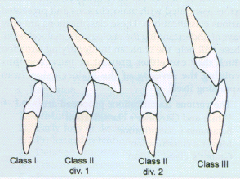
INCISOR CLASSIFICATION
-It was adopted by the British Standards' Institute in 1983
-Based on the relationship of the lower incisor edges and the cingulum plateau of the maxillary Central incisors.
CLASS I
The mandibular incisor edges occludes below the cingulum plateau of the Maxillary central incisors

Slide 69
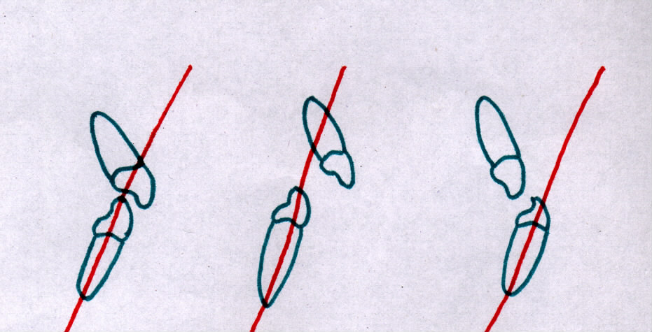
BALLARD'S CLASSIFICATION
CLASS I
CLASS II
CLASS III

Slide 70
CLASS II
The mandibular incisor edges lie posterior to the cingulum plateau of the maxillary central incisors.
Division 1 Division 2
CLASS III
The mandibular incisor edges lie anterior
to the cingulum plateau of the upper
central incisors.
The over jet is reduced or reversed

Slide 71
CANINE CLASSIFICATION
Sometimes it is not possible to assess the buccal segment relationship using the first permanent molars (e.g. if one or more have been extracted). In this case it will be necessary to describe either the premolar or canine relationship.
Maxillary canines are among the most stable of dental units because they are the longest rooted of all teeth and therefore very well anchored to the alveolar bone.
The canine is the "keystone" tooth in the dental arch, and it provides a buttressing support for the incisors, as well as the posterior teeth.
Also, canines provide a vital protective function in lateral excursive movements.

Slide 72
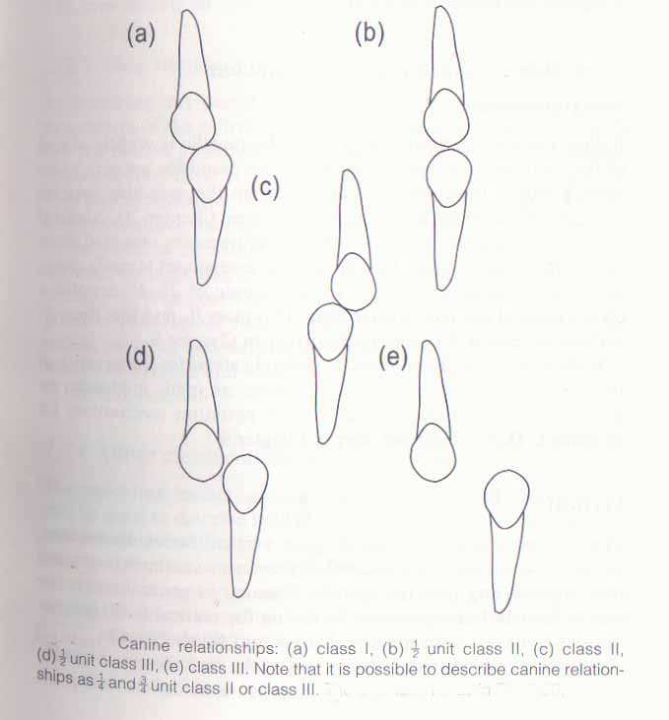
Class I canine relationship – the upper permanent canine occludes in the embrasure between the lower permanent canine and first premolar.
Class II canine relationship – the upper canine occludes a whole tooth width further anteriorly and lies in the embrasure between the lower canine and lateral incisor.
Class III canine relationship – the upper canine occlude a whole tooth width further posteriorly than normal and occludes in the embrasure between the lower first and second premolars

Slide 73
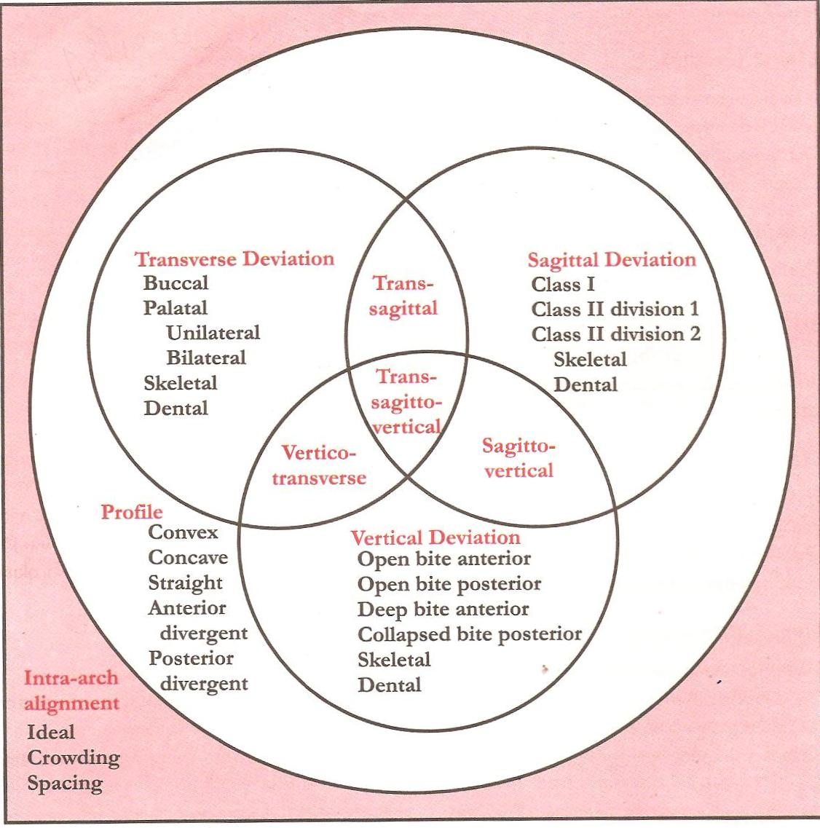
ACKERMAN-PROFITT CLASSIFICATION
3
4
6
9
7
8
2
5
1
VENN’S DIAGRAM

Slide 74
-Since the degree of alignment is common to all dentitions Group 1 is represented as the envelope or universe.
-The profile Group 2 is affected by malocclusions so it becomes a major set in the universe.
-Deviations in three planes of space lateral, antero-posterior & vertical are represented as Groups 3 to 5.
-The overlapping of groups are seen in the centre of the Venn diagram Groups 6 to 9.
-These are more severe problems with characteristic from contgiuous & enveloping groups.

Slide 75
Salient features include:
Transverse and vertical discrepancies can be considered in addition to anteroposterior malrelations.
Crowding and arch asymmetry can be evaluated.
PROFILE is taken into account.
Skeletal & dental problems are differentiated.
Readily adaptable to computer processing.
Disadvantages:
Aetiological factors not included
Functional occlusion not included.

Slide 76
ADDITIONS TO FIVE CHARACTERISTICS CLASSIFICATION SYSTEM
-Recent revision of the classification scheme has focussed on broadening it to incorporate new aspects of orthodontic diagnosis.
The most important change , however is the greater emphasis now on evaluating facial soft tissue proportions and the relationship of the dentition to the lips and cheeks , on smile as well as rest.
-Two things particularly help this more thorough analysis:
1) The esthetic line of the dentition.
2) Pitch , Roll and Yaw in systematic description.

Slide 77
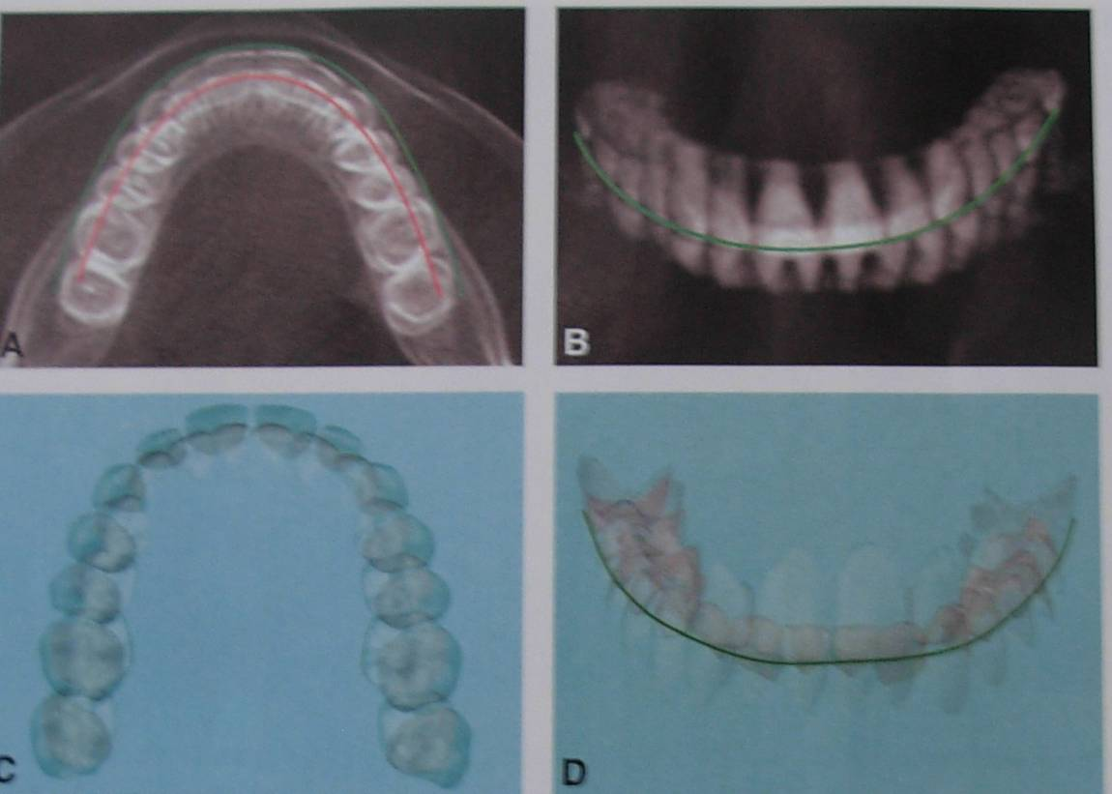
ESTHETIC LINE OF THE DENTITION
For over century , Angle’s line of occlusion has been used to characterize the positions of the teeth within the dental arch and as a reference for assessing arch form and arch symmetry.It is hidden at the time of occlusion.
-The esthetic line of the dentition follows the facial edges (cusp tips & incisal edges)of the maxillary anterior and posterior teeth.
-It characterizes the appearance of dentition and is seen when evaluating anterior tooth display.

Slide 78
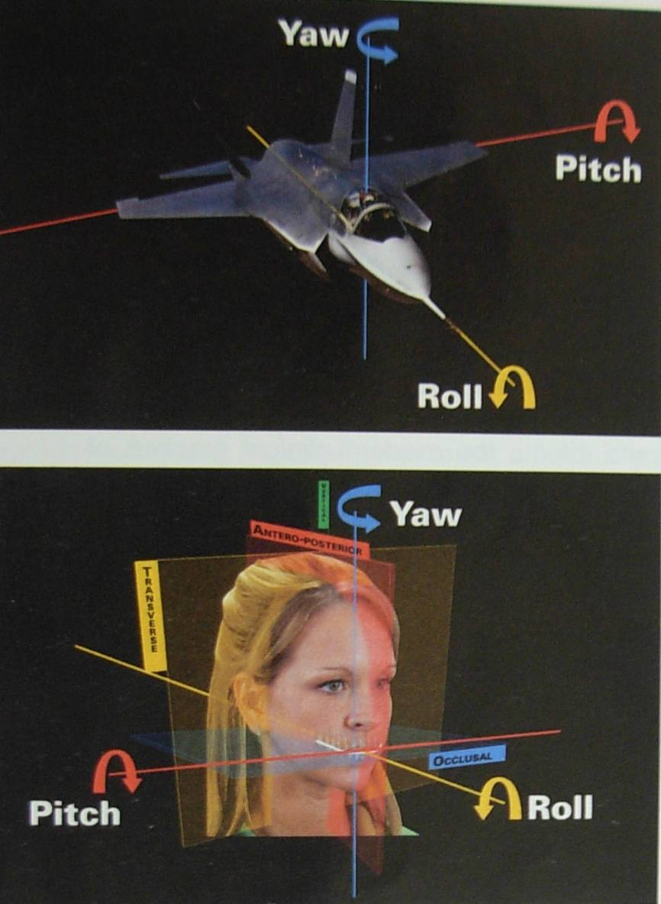
PITCH , ROLL AND YAW IN SYSTEMATIC DESCRIPTION
In addition to relationships in the transverse , antero-posterior , and vertical planes of space used in traditional 3-D analysis , rotations around these planes also must be evaluated. These rotations are-
PITCH – Viewed as up-down deviations around the antero-posterior axis.
ROLL – Viewed as up-down deviations around the transverse axis.
YAW- Viewed as left-right deviations around the vertical axis.
THE ROTATIONS SHOULD BE EVALUATED FOR THE JAWS AND FOR THE ESTHETIC LINE OF THE DENTITION.

Slide 79
WHO/FDI CLASSIFICATION
It has 5 major groups
GROUP 1 – Dentofacial abnormalities are recorded.
GROUP 2 – Has individual tooth malpositions like Anodontia , Supernumerary tooth, Malformed incisors , Ectopic tooth eruption.
GROUP 3 – Arch length problems like Spacing, Crowding , Diastema are noted.

Slide 80
GROUP 4 – Evaluation of occlusion
a) INCISAL segment- Overjet ,Deep bite Open bite ,Crossbite ,Midline shift
b) LATERAL segment- Anteroposterior relation Open bite,Posterior crossbite
GROUP 5 – Subjective judgement of orthodontic treatment
-Necessary -Doubtful
-Not necessary -Urgent

Slide 81
ETIOLOGICAL CLASSIFICATION- by moyer’’s
Based on tissues primarily involved--
OSSEOUS-Includes abnormalities in growth, size, shape or proportion of any of the bones of craniofacial complex leading to orthodontic problems
-Skeletal malocclusion
-Dentofacial deformity
2) MUSCULAR-Includes neuromuscular problems leading to malocclusion
-Sucking habits
-Tongue thrust
-Mouth breathing
DENTAL(problems in teeth & supporting structures)
-Malpositions of teeth
-Anomalies in size and shape of teeth

Slide 82
BENNET’S CLASSIFICATION
Based on etiology.
Class I - Abnormal position of one or more teeth due to local causes.
Class II - Abnormal formation of a part or whole of either arch due to developmental defects of bone.
Class III- Abnormal relationship between upper and lower arches, and between either arch and facial contour and correlated abnormal formation of either arch.

Slide 83
QUANTITATIVE CLASSIFICATION
# TPI SCORE ( Treatment Priority Index) – BY GRAINGER
- It is a valid epidemiological indicator OF MALOCCLUSION
-Patients are ranked according to severity of malocclusion.
-Criteria taken for measurement
1. upper anterior segment overjet
2.lower anterior segment overjet
3.overbite
4.anterior open bite
5.cogenital absence of incisors
6.distal molar relation
7.mesial molar relation
8 posterior cross bite
9.tooth displacements

Slide 84
TPI SCORE | CRITERIA
0 | NEAR IDEAL OCCLUSION
1-3 | MILD OCCLUSION
4-6 | MODERATE OCCLUSION
>6 | SEVERE

Slide 85
IOTN-Index of treatment needs classification- BY SHAW’S
FEATURES | GRADE 1 | GRADE 2 | GRADE 3 | GRADE 4 | GRADE 5
Contact point displacement | <1mm | 1 to 2mm | 2 to 4mm | >4mm | >4mm
OVERJET | ------- | 3.5 to 6mm Competent lips | 3.5 to 6mm Incompetent lips | 6 to 9mm | >9mm
REVERSE OVERJET | -------- | 0 to 1mm | 1 to 3.5mm | >3.5mm No speech &Masticator problems | >3.5mm speech &Masticator problems
OVERBITE | -------- | </=3.5mm | Deepbite No trauma | Deepbite with trauma | Deepbite with trauma
OPENBITE | --------- | 1 to 2mm | 2 to 4mm | >4mm | >4mm
CROSS BITE | --------- | </=1mm | 2 to 4mm | >4mm | >4mm

Slide 86
LIMITATIONS OF ALL CLASSIFICATION SYSTEM
-NO SYSTEM IS TRULY INCLUSIVE
-ALL ARE STATIC IN CONCEPT
-MOST ARE NARROW IN FOCUS
-MOST ARE TRADITIONALLY APPLIED

Slide 87
CONCLUSION
All the relevant classifications have been discussed.
The Ackerman and Profitt classification conveys the maximum information regarding the characteristics of a malocclusion, yet it is not frequently used.
The incisor classification is the simplest to use, yet not the most frequently used.
Angle's classifications with all its shortcomings, is still by far the most commonly used classification of malocclusion.

Slide 88
The dentist must be aware that the broad classes of malocclusion have etiologic, structural,functional & aesthetic implications.
There is a basic need for a system of classification of malocclusion that would be adequate for clinical, semantic and public health purpose and could be universally employed by those practicing the specialty throughout the world

Slide 89
REFERENCES
#Graber TM: Orthodontics – Principles and Practice (third edn.), WB Saunders Co.,1996
#Proffit WR: Contemporary Orthodontics (third edn.), Mosby
#Textbook of Orthodontics-Sameer Bishara
#Baets JD, Chiarini M: The pseudo-class I; a newly defined type of malocclusion, J. Clin. Orthod., February 1995
#Rinchuse DJ, Rinchuse DJ: Ambiguities of Angle’s classification, angle orthodontist, 1989 no.4, 295-298
#Katz MI: Angle classification revisited 1: Is current use reliable?, Am. J. Orthod. Dentofac. Orthop.,August 1992
#Katz MI: Angle classification revisited 2: A modified Angle classification, Am. J. Orthod. Dentofac. Orthop.,September 1992

Slide 90
#Asbell MB: A Brief History of Orthodontics, Am. J. Orthod. Dentofac. Orthop., August 1990
#Tang ELK, Wei SHY: Recording and measuring malocclusion: a review of the literature, Am. J. Orthod. Dentofac. Orthop., April 1993
#Jarvinen S: indexes for orthodontic treatment need, Am. J. Orthod. Dentofac. Orthop.,September 2001
#Ackerman JL, Proffit WR: The characteristics of malocclusion: a modern approach to classification and diagnosis, Am. J. Orthod 56:443, 1969

Slide 91
THANK YOU

