Slide 1
BACTERIA VIRULENCE FACTOR
DR. PARTH SHRMA
PG 1ST YEAR

Slide 2
contents
INTRODUCTION
BACTERIA
MORPHOLOGY
CHARACTERISTICS
VIRULENCE FACTORS
FUNCTIONS
VF OF VARIOUS PATHOGENS
CONCLUSION
REFERENCES

Slide 3
introduction
All living beings can be classified into three kingdoms: Plant, Animal, and Protista. Microorganisms are classified under the kingdom Protista.
The kingdom Protista includes unicellular organisms, such as bacteria, fungi, protozoa, and algae.
Based on the differences in cellular organization and biochemistry, the kingdom Protista has been divided into three groups: prokaryotes, eukaryotes, and the most recently described archaebacteria.
1. Prokaryotes: Bacteria and blue green algae are prokaryotes.
2. Eukaryotes: Fungi, algae other than blue green, protozoa, and slime moulds are eukaryotes.
3. Archaebacteria: These are more closely related to eukaryotes than prokaryotes. They however do not include any human pathogens.

Slide 4
Bacteria
Microscopic and very small in size.
Microns.
1 micron (m) 1/1000 millimeter (mm).
1 nanometer (nm) 1/1000 micron (m).
These organisms reproduce asexually by binary transverse fission.
Estimated that bacterial species on Earth number in the hundreds of thousands, of which only about 5500 have been discovered and described in detail.

Slide 5
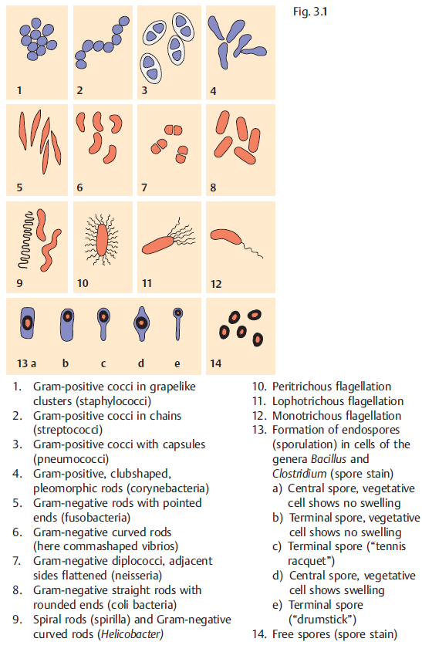
Notes:
1. Cocci: The cocci (kokkos, berry) are oval or spherical cells.
These may be arranged in pairs (e.g., pneumococci, meningococci,
and gonococci), tetrads (micrococci), chains (e.g.,
streptococci), and clusters (e.g., staphylococci).
2. Bacilli: The bacilli (bacillus, rod) are rod shaped. These bacilli
may show either of the following arrangement:
(a) Coccobacilli: Length of the bacteria is approximately the same
as its width, e.g., Brucella.
(b) Streptobacilli: These are arranged in chains, e.g., Streptobacillus.
(c) Comma shaped: They exhibit curved appearance, e.g., Vibrio.
(d) Spirilla: They exhibit rigid spiral forms, e.g., Spirillum.
3. Spirochetes: Spirochetes (spira, coil; chaite, hair) are slender,
flexuous spiral forms, e.g., Treponema.
4. Actinomycetes: Actinomycetes (actin, ray; mykes, fungus) are
branching filamentous bacteria resembling fungi. They possess
a rigid cell wall.

Slide 6
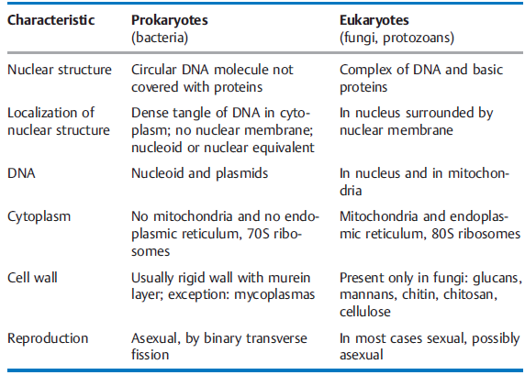

Slide 7
VIRULENCE FACTORS
The term “virulence” is generally defined as the relative ability of a organism to cause disease or to interfere with a metabolic or physiologic function of its host.
The word is derived from the Latin, ‘virulentus’ or ‘full of poison’.
virulence refers to the ability of a microbe to express pathogenicity (eg virulent), which is contrasted with nonpathogenic or avirulent organisms.
Property of invasive power [H Zinsser. 1914]
Strength of the pathogenic activity [WW Ford 1927]
Relative capacity to enter and multiply in a given host .[T.Smith. 1934]
A component of a pathogen that damages the host; can include components essential for viability including modulins. [Casadevall A, Pirofski LA 1999]

Slide 8
FUNCTIONS
The ability to induce microbe-host interactions.
The ability to invade the host.
The ability to grow in the confines of a host cell.
The ability to evade/interfere with host defenses.

Slide 9
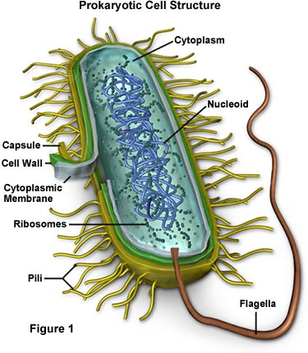
Major virulence factors –
FIMBRIAE
CAPSULE
LIPOPOLYSACCHARIDES
EXOTOXINS
ENZYMES

Slide 10
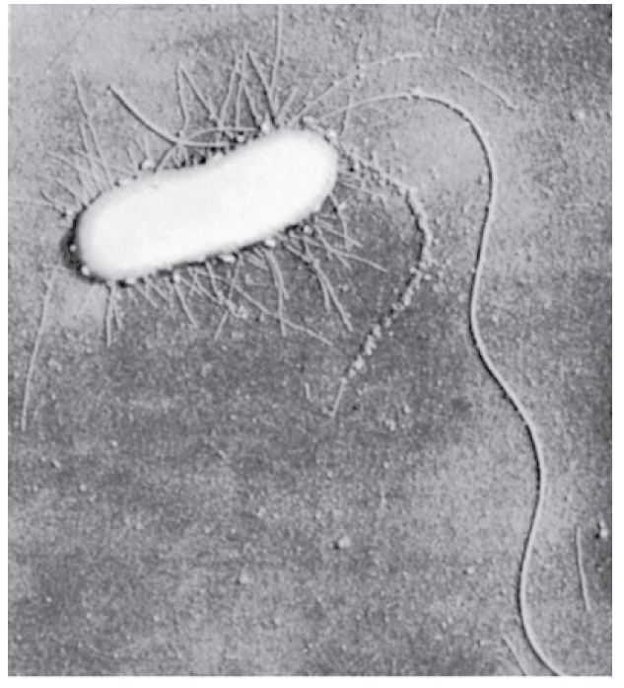
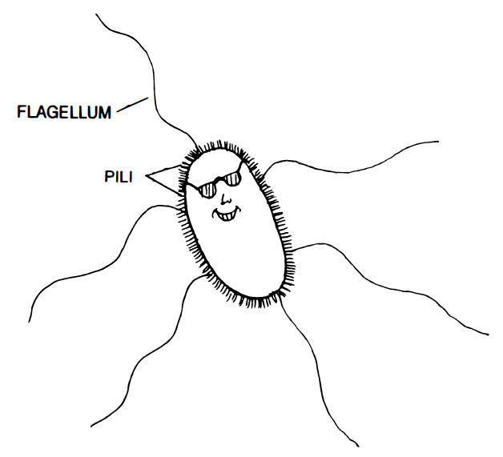
FIMBRIAE
Rigid surface appendages on bacterial surface.
Shorter and finer than flagella.
Composed of structural protein called ‘PILIN’.
Tips of theses structures are minor proteins – ADHESINS.
These possess attachment properties.

Slide 11
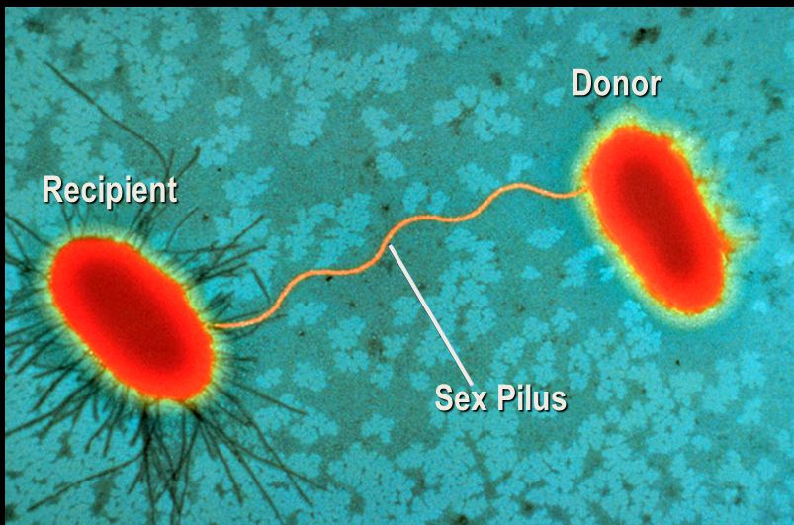
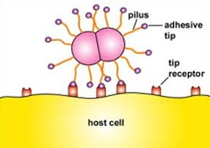
2 CLASSES –I.) Ordinary pili (adherence of symbiotic & pathogenic bacteria to host)
II.) Sex pili ( attachment of donor and recipient cells in bacterial conjugation )
Motility brought on by twitching & is widespread.
Different species produce antigenically distinct pili.
Lead to antibody formation by host.
Different species can attach in presence of these antibodies.
Strains of N. Gonorrhoeae make pili of different antigenic types ( antigenic variation) and still adhere in the presence of antibodies of original pili.
Notes:
Tips strogly adhere at a distance aways from cell surface. Pili depolymerise from in0ner end and retract inside the cell. Thus moving the entire cell forward.
Pili of different bacct. Are antigenically distinct and elicit formation of antibodies by the host. Antibodies against pili of one bacterial species wont prevet attachment of another species.
But species of pili made of other antigen types can still adhere irrespective of the antibodies pesent.

Slide 12
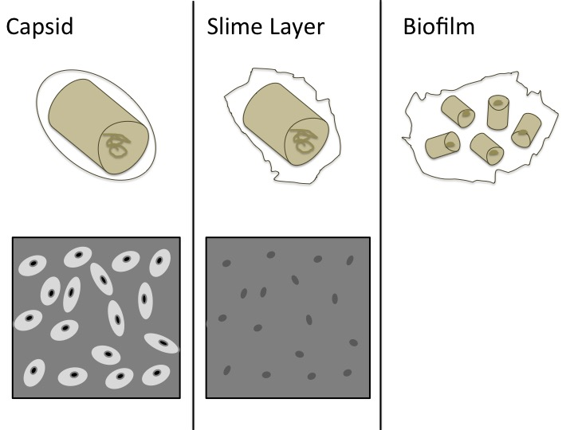
CAPSULE
Many bacteria synthesize extracellular polymer enzymes around themselves in their natural environment.
Material is exopolysaccharide ( glucans , fructans)
It’s called capsule and protects from phagocytosis.
Terms capsule & slime layer used to describe the polysaccharide layers ; more inclusive term glycocalyx is also used.
GLYCOCALYX – loosely associated polysaccharide layer not excluding particles referred as SLIME LAYER.
CAPSULE – condensed well defined layer surrounding the cell excluding particles

Slide 13
Contributes to the invasiveness of pathogenic encapsulated bacterial cells & protecting them from phagocytosis.
Glycocalyx helps in adhererence of bacteria to surfaces in their environment.
Streptococcus mutans adheres tightly to the tooth enamel via glycocalyx.
Bacteria of same or different species become entrapped in the glycocalyx forming a layer of plaque on the tooth surface. Acidic products released by the group then further cause dental caries.

Slide 14
lipopolysaccharides
Complex molecules present in the outer membrane of the Gram-negative bacteria.
As many of the periodontal pathogens are gram negative, levels of LPS are increased in the periodontal pocket.
In addition to cell-associated LPS, periodontal pathogens also release large amounts of membrane vesicles that contain LPS and will deliver these toxic components directly into the gingival tissues, which they can penetrate because of their small size

Slide 15
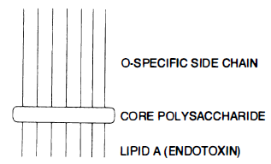
Structurally, the LPS consist of three main components –
Lipid A
The core oligosaccharide
O polysaccharide or O-antigen

Slide 16
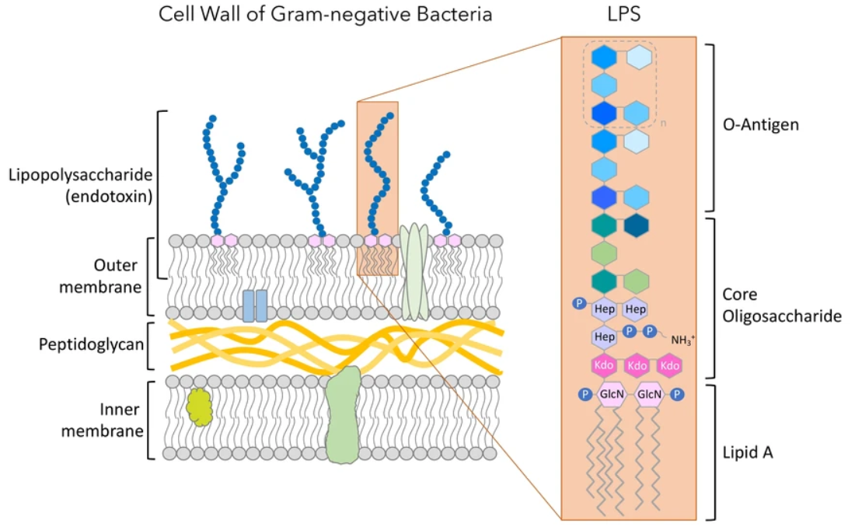
O polysaccharide or O-antigen: It is the portion extending outwards from the core.
It has several peculiar sugars and varies in composition between bacterial strains, conferring species-specific antigen specificity.
It is exposed to host– immune system.
Gram-negative bacteria may thwart host defenses by rapidly changing the nature of their O side chains to avoid detection.

Slide 17
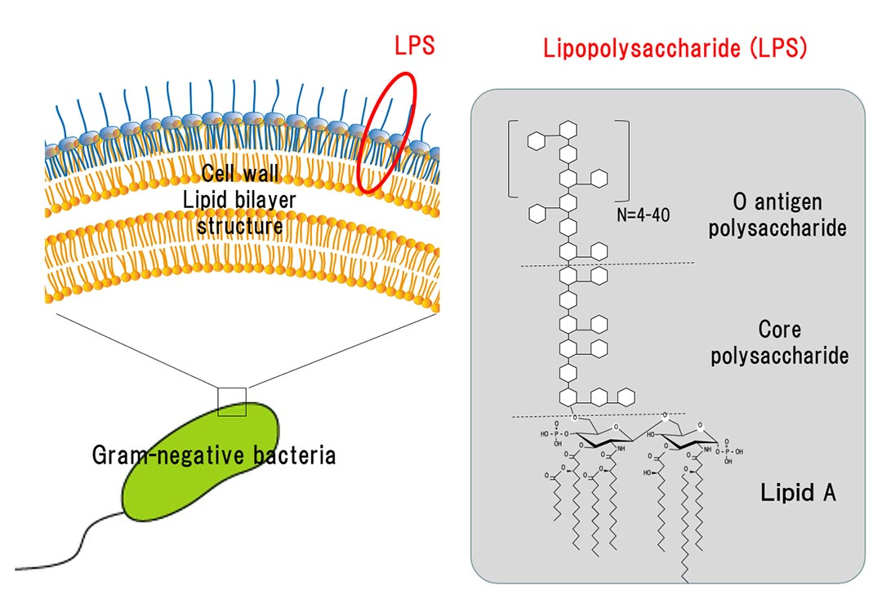
II.) Core oligosaccharide:
This is genus specific and similar in all Gram-negative bacteria.
Lipo oligosaccharides (LOS) are smaller glycolipids. They have relatively short, branched glycans present in bacteria that colonize mucosal surfaces.
LOS is an important virulence factor.
Epitopes identified on LOS which mimic host structures enabling organism to evade HIR.
Sialylation of the N-acetyllactosamine residue in vivo provides the organism with the environmental advantages of molecular mimicry of a host antigen and the biologic masking thought to be provided by sialic acids

Slide 18
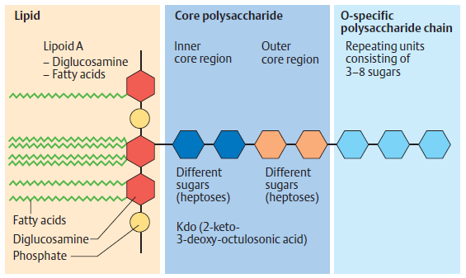
III.) LIPID A :
Interior to the core polysaccharide.
Is a disaccharide with multiple fatty acid tails reaching into the membrane.
Lipid A is toxic to humans and is known as the gram-negative endotoxin.
When bacterial cells are lysed by our efficiently working immune system, fragments of membrane containing lipid A are released into the circulation, causing fever, diarrhea.
As a free substance, or bound up in the LPS complex, it stimulates—by binding together with the LPS binding protein (LBP) to the CD14 receptor of macrophages—the formation and secretion of cytokines that determine clinical endotoxin symptomatology.
Interleukin 1 (IL-1) and tumor necrosis factor (TNF) induce an increased synthesis of prostaglandin E2 in the hypothalamus, thus setting the “thermostat” in the temperature control center higher, resulting in fever.

Slide 19
Fever.
Hypotension, shock and reduced perfusion of major organs due to vasodilatation, are brought about by bradykinin release, increased vascular permeability and decreased peripheral resistance.
Activation of the alternative pathway of the complement cascade results in inflammation and tissue damage.
Generalized activation of the coagulation system (via factor XII) leads to thrombosis and tissue ischemia.
There is increased phagocytic activity of macrophages and polyclonal B cell activation (but not T lymphocytes).
There is increased antibody production.

Slide 20
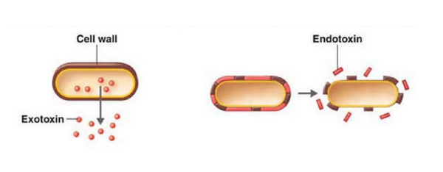
EXOTOXINS
Exotoxins are proteins that are released by both gram-positive and gram-negative bacteria.
Exotoxins are released by most of the major gram-positives.
Exotoxins in particular can cause disease in distant parts of the body as a result of diffusion or carriage of the toxin via systemic routes (e.g. tetanus bacillus infecting a lesion in the foot produces an exotoxin, which causes ‘lockjaw’ or spasm of masseter muscles on the face).
They are polypeptides & highly toxic.

Slide 21
Bacterial exotoxins can be broadly categorized as:
Neurotoxins
Enterotoxins
Miscellaneous exotoxins
NEUROTOXINS are exotoxins that act on the nerves or motor endplates to cause paralysis. Tetanus toxin and botulinum toxin.
ENTEROTOXINS are exotoxins that act on the gastrointestinal (GI ) tract to cause diarrhoea. Enterotoxins inhibit NaCl resorption, activate NaCl secretion, or kill intestinal epithelial cells. The common end result is the osmotic pull of fluid into the intestine , which causes diarrhoea. (E.Coli)
MISCELLANEOUS EXOTOXINS which are the principle virulence factors for many bacteria, can cause disease unique to the individual bacterium. C.Welchii = gas gangrene.

Slide 22
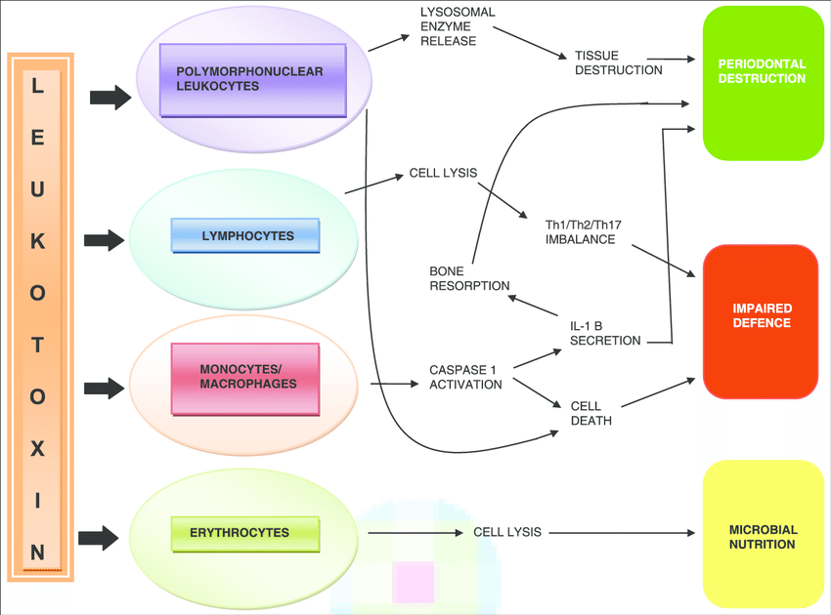
Periodontal pathogens generally do not potent exotoxins, the exception being A. actinomycetemcomitans, which produces a leukotoxin (LtxA) and a cytolethal distending toxin (Cdt).
LEUKOTOXIN = Leukotoxin (LtxA) is a member of the pore-forming cytolethal toxins.
Leukotoxin binds to leukocyte function antigen 1 (LFA-1) on the surface of monocytes, neutrophils, and a subset of lymphocytes.
The action of the toxin causes a pore to form in the host cell membrane, and cell death can result from interference with osmotic homeostasis or through an apoptotic effect.
A. actinomycetemcomitans strains that produce high levels of leukotoxin are more often associated with severe disease than minimally leukotoxic strains, and antibodies to the toxin correlate with reduced attachment loss in patients with early-onset periodontitis.

Slide 23
Cytolethal Distending Toxin
Cdt is a heterotrimer comprised of subunits CdtA, CdtB, and CdtC.
The CdtB protein is the active subunit and possesses the DNase activity.
A. actinomycetemcomitans Cdt is a DNase that induces cell cycle arrest, is followed by arrest of proliferating lymphocytes, as well as eukaryotic cell distension.
Cdt shows activity against a variety of cell types including epithelial cells, fibroblasts, and lymphocytes.
A. actinomycetemcomitans strains that possess it are more frequently isolated from patients diagnosed with localized aggressive periodontitis.

Slide 24
enzymes
Many species of bacteria produce enzymes which play an important role in the infectious process.
COLLAGENASE
C.PERFRINGES STREPTOCOCCUS PYOGENES
Degrades collagen in connective tissue; spreading infection
COAGULASE
STREPTOCOCCUS AUREUS
Formation of fibrin walls around staphylococcul lesions helping in persistence.
HYALURONIDASE
STREPTOCOCCI, STAPHYLOCOCCI
Hydrolyses hyaluronic acid in connective tissues; aids n spread
Deposition of fibrin on staphylococcus protecting it from phagocytosis.

Slide 25
IMMUNOGLOBULIN A PROTEASE (IgA Protease)
N.GONORRHOEAE, H.INFLUENZAE, S.PNEUMONIAE
Degrades protective IgA on mucosal surfaces; allows adhesion to mucous membranes.
LEUKOCIDINS
AGGREGATIBACTER ACTINOMYCETECOMITANS
Destroy both leukocytes & macrophages.

Slide 26
VIRULENCE FACTORS OF PERIODONTAL PATHOGENS
P. Gingivilis
Actinobacillus Actinomycetum Comitans
Treponema Denticola
T. Forsythia

Slide 27
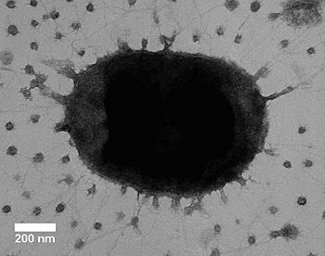
PORPHYROMONAS GINGIVALIS
A gram-negative, non-spore forming, non-motile, asaccharolytic, obligate anaerobic coccobacillus.
Capsule
Lipopolysaccharide
Fimbriae
Heat shock protein
Haemagglutinins

Slide 28
FIMBRIAE
Single-stranded filaments, 5 nm in diameter.
Important for the adhesion.
CAPSULE
Surface antigen that surrounds the
outer membrane.
Inhibits the attachment of PDL fibroblasts to the tooth root surface.
Encapsulated strains more resistant to
phagocytosis by polymorphonuclear cells.
LIPOPOLYSACCHARIDES
induces a variety of cytokines from a number of different cells.
HGF secrete Il-1β, IL-6 and IL-8
potent inducer of bone resorption by the stimulation of local Il-1α and Il-1β
composed of fimbrillin.
HAEMAGGLUTININS
A surface antigen.
Inhibit haemagglutination and binding of P. Gingivalis to epithelial cells

Slide 29
GINGIPAINS
Major virulence factor
Targeting of host
structural proteins (e.g., collagens, fi bronectin, and laminin)
Activate the kallikrein cascade and cause the release of kinins with subsequent
induction of vascular permeability, which may allow systemic dissemination
of P. gingivalis
Involves activation
of host MMPs, particularly MMP-2 (gelatinase A-type IV collagenase),
MMP-8 (neutrophil collagenase-2), and MMP-9 (gelatinase B-type
IV collagenase)
Gingipains can also degrade tissue inhibitors
of MMPs

Slide 30
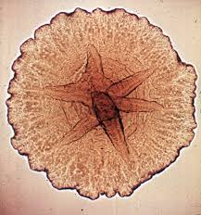
ACTINOBACILLUS ACTINOMYCETUM COMITANS
Actinomycetemcomitans is a gram-negative, non-spore forming, non-motile, capnophilic , facultative anaerobic coccobacillus.
Associated with aggressive periodontitis.
FIMBRAE
EXTRACELLULAR VESICLES
LEUKOTOXIN
LIPOPOLYSACCHARIDE

Slide 31
FIMBRIAE
5 nm in diameter and several μm in length
role in colonization
LEUKOTOXIN
immunomodulating protein antigen
pore-forming protein
Affinity for epithelial cells and saliva-coated hydroxyapatite
high concentrations, binds to cell membranes, forms large pores allowing the rapid influx of ca2+ and loss of ATP, resulting in necrosis.
LIPOPOLYSACCHARIDE
Stimulates-
1.) IL 1
2.) PGE2
3.) TNF α

Slide 32
EXTRACELLULAR VESICLES
LEUKOTOXINS
ENDOTOXINS
Factors involving bone resorption

Slide 33
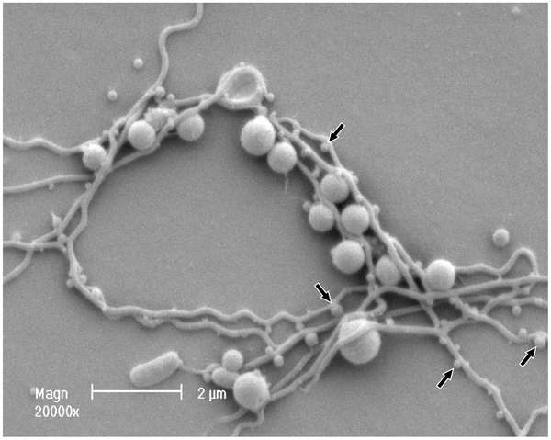
TREPONEMA DENTICOLA
Gram-negative, motile, asaccharolytic, anaerobic spirochete with typical helical morphology.
Lipopolysaccharides
Major sheath protein
Flagellum
Extracellular Proteolytic enzymes

Slide 34
FLAGELLA
Cork screw-like locomotion.
Movement in highly viscous environments like GCF and the penetration of gingival epithelial and connective tissue.
LIPOPOLYSACHRIDES
Induces nitric oxide, TNF-α and IL-1 from macrophages, in a dose dependent manner.
outer membrane is able to induce bone resorption.
MAJOR SHEATH PROTEIN
It is a major surface protein and antigen of T. Denticola.
Binds to host matrix proteins and form pores on gingiva fibroblasts, epithelial cells, lymphocytes and erythrocytes.
Three core proteins flaB1, flaB2 and flaB3 and a major sheath protein flaA (adherence).
DENTILISIN
Enzyme occurs on the cell surface.
Degrade pro-Il1β into its bioactive forms and thus stimulate the inflammatory response.
CYSTALYSIN
Putative hemolysin.
Lysis of human erythrocytes.
Induce apoptosis in epithelial cells.

Slide 35
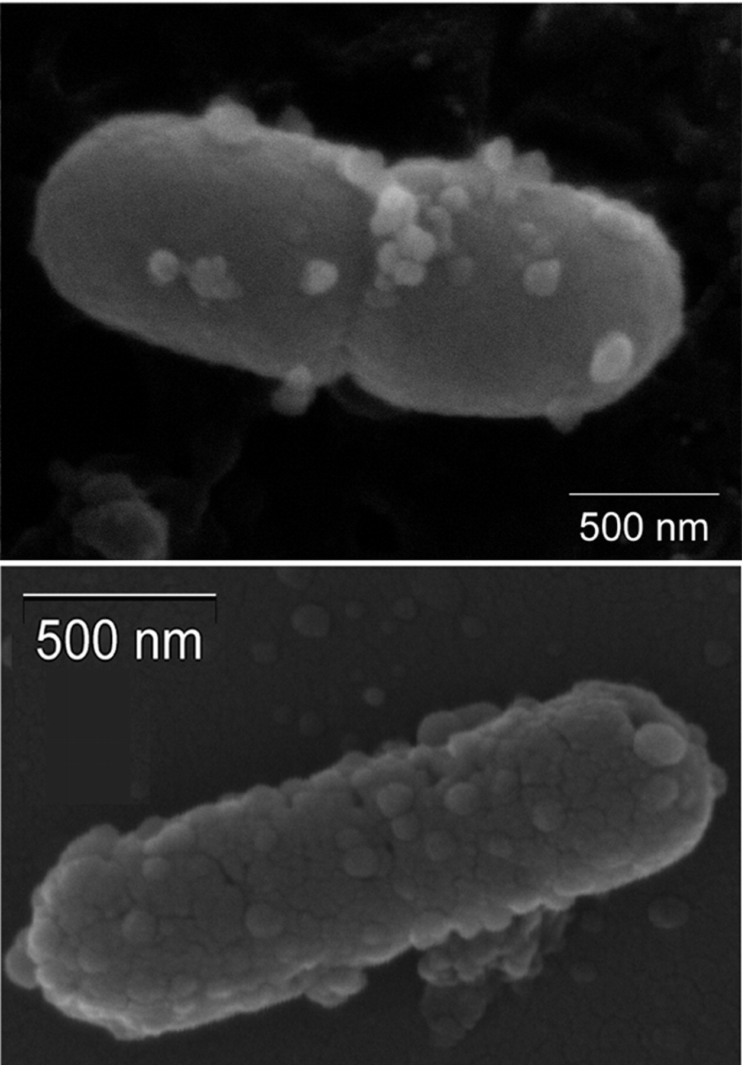
tannerella forsythia
A gram-negative, anaerobic, saccharolytic fusiform bacterium.
Lipopolysachrides
Extracellular proteolytic enzymes
Other antigenic Outer membrane proteins

Slide 36
BSPA LEUCINE-RICH PROTEIN
Epithelial cells, matrix proteins, interspecies binding; necessary for epithelial cell invasion and alveolar bone loss in mice,
PRTH PROTEASE
Cysteine endopeptidase.
Responsible for apoptosis of eukaryotic cells.
KARILYSIN
Metalloendopeptidase structurally closely related to MMPs.
Interferes with all three pathways of complement activation (classical, mannose, and alternative)

Slide 37
CONCLUSION
Mere presence of the Bacteria on the surface cannot affect an organism whose body system incorporates a varied and complex network of defence mechanisms acting as a surveillance system against any intruders set out to do more harm than good to that being.
Presence of certain factors in the bacteria are required to act as loop holes against these systems, which can not only ensure it’s survival but also alter the way ahead for it’s own benefit.
Understanding the mechanism’s of such structures could greatly help the host’s defense to rise up to the occasion of eradicating these structures exhibited by the pathogen and prevent the disease progression.

Slide 38
REFERENCES
Lange Medical Microbiology-McGraw-Hill Medical, 24th edition.
Prescott, Harley, and Klein's Microbiology, 7th Ed.
Oral Microbiology and Immunology, 2nd edition.
Essential microbiology for dentistry, 4th edition.
Clinical Periodontology and Implant Dentistry, 2 Volume Set by Niklaus P. Lang, Jan Lindhe, 6th edition.
Carranza’s Clinical Periodontology, 9th & 13th edition.

