Slide 1
Tunnel Preparation
CASE REPORT
Indian journal of oral health and research
Year : 2015 | Volume : 1 | Issue : 1 | Page : 33-36
Presented by:
Dr.Hemendra Pratap
M.D.S IIIRD YEAR
(PROMOTED )

Slide 2
CONTENT
INTRODUCTION
CASE REPORT
DISCUSSION

Slide 3
INTRODUCTION
Treatment and management of teeth with deep furcation involvement is a substantial clinical problem
Earlier, the opinions on the prognosis for treatment of furcation involved teeth were rather pessimistic, and the treatment of choice was commonly extractions.
However, the prognosis for treatment and maintenance of furcation involved teeth is now regarded more optimistically.

Slide 4
This is due to a better understanding of the significance of combined periodontal treatment of furcations and meticulous plaque control.
The currently recommended treatment modalities for deep furcation defects range scaling and root planning, occlusal adjustments, and gingivoplasty procedures to more radical approaches such as root amputation or tooth hemisection.

Slide 5
Although root amputation and tooth hemisection provide good access for plaque control, these procedures also require endodontic treatment and in some instances, a crown restoration.
These additional treatments imply potential risks for complications.

Slide 6
Tunnel preparation is another technique used to manage furcation defects especially those with "through-and-through" defects.
If the root anatomy permits it, the bi- or tri-furcations are widened by resection of bone, to give access for interradicular cleaning postsurgically.
In general, this technique does not require endodontic or restorative treatment.

Slide 7
Tunnel preparations have, however, been associated with a poor prognosis. In particular, it has been reported that the risk of root caries development is a major concern.
Commonly, this type of the resective therapy can be offered at mandibular molars, which have a short root trunk, a wide separation angle, and long divergence between the mesial and distal root.
Tunnel can be prepared on a maxillary molar also (mesio-buccal and disto-buccal).

Slide 8
CASE REPORT
A 38-year-old female patient reported with the complaint of pain of left mandibular first molar with a recurrent swelling
On examination, there was chronic periodontal abscess on the lingual side with #36 and it was sensitive to percussion
On probing the area, there was a 7-mm-deep periodontal pocket around the furcation area

Slide 9
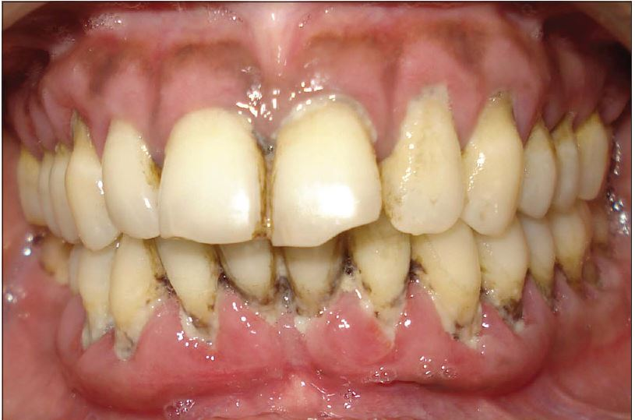
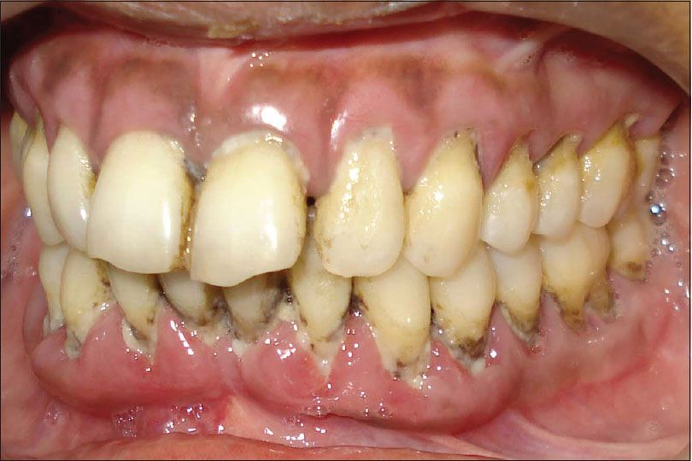
Preoperative view showing generalized chronic periodontitis
Preoperative lower left lateral view with grade III furcation involved tooth #36

Slide 10
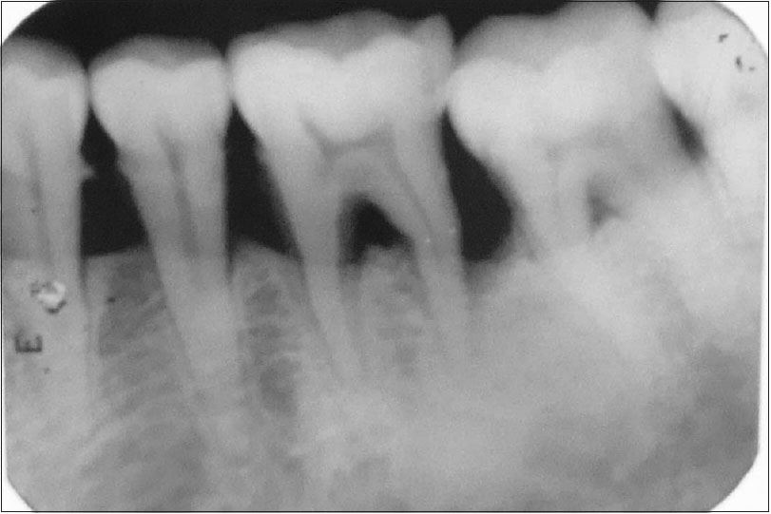
On radiographic examination, severe bone loss was evident in tooth #36 with grade III furcation involvement.
The bony support on mesial and distal side of #36 was relatively intact. No periapical lesion was investigated around each root

Slide 11
Phase I periodontal therapy completed and patient re-evaluated after 4 weeks and scheduled for surgery.
Under local anesthesia, periodontal surgery was performed.
On intra-operative examination, severe bone loss and grade III furcation involvement was evident with tooth #36.

Slide 12
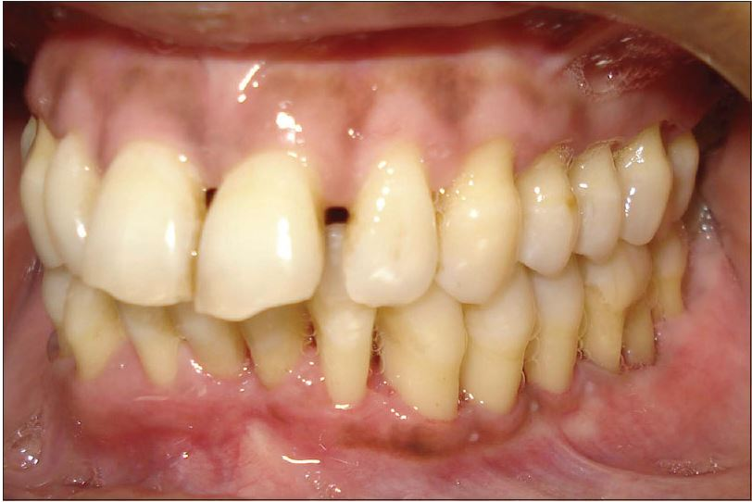
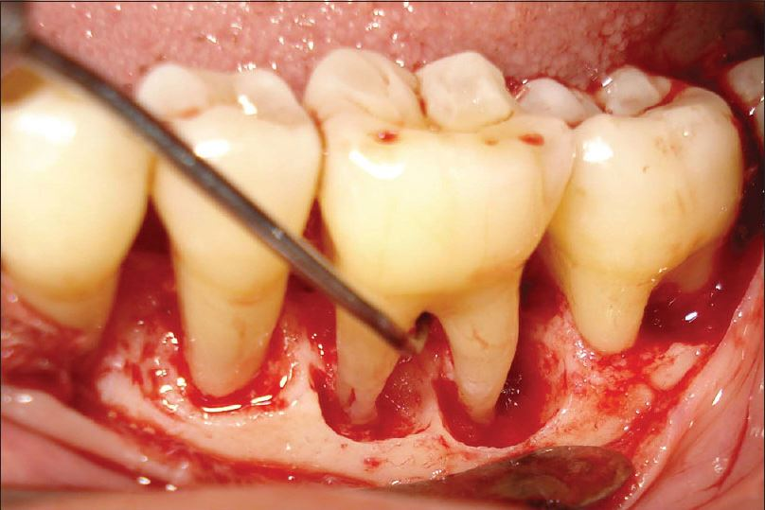
View after completion of periodontal phase I therapy
Intra-operative view showing furcal bone loss with grade III furcation involved tooth #36

Slide 13
During the surgical procedure,
The reflection of buccal and lingual flaps was done
Granulation tissue in the defect was removed and the root surfaces were scaled and planed, the furcation area was widened by round burs at the entrance and then by bone files to create space for postsurgical interradicular plaque control

Slide 14
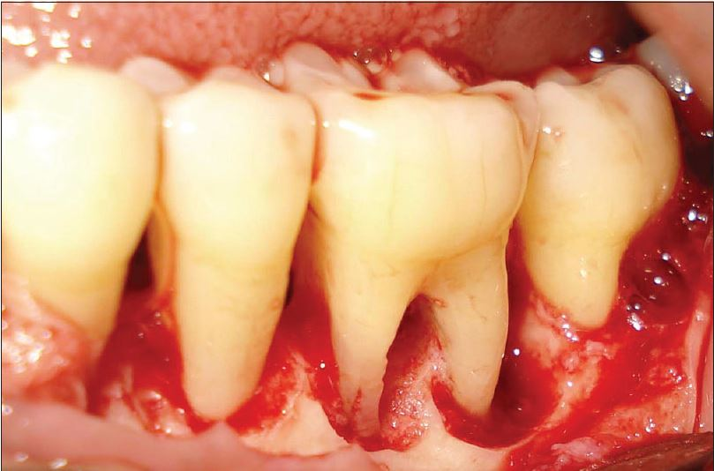
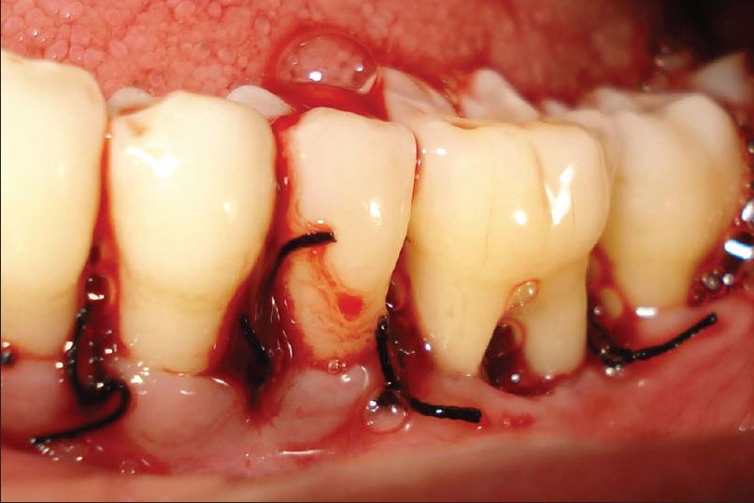
During surgery, for proper access furcation widened
Flap placed apically and sutured

Slide 15
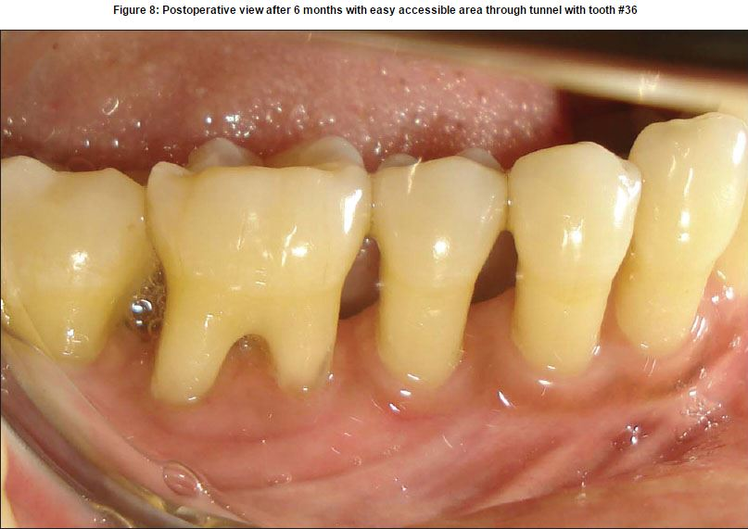
After the removal of the dressing, the patient was taught to maintain the tunnel area plaque-free with interdental brushes.
The majority of the patients followed a postsurgical schedule, which included rinsing with a 0.12% chlorhexidine digluconate solution for 4-6 weeks.
Postoperative view after 6 months with easy accessible area through tunnel with tooth #36

Slide 16
Daily rinses with 0.025% sodium fluoride solution and the use of a fluoride dentifrice applied directly by the "interradicular" brushes was also recommended, while such treated areas are more prone for caries
Patient followed regular 3-6 months maintenance visits for a period of 1-year. At this time, the patient returned to her referring dentist for continued follow-up

Slide 17
Discussion
The ultimate goal of treatment for teeth with advanced furcation involvement is to eliminate the furcation, which is main plaque retentive area in multirooted teeth and makes them more difficult to clean by the patient with mechanical plaque control measures
Alternative approach to treating an advanced Class II and Class III furcation involvement of especially a mandibular molar is called "tunnel preparation."

Slide 18
The clinician widened the furcation area by round burs at the entrance and then by bone files to create space for postsurgical interradicular plaque control with the help of interdental aids in the form of the interdental brush

Slide 19
It is important to consider the following factors before deciding to undertake any tunnel preparation procedures:
Advanced bone loss around furcation area acceptable
Level of bone around the roots
Angulations and position of the tooth in the arch.A molar that is buccally, lingually, mesially or distally titled, cannot be treated
Divergence of the roots-teeth with divergent roots is easier to prepare the tunnel.
Length and curvature of roots-long and straight roots are more favorable for tunnel preparation than short, conical roots.

Slide 20
Root resections and tooth hemisections are usually associated with time consuming and expensive endodontic and prosthodontic treatments.
The major advantage of tunnel preparation is that, in general, it does not require subsequent endodontics or fixed prosthetics.

Slide 21
Tooth extraction is the ultimate or last and radical treatment modality in periodontally compromised teeth.
The tunnel preparation procedure is preferable to extraction when other treatments are precluded for financial or other reasons.

Slide 22
This commonly necessitated a relatively radical widening of the furcation.
Secondary healing and interradicular placement of surgical dressing during the initial healing period, followed by early initiation of cleaning with interdental brushes, were useful means to solve such access difficulties.

Slide 23
THANK YOU

