Slide 1
INTERNAL CAROTID ARTERY
SURESH BABU K

Slide 2
◆ The Internal carotid artery is a terminal branch of the common carotid artery.
◆ Origin
It arises most frequently between C3 and C5 vertebral level, where the common carotid bifurcates to form the internal carotid and the external carotid artery (ECA).
◆ It has no branches outside the skulls and passes straight up in the carotid sheath, beside the pharynx to the carotid canal in the base of the skull.
Supply:
There are two sources responsible for feeding the brain with its much needed arterial blood called anterior and posterior circulations. The internal carotid arteries are part of the anterior circulation, which is responsible for supplying the forebrain.

Slide 3
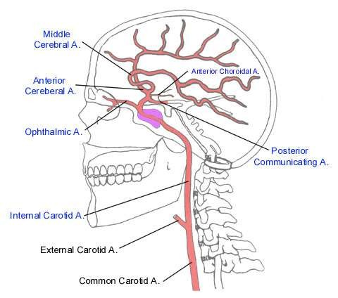

Slide 4
◆ Segments Of Internal Carotid Artery
◆ There are seven segments in the Bouthillier classification: Their classification system is used clinically by neurosurgeons, neuroradiologists and neurologists and relies on the angiographic appearance of the vessel and histological comparison rather than on the embryonic development.
◆ cervical segment (C1)
◆ petrous (horizontal) segment (C2)
◆ lacerum segment (C3)
◆ cavernous segment (C4)
◆ clinoid segment (C5)
◆ ophthalmic (supraclinoid) segment (C6)
◆ communicating (terminal) segment (C7)

Slide 5
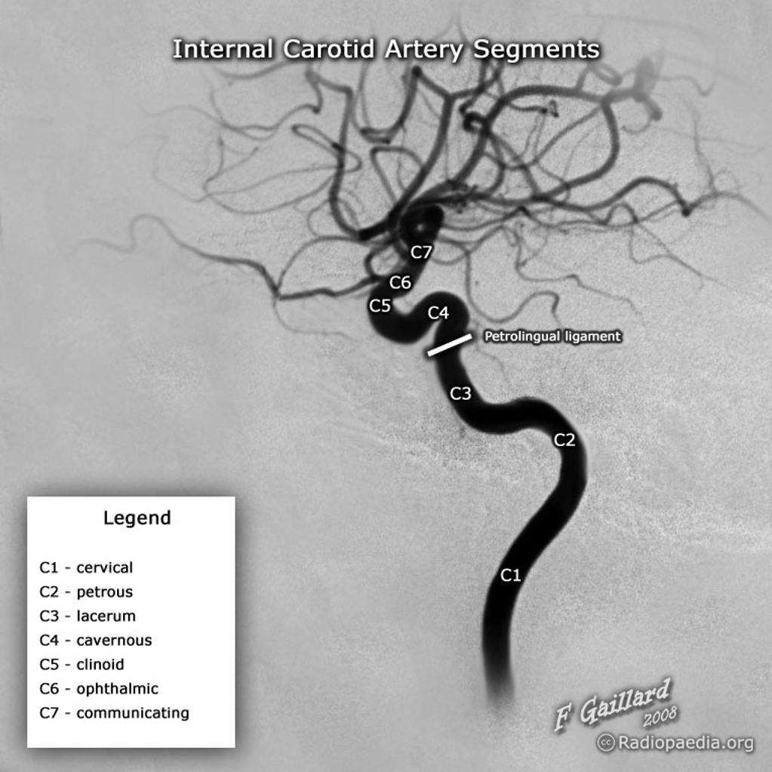

Slide 6
◆ Branches
◆ Except for the terminal segment (C7) the odd numbered segments usually have no branches, whereas the even numbered segments (C2, C4, C6) each have branches.
C1: cervical segment
Extends from the bifurcation of the common carotid to carotid canal located anterior to the jugular foramen
Superiorly the internal jugular vein, and vagus nerve lie laterally, medially is the pharynx .
At the base of the skull the glossopharyngeal, vagus, accessory and hypoglossal nerves lie between the internal carotid artery and the internal jugular vein .
No branches

Slide 7
C2: petrous segment
From carotid canal to foramen lacerum within the petrous temporal bone
Separate from middle ear by a thin plate
Surrounded by extensive sympathetic plexus
◆ This segment extends until the foramen lacerum.
◆ an ascending, or vertical portion; the genu, or bend; and the horizontal portion.
Branches
  Vidian artery - anastomoses with external carotid artery (ECA)
  Caroticotympanic artery (supplies middle ear)

Slide 8
C3: lacerum segment
Small segment that extends from petrous apex above foramen lacerum, curving upwards toward cavernous sinus
Turns 90% superiorly following extra dural course.
Covered by trigeminal ganglion
No branches

Slide 9
◆ C4: Cavernous segment
◆ Pass from the petrous apex to the dural ring of the anterior clinioid process surrounded by cavernous sinus .
◆ Major branches :
◆ Meningohypophyseal trunk (include the tentorial basal branch, the tentorial marginal branch, the meningeal branch, the clivus branches and the inferior hypophyseal artery)
◆ Inferolateral trunk (The capsular branches also come from the fourth segment as do the branches from the inferolateral trunk, namely the branches that supply the trigeminal ganglion, the artery of the foramen rotundum and branches that run with certain nerves.)

Slide 10
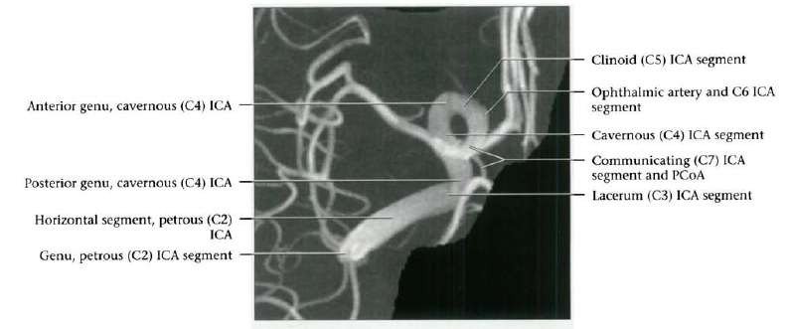

Slide 11
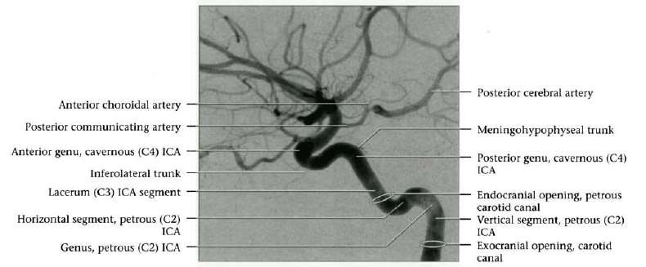

Slide 12
C5: Clinoid segment
Between proximal, distal dural rings of cavernous sinus
Ends as ICA enters subarachnoid space near anterior clinoid process
No important branches unless ophthalmic artery arises within clinoid segment.

Slide 14
◆ C6: Ophthalmic segment
◆ Extends from distal dural ring at superior clinoid to just below posterior communicating artery (PCoA) origin
◆ Two important branches
◆ the ophthalmic artery
◆ the superior hypophyseal artery
The superior hypophyseal artery is an artery supplying the pars tuberalis, the infundibulum of the pituitary gland, and the median eminence

Slide 15
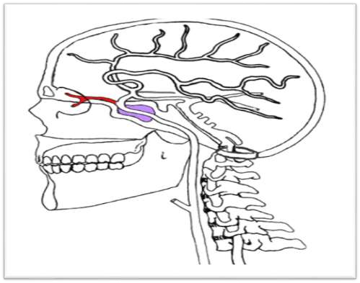
Ophthalmic artery
Origin:-
branch of internal carotid artery as it leaves cavernous sinus

Slide 16
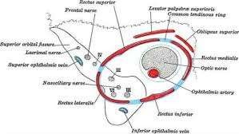
course and relation
passes forward through optic canal , inferolateral to optic nerve
In the orbit it crosses above optic nerve obliquely from lateral to medial accompanied by nasocilliary nerve
runs in the medial wall of the orbit

Slide 17
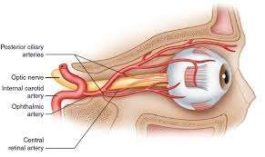
termination
ends at the upper eyelid by dividing into supratrochlear and dorsal nasal arteries

Slide 18
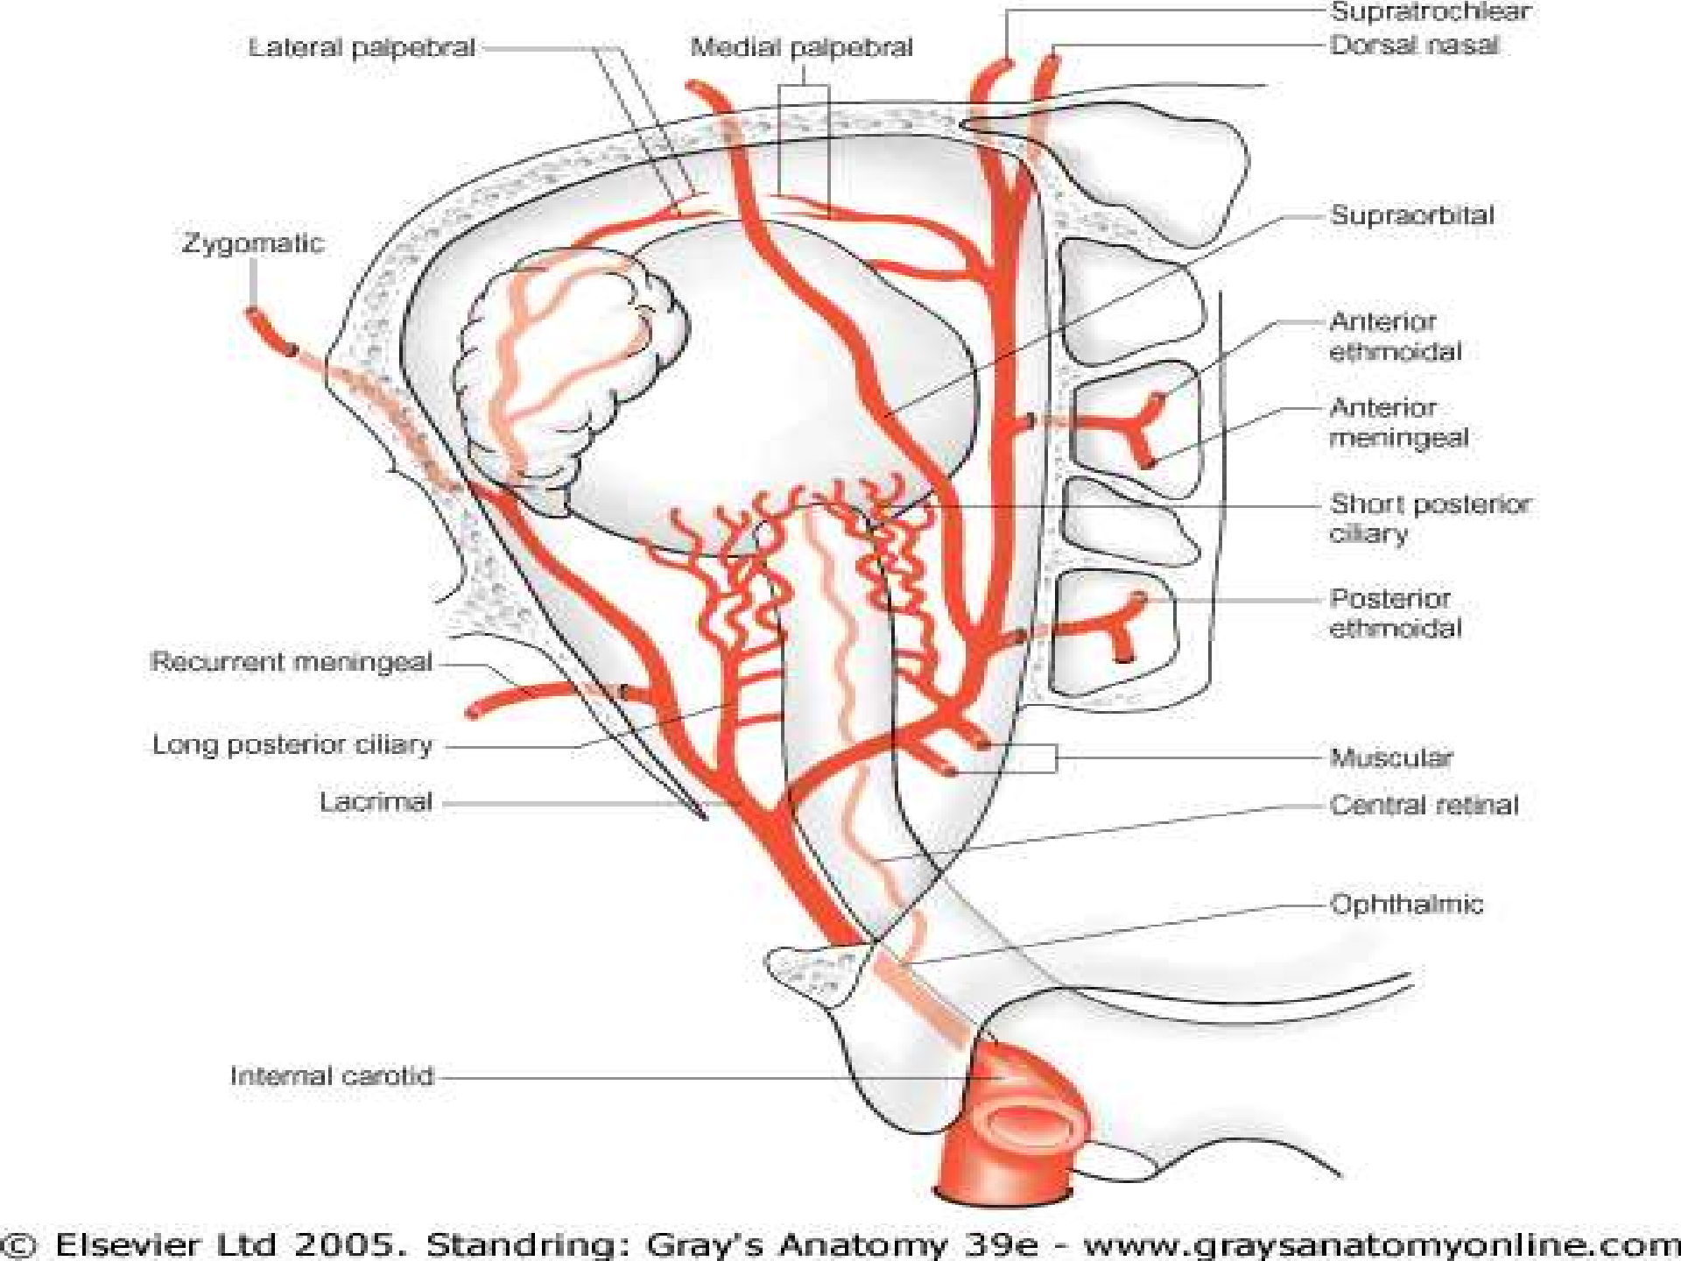

Slide 19
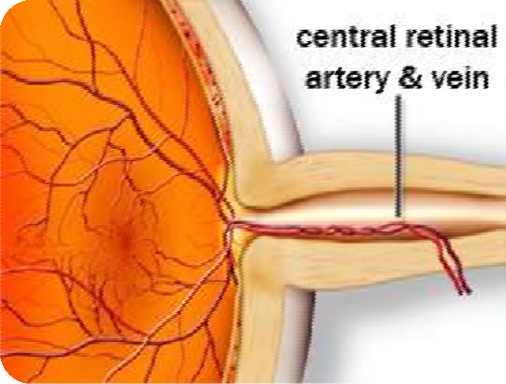

Branches
1-central artery of the retina
- arise in the optic canal
-pierce the nerve inferomedially 1 cm behind and run within its substance.
-divides into superior and inferior branches each one divide into temporal and nasal branches

Slide 20
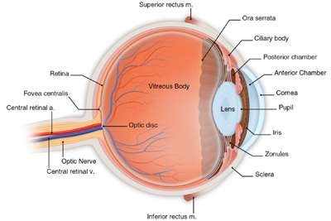
- It is an end artery i.e. it’s occlusion leads to complete blindness
-only artery can be seen by naked eye during funds examination

Slide 21
Branches
2-lacrimal artery
Runs forward along upper border of lateral rectus to reach lacrimal gland
-acompanied by lacrimal nerve
-gives off :-
-supirior and inferior lateral palpebral
-zygomatic branches
-muscular branches
-Recurrent meningeal branches

Slide 22
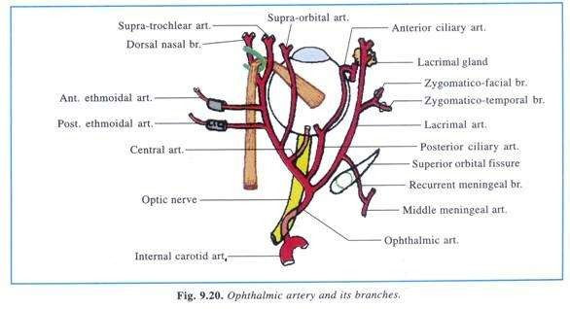

Slide 23
branches
3-supraorbital
-arise where the ophthalmic artery crosses the optic nerve
-runs with corresponding nerves above levator balpebrea supirioris
-leaves the orbit through supraorbital foramen to supply forehead and scalp

Slide 24
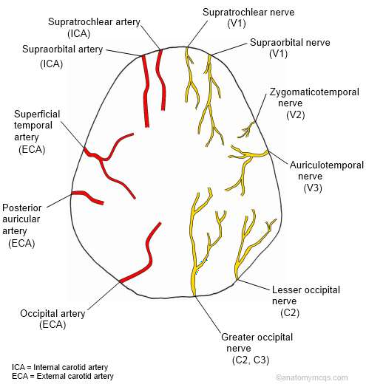

Slide 25
branches
4-ciliary arteies
They are divided into three groups
Long posterior cilliary | Short posterior cilliary | Anterior cilliary
2 branches pierce the sclera on either side if optic nerve They form circulus arteriosus major which supply the iris | 7branches pierce the sclera around the optic Nerve Supply choroid and cilliary process | Pierce the anterior part of sclera near the limbus Terminate in circulus arteriosus major

Slide 26
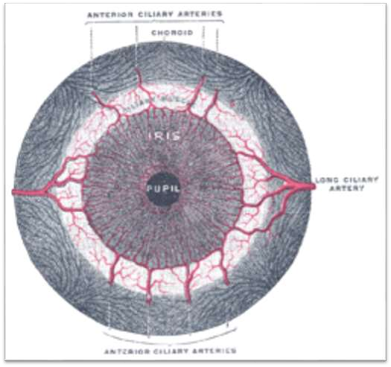

Slide 27
Branches
5-ethmoidal branches
Anterior ethmoidal
-Enter through anterior ethmoidal canal to reach anterior cranial fossa
-gives :-
-meningeal to durra
-nasal mucosa
-anterior, middle ethmoidal air sinus
Posterior ethmoidal
Passes through posterior ethmoidal canal
- gives branches to:-
- meningeal to durra
- nasal mucosa
-posterior ethmoidal air sinus

Slide 28
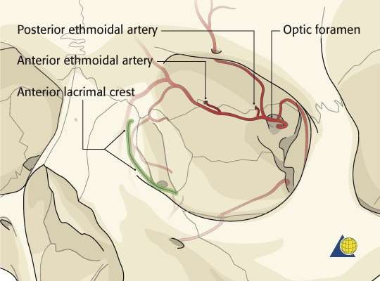

Slide 29
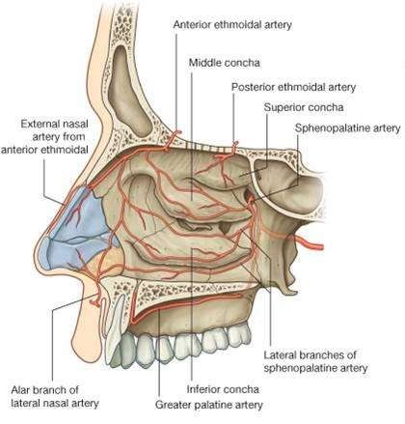

Slide 30
branches
meningeal branch
passes backward to enter middle cranial fossa though superior orbital fissure
musular branches
Accompany nerves to extraocular muscles
medial palpebral branch
Superior and inferior branches to medial part of both eyelid

Slide 31
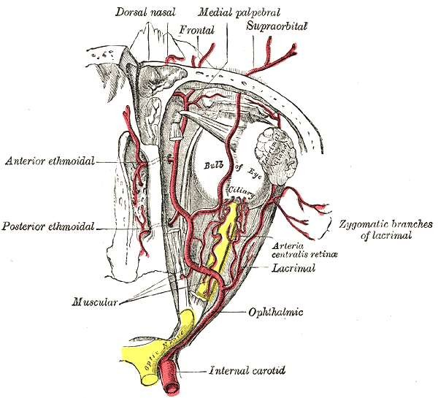

Slide 32
Branches
two terminal branches
9-dorsal nasal
-leaves the orbit below the trochlea to supply dorsum of the nose
-Anastomose with angular of facial
10-supratrochlear
Leave the orbit above the trochlea to supply the forehead and scalp

Slide 33
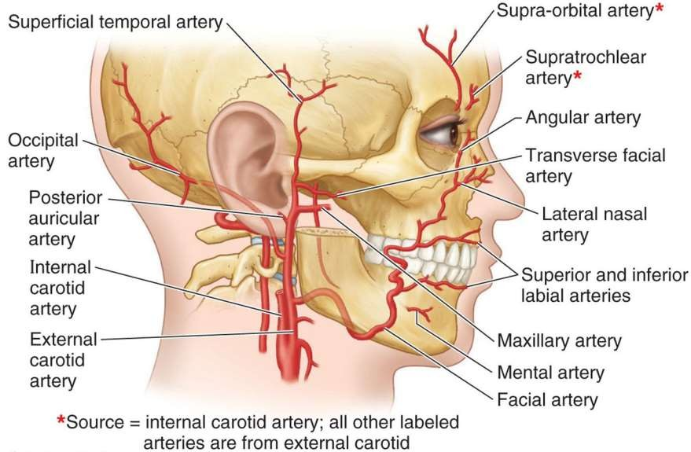

Slide 34
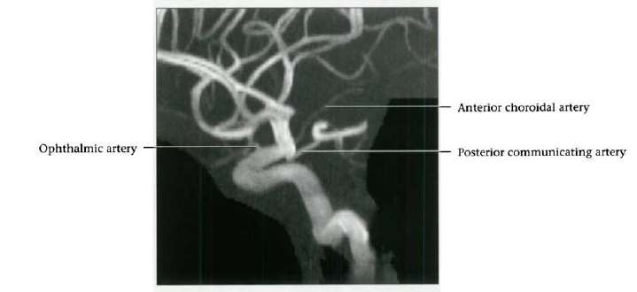

Slide 35
C7: Communicating segment
Extends from below PCoA to terminal ICA bifurcation into anterior cerebral artery (ACA), middle cerebral artery (MCA)
Passes between optic (CN2), oculomotor (CN3) nerves
Major branches
  Posterior communicating artery
  Anterior choroidal artery
Anterior and middle cerebral artery.

Slide 36
POSTERIOR COMMUNICATING ARTERY
In human anatomy, the left and right posterior communicating arteries are arteries at the base of the brain that form part of the circle of Willis.
Each posterior communicating artery connects the three cerebral arteries of the same side. Anteriorly, it connects to the internal carotid artery (ICA) prior to the terminal bifurcation of the ICA into the anterior cerebral artery and middle cerebral artery.
Posteriorly, it communicates with the posterior cerebral artery.

Slide 37
ANTERIOR CHOROIDAL ARTERY
The anterior choroidal artery originates from the internal carotid artery. However, it may (rarely) arise from the middle cerebral artery.
The full extent of the damage caused by occlusion of the anterior choroidal artery is not known. However, studies show that the interruption of blood flow from this vessel can result in hemiplegia on the contralateral (opposite) side of the body, contralateral hemi-hypoesthesia, and homonymous hemianopsia.

Slide 38
ANTERIOR AND MIDDLE CEREBRAL ARTERIES
The anterior cerebral artery (ACA) is one of a pair of arteries on the brain that supplies oxygenated blood to most midline portions of the frontal lobes and superior medial parietal lobes. The two anterior cerebral arteries arise from the internal carotid artery and are part of the circle of Willis. The left and right anterior cerebral arteries are connected by the anterior communicating artery.
The middle cerebral artery (MCA) is one of the three major paired arteries that supply blood to the cerebrum. The MCA arises from the internal carotid and continues into the lateral sulcus where it then branches and projects to many parts of the lateral cerebral cortex. It also supplies blood to the anterior temporal lobes and the insular cortices.

Slide 39
◆ Branches
◆ C1: cervical segment, none
◆ C2: petrous (horizontal) segment
◆ caroticotympanic artery
vidian artery
◆ C3: lacerum segment, none
◆ C4: cavernous segment
◆ meningohypophyseal trunk
◆ inferolateral trunk
◆ C5: clinoid segment, none

Slide 40
◆ C6: ophthalmic (supraclinoid) segment
ophthalmic artery
superior hypophyseal artery
◆ C7: communicating segment
◆ posterior communicating artery
◆ anterior choroidal artery
◆ anterior cerebral artery
◆ middle cerebral artery

