Slide 1
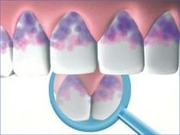
DISCLOSING AGENTS
PRESENTED BY
- BHARTI II YR

Slide 2
CONTENTS
INTRODUCTION.
HISTORY.
DEFINITION OF DISCLOSING AGENT.
MECHANISM OF ACTION
UTILITY
IDEAL PROPERTIES
TYPES OF DISCLOSING AGENTS
FORMULAE OF DISCLOSING AGENTS
METHOD OF APPLICATION
RECENT ADVANCES
TECHNICAL HINTS
CONCLUSION
REFERENCES

Slide 3
INTRODUCTION

Slide 4
HISTORY
SCIENTISTS
Skinner
Berwick
Easlick
Raybin
Amim
Lang
Block

Slide 5
Definition
According to Wilkins (1959) - A disclosing agent is a selective dye in solution, tablet, or lozenge form used to visualize and identify dental biofilm on the surfaces of the teeth.
According to Raybin (1943) - Disclosing agent is a solution which when applied on the tooth, makes visible by staining roughness and foreign matter on the tooth. (Foreign matter is meant to include mucinous plaque, calculus and material surfaces).

Slide 6
A disclosing agent is a material, usually some form of dye in liquid or tablet form that is applied to teeth to stains plaque on the surfaces of teeth. Mosby’s Dental dictionary. 2nd edition
Disclosing agents are solutions or wafers capable of staining bacterial deposits on the surfaces of teeth, tongue, and gingiva.

Slide 7
MECHANISM OF ACTION
Disclosing solutions work by changing the colour of dental plaque so that it contrasts with the white tooth surface.
The polarity difference between the components of the plaque and the dyes. The particles are bound to the surface by electrostatic interaction (proteins) and hydrogen bonds (polysaccharides).

Slide 8
Differential staining phenomenon of the two-tone disclosing agent.
Dependent upon the thickness of the plaque and not associated with the type of bacterial flora or other biochemical factors.
Metachromasia of dental plaque stained with Two-tone disclosing agent was a result of a diffusion phenomenon in which one component diffuses more readily than another from plaque, rather than from any chemical changes that might occur in vivo.

Slide 9
UTILITY OF DISCLOSING AGENT
Diagnosing the dental plaque.
Personalized patient instruction and motivation.
Self- evaluation by the patient.
To evaluate the effectiveness of oral hygiene maintenance.
Preparation of plaque indices.

Slide 10
Ideal Properties

Slide 11
TYPES OF DISCLOSING AGENTS
A. Iodine Preparations.
1. Skinner’s iodine solution
2. Diluted tincture of iodine
B. Mercurochrome Preparations.
1. Mercurochrome solution 50%
2. Flavoured mercurochrome disclosing solution
C. Bismark Brown
D. Merbromin
E. Erythrosine (FD & C Red No. 3/ No. 28)
F. Fast Green (FD & C Green No. 3)
G. Fluorescein (used with ultraviolet light source to make the agent visible)
H. Two Tone Solutions (FD & C Blue No. 1, FD & C Red No. 3)
I. Basic Fuchsin
J. Crystal Violet

Slide 12
Iodine preparations
SKINNER’S IODINE SOLUTION
Iodine crystals – 3.3%
Potassium iodide – 16%
Zinc iodide -10%
Distilled water – 16%
Diluted tincture of iodine
Tincture of iodine – 21%
Distilled water – 15%

Slide 13
Mercurochrome preparations
Mercurochrome solution – 5%
Mercurochrome – 1.5%
Distilled water – 30%
Flavoured Mercurochrome solution
Mercurochrome – 13.5 gm
Distilled water – 3 ml
Oil of peppermint – 3 drops

Slide 14
Bismark Brown (Easlick’s disclosing solution)
Bismark brown 3 gm
Glycerin 120 ml
Ethyl alcohol 10 ml
Anise (flavor) 1 drop

Slide 15
Merbromin
Merbromin NF – 450 mg
Oil of Peppermint – 1 drop
Distilled water – 100 ml

Slide 16
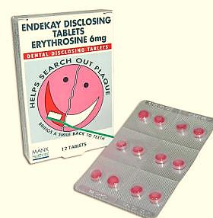
Erythrosin
Rinsing
F.D & C. Red No. 3 or No. 28 – 6 gm
Alcohol - 10 ml
Distilled water - 100 ml
Peppermint Oil - 2 drops
BASED ON PURPOSE
By Rinsing
For Direct topical application
Tablet or Wafers
Direct topical application
Erythrosine – 0.8 gm
Alcohol - 10 ml
Distilled water - 100 ml
Peppermint Oil - 2 drops
Tablet or Wafers
F.D & C. Red No. 3 – 15 gm
Sodium chloride – 0.747%
Sodium sucaryl – 0.747%
Calcium stearate – 0.995%
White oil – 1.124%
Flavoring agent – 2.239%

Slide 17
FAST GREEN
F. D. & C. Green No. 3 – 5%
FLUOROSCEIN
F.D. & C. Yellow No. 8.
Used with special ultraviolet light source to make the agents visible.

Slide 18
Introducing 2 drops of Fluorescein – based solution in patient’s mouth
Patient is asked to swish
Affinity for plaque by the indicator fluid
The light makes it visible as a greenish yellow glow.
PLAK – LITE:
John Forrest 1981 →
The apparatus consists of
a small mains operated lamp
gives off white light
through a dichrotic filter

Slide 19
Following application of the Plak-Lite® solution, the fluorescence remained unchanged for 20 minutes following which it began to fade, and after 2 hours, the fluorescence was completely absent.
The Plak-Lite® system consists of a fluorescent disclosing agent and a light source to make the agent visible. The solution has a light absorbency which lies within the frequencies of 2000-5400 A. The highest peak is at 4800 A and two lower peaks appear at 3250 A and 2900 A.
The Plak-Lite® lamp transmits light in the frequency range 4200-5600 A.

Slide 20
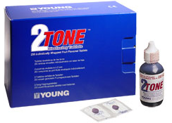
Two Tone solution
F. D. & C. Green No. 3
F. D. & C. Red No.3
Thicker (older) plaque stains Blue.
Thinner (newer) plaque stains Red.

Slide 21
The central blue-staining mass would show a bacterial population and degree of organization that would be typical of old plaque, while the red peripheral zone would show the characteristics of newly formed plaque.
The red staining may have been due to the uptake of dye by the structureless cuticle or mucoprotein layer which forms on the enamel surface prior to plaque formation.

Slide 22
Basic Fuchsin
Basic Fuchsin - 6 gm
Ethyl alcohol 100 ml - 95 %
Used by adding 2 drops to distilled water in a dappen dish.

Slide 23
METHODS OF APPLICATION
Solution for direct application:
Retracting the cheeks and tongue.
Air drying the teeth.
Carrying the solution in cotton pellet or swabs and applying it on the crowns of teeth.
The patient is directed to spread the solution over all surfaces of teeth.
The distribution is examined and patient is instructed to rinse off.

Slide 24
Rinsing
Few drops of concentrated preparation
Water is added to dilution
Swish and rinse for 1 minute
Examining all the tooth surfaces.

Slide 25
Tablets or Wafers

Slide 26
GC Tri Plaque ID Gel

Slide 27
COMPOSITION :
Glycerol – 10 – 20%
Sucrose – 5 – 10%
Ethyl alcohol – 1 – 5%
Sodium carboxyl methyl cellulose – 1 – 5%

Slide 29
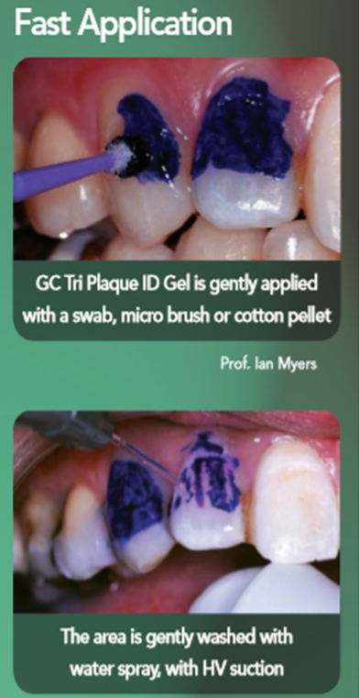

Slide 30
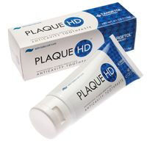

Slide 31
COMPOSITION

Slide 32
TECHNICAL HINTS
Avoid using disclosing or antiseptic solutions on teeth that have tooth-color restorations because these materials may be stained by coloring agents.
Do not apply a disclosing agent before a sealant is to be placed.
Purchase solutions in small quantities. Do not keep solutions containing alcohol longer than 2 or 3 months because the alcohol will evaporate and render the solution too highly concentrated.

Slide 33
Use small bottles with dropper caps for solutions. Transfer solution to a dapen dish for use. Do not contaminate the solution by dipping cotton pliers with pellet directly into the container bottle.
Request local druggist to stock disclosing tablets for patients to purchase. Advice patients of the stores where the agents may be purchased.

Slide 34
REFERENCES
Carranza’s clinical peridontology – 9th edition.
Lang et al.,1972. A fluorescent plaque disclosing agent. J. periodont Res.7: 59-67.
Cohen et al 1972. A Comparison of Bacterial Plaque Disclosants in Periodontal Disease. J Periodonol.43[6]: 333-338.
Chetrus and Ion 2013. Dental Plaque – classification, formation, and identification. International Journal of Medical Dentistry.3[2]:139-143.
Dumitrescu AL. Etiology and Pathogenesis of Periodontal disease: Springer – Verlag Berlin Heidelberg, 2010.

