Slide 1
JUNCTIONAL EPITHELIUM
Notes:
KARTHIK

Slide 2
CONTENTS
INTRODUCTION.
HISTORY-STUDIES RELATED TO JUNCTIONAL EPITHELIUM.
DEVELOPMENT OF JUNCTIONAL EPITHELIUM.
ATTACHMENT CONCEPTS.
STRUCTURAL, ULTRASTRUCTURAL OF JUNCTIONAL EPITHELIUM.
HISTOLOGY OF JUNCTIONAL EPITHELIUM.
DYNAMICS OF JUNCTIONAL EPITHELIUM.
VARIOUS FUNCTIONS OF JUNCTIONAL EPITHELIUM-STRUCTURES AND MOLECULES RELATED TO IT.
APPLIED ASPECT.
CONCLUSION.

Slide 3
INTRODUCTION

Slide 4
INTRODUCTION
DEFENITION- JUNCTINAL EPITHELIUM IS THE NON KERATINISED STRATIFIED SQUAMOUS EPITHELIUM WHICH ATTACHES AND FORM A COLLAR AROUND THE CERVICAL PORTION OF THE TOOTH THAT FOLLOWS CEJ.

Slide 5
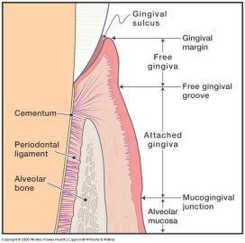
INTRODUCTION
THE GINGIVA IS DIVIDED ANATOMICALLY INTO MARGINAL, ATTACHED AND INTERDENTAL AREAS. THE TISSUES THAT MAKE UP FREE MARGINAL GINGIVA INCLUDES
THE ORAL GINGIVAL EPITHELIUM CORONAL TO GINGIVAL GROOVE.
ORAL SULCULAR EPITHELIUM.
JUNCTIONAL EPITHELIUM (PREVIOUSLY CALLED ATTACHMENT OR CREVICULAR EPITHELIUM)
Junctional
epithelium

Slide 6
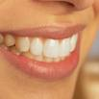
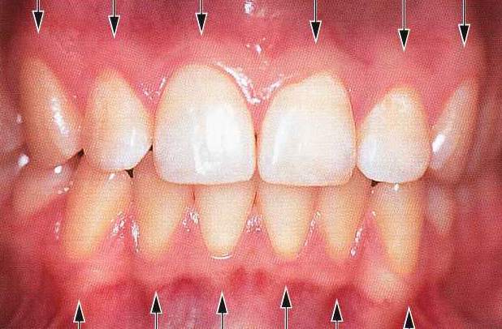
INTRODUCTION
THE MUCOCUTANEOUS JUNCTION- JUNCTION BETWEEN THE SKIN OF LIP AND ORAL MUCOSA.
THE MUCOGINGIVAL JUNCTION- JUNCTION BETWEEN THE GINGIVA AND ALVEOLAR MUCOSA.

Slide 7
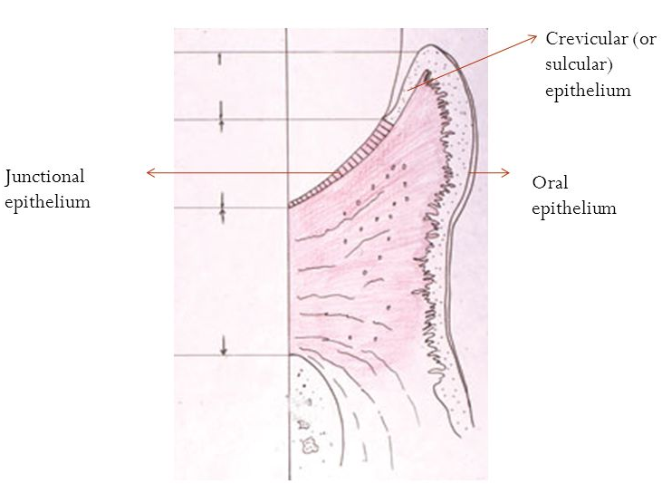
INTRODUCTION
DENTOGINGIVAL JUNCTION- IT IS THE REGION WHERE THE ORAL MUCOSA MEETS THE SURFACE OF THE TOOTH. IT IS A UNIQUE JUNCTION OF CONSIDERABLE IMPORTANCE. IT REPRESENTS A POTENTIAL WEAKNESS IN THE CONTINUOUS EPITHELIAL LINING OF THE ORAL CAVITY. IT IS THE PRINCIPAL SEAL BETWEEN THE ORAL CAVITY AND THE UNDERLYING TISSUES.

Slide 8
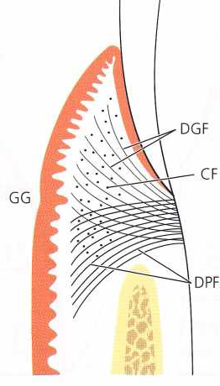
INTRODUCTION
THE ATTACHMENT OF THE JUNCTIONAL EPITHELIUM TO THE TOOTH IS REINFORCED BY THE GINGIVAL FIBERS, WHICH BRACE THE MARGINAL GINGIVA AGAINST THE TOOTH SURFACE. FOR THIS REASON, THE JUNCTIONAL EPITHELIUM AND THE GINGIVAL FIBERS ARE CONSIDERED A FUNCTIONAL UNIT, REFERRED TO AS THE DENTOGINGIVAL UNIT.

Slide 9
INTRODUCTION
TERMINOLOGIES-
EPITHELIAL ATTACHMENT – GOTTLIEB; 1921
EPITHELIAL CUFF – WAERHAUG; 1952
ATTACHED EPITHELIAL CUFF – ORBAN; 1956
ATTACHMENT EPITHELIUM – GRANT & STERN; 1968
JUNCTIONAL EPITHELIUM - ANDERSON & STERN; 1967

Slide 10
HISTORY

Slide 11
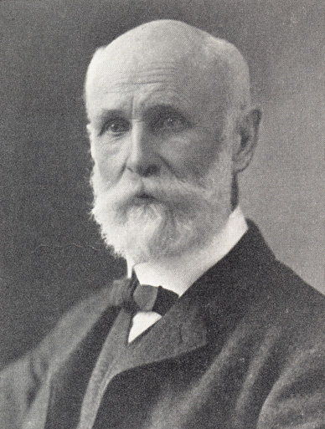
HISTORY
G V BLACK, 1915 OBSERVED CELLS GROWING IN THE GINGIVAL SULCUS. HE STATED THAT THE CELLS WERE ATTACHED TO THE TOOTH AND THAT TOO ONLY ON THE CEMENTUM SURFACE.

Slide 12
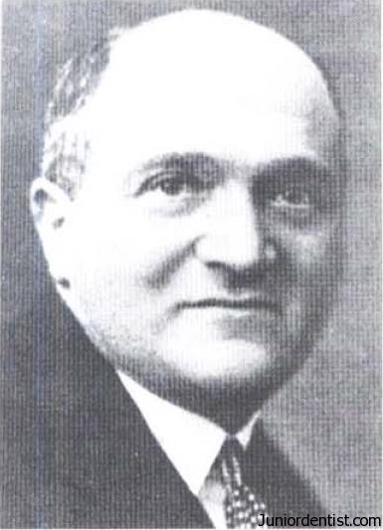
HISTORY
GOTTLEIB, 1921 HAS STATED THAT THE GINGIVAL SULCUS DEVELOPED BETWEEN THE ENAMEL SURFACE & THE EPITHELIUM COVERING THE CONNECTIVE TISSUE.
THIS EPITHELIUM AT THE BOTTOM OF THE SULCUS ADHERED TO TO THE TOOTH STUCTURE AND COULD BE SEPERATED FROM THE TOOTH WITHOU TEARING IT, “EPITHELIAL ATTACHMENT”
WESKI, 1923 & EULER, 1924.
Notes:
WESKI BELIEVED THAT SULCUS DEVELOPS FROM THE EPITHELIAL CELLS BY “INTRA-EPITHELIAL SPLIT”.
EULER STATED THAT THERE EXISTED A CONNECTIVE TISSUE BETWEEN EPITHELIUM AND ENAMEL

Slide 13
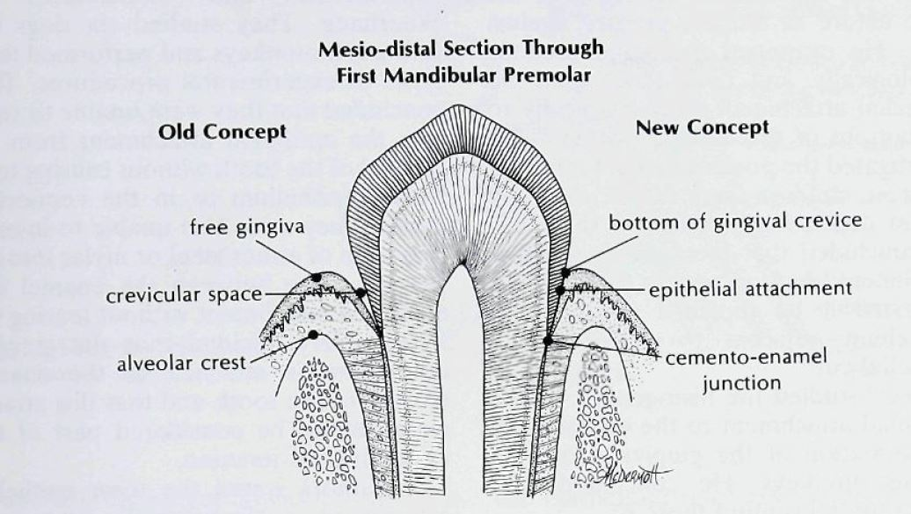
HISTORY
ORBAN & MUELLER. 1929 :-
APICAL 1/3rd OF THE CROWN IS STILL IN CONTACT WITH THE SURROUNDING ORGANIC CONNECTIVE TISSUE.
EPITHELIAL ATTACHMENT IS NOT FIXED THROUGHOUT THE LIFE.

Slide 14
HISTORY
BECKS, 1929 HAS DESCRIBED THE FORMATION OF “GINGIVAL SULCUS” i.e. “NORMAL POCKET AND ALSO THE FORMATION OF “PATHOLOGICAL POCKET”
POCKET FORMED BETWEEN THE ENAMEL EPITHELIUM AND THE MOUTH EPITHELIUM.
HE ALSO REVIEWED THE LITERATURE WORK PERFOMED BY WESKI, ORBAN & MUELLER AND SUPPORTED IT.

Slide 15
HISTORY
KRONFIELD, 1930- SHOWED A DISAGREMENT WITH TERM “EPITHELIAL ATTACHMENT GIVEN BY GOTTLIEB.
HE ALSO STATED THAT THE ATTACHMENT FOUND BETWEEN THE TOOTH AN ORAL EPITHELIUM IS “UNIQUE” AND NOT FOUND ELSEWHERE IN THE BODY

Slide 16
HISTORY
ORBAN, 1932:-
HISTOLOGICAL DIFFERENCES BETWEEN JUNCTIONAL EPITHELIUM AND SULCULAR EPITHELIUM.
DESCRIBED THE EXACT MORPHOLOGICAL LOCATION OF JUNCTIONAL EPITHELIUM.
PATHOLOGICAL POCKET AROSE DUE TO THE DEGENERATIVE CHANGES OCCURING IN THE CELLS OF EPITHELIAL ATTACHMENT.

Slide 17
HISTORY
MANLEY, 1936 STUDIED THIN SECTIONS FROM DOGS AND STATED THAT THERE EXISTED AN ORGANIC UNION BETWEEN THE ENAMEL CUTICLE & THE ORAL EPITHELIUM.
TOLLER, 1939 ALSO WORKED ON 6 MONTHS OLD DOGS AND SUPPORTED MANLEY AND ORBAN
.GOLDMAN. 1944 STATED THAT APICAL PROLIFERATION OF THE EPITHELIAL ATTACHMENT OCCURRED DUE TO THE DESTRUCTION OF THE UBNDERLYING CONNECTIVE TISSUE ATTACHED TO IT.

Slide 18
HISTORY
WAREHAUG, 1952 FELT THAT THE HISTOLÓGICA! CONCEPT OF THE GINGIVAL SULCUS, AS PROPOSED BY GOTTLIEB, DID NOT CORRELATE WITH THE CLINICAL PICTURE.
HE BELIEVED THAT IT WAS OF GREAT SIGNIFICANCE THAT THE RELATION BETWEEN THE CLINICAL AND THE HISTOLOGICAL CONCEPT OF THE GINGIVAL POCKET BE UNDERSTOOD AS WELL AS DISTINGUISHING BETWEEN A PHYSIOLOGIC AND A PATHOLOGIC POCKET.

Slide 19
HISTORY
BASE OF THE POCKET WAS AT THE CEMENTOENAMEL JUNCFION (CEJ).
HE ALSO OBSERVED AN ADHERENCE OF THE SULCULAR EPITHELIUM TO THE TOOTH SURFACE AND DESCRIBED IT AS BEING OF THE SAME NATURE AS MUCOSA PRESSED AGAINST GLASS.
HE EXAMINED THE SAME SECTIONS HISTOLOGICALLY AND CONCLUDED "THAT NO EPITHELIAL ATTACHMENT EXISTED APICALLY TO THE BOTTOM OF THE CLINICAL POCKET."
HE CONCLUDED THAT THE TERM "EPITHELIAL ATTACHMENT" HAD NO REASON TO EXIST AND SUGGESTED IT BE REPLACED WITH “POCKET EPITHELIUM ADJACENT TO THE TOOTH” (OR) “EPITHELIAL CUFF”.

Slide 20
HISTORY
BAUME, 1953 STUDIED THE STRUCTURAL ELEMENTS INVOLVED WITH THE MECHANICAL CONNECTION BETWEEN EPITHEHUM AND TOOTH SURFACE USING.PHASE CONTRAST MICROSCOPY WAS USED.
HE CONCLUDED THE EPITHELIAL ATTACHMENT IS OF A FIBROUS NATURE (TONOFIBRILS) AN DEPENDENT UPON THE VITALITY OF THE EPITHELIAL CELIS.

Slide 21
HISTORY
USSING, 1955 ATTEMPTED TO RESOLVE THIS CONTROVERSY BY STUDYING THE RELATION BETWEEN THE ENAMEL CUTICLE AND THE TOOTH SURFACE UNDER THE ELECTRON MICROSCOPE. SHE FOUND THAT AN ORGANIC CONNECTION VIA FIBRILS EXISTED BETWEEN THEM.
SCHULTZ-HAUDT, 1962 PRESENTED FURTHER CONVINCING ARGUMENTS THAT ADHESION (CHEMICAL BONDING AND PHYSIOCHEMICAL FORCES) AND EPITHELIAL STICKINESS ARE RESPONSIBLE FOR MAINTAINING EPITHELIAL CONTACT WITH ENAMEL.

Slide 22
HISTORY
ORBAN, 1956 CONCLUDED THAT IT WAS NOT POSSIBLE TO SEPARATE THE EPITHEHAF ATTACHMENT FROM THE ENAMEL OF THE TOOTH WITHOUT CAUSING TEARS IN THE EPITHEHUM OR IN THE CONNECTIVE TISSUE.
HE TOLD THAT THE GINGIVAL EPITHELIUM IS ATTACHED TO THE ENAMEL SURFACE OF THE TOOTH AND THAT THIS ATTACHMENT SHOULD BE CONSIDERED PART OF THE DENTOGINGIVAI JUNCTION. AND SUGGESTED THE TERM “ATTACHED EPITHELIAL CUFF” SHOULD BE USED INSTEAD.

Slide 23
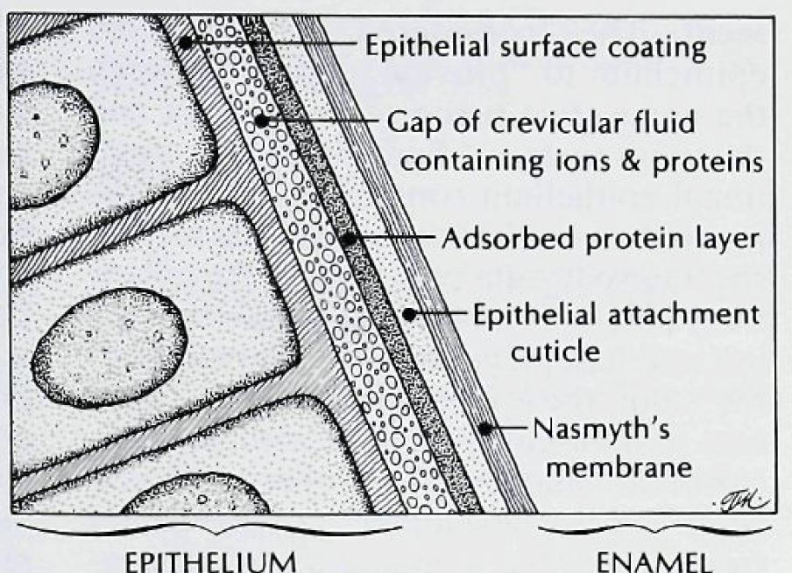
HISTORY
SCHULTZ-HAUDT, 1965 PRESENTED FURTHER CONVINCING ARGUMENTS THAT ADHESION (CHEMICAL BONDING AND PHYSIOCHEMICAL FORCES) AND EPITHELIAL STICKINESS ARE RESPONSIBLE FOR MAINTAINING EPITHELIAL CONTACT WITH ENAMEL AND GAVE THE “ADHESION MODEL”.
TOTO & SICHER, 1964 STUDIED THE GINGIVA AND FOUND THAT THE MUCOPOLYSACCHARIDE BINDS THE EPITHELIAL CELLS FO THE TOOTH.

Slide 24
HISTORY
ENGLER, 1965 INVESTIGATED THE EPITHELIAL ATTACHMENT USING A LABELING ISOTOPE AND FOUND THAT EPITHELIAL ATTACHMENT DIFFERED IN MITOTIC ACTIVITY BETWEEN THE ERUPTING AND THE FULLY ERUPTED TOOTH.
HE EXPLAINED THAT GOTTLIEB'S CONCEPT OF AN ORGANIC UNION MAY BE VALID WHEN THE TOOTH IS ERUPTING, BUT THEN CHANGES TO AN EPITHELIAL ADHESION WHEN THE TOOTH IS FULLY ERUPTED.

Slide 25
HISTORY
SCHROEDER AND LISTGARTEN, 1967 REVIEWED THE LITERATURE AND HELPED SOLVE THE QUESTIONS CONCERNING THE ULTRASTRUCTURAL FEATURES OF THE JUNCTIONAL EPITHELIUM. THE AUTHORS DEFINED TERMINOLOGY AND DISCUSSED THE DEVELOPMENT OF, AND TRANSITION FROM, THE PRIMARY TO THE SECONDARY EPITHELIAL ATTACHMENT. THEY GAVE THE TERM “JUNCTIONAL EPITHELIUM”.

Slide 26
HISTORY
BRAGA AND SQUIER, 1981 STUDIED THE REFORMATION OF NEW EPITHELIAL ATTACHMENT FOLLOWING SURGICAL REMOVAL OF ALL OR PART OF THE ORIGINAL JUNCTIONAL EPITHELIUM BY INTERNAL OR EXTERNAL BEVEL TECHNIQUES RESPECTIVELY. IT WAS OBSERVED THAT THE JUNCTIONAL EPITHELIUM REGENERATED COMPLETELY.
THEY CONCLUDED THAT JUNCTIONAL EPITHELIUM COULD ARISE NOT ONLY FROM REDUCED ENAMEL EPITHELIUM BUT ALSO FOM GINGIVAL EPITHELIUM.

Slide 27
DEVELOPMENT OF JUNCTIONAL EPITHELIUM

Slide 28
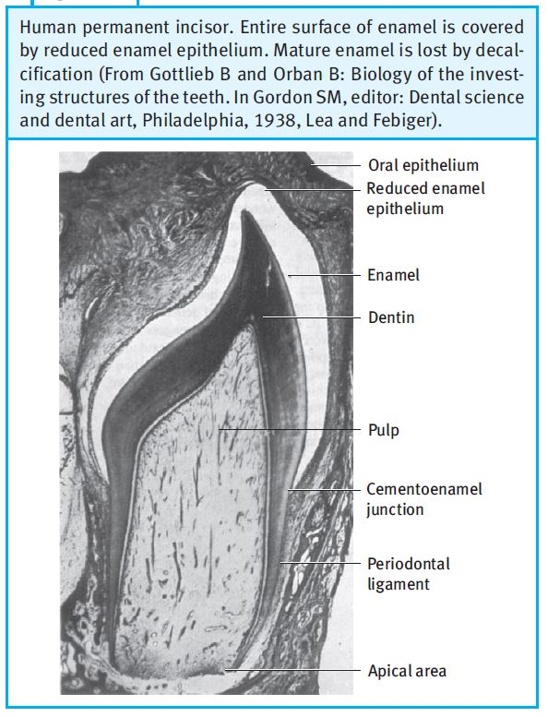
DEVELOPMENT OF JUNCTIONAL EPITHELIUM
AS THE AMELOBLASTS FINISH FORMATION OF THE ENAMEL MATRIX, THEY LEAVE A THIN MEMBRANE ON THE SURFACE OF THE ENAMEL, THE PRIMARY ENAMEL CUTICLE. THIS CUTICLE MAY BE CONNECTED WITH THE INTERPRISMATIC ENAMEL SUBSTANCE AND THE AMELOBLASTS. THE AMELOBLASTS SHORTEN AFTER THE PRIMARY ENAMEL CUTICLE HAS BEEN FORMED, FEW LAYERS OF FLAT CUBOID CELLS REMAIN WHICH ARE THEN CALLED REDUCED ENAMEL EPITHELIUM.

Slide 29
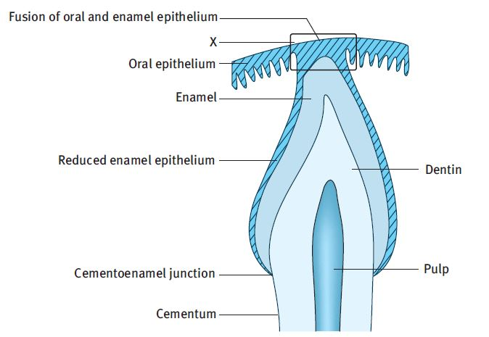
DEVELOPMENT OF JUNCTIONAL EPITHELIUM
DURING ERUPTION, THE TIP OF THE TOOTH APPROACHES THE ORAL MUCOSA, AND THE REDUCED ENAMEL EPITHELIUM AND THE ORAL EPITHELIUM MEET AND FUSE. THE REMNANT OF THE PRIMARY ENAMEL CUTICLE AFTER ERUPTION IS REFERRED TO AS NASMYTH’S MEMBRANE.

Slide 30
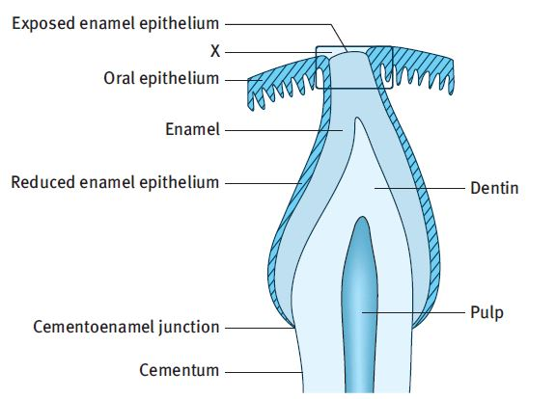
DEVELOPMENT OF JUNCTIONAL EPITHELIUM
THE EPITHELIUM THAT COVERS THE TIP OF THE CROWN DEGENERATES IN ITS CENTER, AND THE CROWN EMERGES THROUGH THIS PERFORATION INTO THE ORAL CAVITY.
AS A RESULT OF THIS, CELLS OF OUTER LAYER OF REDUCED DENTAL EPITHELIUM AND CELLS OF ORAL EPITHELIUM PROLIFERATE AND MIGRATE INTO THE DEGENERATING CONNECTIVE TISSUE, EVENTUALLY FUSING TO ESTABLISH A MASS OF EPITHELIAL CELLS ALSO KNOWN AS EPITHELIAL CUFF OVER THE ERUPTING TOOTH.

Slide 31
DEVELOPMENT OF JUNCTIONAL EPITHELIUM
THE REDUCED ENAMEL EPITHELIUM REMAINS ORGANICALLY ATTACHED TO THE PART OF THE ENAMEL THAT HAS NOT YET ERUPTED. ONCE THE TIP OF THE CROWN HAS EMERGED, THE REDUCED ENAMEL EPITHELIUM IS TERMED THE PRIMARY ATTACHMENT EPITHELIUM.

Slide 32
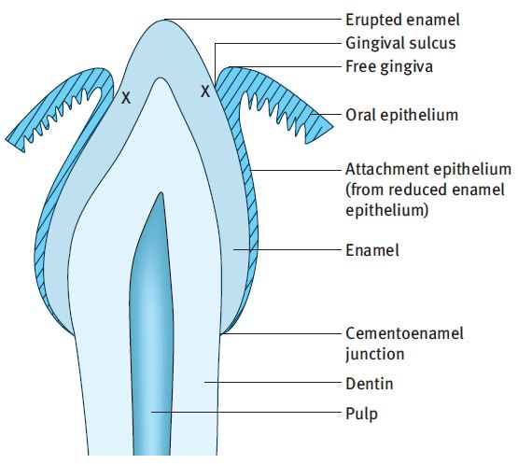
DEVELOPMENT OF JUNCTIONAL EPITHELIUM
AT THE MARGIN OF THE GINGIVA THE ATTACHMENT EPITHELIUM IS CONTINUOUS WITH THE ORAL EPITHELIUM. AS THE TOOTH ERUPTS, THE REDUCED ENAMEL EPITHELIUM GROWS GRADUALLY SHORTER. A SHALLOW GROOVE, THE GINGIVAL SULCUS, MAY DEVELOP BETWEEN THE GINGIVA AND THE SURFACE OF THE TOOTH AND EXTEND AROUND ITS CIRCUMFERENCE.

Slide 33
DEVELOPMENT OF JUNCTIONAL EPITHELIUM
THE FINAL CONVERSION OF REDUCED ENAMEL EPITHELIUM TO JUNCTIONAL EPITHELIUM MAY NOT OCCUR UNTIL 3 TO 4 YEARS AFTER THE TOOTH HAS ERUPTED. IMMEDIATELY AFTER ALL THE REDUCED ENAMEL EPITHELIUM HAS BEEN TRANSFORMED INTO SQUAMOUS EPITHELIUM, THE DEVELOPMENT OF DENTO GINGIVAL JUNCTION MAY BE REGARDED AS COMPLETE.
ALTHOUGH THE DENTAL EPITHELIUM CONTRIBUTES SPECIFICALLY TO THE DEVELOPMENT OF THE DENTOGINGIVAL JUNCTION, IT IS NOT REQUIRED FOR THE REDEVELOPMENT OF THIS JUNCTION AFTER A GINGIVECTOMY. AFTER SURGICAL PROCEDURE, THE JUNCTION IS REESTABLISHED AT THE LOWER LEVEL ON THE TOOTH AND ITS EPITHELIAL COMPONENT COMES SOLELY FROM CELLS STEMMING FROM THE ORAL EPITHELIUM.

Slide 34
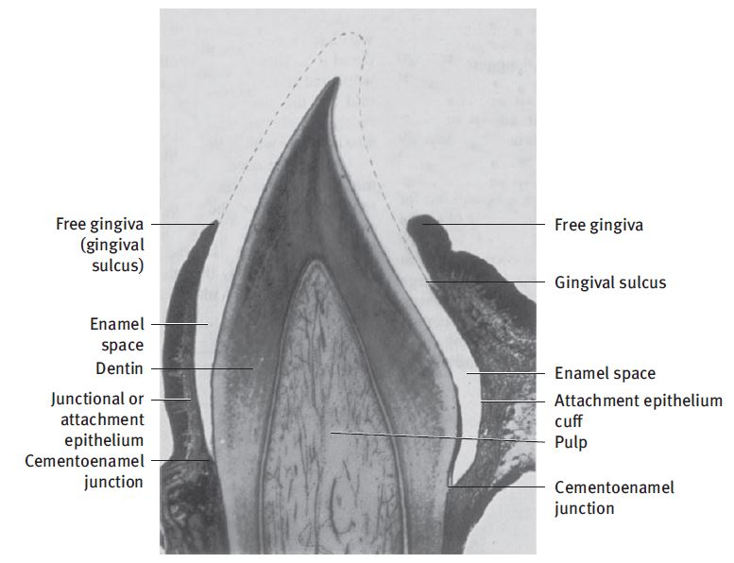
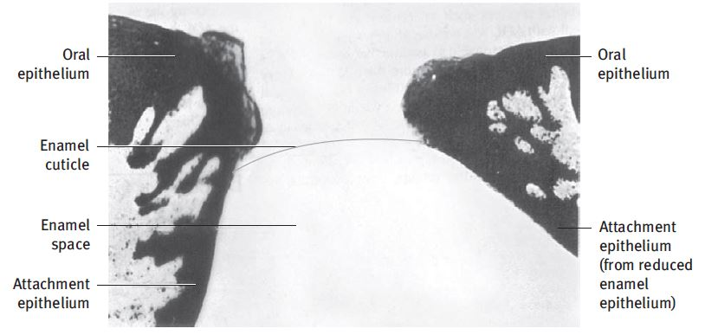
1
3
2

Slide 35
EITHELIUM ATTACHMENT CONCEPTS

Slide 36
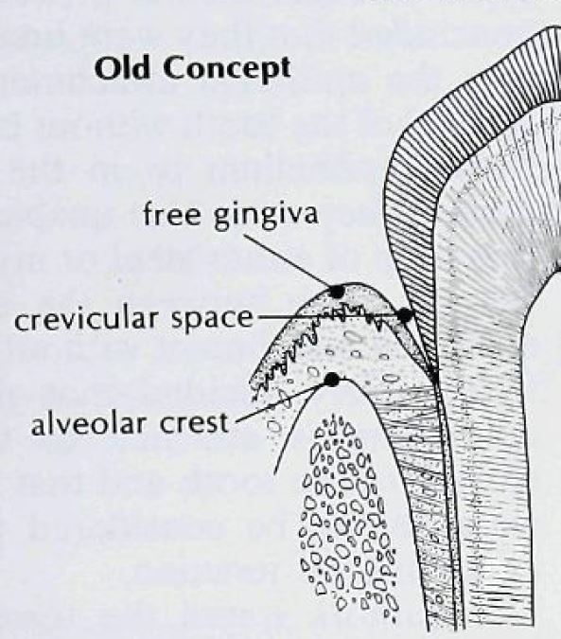
EITHELIUM ATTACHMENT CONCEPTS
GOTTLEIB, 1921
EPITHELIAL ATTACHMENT IS ORGANICALLY UNITED TO THE TOOTH SURFACE AND CAN BE SEPARATED EASILY WITHOUT TEARING THE EPITHELIAL CELLS OR CONNECTIVE TISSUE
ORGANIC ATTACHMENT.

Slide 37
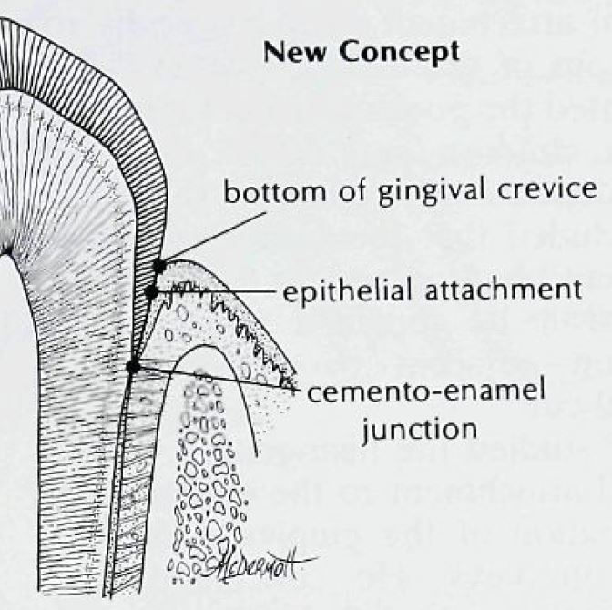
EPITHELIUM ATTACHMENT CONCEPTS
2. WAERHAUG -1960
POSTULATED THAT THE CELLS OF THE EPITHELIAL ATTACHMENT ADHERE WEAKLY TO THE TOOTH SURFACE AND IT FORMS THE LINING OF THE PHYSIOLOGIC POCKET.
IT WAS CONCLUDED THAT GINGIVAL TISSUE AND TOOTH ARE CLOSELY ADAPTED BUT NOT ORGANICALLY UNITED.

Slide 38
EPITHELIUM ATTACHMENT CONCEPTS
3. SCHULTZ-HAUDT, 1965

Slide 39
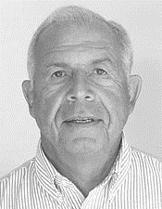
EPITHELIUM ATTACHMENT CONCEPTS
4. MAX LISTGARTEN- 1966-67

Slide 40
STRUCTURE & ULTRSTRUCTURE

Slide 41
STRUCTURE & ULTRSTRUCTURE
JUNCTIONAL EPITHELIUM IS CLASSIFIED AS NON-KERATINIZED STRATIFIED SQUAMOUS EPITHELIUM. INTERCELLULAR JUNCTIONS FORMED IN JE ARE RELATIVELY LOOSE AND CONTAIN ONLY FEW DESMOSOMES, ADHERENS JUNCTIONS, AND GAP JUNCTIONS, WHICH ALLOW TISSUE EXUDATE AND INFLAMMATORY CELLS TO PENETRATE TOWARD THE GINGIVAL SULCUS.

Slide 42
STRUCTURE & ULTRSTRUCTURE
JUNCTIONAL EPITHELIUM HAS A TRUE BASEMENT MEMBRANE TOWARDS THE CONNECTIVE TISSUE OF GINGIVA CALLED THE EXTERNAL BASAL LAMINA, EBL AND A SIMPLE INTERNAL BASAL LAMINA, IBL AGAINST THE ENAMEL.
THE EBL CONTAINS STRUCTURES THAT ARE IDENTICAL TO THOSE OF A TYPICAL BASEMENT MEMBRANE, WITH THE LAMINA LUCIDA AGAINST THE BASAL KERATINOCYTES AND THE LAMINA DENSA TOWARDS THE UNDERLYING CONNECTIVE TISSUE.

Slide 43
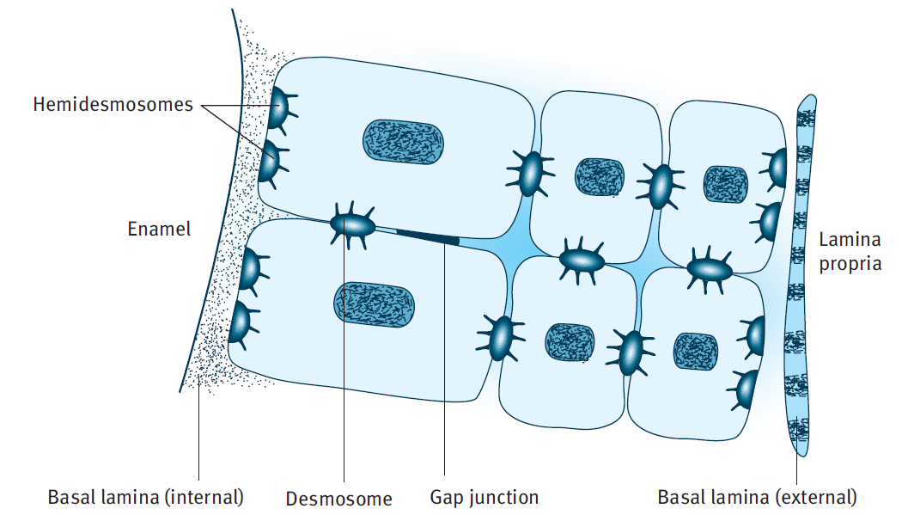
STRUCTURE & ULTRSTRUCTURE

Slide 44
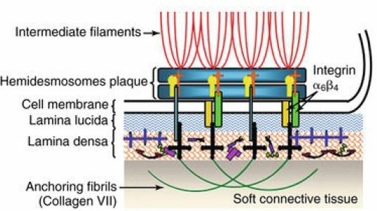
STRUCTURE & ULTRSTRUCTURE

Slide 45
STRUCTURE & ULTRSTRUCTURE

Slide 46
STRUCTURE & ULTRSTRUCTURE
INTERNAL BASAL LAMINA- THIS ATTACHES THE JUNCTIONAL EPITHELIUM TO THE TOOT SURFACE.
EXTERNAL BASAL LAMINA- THIS BASAL LAMINA MEDIATES THE ATTACHMENT OF THE JUNCTIONAL EPITHELIUM TO THE CONNECTIVE TISSUE OF THE JUNCTIONAL EPITHELIUM.
THE 2 ZONES OF BASAL LAMINA ARE THE
LAMINA LUCIDA (ELECTRON LUCENT ZONE) &
THE LAMINA DENSA (ELECTRON DENSE ZONE).

Slide 47
STRUCTURE & ULTRSTRUCTURE
THE INTERNAL BASAL LAMINA- DIFFERS FROM THE EXTERNAL BASAL LAMINA IN THAT THEY LACK LAMININ, ANCHORING FIBRILS AND TYPE IV COLLAGEN
LAMININ-5, HOWEVER, APPEARS TO BE EXPRESSED IN THE INTERNAL BASAL LAMINA BUT NOT IN THE EXTERNAL BASEMENT MEMBRANE OF THE JUNCTIONAL EPITHELIUM.
THE INTERNAL BASAL LAMINA IS APPROXIMATELY THREE TIMES THICKER THAN THE EXTERNAL BASAL LAMINA.
THE INTERNAL BASAL LAMINA CONTAINS GLYCOPROTEINS, LAMININ, AND PROTEOGLYCANS AND LACKS TYPE IV COLLAGEN.

Slide 48
STRUCTURE & ULTRSTRUCTURE
EXTERNAL BASAL LAMINA- THE EXTERNAL BASAL LAMINA CONTAINS COLLAGEN TYPE IV, HEPARAN SULFATE PROTEOGLYCAN, LAMININ, AND FIBRONECTIN. ANCHORING FIBRILS ARE LESS PROMINENT IN THE CONNECTIVE TISSUE BELOW THE JE THAN THEY ARE IN THE OGE.
THUS THE INTERFACE BETWEEN THE JUNCTIONAL EPITHELIUM AND THE ENAMEL IS STRUCTURALLY IS VERY SIMILAR TO THE EPITHELIUM CONNECTIVE TISSUE INTERFACE, WHICH MEANS THAT THE JUNCTIONAL EPITHELIUM IS NOT ONLY IN CONTACT WITH THE ENAMEL BUT IS ACTUALLY PHYSICALLY ATTACHED TO THE TOOTH VIA HEMIDESMOSOMES.

Slide 49
STRUCTURE & ULTRSTRUCTURE
THE WIDTH OF THE BASAL LAMINA IS REPORTED TO BE IN THE VICINITY OF 800A TO 1200A. ITS COMPO­NENTS, THE LAMINA DENSA AND LAMINA LUCIDA, ARE NOT ALWAYS EVIDENT, PARTICULARLY IN SOME DECALCIFIED PREPARATIONS.
STERN DEFINED THE LAMINA LUCIDA, ~400A, AS THE STRUCTURE BETWEEN THE OUTER LEAFLET OF THE EPITHELIAL CELL MEMBRANE AND THE LAMINA DENSA.
THE LAMINA DENSA OF VARIOUS EPITHELIAL-CONNECTIVE TIS­SUE INTERFACES HAS A PROTEINACEOUS COMPOSITION INCORPO­RATING COLLAGENOUS ELEMENTS AND IS ABOUT 800A.

Slide 50
STRUCTURE & ULTRSTRUCTURE
KOBAYASHI ET AL. DESCRIBED A THIRD LAMINA, THE SUBLAMINA LUCIDA (120 ± 20A), BETWEEN THE TOOTH AND LAMINA DENSA.
KOBAYASHI ET AL. VIEWED THE SUB-LAMINA LUCIDA AS SUCH A "SPACE" CREATED BY AN INTERPLAY OF FORCES BETWEEN THE LAMINA DENSA AND THE TOOTH, THUS HAVING AN IMPORTANT ROLE IN ADHESION. FRANK AND CIMISONI AND STERN IMPLIED THAT THE LAMINA LUCIDA PLAYS THE IMPORTANT ROLE.

Slide 51
STRUCTURE & ULTRSTRUCTURE

Slide 52
STRUCTURE & ULTRSTRUCTURE

Slide 53
STRUCTURE
&
ULTRSTRUCTURE

Slide 54
JUNCTIONAL EPITHELIUM
BY S S SAI KARTHIKEYAN
MDS II ND YR
DEPARTMENT OF PERIODONTICS & IMPLANTOLOGY

Slide 55
CONTENTS
INTRODUCTION.
HISTORY-STUDIES RELATED TO JUNCTIONAL EPITHELIUM.
DEVELOPMENT OF JUNCTIONAL EPITHELIUM.
ATTACHMENT CONCEPTS.
STRUCTURAL, ULTRASTRUCTURAL OF JUNCTIONAL EPITHELIUM.
HISTOLOGY OF JUNCTIONAL EPITHELIUM.
DYNAMICS OF JUNCTIONAL EPITHELIUM.
VARIOUS FUNCTIONS OF JUNCTIONAL EPITHELIUM-STRUCTURES AND MOLECULES RELATED TO IT.
APPLIED ASPECT.
CONCLUSION.

Slide 56
HISTOLOGY OF JUNCTIONAL EPITHELIUM

Slide 57
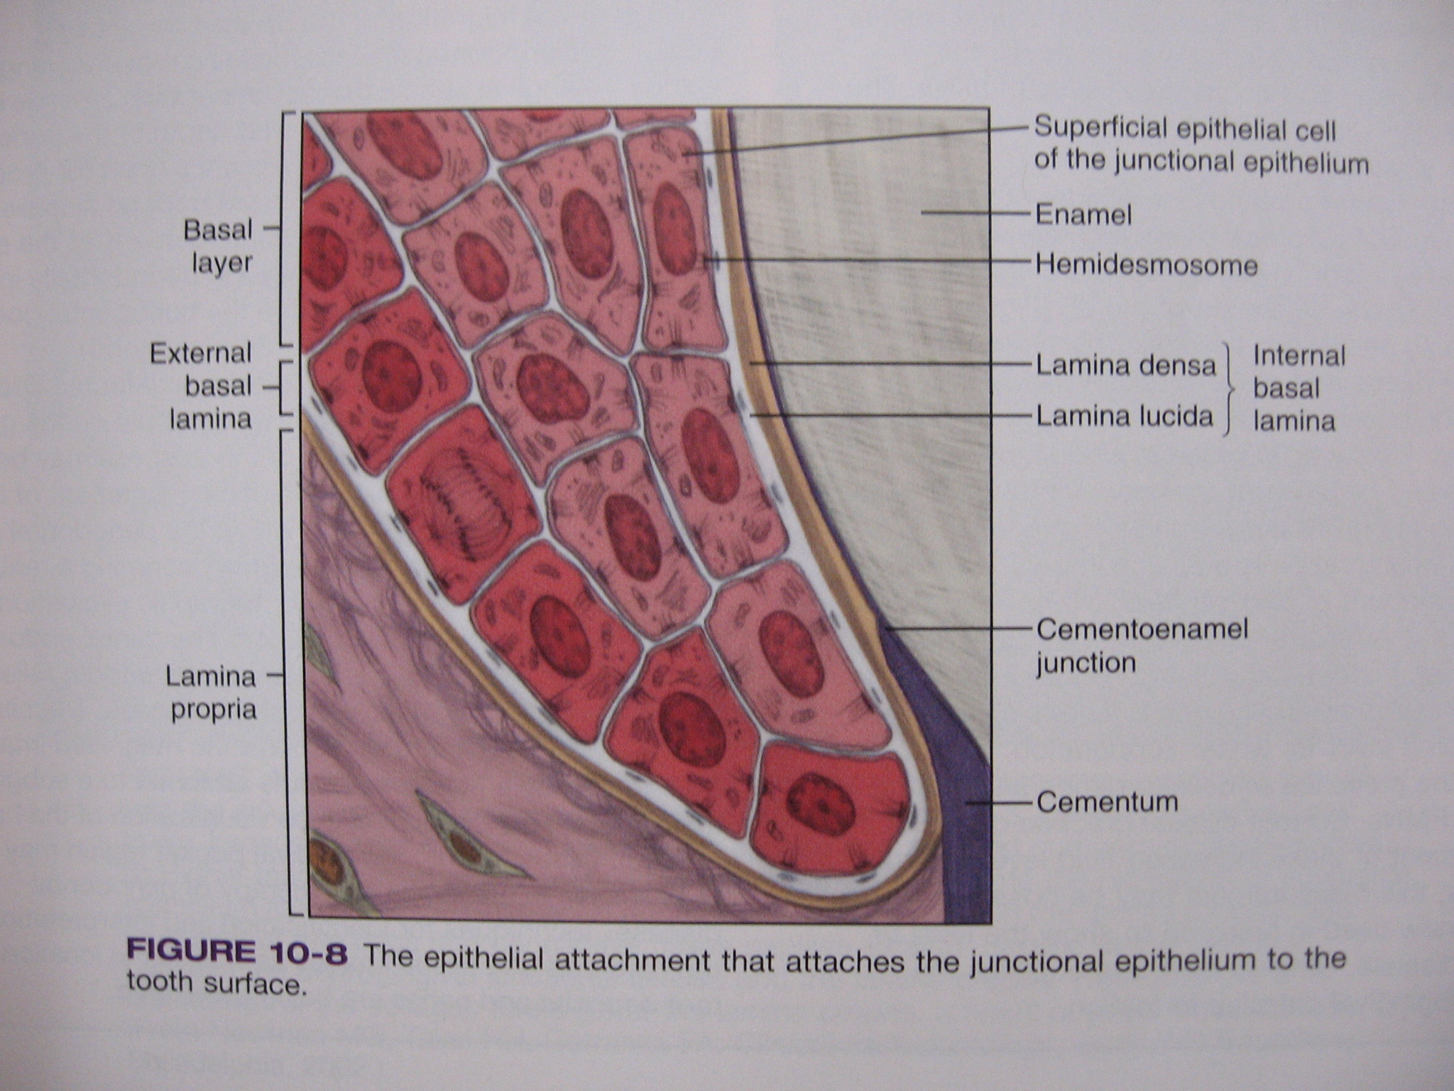
HISTOLOGY OF JUNCTIONAL EPITHELIUM
JUNCTIONAL EPITHELIUM CONSISTS OF A COLLAR LIKE BAND OF STRATIFIED SQUAMOUS NON-KERATINIZING EPITHELIUM.
APICALLY - 1 TO 3 CELLS THICK
CORONALLY - 15 TO 30 CELLS THICK
TOTAL THICKNESS - 30 TO 100/UM
LENGTH - 0.25 TO 1.35 MM

Slide 58
HISTOLOGY OF JUNCTIONAL EPITHELIUM
IT IS A STRATIFIED SQUAMOUS NON-KERATINIZING EPITHELIUM THAT IS MADE UP OF 2 STRATA ONLY, I.E., A BASAL LAYER (THE STRATUM BASALE) AND A SUPRABASAL LAYER (THE STRATUM SUPRABASALE).
1 BASAL LAYER (STRATUM GERMINATIVUM) - SINGLE CELL LAYER OF CUBOIDAL CELLS.
2. SUPRA BASAL LAYER (EQUIVALENT TO STRATUM SPINOSUM) - FLATTENED CELLS- SEVERAL LAYERS OF CELLS OVERLIE BASAL LAYER

Slide 59
HISTOLOGY OF JUNCTIONAL EPITHELIUM
TO DIFFERENTIATE FROM SULCULAR EPITHELIUM
THE INTERCELLULAR SPACE (18%) IN THE JUNCTIONAL, COMPARATIVELY WIDER THAN IN ORAL EPITHELIUM.
THE SIZE OF THE CELLS IN THE JUNCTIONAL EPITHELIUM , RELATIVE TO THE TISSUE VOLUME, ISLARGER THAN IN THE ORAL EPITHELIUM.
THE NUMBER OF DESMOSOMES IS SMALLER IN THE JUNCTIONAL EPITHELIUM THAN IN THE ORAL EPITHELIUM (4 TIMES LESS).

Slide 60
HISTOLOGY OF JUNCTIONAL EPITHELIUM
4. THERE ARE FEWER INTERCELLULAR JUNCTIONS IN THE JUNCTIONAL EPITHELIUM THAN IN THE ORAL OR SULCULAR EPITHELIUM. THIS MAY EXPLAIN BOTH ITS SUSCEPTIBILITY TO TEARING DURING PROBING AND ITS GREATER PER­MEABILITY TO MIGRATING CELLS AND FLUIDS.
5. HAVE MORE PROMINENT GOLGI APPARATUS THAN OTHER SURFACE GINGIVAL EPITHELIUM

Slide 61
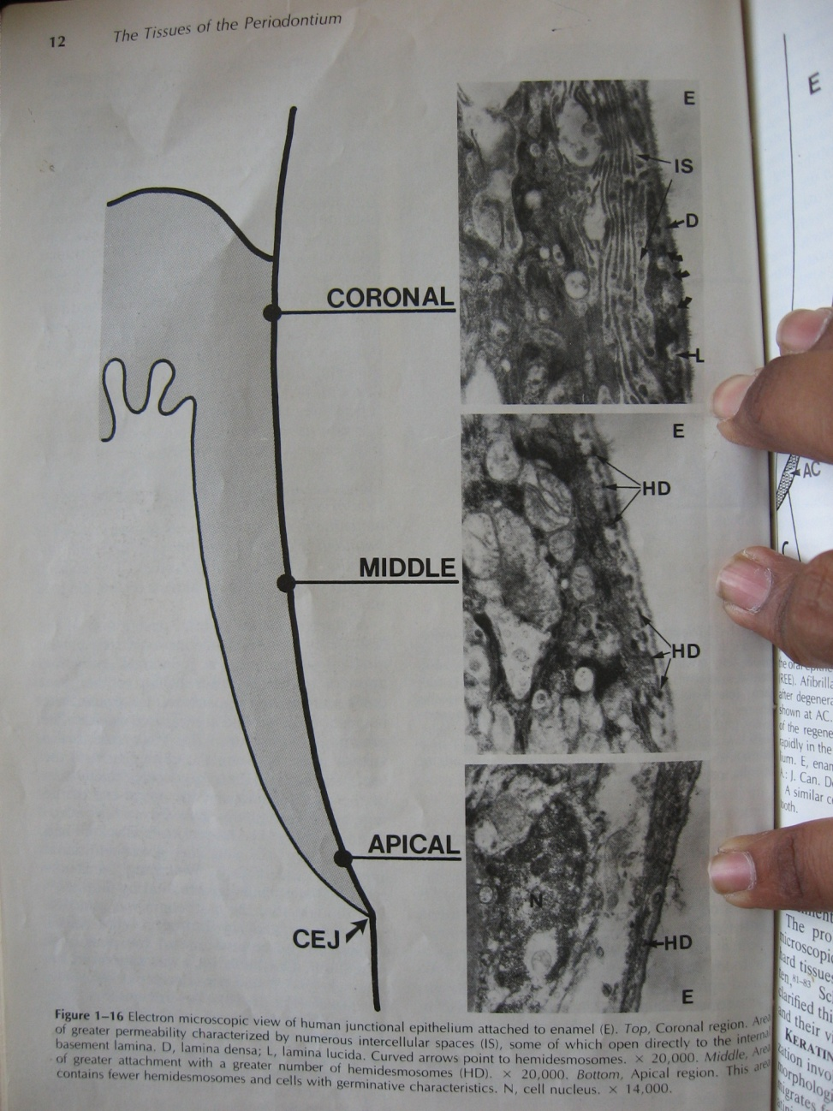
HISTOLOGY OF JUNCTIONAL EPITHELIUM
ZONES OF JUNCTIONAL EPITHELIUM:
APICAL ZONE:- CONTAINS FEWER HEMIDESMOSOMES AND CELL WITH GERMINATIVE CHARACTERISTICS.
MIDDLE ZONE:- AREA OF GREATEST ATTACHMENT HAVING LARGE NUMBERS OF HEMIDESMOSOMES
CORONAL ZONE:- AREA OF GREATEST PERMEABILITY CHARACTERIZED BY NUMEROUS INTERCELLULAR SPACES. SOME OF WHICH DIRECTLY OPEN INTO INTERNAL BASAL LAMINA.

Slide 62
DYNAMICS OF JUNCTIONAL EPITHELIUM.

Slide 63
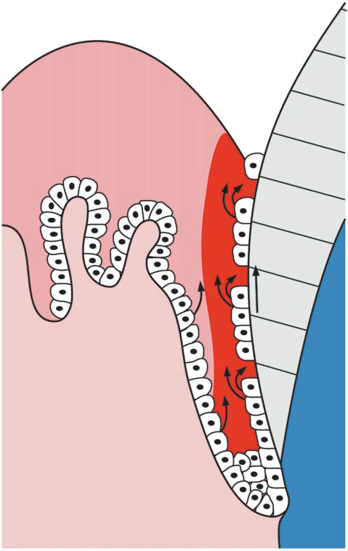
DYNAMICS OF JUNCTIONAL EPITHELIUM.
CELL MITOSIS OCCURS IN THE BASAL AND DAT CELLS (SALONEN 1994). DAT CELLS IN CORONAL JE EXPRESS NUMEROUS TRANSFERRIN RECEPTORS INDICATING ACTIVE METABOLISM AND HIGH TURNOVER. SINCE THE DAT CELLS ARE CONNECTED TO THE BASAL LAMINA, A REMODELING OF THE EPITHELIAL ATTACHMENT OCCURS STATING ITS DYNAMIC NATURE.
JE CELLS MIGRATE IN CORONAL DIRECTION FROM BASAL LAYER TO DESQUAMATE IN THE GINGIVAL SULCUS IN APPROXIMATELY 6 DAYS.

Slide 64
DYNAMICS OF JUNCT- IONAL EPITHELIUM.
DISTURBANCES OF THE EPITHELIAL ATTACHNENT RESULTS IN DEEPENING OF GINGIVAL SULCUS.
THIS CAN BE DUE TO i. INFLAMMATORY PROCESS, ii. IMMUNE RESPONSE TO BACTERIA, iii. MECHANICAL IRRITATION DUE TO INSTRUMENTATION, FOOD IMPACTION & PLAQUE AND CALCULUS FORMATION.
EVEN WHEN JUNCTIONAL EPITHELIUM HAS COMPLETELY MIGRATED ONTO CEMENTUM, ATTACHMENT IS STILL MEDIATED BY BASAL LAMINA AND BY HEMIDESMOSOMES.

Slide 65
FUNCTIONS OF JE- STRUCTURES & MOLECULES RELATED TO IT

Slide 66
FUNCTIONS OF JE- STRUCTURES & MOLECULES RELATED TO IT
FUNCTIONS INCLUDE-
EPITHELIAL BARRIER
SEMI PERMEABILITY
RAPID TURNOVER
DEFENSE
PROTECTIVE NATURE

Slide 67
FUNCTIONS OF JE- STRUCTURES & MOLECULES RELATED TO IT

Slide 68
FUNCTIONS OF JE- STRUCTURES & MOLECULES RELATED TO IT

Slide 69
FUNCTIONS OF JE- STRUCTURES & MOLECULES RELATED TO IT

Slide 70
FUNCTIONS OF JE- STRUCTURES & MOLECULES RELATED TO IT

Slide 71
APPLIED ASPECTS
ROLE IN PERIO-RESTORATIVE INTERRELATIONSHIP.
ROLE IN ERRUPTION OF TOOTH.
ROLE IN FORMATION OF POCKET.
ROLE IN REGENERATION.
JUNCTIONAL EPITHELIUM AROUND IMPLANTS.

Slide 72
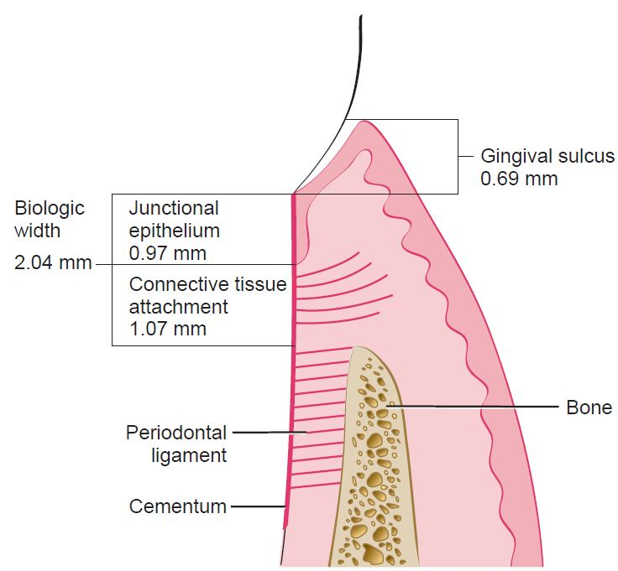
APPLIED ASPECT
ROLE IN PERIO-RESTORATIVE INTERRELATIONSHIP.
IT IS THE PHYSIOLOGIC DIMENSION OF JUNCTIONAL EPITHELIUM AND CONNECTIVE TISSUE ATTACHMENT.
RANGES FROM 0.75MM TO 4.3MM

Slide 73
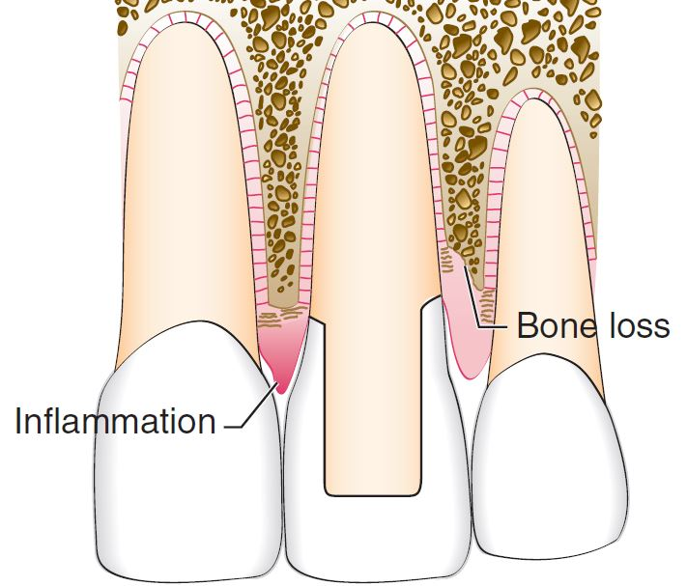
APPLIED ASPECT
ROLE IN PERIO-RESTORATIVE INTERRELATIONSHIP.
SEVERE GINGIVAL INFLAMMATION- DOES NOT LEAD TO REESTABLISHMENT OF NORMAL BIOLOGIC WIDTH.
GINGIVAL RECESSION WITH BONE LOSS- LEADS TO REESTABLISHMENT OF NORMAL BIOLOGIC WIDTH.

Slide 74
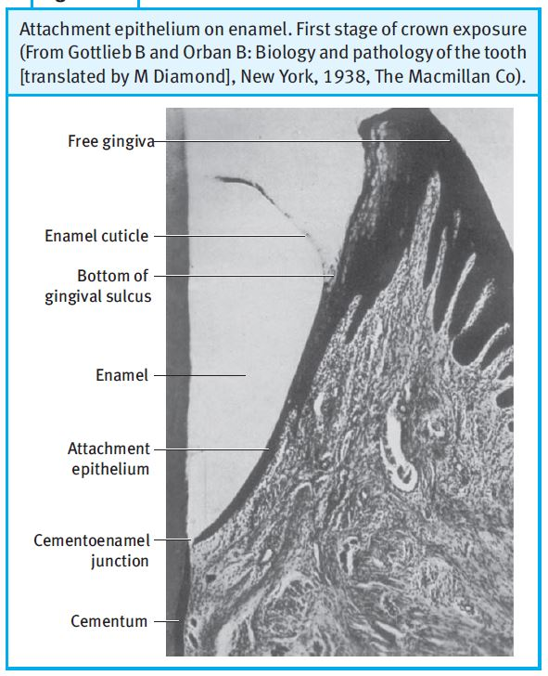
APPLIED ASPECT
2. ROLE IN ERRUPTION OF TOOTH.
FIRST STAGE:
THE BOTTOM OF THE GINGIVAL SULCUS REMAINS IN ENAMEL AND THE APICAL END OF JE IS AT THE CEJ.
THIS PERSISTS IN PRIMARY TEETH ALMOST UPTO 1 YEAR OF AGE BEFORE SHEDDING AND IN PERMANENT TEETH, USUALLY TO THE AGE OF 20 OR 30 YEARS.
CLINICAL CROWN < ANATOMIC CROWN.

Slide 75
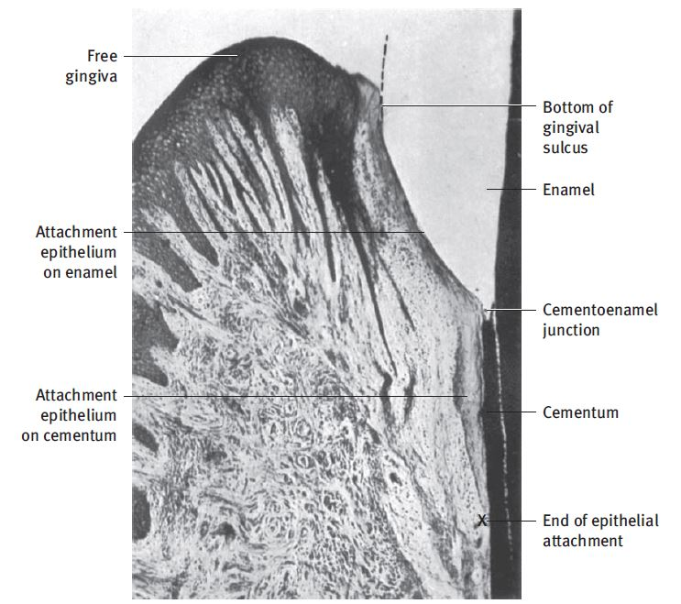
APPLIED ASPECT
Attachment epithelium partly on enamel and partly on cementum.
Second stage of passive tooth exposure
2. ROLE IN ERRUPTION OF TOOTH.
SECOND STAGE:
THE BOTTOM OF THE GINGIVAL SULCUS IS STILL ON ENAMEL AND THE APICAL END OF JE HAS SHIFTED TO THE SURFACE OF THE CEMENTUM.
THIS STAGE OF TOOTH EXPOSURE MAY PERSIST TO THE AGE OF 40 YEARS OR LATER.
CLINICAL CROWN < ANATOMIC CROWN.

Slide 76
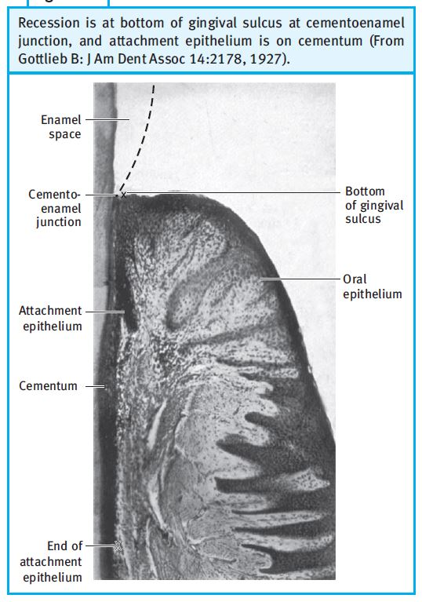
APPLIED ASPECT
2. ROLE IN ERRUPTION OF TOOTH.
THIRD STAGE:
BOTTOM OF THE GINGIVAL SULCUS IS AT THE CEMENTOENAMEL JUNCTION.
THE EPITHELIUM ATTACHMENT IS ENTIRELY ON THE CEMENTUM AND THE ENAMEL-COVERED CROWN IS FULLY EXPOSED.
CLINICAL CROWN = ANATOMIC CROWN.

Slide 77
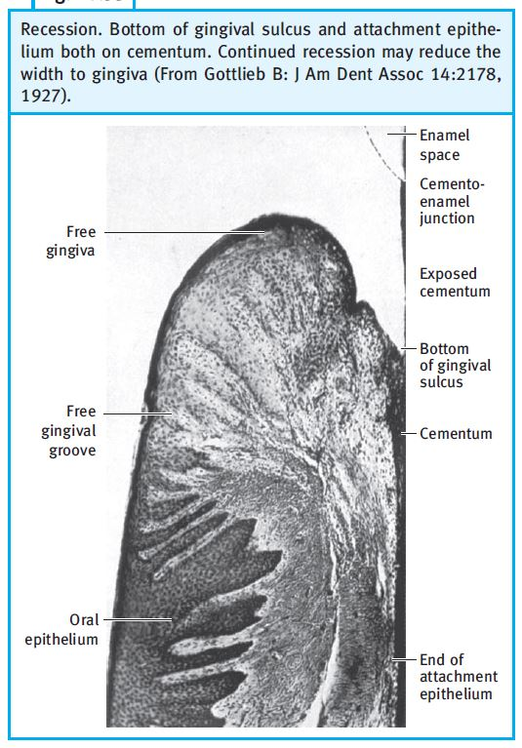
APPLIED ASPECT
2. ROLE IN ERRUPTION OF TOOTH.
FOURTH STAGE:
FOURTH STAGE REPRESENTS RECESSION OF THE GINGIVA. WHEN THE ENTIRE ATTACHMENT IS ON CEMENTUM, THE GINGIVA MAY APPEAR NORMAL BUT IS BELIEVED TO HAVE RECEDED AS A RESULT OF PATHOLOGY.
IT MAY OCCUR WITHOUT OTHER CLINICAL EVIDENCE OF INFLAMMATORY PERIODONTAL DISEASE.

Slide 78
APPLIED ASPECTS
3. ROLE IN FORMATION OF POCKET- EPITHELIAL COMPARTMENT. (SCHROEDER AND LISTGARTEN 1977)
MORPHOLOGIC CHANGES OF THE EPITHELIUM IN THE PRESENCE OF INFLAMMATION INCLUDE:
INTERCELLULAR EDEMA, EVIDENT THROUGH WIDENED INTERCELLULAR SPACES.
DECREASED NUMBERS OF DESMOSOMES.
DISRUPTION OF THE OUTER (CON­NECTIVE-TISSUE) FACING BASAL LAMINA .
CELLULAR DIS­RUPTIONS.
PERFORATIONS IN THE BASAL LAMINA WHICH ARE PRODUCED, AS INFLAMMATORY CELLS MIGRATE THROUGH.

Slide 79
APPLIED ASPECTS
3. ROLE IN FORMATION OF POCKET- EPITHELIAL COMPARTMENT.
6. THE BORDER BETWEEN JUNCTIONAL EPITHELIUM AND CONNECTIVE TISSUE IS STRAIGHT IN HEALTH AND CONTAINS PROJECTIONS (EPITHELIAL PEGS OR RIDGES) IN DISEASE.
7. THE APPARENT BORDER BETWEEN JUNCTIONAL EPITHELIUM AND THE ADJACENT SULCULAR EPITHELIUM BECOMES MORE MARKED AS THE CELLULAR INFILTRATE IN THE JUNCTIONAL EPITHELIUM INCREASES FROM 30% TO 60%. THESE CHANGES ARE RELATED TO POCKET FORMATION.

Slide 80
APPLIED ASPECTS
3. ROLE IN FORMATION OF POCKET- CONNECTIVE TISSUE COMPARTMENT.
IT IS THE PRIMARY SITE OF THE INFLAMMATORY RESPONSE OF PERIODONTAL DISEASE.
AS A CONSEQUENCE OF THE LOSS OF COLLAGEN, THE APICAL PORTION OF THE JUNCTIONAL EPITHELIUM PROLIFERATES ALONG THE ROOT.
THE FIBROBLASTS UNDERGO VARIOUS PATHOLOGIC ALTERATIONS−THEIR NORMAL SPINDLE OR ELONGATED SHAPE IS TRANSFORMED INTO A ROUNDED ONE AND THEY BECOME UP TO 3 TIMES AS LARGE (ACTIVE IN COLLAGENOLYSIS).
PARTICULAR ATTENTION HAS BEEN PAID TO ELUCIDATING THE MECHANISMS BY WHICH AA.COMITANS, P.GINGIVALIS, IMPLICATED AS MAJOR ETIOLOGICAL AGENTS IN AGGRESSIVE AND CHRONIC PERIODONTITIS, ADHERE TO, INVADE, AND REPLICATE IN EPITHELIAL CELLS (FORNG ET AL 2000; QUIRYNEN ET AL 2001).

Slide 81
APPLIED ASPECTS
3. ROLE IN FORMATION OF POCKET- CONNECTIVE TISSUE COMPARTMENT.
EPITHELIAL CELLS CHALLENGED BY P. GINGIVALIS EXHIBIT PROTEOLYSIS OF ADHERENS JUNCTION PROTEINS AND ADHESION SIGNALING MOLECULES (HINTERMANN ET AL 2002).
RECENTLY, ITS FOUND THAT GINGIPAINS SPECIFICALLY DEGRADE COMPONENTS OF THE EPITHELIAL CELL TO CELL JUNCTIONAL COMPLEXES (CHEN ET AL 2001; HINTERMANN ET AL 2002).
GINGIPAINS MAY ALSO DISTURB THE ICAM-1-DEPENDENT ADHESION OF PMNS TO ORAL EPITHELIAL CELLS, WHICH POINTS TO THE IMPORTANT FOR THE DISINTEGRATION OF THE JUNCTIONAL EPITHELIUM (TADA ET AL 2003).

Slide 82
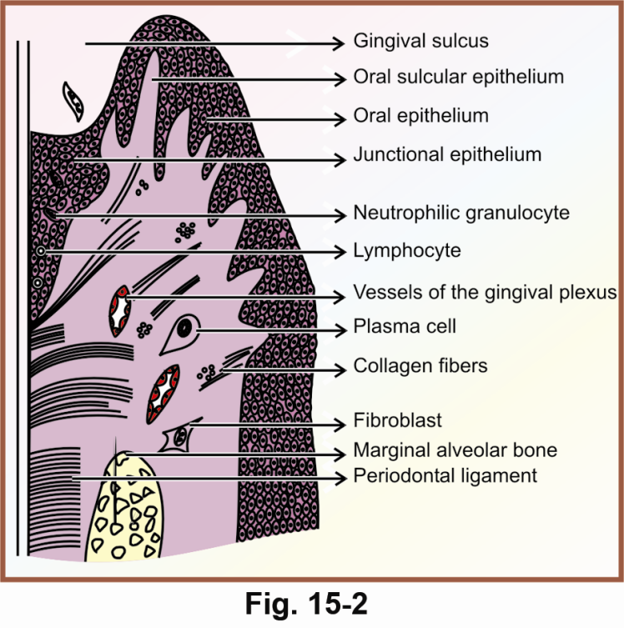
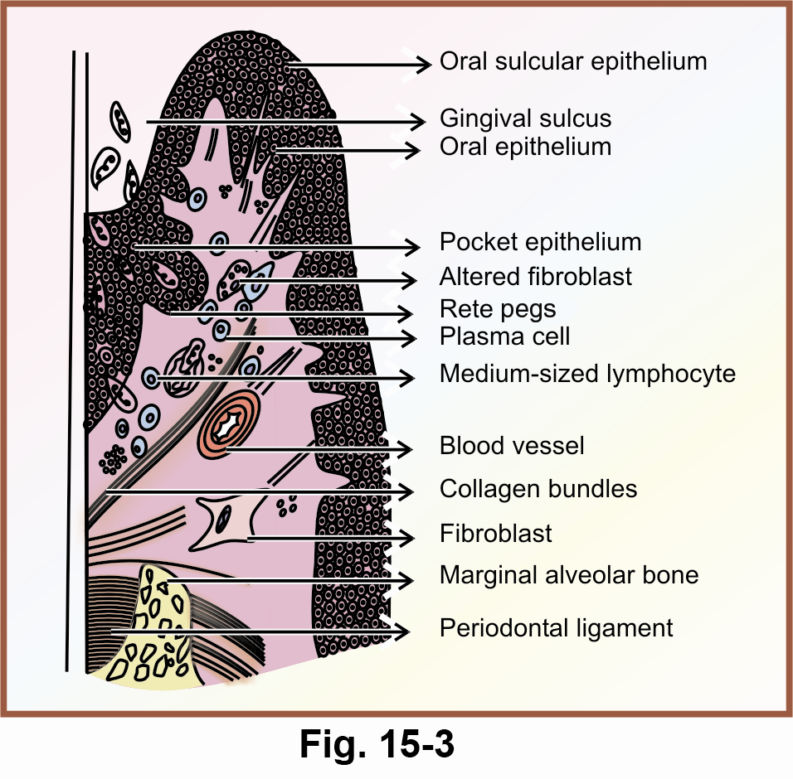
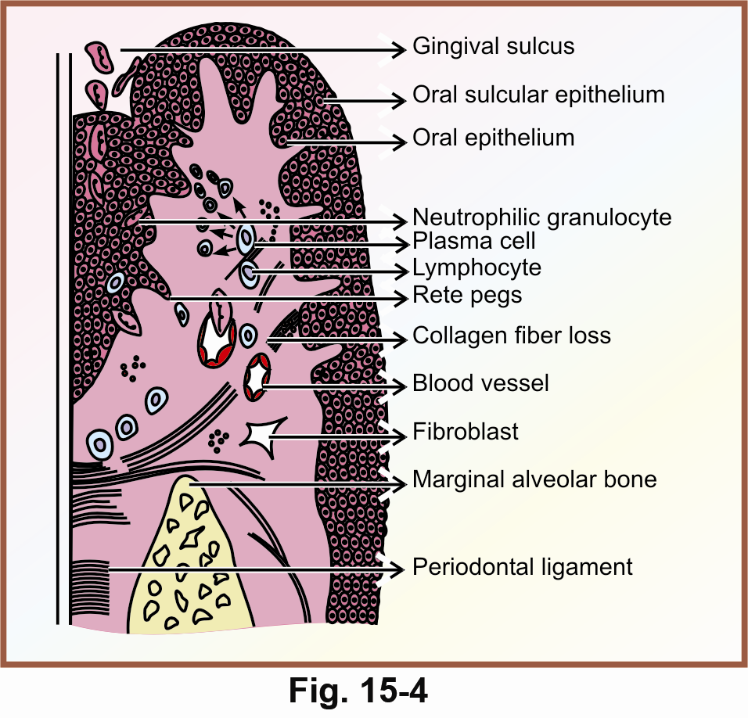
APPLIED ASPECTS- ROLE IN POCKET FORMATION

Slide 83
APPLIED ASPECTS
4. ROLE IN REGENERATION ((TAYLOR AND CAMPBELL, 1972)-
SINCE THE JUNCTIONAL EPITHELIUM IS LOCATED AT A STRATEGICALLY IMPORTANT BUT ALSO DELICATE SITE, IT MAY BE EXPECTED THAT IT SHOULD BE VERY WELL-ADAPTED TO COPE WITH MECHANICAL INSULTS.
IN AN EXPERIMENTAL STUDY IN MARMOSETS, FOLLOWING PROBING, A NEW AND COMPLETE ATTACHMENT INDISTINGUISHABLE FROM THAT IN CONTROLS WAS ESTABLISHED 5 DAYS AFTER COMPLETE REMOVAL OF THE JUNCTIONAL EPITHELIUM FROM THE TOOTH SURFACE.
THE REESTABLISHMENT OF THE EPITHELIAL SEAL AROUND IMPLANTS AFTER CLINICAL PROBING WAS SHOWN TO OCCUR WITHIN ABOUT THE SAME TIME PERIOD (ETTER ET AL., 2002).

Slide 84
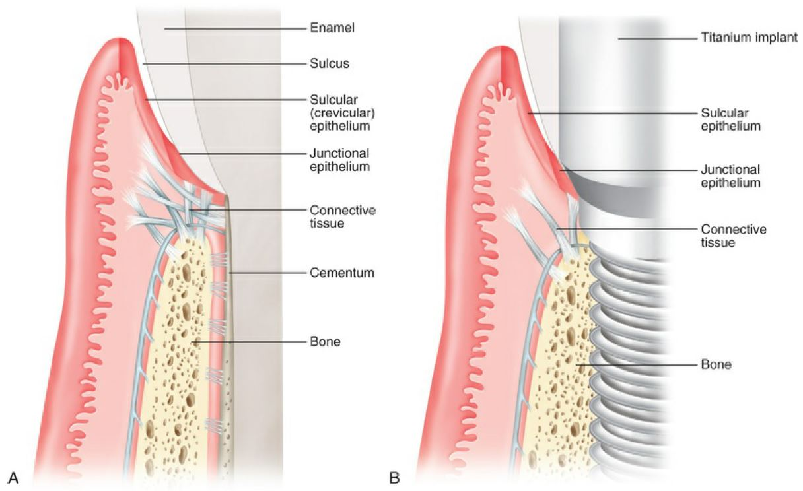
APPLIED ASPECTS
5. JUNCTIONAL EPITHELIUM AROUND IMPLANTS

Slide 85
APPLIED ASPECTS
5. JUNCTIONAL EPITHELIUM AROUND IMPLANTS

Slide 86
CONCLUSION

Slide 87
REFRENCES
Tintari C.R. Junctional Epithelium: A Literature Review. Quintessence Int Dent Dig. 1983;14(3):327-34.
Bosshardt D, Lang N. The Junctional Epithelium: from Health to Disease. Journal of Dental Research. 2005;84(1):9-20.
Shimono M. Biological characteristics of the junctional epithelium. Journal of Electron Microscopy. 2003;52(6):627-639.
Stern I. Current Concepts of the Dentogingival Junction: The Epithelial and Connective Tissue Attachments to the Tooth. Journal of Periodontology. 1981;52(9):465-476.
Carranza F, Klokkevold P, Newman M, Takei H. Carranza's Clinical periodontology. 13th ed.

Slide 88
THANK YOU
HARD WORK
PAYS OFF
. .

