Slide 1
HISTOLOGY OF TESTIS AND OVARY
SURESH BABU K

Slide 2
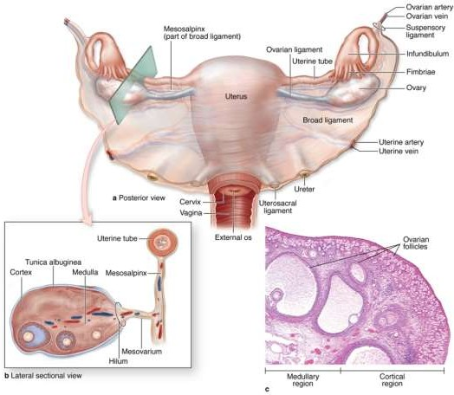
Ovary
Size: 3x1.5x1 cm
Location: Lateral pelvic wall
Coverings:Extension of mesovarium forming germinal epithelium, overlying tunica albuginea
Parts:Cortex & Medulla

Slide 3
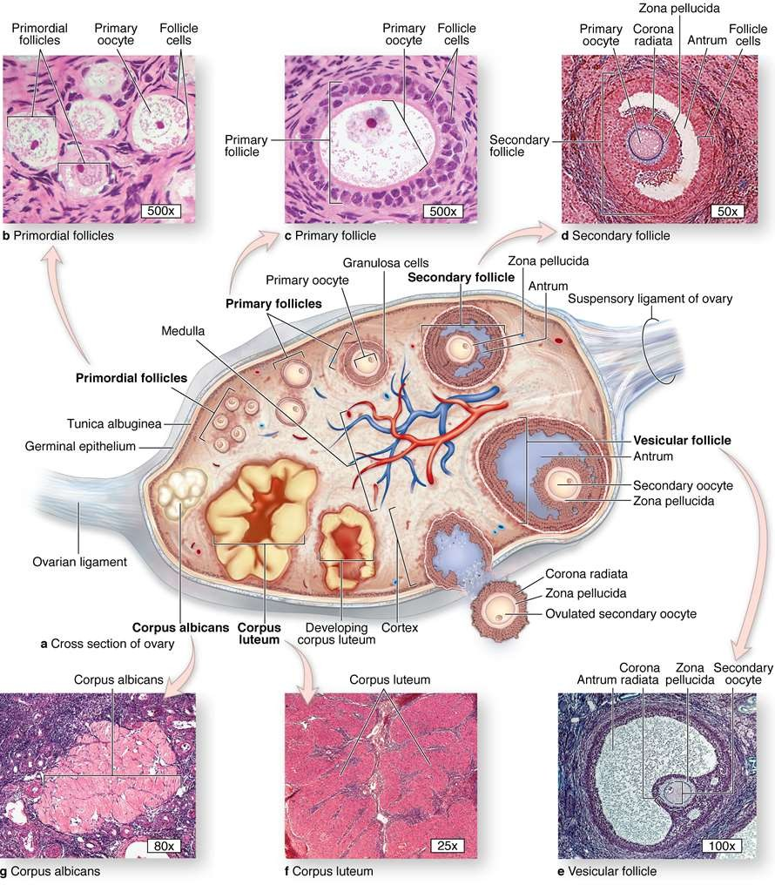
Ovary
Cortex: outer part consists of:
Stroma: connective tissue & stromal cells
Paranchyma: different phases of ovarian follicles

Slide 4
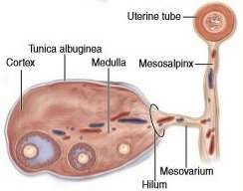
Ovary
Medulla: Most internal part of the ovary, consists of loose con. Ts. and blood vessels entering through hilum from mesenteries.

Slide 5
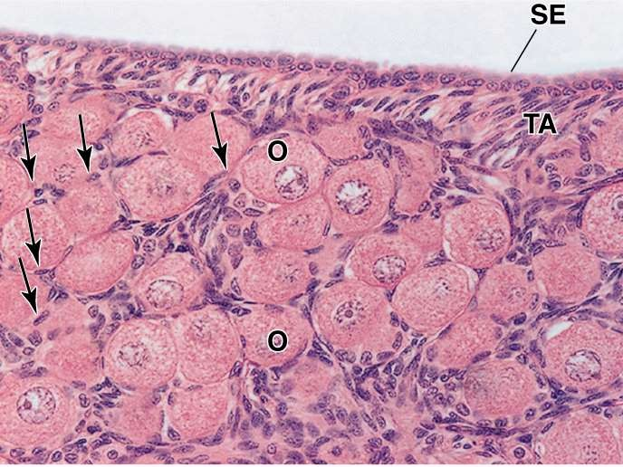
Primordial Follicle
Prim. Oocyte 25 μm in diameter with pale staining large nucleus in 1st Meiotic prophase, surrounded by a single layer of follicular cells resting on B/M

Slide 6
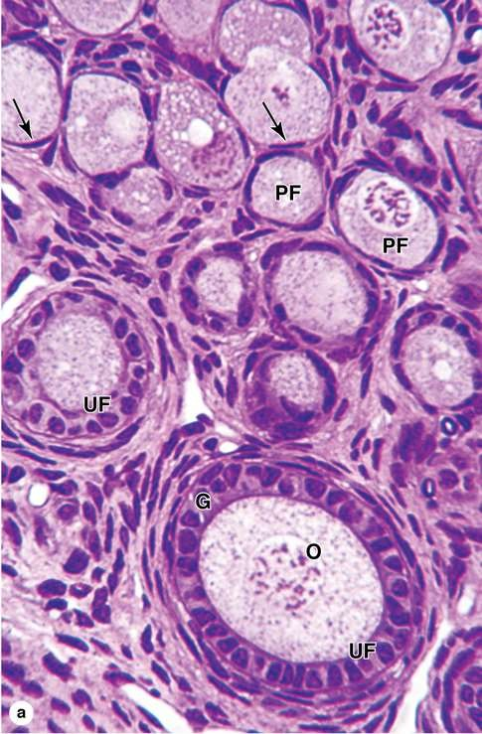
Primary Follicle
Growing follicles include:
Uni-laminar primary follicle
Multi-laminar primary follicle
Antral follicle
As follicles started growth three things change:
Oocyte
Follicular cells
Surrounding stroma

Slide 7
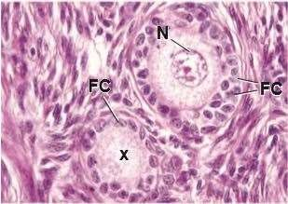
Primary Follicle
Formation of primary follicle – marked by
Growth of oocyte size from 25-30µm to 50 then 80µm
Flattened follicular cells start mitosis and become cuboidal then single layer of columnar cells forming unilaminar primary follicle

Slide 8
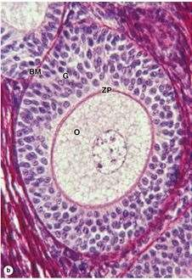
Primary Follicle
Further proliferation of follicular cells forming multilaminar primary follicle- stratum granulosum
With growth of oocyte it started secreting zona pellucida – gel like material rich in glycopr. & glycosaminoglycans

Slide 9
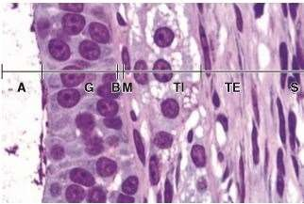
Growing Follicle
With further growth surrounding connective tissue stroal cells specialize forming a sheath “Theca folliculi”
Fibroblasts outside the growing follicles have developed as a steroid- secreting theca interna (TI)
A covering theca externa where some stromal cells become smooth muscle cells

Slide 10
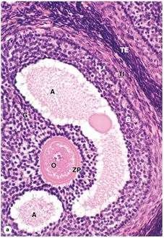
Antral Follicle
An antral follicle with large, fluid-filled antral cavities or vesicles (A) forming within granulosa layer by the follicular cells.
The oocyte (O) is surrounded by the zona pellucida (ZP) and granulosa cells (G).

Slide 11
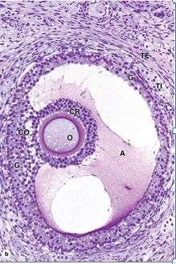
Antral Follicle
Granulosa cells also line wall of follicle.
Granulosa cells make up the corona radiata.
The corona radiata and oocyte are attached to the side of the follicle within a larger mass of granulosa cells called the cumulus oophorus

Slide 12
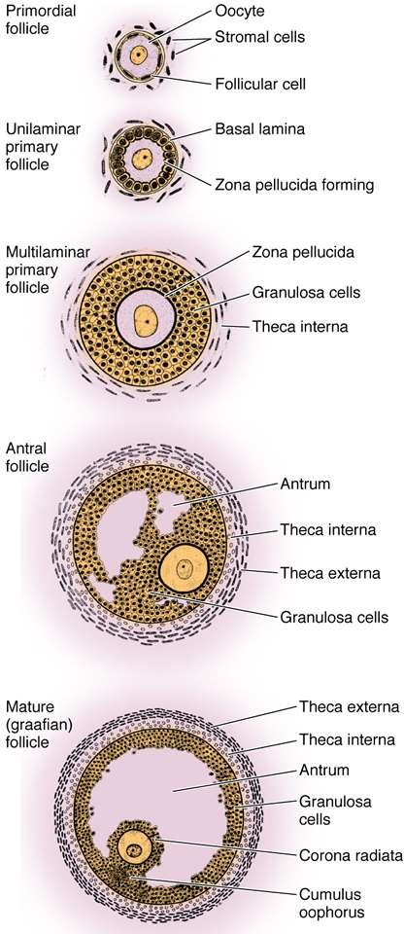
Graafian follicle
When size of growing follicle reaches 10mm called Graafian follicle
Oocyte development:
Formation of cortical granules
Formation of microvilli
Follicular development:
Single layer of corona cells
Accumulation of fluid with increase in size upto 10mm.

Slide 13
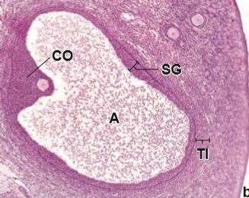
Graafian follicle
A buldge on suface of ovary
Development of theca cells
Accumulation of lipid drolets in theca interna cells

Slide 14
Ovulation & Atresia
Release of secondary oocyte from mature graafian follicle, during LH surge.
Factors responsible are
  Increase in volume & pressure of follicular fliud
  Lysis of follicular by activated plasminogen
  Contraction of smooth muscles in theca externa
Only one follicle reaches this fate others undergo atretic changes. Atresia involves apoptosis and detachment of the granulosa cells, autolysis of the oocyte, and collapse of the zona pellucida. Macrophages invade the degenerating follicle and phagocytose the debris

Slide 15
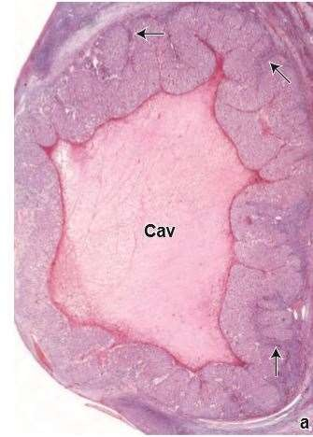
Corpus Luteum
After ovulation reorganization of collapsed follicular wall
Formation of the corpus hemorrhagicum
Invasion of connective tissue
Differentiation of granulosa & theca interna cells into luteal cells – luteinization
Leuteal cells have structure of steroid secreting cells.

Slide 16
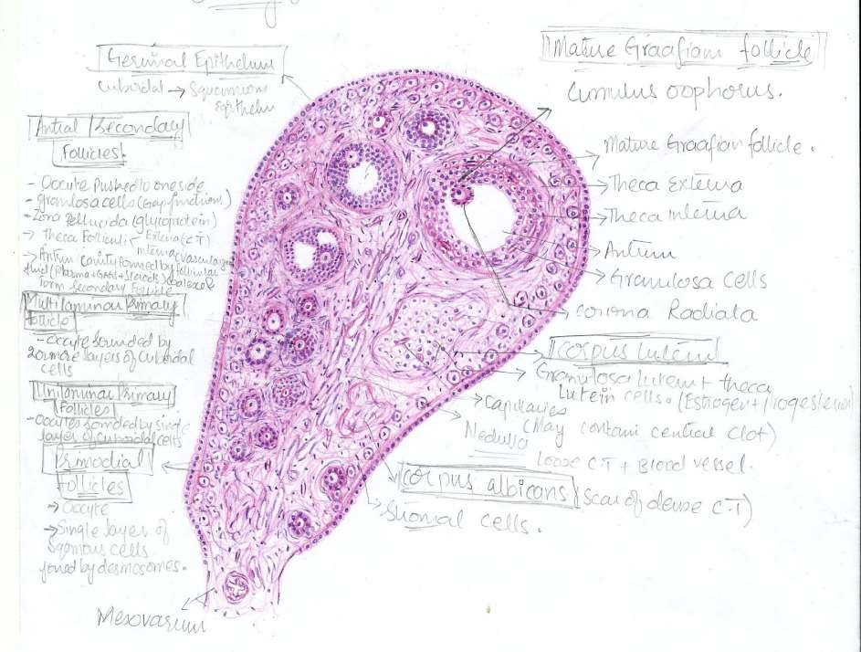

Slide 17
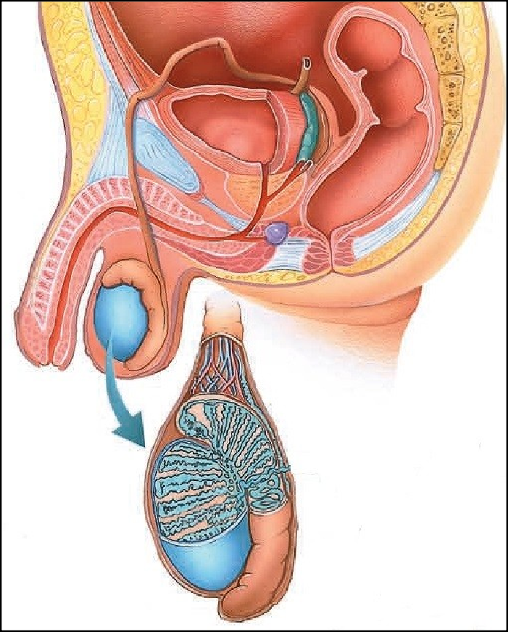
INTRODUCTION
31-03-2014
Ductus deferens
Seminal vesicle
Ejaculatory duct
Penis with urethra
Prostate gland
Bulbourethral gland
Testes
Epididymis
The male reproductive system consists of the two testes male gonads), a system of genital ducts, accessory glands,
he penis.

Slide 18
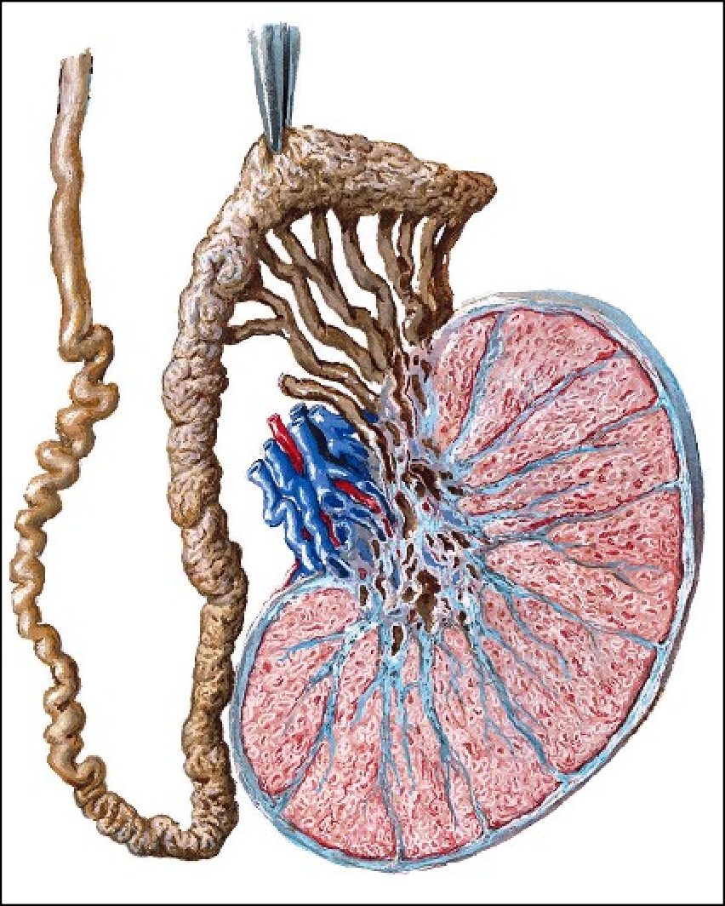
Testes
31-03-2014
Each testis is an oval structure housed in its separate compartment within the scrotum.
The tunica albuginea, the fibromuscular connective tissue capsule of the testis, is thickened at the mediastinum testis, from which septa are derived to subdivide the testis into approximately 250 small, incomplete compartments, known as the
Tunica alb^{lo}ug^{b}in^{u}e^{l}a^{i testis.}
iastinum
tis
Septae
Lobuli testis

Slide 19
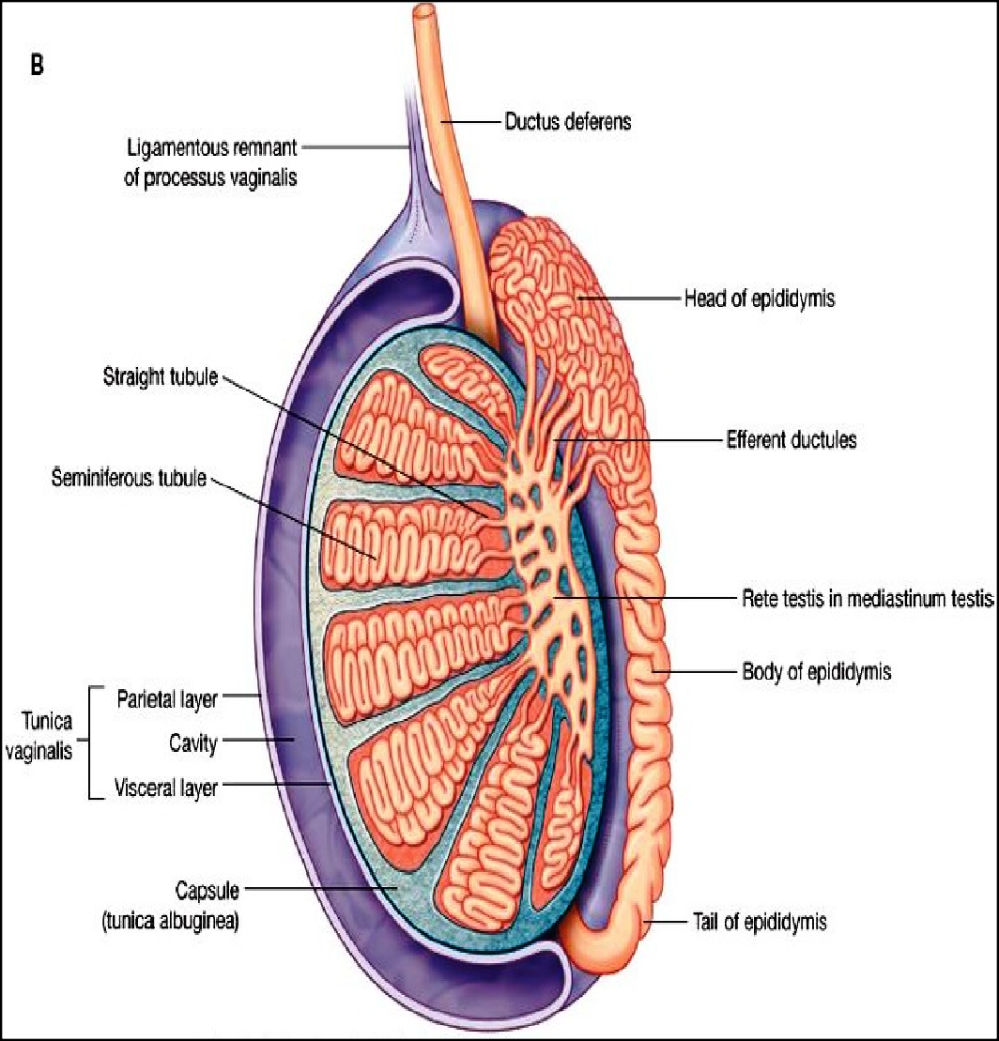
Coverings of testes
31-03-2014
❑ It is covered from outside inwards by
Tunica Vaginalis
Tunica albuginea
Tunica vasculosa

Slide 20
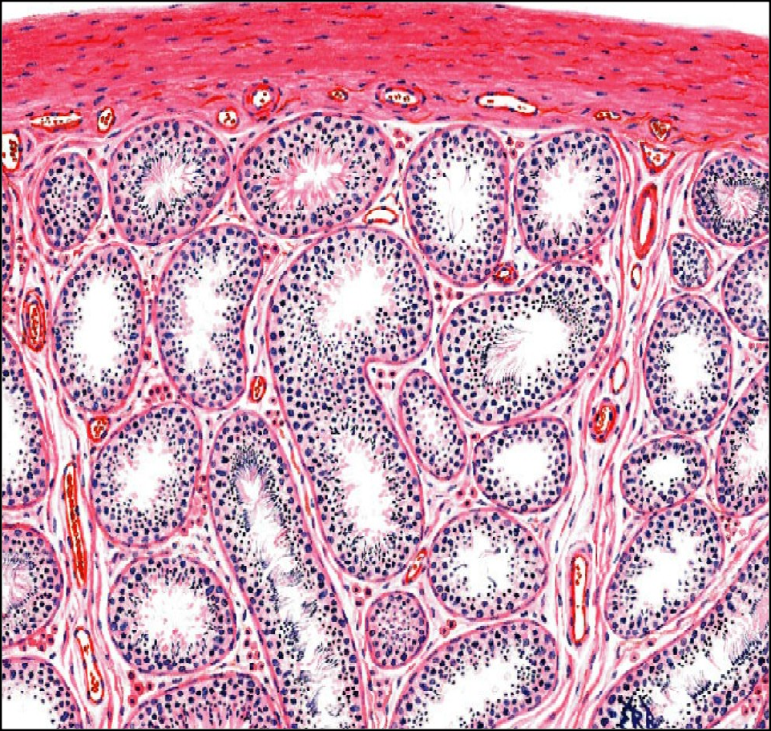
Testes (contd...)
31-03-2014
_{Semineferous tubule}
Tunica vasculosa
Each lobule contains 1 to 4 tightly coiled tubules, the seminiferous tubules.
Each seminiferous tubules is about 30-70cm long and 200μm in diameter.
In between seminiferous tubules there is presence of loose connective tissue and blood vessels.
Interstial tissue contains interstitial cells (Leydig
❑
cells) which produce testosterone.
Interstitial Cells (Leydig Cells)
Interstitial Connective tissue
Septum

Slide 21
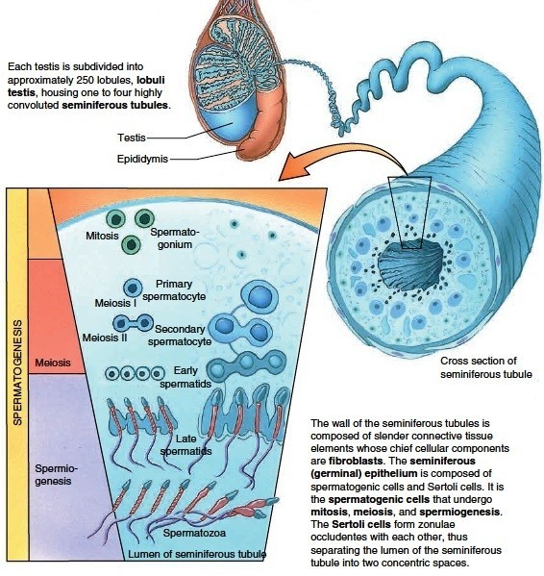
Testes (contd...)
31-03-2014

Slide 22
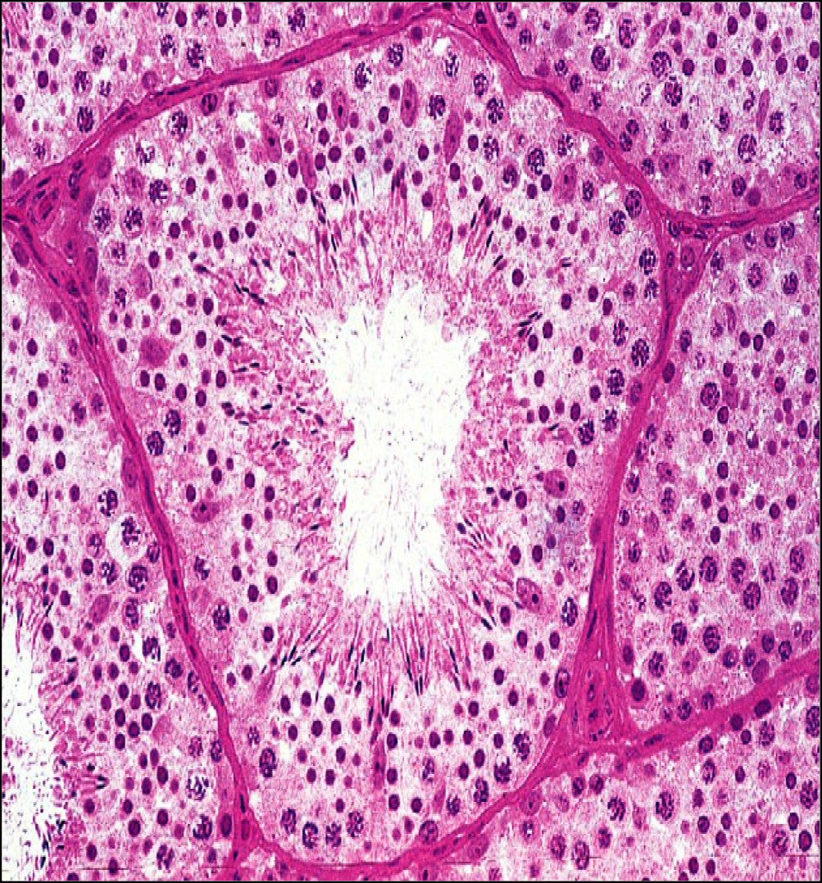
Testes (contd...) S
31-03-2014
Seminiferous tubule:
❑ The seminiferous tubules are lined by complex stratified epithelium which consists of two major class of cells
Supporting cells (sertoli cells)
Spermatogenic cells
❑
It is surrounded by layer of connective tissue.
7
connective tissue
Spermatogenic cells

Slide 23
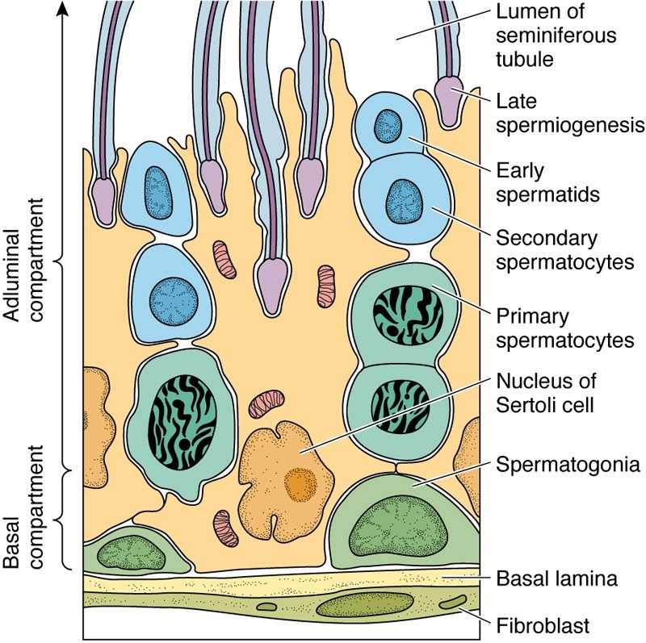
Testes (contd...)
31-03-2014
Sertoli cells:
Tall columnar cells extending from basal lamina to free epithelial surface.
❑ They have irregular outlines as they have lateral processes which surround spermatogenic cells.
❑
8

Slide 24
Functions of sertoli cells
31-03-2014
Support: provides structural and metablic support to spermatogenic cells
Protection and nutrition
Phagocytosis: phagocytose excess cytoplasm which is shed from differentiating spermatids during spermiogenesis.
Secretion:
Some components of testicular fluid
Secrete androgen binding proteins which help in concentration of testosterone
Secrete inhibin that inhibits FSH secretion from pituitary
❑ Form blood – testes barrier

Slide 25
BLOOD – TESTES BARRIER
31-03-2014
Adjacent sertoli cells are joined together by tight junction through their basal cytoplasmic processes over spermatogonia.
These tight junctions form blood-testes barrier.
The blood-testes barrier prevents entry of harmful substances from blood affecting developing sperms and at the same time preventing sperms related proteins to enter circulation.
❑
blood-testes barrier

Slide 26
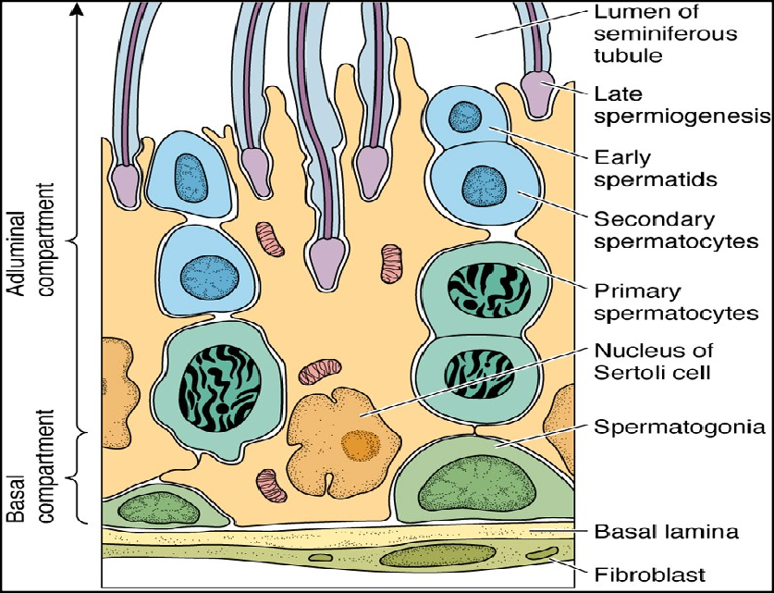
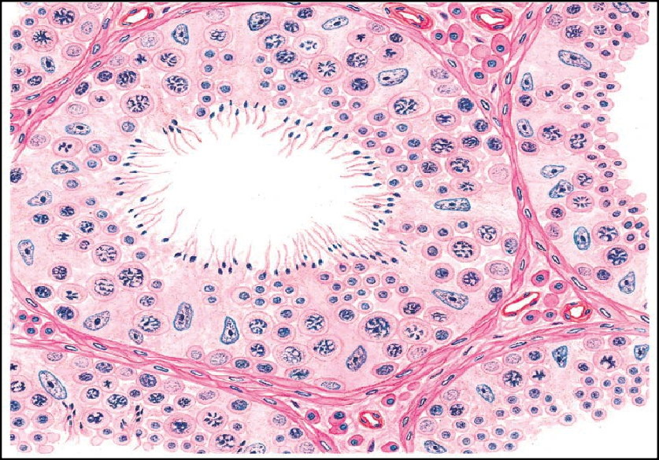
SPERMATOGENIC CELLS
31-03-2014
❑
It is arranged as complex stratified epithelium which consists of stem cells (spermatogonia) at the base of the epithelium.
❑ The other cells are arranged
in the order of development.
i.e spermatogonia, spermatocytes, spermatids, spermatozoa.
primary spermatocyte
late spermatogonia
s p e r m a t
i d s
❑ This process of differentiation
sertoli
c e l l s
of spermatogonia to spermatozoa is called spermiogenesis. It takes usually 64±4 days in men.
early sprmatids
leydig cells

Slide 27
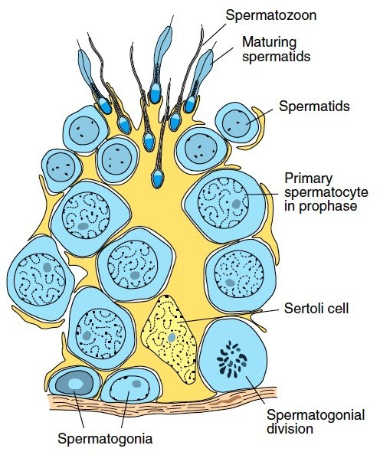
spermatogonia
31-03-2014
❑ These are immature spermatogenic cells lying on the basement membrane of seminiferous tubule.
Spermatogonia (Mitosis)
Type A spermatogonia
Type B spermatogonia
Serve as stem cell Of Germinal
epitheliu m
Undergo
matur ation to form primar
12

Slide 28
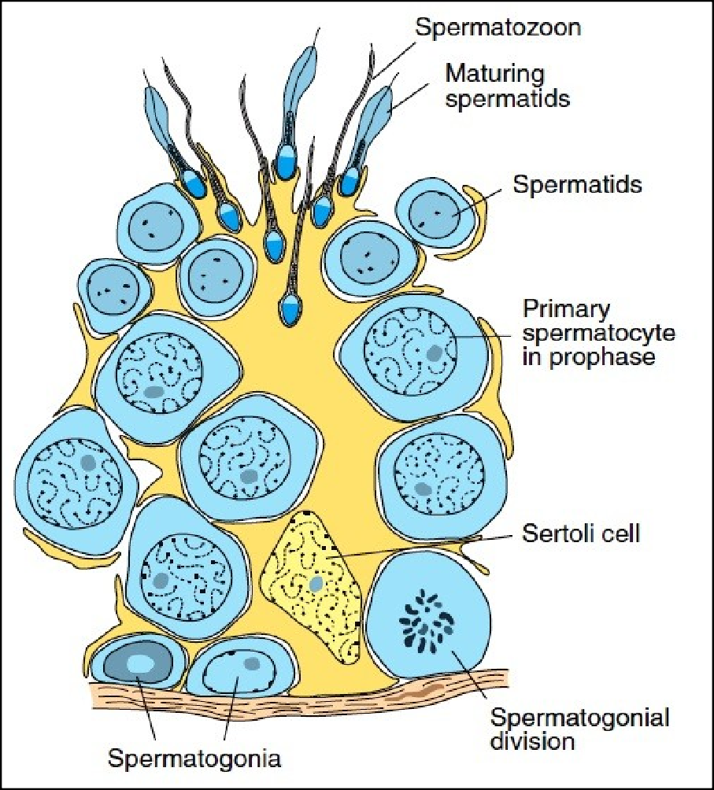
Primary spermatocyte
31-03-2014
These are largest germ cells occupying the middle region of seminiferous tubule.
They have large nucleus with coarse chromatin clumps.
Primary spermatocytes (I Meiotic division)
condary spermatocytes aploid no. of chromosomes)

Slide 29
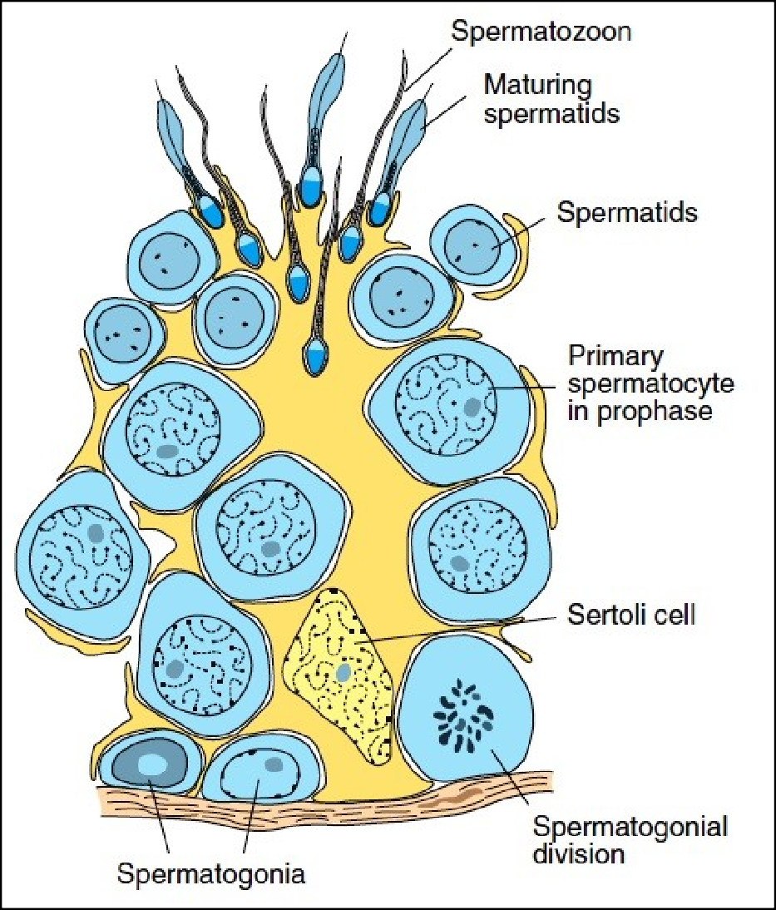
SECONDARY SPERMATOCYTES
31-03-2014
❑
Are smaller in size with their nuclei having less dense chromatin.
Secondary spermatocytes (II Meiotic division)
Spermatids
(Haploid no.of chromosomes)

Slide 30
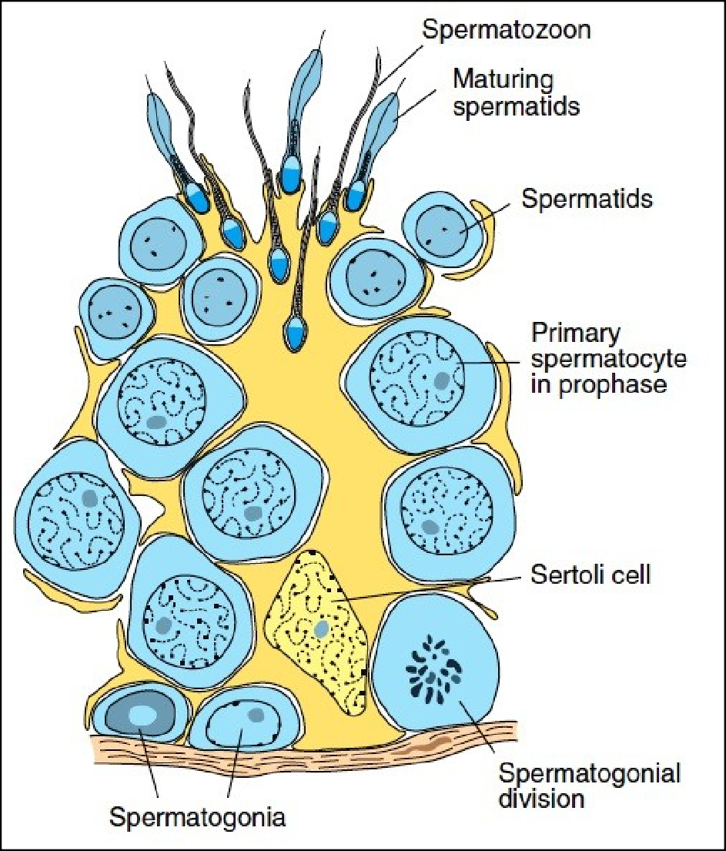
SPERMATIDS
31-03-2014
They are much smaller and lie in groups in sertoli cells.
With the formation of spermatids the first phase of spermatogenesis i.e spermatocytogenesis is completed.
II Phase (Spermiogenesis):
Spermatids (Non – motile)
Motile spermatozoa (By spermiogenesis)
15

Slide 31
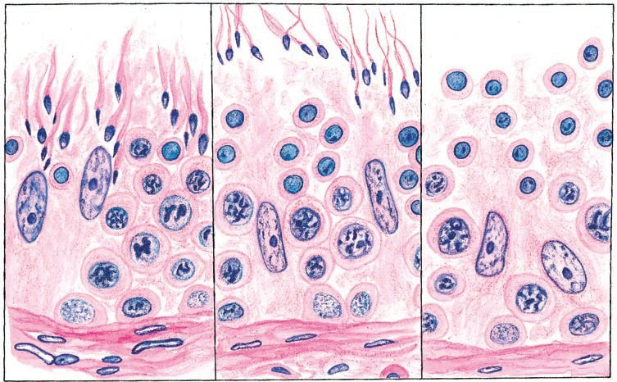
Spermatogenic Cells in different Stages of development
secondary spermatoc
yt e
spematids
pimary spermat
sertoli
c e
o
c y t e
l l
s

Slide 32

GENITAL DUCTS
31-03-2014
Genital ducts conduct sperms to urethra.
They are
Epididymis
Ductus deferens
Ejaculatory duct
18

Slide 33
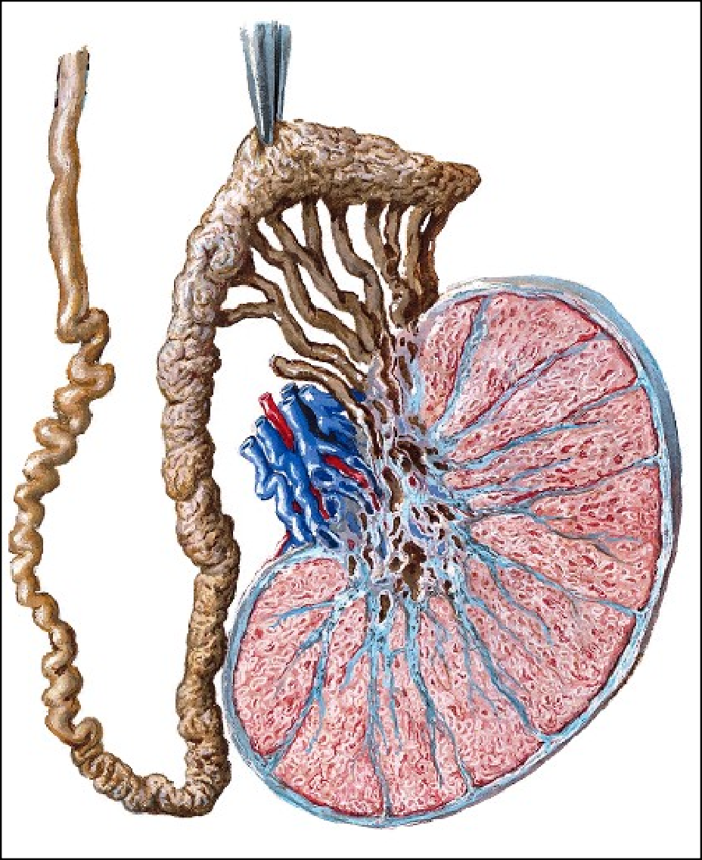
EPIDIDYMIS
31-03-2014
epididysmus
It is a comma shaped structure on the posterolateral aspect of testes.
It is 6m long, highly coiled and supported by vascular connective tissue.
It is lined by pseudostratified columnar epithelium.
It consists of two types of cells
I) Tall columnar principle cells
II) Small basal cells
19

Slide 34
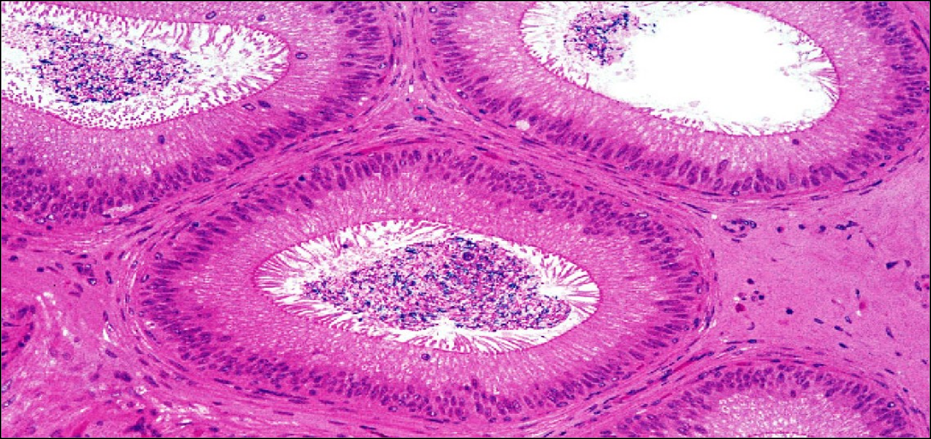
EPIDIDYMIS
31-0
Stereocilia
3
- 2
0
1
4
sperm
principle cel ls
Pseudostratified epithelium
Smooth muscles
cells
❑
Tall columnar principle cells bear microvilli called stereocilia which
are involved in both secretion and absorption.
❑
Beneath the epithelium there is a circularly arranged smoot₂h₀
muscle fibres.

Slide 35
EPIDIDYMIS - FUNCTIONS
31-03-2014
Storage of spermatozoa – Epididymis is so long that it takes a month for the sperm to make the journey.
Smooth muscles in the wall contracts rhythmically during ejaculation to move the sperm along.
Epithelial cells are phagocytic and degenerate the sperms and residual bodies.
Maturation of spermatozoa – they become motile
Absorption of testicular fluid – 90% of testicular fluid is absorbed here.

Slide 36
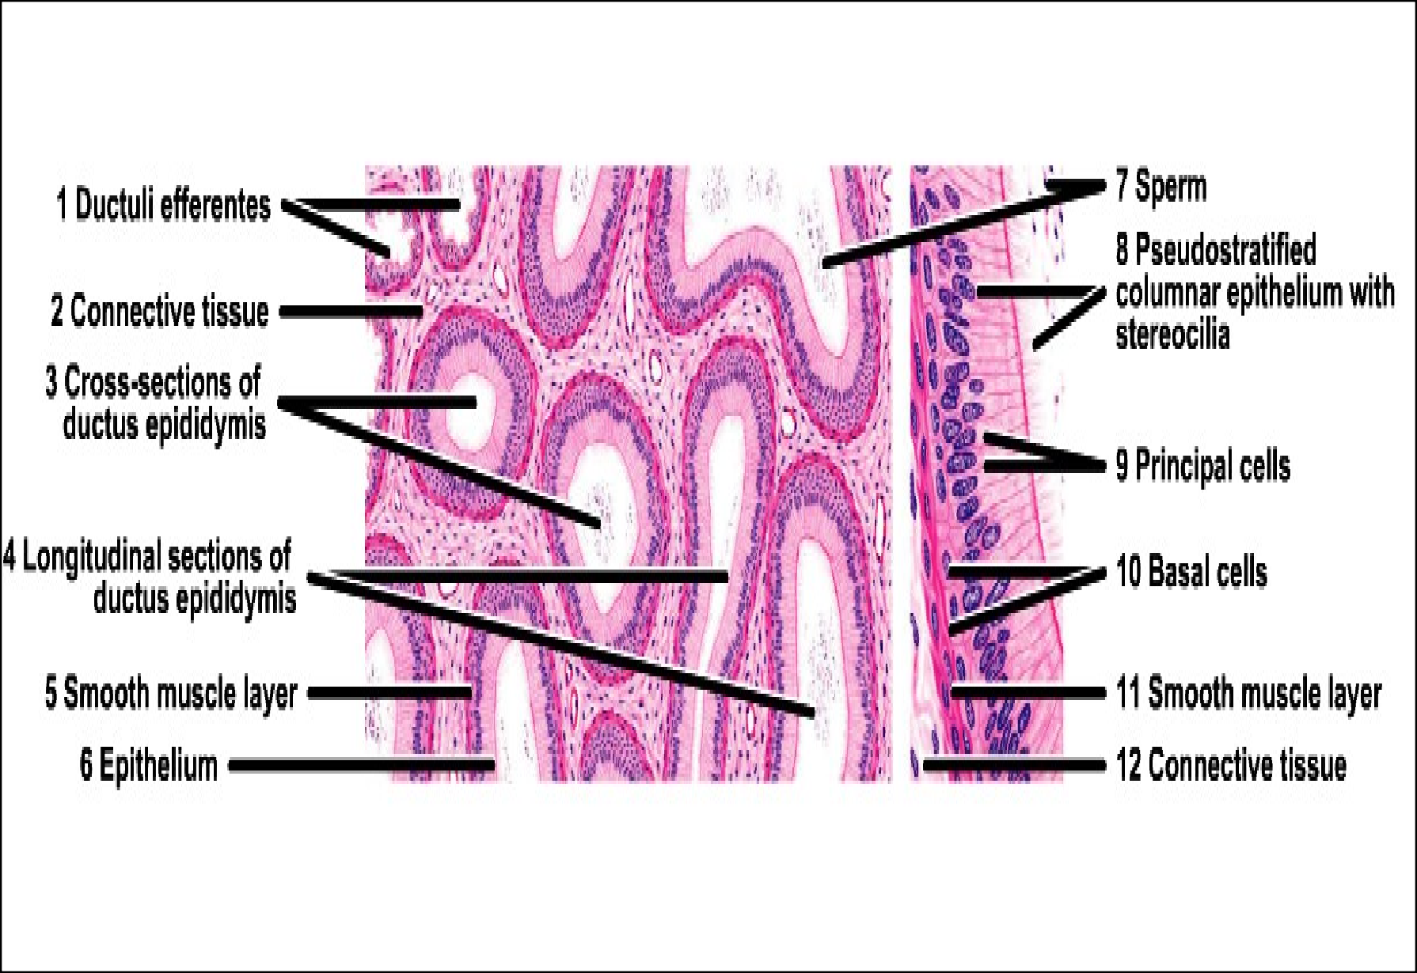
EPIDIDYMIS – PANORAMIC VIEW
31-03-2014
22

Slide 37
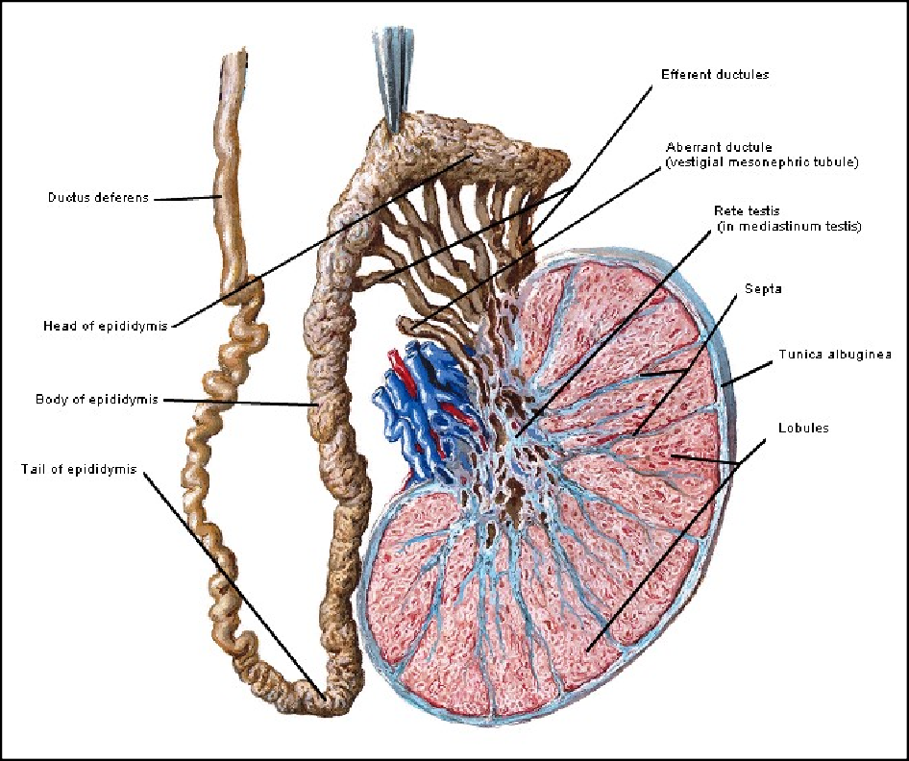
DUCTUS DEFERENS
31-03-2014
It is a thick muscular tube extending from the tail of epididymis to prostatic urethra.
The distal end of ductus deferens is dilated to form ampulla which joins with duct of seminal vesicle to form ejaculatory duct.
Ductus deferens is also called vas deferens.
23

Slide 38
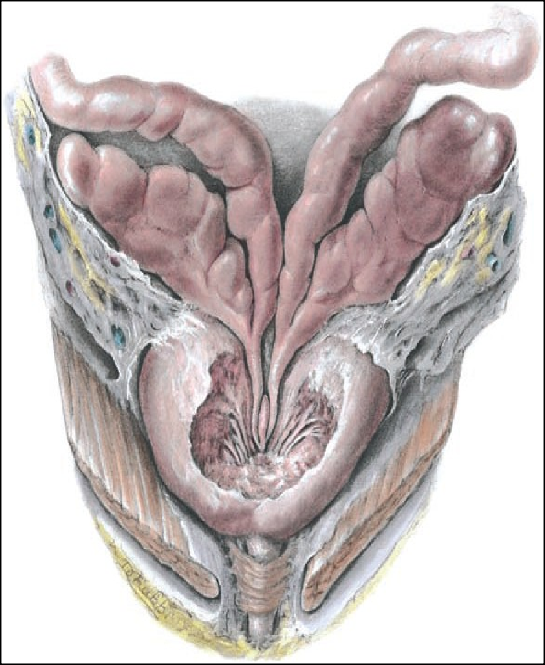
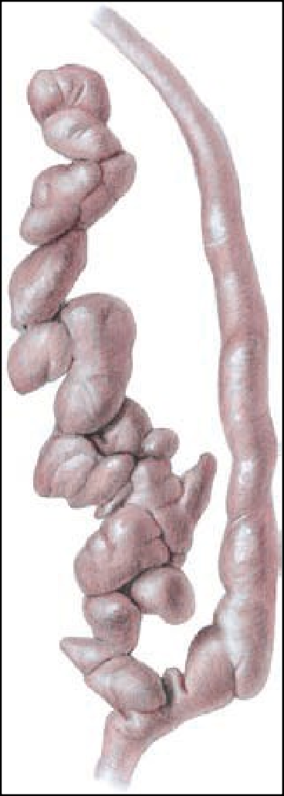
Ductus deferens
31-03-2014
Seminal
Ductus deferens
vesicl
e
Seminal vesicle
ovulatory duct
Ejaculatory
duc t
Ampulla
ejaculatory duct pierces the prostate and opens into prostatic urethra.
s deferens consists of three coats
24
cosa II) Muscular layer III) Adventitia

Slide 39
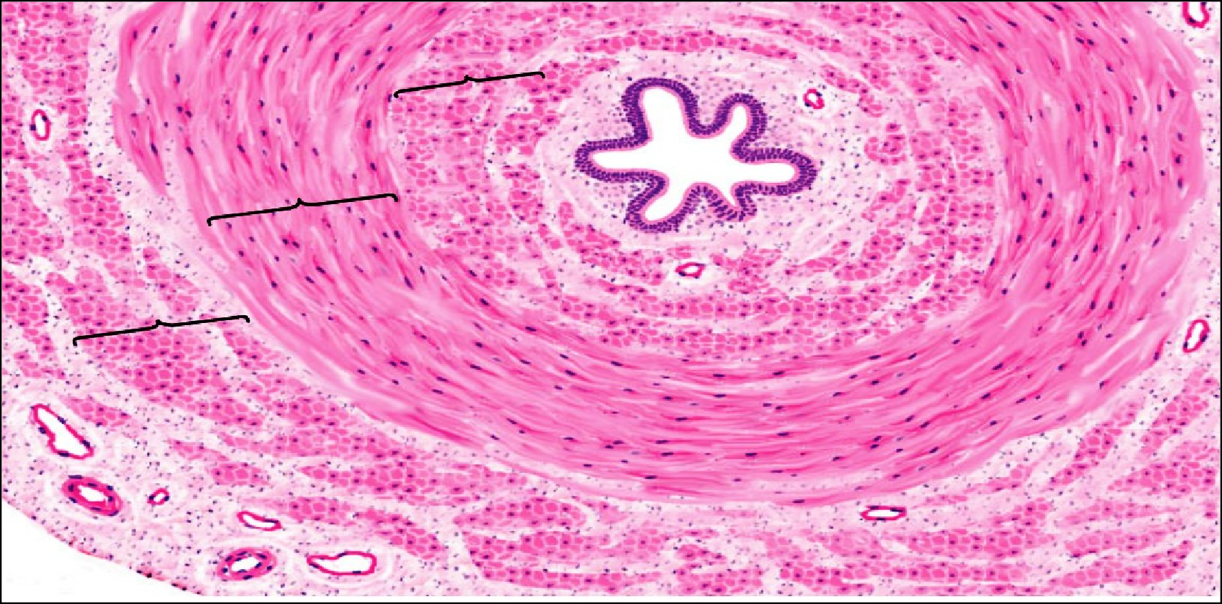
DUCTUS DEFERENS
31-03-2014
Inner longitudinal
Mucosa
Middle circular
ter
ngitudinal
ventitia
Mucosa – It is irregular star shaped and is lined by pseudostratified columnar epithelium with stereocilia. Lamina propria contains
collagen and elastic fibres.
Muscle layer – Inner and outer longitudinal, middle circular Adventitia – fibroelastic CT with blood vessels and nerves
25

Slide 40
ACCESSORY SEX GLANDS
31-03-2014
These glands are androgen dependant organs whose secretions provide medium for transport and nourishment of sperms and constitute the bulk of semen (Seminal fluid).
They are
Seminal vesicle (Accounts for 30% of seminal fluid)
Prostate gland (Accounts for 60% of seminal fluid)
Bulbourethral glands (Accounts for 10% of seminal fluid)
26

Slide 41
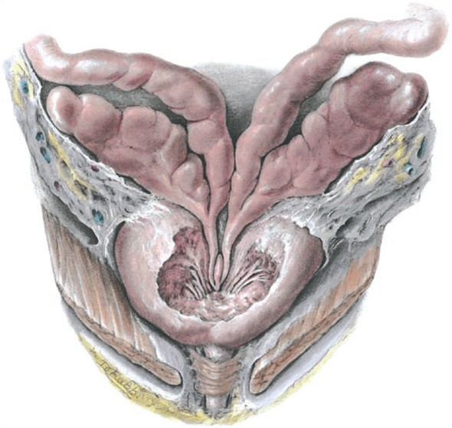
SEMINAL VESICLE
31-03-2014
These are paired glands present at the base of urinary bladder.
Each gland is elongated blind tube (12-15cm)
Secretes thick yellow viscous alkaline fluid rich in fructose that nourishes the sperm. It also contains ascorbic acid and prostaglandin.
Ductus
deferens
Seminal vesicle
Ductus deferens
Seminal vesicle
made up of three coats
ucosa II) Muscle layer III) Adventitia
27

Slide 42
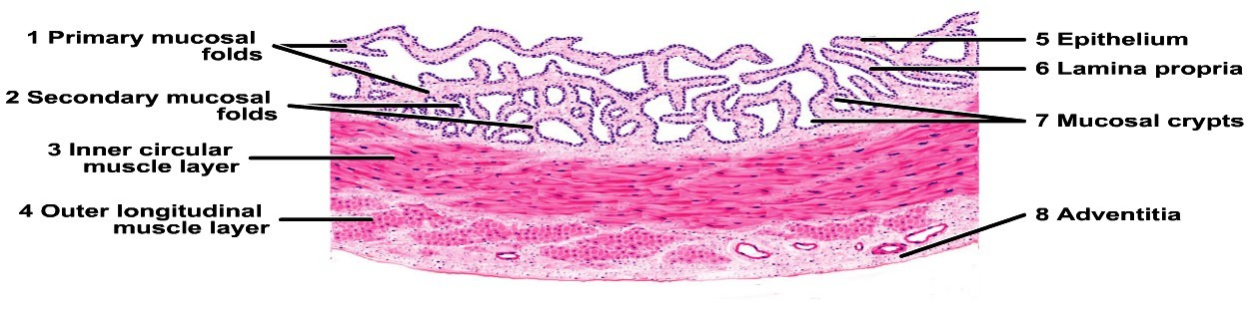
SEMINAL VESICLE
31-03-2014
28

Slide 43
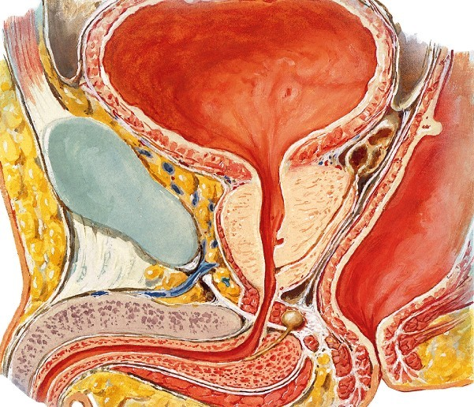
PROSTATE GLAND
31-03-2014
❑
It is present at the beginin g of male urethra It is of the size of chestnu
Urinary bladder
❑
t.
29
❑
It is 20g in
Prostate gland
Seminal vesicle

Slide 44
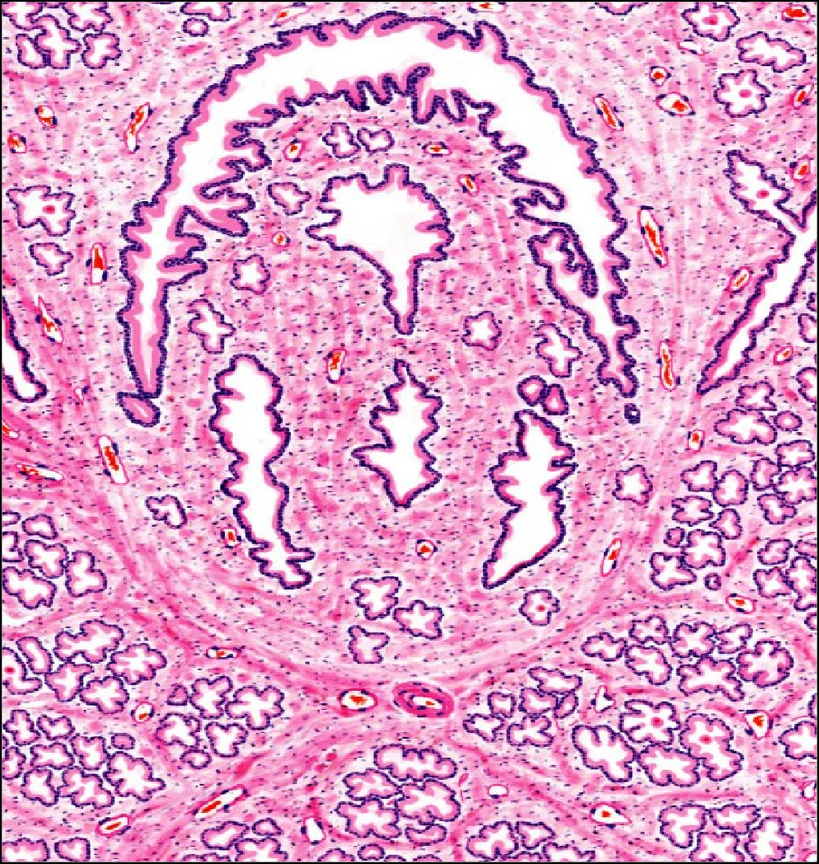
PROSTATE GLAND
31-03-2
Histologically prostate consists of parenchyma (tubulo-alveolar glands) and a characteristic fibromuscular stroma.
Glandular parenchyma:
0
1
4
30
−
Formed by irregular prostatic alveoli with wide lumen.
Secretory lining of alveoli varies from cuboidal to columnar depending upon activity.
Glandular parenchyma Fibromuscular stroma
−

Slide 45
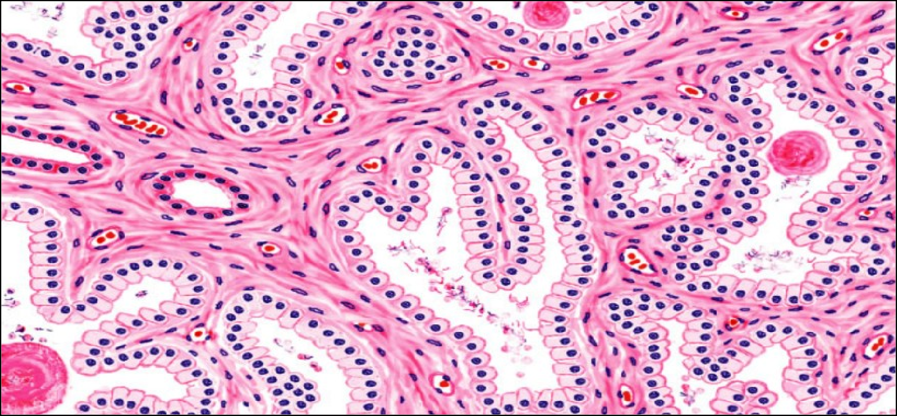
PROSTATE GLAND
Corpora
amylace
31-03-2014
The lumen contains spherical prostatic concretions or corpora lacea which are formed by condensation of prostatic secretions. The number of concretions increase with age and may become
ified.
31

Slide 46
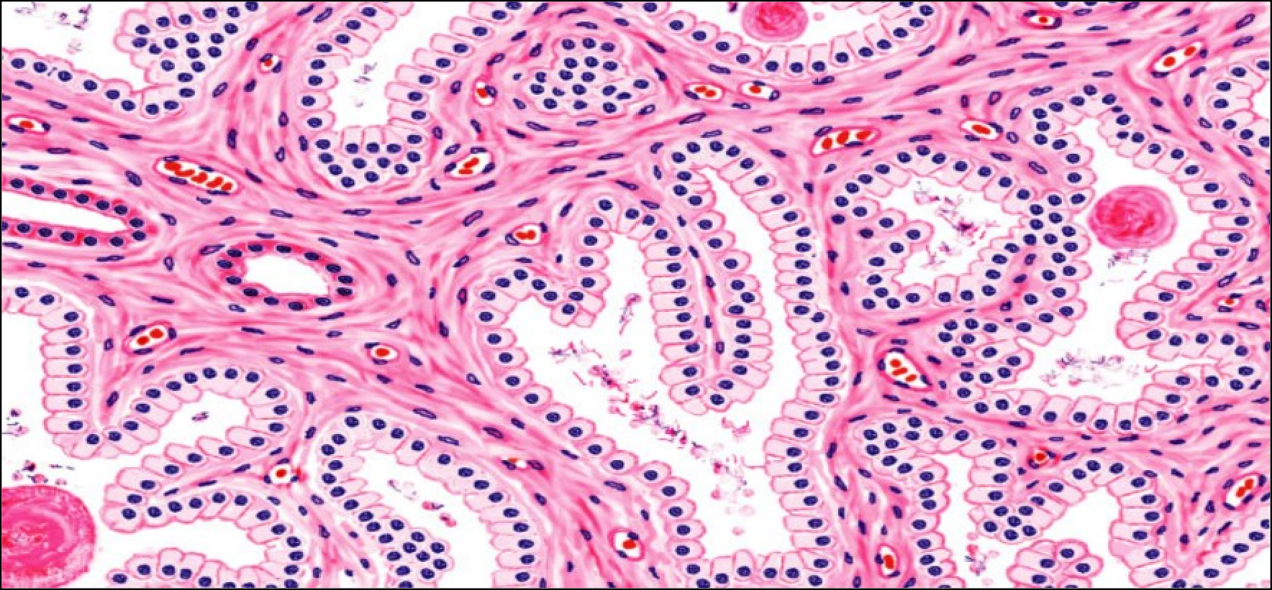
Fibromuscular stroma with blood vessels
31
-
0
3
- 2
0
1
4
Fibromuscular stroma:
❑
It supports the parenchyma and is made of smooth muscle
fibres
mixed with connective tissue fibres running in different directions.
The stroma also contains blood vessels, lymphatics and
32
❑

Slide 47
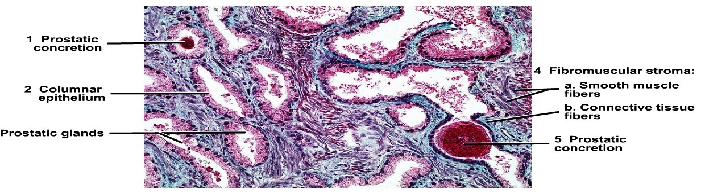
PROSTATE GLAND (PANORAMIC VIEW)
31-03-2014
33

Slide 48
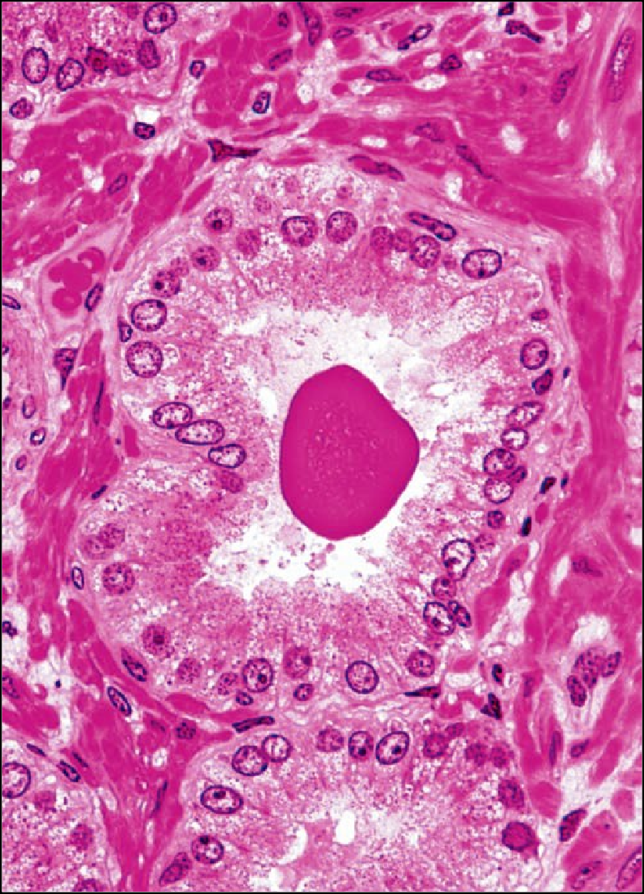
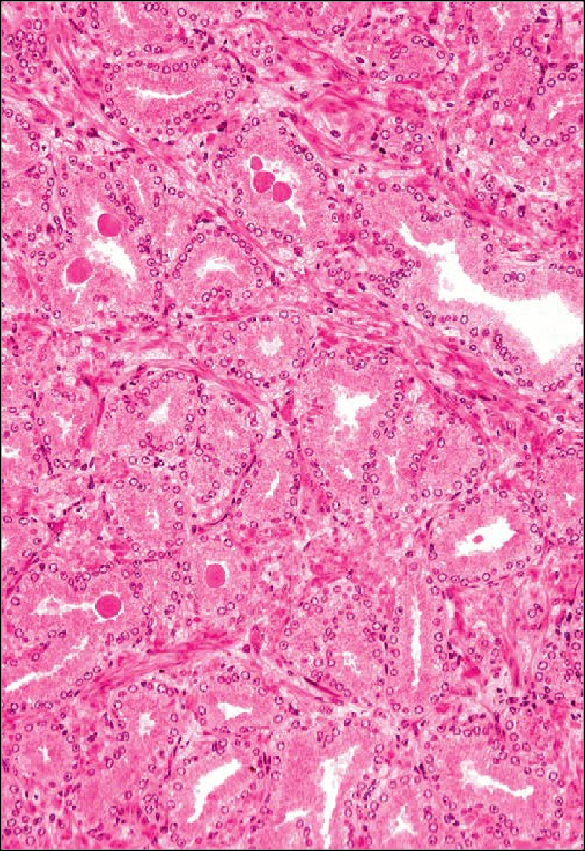
PROSTATE GLAND (PANORAMIC VIEW)
Glandular parenchyma
31-03-2014
Fibromuscular stroma
Columnar
cells
PC
Fibro muscular stroma
4
3
Prostatic concretions

Slide 49
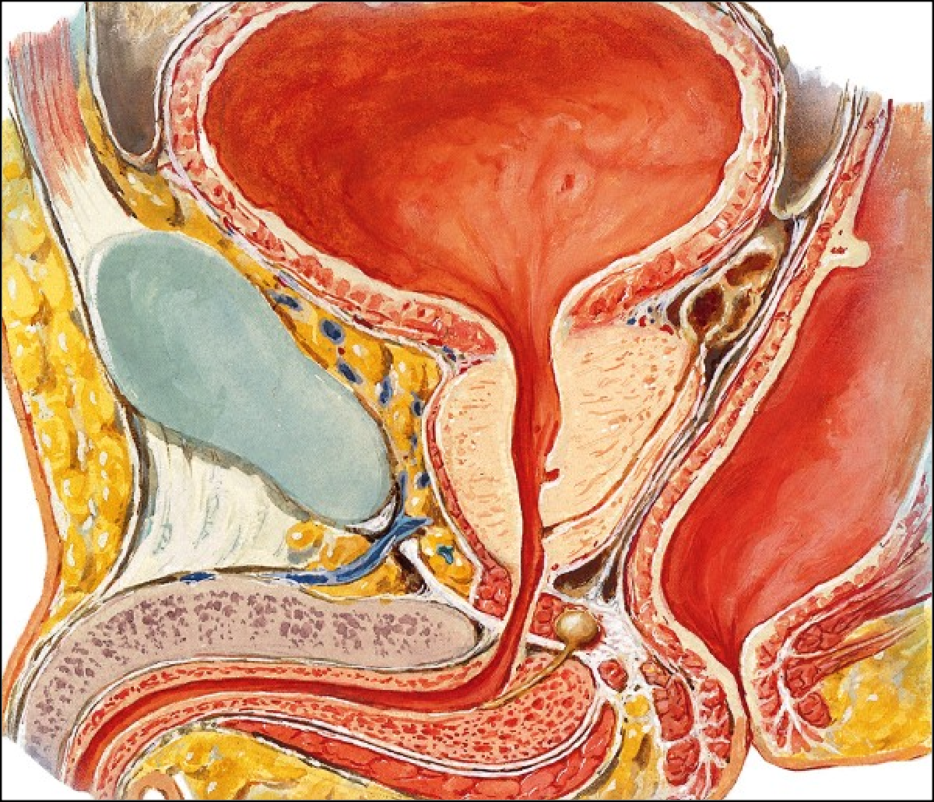
BULBOURETHRAL GLANDS
31-03-2014
These glands are 2 in number and are of the size of a pea.
They lie in deep perineal pouch and secrete mucus like fluid that lubricates penile urethra before ejaculation.
35
Bulbourethral glands

Slide 50
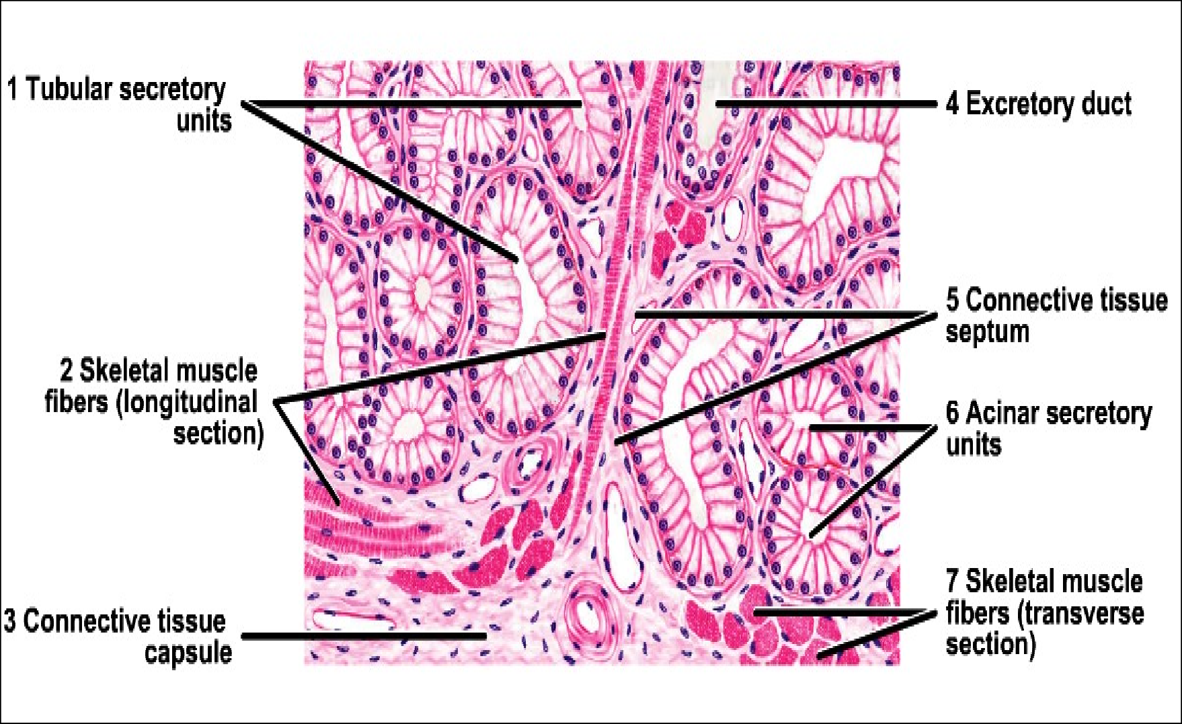
BULBOURETHRAL GLANDS
31-03-2014
36

Slide 51
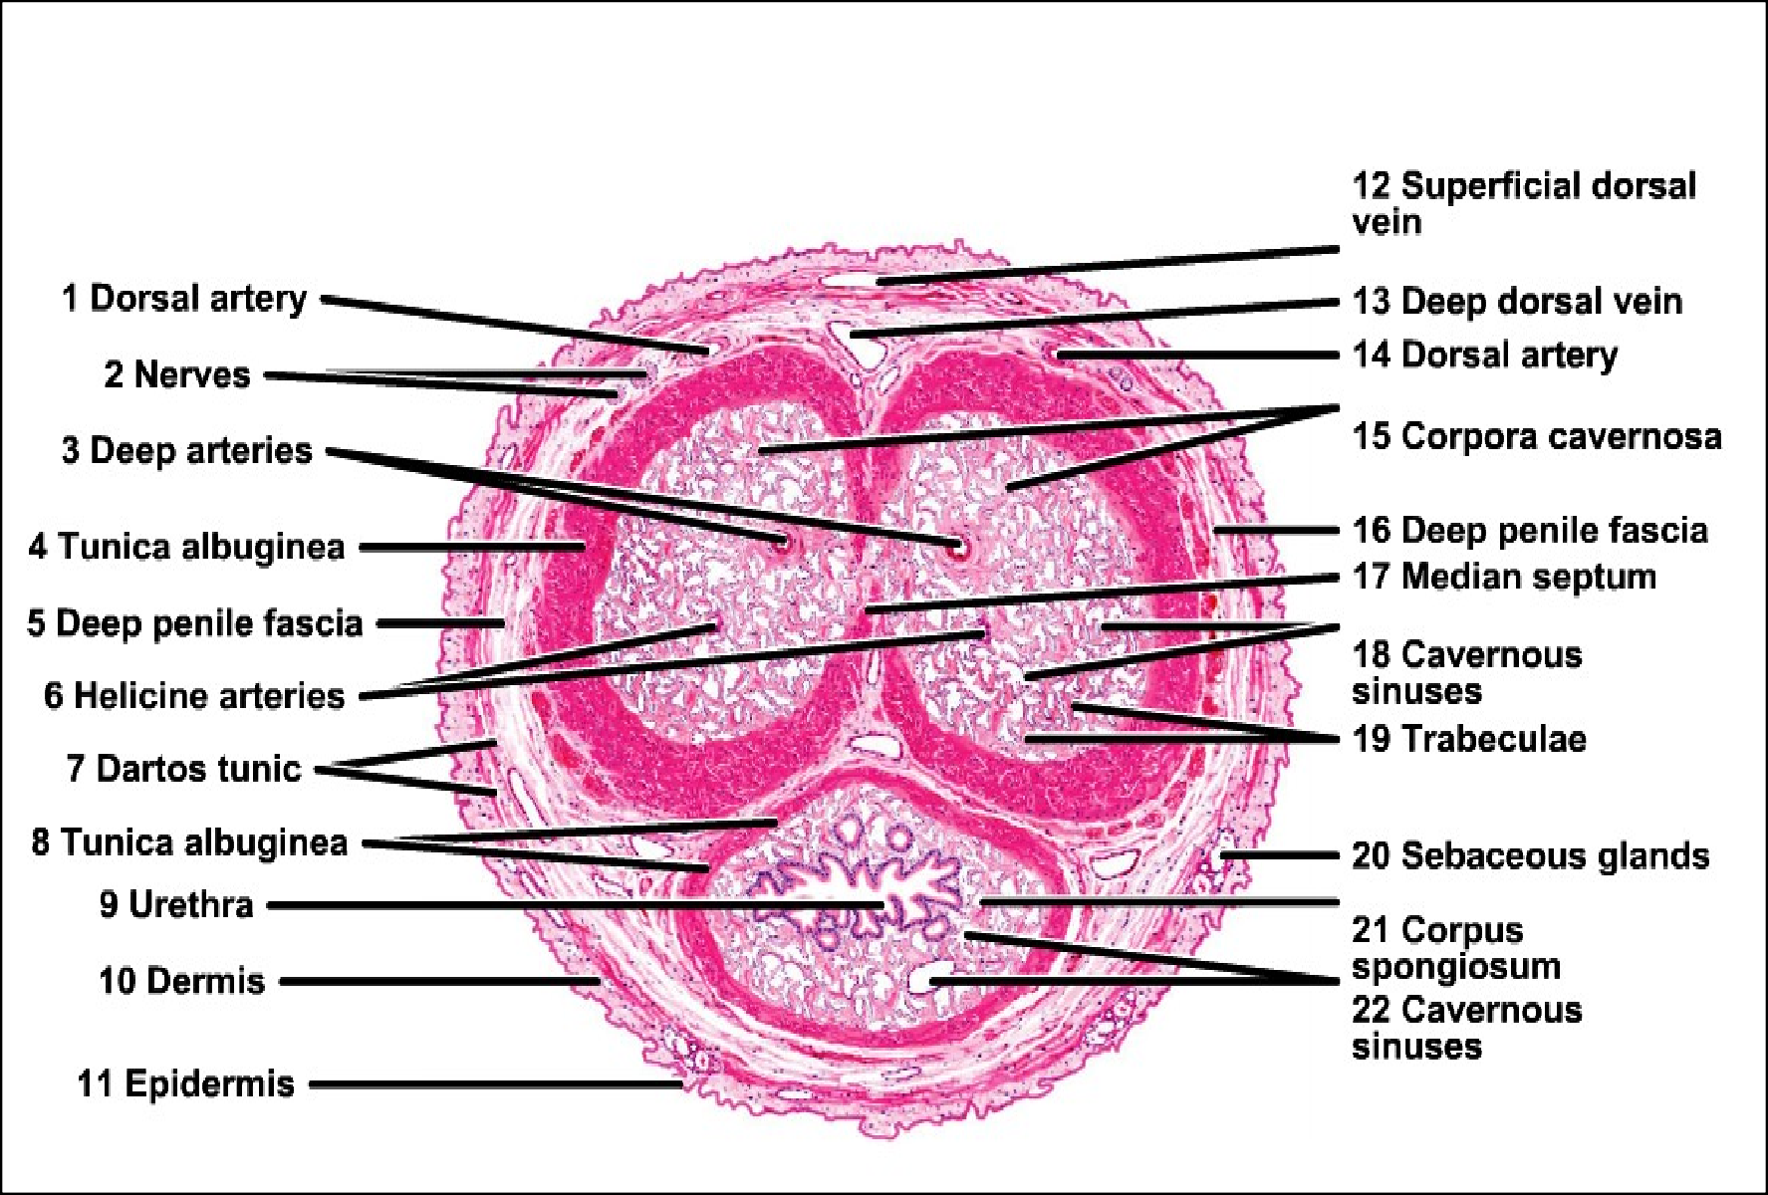
PENIS
31-03-2014
37

