Slide 1
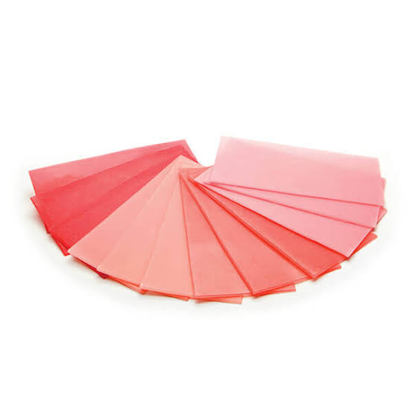
DENTAL WAXES AND INVESTMENT MATERIALS

Slide 2
CONTENTS
INTRODUCTION TO WAXES
COMPONENTS OF WAX
CLASSIFICATION
CHARACTERISTIC PROPERTIES
DENTAL WAXES
INVESTMENT MATERIAL
CLASSIFICATION
GYPSUM BONDED
PHOSPHATE BONDED
ETHYL-SILICATE BONDED

Slide 3
Introduction
Dental waxes can be defined as a thermoplastic molding material that is solid at room temperature and when subjected to moderate temperature become a low viscosity liquid.
They are esters of fatty acid, alcohol or hydrocarbons.

Slide 4
Dental waxes may be composed of natural and
synthetic waxes- gums, fats, fatty acids, oils, natural
and synthetic resins, and pigments of various types.

Slide 5
COMPONENTS
SYNTHETICC
NATURAL
ADDITIVES
FATS
STEARIC ACID
GLYCERAL TRYSTEARATE
OILS TURPENTINE COLORANT NATURAL RESINS
COPAL, DAMMAR,SHELLAC, KAURI
SYNTHETIC RESIN ELVAX, POLYETHYLENE, POLYSTYRENE
MINERAL
PLANT
INSECTS AND ANIMAL
Paraffin
Ceresin
Montan
Barns dahl
Microcryst alline
Ozokerite
Carnauba
Candelilla
Ouricury
Japan wax
Coco butter
Bees wax
Spermaceti

Slide 6
PARAFFIN WAXES
Obtained from the high-boiling point fractions of petroleum.
The melting temperatures generally increase with increasing molecular weights. Melting range 40-71°C.
During solidification and cooling, there is a volumetric contraction that varies from 11% to 15%.

Slide 8
MICROCRYSTALLINE WAXES
Obtained from the heavier oil fractions in the petroleum industry- have higher melting points.
Tougher & more flexible than paraffin waxes.
Melting range is 60-90°C
Microcrystalline waxes have less volumetric change during solidification than paraffin waxes.
Notes:
60-90

Slide 10
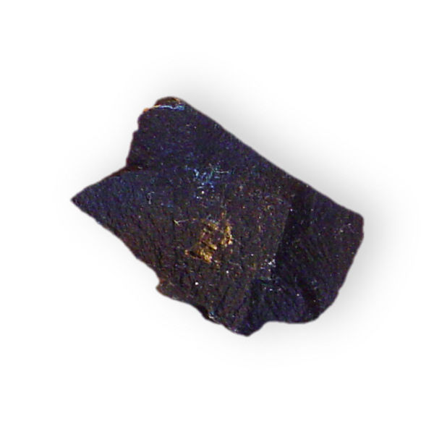
BARNSDAHL WAX
Microcrystalline wax used to increase the melting range & hardness & reduce the flow of paraffin waxes.
Notes:
70-74

Slide 11
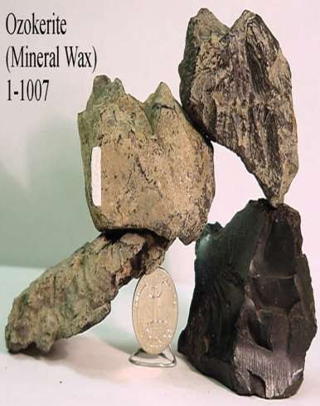
OZOKERITE WAX
Typically a white earth wax extracted from ozokerite
It also has great affinity for oil, & in quantities of 5% to 15% greatly improves the physical characteristics of paraffin in the melting range of 54⁰C.
Notes:
MR- 65 C

Slide 12
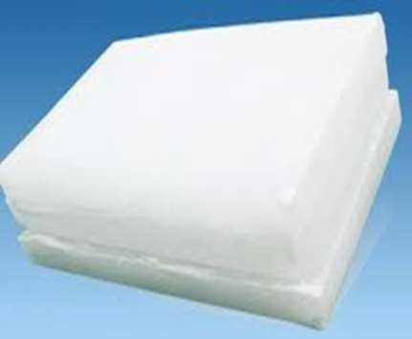
CERESIN WAX
Obtained from natural-mineral petroleum refining or lignite refining
Increase the melting range of paraffin waxes.

Slide 13
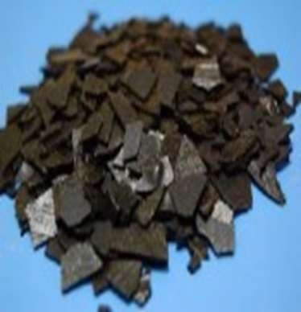
MONTAN WAXES
Mineral wax obtained by extraction from various lignites or coals.
Hard, brittle & lustrous.
Improves the hardness & melting range of paraffin waxes.
Notes:
72-92

Slide 14
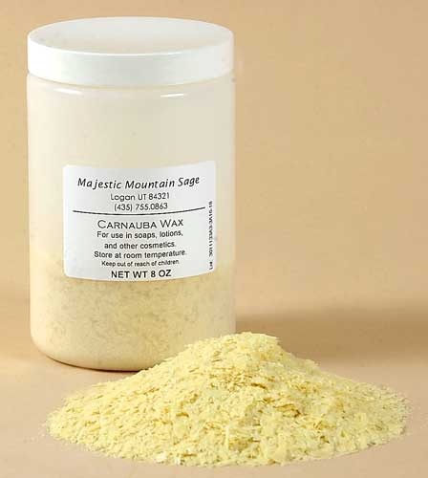
CARNAUBA WAX
High hardness, brittleness & high melting temperatures (84-91 C).
Increases melting
Range and hardness
Of paraffin wax.
Notes:
Adding 10 percent of carnauba wax to paraffin with 20 mr increase mr to 46.

Slide 15
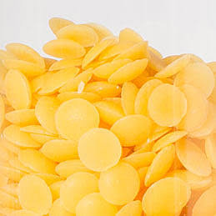
CANDELILLA WAXES
Hardens paraffin waxes but are not effective for increasing the melting range.
Notes:
68-75

Slide 16
JAPAN WAX & COCOA BUTTER
Not true waxes; chiefly fats.
Japan wax is a tough, malleable & sticky material that melts at about 51⁰C, whereas cocoa butter is a brittle substance at room temperatures.
Japan wax- improves tackiness.
Cocoa butter is used to protect against dehydration of soft tissue.
Notes:
To protect gic from moisture during setting or from dehydrating after they set

Slide 17
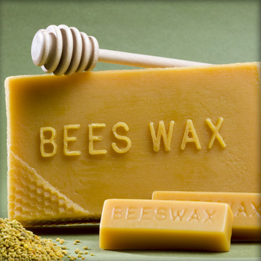
BEESWAX
Insect wax used in dentistry.
Brittle material at room temperature, becomes plastic at body temperature.
Melting range is 63-70°C
Notes:
63-70 main component of sticky wax

Slide 18
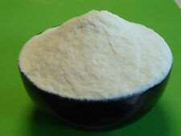
SPERMACETI WAX
Used as a coating in the manufacture of dental floss.

Slide 19
SYNTHETIC WAXES
Complex organic compounds of varied chemical compositions.
Synthetic waxes include:
Polyethylene waxes
Polyoxyethylene glycol waxes
Halogenated hydrocarbon waxes
Hydrogenated waxes
Wax esters from the reaction of fatty alcohols and acids.

Slide 20
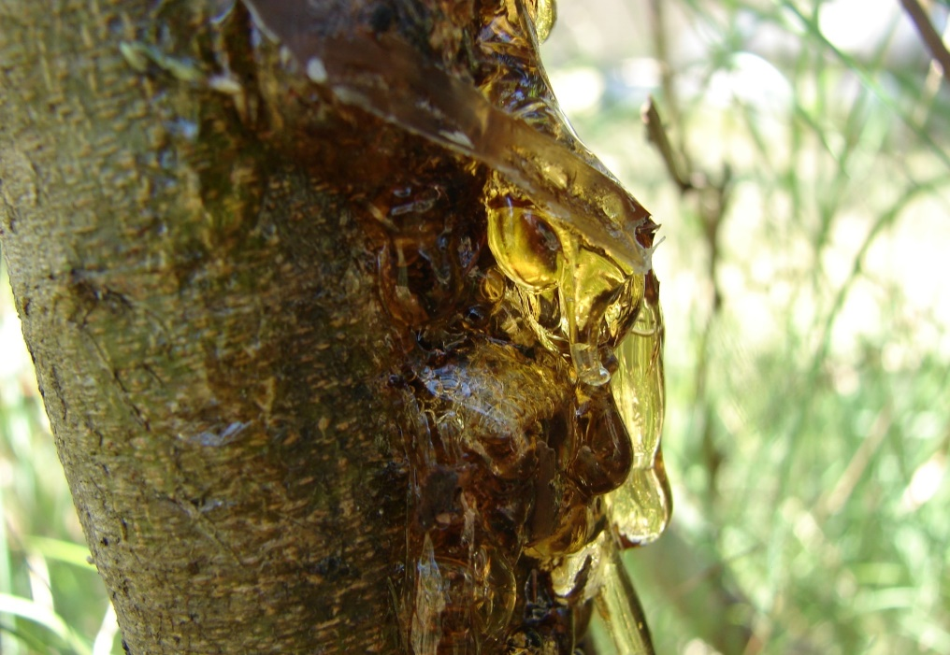
GUMS
Viscous, amorphous exudates that harden on exposure to air.
Most gums are mixtures containing large carbohydrates, when they are mixed with water, they either dissolve or form sticky, viscous liquids.
Notes:
Gum Arabic and tragacanth many plants produce a variety of gums that are

Slide 21
FATS
Composed of esters of various fatty acids with glycerol & are known as glycerides, e.g. mixed glyceride of oleic, palmitic & butyric acids found in butter.
Increases melting range & hardness of compounded wax.

Slide 22
RESINS
Many species of trees & other plants produce exudates of natural resins, such as dammar, rosin or sandarac.
Natural resin like dammar is compatible with most natural waxes & produce harder products.
Synthetic resins, such as polyethylene resin may be added to paraffin waxes to improve their toughness, film forming characteristics, & melting ranges.
Notes:
Shellac resin- insect

Slide 23
CHARACTERISTIC PROPERTIES OF WAXES

Slide 24
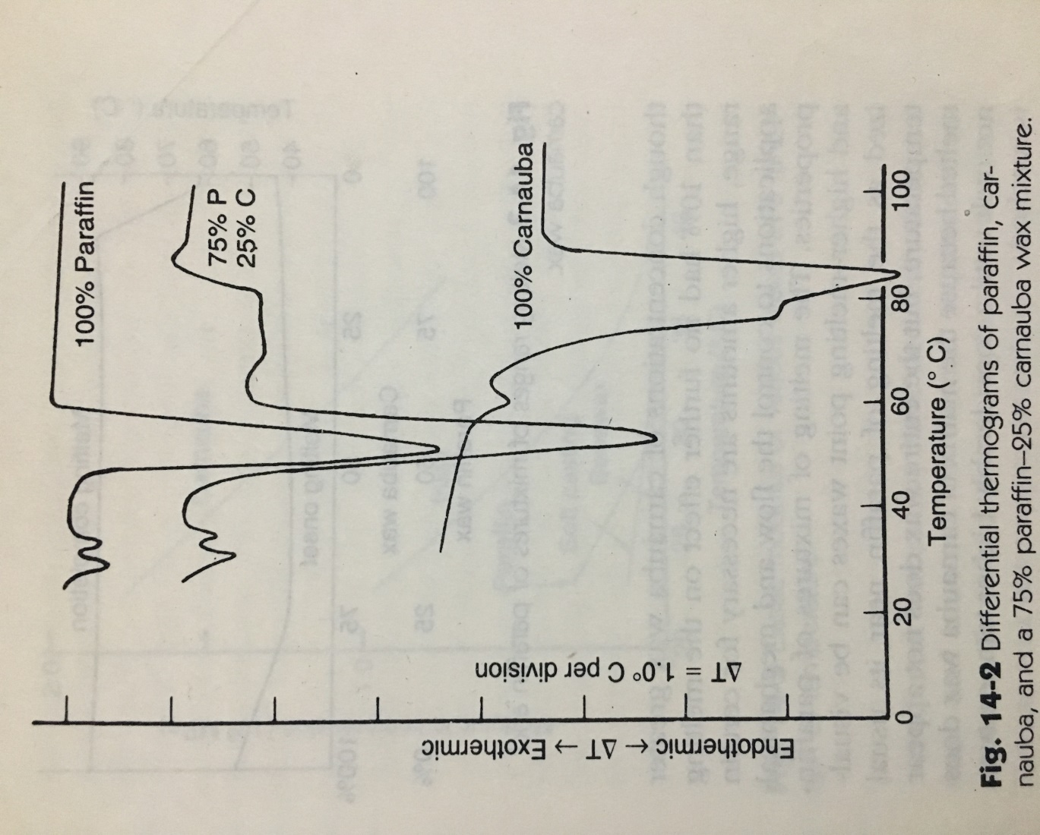
MELTING RANGE
They have melting ranges rather than melting points.
Notes:
Contain several type of molecules, each have a different moleciuular weight
The melting range for paraffin wax is from 44°C to 62°C & for carnauba wax, from 50°c to 90°c.
When a mixture of 75% paraffin & 25% carnauba wax was prepared, the paraffin components melted at essentially the same temperatures, but the melting temperature of carnauba wax was decreased slightly.
Adding carnauba to paraffin wax dramatically increased the melting range to 44˚C , compared with 18˚C for paraffin alone.

Slide 25
THERMAL EXPANSION
Waxes expand when subjected to a rise in temperature.
Inlay wax thermally expands and contracts more per degree of temperature change than any other dental material.
Mineral waxes generally have higher coefficient of linear thermal expansion than plant waxes.
Notes:
as waxes heated than they absorb more energy due to which movements of molecules or waxex components occurs. Mineral waxes have weak valence forces and as we increase temp energy is absorbed and mkre movement of wax components occurs.

Slide 26
MECHANICAL PROPERTIES
The elastic modulus, proportional limit & compressive strength of waxes are low.
Elastic modulus of;
Carnauba wax ↓ from 1790 to 760 MPa from 23⁰ to 37˚C
Paraffin wax ↓ from 310 to 28 MPa from 23⁰ to 30˚C
Inlay wax(25% carnauba + 75% paraffin) ↓ from 760 to 48 MPa btw 23⁰ and 40˚C.
Notes:
Stiffness of material within the elastic limit. Stronger the attraction force between molecules- more will be em. Eg- plastic and metal- metal has more em

Slide 27
FLOW
Results from the slippage of molecules over each other.
Dependent on the temperature of wax, the force bringing about the deformation, & the time the force is applied.
Increases at the melting point.
Although a high % of flow at a given temperature may be required for a specific wax, it may be extremely deleterious at a temperature a few degrees lower. This is specially true for the direct inlay wax.

Slide 28
Notes:
Flow at 10 minutes

Slide 29
RESIDUAL STRESS
Regardless of the method used to prepare a wax pattern, residual stress exists in the completed pattern.
When a specimen is held under compression during cooling, the atoms and molecules are forced closed together. After the specimen is cooled to room temperature and the load is removed, the motion of molecules is restricted.
This restriction results in residual stress.

Slide 30
DUCTILITY
Ductility increases as the temperature is increased.
Influenced by the distribution of the melting temperatures of the component waxes.
Waxes with low melting temperature have a greater ductility at any given temperature than those with higher melting temperature.

Slide 31
DENTAL WAXES

Slide 32
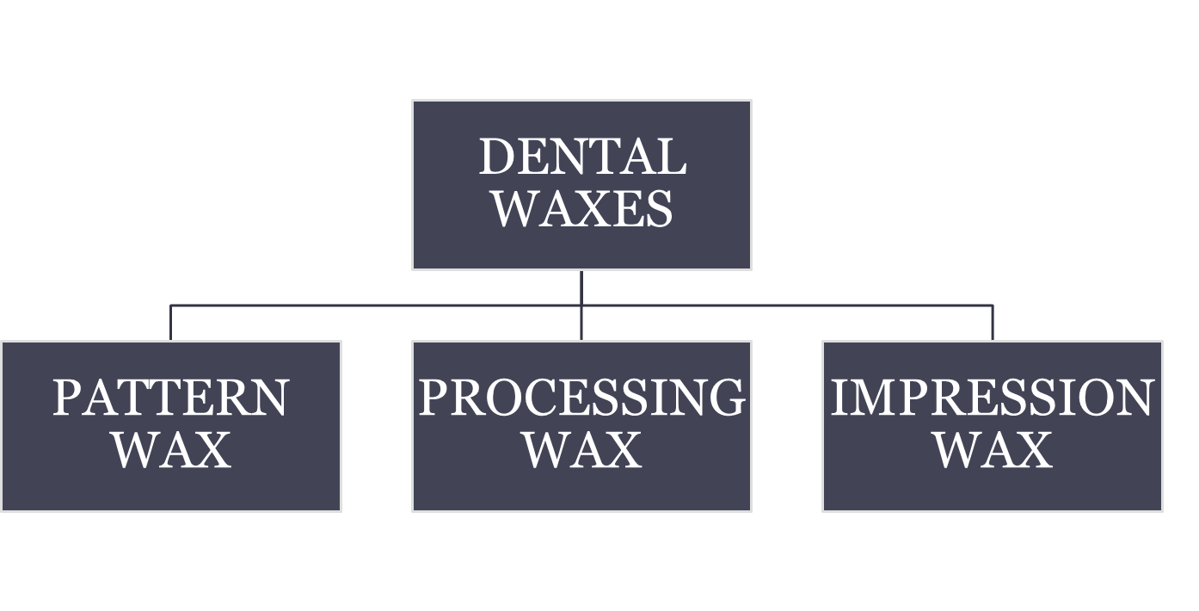
CLASSIFICATION OF DENTAL WAXES
INLAY WAX
CASTING WAX
BASEPLATE
BOXING WAX
UTILITY WAX
STICKY WAX
CORRECTIVE IMPRESSION WAX
BITE REGISTRATION WAX

Slide 33
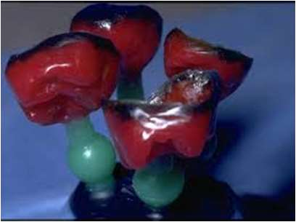
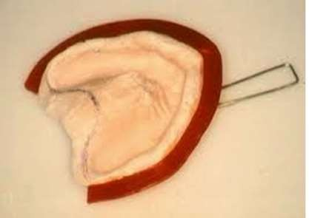
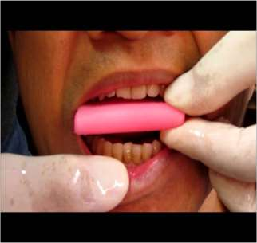
Classification
Pattern wax
Processing wax
Impression wax
.
.

Slide 34
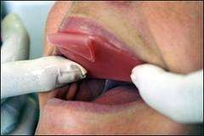
CLINICAL USE
LAB USE
BITE REGISTRATION
DISCLOSING WAX
UTILITY WAX
TYPE 1 INLAY WAX
BOXING WAX
STICKY WAX
BEADING WAX
TYPE 2 INLAY WAX

Slide 35
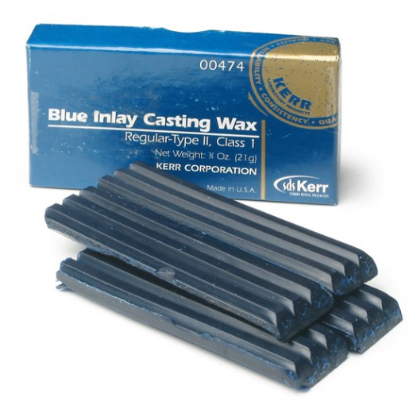
A. INLAY WAX
Used to make patterns for Inlays, crowns & FPDs by the lost wax technique.
Composition: Paraffin- 60%
Carnauba- 25%
Ceresin- 10%
Bees wax- 0-5%
Gum dammar-0-1 %
Microcrystalline wax- minute
Coloring agents- traces

Slide 36
TYPES
ADA specification no.4:
TYPE I is for medium wax employed in direct techniques
TYPE II is for soft waxes used in the indirect techniques

Slide 37
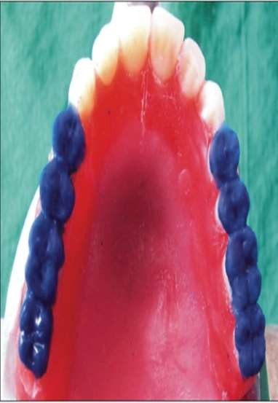
Ideal requirements :
It should be uniformly softened.
There should be no irregularities.
It should have good colour contrast.
It should not chip off during carving.
It should be smoothly contoured.
.

Slide 38
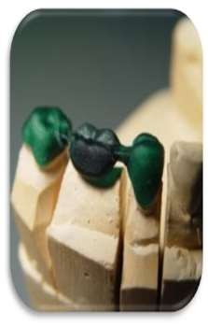
It should be completely eliminated during burnout.
It should be dimensionally stable.
It should have good flow at oral temperature but rigid once removed and cooled.

Slide 39
PROPERTIES
1. Flow

Slide 40
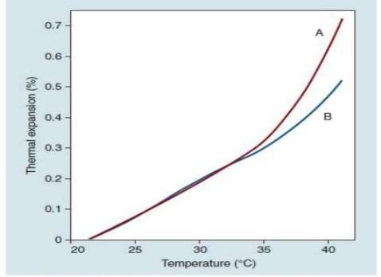
2. Thermal properties
Notes:
Curve a- thermal expansion when wax was held under pressure while it was cooling
B- when same wax allowd to cool without pressure and again heated.

Slide 41
WAX DISTORTION
Distortion results from
-relaxation of stresses
(on cooling)
-occluded air
-molding
-carving
-removal and the time and temp
of storage
Waxes tend to return to their original shape after manipulation, property is known as elastic memory.

Slide 42
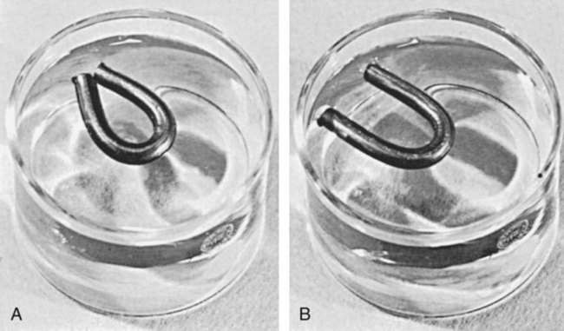
The casting fits best when the wax pattern is invested immediately
Notes:
To demonsterate this effect- stick of inlay wax softend over a burner and bent into horseshoe shape and chilled. And when it kept in room temp water for a several hour thn the stick will open.

Slide 43
MANIPULATION OF INLAY WAX
Dry heat is preferred over the use of water bath (54⁰-60⁰C)
For type I (direct technique), it is softened over a flame until it becomes shiny.
It is kneaded, shaped and pressed in the prepared cavity.
Pressure is applied by finger or patient biting on it.
It is cooled gradually, before taking out.

Slide 44
For fabricating indirect pattern (type II) die should be lubricated, preferably with a lubricant, containing a wetting agent.
Excess must be avoided.
Melted wax is added in layers with a spatula or waxing instrument or may be painted on with a brush.
Wax is then carved to proper contour.
A silk or fine cloth may be used, for final polishing.

Slide 45
CASTING WAXES
The pattern for metallic framework of RPD and other similar structures.
Available in the form of sheets (0.40 to 0.32mm) thickness, ready made shapes and in bulk.
Ready made shapes are supplied in round, half round and pear shaped rods & wires of various gauges in approx. 10 cm length.

Slide 47
PHYSICAL CHARACTERSTICS
Degree of tackiness.
max of 10% flow at 35⁰C and min of 60% flow at 38⁰C.
Requirement for ductility is high
Like inlay wax they must vaporize at 500⁰C with no residue other than carbon.
Notes:
Helps to maintain their position on cast. Heating over a flame and the compression to adapt the casting wax may alter their thickness and contour

Slide 48
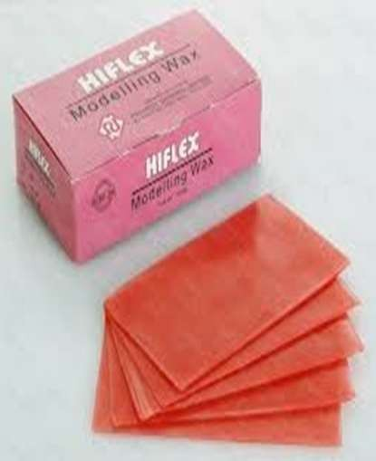
C. BASEPLATE WAX OR MODELLING WAX
ADA no 24
Used for constructing full denture patterns and occlusal rims.
Also for bite registration.
Hard and brittle at room temperature.

Slide 49
COMPOSITION OF BASEPLATE WAX
80% ceresin
12% beeswax
2.5% carnauba
3% natural or synthetic resins
2.5% microcrystalline or synthetic waxes.

Slide 50
PHYSICAL CHARACTERISTICS
Sheets 7.60×15.00×0.13cm in pink or red.
3 type of waxes are included:
TYPE I is a soft wax for building contour and veneers.
TYPE II is a hard wax to be used for patterns to be tried in the mouth temperate climates.
TYPE III is an extra hard wax for patterns to be tried in the mouth in tropical weather.

Slide 51
The dimensional stability that may take place because of variation in temperature are important.
Baseplate wax should be easily trimmed with a sharp instrument at 23°c & should yield a smooth surface after gentle flaming.
These waxes should not leave any residue on porcelain teeth, and the coloring agent in the wax should not impregnate the plastic mold during processing.

Slide 52
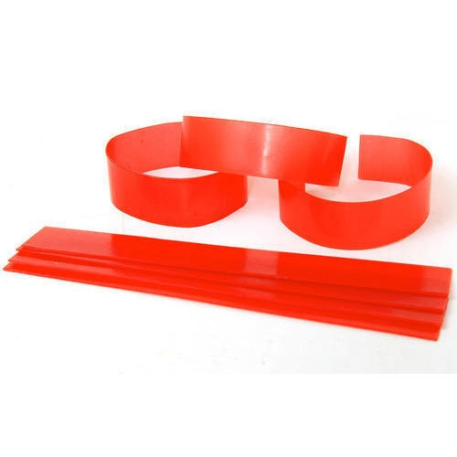
BOXING WAX
To form a plaster or stone cast from an impression of the edentulous arch, first a wax box must be formed around the impression, into which the freshly mixed plaster or stone is poured & vibrated.

Slide 53
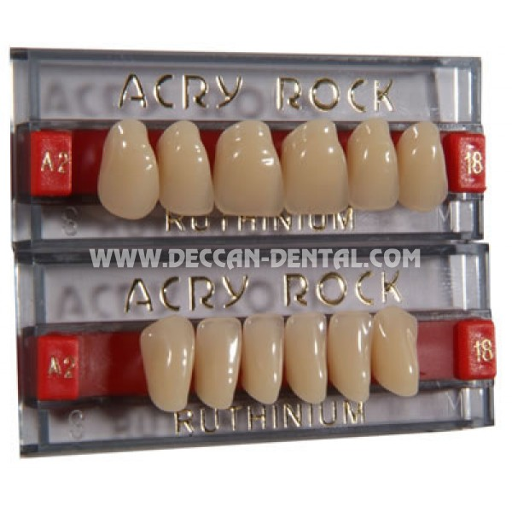
CARDING WAX was the original material on which porcelain teeth were fixed when received from the manufacturer.

Slide 54
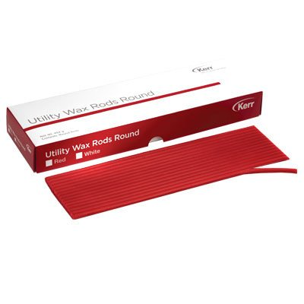
UTILITY WAX
As easily workable, adhesive wax is often desired. For example, a standard perforated tray for use with hydrocolloids may easily be brought to a more desirable contour by such a wax.
UTILITY WAX STRIPS

Slide 55
This is done to prevent a sag & distortion of the impression material.
The utility wax is usually supplied in both stick & sheet in dark red or orange.
The flow of the wax should not be less than 65% nor more than 80% at 37.5⁰ C

Slide 56
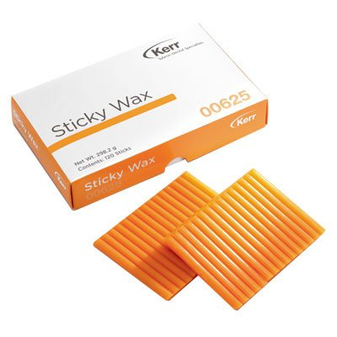
STICKY WAX
It is formulated from a mixture of waxes and resins or other additive ingredients. Such a material is sticky when melted & adheres closely to the surfaces on which it is applied.

Slide 57
However, at room temperature the wax is firm, free from tackiness, and brittle. Sticky wax should fracture rather than flow if it is deformed during soldering or repair procedures.
Although this wax is used to assemble metallic or resin pieces in a fixed temporary position, it is primarily used on dental stones and plasters.

Slide 58
CORRECTIVE IMPRESSION WAX
Used as a wax veneer over an original impression to contact & register the detail of the soft tissues.
It is claimed that this type of impression material records the mucous membrane & underlying tissues in a functional state in which movable tissue is displaced to such a degree that functional contact with the base of the denture is obtained.
Corrective waxes are formulated from hydrocarbon waxes such as paraffin, ceresin & beeswax & many contains metal particles.

Slide 59
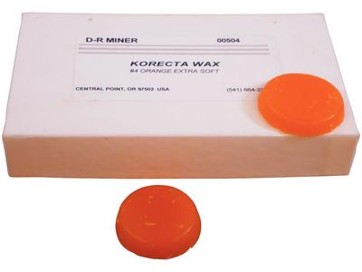
These waxes are subject to distortion during removal from the mouth.
They are replaced by elastomeric impression materials.

Slide 60
BITE REGISTRATION WAX
Used to accurately articulate certain models of opposing quadrants.
Often made from 28 gauge casting wax sheets or from hard baseplate wax.
The flow of several bite waxes as measured by penetration at 37⁰C ranges from 2.5% to 22%, indicating that these waxes are susceptible to distortion on removal from the mouth.

Slide 61
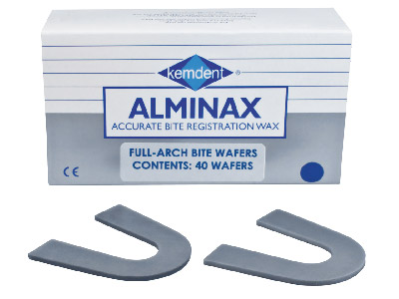

Slide 62
INVESTMENT
MATERIALS

Slide 63
Contents
Introduction
Requirements
General composition
Classification
Gypsum bonded investment
Phosphate bonded investment
Ethyl silicate bonded investment
Conclusion
References

Slide 64
Introduction
The adoption of the casting practice in dentistry for making crowns, bridges, gold alloy inlays and other restorations represent one of the major advancement in restorative dentistry.
Following the production of a wax pattern, the next step in many dental procedures involves the investment of the pattern to form a mold.

Slide 65
INVESTMENT MATERIALS
Dental casting investment: A material consisting principally of an allotrope of silica and a bonding agent; the bonding substance may be gypsum or phosphates and silica. GPT9
According to craig, an investment can be described as a ceramic material that is suitable for forming a mold into which a metal or alloy is cast.

Slide 66
Requirements of an investment material
Easily manipulated
Sufficient strength at room temperature
Stability at higher temperatures
Sufficient expansion
Porosity
Ease of divestment
Smooth surface
Inexpensive
Notes:
Porous enough to permit the air or other gases from mold cavity.
Divestment- shoul break away readily from surface of metal, should not reacted chemically with metal.

Slide 67
General composition of Investments
Refractory material: withstand high temperature.
e.g. silica
Binder material: set and bind together the particles of refractory substance
e.g. alpha calcium sulfate hemihydrate, phosphate, ethyl silicate
Chemical modifiers:
e.g. sodium chloride, boric acid, potassium sulfate
Notes:
Quartz, cristovalite, tridymite.

Slide 68
CLASSIFICATION

Slide 69
Based on the binder used:
Gypsum-bonded investment materials: used for conventional casting of inlays, onlays, crowns and fixed partial dentures of gold alloys.
Phosphate-bonded investment materials: used for metal-ceramic prostheses and for some base metal alloys.
Ethyl silicate-bonded investment materials: used in casting of removable partial dentures with base metal alloys (cobalt or nickle-based alloys)

Slide 70
Based on the method of obtaining expansion:
Type I investments- Expansion by thermal expansion.
Type II investments- Expansion by hygroscopic expansion.
Type III investments- used for construction of partial dentures with gold alloys.

Slide 71
Gypsum bonded investments

Slide 72
Composition
Refractory material- Quartz or cristobalite (60-65%)
Binder- alpha-hemihydrate form of gypsum (25-35%)
Chemical modifiers- 2-3%

Slide 73
Temperature
Calcium sulfate bonded investment is usually limited to gold casting, and is not heated above 700 degree celsius

Slide 74
Gypsum bonded investment shrinks after dehydration between 200-400°C and a slight expansion occur between 400-700°C and then a large contraction occurs.
This not only cause shrinkage but also contaminates castings. So gypsum bonded investments should not be heated above 700°C
Notes:
Sulfides- silver and cooper

Slide 75
Setting Time
According to ANSI/ADA Specification No. 2, setting time should not be shorter than 5 min or longer than 25 min.
Usually, the modern inlay investments set initially in 9 to 18 min.

Slide 76
Normal Setting Expansion
ANSI/ADA Specification No. 2 for Type I investment permits a maximum setting expansion in air of only 0.6%.
The purpose of the setting expansion is to aid in enlarging the mold to compensate partially for the casting shrinkage of the gold.
Notes:
3 round particles of hemih surrounded by water, nuclei of crystallization occur as dihydrate crystal grows, water reduces around the oarticles thn the contact each other,

Slide 77
Lower the W/P ratio, greater is the expansion.
Longer the Mixing time, greater is the expansion
Small amounts of sodium, potassium chlorides- eliminates the contraction and increases the expansion without the presence of an excessive amount of silica.

Slide 78
Hygroscopic Setting Expansion:
If the material is allowed to set in contact with water a greater expansion occurs. This is known as hygroscopic expansion.

Slide 79
Hygroscopic expansion is proportional to the percentage of silica in the investment.
GREATER | LESSER
Finer the silica particle | Higher the water content in the original mix
Placed in water before its initial setting. | Reduced mixing time
 | Older materials
 | When confined to the casting ring.
Notes:
Once setting starts, nuclei of cry already started in normal way . Due to more water some crystal intermeshed , inhibiting further growth

Slide 80
The common method of obtaining hygroscopic expansion is to immerse the ring filled with investment into water at 37 ⁰C, at the initial setting time of the material and allows it to remain there for 30 minutes.

Slide 81
Phosphate bonded investment

Slide 82
Composition
Refractory material- quartz or cristobalite (80%)
Binder consists of magnesium oxide (basic) and a phosphate (acid).
Liquid- water or colloidal silica in water.

Slide 83
Carbon - produce clean castings and facilitate the divesting of the casting from the mold.
It is believed that carbon embrittles the alloys, even though the investment is heated to temperatures that burn out the carbon.
Notes:
Bcz palladium rects with carbon greater than 1500. so applicable only in gold alloys

Slide 84
SETTING REACTIONS
NH4H2PO4 + MgO + 5H2O→NH4MgPO4.6H2O +H2O
Notes:
Acid base rxn between acid monoammonium phosphate reacts with magnesia in water and form a colooidal type particle. Ammopnium magnesis phosphate. After heating final product that is trimagnesis di phospate
This is hydration reaction followed by crystallization reaction

Slide 85
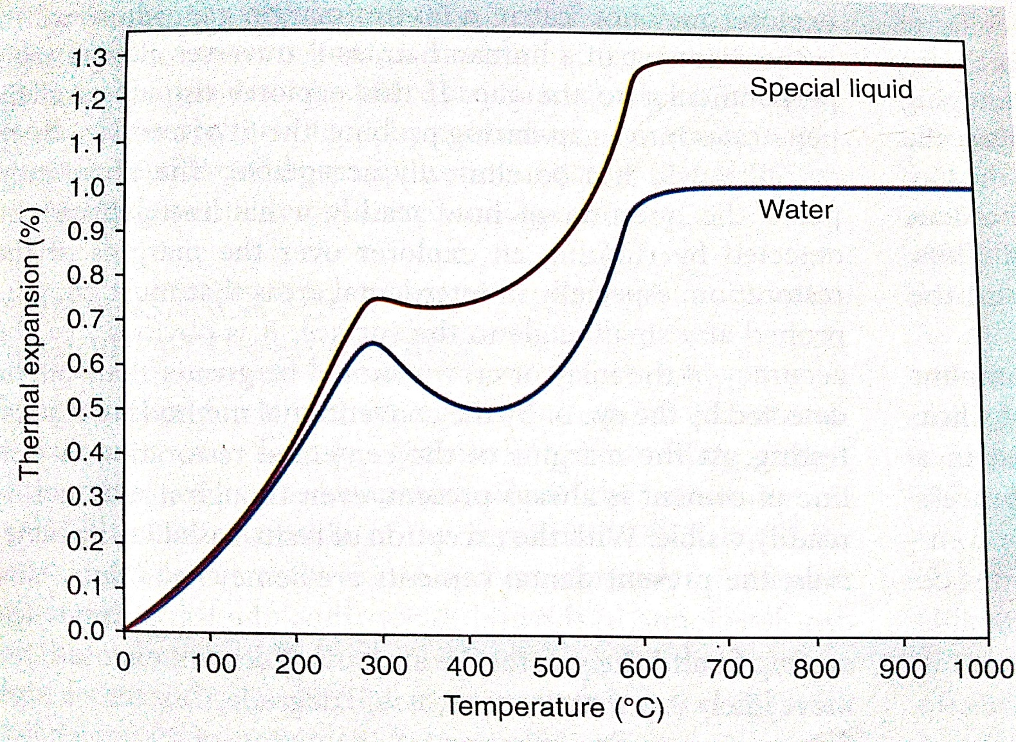
Setting and Thermal Expansion
There is a slight expansion, and this can be increased by using a colloidal silica solution instead of water.

Slide 86
Decrease expansion by increasing the liquid/powder (L/P) ratio rather than by decreasing the concentration of the special liquid, or they may use a combination of these methods.

Slide 87
Working and setting time
The warmer the mix, the faster it sets. The setting reaction itself gives off heat, and this further accelerates the rate of setting.
The more efficient the mixing, the better the casting in terms of smoothness and accuracy. Mechanical mixing under vacuum is preferred.
An increase in the L/P ratio increases the working time.

Slide 88
ETHYL-SILICATE BONDED INVESTMENTS

Slide 89
Construction of the high-fusing base metal partial denture alloys.
Binder is a silica gel
1. Addition of an acid or an acid salt to sodium silicate- a bonding silicic acid gel forms.
2. A colloidal silicic acid is formed by hydrolyzing ethyl silicate in the presence of hydrochloric acid, ethyl alcohol, and water.

Slide 90
The solution is then mixed with the quartz or cristobalite
A coherent gel of polysilicic acid then forms, accompanied by a setting shrinkage.
This soft gel is dried at a temperature below 168˚C. During the drying process, the gel loses alcohol and water to form a concentrated, hard gel.
A volumetric contraction accompanies the drying, which reduces the size of the mold. This contraction is known as green shrinkage, and it occurs in addition to the setting shrinkage.
Notes:
1090-1180 C

Slide 91
Powder - added to the ethyl silicate liquid- mixed quickly-vibrated into a mold- placed on the platform of a special type of vibrator- tamping action.
Heavier particles settle quickly while the excess liquid and some of the fine particles rise to the top.
In about 30 min, the accelerator in the powder hardens the settled part, and the excess at the top is poured off.
Thus the L/P ratio in the settled part is greatly reduced, and the setting shrinkage is reduced to 0.1%.

Slide 92
This type of investment can be heated between 1090˚ C and 1180˚ C
Compatible with the higher fusing alloys.

Slide 93
CONCLUSION
Out of the three types of casting investment materials, the phosphate bonded products are most widely used.
The investment material which is best able to retain its integrity at the casting temperature, and able to provide the necessary compensation for casting shrinkage is chosen.

Slide 94
References
Robert G. Craig: Restorative dental materials. 11th edition.
John J Manappallil: basic dental materials 4th edition.
Phillips Science of Dental Materials 12th edition.

