Slide 1
CONSIDERATION OF OCCLUSION

Slide 2
Occlusion :the static relationship between the incising or masticating surfaces of the maxillary or mandibular teeth or tooth analogues.( GPT-9)
These can be broadly categorized as:
Bilaterally balanced
Unilaterally balanced, and
Mutually protected.

Slide 3
Bilaterally balanced articulation
Refers to a maximum number of teeth in contact in maximum intercuspation and all excursive positions.
In complete denture fabrication, this tooth arrangement helps maintain denture stability because the nonworking contact prevents the denture from being dislodged.

Slide 4
However, as the principles of bilateral balance were applied to the natural dentition and in fixed prosthodontics, it proved to be extremely difficult to accomplish and the rate of failure was high
An increased rate of occlusal wear, increased or accelerated periodontal breakdown, and neuromuscular disturbances were commonly observed.
Thus the concept of a unilaterally balanced occlusion (group function) evolved.

Slide 5
Unilaterally balanced articulation (group function)
In a unilaterally balanced articulation, excursive contact occurs between all opposing posterior teeth on the laterotrusive (working) side only.
On the mediotrusive (nonworking) side, no contact occurs until the mandible has reached centric relation.
Thus, in this occlusal arrangement the load is distributed among the periodontal support of all posterior teeth on the working side.

Slide 7
Long Centric:
As the concept of unilateral balance evolved, it was suggested that allowing some freedom of movement in an anteroposterior direction is advantageous. This concept is known as long centric.
Schuyler" was one of the first to advocate such an occlusal arrangement.

Slide 8
Others have advocated long centric because centric relation only rarely coincides with the maximum interecuspation position in healthy natural dentitions.
This theory presupposes that the condyles can translate horizontally in the fossae over a commensurate trajectory before beginning to move downward.

Slide 9
It also necessitates a greater horizontal space between the maxillary and mandibular anterior teeth, allowing horizontal movement before posterior disocclusion.

Slide 10
Mutually protected occlusion
During the early 1960s, an occlusal scheme called mutually protected occlusion was advocated by Stuart and Stallard, based on earlier work by D'Amico.
In this arrangement, centric relation coincides with the maximum intercuspation position.

Slide 11
The six anterior maxillary teeth, together with the six anterior mandibular teeth, guide excursive movements of the mandible, and no posterior occlusal contacts occur during any lateral or protrusive excursions.
The relationship of the anterior teeth, or anterior guidance, is critical to the success of this occlusal scheme.

Slide 12
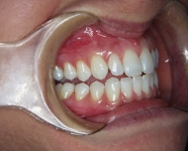
The incisors protect the canine and posterior teeth during protrusive movements.

Slide 13
In a mutually protected occlusion, the posterior teeth come into contact only at the very end of each chewing stroke, minimizing horizontal loading on the teeth.
The posterior teeth act as stops for vertical closure when the mandible returns to its maximum intercuspation position.

Slide 15
Optimum Occlusion
In an ideal occlusal arrangement, the load exerted on the dentition should be distributed optimally.
Occlusal contact has been shown to influence muscle activity during mastication.
Any restorative procedures that adversely affect occlusal stability may affect the timing and intensity of elevator muscle activity.

Slide 16
Horizontal forces on any teeth should be avoided or at least minimized, and loading should be predominantly parallel to the long axes of the teeth.
This is facilitated when the tips of the centric cusps are located centrally over the roots and when loading of the teeth occurs in the fossae of the occlusal surfaces rather than on the marginal ridges.

Slide 17
The features of a mutually protected occlusion are as follows:
Uniform contact of all teeth around the arch when the mandibular condylar processes are in their most superior position.
Stable posterior tooth contacts with vertically directed resultant forces

Slide 18
Centric relation coincident with maximum intercuspation (intercuspal position) (CR = MI)
No contact of posterior teeth in lateral or protrusive movements
Anterior tooth contacts harmonizing with functional jaw movements

Slide 19
PATHOGENIC OCCLUSION
A pathogenic occlusion is defined as an occlusal relationship capable of producing pathologic changes in the stomatognathic system.
SIGNS AND SYMPTOMS:
The teeth may exhibit hypermobility, open contacts, or abnormal wear.

Slide 20
There is no convincing evidence that chronic periodontal disease is caused directly by occlusal overload. However, a widened periodontal ligament space (detected radiographically) may indicate premature occlusal contact and is often associated with tooth mobility

Slide 21
Acute or chronic muscular pain on palpation can indicate habits associated with tension such as bruxing or clenching. Chronic muscle fatigue can lead to muscle spasm and pain.
Pain, clicking, or popping in the TMJs can indicate TM disorders. Clicking and popping may be present without the patient's awareness.

Slide 22
The myofascial pain dysfunction (MPD) syndrome presents as diffuse unilateral pain in the preauricular area, with muscle tenderness, clicking, or popping noises in the contralateral TMJ and limitation of jaw function.

Slide 23
Summary of occlusion
A balanced occlusion provides complete denture patients with stability, because there is even contact between all the teeth in each excursion. This is potentially destructive in dentate patients and is not indicated for fixed prosthodontic treatment.
Unilateral (group function) occlusion may be indicated when it is important to distribute the occlusal load over multiple teeth, for example when the canine dissocclusion is lost due to tooth wear.

Slide 24
Group function occlusion is also indicated when the periodontal support of canine is compromised.
The mutually protected occlusion offers the most desirable distribution of occlusal load. In this arrangement, centric relation coincides with the maximum intercuspation position. It is indicated when full mouth rehabilitation is planned such as in cases of abnormal tooth wear such as attrition, abrasion.

Slide 25
In the presence of pathology that is potentially related to malocclusion, occlusal therapy may be indicated. Occlusal devices can serve as useful diagnostic and therapeutic adjuncts to treatment. For such patients, occlusal therapy should be initiated and completed before any substantial restorative care is undertaken.

Slide 26
TREATMENT PLANNING

Slide 27
IDENTIFICATION OF PATIENT NEEDS:
Successful treatment planning is based on proper identification of the patient’s needs.
Following objectives should be followed:
Correcting an existing disease
Preventing future disease
Restoring function
Improving appearance

Slide 28
Correcting an existing disease:
Existing disease can usually be arrested by identification and reduction of the initiating factors, identification and improvement of resistive factors, or both.
E.g. oral hygiene instruction will reduce the amount of residual plaque, and thus will reduce the likelihood of further dental caries.

Slide 29
Prevention of future disease:
The likelihood of future disease can be predicted by evaluating the patient’s disease experience and by knowing the prevalence of the disease in the general population.

Slide 30
Restoring function:
Treatment may be proposed to correct impaired function (e.g., mastication or speech).

Slide 31
Improvement of appearance:
Patients often seek dental treatment because they are dissatisfied with their appearance.
Dentist should appraise the appearance of the patient’s dentition and listen carefully to the patient’s view.
If the appearance is far outside socially accepted values, the feasibility of corrective procedures should be brought to the patient’s attention.

Slide 32
AVAILABLE MATERIALS AND TECHNIQUES AFFECTING THE DESIGN OF FPD
PLASTIC MATERIALS
Plastic materials (e.g., silver amalgam or composite resin) are the most commonly used dental restoratives.
They allow simple and conservative restoration of damaged teeth but their success.

Slide 34
Intracoronal restorations
An intracoronal cast metal restoration or inlay relies on the strength of the remaining tooth structure for support and retention.
However, greater tooth bulk is needed to resist any wedging effect on the preparation walls.
Therefore, this restoration is contraindicated in a significantly weakened tooth.
Disadvantage- requires extensive tooth preparation even for small lesions

Slide 35
Extracoronal Restorations
An extracoronal cast metal restoration or crown encircles all or part of the remaining tooth structure. As such, it can strengthen and protect a tooth weakened by caries or trauma.
Disadvantage-
Extensive tooth preparation is required
Margins are placed near gingiva, predisposing to periodontal problems.

Slide 36
Metal ceramic
Resin-veneer
Fibre- reinforced
Complete ceramic
Fixed dental prosthesis
Implant- supported prosthesis
Partial removable dental prosthesis
Complete dentures

Slide 37
Selection of abutment teeth
Whenever possible, FPDs should be designed as simply as possible, with a single retainer fixed rigidly at each end of the pontic. The use of non-rigid connectors, or intermediate abutments makes the procedure much more difficult, and often the result compromises the long-term prognosis

Slide 38
REPLACEMENT OF A SINGLE MISSING TOOTH:
A single missing tooth can almost always be replaced by a three-unit FPD having one mesial and one distal abutment tooth.
An exception is when the FPD is replacing a maxillary or mandibular canine. Under these circumstances, the small anterior abutment tooth needs to be splinted to the central incisor to prevent lateral drift of the FPD.

Slide 39
Cantilever Fixed Partial Dentures
FPDs in which only one side of the pontic is attached to a retainer are referred to as cantilevered.
Example- lateral incisor pontic attached only to an extracoronal metal-ceramic retainer on a canine.
The long-term prognosis of the single abutment cantilever is poor. Forces are best tolerated by the periodontal supporting structures when directed in the long axis of the teeth.

Slide 41
Evaluation of abutment teeth
Endodontically treated abutments
Unrestored abutments
Mesially tilted second molar.

Slide 42
Endodontically Treated Abutments:
If a tooth is Endodontically treated, it can serve well as an abutment with a post and core foundation for retention and strength.

Slide 43
Unrestored abutments:
An unrestored, caries free tooth is an ideal abutment.
It can be prepared conservatively for a strong retentive restoration with optimum esthetics.

Slide 44
Mesially tilted second molar:
Loss of a permanent mandibular first molar to caries early in life is still relatively common.
If the space is ignored, the second molar may drift mesially, especially with eruption of the third molar.
In such circumstances, an FPD is sometimes made with modified preparation designs or with a non-rigid connector.

Slide 45
Mild encroaching- restoring and recontouring or cantilever prosthesis, or non rigid connectors can be given.

Slide 46
Tilting is severe – corrective measures in the form of orthodontic correction

Slide 47
REPLACEMENT OF SEVERAL MISSING TEETH
Fixed prosthodontics becomes more difficult when several teeth must be replaced.
One key to ensuring a successful result is to plan the prostheses by waxing the intended restorations on articulated diagnostic casts.

Slide 48
Overloading of Abutment Teeth:
The ability of the abutment teeth to accept applied forces without drifting or becoming mobile must be estimated and has a direct influence on the prosthodontic treatment plan.

Slide 49
Direction of Forces:
A well-fabricated fixed partial denture can distribute the forces in the most favourable way, i.e., by directing them in the long axis of the abutment teeth.

Slide 50
Root Surface Area:
Ante’s law
Jepsen’s rule

Slide 51
Root shape and angulation:
When tooth support is compromised, the shape of the roots and their angulation should be considered. A molar with divergent roots will provide better support than a molar with conical roots.
A single-rooted tooth with an elliptic cross section will offer better support than a tooth with similar root surface area but a circular cross-section.

Slide 52
Periodontal disease:
Because of the conical shape of most roots when one third of the root length has been exposed, half of the supporting area is lost.
In addition, the forces applied to the supporting bone are magnified because of the greater leverage associated with the lengthened clinical crown.

Slide 53
conical shape of most roots, with one third root exposure, the center of rotation (R) moves apically and the lever arm (L) increases, magnifying the forces on the supportive structure.

Slide 54
Span length:
All FPDs flex slightly when subjected to a load-the longer the span, the greater the flexing.

Slide 56
When a long-span FPD is fabricated, pontics and connectors cross-sectionally should be made as bulky as possible to ensure optimum rigidity without interfering gingival health. In addition, the prosthesis should be made of a material that has high strength and rigidity.

Slide 57
REPLACING MULTIPLE ANTERIOR TEETH
Mandibular incisors, because of their small size, generally make poor abutment teeth. It is particularly important not to have over-contoured restorations on these teeth because plaque control will be nearly impossible.

Slide 58
The maxillary incisors are not positioned in a straight line (particularly in patients with narrow or pointed dental arches). Tipping forces could be resisted by means of two abutment teeth at each end of a long span anterior FPD. Thus, when replacing the four maxillary incisors, the clinician should generally use the canines and first premolars as abutment teeth.

Slide 59
If anterior bone loss has been severe, as can happen when teeth are lost due to trauma or periodontal disease, there may be a ridge defect. In these patients, a removable dental prosthesis should be considered, especially when the person has a high smile line, since a fixed partial denture generally replaces only the missing tooth structure, not the supporting tissues.

Slide 60
TREATMENT SEQUENCE
Treatment of symptoms
Stabilization of deteriorating conditions
Dental caries
Periodontal disease
Definitive therapy
Oral surgery
Periodontics
Endodontics
Orthodontics

Slide 61
Fixed prosthodontics
Occlusal reshaping : Occlusal adjustments are often necessary before initiation of fixed prosthesis. Any supra eruption should be corrected.

Slide 62
Anterior restorations:If both anterior and posterior teeth are to be restored, the anterior teeth are usually done first because they influence the border movements of the mandible and thus the shape of the occlusal surfaces of the posterior teeth.

Slide 63
Posterior restorations : One side of the mouth should be completed before the other side is treated, restoring all four posterior segments at the same time might lead to considerably more complications for the patient and dentist.

Slide 64
Complex prosthodontics
Two sets of diagnostic casts are accurately mounted so they can be precisely interchanged on the articulator. Definitive tooth preparation starts in one arch only, preserving the occlusal surfaces of the opposing arch to act as an essential reference for mounting the working cast.

Slide 65
The definitive restorations are waxed against the diagnostically waxed cast, establishing optimal occlusion. When one arch has been completed, the opposing cast can be restored, achieving the predicted result.

Slide 66
FOLLOW UP
A specific program of follow up and regular recall is an essential part of treatment plan
The aim is to identify the newly developed signs of disease at an early stage and to initiate corrective measures.

Slide 67
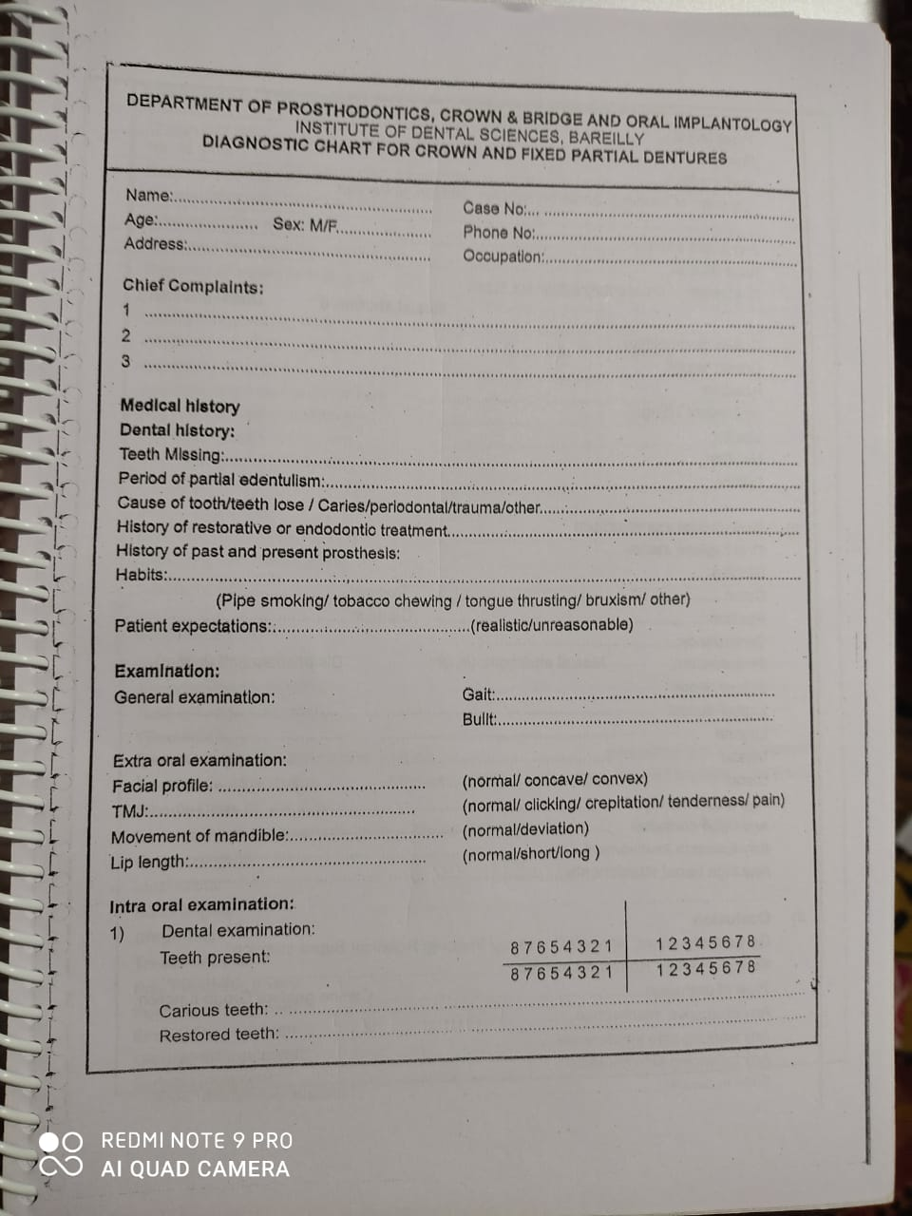
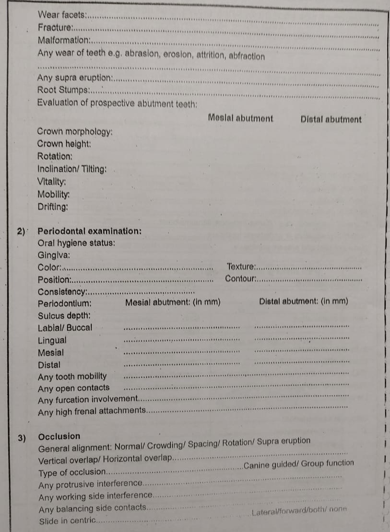
CASE HISTORY OF DEPARTMENT

Slide 68
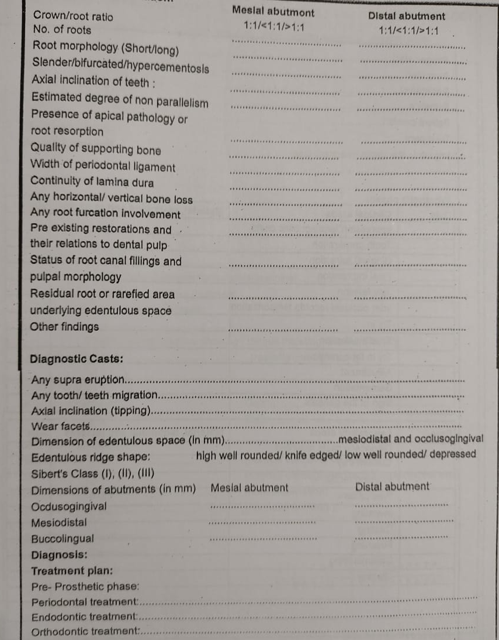
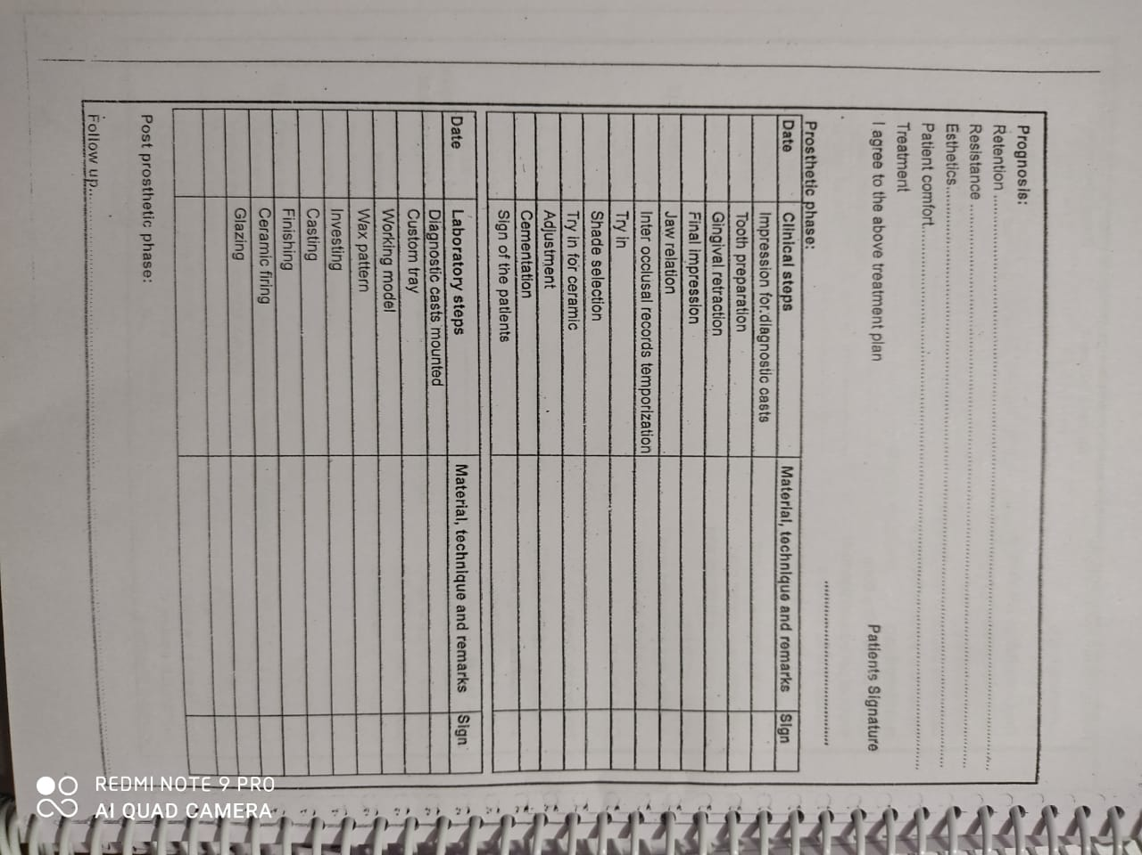

Slide 69
CONCLUSION
The history and clinical examination must provide sufficient data for the practioner to formulate a successful treatment plan.
In particular it is critical to develop a through understanding of special patient concerns relating to previous care and expectations about future treatment.
A diagnosis is a summation of the observed problems and their underlying etiologies.

Slide 70
MOUTH PREPARATION

Slide 71
Mouth preparation refers to the dental procedures that need to be accomplished before fixed prosthodontics can be properly undertaken.
Fixed prosthodontics will be successful only if restorations are placed on well-restored teeth in a healthy environment

Slide 72
A typical sequence in the treatment of a patient with extensive dental disease-including missing teeth, retained roots, caries, and defective restorations:
Preliminary assessment
Emergency treatment of presenting symptoms
Oral surgery

Slide 73
Caries control and replacement of existing restorations
Endodontic treatment
Definitive periodontal treatment
Orthodontic treatment
Definitive occlusal treatment

Slide 74
Fixed prosthodontics
Removable prosthodontics
Follow-up care

Slide 75
A, The patient has pain that seems to originate from the maxillary right central incisor. In addition, there are several missing teeth, retained roots, caries, calculus, and defective restorations. B, Relief of the acute problem by endodontic treatment of the incisor. C, Removal of deposits and unrestorable teeth.

Slide 76
D, Caries are controlled, and defective restorations are replaced. The progress of ongoing disease has been halted. E, Endodontic treatment is undertaken, and post-and-cores and a provisional restoration are placed. F, Definitive periodontal treatment is performed.

Slide 77
G, Teeth are prepared for the final restoration. H, The fixed restorations are completed. I, Active phase of the treatment has been accomplished.
IN SUCH A CASE, EITHER RPD OR IMPLANT CAN BE PLANNED AS A DEFINITE TREATMENT

Slide 78
ORAL SURGERY
SOFT TISSUE PROCEDURES:
Any soft tissue abnormalities that may require surgical intervention should be recognized during the initial or radiographic examination
Elective soft tissue surgery includes: Alteration of muscle attachments
removal of a wedge of soft tissue distal to the molars
increase of the vestibular depth or modification of edentulous ridges to accommodate fixed or removable partial prostheses

Slide 80
HARD TISSUE PROCEDURES:
Tooth removal
Tuberosity reduction
Impacted or unerupted supernumerary teeth
Maxillary or mandibular tori
ORTHOGNATHIC SURGERY
IMPLANT-SUPPORTED FIXED PROSTHESES

Slide 81
CARIES AND EXISTING RESTORATIONS
Most teeth will require foundation restorations.
Small defects resulting from less extensive lesions can often be incorporated in the design of a cast restoration or can be blocked out with cement

Slide 82
Foundation restorations
A foundation restoration, or core, is used to build a damaged tooth to ideal anatomic form before it is prepared for a crown.

Slide 84
ENDODONTICS
The clinical examination should include vitality testing of all teeth in the dental arch.
Tenderness to percussion should also be noted.
Any abnormal sensitivity, soft tissue swellings, fistulous tracts, or discolored teeth will prompt a suspicion of pulpal involvement.

Slide 85
DEFINITIVE PERIODONTAL TREATMENT
During each examination, probing depth, attachment levels, extent of mobility, crown to root ratio, furcation involvement, tissue health, presence of calculus, and efficacy of plaque control measures by patient is recorded.
Certain specific periodontal procedures may be indicated to improve the prognosis of a restoration.

Slide 86
Mucosal reparative therapy
The width of the band of attached keratinized gingiva may be increased by surgical grafting as part of mouth preparation before restorative treatment.
It is recommended that a tooth to be treated with a restoration extending into the gingival sulcus should have approximately 5 mm of keratinized gingiva, at least 3 mm of which is attached gingiva.

Slide 87
Where less keratinized gingiva is present, or in areas of localized gingival recession, a grafting or other gingival augmentation procedure should be considered.

Slide 88
Crown- lengthening procedures
Surgical crown lengthening or extension may be indicated to improve the appearance of an anterior tooth or when the clinical crown is too short to provide adequate retention without the restoration's impinging on the normal soft tissue attachment or biologic width.
Crown lengthening may be accomplished either surgically or with combined orthodontic-periodontic techniques, depending on the patient and the dental situation.

Slide 90
Surgical crown lengthening
Gingivectomy or removal of gingiva by electrosurgery alone is done, although most often osseous recontouring is needed to prevent encroachment of the prosthesis on the biologic width.
the following factors should be considered:
Esthetics: the osseous reduction should be on the lingual or palatal side, where there is usually no esthetic problem, with blending on the labial or buccal side only as necessary.

Slide 91
Root length within bone: If there is limited osseous support, it may be better to remove the tooth and replace it with a prosthesis.
Effect on adjacent teeth: Often a fracture or defect will be deep, in these instances removal or orthodontic extrusion may be preferable.
Root furcation exposure in a posterior tooth: the tooth may require removal.

Slide 92
Mobility: mobility of a tooth with small or conical roots may require removal.
Extent of the defect: The severity and complications of any fracture, root caries, or cervical wear must be carefully evaluated during the treatment planning phase.
Root perforation: (uncommon) but if it occurs during endodontic therapy, its location will determine whether to remove, orthodontically extrude, or lengthen the tooth surgically

Slide 93
Maintenance and reconstruction of the interdental papilla

Slide 94
The reconstruction or preservation of the papilla is dependent on multiple factors :
The amount of attachment lost in the area,
The blood supply available for the newly created papilla, and
The distance from the contact area to the crest of the interproximal bone

Slide 95
ORTHODONTIC TREATMENT
Minor orthodontic tooth movement can significantly enhance the prognosis of subsequent restorative treatment.
Uprighting malpositioned abutment teeth can improve axial alignment, create more favorable pontic spaces, and improve embrasure form in the fixed prosthesis and can also direct occlusal forces along the long axes of the teeth

Slide 96
The need for orthodontic treatment is determined through a careful analysis of articulated diagnostic casts, whose usefulness can be enhanced with a dental surveyor

Slide 97
DEFINITIVE OCCLUSAL TREATMENT
Mouth preparation often involves reorganization of the patient's occlusion, typically to make intercuspal position coincident with centric relation and remove eccentric interferences.
The coincidence of CR and MI greatly facilitates accurately transferring the patient's casts to an articulator.
When selective reshaping of the natural dentition is being considered, it is important to remember that this is a purely subtractive procedure, and it is limited by the thickness of the enamel

Slide 98
DIAGNOSTIC RESHAPING
Two sets of articulated diagnostic casts are required for diagnostic occlusal adjustment.
The primary objectives of selective occlusal reshaping are:
To redistribute forces parallel to the long axes of the teeth by eliminating contacts on inclined planes and creating cusp-fossa occlusion
To eliminate deflective occlusal contacts: centric relation coincides with the maximum intercuspation.

Slide 99
To improve worn occlusal anatomy, enhance cuspal shape, narrow occlusal tables, and reemphasize proper developmental and supplemental grooves in otherwise flat surfaces
To correct marginal ridge discrepancies and extrusions so oral hygiene will be easier
To correct tooth malalignment through selective reshaping

Slide 100
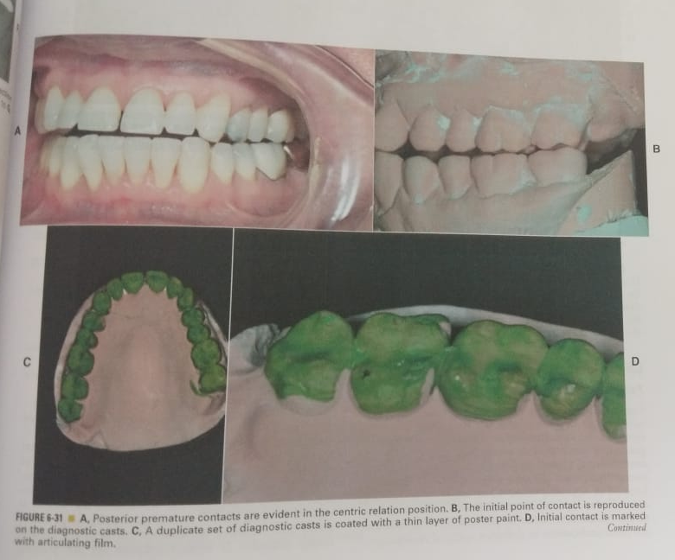

Slide 101
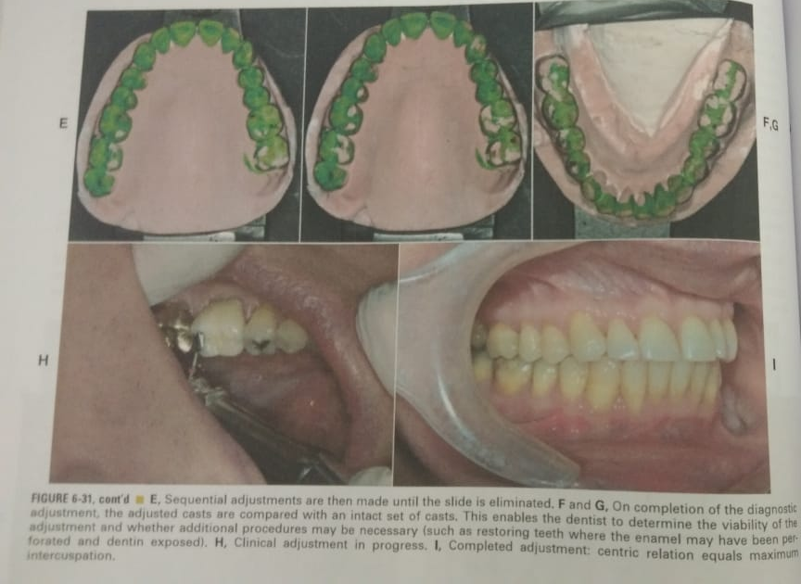

Slide 102
CLINICAL OCCLUSAL RESHAPING
Careful analysis of the diagnostic occlusal reshaping is necessary to determine whether the patient is a good candidate for such irreversible subtractive treatment.
The following should be considered as contraindications to definitive occlusal adjustment:
A bruxer whose habit cannot be controlled
A diagnostic correction that indicates that too much tooth structure will be removed
A complex spatial relationship (e.g., an Angle Class II and a skeletal Class 111)

Slide 103
Maxillary lingual cusps contacting mandibular buccal cusps
An open anterior occlusal relationship
Excessive wear
Before orthodontic or orthognathic treatment
Before physical or occlusal appliance therapy
A patient with temporomandibular pain
A patient whose jaw movements cannot be manipulated easily

Slide 104
Elimination of Centric Relation interferences
Manipulate the mandible and mark the teeth so both the initial contact in centric relation and the extent and direction of jaw movement to intercuspation are seen.
Find any interferences that cause the condylar processes to be displaced anteriorly. These will usually be between the mesial inclines of maxillary teeth and the distal inclines of mandibular teeth

Slide 105
Continue the adjustment until all teeth contact evenly.
When dealing with a lateral slide, adjust the buccal inclines of the maxillary lingual cusps and the lingual inclines of the mandibular buccal cusps until there is contact on the cusp tips.
When dealing with a medial slide, adjust the buccal inclines of the mandibular buccal cusps or the lingual inclines of the maxillary lingual cusps until there is contact on the cusp tips.

Slide 106
Correcting a medial slide by selective grinding. A, The contacting inclines are adjusted until the cusp tips are in contact (B). The opposing central grooves are then widened (C and D).

Slide 108
CONCLUSION
A logical treatment sequence should be planned before beginning any fixed prosthodontic intervention. Such planning will normally be multidisciplinary.
Mouth preparation is particularly important to fixed prosthodontics, which, like all dental disciplines, is facilitated and enhanced by meticulous preparatory treatment.

Slide 109
REFERENCES
Contemporary fixed prosthodontic; Stephen.F. Rosenstiel –fifth edition.
Carranza’s clinical periodontology- tenth edition.
Fundamentals of fixed prosthodontics- fourth edition

