Slide 1
VITAMINS
MANOHAR .Y

Slide 2
Vitamin: from Latin vita ‘life’ + English amine, because vitamins were originally thought to contain an amino acid.
Vitamins are the nutrients, our bodies need in order to maintain functions such as immunity and metabolism.
They are required in small quantities in the diet because they cannot be synthesized by the body.

Slide 3
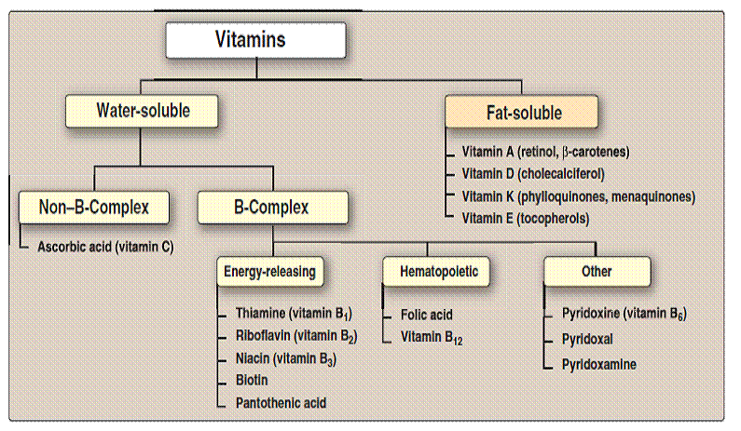

Slide 4
Fat-Soluble Vitamins
Vitamins A, D, E, K:
• Not lost easily in cooking
• Lost when mineral oil is ingested
• Excess amounts are stored in the liver.
• Deficiencies are slow to appear.
• easily absorbed through the intestinal tract.

Slide 5
Vitamin A : Retinol
several fat-soluble vitamins found especially in animal products.
Sources of Vitamin A:
• Animal sources: Milk Meat Fish Liver Eggs
• Plant sources: Green leafy vegetables
yellow fruits,red palm oil

Slide 6
Characteristics of Vitamin A:
• Formation of blood cells and gene transcription.
• It is mainly necessary for body tissue repair, to maintain the skin and mucous membranes in good health.
• Build and take care of bones,hair,nails,teeth. • Body stores fat soluble vitamins in the liver and appears in the retina of the eye in some components called retinoids.Eyes need it for a correct vision.
• Act as antioxidant.

Slide 7
Functions of Vitamin A:
• Body function: Vitamin A helps form and maintain healthy skin, teeth, skeletal and soft tissue, mucus membranes, and skin.
• Vision: Vitamin A promotes good vision, especially in low light .
• Immune system: Vitamin A is essential for maintaining healthy immune function and deficiency can lead to an impaired response to infection.
It may also be needed for reproduction and breast-feeding.

Slide 8
VITAMIN D:
Is synthesized in skin exposed to sunlight.
Regulates the absorption of phosphorus and calcium during bone growth.
• Deficiency can result in weakened bones.
• Sources include cod liver oil, egg yolk, and enriched milk.

Slide 9
Characteristics of Vitamin D:
• Vitamin D is preventing and treating rickets,
• Vitamin D is also used for treating
Weak bones (osteoporosis),
bone pain (osteomalacia),
bone loss hyperparathyroidism,
inherited disease (osteogenesis imperfecta) in which the bones are especially brittle and easily broken.
• Preventing low calcium and bone loss (renal osteodystrophy) in people with kidney failure.

Slide 10
Functions of Vitamin D:
• Immune system, which helps you to fight infection
• Muscle function
• Cardiovascular function, for a healthy heart and circulation
• Respiratory system –for healthy lungs and airways
• Brain development
Anti-cancer effects

Slide 11
VITAMIN E
Tocopherols and tocotrienols.
Sources of vitamin E :
Vegetable oils: corn, soybean, safflower, and cottonseed, and nuts, and green leafy vegetables.
Characteristics of Vitamin E
• Vitamin E is considered the heart vitamin,since it is necessary to have vitamin E needs covered for a healthy heart
• As a fat-soluble antioxidant, it stops the production of reactive oxygen species formed when fat undergoes oxidation.

Slide 12
Functions of Vitamin E:
• Antioxidant
• Prevention of hemolytic anemia among premature infants
• Enhances immune system
• Retards spoilage of commercial foods
• Vitamin E also has an effect on gene expression

Slide 13
Vitamin K
• Made up of several compounds essential to blood clotting
Vitamin K1 (phylloquinone)
Vitamin K2 (menaquinone)
Synthetic vitamin K (menadione) Vitamin K is destroyed by light and alkalis.
Sources of Vitamin K:
• Green leafy vegetables such as broccoli, cabbage.
• Dairy products, cow’s milk, eggs, meats, fruits, and cereals
• Bacteria in small intestine synthesizes some vitamin K, but must be supplemented by dietary sources.

Slide 14
Functions of Vitamin K:
• Formation of prothrombin for clotting of blood
• Candidates likely to receive vitamin K
▫ Newborns immediately after birth
▫ After extensive antibiotic therapy
▫ Antidote for an overdose of anticoagulant or treatment of haemorrhage.

Slide 15
Water-Soluble Vitamins
• Vitamin B complex and C
• Dissolve in water
• Easily destroyed by air, light, and cooking
• Cannot be stored and is readily extracted from the body.
Vitamin C: Ascorbic Acid
• antioxidant properties and protects food from oxidation
• Role in formation of collagen and absorption of nonheme iron.
• Prevents scurvy.
• May be involved with formation or functioning of norepinephrine, some amino acids, folate, leukocytes, the immune system, and allergic reactions

Slide 16
Functions of Vitamin C :
• Vitamin C is required for the synthesis of collagen, the intercellular ‘cement’ substance which gives structure to muscles, vascular tissues, bones, tendons and ligaments
• vitamin C contributes to the health of teeth and gums, preventing haemorrhaging and bleeding.
• vitamin C is also needed for the metabolism of bile acids which may have implications for bloodcholesterol levels and gallstones.
• vitamin C plays an important role in the synthesis of several important peptide hormones, neurotransmitters and carnitine.
• Anti-allergic• Antioxidant

Slide 17
Vitamin B1
• Thiamine.
• Sources include unrefined and enriched cereals, yeast, wheat germ, lean pork, organ meats.
Characteristics of Vitamin B1
• It is unstable when exposed to ultraviolet light and gamma radiation.
• Thiamine is a colorless organosulfur compound
• soluble in water, methanol, and glycerol.
Functions of Vitamin B1
• The production of energy from food
• The synthesis of nucleic acids (e.g., DNA)
• The conduction of nerve impulses
• The normal function of the heart

Slide 18
• Normal carbohydrate and energy-yielding metabolism
• The normal function of the nervous system
• Normal psychological functions
Vitamin B2
• Vitamin B2, also known as riboflavin, is one of eight B vitamins that are essential for human health.
• It is crucial for breaking down food components, absorbing other nutrients, and maintaining tissue.
• Necessary for the metabolism of carbohydrates, protein, and fats.
• Sources: milk, meats, poultry, fish, enriched breads, cereals, broccoli, spinach, and asparagus

Slide 19
Functions of Vitamin B2:
• Along with vitamin A, maintaining the mucous membranes in the digestive system
• Healthy eyes, nerves, muscles and skin
• the maintenance of normal red blood cells
• convert food (carbohydrates) into glucose, which is used to produce energy.
• convert vitamin B6 and vitamin B9 into active forms
• the reduction of tiredness and fatigue

Slide 20
Vitamin B3 Niacin
• Is part of the coenzyme nicotinamide adenine dinucleotide (NAD+ ) involved in oxidation reduction reactions.
• Deficiency can result in dermatitis, muscle fatigue, and loss of appetite.
Is found in meats, rice, and whole grains.

Slide 21
Vitamin B5 Pantothenic Acid :
• Is part of coenzyme A needed for energy production as well as glucose and cholesterol synthesis.
• Deficiency can result in fatigue, retarded growth and anemia.
Functions:
Part of coenzyme A
• Reduces stress, prevents tiredness
• Necessary for formation of glycogen, fatty acids, steroid hormones
Sources: whole grains, and vegetables ,eggs,liver, heart, yeast

Slide 22
Vitamin B6 Pyridoxine :
• Pyridoxine and pyridoxal are two forms of vitamin B6 , which are converted to the coenzyme pyridoxal phosphate (PLP).
• PLP is required in the transamination of amino acids and decarboxylation of carboxylic acids.
• Deficiency of pyridoxine may lead to dermatitis, fatigue, and anemia.
Functions:
Amino acids and protein metabolism
Serves as a catalyst in conversion of tryptophan to niacin; helps synthesize neurotransmitters such as serotonin and dopamine
• Cure of anaemia
• Formation of red blood cells

Slide 23
• Sources: meat, fish, liver, vegetables, cereals, yolk.
Vitamin B7 biotin
• Coenzyme in synthesis of fatty acids and amino acids
• Biotin can only be synthesized by bacteria, molds, yeasts, algae, and by certain plant species.
• Sources include liver, egg yolk, soy flour, cereals, and yeast

Slide 24
Functions of Vitamin B7:
• activate protein/amino acid metabolism in the hair roots and fingernail cells.
• the maintenance of normal skin and mucous membranes
• A vitamin H supplement may help to reduce muscle pain.
• Produce fatty acids and amino acids (the building blocks of protein)

Slide 25
Vitamin B12 • cobalamin.
A key role in the normal functioning of the brain and nervous system, and for the formation of blood
•The body can store vitamin B12 for years in the liver.
• Involved in folate metabolism, maintenance of the myelin sheath, and healthy red blood cells
• To be absorbed, must bind with intrinsic factor in stomach.

Slide 26
Functions of Vitamin B12 :
• Vitamin B12 is used for building proteins in the body, formation of red blood cells.
• Vitamin B12 is essential for the preservation of the myelin sheath around neurons and for the synthesis of neurotransmitters.
• It helps in the maintenance of the central nervous system.

Slide 27
Vitamin C
Ascorbic acid
• Hypervitaminosis: addiction, diarrhea
• Hypovitaminosis: scurvy-4Ds
• Source: fruits,vegetables
Functions:
Hormone, collagen synthesis
• Infection resistance, cure of cuts.

