Slide 1
Restoring Contacts and Contours

Slide 2
Benefits of an ideal contact and contour
Conserves health of periodontium.
Prevents food impaction.
Makes the area self-cleansable.
Improves longitivity of proximal restoration.
Maintain s normal mesio-distal relationship of teeth in dental arch.

Slide 3
Height of Contour
The area of the greatest circumference on the facial and lingual surfaces of the tooth.
Protects gingival tissue by preventing food impaction.
In posterior teeth: located at gingival third of facial surface and in middle third of lingual surface.

Slide 4
Proximal Contact Area
Area of proximal height of contour of the mesial or distal surface of a tooth that contacts its adjacent tooth in the same arch.
Maxillary and mandibular anteriors:
Incisal third and slightly facial.
Maxillary and mandibular posteriors:
near the junction of occlusal and middle thirds or in the middle third.

Slide 5
Matrix
Definition:
A device that is applied to a prepared tooth before the insertion of the restorative material to assist in the development of the appropriate axial tooth contours and in order to confine the restorative material excess.

Slide 6
Classification of matrices
Based on mode of retention
With retainer: Tofflemire matrix
Without retainer: Automatrix
Based on type of band
Metallic non-transparent matrix
Nonmetallic transparent matrix
Based on type of cavity for which it is used
Class I cavity: Barton matrix
Class II Cavity: Tofflemire matrix
Ivory matrix no 1 & 8

Slide 7
Class III cavity: Mylar strip
S- shaped matrix
Class IV cavity: Custom lingual matrix
Mylar strip matrix
Transparent crown form matrix
Modified S-shaped band
Class V cavity: Window matrix
Cervical matrix

Slide 8
Functions of matrix:
Rigidity
Establishment of proper anatomical contour
Restoration of correct proximal contact relation
Convenient application
Ease of removal

Slide 9
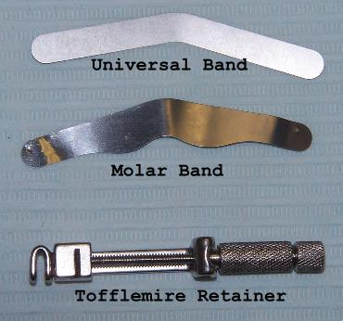
Matrix application for Class II amalgam
Tofflemire Matrix

Slide 10
Types of Bands
Uncontoured bands: Available in 2 thickness:
0.002 inch (0.05mm)
0.0015 inch (0.038mm)
Precontoured bands: need little or no adjustment
More expensive
Require less chair side time

Slide 11
Clinical Technique
Shaping the matrix:
Burnishing to achieve contacts and contours.
Using No. 26-28 burnisher.

Slide 12
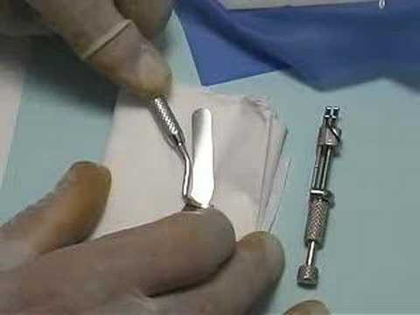
Burnishing the matrix band

Slide 13
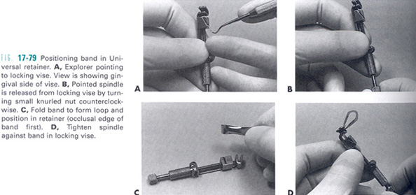
Preparing retainer to receive the band

Slide 14
Placing the band with retainer on prepared tooth:
Allowing gingival edge of the band to be positioned atleast 1 mm apical to gingival margin
Band is then tightened.
It must be touching adjacent contact area.

Slide 15
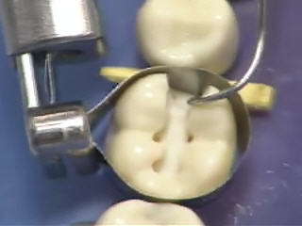
Placing the band with retainer on prepared tooth

Slide 16
Removal of the band with retainer:
Retract the pointed spindle by turning small nut counter clockwise.
Remove band after ensuring hardening of amalgam to avoid fracture.
Remove the retainer first and then the band.
Wedge may be left in place to provide separation of teeth while removal of band.

Slide 17
Wedging Techniques
Single wedge technique
Grasp the wedge with pliers.
Insert it from embrassure, slightly gingival to gingival margin.
Wedge the band tightly against tooth and margin.

Slide 18
Piggy back wedging technique
If wedge is significantly apical to gingival margin, a Iind wedge is placed on top of first wedge to wedge adequately the matrix against margin.
Indicated in patients with receded interproximal tissue level.

Slide 19
Double wedging
Use of 2 wedges: one from lingual embrasure, another from facial embrasure.
Indicated if proximal box is wide faciolingually.

Slide 20
Wedge wedging
A IInd wedge is inserted between the Ist wedge and the band.
Indicated when concavity is present on proximal surface (fluted root) eg mesial surface of maxillary first premolar.

Slide 21
Round wedge
Wedge of choice with conservative proximal boxes.
Wedging action is nearer the gingival margin.

Slide 22
Triangular wedge
Indicated in:
Preparation with deep gingival margin.
With Tofflemire MOD matrix band.

Slide 23
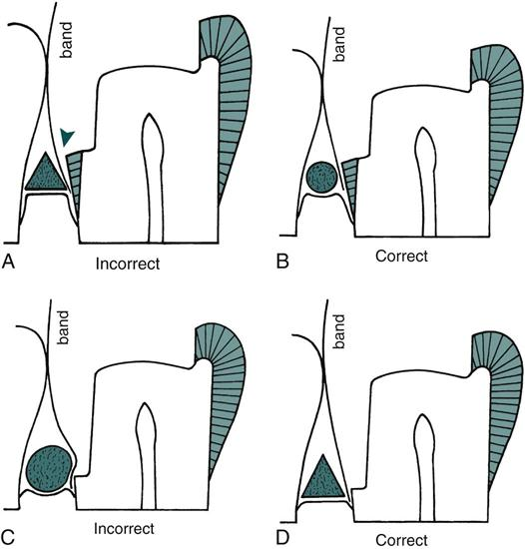

Slide 24
Matrix application for Class III Composite
Steps
Contouring the mylar strip.
Pre wedge insertion.
Positioning of mylar strip.
Wedging: placed from facial approach for lingual access and vice-versa.
Insertion and light activation of the composite.

Slide 25
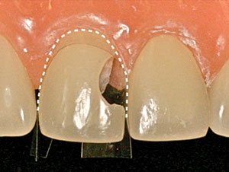
Matrix application for Class III Composite

Slide 26
Matrix application for Class IV composite restoration
Custom lingual matrix
Shade selection prior to isolation.
Preparation of lingual matrix using polyvinyl siloxane impression putty.
Insertion and light activation of composite in increments less than 2mm
After polymerisation, lingual matrix is removed, and restoration is light activated from both facial and lingual direction.

Slide 27
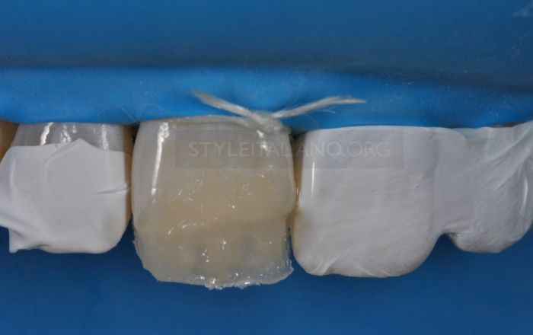
Custom lingual matrix

Slide 28
Automatrix
It is a retainer-less matrix system designed for any tooth regardless of its circumference and height.
Types of bands:
3/16 inch (4.8mm) 0.002 inch thickness
¼ inch (6.35mm) 0.002 and 0.0015 inch thickness
5/16 inch (7.79mm)0.002 inch thickness.

Slide 29
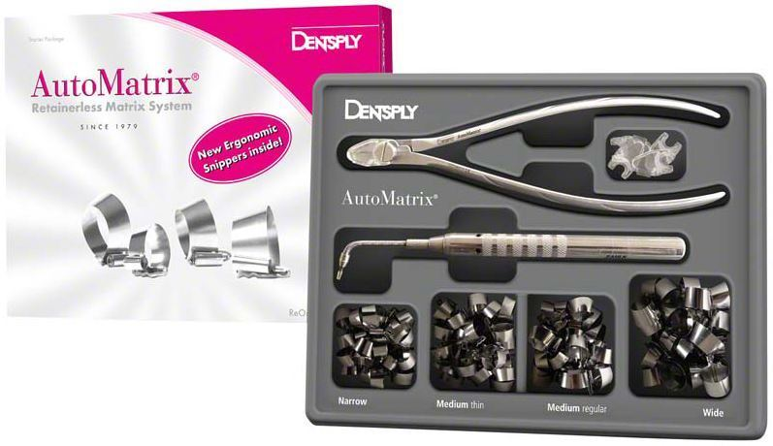
Automatrix

Slide 30
Advantages:
Convenience.
Improved visibility because of absence of a retainer.
Ability to place the autolock loop on facial or lingual surface of the tooth.

Slide 31
Disadvantages:
The band is flat and difficult to burnish.
Sometimes, band is unstable even when wedges are in place.
Development of proximal contact and contours can be difficult with Automatrix bands.

Slide 32
Conclusion
Restoration of proper contacts and contours is the most intricate restorative challenge to a clinician.
Appreciation of anatomic landmarks and properly restoring them is important.
The use of appropriate matrix system in a proper manner is of paramount importance in clinical conditions.

