Slide 1
DR LAVANYA
MDS 1ST YEAR
09-03-2020
HYPERSENSITIVITY REACTIONS
DR. LAVANYA
MDS 1ST YEAR

Slide 2
CONTENTS
HISTORY
INTRODUCTION
CAUSES OF HYPERSENSITIVITY
CLASSIFICATION OF HYPERSENSITIVITY REACTIONS
DISTINGUISHING FEATURES
IMMEDIATE HYPERSENSITIVITY
DELAYED HYPERSENSITIVITY
TYPE V HYPERSENSITIVITY
MANAGEMENT
CONCLUSION
REFERENCES

Slide 3
HISTORY
Prince of Monaco first observed the deleterious effects of jellyfish on bathers.
Portier and Richet (1906) suggested a toxin to be responsible for these effects and coined the term “Anaphylaxis”.
Human IgE responsible for allergies was discovered in 1965 by K. & T. Ishizaka.
Passive transmission of hypersensitivity with human antibody by prausnitz (P-K reaction, 1921)
The use of smooth muscle contraction (Dale, 1913) and vascular permeability increase (Ovary, 1948) became important for experimental studies.

Slide 4
INTRODUCTION
Immune responses that are normally protective and are also capable of causing tissue injury.
Hypersensitivity reaction denotes an immune respone resulting in exaggerated or inappropriate reactions harmful to the host.
Hypersensitivity reactions has two components- priming dose and shocking dose

Slide 5
ETIOLOGY
Autoimmunity
Reactions against microbes
Reactions against environmental antigens

Slide 6
CLASSIFICATION OF HYPERSENSITIVITY
Immediate (Type I) Hypersensitivity
Antibody mediated (Type II) Hypersensitivity
Immune complex-mediated (Type III) Hypersensitivty
T cell- mediated (Type IV) Hypersensitivity
Type V Hypersensitivity

Slide 7
TYPE I HYPERSENSITY REACTION

Slide 8
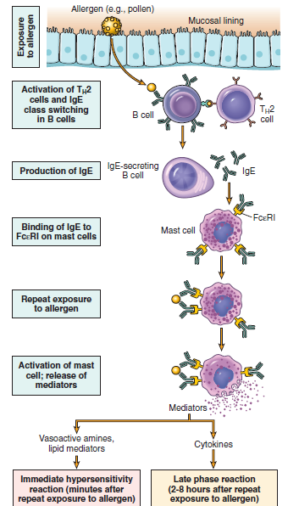

Slide 9
Initiator cells
Initiater of type I reaction is otherwise known as allergen.
plant pollen, proteins (foreign serum and vaccines)
Food items (eggs milk seafood, nuts)
Drugs (pencillin, local anesthetics)
Inspect products (venom from bees, wasps and nuts)
Dust mites, mould spores
Animal hair, dander

Slide 10
Effector cells in anaphylaxis
Mast cells
Basophils
Eosinophils

Slide 11
Mediators of anaphylaxis
Histamine
Slow- reacting substances of anaphylaxis
Serotonin
Eosinophilic chemotactic factor of anaphylaxis
Prostaglandins and Thromboxanes

Slide 12
PHASES OF ANAPHYLAXIS
Immediate phase
Late phase

Slide 13
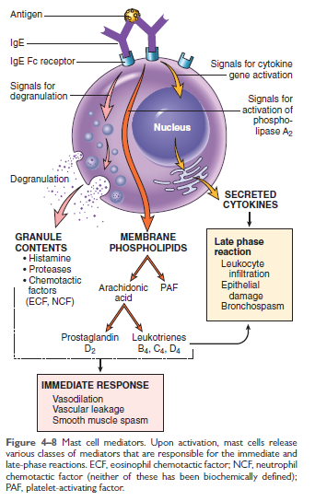

Slide 14
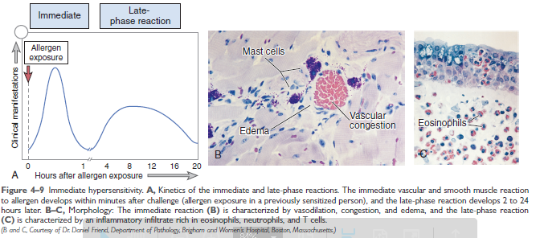

Slide 15
Clinical manifestations
Anaphylaxis is an acute, life threatening reaction usually affecting multiple organs.
Multiple organ systems are usually affected, including the skin (pruritis, flushing, utricaria and angioedema), respiratory tract (bronchospasm and laryngeal edema), and cardiovascular system (hypotension and cardiac arrhythmias).

Slide 16
ANAPHYLACTOID REACTION
Not IgE mediated
Inciting agents (such as drugs or iodinated contrast media) stimulate directly basophils and mast cells to release mediators without any involvement of IgE

Slide 17
atopy
Atopy was first coined by coca(1923) to denote a condition of familial hypersensitivity that occur spontaneously in humans.
Atopy is recurrent, nonfatal, and local manifestation of immediate hypersensitivity reaction.
High degree of familial predisposition and is associated and it is associated with high level of IgE
Common manifestations of atopy are asthma, rhinitis, utricaria

Slide 18
Commonest of atopic reactions is bronchial asthma .
Atopy is associated with mutations in certain genes encoding the alpha chain of the IL-4 receptor, which facilitate its effectiveness resulting in an increased production of IgE synthesis by B cells
Atopic hypersensitivity is non- transferable by lymphoid cells, but by serum. It is used for the diagnosis of passive cutaneous anaphylaxis reaction by Prausnitz-kustner reaction.
RSAT, ELISA, Passive agglutination tests are frequently used for detection of IgE in the serum for diagnosis of atopy.

Slide 19
MANAGEMENT AND PREVENTION
Acute desensitization
Chronic desensitization

Slide 20
TYPE II HYPERSENSITIVITY REACTION

Slide 21
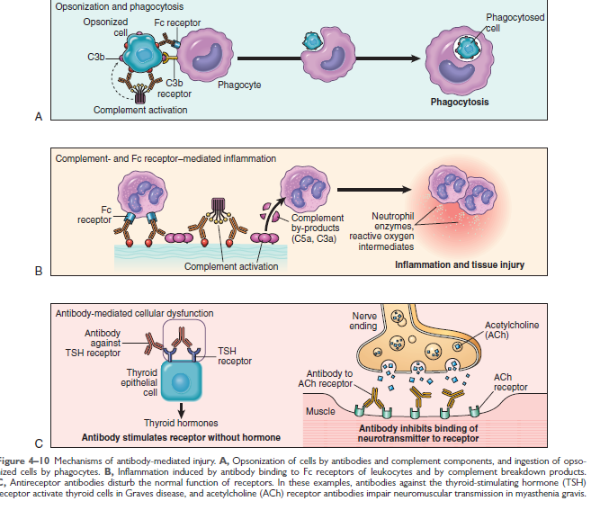

Slide 22
TRANSFUSION REACTIONS
ERYTHROBLASTOSIS FETALIS

Slide 23
DRUG-INDUCED HEMOLYSIS
GOODPASTURE’S SYNDROME
RHEUMATIC FEVER

Slide 24
TYPE III HYPERSENSITIVITY REACTION

Slide 25
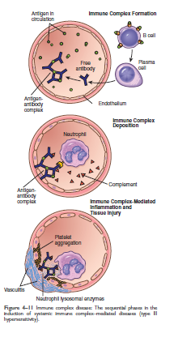

Slide 26
Arthus reaction
Inflammatory reaction caused by the deposition of immune complexes at a localized site.
Named after Dr Arthus who first described this reaction.
Edematous in early stages but later become hemorrhagic and eventually necrotic.
Hypersensitivity pneumonitis is the clinical manifestation of arthus reaction.
Farmers lung, cheese-washers lung, wood-workers lung, wheat millers lung are the examples of hypersensitivity pneumonitis.
Arthus reaction can also occur at site of tetanus immunization if toxoids are given at same site within a very short period of time.

Slide 27
Serum sickness
Serum sickness is a systemic inflammatory reaction caused by the deposition of immune complexes at many sites of the body.
Manifests after a single injection of a high concentration of foreign serum or certain drugs like pencillin ( few days to weeks)
Fever, lymphadenopathy, rashes, arthritis, splenomegaly, eosinophilia

Slide 28
Immune complex diseases
Auto-immune diseases
Systemic lupus erythematosus(SLE)
Rhematoid arthritis
Drug reactions
Allergies to pencillin and sulfonamides
Infectious disesases
Poststreptococcal glomerulonephritis
Meningitis, Hepatitis, Malaria
Infectious mononucleosis
Trypanosomiasis

Slide 29
TYPE IV HYPERSENSITIVITY REACTION

Slide 30
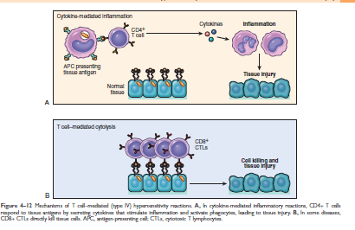

Slide 31
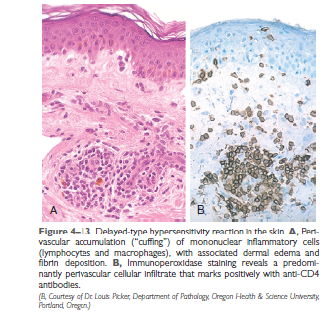

Slide 32
Contact hyperseNSITIVITY
It is a manifestation of DTH occurring after sensitization with certain substances.
Drugs such as sulfonamides and neomycin, plant products like poison ivy and poison oak chemicals such as formaldehyde and nickel, cosmetics, soaps and other substances
Reaction occurs when substances acting as haptens enter the skin and combine with body proteins to become complete antigens to which a person become sensitized.
On second exposure to the same antigen the immune system responds by attack of cytotoxic T cells that cause damage, mostly skin, mostly manifests as itching, erythema, vesicle, eczema or necrosis of skin within 24 hours of second exposure.

Slide 33
Tuberculin -type hypersensitivity
Tuberculin skin test:
tuberculin protein from cell wall of mycobacterium tuberculosis is injected intradermally
Red slightly swollen firm lesion at the site of injection after 48-72 hrs indicates positive
Positive test indicates that person has been infected with bacteria but does not confirm the presence of the disease like tuberculosis
If person with tuberculin negative skin test becomes positive, then it indicates that the patient has been recently infected

Slide 34
Skin test can be negative:
Infected persons receiving therapy with immunosuppressive drugs (corticosteroids, anticancer drugs)
In those suffering from the disease associated with suppressed cell-mediated immunity(AIDS, sarcoidosis, lymphoma, post measles vaccination)

Slide 35
Type v hypersensitivity
Known as stimulatory hypersensitivity reaction
Modification of type II hypersensitivity reaction.
Plays an important role in pathogenesis of graves disease, in which thyroid harmones are produced in excess quantity

Slide 36
Characteristics Type I Type II Type III Type IV
ANTIBODY IgE IgG, IgM IgG, IgM None
ANTIGEN exogenous cell surface soluble tisue & organs
RESPONSE 15-30 min minutes- hours 3-8 hrs 48-72 hrs
APPEARANCE weal & flare lysis & necrosis erythema, edema erythema, induration
HISTOLOGY basophils antibody & complement complement &neutrophils monocytes&lympho
TRANFERRED antibody antibody antibody T- cells
EXAMPLES allergic, asthma erythroblastosis fetalis SLE, farmers lung tuberculin test,granulom

Slide 37
Hypersensitivity to dental materials
Latex
Alginate
Chlorhexidine
Methyl methacrylate
Prosthesis
Eugenol
Sodium hypochlorite

Slide 38
mANAGEMENT

Slide 39
conclusion

Slide 40
references
Ananthanarayana and panikers textbook of microbiology- 7th edition.
Subhash Chandra Pariji textbook of microbiology and immunology- 2nd edition
Guyton and Hall text book of medical physiology- 12th edition

Slide 41
Pichler WJ. Delayed drug hypersensitivity reactions. Annals of internal medicine. 2003 Oct 21;139(8):683-93.
Samuelsson B. Leukotrienes: mediators of immediate hypersensitivity reactions and inflammation. Science. 1983 May 6;220(4597):568-75.
Burks AW, Mallory SB, Williams LW, Shirrell MA. Atopic dermatitis: clinical relevance of food hypersensitivity reactions. The Journal of pediatrics. 1988 Sep 1;113(3):447-51.
Gomes ER, Demoly P. Epidemiology of hypersensitivity drug reactions. Current opinion in allergy and clinical immunology. 2005 Aug 1;5(4):309-16.

Slide 42
Gomes ER, Demoly P. Epidemiology of hypersensitivity drug reactions. Current opinion in allergy and clinical immunology. 2005 Aug 1;5(4):309-16.
Weiss ME, Adkinson NF. Immediate hypersensitivity reactions to penicillin and related antibiotics. Clinical & Experimental Allergy. 1988 Nov;18(6):515-40

