Slide 1
SELECTION OF ANTERIOR TEETH IN COMPLETE DENTURES

Slide 2
INTRODUCTION
Methods Used to Select ArtificialAnterior Teeth for the Edentulous Patient: A Historical Overview; int j Prosthodont 1999:12:51-58.

Slide 3
One of the main objectives in selecting and arranging artificial teeth is to produce a prosthesis that defies detection.
With the appropriate clinical expertise, selecting artificial teeth that blend harmoniously with the natural dentition should be a relatively straightforward procedure.

Slide 4
However the choice of artificial teeth is more complex, when no natural teeth remain and no pre-extraction records are available.
The resultant prosthesis can be disappointing for both the dentist and the patient, especially where there are conflicting ideals and expectations.
Notes:
The anterior teeth are selected primarily to satisfy esthetic requirement.There are no rules of thumb for this procedure;

Slide 5
History of Teeth Selection

Slide 6
Teeth selection is not simply a mechanical procedure, but requires dexterity and knowledge of biology.
In earlier century artificial teeth were carved from stone, wood, ivory and metal. They looked like blocks. Even human teeth were used in early dentures.

Slide 8
Before 1914 there were no lifelike artificial anterior teeth.
There were hundreds of moulds which had been carved as copies of pleasing natural teeth.
They were carved by skilled artisans, most of whom were not dentists

Slide 9
Classification Of Human Beings
Empedocles 5th century B.C.
Doctrine : Universe : Four Elements Fire ,Water, Earth and Air
Man is a microcosm
Man is composed of blood ,phlegm ,yellow and black bile.

Slide 10
Hippocrates
Dominance of humor
Sanguineous for blood dominance
Phlegmatic for phlegm dominance
Choleric for the yellow bile dominance
Melancholic for black bile dominance
Notes:
Some of the characteristics were: large and small body stature; heavy and powerful, or small and weak muscles; slow or rapid gait or movements ; face ruddy or pallid, and tine- or coarse-featured; digestion good or poor

Slide 12
Hippocrates termed these body characteristics “temper,” or “temperaments habitus.” The habitual association with the temperaments, from their inception, or certain mental, functional, and physical characteristics created the theory of temperaments or the “temperamental theory,”
Notes:
Many new physical and functional characteristics were added, or the old order was rearranged during the time interval of its validity. It seems natural and appropriate that dentistry, at its period of need, should have turned to the temperamental theory for values indicating a choice of tooth physical forms.

Slide 13
EVOLUTION OF TECHNIQUES
Young JPD 1954,4;748-59
Notes:
In this narration of selecting techniques used or projected, it is proper begin at the beginning and include all such techniques, even though they have little value today.

Slide 14
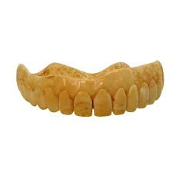
Technique I
During the ivory age and the early porcelain periods, teeth were selected, or created, mostly by dimensional measurements, with slight consideration given to face form or other qualities.
Notes:
This method, in modified form, and in specific application to denture space and arch size, is still a projected and used technique.

Slide 15
Technique 2
“Correspondence and Harmony,” projected by J. W. White in 1872.”
The basis of this concept was that the temperaments called for a characteristic association of tooth form and color
Harmony called for a corresponding proportion and size of tooth to that of the face
Tooth color in harmony with facial complexion; that both form and color were modified to be in harmony with sex and age.

Slide 16
Technique 3
“Typal Form Concept” projected
by W. R. Hall in 1887,”
The major basis was the tooth’s labial surface curvatures (transverse and gingival-incisal), outline form, and neck width.
The minor basis was the labiolingual inclination of the upper incisors in relation to profile types of straight, convex, and concave.
Notes:
Hall gave the first definite measurements of typal tooth
forms in l/48 inch, and the relative size of the teeth in an arch, using the upper
central incisor as the model tooth. He listed three classifications, using terms of (1) ovoid, (2) tapering, and (3) square. This classification apparently exerted little influence on practice procedure of that time.

Slide 19
Technique 4
The “Temperamental Technic” 1885 of selecting tooth form should be considered the fourth technique chronologically, yet the first technique from the point of view of influence and universal acceptance.

Slide 20
It required several years to associate and establish dental characteristics of the temperaments, and to incorporate them in manufactured tooth forms ; therefore, it seems more appropriate to designate it as a specific technique only after it had attained maturity and universal usage.
The basic items considered as indicative of tooth form for the edentulous patient were body and face size, form, and function, complexion, and color of hair and eyes. The choice of tooth mold was determined by analysis of the dominant and associated body characteristics.

Slide 21
Sanguine arch:
Resembled a horseshoe in outline, while the palatal contour was semicircular.

Slide 22
Nervous temperament :
had an arch that gently curved on either side to form a rounded point anteriorly . Likewise, the palate had a high vault, reminiscent of a gothic arch.

Slide 23
Lymphatic temperament:
An almost semicircular arch typified the with a rounded, shallow palate.

Slide 24
Technique 5
“Berry’s Biometric Ratio Method," projected in 1906.‘”
Berry projected, in 1903, that the outline form of the inverted upper central incisor tooth closely approximated the outline form of the face.

Slide 25
He discovered that the proportion of upper CI is 1/16 the face width & 1/20 the face length

Slide 26
Technique 6
Clapp’s “Tabular Dimension Table
& Method,” presented around 1910.‘”
This method was based on selecting tooth size from the over-all dimension of six anterior teeth arranged on the Bonwill circle and the vertical tooth space present in the patient.
Outline form was based on the operator’s impression of harmony in face and tooth forms.
This tabular method enabled to select a mould of teeth by number.

Slide 27
Technique 7
Valderrama’s “molar Tooth Basis,” was projected in 1913.”
According to this method, varying measurements between combinations of cusp points indicated the size of the individual and over-all tooth measurements.

Slide 28
There is no indication that this technique ever received clinical use, principally because no molars are present in edentulous patients

Slide 29
Technique 8
Projected by Cigrande in 1913
This consisted of using the outline form of the fingernail to select the outline form of the upper central incisor.
The size was modified to meet the requirements of tooth space and other relationships.

Slide 30
Technique 9
“Williams’ Typal Form Method,” projected in 1914.‘”
The projected basis of this method was Nature’s uninhibited ground plan in developing human face and tooth forms.
This ground plan was interpreted by the geometric pattern created by the outline form of the bony face frame.

Slide 31
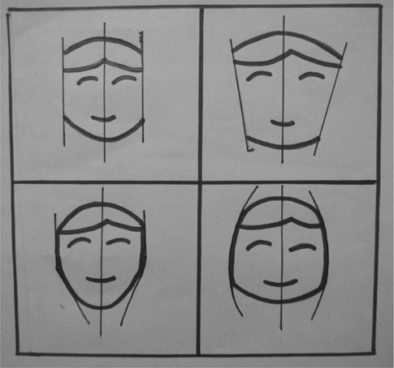
Leon Williams Face Forms

Slide 32
This pattern was the square, tapering, and ovoid forms.
The upper central incisor tooth was considered the modal tooth of the arches.
M. M. House has projected data showing that the classification is applicable to root, crown, and occlusal form as well as face form.The typal form technique was the basic and almost universally used technique.

Slide 33
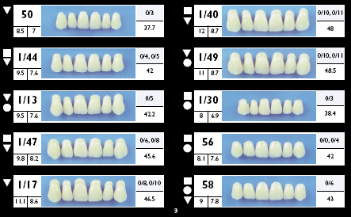
Technique 10
Mould guide
sample teeth.
This made the selection of the form & size much easier & is a method known to all today.

Slide 34
Technique 11
The “Wavrin Instrumental Guide Technic,” projected about 1920,” which was based on Berry’s Biometric Ratio Method, and Williams’ Typal Form teeth.
While the instrument was quite satisfactory, its usefulness was mostly limited to a single manufacturer’s product, so apparently it has been dropped as a regular method

Slide 35
Technique 12
“Maxillary Arch Outline Form,” projected by Nelson in 1920.”
This technique assumed that the arch outline form was a valid method, since it was related to the individual’s anatomy, and since clinical use had proved it a reliable method easily executed.

Slide 36
Technique 13
“Wright’s Photometric Method,” projected in 1936.”
This was based on using a photograph of the patient with natural teeth, and establishing a ratio by comparative computation of measurements of like areas of the face and photograph.
The simple unknown mathematical formula could be used to select teeth or to create correct vertical dimension.

Slide 37
Technique 14
“ Multiple choice method ,” projected by Myerson in 1937.”
This was based on a need for a selective range in labial surface characteristics of transparent labial and mesial surfaces, varying surface color tone, and characterizations of teeth by time, wear, etc.
Harmony of tooth size and shape with face size and shape was associated with this technique.

Slide 38
Technique 15
“Stein’s Coordinated Size Technic,” projected in 1940.”
This was based on the coronal index of 70 to 100, commonly used in prosthetics on four model teeth representing the range of maximum frequency of use, and on the common variability in size of individual natural teeth.
The index is the width per cent of the length. The variability is 0.5mm. ; model size varied from 7.2 to 8.7 mm.

Slide 39
Technique 16
“Anthropometric-Cephalic Index Method,” projected by Sears in 1941.
This was based on the fact that the width of the upper central incisor could be determined by dividing either the transverse circumference of the head by 13 or the bi-zygomatic width by 3.3.
The tooth length was in proportion to the face length.

Slide 40
Sear’s anthropometric cephalic index method

Slide 41
Technique 17
“Frame Harmony Method,” projected by The Justi Company in 1949.”
The basis of the method is that the size and proportions of the teeth are in harmony with the general bony proportions of the skeleton.
The over-all tooth size is selected by a mathematical formula, one-seventh the total dimension of the upper and lower bearing areas, with the dimensions of the individual anterior teeth correlated with a developed table of tooth dimensions to give the indicated over all dimension.

Slide 42
Technique 18
“Bioform technic,” projected by the Dentists’ Supply Company in 1950.”
It is based on the geometric outline forms of face and teeth, the “House” classification of four basic and three combination typal forms, and three-dimensional harmony of tooth form and face form.
It is associated with the tabular table and mold guide systems.

Slide 44
Technique 19
The “Selection Indicator Instrument
Method,”
projected by the Dentists Supply Company, which is correlated
with Williams’ and House’s typal form theory and the tabular table technique.

Slide 45
Technique 20
“House Instrumental method”
of projecting typal outline and profile silhouettes onto the face by means of a telescopic projector instrument, and silhouette form plates.
This was correlated with designated mold numbers and size variation.” It was projected by House in 1939 and by the Dentists Supply Company in 1950..

Slide 47
Technique 21
“Automatic Instant Selector Guide” of the Austenal Company, projected in 1951.*
This technique correlates form, size, and appearance in such a manner that a single reading only is required to select the appropriate tooth mold based on dimensions of denture space and harmony of face and tooth form.

Slide 48
Concepts of Teeth Selection

Slide 49
White’s Concept
This method was based on a 5th century BC concept attributed to Hippocrates. Temperamental types were sanguine, nervous, bilious and lymphatic named for the physiologic functions of blood, nerves, bile and lymph of the individual.

Slide 50
A ‘‘bilious’’ individual would be expected to have short, broad, tapering incisor teeth
A ‘‘sanguineous’’ individual would possess long, thin, and narrow teeth

Slide 51
H.Pound’s Concept
Evaluates tooth width by ‘‘measuring the distance from zygoma to zygoma,( one to one half inches back of the lateral corner of the eyes)’’
Width of the central incisor ¼ bizygomatic width=16 Length is a measure of the distance from the hairline to the lower edge of the bone of the chin with the face at rest.
Length of the central incisor ¼ length of the face=16:

Slide 52
Dentogenic Concept
Tooth selection using the concepts of dentogenics is based on the age, sex and personality of the patient put forth by Frush and Fisher 1955. This concept has been explained as the prosthodontic appearance interpretation of three vital factors which every patient possess.
The factors are sex, personality and age of the patient.

Slide 53
Winkler’s Concept
According to Winkler, the teeth should be selected on three different views as follows
Physiological-biological The facial musculature contributes to the aesthetics of a patient. Increasing the thickness of the denture base in the labial and buccal sulci can produce a puffy appearance.
Facial wrinkles fade when the vertical dimension is increased. But this should not be carried out to avoid other complications listed and evaluate the perioral tissues and arrange the teeth accordingly.

Slide 54
Psychological : A patient with a positive self-evaluation shows a broad smile and the one with a negative self-evaluation shows a tight-lipped small smile. The Camper's line is the psychological plane of orientation. It is raised in happy people arid is tilted downward in depressed people

Slide 55
Biomechanical The teeth should be placed such that they fulfill the biomechanics of the denture It is not necessary to set the teeth on, outside, inside the ridge.
Instead they should be set in the neutral zone (the zone of balance between the buccal and lingual musculature)

Slide 56
Leon William’s Concept
William formulated a method called the “Law Of Harmony”.
He believed that a relationship exists between the inverted face form and the form of maxillary central incisor in most people.
He described three typal forms of teeth as square , tapering , ovoid.

Slide 57
METHODS OF ANTERIOR TEETH SELECTION
Using pre-extraction record
Post extraction examination of the patient

Slide 58
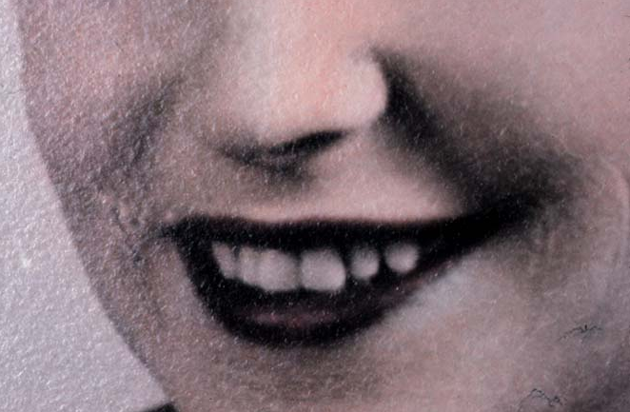
Pre extraction guides
Diagnostic cast
Recent photographs before extraction.
Pre-extraction radiographs
Preserved extracted teeth

Slide 59
Pre extraction guides
The following pre-extraction records can be used to determine the size of the artificial teeth
Diagnostic casts : of patients natural teeth or restored teeth prior to extraction of remaining teeth.
Recent photographs : They will often provide general information about the width of the teeth and possibly their outline form that is more accurate than information from any other source.

Slide 60
Radiographs of teeth : Radiographs made before the natural teeth were lost can supply information about the size and form of the teeth to be replaced.
Radiographic images are however always enlarged and may be distorted because of divergence of the x-ray.
Preserved extracted teeth
The best method to determine the size and contour of the anterior teeth

Slide 61
Bissasu ⁸ reviewed the pre-extraction records proposed for determining the vertical dimension of occlusion, recording centric relation, and arranging the maxillary anterior teeth.
The review of the literature indicated that
pre-extraction records provided a useful guide in determining the edentulous patient’s original VDO and arranging the maxillary anterior teeth.

Slide 62
Post extraction examination
Size and form of edentulous foundation
Matching teeth to face forms and arch forms

Slide 63
Post extraction examination
If the patient is edentulous and wearing complete dentures, then on the basis of the teeth the patient is wearing, determine whether to choose teeth that are longer, smaller or shorter, wider or narrower, flatter or having a more curved labial surface

Slide 64
The various factors that comprise the anterior teeth selection are their
Size
Form
Color
Composition.
The science of anterior teeth selection for a completely edentulous patient:
a literature review;JIPS(jan –mar)11(1):7-13

Slide 65
Factors to be Considered in Selecting the Size

Slide 66
Size of the teeth
Size of the face
Size of the maxillary arch
Incisal papilla and the cuspid eminences or the buccal frenum
Interalar distance
Maxillomandibular relations
Contour of the residual ridges
Vertical distance between the ridges
Lips
Intercanthal distance as a guide

Slide 67
Size of the face
Average width of the maxillary central incisor = 1/16th of the width of the face measured between the zygoma.
Combined width of the six maxillary anterior teeth = slightly less than 1/3rd of the bizygomatic breadth of the face.(face bow)

Slide 68
1:2=1:16

Slide 69
The trubyte tooth indicator is also useful in determining the size of maxillary central incisors.
Levin observed that the widths of the maxillary anterior teeth when viewed in the frontal plane lie within the golden proportion of 1.681.
Trubyte tooth indicator

Slide 71
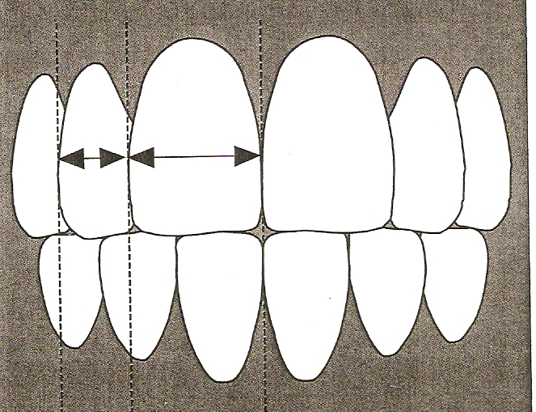
The golden proportion 1.618:1 represents the ratio of the visible part of the central incisor to the visible part of the lateral incisor. The same ratio applies to the visible part of the lateral to the visible part of the canine

Slide 72
Size of the Maxillary Arch
The mould selectors are used to make measurements of the maxillary cast. Measurements are made from the crest of the incisive papilla to the hamular notches and from one hamular notch to the opposite side hamular notch. The combined length of the three legs of the triangle in millimetres is used as the selector. The circular slide rule indicates the anterior and posterior tooth size.

Slide 73
Incisive papilla and the canine eminences or the buccal frenum
A line is placed on the cast at the distal termination of the canine eminence.
If the canine eminence is not discernible a line is placed slightly anterior to the buccal frenum attachment, which will be distal to the eminence.
A flexible ruler is used to measure the distance from the distal of one canine eminence to the distal of the other.

Slide 75
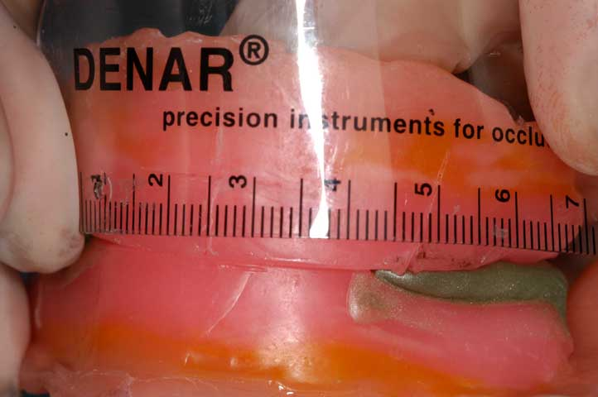

Slide 76
The ruler should follow the contour of the ridge and as it reaches the midline it should be placed on the anterior border of the incisal papilla as the maxillary centrals are situated labially to the papilla
The combined width of the six maxillary anterior teeth is determined in mm. The distance between the marks will give the combined width of the six maxillary anterior teeth.

Slide 77
Determination of appropriate size of anterior denture teeth when mandibular anterior teeth are present
D.Raymond Mc Arthur JPD1985;53,369-373

Slide 78
The result of this study showed that a reliable relationship exists between the anterior mandibular arch width measured on a curve & the maxillary anterior teeth.

Slide 79
This relationship can be expressed as a ratio:
Max = 1.3
Mand
To allow for intentional disclusion of maxillary anterior teeth arrangement, the ratio can be slightly modified.

Slide 80
A ratio of 1.38 will usually yield the desired results.
The possible range of mandibular anterior teeth width is 32 to 45 mm.
Dentsply Intl Inc. has developed a table based on this ratio.

Slide 81
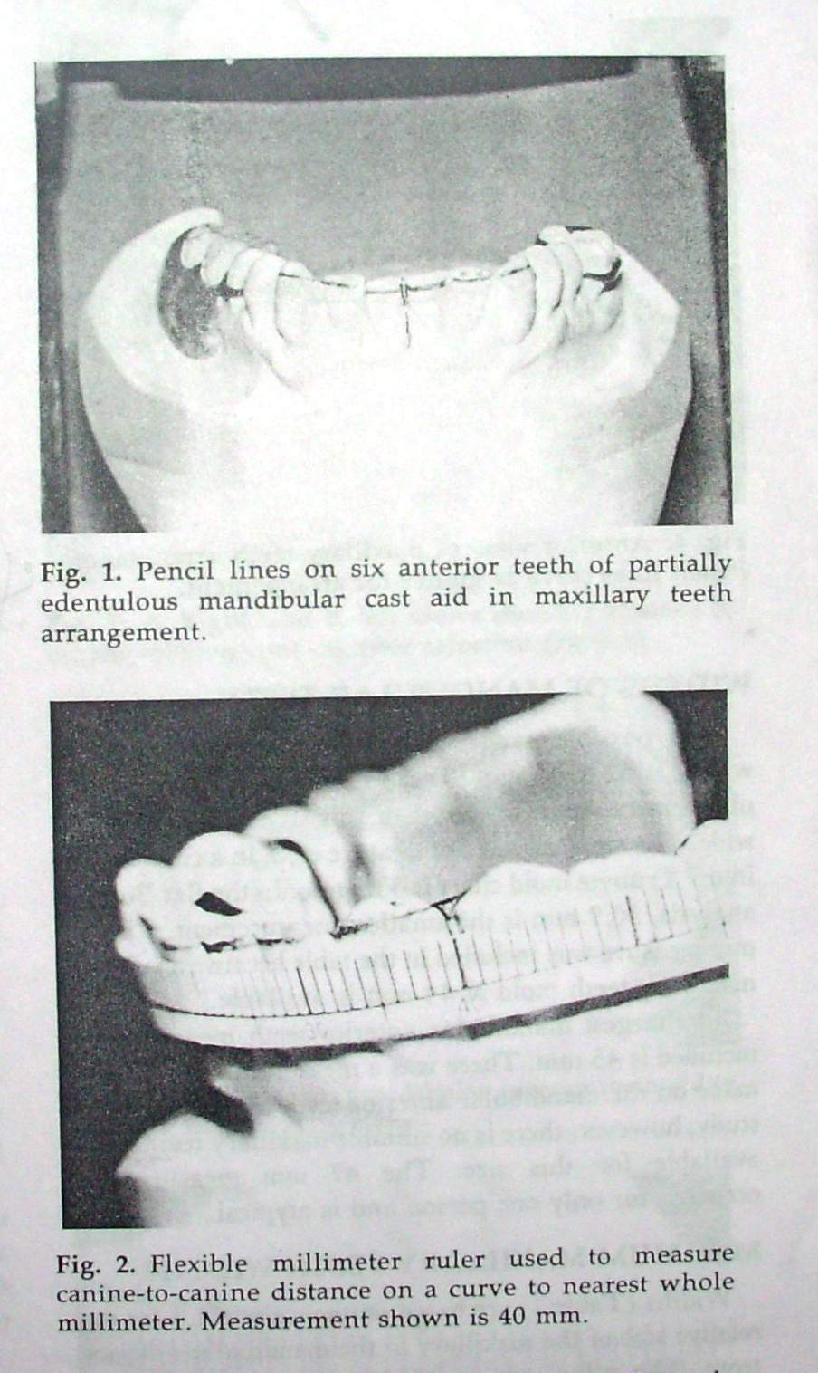

Slide 83
Maxillomandibular Relations
Any disproportion in size between the maxillary and mandibular arches influences the length, width and position of the teeth. This is of importance in class II and class III maxillomandibular relations.

Slide 84
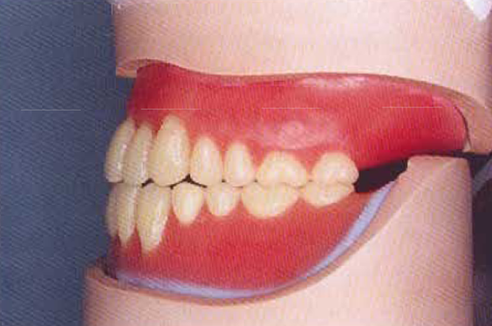
CLASS II ridge relation
CLASS III ridge relation

Slide 85
Contour of the Residual Ridge
The artificial teeth should be placed to follow the contour of the residual ridges that existed when natural tooth were present. As resorption occurs there is alteration in the contours of the ridge.

Slide 86
Vertical Distance Between the Ridges
The length of the teeth is determined by the available space between the existing ridges.
It is advisable to use a tooth long enough to eliminate the display of the denture base.

Slide 87
Lips
Labial surface of the maxillary anterior teeth supports the relaxed lip. Frequently incisal edges extends inferior to or slightly below the lip margin.
When the teeth are in occlusion and lips closed the labial incisal third of the maxillary anterior teeth supports the superior border of the lower lip.
In speech, incisal edges of maxillary anterior teeth contacts the lower lip at the junction of the moist and dry surfaces of the vermilion border

Slide 88
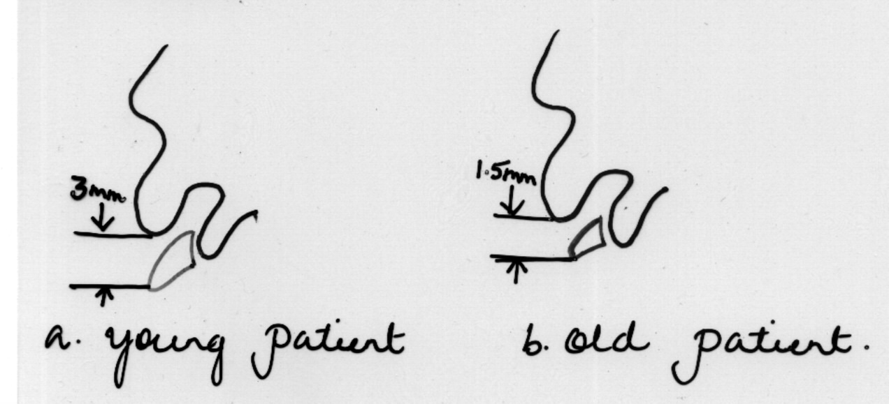
Normally necks of anterior teeth overlap the anterior ridge by 2-3mm cervically and incisal edges will show below the relaxed lip.
3mm – in young patients
Half of it – in old patient.

Slide 89
Location of Corner of the mouth
Corners of the mouth on the occlusal rim in the mouth is marked and the distal surface of the upper canines can be indicated by marks made on the upper rim at the corners of the mouth
Then the distance between the marks is measured around the labial surface of the occlusal rim and anterior teeth of this width are arranged as indicated by the occlusal rim

Slide 90
Inter alar width
Lee estimated that the distance between the outer surface of the alae of the nose seemed to be the same as that between the tips of the canine.
European noses wary in width between 28 & 45 mm.
Instruments-
Dividers
Willis gauge
Boley’s gauge.

Slide 92
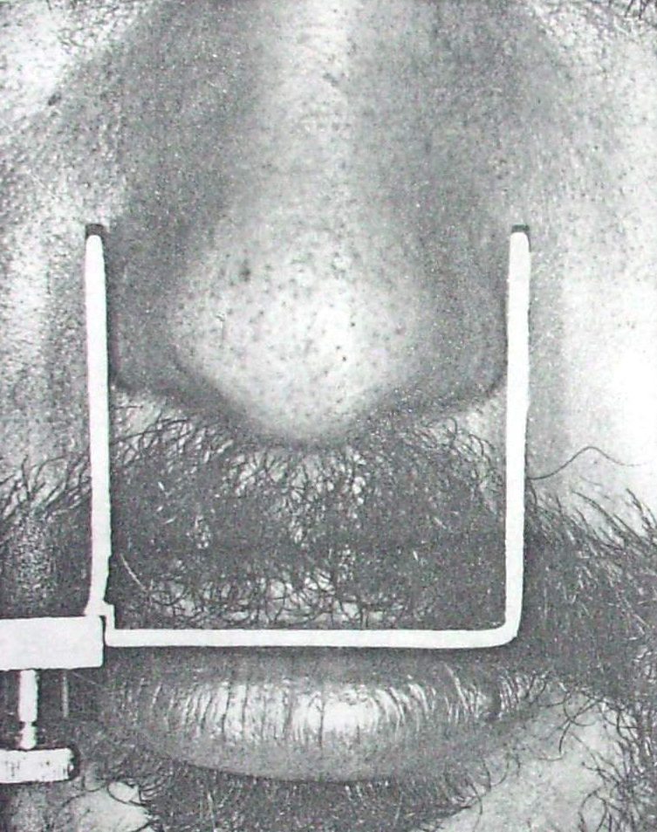

Slide 93
Wehner at al suggested that parallel lines extended from the lateral surfaces of the alae on to the labial surface of the upper occlusal rim coincide with the middle vertical axis of the upper canine teeth.

Slide 94
A flexible plastic rule is used to measure the distance between the canine line on the wax rims.

Slide 95
Nasal width & Incisive papilla
Lee & heartwell found that incisive papilla which is a reliable & stable landmark, lies 10 mm posterior to the incisal edge of maxillary CI.

Slide 96
Watt & Likeman pointed that as a result of alv resorption the papilla moved forward about 1.6 mm.

Slide 97
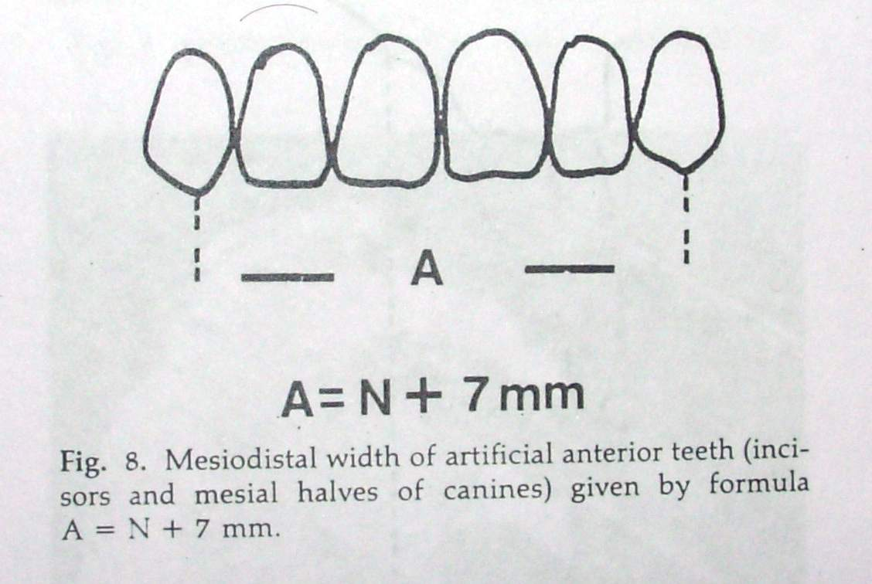
Mavroskoufis et al[ JPD1981;45,592-7]
Developed a formula:
A = N + 7 mm
Where A is the length of anterior arc,
N the nasal width

Slide 98
Intercanthal distance JPD 2001;86,608-12
The ICD dimension is defined as distance between the median[inner] angles [ canthi ] of the palpebral fissure.

Slide 99
The ICD is considered normal at a dimension of 28 to 35 mm.No difference related to sex ,race or age have been shown in the ICD.
This makes ICD a reliable anatomic that may provide a valuable approach to the selection anterior teeth.
A Boley’s gauge was used to measure the ICD.

Slide 100
It was found that the biometric ratio of 1 : 0.267 could be used to estimate the CI width.
& a ratio of 1 : 1.426 could be used to estimate the combined width of 6 max anterior teeth

Slide 101
Hasanreisoglu and et al ⁶ analyzed the clinical crown dimensions of maxillary anterior teeth to determine whether consistent relationships exist between tooth width and several facial measurements. They concluded that the Bizygomatic width and interalar width may serve as references for establishing the ideal width of the maxillary anterior teeth

Slide 102
Length of teeth depend on the following factors
Length of the lip
Mobility of the upper lip
Vertical height of occlusion.
Vertical overlap

Slide 103
Form of anterior teeth
Form of the tooth should confirm to the contour of the face as considered from the Labial, mesial, distal and incisal aspect .
General outline of the tooth should confirm to the general outline of the face when viewed from the frontal aspect.
A tooth viewed from the mesial or distal aspect should confirm to the contour of the profile. Berry probably was the first to demonstrate the correlation between the outlined form of the maxillary central incisor and the inverted outline form of the face

Slide 104
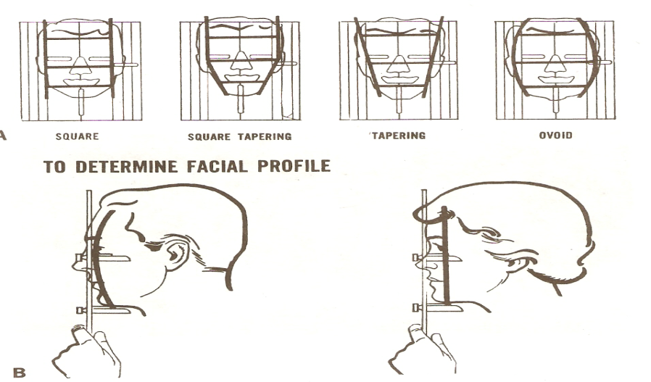
Based on face form:
Classification of face form by Leon Williams:
It consists of two imaginary lines passing about 2.5cm in front of the tragus of the ear and through the angle of the jaw.
Lines almost parallel – square.
Lines diverging at the chin-ovoid.

Slide 105
Lines converging at the chin – tapering
Lines parallel and then converging at the chin – Square tapering

Slide 106
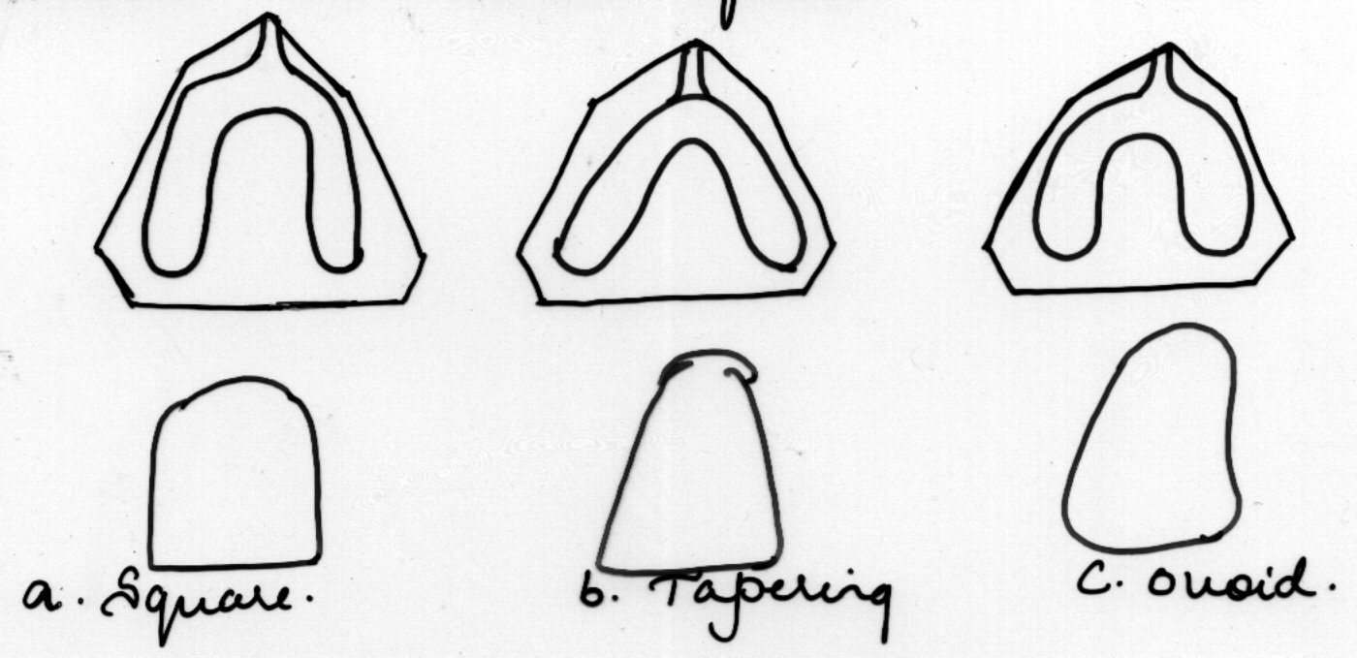
Form of anterior teeth
Based on arch form

Slide 107
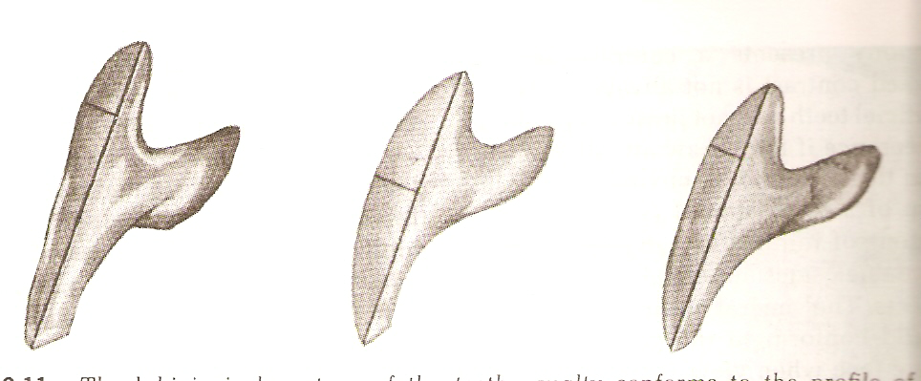
Based on profile of the face
The labial curvature
of the teeth viewed
from the mesial
aspects should show
a contour similar to that
when viewed in profile.

Slide 108
The labial surface of the tooth viewed from the incisal aspect should show a convexity or flatness similar to that seen when the face is viewed from under the chin or from the top of the head.

Slide 109
Color, Light & Shade Matching
JPD 1970,27;236-68
JPD 1973;29;358-382

Slide 110
Billmeyer & Saltzman-
Define color as the result of the physical modification of light by colorants as observed by the human eye & interpreted by the brain.

Slide 111
Light is the physical
Colorant are chemical
Eye is physiologic
& Brain is psychologic
Dentin is primarily responsible for tooth color, while enamel contributes only by projecting tbe underlying shades, utilizing its perpendicular rods in a manner similar to that of a fiber-optic system.

Slide 112
The three main components of color are –
Hue
Intensity / Chroma
Value
“Maverick” color

Slide 113
A look at dental esthetics A, J. E, Qualtrough* / F. J. T, Burke*(Quintessence Int 1994;25:7-14.)

Slide 114
HUE
Refers to the characteristic of a color that give it identity & differentiate it from other colors.
Red is hue: so are blue, yellow & other colors of the spectrum

Slide 115
When the light waves strike an object some of the rays are absorbed & some are reflected.
It’s the reflected light that give the object its color.

Slide 116
Example-
If the light waves strike an object which absorbs all except the red area of spectrum.only the red light waves are reflected to the eyes & the object is seen as a red.

Slide 117
INTENSITY
Refers to how much of the pigment is in the color being described.
If the color has a strong concentration of hue pigment ,it is a strong color.

Slide 118
Example-
A strong red has a heavy hue pigment conc.A weak red may have the same quality of hue pigment,but also has other colors mixed which dilute the effect of red pigment.

Slide 120
Value
Describes lightness or darkness of a color.
Black & white are described as “not colors”
They result from light waves that hit objects that do not absorb portions of the spectrum but reflect the entire light wave.

Slide 121
The objects that reflect the most light waves are white.
The objects that reflect the fewest light waves are black.

Slide 122
Value in denture esthetics
Hue is not of critical importance.the intensity of hue in dental shades is so low that it is almost disregarded.
The problem of matching a tooth to denture or denture to a face is one of selecting the proper value & not proper color.

Slide 123
Value scale
Value run from white to black.it is assumed that no one would select pure white, or pure yellow as a shade for tooth.
The two or three whitish or darkish gradients nearer the white or darkest ends are not used.

Slide 124
1
2
3
4
5
6
7
8
9
10
11
12
13
14
Value
scale
This leaves only the middle third of the value from which to choose.

Slide 125
Factors affecting color
Amount of light striking the tooth
Texture of the tooth
Glaze & inciso gingival angulation of tooth.
Background against which a color is seen.

Slide 126
Important factors affecting shade selection

Slide 127
Personality | Feature | Skin | Total tooth area | Light | Shade
3 Strong | Strong | light | Small | Dark | Light
2 Avg | Avg | Avg | Avg | Avg | Medium
1 Soft | Weak | Dark | large | Bright | Dark
*Note: the stronger the factor the lighter the shade it requires.

Slide 128
Value is the essence of the shade & it can be expressed by the formula-
P+ F + S + TTA + L = Shade value
5

Slide 129
P=2 F=2 S=3 TTA=1 L=2 2+2+3+1+2=2 5
PATIENT A

Slide 130
Suggestions for shade selection (according to MacGregor)
Always moisten the shade guide,when in mouth teeth are always moist & this can affect the reflection & refraction & hence color.

Slide 131
Always place teeth in the shade of the upper lip in position, they will appear darker in this position than in hand.
When in doubt ,select a tooth which is obviously too dark,then try one which is too light

Slide 132
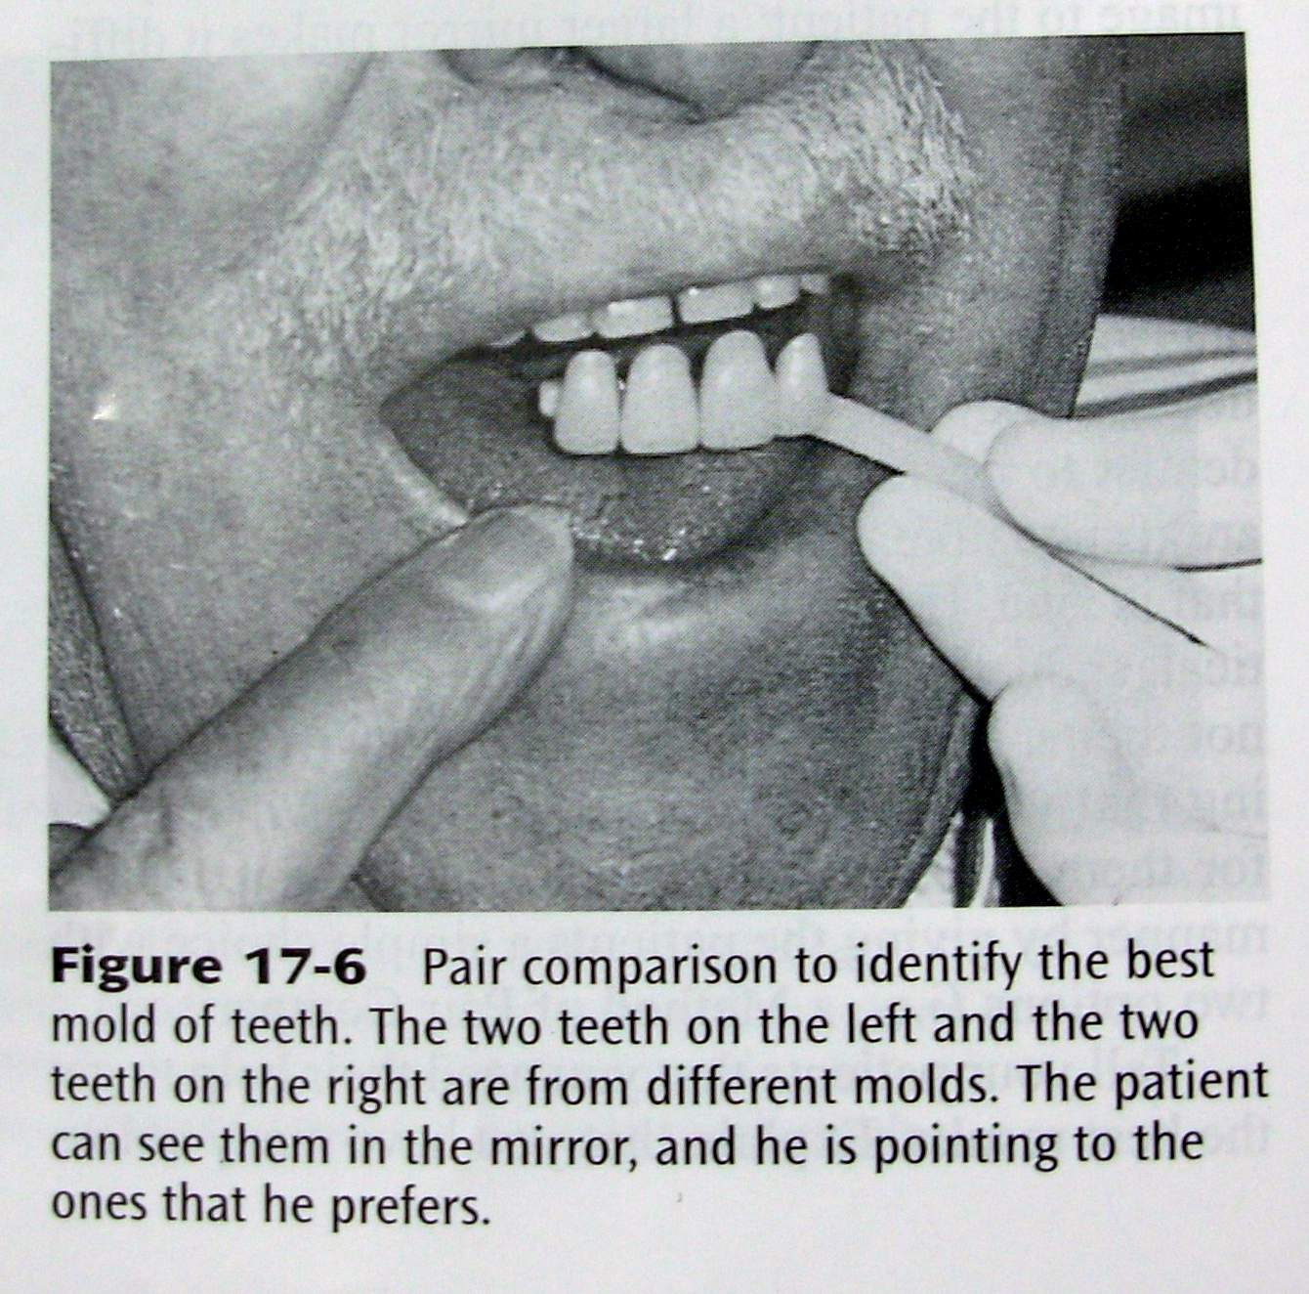

Slide 134
The assistance of pt, & friend may be helpful.
Attempt to look at the face as a whole rather than focus entirely on the teeth.
Select teeth under natural light or color- corrected light.

Slide 135
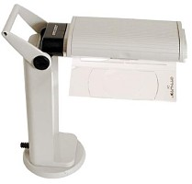

Slide 136
Remember that the lighter the shade the more artificial the tooth looks.
One should not observe the shades for prolonged periods of time because the color receptors tend to accommodate & that specific hue appears increasingly appropriate.

Slide 137
DENTINOGENIC RESTORATIONS
John P. Frush,D.D.S And Roland D Fisher,D.D.S

Slide 138
DENTINOGENIC
A denture as is “eminently suitable” in that for the wearer , the denture adds to that person’s charm, character, dignity, or beauty in a fully expressive smile.
“Dentogenics,” then, means the art, practice, and techniques used to achieve that esthetic goal in dentistry.

Slide 139
“There is beauty in age as well as in youth.” Actually, we can add a few lines to that truism ; we can say, there is beauty in age as well as in youth, but, in fact, age has the edge.
Age has something that youth can never have, that is dignity

Slide 140
The greatest challenge to dentinogenics is to destroy the ” denture look”.

Slide 141
ORIGIN OF DENTINOGENICS
Wilhelm Zech , Zurich ,Switzerland 1952
Teeth according to Zech ,were instruments of personality and projectors of vitality
He realized that every bone in the human face contributes to the total personality. No less the teeth.
As early as 1936 Zech, experimented with moulding ,spacing, & arrangement of teeth in dentures for his father.

Slide 142
He ground & formed teeth which by their configuration would depict distinct styles & personalities.
From this idea the Swissdent Foundation was established in L. A , California in 1952.

Slide 143
ESTHETICS
The word “esthetic” stems from the same Greek root as “esthesia” meaning sensibility or sensation.
In the noun "esthete”we have one who percieves and enjoys pleasant sensation.
Esthetic is the adjective form ,meaning “responsive to the beautiful in art or nature.”

Slide 144
When dentogenics evolved, the full meaning of esthetics was carried into its third dimension:
First , the wearer of a dentogenic restoration must have an inner sensibility of well-being;
Second, the viewer of a dentogenic restoration must perceive beauty or a fulfillment of the wearer’s personality in his smile ;
Third requisite would then follow without cavil, in that the dentist who created the dentogenic restoration would feel deeply rewarded.

Slide 145
DENTOGENIC INTERPRETATION
Sex: There are still only the two sexes,
Age can be easily separated into young, middle, or elderly, and no patient in any group deserves the tooth form or tooth color of either of the other classifications.
Personality is a bit more complex, but, again, a general matter of three : vigorous, medium, or delicate, with the gradations emanating from the middle, medium pleasant-type personality toward either the bold or delicate areas of the “personality spectrum.”

Slide 146
THE SPA FACTORS

Slide 147
The sex factor in dentinogenics

Slide 148
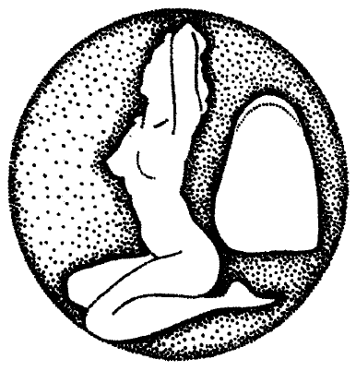
Expression Of Feminine Characterization-
The feminine form is spheroidal

Slide 149
By the roundness, smoothness & softness that is typical of women.
How does a dentist inject feminity? An excellent beginning is to select a mould which expresses softer anatomic characteristics.
The sculptor, by using the spherical form? imparts a sense of softness to his subject which otherwise would be lacking

Slide 151
Regardless of how feminine a tooth may be, it should be further developed according to dentist’s own interpretation.

Slide 153
Now just how a sculptor imparts a sense softness by using spherical form, we can do the same by infusing feminity into the smile.

Slide 154
Now all femininity does not have the bloom of a healthy girl of 16 yr or mature young wife of 28.
However there is still femininity in woman of 60,70,80 & that is where the artist’s & sculptors role is played.
A woman of 50 can be a very soft type or she may be vigorous ,sturdy type.

Slide 155
This individual interpretation of femininity is expressed by definite grinding procedures.
The grinding of incisal edges must follow a curve rather than a straight line.

Slide 156
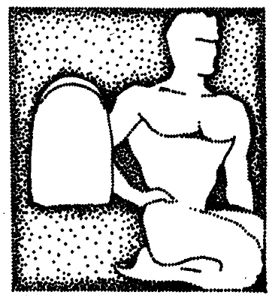
Expression of masculine character
The masculine form is cuboidal

Slide 157
The expression of masculine characteristics
A schema of the masculine form illustrates the cuboidal, hard, muscular, vigorous appearance which is typical of men.
A basic tooth form which expresses masculine characteristics shows vigor, boldness, and hardness.

Slide 158
Thus, as sex identity becomes an automatic part of our procedure, the tooth form will transfer automatically a sense of masculinity to the pt’s smile.

Slide 159
Just as the “feminine” tooth form can be further individualized according to the dentists interpretation so can the masculine tooth form.

Slide 160
This compromise begins with the selection of a basically “masculine "tooth form less harsh in its surface design
By sufficient depth grinding and by further squaring the incisal edges of both the central and lateral incisors ,the effective employment of this basic tooth form can be seen in a man’s smile

Slide 161
Its true that some men have a qualifying softness.

Slide 162
Sex interpretation by tooth positioning
Central incisor-[# 1]
By bringing the incisal edge of one central incisor anteriorly,we create a position which is evident but harsh.

Slide 164
[#2]
However if we move one of the CI from the starting point out at the cervical end, leaving the incisal edges together, we have created a harmoniously, lively position.

Slide 166
[#3]
Is a combined rotation of the two CI with the distal surfaces forward, with one CI depressed at the cervical end & other depressed incisally.

Slide 168
Lateral incisor-
[#1]
The LI rotated to show its mesial surface slightly overlapping the CI gives softness or youthfulness to the smile.

Slide 170
[#2]
By doing the reverse,that is by rotating the LI mesially,the effect of the smile is hardened.
we should select soft position for feminine smile, & hard position for vigrous male.

Slide 173
Cuspid teeth-
In general we adopt conjointly the three of the following positions-
Out at the cervical end
Rotated to show mesial face
Almost vertical as seen from the side

Slide 175
Third dimension- Depth grinding
The denture look is mostly due to the flat appearance of the artificial teeth, their lack of depth or of “ body”.
We always need that feeling of depth, that 3D for realism.

Slide 176
The third dimension is used as well-
For women( spheroidal shape)
For men ( cuboidal shape)

Slide 177
The depth grinding is done on the mesial surface of the CI only.CI are the widest, almost always the longest & therefore the most noticeable.
With a soft stone the mesio-labial line angle of the CI is ground in a definite & flat cut, following the same curve as the mesial contour of the tooth in order to move the deepest visible point further lingually.

Slide 179
After this cut has been made, a careful rounding & smoothening of the sharp angle must be accomplished.

Slide 180
Personality factor

Slide 181
Its not only a good quality , but a necessary quality, if our dentures are going to be as individual as the faces they go into.
The term personality is explained in the three divisions of the personality spectrum.

Slide 183
Delicate-meaning fragile, frail.
Medium- normal, mod robust, healthy & of intelligent appearance.
Vigorous- hard, aggressive, muscular type, almost primitive, ugly.

Slide 184
Smile is considered as the primary objective personality trait of the pt.
We use this & the personality spectrum for selection of a mould category of artificial teeth.

Slide 185
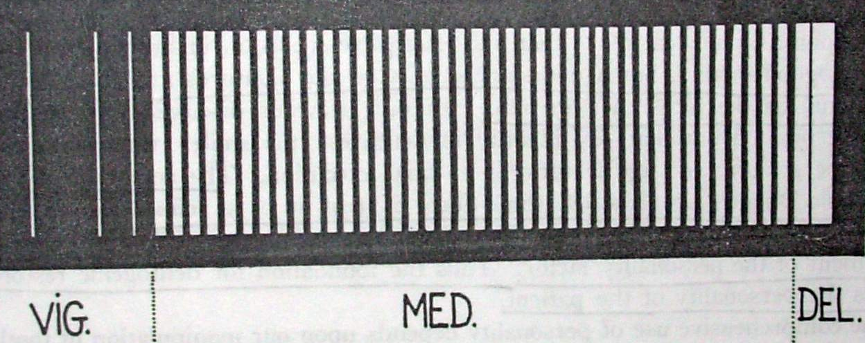
10%
5%
85%
Only about 10 % o pts will be identifiable as truly vigorous, & only about 5% will be identifiable as truly delicate & the greater majority fall in the medium category.

Slide 187
Naturally the CI of any mould can be ground to shorten or narrow the teeth to required proportions.
The next refinement is accomplished by incorporation of sex factor,by curving or squaring the incisal edges.

Slide 188
The last refinement is accomplished by by the incorporation of age factor by simulating erosion, abrasion, diastemas.

Slide 190
Age factor

Slide 191
The goal of the dentist is to help the patient to maintain a favorable relationship between his chronologic age and his physiologic mouth condition.
The objective of the age factor in dentogenics is to guide the prosthodontist in his efforts to maintain a high degree of conformity between his restoration and the patient’s physiologic age structure.

Slide 192
“Not only is there beauty in advanced age as well as in youth, but also there is an additional quality of dignity.”
Dignity can be attained only through the experiences supplied by time itself.
The maintenance of this illusive quality of dignity must be the responsibility of the prosthodontist.

Slide 193
Age in the artificial tooth
It is routine first to consider light shades for young people and darker shades for older ones, but this is not nearly sufficient to satisfy our dentogenic concept.

Slide 194
The sharp tip of the cuspid tooth suggests youth & as age advances it should be judiciously shaped, not abruptly flattened, but artistically ground so as to imply abrasion against opposing teeth.

Slide 198
Age interpretation by tooth position
Tooth position in the artificial denture then becomes important, in that imperfectionis an artistic requirement in creating the illusion of natural teeth.
A condition so common in the natural teeth is the Diastema.

Slide 199
Age in the matrix
The tissues inside the mouth age as do tissues outside of the mouth, and unless some interpretation of the sex, personality, and age factors is made in the gum matrix (denture base) we ignore this fact.
The environment of the tooth is as importantas the tooth itself.
The matrix of the artificial tooth must be meaningful

Slide 200
The Dynsthetic Interpretation Of Dentinogenic Concept

Slide 201
Dynesthetics is a compounded word. The prefix ‘dyn’ is from the Greek word ‘dynamis’ meaning power.
It implies movement, action, change and progression in the esthetic phase of prosthodontics.
This dynamic value has been described as making the difference between an artifact, any object without “life-like effect” such as a spoon, and a work of art or visual objects that are alive in meaning such as a statue.

Slide 202
The selection of artificial teeth, their subsequent sculpturing, the individual and detailed positions of these teeth, and the color and contours of the denture base are all part of the dynesthetic techniques and cannot be done in a comprehensive manner without reference to the patient’s sex, personality, and age as primary factors.

Slide 203
For example, artificial teeth are selected according to the personality of the patient,
subsequent sculpturing is directed toward accentuating masculinity or femininity,
the denture base color and contour helps satisfy the age factor.
we call the secondary factors of a dentogenic restoration Dynesthetics

Slide 204
The following dynesthetic considerations which are necessary to the production of a dentogenic restoration are as follows
Mold
Lip support
Midline
Labioversion
Speaking line
Smiling line
Central incisor position

Slide 205
Lateral incisor postion
Cuspid position
Long axis
Gum line
Spaces
Interdental papilla
Lingual cutaway
Labial and buccal denture base contour
Embrasures
Buccal corridor

Slide 206
Mold
The selection of an acceptable personality mold involves its subsequent treatment for abrasion, erosion, depth grinding, masculinity or feminity, shaping and polishing.
Cut made for normal abrasion to appear in artificial teeth with advancing age
Depth of perception increased by depth grinding

Slide 207
Lip support
This is the bodily anteroposterior position of the teeth which adequately support the upper lip in a natural and pleasing manner

Slide 208
It may be modified to accommodate, but it is not controlled
The pleasing lip support is sacrified only in extreme instances of old age or other circumstances where esthetics is of little considerations in the psychologic and physiologic comfort of the patient

Slide 209
Midline
The mid axis is important to general composition and should be vertical to incisal and occlusal plane

Slide 210
Labioversion
This determination is made by observing the teeth in profile when the patient is standing in normal posture
Labioversion is necessary because the most pleasing effect is obtained when the long axes of the central incisor with a slight labial inclination.

Slide 211
Speaking line is the incisal length or vertical composition of the anterior teeth and said so because the final evaluation of the incisal length is made when the patient is speaking
Using the incisal edges of the central incisors in their relationship to the lip line at rest, as a measure is as :
Young woman 3mm below lip line at rest
Young man 2mm below lip line at rest
Middle age 1¹ / 2 mm below lip line at rest
Old age man, senility 0 - 2mm below lip line at rest

Slide 212
Smiling line is a curve whose path follows the incisal edges of the central incisor up and back to the incisal edges of the lateral and hence to the tips of the cuspids. Its arc is determined by the age of the patient of the and decreases as the patient gets older

Slide 213
Dentistry has arbitarily classified 3 types of smiles that, relating the height of the upper lip relative to the maxillary anterior central incisors, ae referred to as presenting a low lip line, middle lip line and high lip line

Slide 214
High lip line in smiling displays teeth and gingiva
Medium lip line display teeth and marginal interdental papillae
Low lip line display limited part of tooth anatomy

Slide 215
Central Incisor Position
Central incisor are the cornerstones of the tooth position and their correct position positions all other teeth nearly correct and their placement controls
Midline
Speaking line
Labioversion
Smiling line compositon
Central incisors are also the basis of personality mold selection

Slide 216
The shape is controlled by the physical personality of the patient and their position determines the strength and action of the dentogenic composition
The central incisors should contrast sharply in size with lateral incisors and can be accomplished by selecting a smaller sized lateral

Slide 217
Lateral Incisor Postion
The lateral incisor should fall within the line of the arch and its rotation will either harder or soften
The Soft position of lateral incisors is produced by rotating its mesial surface outward and rotation inward produces the hard position of LI
The right and left lateral should have asymmetric long axis
Soft and hard position of lateral incisors
A
A
B
Long axis of A and B should be assymetrical

Slide 218
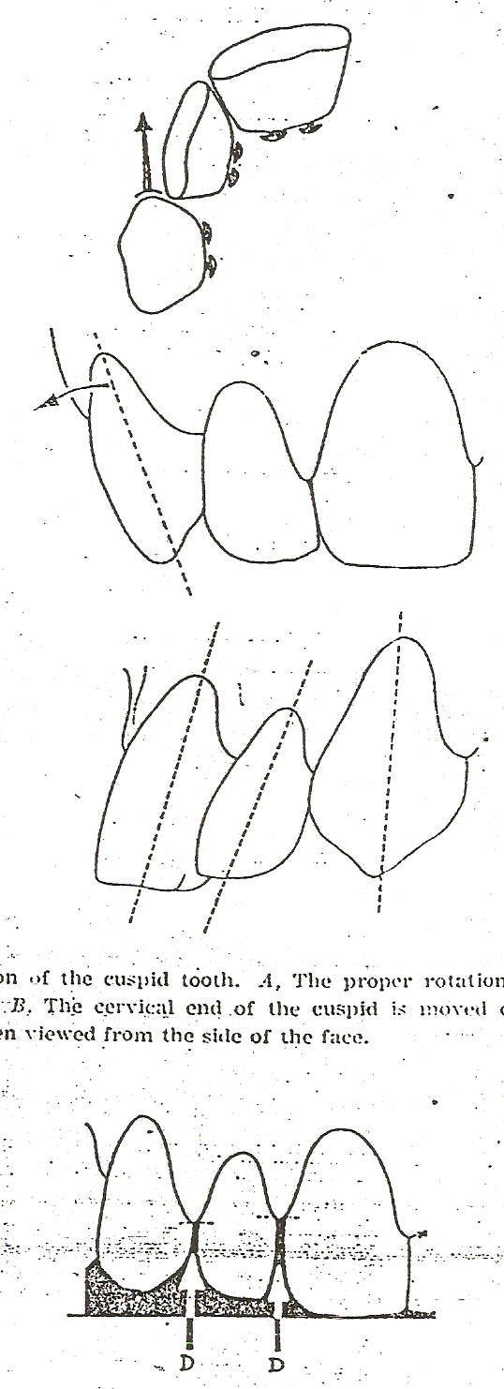
Cuspid Position
The position of canine in the arch form is important because it supports the anterior arch form in its widest part and controls the size of the buccal corridor
1
2
3

Slide 219
3 basic requirements of the cuspid tooth position are as
The tooth should be rotated to show its mesial surface
The cervical end should be prominent (not the tip)
The long axis should be vertical when observed from the side

Slide 220
Cuspid Position
The cuspid should be abraded to convey the physiologic age of the patient
Degree of abrasion created in respect to physiologic age

Slide 221
SPACES
Spaces represents the separation of the proximal surfaces of the teeth
The spaces between the anterior and posterior teeth are extremely effective, but their size and position must be artistically and hygienically formed

Slide 222
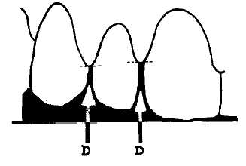
The rules to follow are as
All spaces must be V- shaped to shed food
A diastema between the central incisors is unsightly and should be avoided
Diastemas should be assymetrically placed on either side of the dental arch
The width of the diastema should be controlled so as not to appear unsightly at any instance

Slide 223
Spaces are always placed between the posterior teeth which allows additional spillways for food through these spaces and creates an additional cutting edges from the marginal ridges.
These cutting edges are subsequently sharpened by grinding the proximal surfaces

Slide 225
Embrasures
It represents A divergence of the proximal surface of the teeth form the contact point
Employed more frequently which adds A sense of freedom to the appearance of the dental composition

Slide 226
BUCCAL CORRIDOR
It is a space created between the buccal surfaces of the posterior teeth and the corner of the lips when the patient smiles
The use of the buccal corridor prevents the “sixty tooth smile” or the “molar to molar smile” which is characteristic of a denture
The buccal corridor begins at the cuspid and its size and shape are controlled by the position and slant of the cuspid though the corridor exists posterior to the cuspid tooth

Slide 227
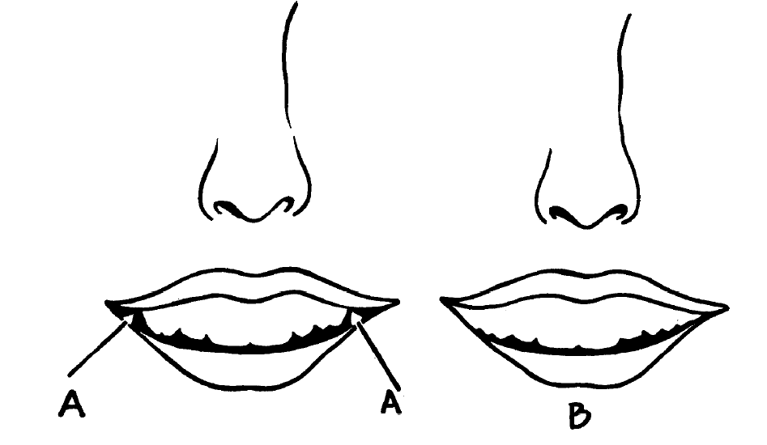
Buccal corridor
A - natural B- in denture

Slide 228
LONG AXIS
It will be noticed that long axes of teeth vary and should be exaggerated in the dentogenic restoration as an artistic device

Slide 229
GUM LINE
Rules that should be followed to form the gum line are
Slightly above the high lip line at the central incisors
Lower than the central incisor gum line at the laterals
Higher than the central or lateral incisor gum line at the cuspid
Slightly lower than at the cuspid, at the bicuspid and variable for the bicuspid and molars

Slide 230
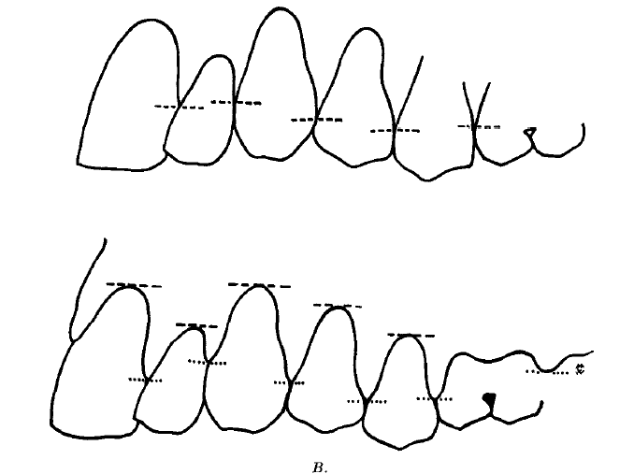

Slide 231
Interdental papilla
It forms the main part of the tooth matrix (visible denture base) and thus occupies one third of the total importance of the dental composition
The other two- third are occupied by the tooth and tooth position

Slide 232
Correctly formed papilla accomplishes 4 purposes
Creates a hygienic, self-cleansing interdental area
It is a complimentary factor in age interpretation
It determines the outline form of a tooth and makes the two dimensional outline form of a tooth incidental to other esthetic requirements
It brings a degree of color reflection to the interdental area which creates the illusion of a natural dental composition.

Slide 233
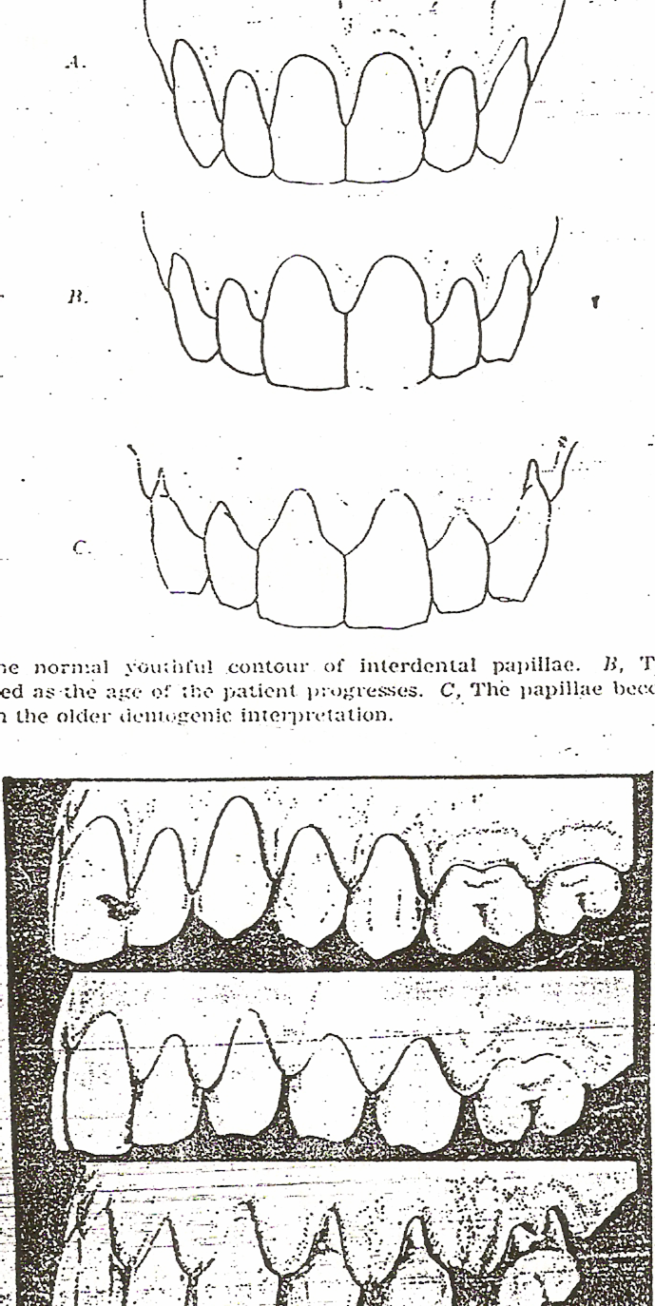
General rules for formation of the interdental papilla are as follows
The papilla must extend to the point of tooth contact for cleanliness
It must be of various lengths
It must be convex in all directions
It must be shaped according to the age of the patient and they are classified as young, middle aged and old aged

Slide 234
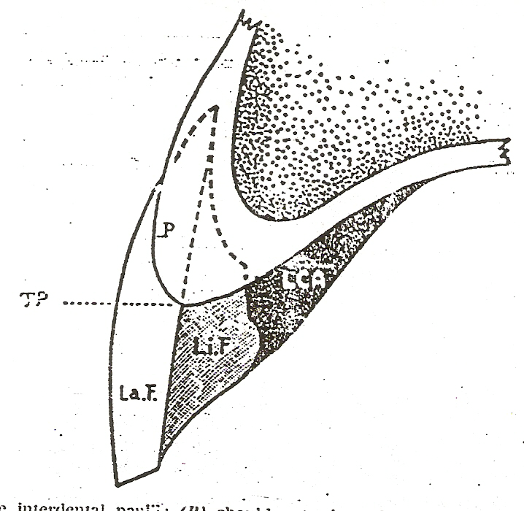
Lingual Cutaway
It is groove in the lingual interdental surface which begins at the contact points of the teeth if they are together or at the tip of the interdental papilla if there is a diastema
The reason for the lingual cutaway is that when food is incised will sweep through this polished channel & keep the area clean

Slide 235
Labial And Buccal Denture Base Contour
The denture base contour beyond the matrix (visible denture base) should provide a self cleansing surface & therefore should not be over accentuated with depressions, wrinkles, folds or any shape which would defeat the smooth action of the cheek or lips

Slide 236
Conclusion
Dynsthetics are a guide and not a compulsion
No matter how carefully we analyze the factors of the patient’s sex, personality and age, there remains the necessity of translating the soft feminine personality or the hard masculine personality of all ages into the prosthodontic interpretation

Slide 237
REFERENCES

Slide 238
Introduction To Dentogenic Restorations. Jpd 1955;5;586-608.
Frush, ,John P., And Fisher, Roland D.: How Dentogenic Restorations Interpret The Sexfactor, J. Pros. Den. 6:160-172, 1956.
Frush, John P., And Fisher, Roland D.: How Dentogenics Interprets The Personality Factor,j. Pros. Den. 6441-449, 1956.
Frush, John P., And Fisher, Roland D.: The Age Factor In Dentogenics, J. Pros. Den.7:5-13, 1957.
Frush, John P., And Fisher, Roland, D.: The Dynesthetic Interpretation Of The Dentogenics
Frush JP, Fisher RD. Dentogenics: its practical application. J ProsthetDent 1959;9:914-21.

Slide 239
Selecting the ant teeth mold.JPD 1954;4;749-59.
Principles of visual perception & their clinical applications. JPD 1973;29;358-82.
Nasal width & incisive papilla as guides for selection of maxillary ant teeth. JPD 1981;45;592-7.
Methods used to select artificial ant teeth for edent pts: a historical overview. IJP 1999;12;51-58.
Methods Used to Select ArtificialAnterior Teeth for the Edentulous Patient: A Historical Overview; int j Prosthodont 1999:12:51-58

Slide 240
Relationship between intercanthal distance & the widths of maxillary anterior teeth.JPD 2001;86;608-12.
SheldonWinkler: Essentials of complete denture prosthodontics.2nd Ed. Ishiyaku Euro America inc.1996.
Ufuk Hasanreisoglu, Semih Berksun, Kerem Aras, and Ilker Arslan. An analysis of maxillary anterior teeth: Facial and dental proportions. J Prosthet Dent 2005; 94: 530-8
Majid Bissasu. Pre-extraction records for complete denture fabrication: A literature review J Prosthet Dent 2004; 91: 55-8.

Slide 241
Thank you

