Slide 1
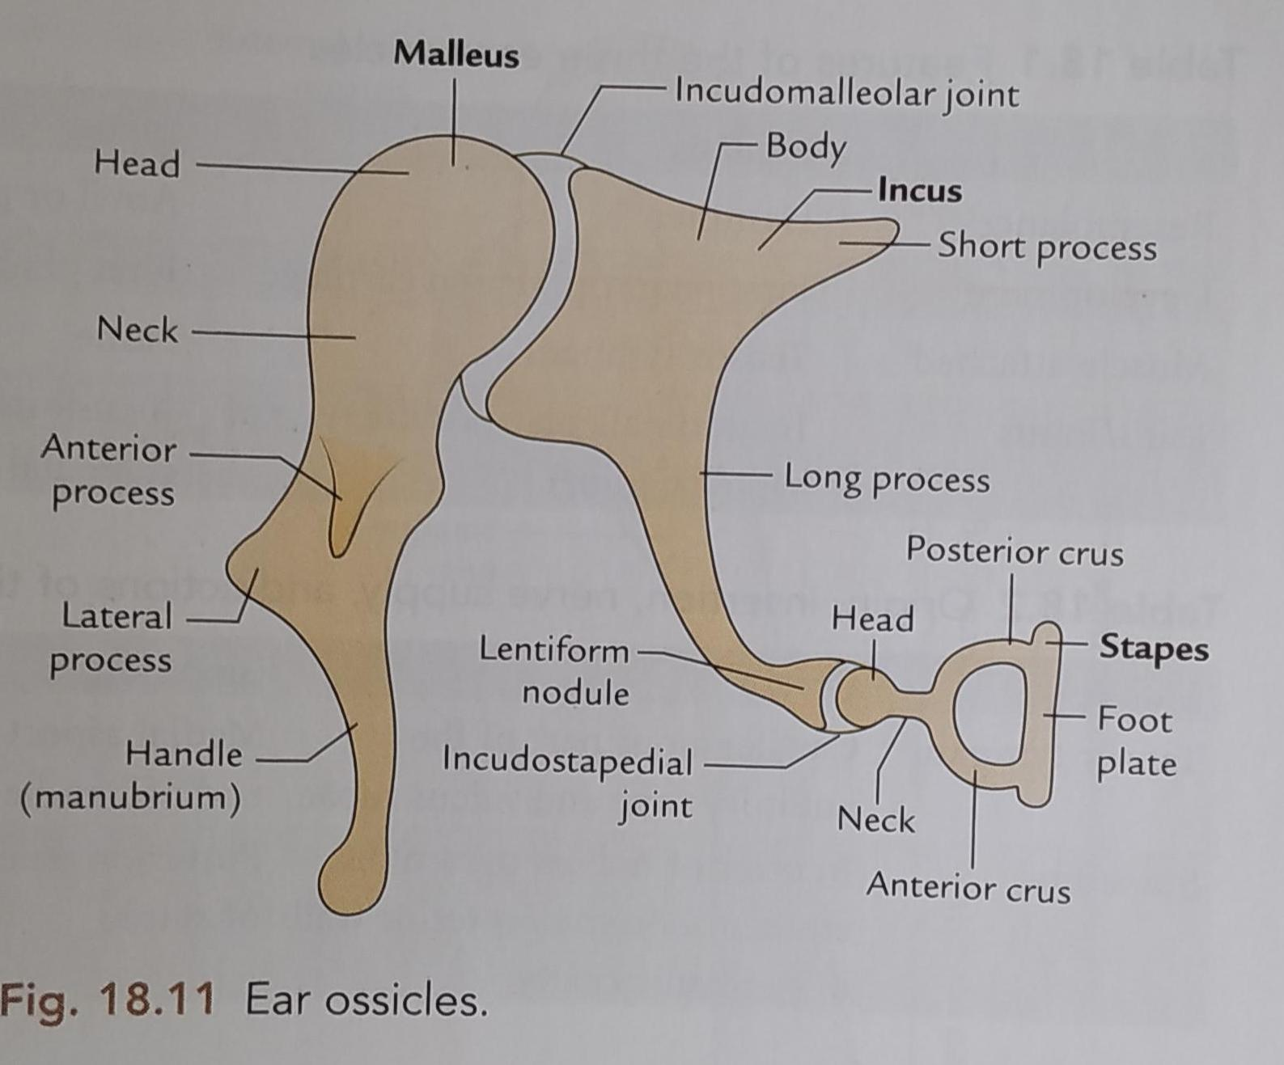
Ear ossicles
Department of Anatomy
Institute of dental sciences
Bareilly International University

Slide 2
Malleus
It is the largest ossicle which is situated just medial to the tympanic membrane.
Malleus is mallet shaped (hammer) and consists of following parts-
1.Head – is the larger, rounded upper end of malleus;it lies in epitympanic part and articulates with the incus.
2.Neck – It is the constricted part present just below the head.
3.Three proccess -(a). Handle of malleus – it is the largest proccess which is directed downwards and is embedded in the medial surface of tympanic membrane.
(B) Anterior process- it is a small projection.
(C) lateral process – it is a conical projection which is attached to the tympanic membrane at the convergence of Anterior & posterior malleolar folds.

Slide 3
Incus
It lies between malleus and stapes and present with a body and two processes.
(A). Body- it is cubicle in shape.it articulates with head of malleus anteriorly.it forms saddle joint
(B). Short process – it is a conical projection towards the epitympanic recess posteriorly.
(C).long process –it extends downwardly from the body and lies parallel to the handle of malleus.the lower end is curved medially and articulates with head of stapes and form Ball & socket joint.

Slide 4
Stapes
It is smallest and medial most ossicle.
It’s shape resembles a stirrup (Rider’s feet).and consist of following parts-
1.Head –it is small and directed laterally to articulate with incus.
2.Neck-it is seen as a small constricted part under the head,it recieves insertion of stapedius muscles on the posterior surface.
3.Anterior and posterior limbs – these arises from the neck and diverge to attach to the base.
4.Base – it is also called foot plate of steps,it consists of plate of bone which is reniform (kidney) in shape.the food plate is connected to the fenestra vestibuli (oval window) by an annular ligament.

