Slide 1
BURS

Slide 2
“Bur is a rotary cutting instrument which has bladed cutting head”.
• Burs remove tooth structure either by chipping it away or by grinding.
• William and Schroeder first made diamond dental bur in 1897.
• Modern diamond bur was introduced in 1932 by WH Drendel by bonding diamond points to stainless steel shanks

Slide 3
CLASSIFICATION
Materials Used for Bur:
• Stainless steel burs: – These were the first developed burs.
– Designed for slow speed < 5000 rpm.
– Usually a bur has eight blades with positive rake angle for active cutting of dentin. But this makes steel burs fragile, so they do not have a long life.
– Used for cutting soft carious dentin and finishing procedures.
• Tungsten carbide burs: –
Designed to withstand heavy stresses and increase shelf life.
– Work best beyond 3,00,000.
– Have six blades and negative rake angle to provide better support for cutting edge.
– Cut metal and dentin very well but can produce microcracks in the enamel so weaken the cavosurface margins (Fig. 6.62).

Slide 4
According to their mode of attachment to the handpiece: – Latch type
– Friction grip type
• According to their composition:
– Stainless steel burs
– Tungsten carbide burs
– A combination of both

Slide 5
According to their use:
– Cutting burs
– Finishing burs
– Polishing burs
• According to their shapes:
– Round bur
– Inverted cone
– Pear-shaped
– Wheel shaped
– Tapering fissure
– Straight fissure
– End cutting bur

Slide 6
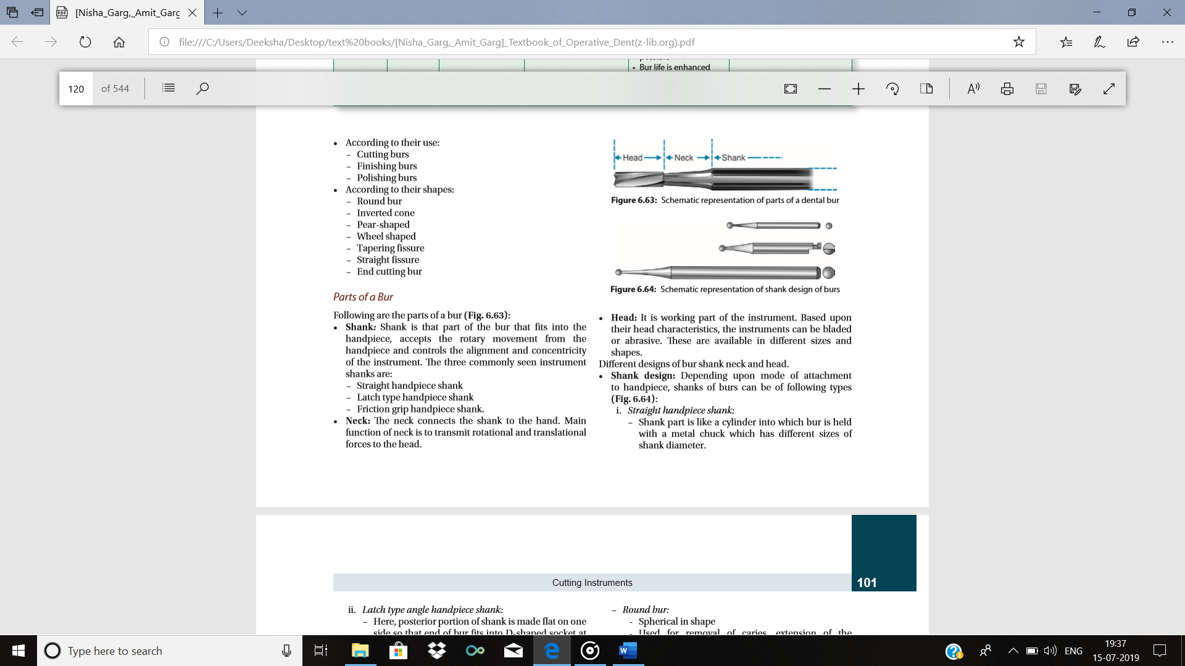

Slide 7
SHANK

Slide 8


Slide 9
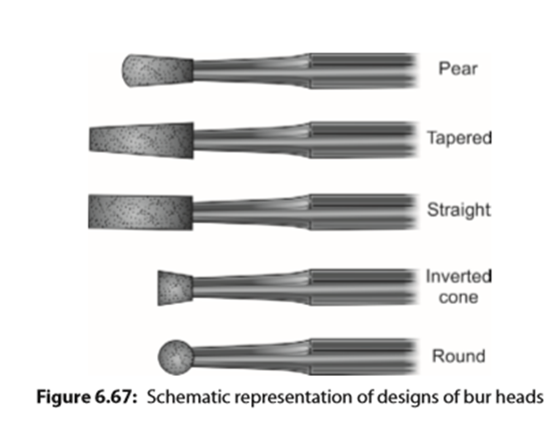
DESIGNS

Slide 10
Bur Design
Bur head consists of uniformly spaced blades with concave areas in between them. These concave depressed areas are called chip or flute spaces.
Normally, a bur has 6, 8, or 10 numbers of blades
• Bur blade: Blade is a projection on the bur head which forms a cutting edge. Blade has two surfaces:
– Blade face/Rake face: It is the surface of bur blade on the leading edge.
– Clearance face: It is the surface of bur blade on the trailing edge.
• Rake angle: This is angle between the rake face and the radial line.
– Positive rake angle: When rake face trails the radial line.
– Negative rake angle: When rake face is ahead of radial line.
– Zero rake angle: When rake face and radial line coincide each other.
• Radial line: It is the line connecting center of the bur and the blade.
• Land: It is the plane surface immediately following the cutting edge.
• Clearance angle: This is the angle between the clearance face and the work. Significance: Clearance angle provides a stop to prevent the bur edge from digging into the tooth and provides adequate chip space for clearing debris.

Slide 11
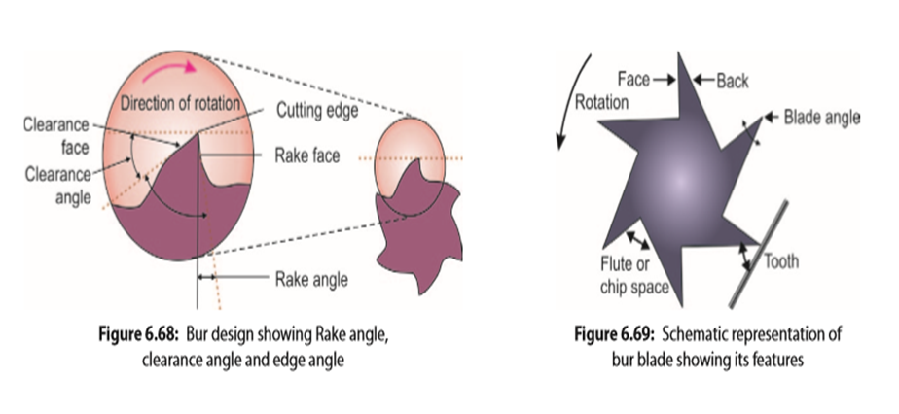

Slide 12
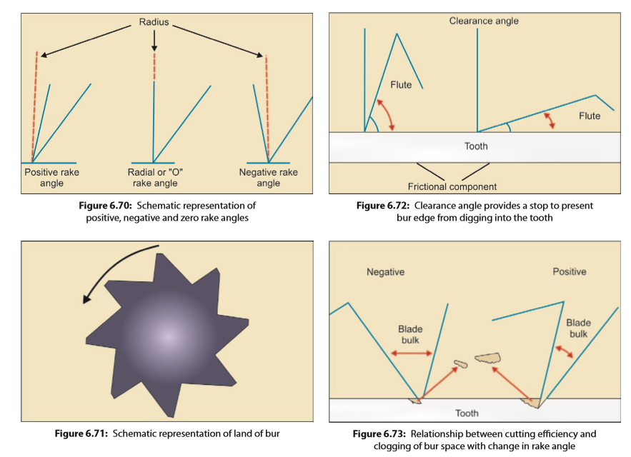

Slide 13
Factors Affecting Cutting Efficiency of Bur
Burs remove the tooth tissue at different rates depending upon various factors. It is always desirable to cut a large quantity of tooth in short-time.
Following factors affect the cutting efficiency of a bur:
• Clearance angle, rake angle and blade angle:
Clearance angle reduces the friction between cutting edge and the work.
It also prevents the bur from digging excessively into the tooth structure.
But an increase in rake angle decreases the blade angle which in turn decreases the bulk of bur blade (see Fig. 6.73).
Positive rake angle increases cutting efficiency of bur, but increase in rake angle causes decrease in bulk of bur blade and clogging of flute space because of production of larger chips.
• End-cutting or side-cutting bur:
According to particular task, choice of bur can be end cutting, side cutting or combination of both. For example, it is preferred to make entry to enamel by end cutting bur, while for making preparation outline, use side cutting bur.
• Neck diameter of bur: If neck diameter of bur is large, it may interfere with accessibility and visibility. But if diameter is too short, it will make bur unable to resist the lateral forces.
• Spiral angle: Burs with smaller spiral angle have shown better efficiency at high speeds.
• Linear surface speed: Within the limit, faster the speed of cutting instrument, faster is the abrasive action and more efficient is the tooth cutting instrument. Bur speed should be increased in limits because with ultrahigh speed, centrifugal force comes into the play.

Slide 14
Application of load: Load is force exerted by operator on tool head. Normally for high speed instruments, load should range between 60 and 120 g and for low rotational speeds, it should range between 1000 and 1500 g. Cutting efficiency decreases when load is applied. There is increase in temperature at work face which results in greater wear and tear of handpiece bearings.
• Concentricity and runout: The average clinically acceptable runout is 0.023 mm. Increase in runout causes increase in vibrations of the bur and excessive removal of tooth structure.
• Lubrication: Lubricant/coolant applied to tooth and bur during cutting increases the cutting efficiency and decreases the rise in temperature during cutting. Absence of coolant can result in increase in surface temperature which may produce deleterious effects on pulp.
• Heat treatment of bur: Heat treatment of bur preserves the cutting edges and increases shelf life of the bur.
• Number of blades: Usually a bur has 6 to 8 number of blades.
Decrease in number of blades reduces the cutting efficiency but causes faster clearance of debris because of larger chip space

