Slide 1
IMPRESSION MATERIALS: Inelastic, Hydrocolloid, Elastomeric

Slide 2
CONTENTS:
Introduction
Impression materials: Requirements
Classification
Inelastic Impression Materials
Impression Compound
Zinc Oxide- Eugenol (ZOE) Impression Pastes

Slide 3
Hydrocolloids
Agar (Reversible)
Alginate (Irreversible)
Elastomeric Impression materials
Polysulfide
Polyether
Addition silicon
Condensation silicon
Conclusion
References

Slide 4
INTRODUCTION
An accurate record of the dimensional characteristics of dental and oral structures is important in many fields of dentistry, including prosthodontics, orthodontics, operative and implant dentistry.
The success of the fabricated prosthesis will be directly related to the quality of replication of oral structures reflecting the accuracy of the impression.

Slide 5
IMPRESSION
According to GPT-9, Impression is a negative likeness or copy in the reverse of the surface of an object; an imprint of the teeth and adjacent structures for use in dentistry.
According to GPT-9, Impression material is any substance or combination of substances used for making an impression or negative reproduction.

Slide 6
REQUIREMENTS OF AN IMPRESSION MATERIAL:
Should be fluid enough to adapt to the oral tissues.
Should be viscous enough to be contained in a tray.
Setting time in mouth should be less.

Slide 7
Should not tear or distort when removed from the mouth.
Should remain dimensionally stable until the cast is poured.
Should be biocompatible.
Associated processing equipment and processing time should be cost-effective

Slide 8
CLASSIFICATION:
BASED ON SETTING MECHANISM:
By chemical reaction- IRREVERSIBLE
Example- Zinc-Oxide Eugenol Paste
Impression Plaster
By Thermally induced physical reaction- REVERSIBLE
Example- Impression Compound

Slide 9
BASED ON ELASTICITY:
Elastic : Agar
Alginate
Non-aqueous elastomers
Inelastic : Zinc oxide eugenol
Impression compound
Impression plaster
Notes:
e.g. – Polysulfide, Polyethe, Condensation Silicone, & Addition silicone

Slide 10
BASED ON TISSUE DISPLACEMENT
Mucostatic: Impression plaster
Zinc oxide eugenol
Mucocompressive: Impression compound

Slide 11
INELASTIC IMPRESSION MATERIALS
These exhibit an insignificant amount of elastic deformation when subjected to bending or tensile stresses.
They tend to fracture without showing plastic deformation if the applied stress is greater than their tensile, shear or compressive strength.

Slide 12
These materials include:
Impression compound
ZOE impression paste
Impression plaster

Slide 13
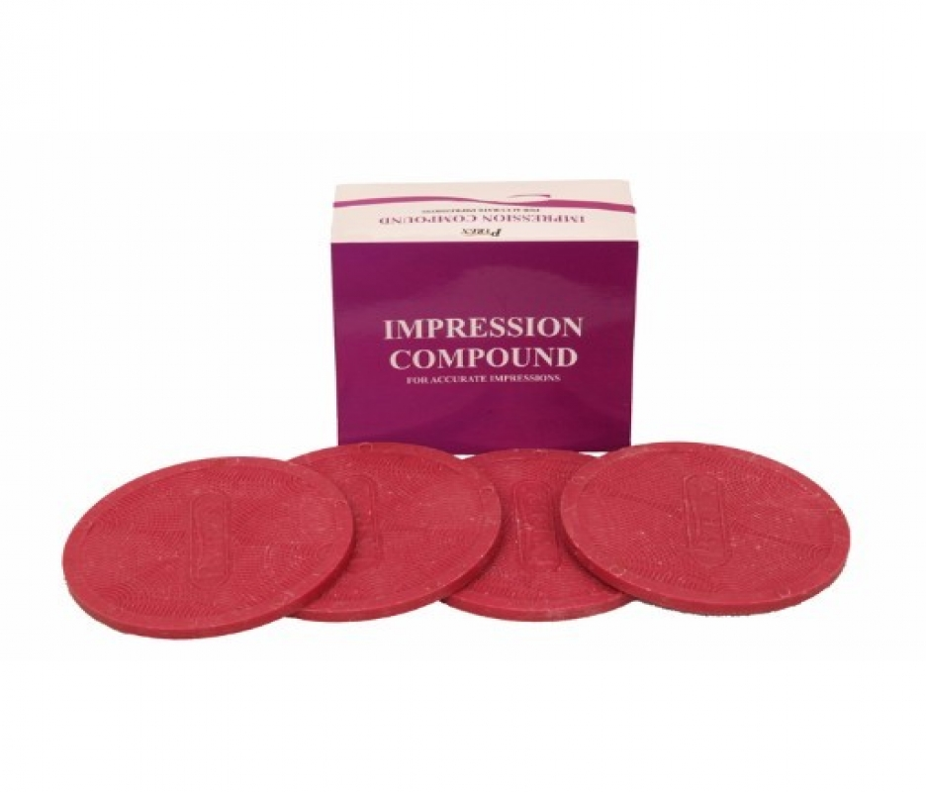
IMPRESSION COMPOUND
Also called as Modeling plastic.
Softened by heat, inserted in an impression tray, and placed against tissues before it cools to a rigid mass.

Slide 14
Primarily used - impression of the edentulous ridge.
Thermoplastic material
Glass transition temperature of 39⁰C
No chemical reaction involved ; set by a temperature change , called as reversible impression material
Notes:
Glass transition temp. – temp. below which the physical properties of plastic change to those of a glassy or crystalline state.
Above gtt, material behave like rubbery and below gtt behave like have little mobility.

Slide 15
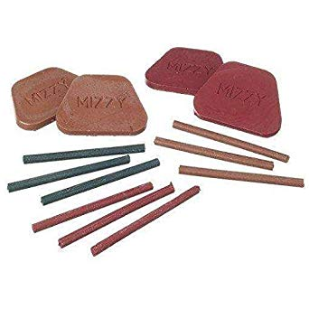
CLASSIFICATION:
Depending on the variation of temperature softening of the material
Low fusing - Green stick compound
High fusing - Impression compound, tray compound.

Slide 16
According to ADA specification no. 3
Type I - Impression compound
Type II- Tray compound

Slide 17
COMPOSITION:
COMPONENT | PARTS | FUNCTION
Resin | 30
Copal resin | 30 | Softens on heating and provides flow and cohesion
Carnauba wax | 10
Stearic acid | 5 | Plasticizer Improves workablitiy
Talc | 25 | Filler (increases rigidity)
Colouring agent | - | Pigment
Notes:
filler increases the viscosity at temperatures above that of the mouth and increases the rigidity of the cornpound at room temperature.

Slide 18
PROPERTIES:
Low thermal conductivity
Muco-compressive
Poor Dimensional Stability
High Coefficient Of Thermal Expansion (Shrinkage is of 0.3-0.5%)
Notes:
POOR DIMENSIONAL STABILITY :so the cast should be poured within one hour of the impression.

Slide 19
Fusion Temperature: 43.5⁰C
Glass Transition Temperature: 39⁰C
Flow of the material is low (less than 6% at 37 ⁰C more than 85% at 45 ⁰ C)
Detail reproduction 4 µ- Comparatively less because of its high viscosity and low flow.
Notes:
Fusion temp.- temp. at which a substance melts.
Glass transition temp. – the temperature at which it changes from rigidglassy materia tosoft material
Above gtt, material behave like rubbery and below gtt behave like have little mobility.

Slide 20
MANIPULATION:
Stick compound- can be softened over a direct flame.
Notes:
Tempering temp= 43.5 degree
Fusion temp- 45 degree
Material starts to soften at 39 degree and then above 43 degree it continues to soften and flow to a plastic mass that can be manipulated

Slide 21
Cakes – softened in warm water in a thermostatically controlled water bath usually in the range of 65 to 75 °C. After the compound is removed from the water bath, kneaded with the fingers in order to obtain uniform plasticity throughout the mass and increases flow.

Slide 22
ADVANTAGES:
The material can be reused a number of times (for the same patient only) in case of errors.
Inaccurate portions can be remade without having to remake the entire impression.

Slide 23
Accuracy can be improved by flaming the surface.
The material has sufficient body to support itself especially in the peripheral portions. It does not collapse completely if unsupported by the tray.

Slide 24
DISADVANTAGES:
Records less detail because of its high viscosity.
Compresses soft tissues during impression.
Distortion due to its poor dimensional stability.

Slide 25
Difficult to remove if there are severe undercuts.
There is always the possibility of overextension especially in the peripheries

Slide 26
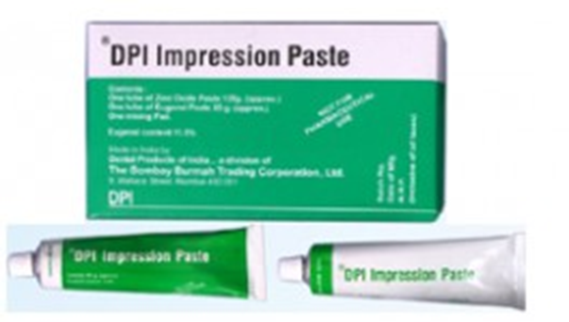
ZINC-OXIDE EUGENOL IMPRESSION PASTE
APPLICATIONS:
Impression material for edentulous arches
Surgical dressing
Bite registration paste
A cementing medium
Temporary relining material for dentures
Notes:
This type of material has been involved in a wide range of applications in dentistry, including use as an

Slide 27
COMPOSITION:
COMPONENTS | PERCENTAGE | FUNCTION
TUBE NO. 1 (BASE)
Zinc oxide | 87
Fixed vegetable or mineral oil | 13 | plasticizer
Notes:
Fixed vegetable or mineral oil acts as plasticizer and also aids in masking the action of eugenol as an irritant.
Calcium chloride acts as an accelerator of setting reaction.

Slide 28
COMPONENTS | PERCENTAGE | FUNCTION
TUBE NO. 2 (ACCELEARATOR)
Oil of cloves or eugenol | 12
Gum or polymerized rosin | 50 | Facilitates the reaction Improves homogeneity
Filler ( silica type) | 20
Lanolin | 3
Resinous balsam | 10 | Improves mixing properties
CaCl₂ & Color | 5 | Accelerator

Slide 29
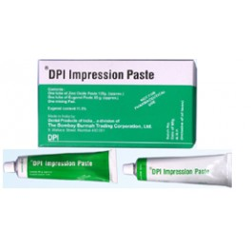
MANIPULATION:
Mixing of two pastes on an oil impervious paper /glass slab.
Proper proportion – squeezing two strip of pastes of same length

Slide 30
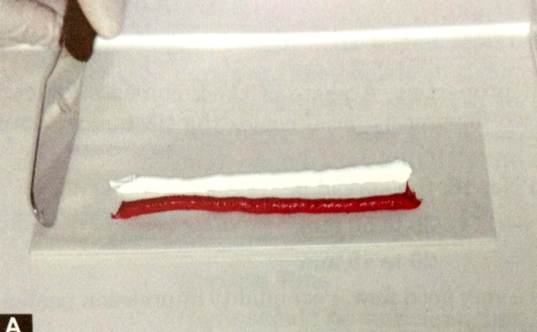
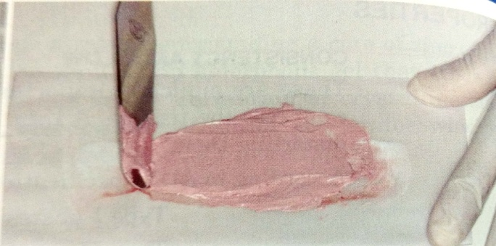
Mixing – stainless steel spatula
Two strips are combined with the first sweep of spatula.
Mixing time – 1min.(Till uniform color is obtained)

Slide 31
SETTING REACTION:
The setting reaction is a typical acid-base reaction to form a chelate.
This reaction is also known as chelation and the product is called Zinc Eugenolate.
ZnO + H₂O Zn(OH)₂
Zn(OH)₂ + 2HE ZnE₂ + 2H₂O
(Base) (Acid) (Salt) (Water)
(Eugenol) (Zinc eugenolate)

Slide 32
SETTING REACTION IS ACCELERATED BY:
High atmospheric temperature
Humid environment
Acetic acid
SETTING TIME:
Initial setting time - 3 – 6 min.
Final setting time -
Type I (hard) paste - 10mins.
Type II (soft) paste - 15mins.
Notes:
Acetic acid – more active catalyst. It increases the formation rate of zinc hydroxide
Water- acts as catalyst. Presence of moisture is essential for setting to occur

Slide 33
FACTORS CONTROLLING SETTING TIME
Accelerator –
Zinc acetate or drop of water decreases the setting time .
Increasing the mixing time, decreases the setting time.
Retarders -
Addition of oils like olive oil, mineral oil and petroleum, increases the setting time.
Cooling of spatula & mixing slab prolongs setting reaction, increasing setting time.
Notes:
Initial setting time – includes time for mixing, filling the tray and seating the impression in the mouth (3 – 6 min.)
Final setting time - it is defined as the time when the material is hard enough to resist penetration under load.

Slide 34
PROPERTIES
Flow- very good
ZnOE has quite accurate surface detail reproduction.
Rigidity and strength - satisfactory

Slide 35
DIMENSIONAL STABILITY:
A negligible shrinkage (less than 0.1%) occurs during hardening.
Impressions can be saved without change in shape.
STRENGTH:
Compressive strength – 7 Mpa ( 1000 psi ) 2 hours after mixing.
.

Slide 36
DISINFECTION
The recommended disinfectant - 2% alkaline glutaraldehyde solution

Slide 37
NON EUGENOL PASTES:
Came into the existence due to the following factors :
Burning sensations by eugenol
Eugenol taste is disagreeable
Chemical reaction :
ZnO + 2RCOOH (RCOO)₂Zn + H₂O
Notes:
Carboxylic acid- zinc carboxylate
Orthoethoxybenzoic acid, is a valuable substitute for eugenol in this regard

Slide 38
Ortho ethoxy benzoic acid (EBA) is valuable substitute.
This reaction is not affected by temperature or humidity.
Medicaments and bactericides can be incorporated without interfering with reaction

Slide 39
ADVANTAGES:
Registers accurate surface details.
Dimensionally stable as it is only used in a thin layer.
Sufficient consistency to make up for any minor under-extension in tray itself during impression making.

Slide 40
Minor defects can be corrected locally without discarding a good impression.
Can be checked in mouth repeatedly without any deformation.
It is hygienic, as fresh material must be used for each impression.

Slide 41
DISADVANTAGES:
Will not produce a satisfactory impression of the periphery unless supported by a very accurate border – molded tray.
Sticky in nature and adheres to tissues.
Notes:
Slump- fall suddenly

Slide 42
Due to presence of eugenol causes burning sensation.
Being inelastic in nature can not be used for impression making of teeth and undercut areas.
May slump in thick layers and therefore can only be used as a wash material

Slide 43
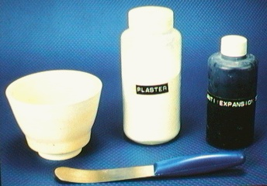
IMPRESSION PLASTER:
Beta calcium sulfate hemihydrate.
Reacts with water to form calcium sulphate dihydrate
W/P ratio 0.5 – 0.6
It is currently used as a bite registration material.

Slide 44
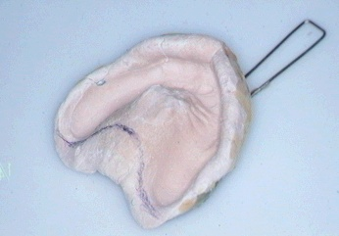
COMPOSITION:
Potassium sulfate –
prevents setting
expansion.
Borax – retarder
Alizarin red- Pigment
MANIPULATION:
Too fluid for stock tray hence custom tray is fabricated with acrylic resin or shellac.
1- 1.5mm spacer

Slide 45
HYDROCOLLOIDS:
A hydrocolloid material is a colloidal suspension (sol) of polysaccharides in water that acts as a precursor for an integrated network or gel.
Kola - ‘glue’ and ‘oid’- like, a ‘glue-like’ character.

Slide 46
Colloids are classified as the fourth state of matter, they lie between suspension and solutions.
Example- In a solution of sugar, the sugar molecules are evenly dispersed in the water and there is no visible physical separation, this is known as solution.
If in the sugar molecules are replaced with larger, visible insoluble particles, such as sand, this is known as suspension.
Notes:
5th state of matter- BOSE- EINSTEIN CONDENSATE.
FOR EX: gas can be ionized at high temperature to form plasma. 5th state of matter can be created at extreme temperatures. Gas is cooled to extreme low temp as 0 degree

Slide 47
If these particles are liquid, such as vegetable oil in water, this system is known as emulsion.
A colloidal system consist of two phases i.e.
The Dispersed Phase
The Dispersion Phase.
Characteristically held together by primary or secondary forces.
The size of the particles larger than solutions & range from to 1 - 200nm

Slide 48
During setting the material sets from a flowable state to a solid state and this change in state is known as SOL-GEL TRANSFORMATION:
If a hydrocolloid contains an adequate concentration of dispersed phase, the sol under certain conditions may change to a semisolid material known as gel.
Notes:
An intervening space, especially a very small one.

Slide 49
In the gel state, the dispersed phase combines together to form chain and fibrils (micelles)
Fibrils branch and intermesh to form a brush-heap structures.
The dispersion medium is held in the interstices between the fibrils by capillary attraction or adhesion

Slide 50
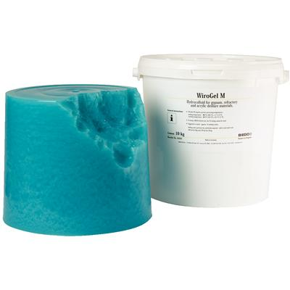
AGAR HYDROCOLLOID:
Introduced by “Alphous Poller of Vienna”in 1925.
Adopted commercially as “Dentacol” in 1928.

Slide 51
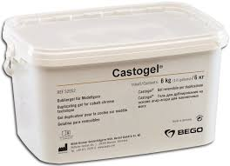
First successful elastic impression material to be used in dentistry.
It is an organic hydrophilic colloid (polysaccharide) extracted from a type of seaweed (Gelidium, Gracilaria, etc.)
Notes:
Polysaccharide- agarose (70%) ( is a linear polymer) and agaropectin(heterogenous mixture of smaller molecules) …… comes from algae called AGAROPHYTES

Slide 52
CLASSIFICATION
BASED ON VISCOSITY
Type 1 — Heavy bodied (for use as tray material)
Type 2 — Medium bodied (for use as tray or syringe material)
Type 3 — Light bodied (for syringe use only)
Type 3A — Light bodied for agar-alginate combination technique

Slide 53
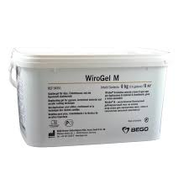
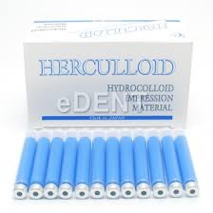
SUPPLIED AS:
Gel in collapsible tubes (for impressions).
Cartridges or gel sticks (syringe material)
Bulk containers (for duplication)

Slide 54
COMPONENT | FUNCTION | COMPOSITION(%)
Agar |  | 13-17
Borate | Strength | 0.2-0.5
Sulfate | Gypsum hardener | 1.0-2.0
Wax, hard | Filler | 0.5-1.0
Thixotropic materials | Thickener | 0.3-0.5
Water | Reaction medium | Balance
COMPOSITION:

Slide 55
SETTING:
The setting of reversible hydrocolloid is called gelation.
The change is induced by a temperature variations.
Notes:
GELATION- (process that involves phase changes from sol to gel states)

Slide 56
The gel converts to the sol condition when it is heated to a certain temperature, is known as liquefaction temperature (70⁰ to 100⁰ C)
When cooled from this temperature, the sol transforms into a gel at a point known as the gelation temperature (between 37⁰ & 50⁰ C).
And since this cycle can be repeated over hence agar is known as reversible hydrocolloid.

Slide 57
MANIPULATION:
Liquefying the hydrocolloid gel in boiling water (100⁰) and hold this temperature for the minimum of 10 minutes.
It is stored in a sol condition at 65⁰ C until it is needed for filling the tray.

Slide 58
Place the material in the impression tray.
Tempering to 46 ⁰ temperature for two minutes with material loaded in tray is done.
Maintaining it in its fluid state to capture the details of the oral structures.
Notes:
Tempering of tray material also increases the viscosity so that it will not flow out of the tray.
If gelation is done at 4-5 degree then the material becomes too hard gel and impression cannot be taken properly.
Rapid cooling can cause concentration of stress as sol is poor thermal conductor

Slide 59
CONDITIONING UNIT
Notes:
Conditioning unit is required for agar impression.
Has 3 compartments, used for liquefying the material, storing and tempering the tray hydrocolloid.

Slide 60
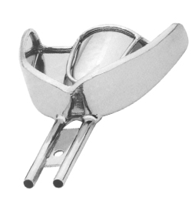
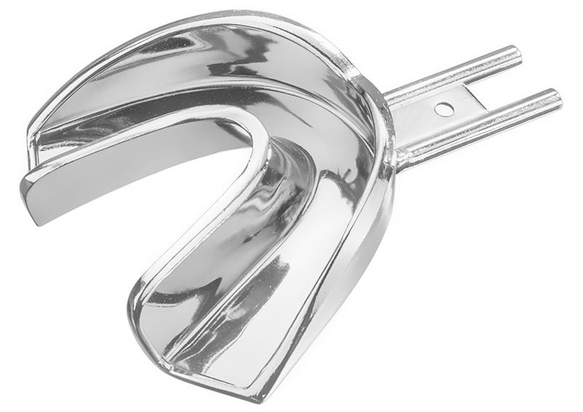
IMPRESSION TRAYS:
Rim lock trays with water circulating devices are used.
Beading in the trays help to retain the material.
It has an inlet and outlet for connecting the water tubes.
Water-cooled trays accelerate the gelation of agar hydrocolloids.

Slide 61
MAKING THE AGAR IMPRESSION:
After tempering the material, it is taken directly from the compartment and is applied to the prepared teeth.
Gelation is accelerated by circulating cool water (approximately 18⁰C to 21⁰C) , through the tray for 3 to 5 minutes.

Slide 62
During the gelation process, the tray must be held in the mouth until gelation has proceeded to the point at which the gel strength is sufficient to resist deformation or fracture.
As this material, exhibits viscoelastic behaviour, it is necessary to remove the material with a snap.

Slide 63
WORKING AND SETTING TIME:
The working time - 7-15 minutes.
Setting time - 5 minutes.
DISINFECTION OF THE IMPRESSION:
0.5% dilution Sodium hypochlorite
or 1:213 Iodophor.

Slide 64
PROPERTIES
Gelation, Liquefaction and Hysteresis
Gelation (solidification) occurs at 37-50 °C.
Liquefaction (melting) occurs at 70-100 °C.
This temperature lag is known as Hysteresis.
Dimensional stability
Shows Syneresis and Imbibition
This result in dimensional changes and therefore inaccurate cast, so impressions should be poured immediately.
Notes:
Most materials melt as well as resolidify at the same temperature. In agar, this does not coincide. This temperature lag between liquefaction and gelation is known as hysteresis.(60-70)
Since hydrocolloids use water as the dispersion medium, they are prone for dimensional change due to either loss or gain of water.
The loss of water in form of small droplets over the gel surface is kn as syneresis
Some of the more soluble constituents are also lost. the process occurs irresp ective of the humidity of the surrounding atmosphere.
If it is immersed in water, it absorbs water by a process known as imbibition.
When immersed in water, they do not imbibe more than original content which was lost by evaporation (unlike alginates).
Flexibility iso 21532:2013 requires flexibility ranging between 4% and 15%, when a stress of 12.2 N is applied. A few set materials, however, have a flexibility of 20%. On an average a flexibility of 11% is desirable.
Elasticity and elastic recovery they are highly elastic, and elastic recovery occurs to the extent of 98.8% (ISO 21532:2013 - min. 96.5 %).

Slide 65
Flexibility
Shows flexibility ranging between 4% and 15%.
Elasticity and elastic recovery
Highly elastic, and elastic recovery occurs to the extent of 98.8%
Tear and Compressive strengths
Tear strength of 0.8–0.9 kN/m
Compressive strength of 0.5–0.9 g/cm2.
The above values are for tray materials. The syringe materials have poor mechanical properties.

Slide 66
Flow
The material is sufficiently fluid to record the fine details if correctly manipulated.
Reproduction of detail
A reproduction of a groove of 25 µm is achievable with agar.
Accuracy and dimensional change
Highly accurate at the time of removal from the mouth, but shrink when stored in air and expand when stored in water.

Slide 67
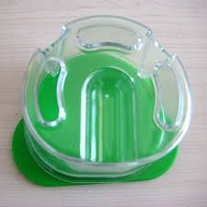
INDICATIONS:
Widely used at present for cast duplication.
For full mouth impression without deep undercuts.
As tissue conditioner.
Was used for crown & bridge before the elastomers.

Slide 68
ADVANTAGES:
Accurate dies can be prepared, if the material is properly handled.
Good elastic properties help reproduce most undercut areas.
Hydrophilic, moist mouth not a problem. It also gives a good model surface.

Slide 69
Palatable and well tolerated by the patient.
Economical when compared to synthetic elastic materials.
Can be reused when used as a duplicating material (reuse is not recommended when used as impression material).
Low cost because it can be reused.

Slide 70
DISADVANTAGES:
Initial expense, complexity of the technique, expensive equipment
Material prepared in advanced
Tears easily
Dimensionally unstable -immediate pour

Slide 71
Difficult to disinfect
Thermal shock to the teeth producing pain and discomfort
Cannot be electroplated

Slide 72
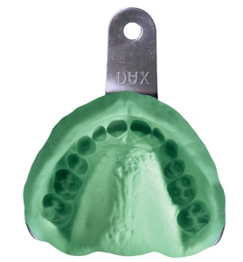
ALGINATE HYDROCOLLOIDS:
An elastic, irreversible hydrocolloid impression material.
Alginic acid is prepared from a marine plant and is a linear polymer of anhydro- β-D-mannuronic acid.
Notes:
Alginic acid- mucous extract from brown seaweed, naturally occurring hydrophilic colloidal polysaccharide.

Slide 73
Used in-
Preliminary impressions
Provisional crown-and-bridge impressions
Study models
Opposing dentition impressions

Slide 74
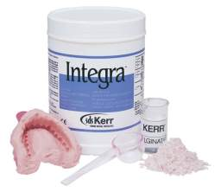
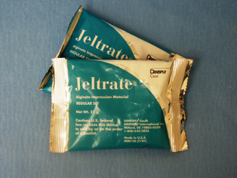
TYPES:
Type I — Fast setting.
Type II — Normal setting
SUPPLIED AS:
Bulk in a can with scoop for measuring powder & measuring cylinder for water
Pre-weighted alginate in foil package

Slide 75
COMPOSITION:
COMPONENT | FUNCTION | WEIGHT %
Potassium alginate | Soluble alginate | 15
Calcium sulfate | Reactor | 16
Zinc oxide | Filler particles | 4

Slide 76
COMPONENT | FUNCTION | WEIGHT %
Potassium titanium fluoride | Accelerator | 3
Diatomaceous earth | Filler particles | 60
Sodium phosphate | Retarder | 2
Coloring and flavoring agent | e.g. wintergreen, peppermint, orange, etc. | Traces

Slide 77
GELATION PROCESS:
Sol-gel reaction-
Reaction of soluble alginate with calcium sulfate to form an insoluble calcium alginate gel.
In addition to these a third water soluble salt i.e. Trisodium phosphate is added to the solution to prolong the working time.
Notes:
Sodium phosphate- retarder

Slide 78
The reactions taking place as:
2Na₃PO₄ + 3CaSO₄ Ca₃(PO₄)₂ + 3Na₂SO₄
When the trisodium phosphate supply is exhausted, the calcium ions begin to react with potassium alginate to produce calcium alginate:
Potassium + CaSO₄ + H₂O Ca + K₂SO₄
alginate alginate
Retarder (sodium phosphate) is added to provide the proper setting time.
Notes:
TRISODIUM + CALCIUM = CALCIUM + SODIUM
PHOSPHATE SULPHATE PHOSPHATE SULPHATE

Slide 79
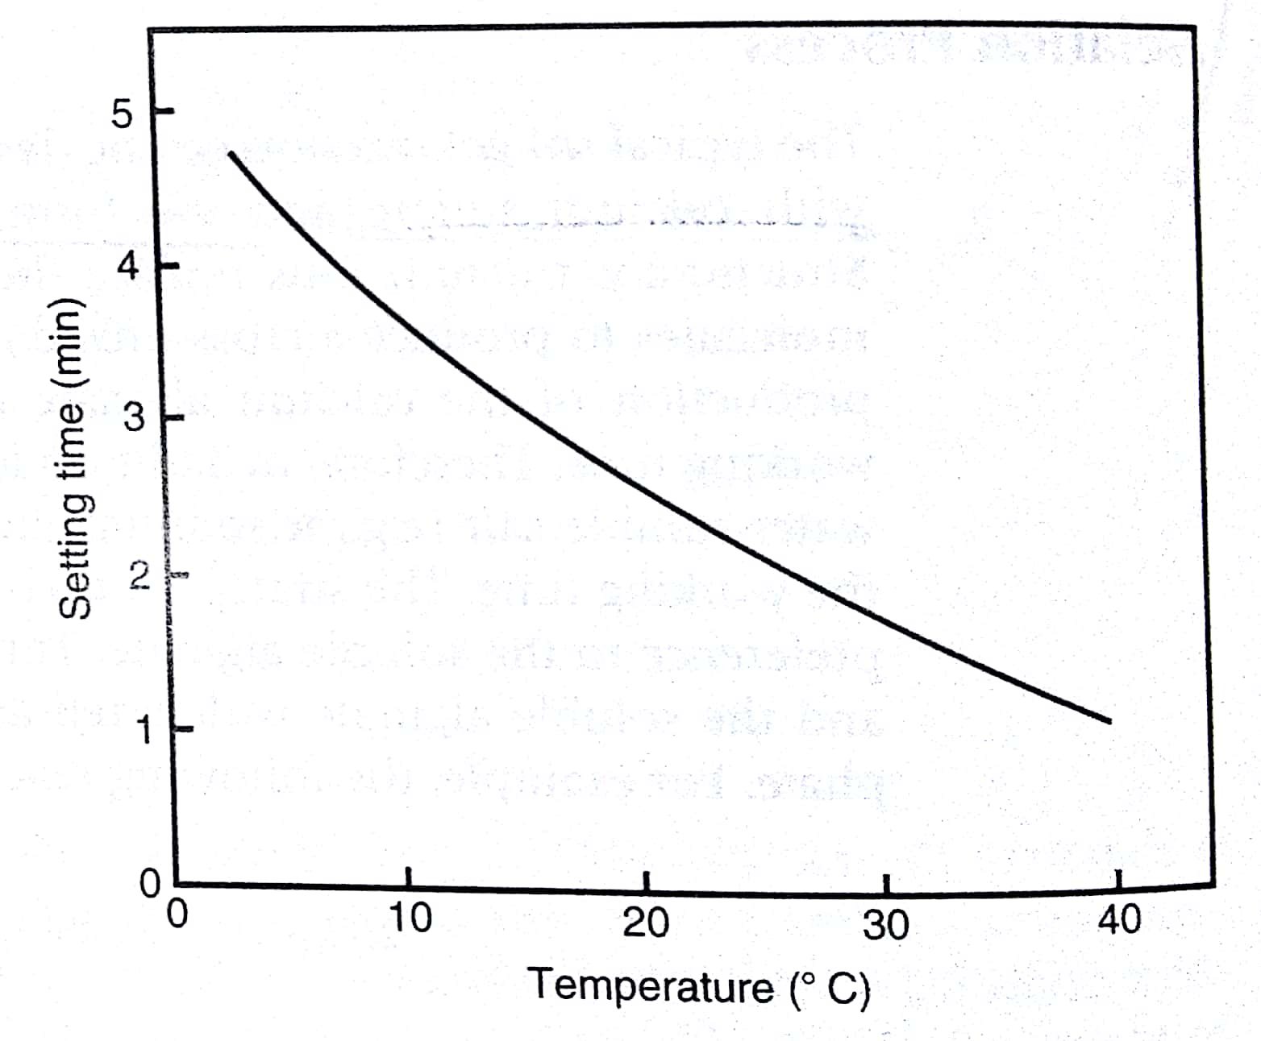
CONTROLLING SETTING TIME:
Setting time-
Fast setting - 1.5-3 min
Slow setting - 2-4.5 minutes.
This can be altered by altering the temperature of the water used for mixing the alginate.
Notes:
This graph shows,,when we increase the temperature setting time is decreased.
The temperature of mixing water should be 20⁰C.
GELATION OCCUR IN ABOUT 3 – 4 MIN. AT ROOM TEMPERATURE.

Slide 80
MANIPULATION:
Water: Powder = 38ml : 16g
Mixing can be done
Manually by mechanical spatulation.
Alginator.

Slide 81
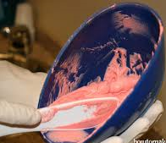
HAND MIXING:
A vigorous figure-8 motion is used, with the mix being swiped against the sides of the rubber-mixing bowl with intermittent rotations (180⁰) of the spatula to press out air bubbles.
45 seconds to 1 minute mixing is sufficient depending on the brand and the type of alginate (fast-setting or slow-setting).

Slide 82
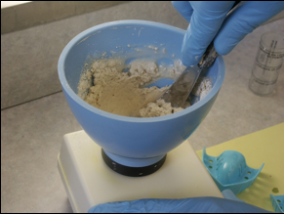
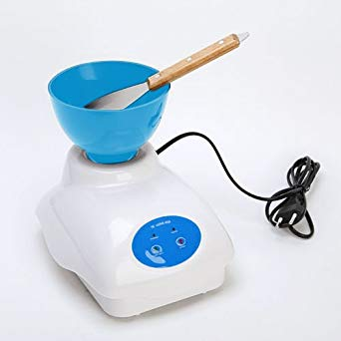
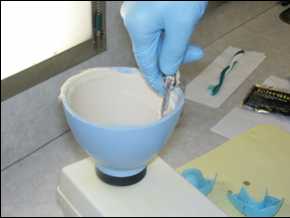
ALGINATOR:
Notes:
, alginator.

Slide 83
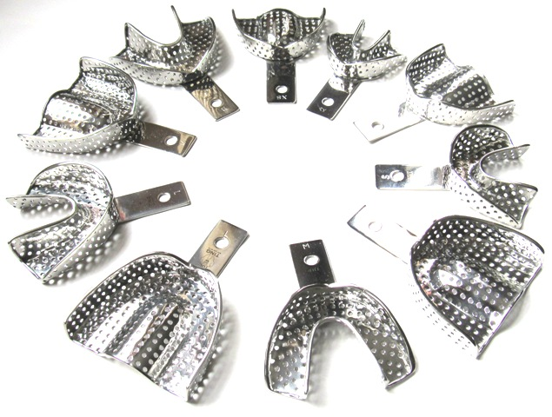
TRAY SELECTION:
Perforated, metal trays are used.

Slide 84
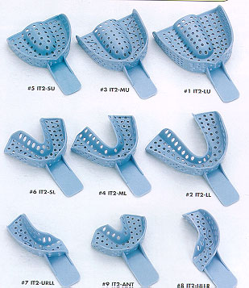
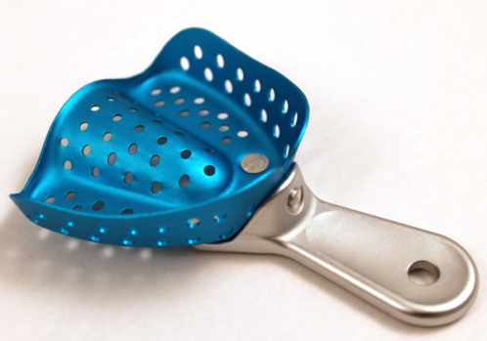
If a plastic tray or metal rim-lock tray is selected, a thin layer of tray adhesive can be applied into the tray.

Slide 85
Tray must fit into the patient’s arch so that there is a sufficient bulk of material.
The thickness of the alginate impression between the tray and the tissues should be at least 3 mm.

Slide 86
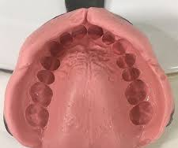
MAKING THE IMPRESSION:
As the material sets from tissues towards the periphery, any movement during gelation may result in distortion.

Slide 87
The alginate should be kept into the mouth for 2-3 minutes after initial gelation.
The tear strength increases when the impression is removed with a snap.

Slide 88
PROPERTIES:
Working time –
Fast set materials - 0.25 – 2 min.
Regular set materials - 3 – 4.5 min.
Mixing time-
Fast set materials - 45 sec.
Regular set materials- 60 sec.

Slide 89
Permanent deformation:
Time dependent property.
Recovery from the deformation that occurs during the removal of the impression should be 96% to 98%.
TASTE AND ODOR
Alginate has a pleasant taste and smell.
Flexibility :
About 14% at a stress of 12.2 N
Water : powder influence flexibility
more water more flexibility
Notes:
Surface detail reproduction 20 um

Slide 90
STRENGTH:
If too much or too little water is used in the mixing, the final gel will be weakened, making the material less elastic.
Insufficient spatulation results in failure of the ingredients to dissolve.
Overmixing breaks up the calcium alginate gel network as it is forming and reduces its strength.
Compressive strength- 0.5-0.9 MPa
Tear strength- 0.4-0.7 kN/m

Slide 91
ACCURACY :
Do not produce fine details (27µ)as done by elastomeric impression material.
Increase in alginate concentration makes the material more accurate, but dimensional stability of material not increased.
Roughness of impression surface causes distortion at the margins of prepared teeth.
So, addition of surfactants to produce smooth surface, thereby obscures accuracy.

Slide 92
DIMENSIONAL STABILITY :
Alginate impression lose accuracy with increased time of storage
Water will evaporates if the impression is stored in air, and the impression will shrinks
If the impression is placed in water, it absorbs water and expands
Storage in humid air approaching 100% relative humidity results in the least dimensional change

Slide 93
ELASTICITY AND ELASTIC RECOVERY
Alginate hydrocolloids are highly elastic (but less when compared to agar)
About 98.2% elastic recovery occurs
BIOLOGICAL PROPERTIES
No known chemical or allergic reaction have been identified for alginate.
Silica particles present in the dust which rises from the can after fluffing alginate powder, are a possible health hazard.
Avoid breathing the dust.

Slide 94
SHELF LIFE AND STORAGE
Deteriorates rapidly at elevated temperatures and humid environment. 
Should be stored in a cool, dry environment (not above 37 °C). 
Stock only for one year.
Notes:
Dustless alginates contain glycol are manufacured

Slide 95
ADVANTAGES:
Easy to mix and manipulate
Minimum equipment is require
Flexibility of the set impression
Accuracy if is properly handled

Slide 96
Low cost
Comfortable to the patient
Hygienic (as fresh material is used for each impression)
Hydrophilic - displace moisture, blood, fluids

Slide 97
DISADVANTAGES:
Do not transfer as much surface detail to gypsum as elastomers or agar do
Tears easily
Dimensionally unstable
Immediate pour
Single cast
Lower detail reproduction
Unacceptable for fixed prosthesis
Difficult to disinfect

Slide 98
Latest advances - Modified Alginates:
2 paste system: One containing the alginate sol, the second the calcium reactor. These materials are said to contain silicone and have superior tear resistance.
Chromatic alginates: Contain acid/base indicator that change colour at different critical points, indicating mixing time, loading into mouths & setting.
Notes:
COLTENE
ZHENMARK

Slide 99
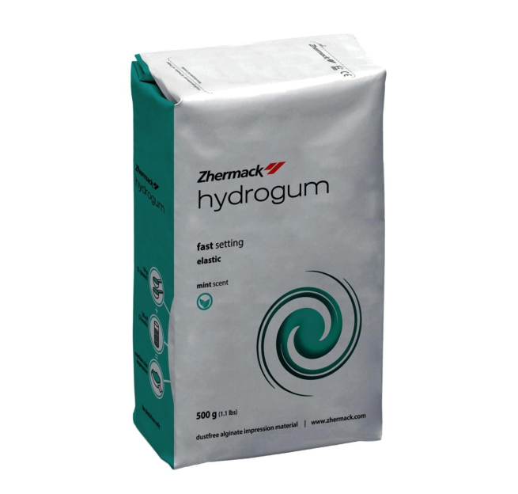
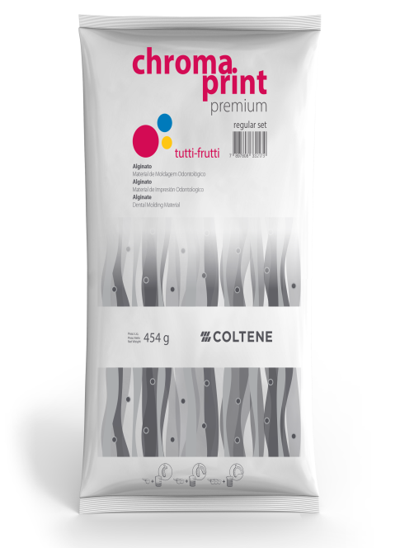
Dustless Alginate: To avoid dust inhalation - coating the material with a glycol.
Siliconised Alginates: Alginates modified by the incorporation of silicone polymers which improve the physical properties.

Slide 100
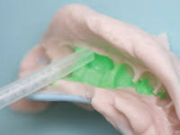
LAMINATE TECHNIQUE (AGAR–ALGINATE COMBINATION TECHNIQUE)
After injecting the syringe agar on to the area to be recorded, an impression tray containing a mix of chilled alginate that will bond with the agar is positioned over it.
The alginate gels by a chemical reaction, whereas the agar gels through contact with the cool alginate, rather than the water circulating through the tray.
Notes:
Schwartz 1951
Gives better details than alginate.
Water cooled trays not required, therefore more convenient.

Slide 101
ADVANTAGES
1. Gives better details than alginate.
2. Less air bubbles.
3. Water cooled trays not required.
4. Sets faster than the regular agar technique.

Slide 102
COMPARISION BETWEEN HYDROCOLLOIDS:
PROPERTIES | AGAR | ALGINATE
Flexibility | 20 % | 14 %
Elasticity & elastic recovery | 98.8 % | 98.2 %
Reproduction of details | Fine <25µm | < agar 25µm
Tear strength | 0.8-0.9 kN/m | 0.4-0.7 kN/m

Slide 103
PROPERTIES | AGAR | ALGINATE
Comp. strength | 0.78 MPa | 0.49-0.88 MPa
Dimensional Stability | Better | Poor
Reuse | Possible | Not possible
Manipulation | Conditioner & rim lock trays | Perforated trays

Slide 105
IMPRESSION MATERIALS: Inelastic, Hydrocolloid, Elastomeric
Presented by:
Dr. Aishwarya Mahajan
MDS 1st year

Slide 106
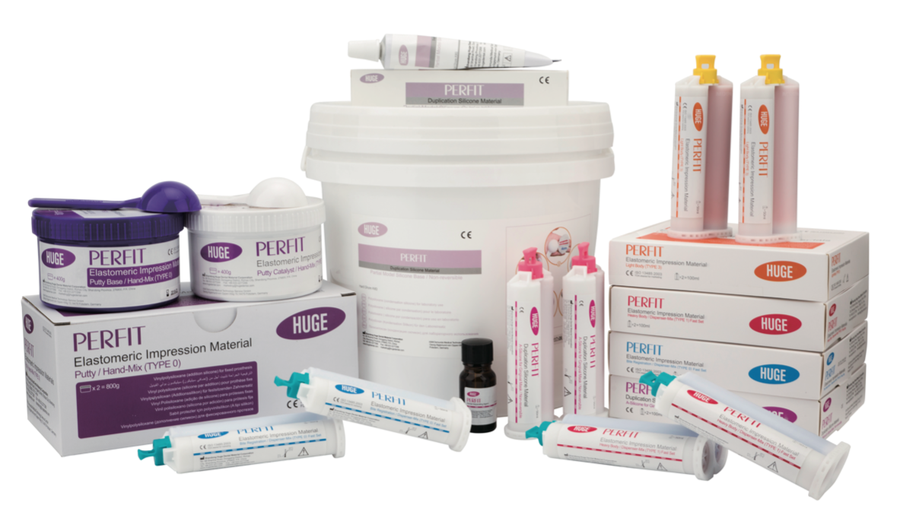
ELASTOMERIC IMPRESSION MATERIALS:

Slide 107
These refer to a group of rubbery polymers that cross-link chemically.
They can be easily stretched.
When applied stress is relieved, they recover their original dimensions.

Slide 108
Setting occurs through a combination of chain-lengthening polymerization and chemical cross-linking by either condensation reaction or addition reaction.
These impression materials are called non-aqueous elastomeric impression materials in ADA Specification no. 19.

Slide 109
CLASSIFICATION
Chemically, there are 4 kinds of elastomers:
Polysulfide
Condensation silicone
Addition silicone
Polyether

Slide 110
Based on viscosity (ISO 4823:2015)
Type 0 — Putty consistency (very heavy)
Type 1 — Heavy-bodied consistency (tray consistency)
Type 2 — Medium-bodied consistency (regular bodied)
Type 3 — Light-bodied (syringe consistency)

Slide 111
USES
In fixed partial dentures for impressions of prepared teeth.
Impressions of dentulous mouths for removable partial dentures.
Impressions of edentulous mouths for complete dentures.
Notes:
Uses of elastomeric impression materials

Slide 112
Polyether is used for border molding of edentulous custom trays.
For bite registration.
Silicone duplicating material is used for making refractory casts during cast partial denture construction.

Slide 113
GENERAL PROPRETIES
Excellent reproduction of surface details(20u).
They are generally hydrophobic (except polyether which is hydrophilic), so the oral tissues in the area of impression should be absolutely dry for better flow of the impression material.
Notes:
The low viscosity is capable of producing very fine details
Because of their hydrophobic (water hating) nature, care must be taken while pouring stone in the impression. The poor wetting and high contact angle can result in air entrapment. Commercial surfactants sprays are available which improve wetting
(though not recommended when high accuracy is critical).

Slide 114
Elastic properties of elastomers is good with near complete elastic recovery(99.7%).
Repeated pouring of impression is possible.
Excellent tear strength (2500-7000gm/cm2).
Electroplating Elastomers can be copper and/or silver plated.

Slide 115
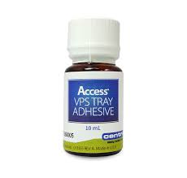
Radiopacity - Radiopacity of impression materials is important for radiographic identification of excess material which may be accidentally swallowed, aspirated or left in gingival tissues.
Presently, only the polysulfide materials exhibit significant radiopacity due to their lead dioxide content.

Slide 116
Retention to tray - Do not adhere well to the impression tray.
They may be retained:
Mechanically by using perforated trays (only in case of putty).
By using tray adhesives (These are tacky liquids that are applied with a brush).
Each elastomer type has specific adhesive which is not interchangeable.

Slide 117
Shelf life - 2 years.
Storage under cool conditions increases shelf life.
Color - They come in a variety of colors

Slide 118
POLYSULFIDES
This was the first elastomeric impression material to be introduced (1950).
It is also known as Mercaptan or Thiokol.
They were first developed as an industrial sealant for gaps between sectional concrete structures.

Slide 119
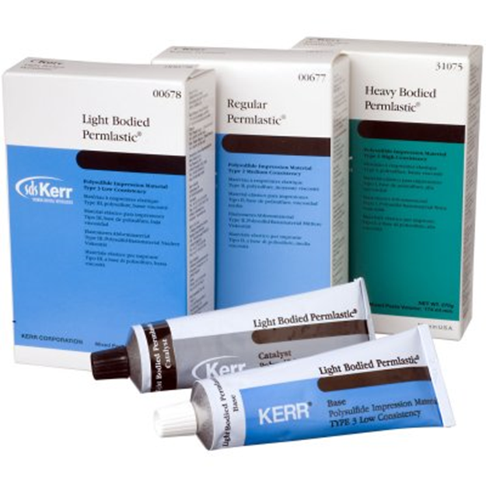
Supplied as:
Two-paste system in
collapsible tubes.
Base paste - white colored.
Accelerator - brown or gray.
Available in three viscosities:
Light bodied
Medium bodied
Heavy bodied

Slide 120
Commercial names:
$•$Coe-flex Lead dioxide system
• Omni flex Copper hydroxide system

Slide 121
COMPOSITION:
BASE PASTE
Polysulfide polymer
Filler that provide strength (eg titanium dioxide)
Plasticizer for appropriate viscosity ( eg. Dibutyl pthalate)
Sulfur (approx. 0.5% to accelerate the reaction)
Notes:
Lead dioxide- initiate polymerization reaction

Slide 122
CATALYST PASTE/ ACCELERATOR PASTE:
Lead dioxide
Oleic or stearic acid – retarder (controls the rate of setting reaction)

Slide 123
CHEMISTRY:
Main component is a multifunctional mercaptan (-SH) or polysulfide polymer.
This linear polymer contains approximately 1 mole percent of pendant –SH groups.
Notes:
Reaction is exothermic with 3-4 degree rise in temperature. Accelerated by heat and moisture.

Slide 124
An oxidizing agent such as lead dioxide is used to initiate polymerization through chain lengthening between terminal –SH groups and cross-linking between the pendant –SH groups.
Mercaptan + lead dioxide polysufide + water

Slide 125
POLYSULFIDE
ADVANTAGES
High tear resistance
Margins easily seen
Modest cost
DISADVANTAGES
Requires custom tray
Stretching leads to distortion
Stains clothes
Unpleasent odour

Slide 126
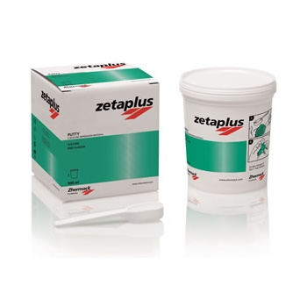
CONDENSATION SILICONE:
These are also referred to as CONVENTIONAL SILICONES.
SUPPLIED AS:
Paste- Base paste + catalyst paste (a low viscosity liquid)
Putty (high viscosity material)

Slide 127
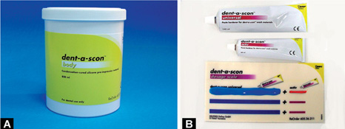
Commercial names:
Sil 21
Coltex
Dent-a-scon

Slide 128
COMPOSITION:
BASE
Alpha omega hydroxly terminated polydimethyl siloxane
Fillers ( colloidal silica)
CATALYST
Stannous octate (catalyst)
Orthoethyl silicate ( cross linking agent)

Slide 129
CHEMISTRY:
It is a condensation reaction.
The formation of elastomers occurs through the cross-linking between the terminal groups of the silicone polymers and the alkyl silicate to form a three-dimensional network.
Notes:
Tray adhesive is polydimethyl siloxane and ethyl silicate

Slide 130
The reaction is exothermic (1⁰C rise in temp)
Dimethyl siloxane + orthoethyl silicate silicone rubber + ethyl alcohol.
Ethyl alcohol is the by-product that evaporates gradually leading to the contraction in the set silicone rubber impression.

Slide 131
CONDENSATION SILICONE
ADVANTAGES
Pleasant odor
Good working time
Easily seen margins
DISADVANTAGES
High polymerization shrinkage
Volatile by-product
Low tear strength
Hydrophobic
Pour immediately

Slide 132
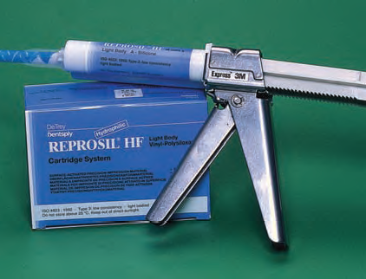
ADDITION SILICONE:
These are also called as Polyvinyl Siloxane or Vinyl Polysiloxane impression materials.
No reaction by-products develop if correct proportions of vinyl silicone and hydride silicone are maintained.
Most widely used impression material.

Slide 133
Supplied as:
Tubes:
The base and catalyst pastes come in equal sized tubes.
2. Cartridge form with static mixing tips. For use with a dispensing gun.
3. Putty jars:
Two equal sized plastic jars—containing the base and catalyst.

Slide 134
4. A larger electric driven autodispenser and mixing device is also available (Pentamix— ESPE). This machine stores larger quantities. At the press of the button, it dispenses and mixes the material.

Slide 135
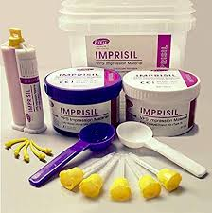
Available in four viscosities
Light bodied
Medium bodied
Heavy bodied
Putty bodied

Slide 136
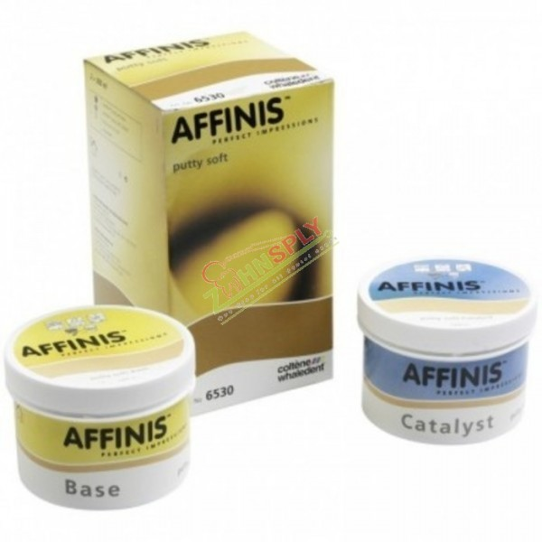
Commercially available as:
Reprosil (Dentsply)
Provil
Affinis

Slide 137
COMPOSITION:
BASE
Polymethyl hydrogen siloxane
Siloxane prepolymers
Fillers
Palladium – hydrogen absorber.
Retarders
CATALYST
Divinyl polysiloxane
Other siloxane prepolymers
Platinum salt activator (catalyst)
Fillers
Notes:
*A non ionic surfactant is added
to the paste to render the surface
of the impression material HYDROPHILLIC

Slide 138
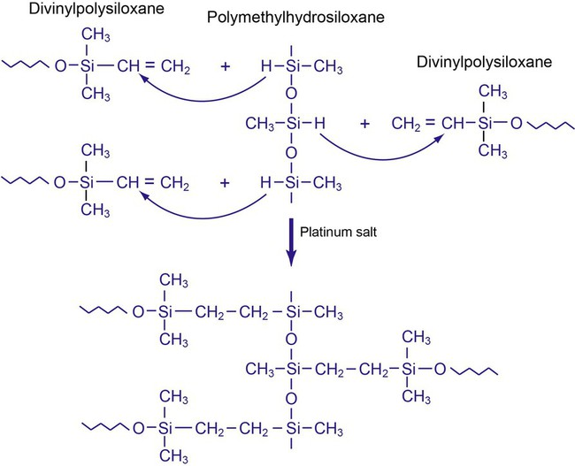
CHEMISTRY:
.
Notes:
TOP- crosslinking of 2 siloxanes using Hydrogen atoms occures to set by addition polymerization reaction
BOTTOM- Final structure after the platinum salt has initiated the addition polymerization reaction Silicon rubber
No byproduct formed
Addition reaction. Base polymer is terminated with vinyl group and crosslinked with silane.

Slide 139
ADDITION SILICONE
ADVANTAGES
Pleasant odor
Easily seen margins
Ideally elastic
Pour repeatedly
Stable delayed pour
DISADVANTAGES
Hydrophobic
Low tear strength
High cost

Slide 140
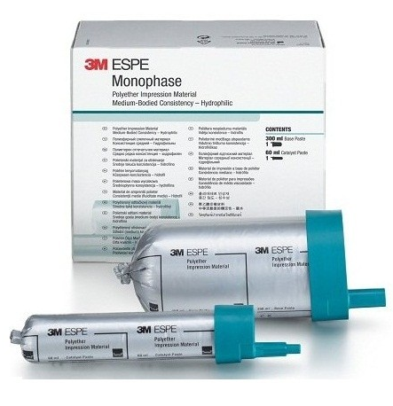
POLYETHER:
Introduced in Germany in late 1960s.
Good mechanical properties and dimensional stability, but short working time,
Very stiff material and expensive.

Slide 141
COMPOSITION:
BASE PASTE
Polyether polymer
Filler - colloidal silica
Plasticizer - glycolether or phthalate
Colouring agent
CATALYST PASTE
Alkyl aromatic sulfonate cross-linking agent
Filler - colloidal silica
Plasticizer - glycolether or phthalate
Colouring agent

Slide 142
CHEMISTRY:
It is a polyether-based polymer that is cured by the reaction between aziridine rings which are at the end of branched Polyether molecules.
AZIRIDINE RING
POLYETHERS

Slide 143
Main chain is a copolymer of ethylene oxide and tetrahydrofuran.
Aromatic sulfonate ester acts as initiator.
Cross­ linking is produced by cationic polymerization via the imine end groups.
SULFONIC ESTER

Slide 144
Polyether + Sulfonic ester
Exothermic reaction - 4-5⁰ C
Notes:
ratio of the stress to strain within the elastic limit.

Slide 145
The original material was extremely difficult to remove from undercut areas because of the high modulus of elasticity.
New formulations of regular or medium-bodied materials are less stiff than the one-step hydrophilic vinyl polysiloxane impression materials.

Slide 146
POLYETHER
ADVANTAGES
Pleasant odor & taste
Easily seen margins
Good stability
Delay pour
DISADVANTAGES
Stiff
Bitter taste
Needs to block undercuts
Absorbs water
High cost

Slide 147
COMPARISION OF PROPERTIES
PROPERTIES | POLY SULFIDES | CONDENSATION SILICONE | ADDITION SILICONE | POLYETHER
MIXING TIME | 45 sec | 45 sec | 45 sec | 30 sec
SETTING TIME | 12.5 mins | 6-9 mins | 5-9 mins | 6-8 mins
DETAIL REPRODUCTION | Heavy- 75µm Light- 20µm | 20µm | 20µm | 20µm

Slide 148
PROPERTIES | POLY SULFIDES | CONDENSATION SILICONE | ADDITION SILICONE | POLYETHER
SHELF LIFE | 2 yrs | < 2 yrs | 1-2 yrs | > 2 yrs
SHRINKAGE | 0.45% | 0.4-0.6% | 0.17% | 0.24%
DEFORMATION | 3-5% | 1-3% | 0.05-0.3% | 0.8-1.6%

Slide 149
DIMENSIONAL STABILITY:
There are five major sources of dimensional change:
Polymerization shrinkage
Loss of condensation reaction by-product
Thermal contraction from oral temperature to room temperature.
Absorption of water or disinfectant
Incomplete recovery of deformation due to plastic deformation, viscoelasticity.

Slide 150
MATERIAL | POLYSULFIDE | CONDENSATION SILICONE | ADDITION SILICONE | POLYETHER
% CONTRACTION AT 24 HOURS | 0.40-0.45 | 0.38-0.60 | 0.14-0.17 | 0.19-0.24

Slide 151
RHEOLOGICAL PROPERTIES
Polysulfide has the lowest viscosity and ranks as one of the least stiff of the elastomeric impression materials of a similar consistency.
The most common consistencies of the condensation materials are the putty and the wash materials.

Slide 152
Addition silicon and polyether are pseudoplastic impression materials.
The significance of this property is that the clinician can use a high-viscosity material, which is more stable and resistant to distortion, to capture the details needed for fixed prosthesis.

Slide 153
THIXOTROPY:
Strain-dependant rheological behaviour
A thixotropic material does not flow until sufficient impact force is applied to overcome its yeild stress.
Beyond this point, the material becomes fluid.
Notes:
stress at which a specific amount of plastic deformation is produced,

Slide 154
ELASTICITY:
Longer the impression remains in the mouth, less distortion will occur during impression removal.

Slide 155
Excluding the very high-viscosity putty class of elastomers, the stiffness of impression materials increases in the following order-polysulfide, condensation silicone, addition silicone, and polyether.
The vinyl polysiloxane are the most ideally elastic of all the current available materials.

Slide 156
TEAR STRENGTH:
Resistance to fracture of an elastomeric material subjected to a tensile force acting perpendicular to the surface.
Tear strength (lowest to highest) if following order:
Hydrocolloids(agar and alginate), silicones( addition and condensation), polyether, and polysulfide..

Slide 157
MATERIAL | POLYSULFIDE | CONDENSATION SILICONE | ADDITION SILICONE | POLYETHER
TEAR STRENGTH (N/m) | 2500-7000 | 2300-2600 | 1500-4300 | 1800-4800

Slide 158
DISINFECTION:
POLYSULFIDE AND SILICONES
Immersion ( not more than 30 mins)
Gluteraldehyde, chlorine, idophors
POLYETHER
Immersion less than 10mins
Chlorine , idophors

Slide 159
MAKING AN IMPRESSION:
STEPS:
Preparing tray
Preparing the material
Making the impression
Removing the impression
Preparing stone cast and dies
Notes:
Trays can be stock or custom made

Slide 160
All the materials are supplied as two component systems.
First step is to mix the components properly to initiate the reaction.
Second step involves the selection and use of preferred viscosity for making an impression.

Slide 161
PREPARATION OF IMPRESSION MATERIALS:
MIXING TECHNIQUES:
Hand mixing
Static mixing/auto mixing system
Dynamic mechanical mixer

Slide 162
HAND MIXING:
When material is provided in 2 paste tubes, user should dispense same length of material onto a mixing pad or glass slab. Both the pastes are mixed with stainless steel spatula. The mixed paste should be uniform in color, with no streaks of base or catalyst appearing in mixture.

Slide 163
When one of the component is liquid, such as catalyst for condensation silicone, length of base is dispensed from tube onto a graduated mixing pad and one drop of liquid catalyst is added for each unit length of base.
In case of 2 putty system, the material is dispensed by volume using an equal no. of scoops of each putty, and the material is kneaded with fingers until uniform color is obtained.

Slide 164
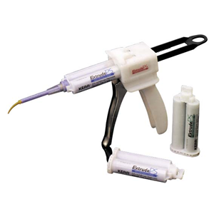
AUTOMIXER AND DISPENSER
When the trigger is pulled, plunger is driven forward
Base and catalyst pastes are forced from cartridge to the mixing tip (spiral)
Paste pass through bore and exit the nozzle as uniform mixed paste.

Slide 165
Syringe tips can be fixed to the nozzle to deliver the mixed paste directly onto the teeth.
ADVANTAGES OF AUTO MIXER:
Great uniformity in proportioning and mixing
Less air incorporation
Mixing time is reduced
Less possibilities for contamination

Slide 166
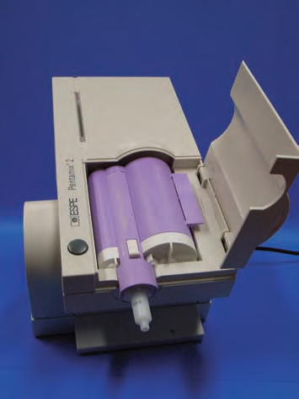
DYNAMIC MECHANICAL MIXER
Recent development in automatic dispensing and mixing device.
The device uses a motor to drive parallel plungers that force the material into mixing tip, and the spiral inside the mixing tip rotates as material is extruded through the tip.
Notes:
pentamix

Slide 167
Using this device, thorough mixing of higher viscosity materials can be achieved with little effort.
Both polyether and addition silicone impression of various viscosities are available with this dispensing system.

Slide 168
MAKING IMPRESSION
MULTIPLE MIX TECHNIQUE:
Method of using the syringe and the tray materials.
Tray is filled with the uniform thickness of heavy material, syringe is loaded with lighter material.
The tray material will force the syringe material to adapt to the prepared tissues.

Slide 169
MONOPHASE OR SINGLE-VISCOSITY TECHNIQUE:
Medium viscosities of polyether and addition silicone impression materials are used for this technique.
The success of this technique depends on the pseudoplastic properties of these materials.
When a medium viscosity material is forced through the syringe tip, the viscosity is reduced and allows material to adapt well to the preparation.

Slide 170
PUTTY-WASH TECHNIQUE:
Two-stage procedure
Primary impression with putty material
This forms intra-oral custom made tray
Make space for the light-body putty material
A thin- consistency wash material is placed onto the putty impression
Then a final impression is made.

Slide 171
Single-stage procedure
Wash material is syringed into place and then unset putty is seated over the light-body material.

Slide 172
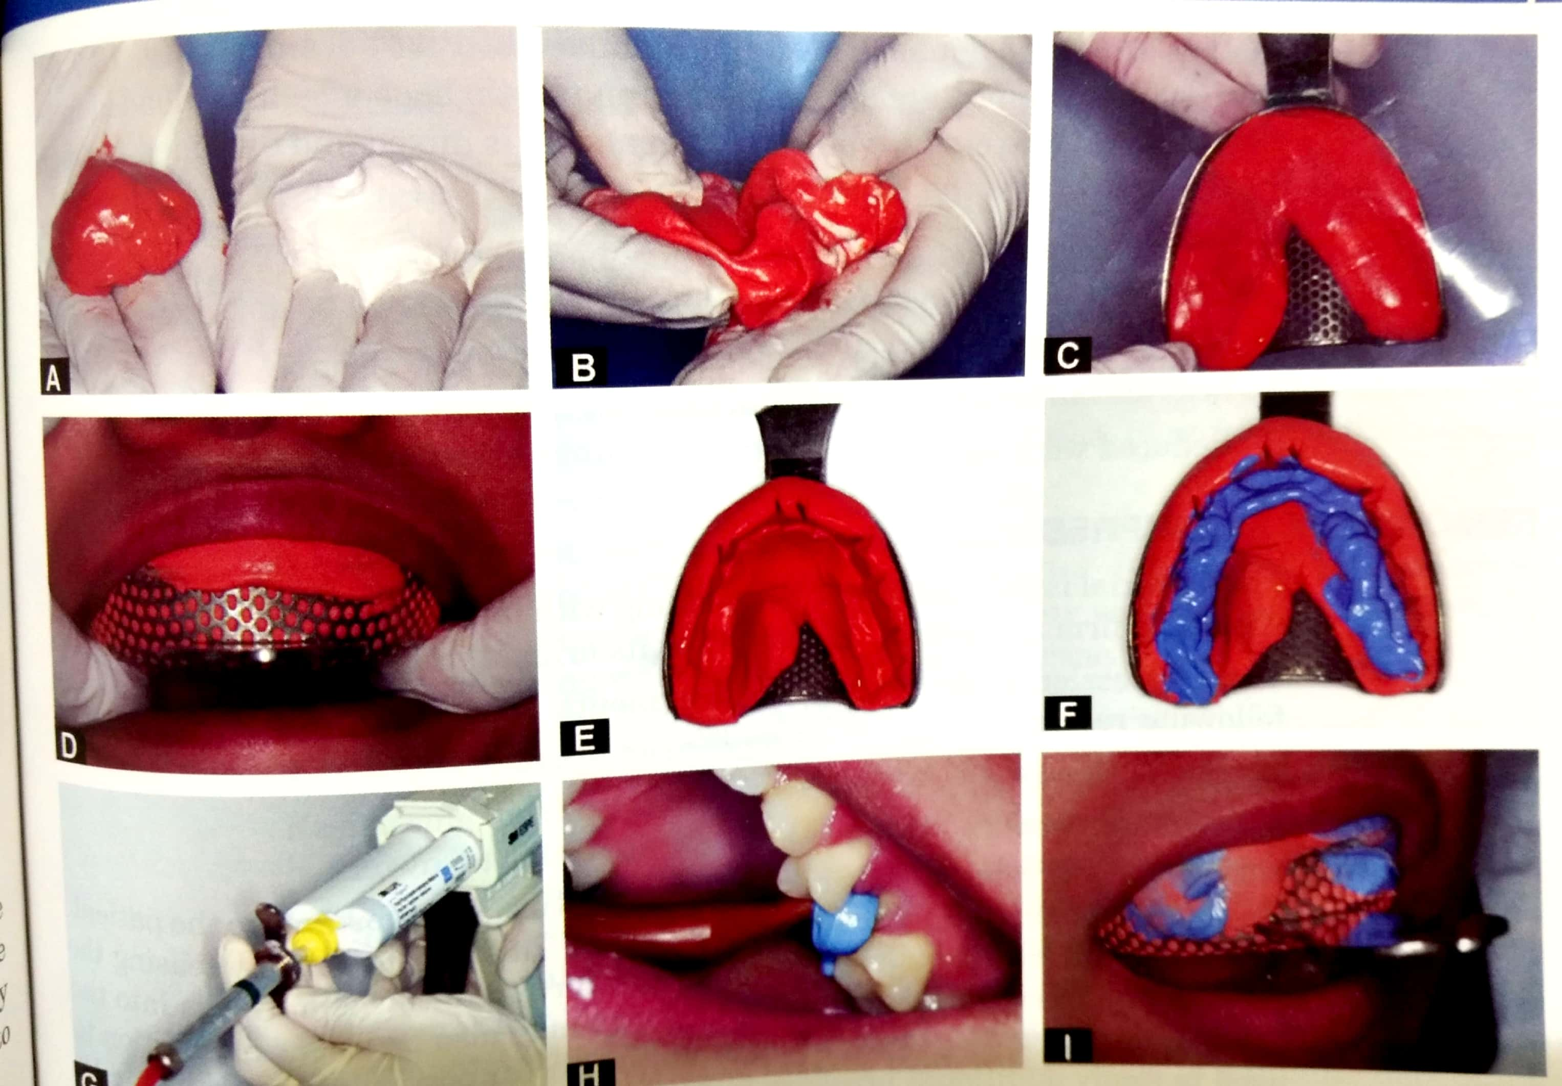
2 stage putty wash technique:

Slide 173
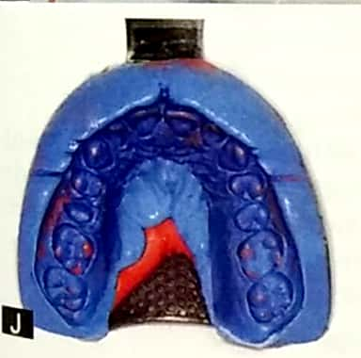

Slide 174
PREPARATION OF CAST
Polyether and addition silicone exhibit excellent dimensional stability- 2 or 3 casts or dies can be made from this.
Each successive die will be less accurate than the first die.
Time interval between the impression pours should not be more than 30 minutes.

Slide 175
CONCLUSION
A good impression is the first step in towards the fabrication of an accurate prosthesis.
Proper selection of impression material and its manipulation is important to achieve accuracy in cast.

Slide 176
It is important that the dentist fully appreciates the various features of these materials, what it is that makes them so useful for dental applications, and what there limitations are. Only then will the dentist be able to select the most appropriate material for a particular application.

Slide 177
References
Phillip’s Science of Dental material- 12th edition
Craig’s Restorative Dental Materials- 10th edition

