Slide 1
Manohar.Y
Assistant Professor.
Department of Pharmacology
RMCH,Bareilly.

Slide 3
ENTERAL
ORAL
SUBLINGUAL
BUCCAL
RECTAL

Slide 4
ORAL ROUTE
Oral refers to
two methods of administration:
applying topically to the mouth
swallowing for absorption along the gastrointestinal (GI) tract into systemic circulation
po (from the Latin per os) is the abbreviation used to indicate oral route of medication administration.

Slide 5
ORAL
Advantages
Convenient - can be self- administered, pain free, easy to take
Absorption - takes place along the whole length of the GI tract
Cheap - compared to most other parenteral routes

Slide 6
ORAL
Disadvantages:
Sometimes inefficient - only part of the drug may be absorbed.
First-pass effect – drug is metabolised before systemic circulation.
irritation to gastric mucosa - nausea and vomiting.
destruction of drugs by gastric acid and digestive juices
effect too slow for emergencies
unpleasant taste of some drugs
unable to use in unconscious patient

Slide 7
First-pass Effect
Metabolism of a drug during it’s passage from the site of absorption into systemic circulation.
When oral administration of drug it metabolised in
stomach
liver then enter systemic circulation.
The greater the first-pass effect, the less the agent will reach the systemic circulation..

Slide 9
Oral Dosage Forms
Common dose forms for oral administration
tablets
capsules
liquids
solutions
suspensions
syrups
elixirs

Slide 10
SUBLINGUAL ROUTE
Sublingual administration is where the dosage form is placed under the tongue
rapidly absorbed by sublingual mucosa
Eg: tab.Nitroglycerine

Slide 11
SUBLINGUAL ROUTE
12
ADVANTAGES
ECONOMICAL
QUICK TERMINATION
FIRST-PASS AVOIDED
DRUG ABSORPTION IS QUICK
DISADVANTAGES
UNPALATABLE & BITTER DRUGS
IRRITATION OF ORAL MUCOSA
LARGE QUANTITIES NOT GIVEN
FEW DRUGS ARE ABSORBED

Slide 12
BUCCAL ROUTE
Buccal administration is where the dosage form is placed between gums and inner lining of the cheek (buccal pouch)
absorbed by buccal mucosa

Slide 13
BUCCAL ROUTE
ADVANTAGES
Avoid first pass effect
Rapid absorption
Drug stability
DISADVANTAGES
Inconvenience
– advantages lost if swallowed
Small dose limit

Slide 14
RECTAL ROUTE :
ADVANTAGES
▪ USED IN CHILDREN
▪ LITTLE OR NO FIRST PASS EFFECT
▪ USED IN VOMITING/UNCONSCIOUS
▪ HIGHER CONCENTRATIONS
DISADVANTAGES
▪ INCONVENIENT
▪ ABSORPTION IS SLOW
▪ IRRITATION OR INFLAMMATION OF RECTAL MUCOSA.

Slide 15
SYSTEMIC-PARENTERAL
Parenteral administration is injection or infusion by means of a needle or catheter inserted into the body
The term parenteral comes from Greek words
para, meaning outside
enteron, meaning the intestine
This route of administration bypasses the alimentary canal

Slide 16
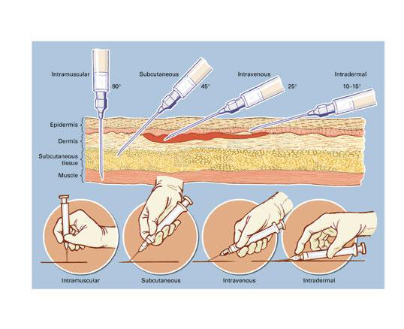
Angles for inserting injections:

Slide 17
SYSTEMIC-PARENTERAL
17
INJECTABLES
INTRAVENOUS
II. INTRAMUSCULAR SUBCUTANEOUS
INTRA-ARTERIAL
INTRA-ARTICULAR
INTRATHECAL
I.
III.
VII. INTRADERMAL
INHALATION - Absorption through the lungs

Slide 18
INTRAVENOUS
18
ADVANTAGES
BIOAVAILABILITY 100%
DESIRED BLOOD CONCENTRATIONS ACHIEVED
LARGE QUANTITIES
VOMITING & DIARRHEA
EMERGENCY SITUATIONS
FIRST PASS AVOIDED
GASTRIC MANUPALATION AVOIDED
DISADVANTAGES
IRRITATION & CELLULITIS
THROMBOPHELEBITIS
REPEATED INJECTIONS NOT
ALWAYS FEASIBLE
LESS SAFE
TECHNICAL ASSISTANCE REQUIRED
DANGER OF INFECTION
EXPENSIVE
LESS CONVENIENT AND PAINFUL

Slide 19
INTRAMUSULAR ROUTE
19
ADVANTAGES
ABSORPTION
REASONABLY UNIFORM
RAPID ONSET OF ACTION
MILD IRRITANTS CAN BE GIVEN
FIRST PASS AVOIDED
GASTRIC FACTORS CAN BE AVOIDED
DISADVANTAGES
ONLY UPTO 10ML DRUG GIVEN
LOCAL PAIN AND ABCESS
EXPENSIVE
INFECTION
NERVE DAMAGE

Slide 20
SUBCUTANEOUS
Injected under the skin.
Absorption is slow, so action is prolonged.
IMPLANT :a tablet or porous capsule is inserted into the loose tissues by incision of the skin, which is then stiched up.
example : certain hormonal drugs

Slide 21
INTRA-ARTERIAL
Rarely used
Anticancer drugs are given for localized effects
Drugs used for diagnosis of peripheral vascular diseases

Slide 22
INTRA-ARTICULAR
injections of antibiotics and corticosteroids are administered in inflammed joined cavities by experts.
example: hydrocortisone in rheumatoid arthritis

Slide 23
INTRADERMAL
drug is given within skin layers (dermis)
Painful
Mainly used for testing sensitivity to drugs.
e.g. penicillin, ATS (anti tetanus serum)
INOCULATION :administration of vaccine (like small pox vaccine )

Slide 24
Topical Routes of Administration
Topical administration is the application of a drug directly to the surface of the skin
Includes administration of drugs to any mucous membrane
eye
nose
ears
lungs
vagina
urethra
colon

Slide 25
Topical Dosage Forms
Dose forms for topical administration include:
Skin:
creams
ointments
lotions
gels
transdermal patches
disks
Eye or ear:
solutions
suspensions
ointments
Nose and lungs:
sprays and powders

Slide 26
Advantages and Disadvantages of the Topical Route
Local therapeutic effects
Not well absorbed into the deeper layers of the skin or mucous membrane
lower risk of side effects
Transdermal route offers steady level of drug in the system
sprays for inhalation through the nose may be for local or systemic effects

Slide 27
Transdermal
absorption of drug through skin (systemic action)
stable blood levels
no first pass metabolism
drug must be potent.

Slide 28
Route for administration
-Time until effect-
intravenous
intraosseous
endotracheal
inhalation
sublingual
intramuscular
subcutaneous
rectal
ingestion
transdermal (topical)
30-60 seconds
30-60 seconds
2-3 minutes
2-3 minutes
3-5 minutes
10-20 minutes
15-30 minutes
5-30 minutes
30-90 minutes
variable (minutes to hours)

Slide 29
SELECTION OF ROUTE
TE
The ROA is determined by :
the physicala and chemical characteristics of the drug (solid/liquid/gas.solubility,PH,irrytency)
Site of desired action-local and general..
the need to bypass hepatic metabolism
to achieve high conc. at particular sites
Accuracy of dosage required..
Condition of the patient

