Slide 1
GOOD AFTERNOON

Slide 2
BONE GRAFTs- AUTOGENOUS GRAFT
Presented by
Dr. s s sai karthikeyan
Mdsdepartment of periodontics 3rd yr

Slide 3
contents
Introduction
Classification
Mechanism of bone formation
Sources of auto graft
Various autografts
Volume of autografts
Armamentarium for harvesting
Resorption time
Fate of autograft
conclusion

Slide 4
introduction
Textbook of Periodontics- by Eley and Manson

Slide 5
Classification of bone grafts
BONE GRAFTS
Autografts
Allografts
Xenografts
Alloplats
Intra oral grafts
Extra oral grafts
TYPE OF BONE PRESENT
CORTICAL BONE
CANCELLOUS BONE
CORTICO-CANCELLOUS BONE
Textbook- Next Generation Biomaterials for Bone & Periodontal Regeneration by Richard
Textbook- 20 Years of Guided Bone Regeneration0- Daniel Buser

Slide 6
Mechanism of ACtion
Osteogenic
Osteopromotive
Osteoneutral
Osteoinductive
Osteoconductive
Textbook- Next Generation Biomaterials for Bone & Periodontal Regeneration by Richard
Textbook- 20 Years of Guided Bone Regeneration0- Daniel Buser

Slide 7
Sources of autografts
INTRA ORAL
1. Symphysis
EXTRA ORAL
1. Iliac crest
2. Body of Mandible
3. Ramus of Mandible
4. Body of mandible
5. Maxillary tuberosity
6. Zygomatic Body
2. Fibula
3. Calvarium
4. Tibial condyle
Textbook- Next Generation Biomaterials for Bone & Periodontal Regeneration by Richard
Textbook- 20 Years of Guided Bone Regeneration0- Daniel Buser

Slide 8
Method of harvesting-autografts
CORTICAL BONE CHIPS (Nabers & O’Leary, 1965)
BONE SWAGGING (Ewen, 1965)
OSSEOUS COAGULUM (Robinson, 1969)
BONE BLEND (Bowers, 1972)
Textbook- Next Generation Biomaterials for Bone & Periodontal Regeneration by Richard
Textbook- 20 Years of Guided Bone Regeneration0- Daniel Buser
Textbook of Clinical Periodontology- Carranza 9 & 13th Edition

Slide 9
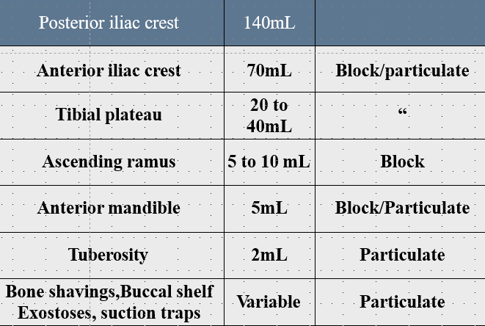
Volume of autografts
Textbook- Next Generation Biomaterials for Bone & Periodontal Regeneration by Richard
Textbook- 20 Years of Guided Bone Regeneration0- Daniel Buser

Slide 10
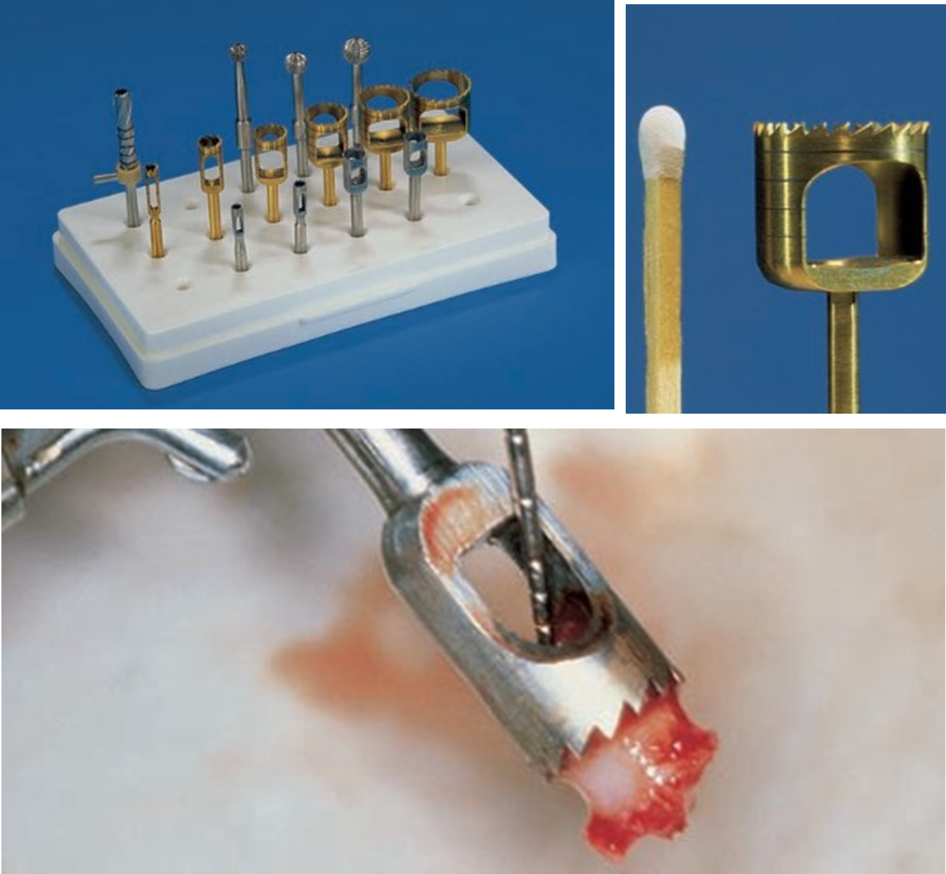
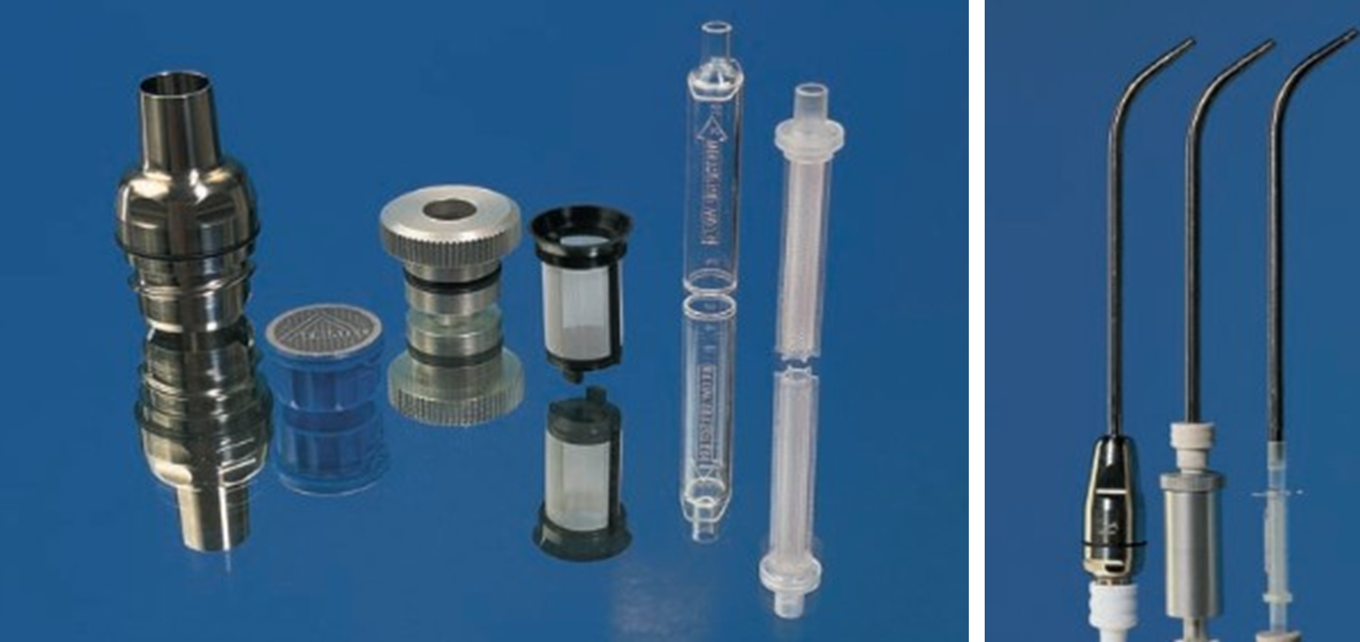
Armamentarium
Bone mills
Trephine burs
Hollow burs
Internally cooled burs
Bone Filter/ Bone Trap
Ti Filter seieve
Osseous coagulum trap
Bone trap
Suction Canula with Filter system
Textbook- Next Generation Biomaterials for Bone & Periodontal Regeneration by Richard
Textbook- 20 Years of Guided Bone Regeneration0- Daniel Buser

Slide 11
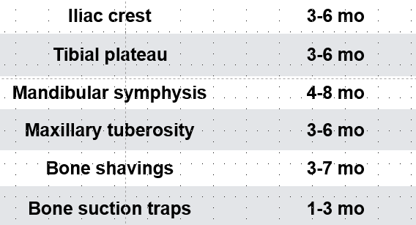
Resorption profile
Textbook- Next Generation Biomaterials for Bone & Periodontal Regeneration by Richard
Textbook- 20 Years of Guided Bone Regeneration0- Daniel Buser

Slide 12
Fate of autografts
Phase I formation
Hypoxia
Acidic pH- 4
Macrophages move in
Platelets move in
Phase II formation
Plasmatic Diffusion
Osteoblasts and osteomacs work together
Macrophages moves out
Osteoblasts predominate
MATURE BONE
Creeping substitution
Textbook- Next Generation Biomaterials for Bone & Periodontal Regeneration by Richard
Textbook- 20 Years of Guided Bone Regeneration0- Daniel Buser
EFP WORKSHOP ON OSTEOLOGY-2018

Slide 13
Regenerative capacity
GRAFT TYPE | CELLS | GROWTH FACTORS | STABILITY | Resorption
CORTICAL BLOCK | ++ | ++++ | +++++ | +
CORTICAL PARTICLES | + | +++ | +++ | +++
CANCELLOUS PARTICLEDS | +++ | ++ | ++ | ++++
Textbook- Next Generation Biomaterials for Bone & Periodontal Regeneration by Richard
Textbook- 20 Years of Guided Bone Regeneration0- Daniel Buser

Slide 14
conclusion
Textbook- Next Generation Biomaterials for Bone & Periodontal Regeneration by Richard
Textbook- 20 Years of Guided Bone Regeneration0- Daniel Buser

Slide 15
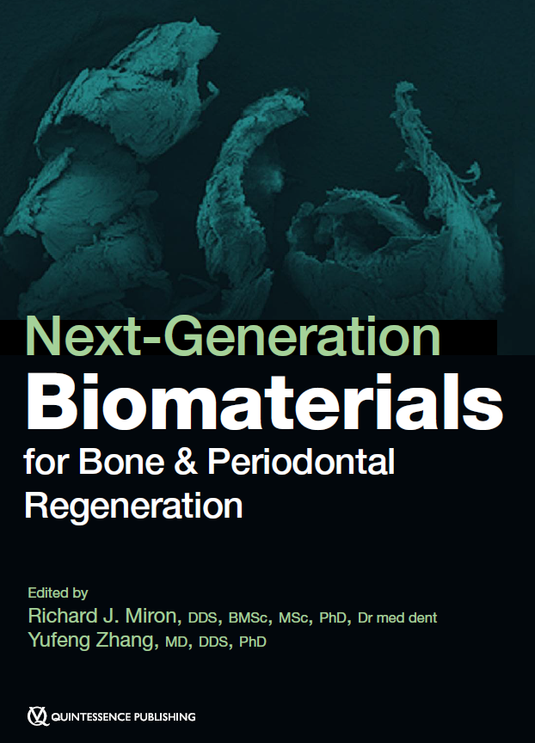
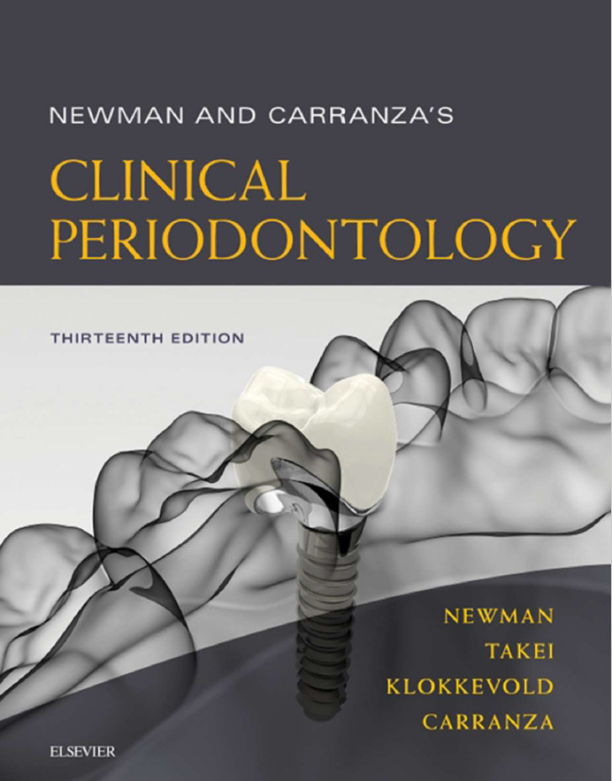
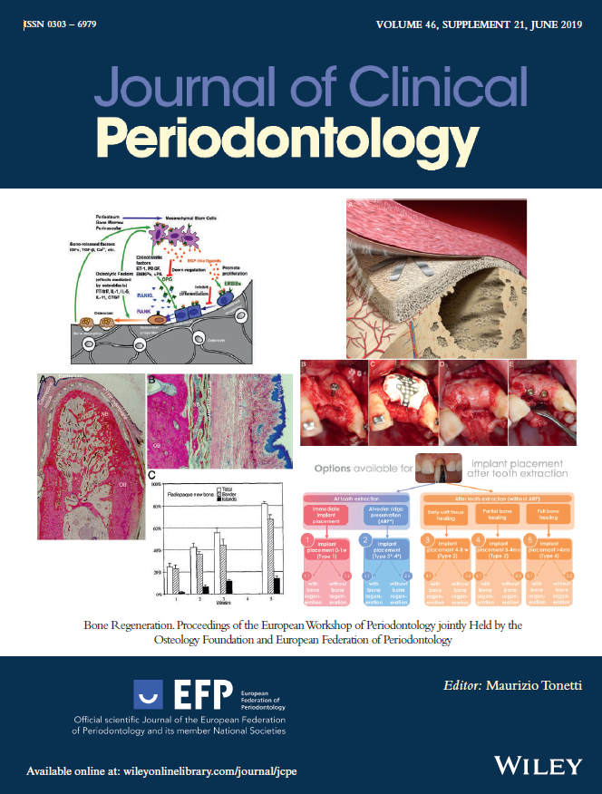
refrences

