Slide 1
Myofunctional appliances

Slide 2
INTRODUCTION
There are essentially 3 alternatives for treating any skeletal malocclusion –
(i) Orthognathic surgery
(ii) Dental camouflage
(iii) Growth modification
Growth modification……………the best option !!!

Slide 3
Goal of growth modification ???
There are 2 types of orthodontic appliances that can be used for modifying the growth of maxilla/mandible-
(i) Orthopedic appliances
(ii) Functional appliances

Slide 4
Myofunctional appliances
These are the appliances which either transmit , eliminate or guide the natural forces of the musculature.
The appliances are used for growth modification procedures aimed at intercepting & treating jaw discrepancy
Functional appliance (FA) is defined as loose fitting or passive appliances which harness natural forces of the oro-facial musculature that are transmitted to the teeth and alveolar bone through the medium of the appliance.

Slide 5
They can bring about the following changes:
An increase or decrease in jaw size,
A change in spatial relationship of jaws,
A change in direction of growth of jaws and
Acceleration of desirable growth.

Slide 6
Classification of myofunctional appliances
Classification given by Profitt:
i ) Passive tooth borne appliances :-
Eg: Activator, Bionator and Twin block
ii) Active tooth borne appliances :
E.g.: Expansion activator, twin block with expansion screw, modified bionator etc.
iii) Tissue borne passive appliances :
E.g..:oral screen, lip bumper.
iv) Tissue borne active appliances :
Frankel appliance

Slide 7
Myofunctional appliances can also be classified as :
1. Removable - Activator, Bionator, Twin block Frankel ,Elastic activators etc.,
2. Semi fixed - Bonded Herbst appliance, Magnetic appliance
3. Fixed - Jasper jumper, Evaa appliance, Forsus, Churro jumper appliance

Slide 8
Myotonic and Myodynamic appliance.
Myotonic : They are functional appliances that depend on muscle mass for their action.
Myodynamic appliances are that which depend in muscle activity for their function.

Slide 9
Classification given by Tom Graber
Group I
These consist of appliances that transfer muscle force directly to the teeth.
E.g., oral screen, lip bumper.
Group II
Reposition the mandible and resultant force is transmitted to the teeth and other structures.
E.g., activator and bionator.
Group III
These appliances also reposition the mandible but their area of operation is the vestibule.
E.g., Frankel’s regulator.

Slide 10
Treatment principles
FA work on 2 broad principles
Force application.

Slide 11
Activation of muscles
Force transmitted to adjacent tissues
Compressive stress and strain on tissues
Re-direction of bone and tissue growth

Slide 12
2. Force elimination.
the principle involves the elimination of abnormal and restrictive environmental influences on dentition thereby allowing optimal development, thus function is rehabilited with a secondary change in form.

Slide 13
Visual Treatment Objective (VTO).
Diagnostic test undertaken before making a decision to use FA.
Enables to visualize how patient’s profile would be after FA.
Its performed by asking the patient to bring the mandible forward, an improvement in profile is considered a positive VTO.

Slide 14
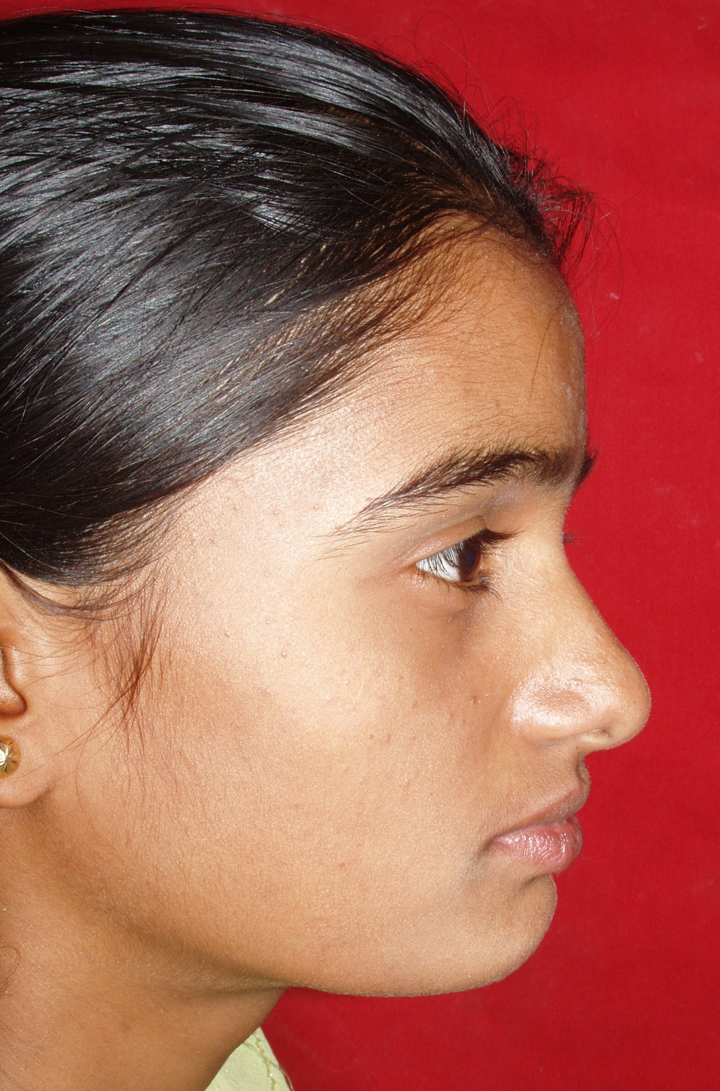

Slide 15
Advantages:
Enables elimination of abnormal functions.
Treatment can be started at an early age (mixed dentition).
As the treatment starts early psychological disturbances can be avoided.
Appliances are fabricated in the lab thus chair side time spent is less.
The frequency of patient visit is less.
Do not interfere with oral hygiene.

Slide 16
Disadvantages:
They cannot be used in adult patients in whom growth has ceased.
Cannot be used to bring about individual tooth movement.
May require prefunctional orthodontic tooth movements.
Fixed therapy may be required at the termination of treatment for final detailing of the occlusion.
Patient cooperation is essential.

Slide 17
Case selection
Age: late mixed dentition to early permanent dentiton, pre-pubertal growth spurts.
Dental considerations: ideal case is one that is devoid of irregularities like rotations and crowdings.
Skeletal: moderate to severe class II div 1 cases with retruded mandible are suitable for FA. Low angle cases respond well to FA therapy..

Slide 18
History of Functional Appliances
In 1879, Norman Kingsley introduced the term and concept of “jumping the bite”
Hotz deviced Vorbissplatte.
Pierre robin deviced an appliance called as “Monoblock” to correct the mandibular retrognathism.
Viggo Anderson in 1908 designed a loose fitting appliance (Activator), which he first used on his daughter.

Slide 19
Activator

Slide 20
Indications
Class II, Division 1 malocclusion
Class II, Division 2 malocclusion
Class III malocclusion
Class I open bite malocclusion
Class I deep bite malocclusion

Slide 21
Contraindications
Crowded arch
Severe proclination of mandibular incisors
Retroclined upper incisors
Excessive vertical growth tendency
Patients in which growth is completed
Patients showing poor compliance

Slide 22
Steps in planning treatment with activator
Diagnostic impression
VTO
Construction bite
Cephalometric analysis
Impression
Fabrication of wire components.

Slide 23
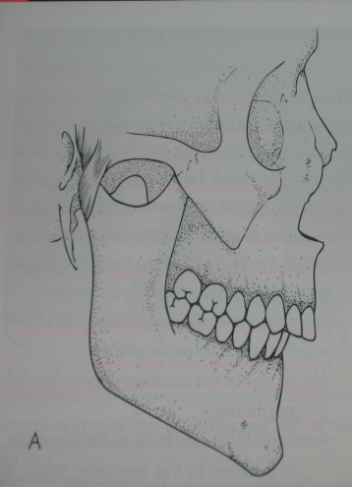
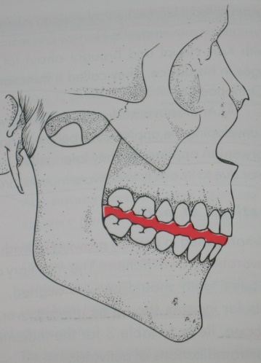
Construction bite
A horseshoe-shaped wax bite rim is taken
The softened wax bite rim is placed in the mouth
Mandible is gently guided into the predetermined position.

Slide 24
The edge-to-edge incisal relationship and midline registration is checked.
Wax cut away from the labial of the central incisors- midline observed and a correct reproduction of the incisal relationship established.

Slide 25
Rule of 10
Vertical + saggital
advancement
10
The saggital advancement should be 70% of total protrusive path

Slide 26
The general considerations for construction bite include:
In case the overjet is too large, the forward positioning is done step wise in 2-3 phases.
In case of forward positioning of the mandible by 7-8 mm the vertical opening should be slight to moderate i.e. 2-4 mm.
If the forward positioning is not more than 3-5 mm then the vertical opening can be 4-6 mm.

Slide 27
MODE OF ACTION OF FUNCTIONAL APPLIANCES
Increased contractile activity of LPM
Increase in growth-stimulating factors
Change in condylar trabecular orientation
Additional growth of condylar cartilage
Supplementary lengthening of the mandible.

Slide 28
Fabrication of wire components
Labial bow – 0.8 or 0.9 mm stainless steel wire.
Fabrication of acrylic portion
Activator consists of 3 parts:
Maxillary part
Mandibular part
Interocclusal part.

Slide 29
Trimming of activator
Activator appliance aims at correction of skeletal defect and provide tooth movement in all 3 planes along with tooth eruption guidance for occlusal settling.

Slide 30
Trimming for sagittal control
Activator appliance aims for the correction of skeletal malocclusion and molar relationship.
Maxillary molar/ posterior teeth – trimming of the disto-palatal surface
Mandibular molars / posterior teeth – trimming of the mesio-lingual surface.

Slide 31
Protrusion of Incisors
By loading their lingual surfaces with acrylic contact
Screening away the lip strain with a passive labial bow or lip pads.
Retrusion of Incisors
The acrylic is trimmed away from the backs of the incisors.
The active labial bow, provides the force for moving these teeth.

Slide 32
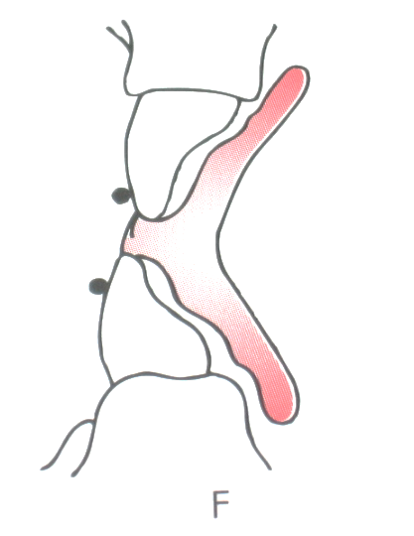
Trimming for vertical control
Intrusion of Teeth
Indicated in deep overbite cases.
Intrusion of incisors by loading the incisal edges.
Active labial bow below the area of greatest convexity or on the incisal third.
Intrusion of molars is performed by loading only the cusps.

Slide 33
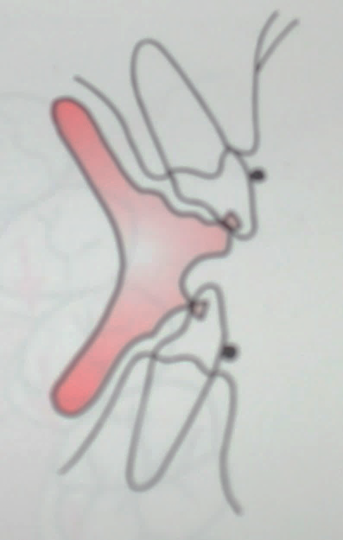
Extrusion of Teeth
Open-bite
Extrusion of incisors requires loading their lingual surfaces
Deep-bite problems
Extrusion of molars can be facilitated by loading the lingual surfaces

Slide 34
For transverse control
Jackscrew is incorporated for expansion in transverse direction.

Slide 35
Management of the appliance
Patient should be demonstrated to place and remove the appliance in mouth.
For 1st week – appliance worn for 2-3 hrs.
Second week – 2-3 hours + night time wear.
Third week – full time wear of the appliance.

Slide 36
Bionator

Slide 37
Bionator – William Balter in 1960
Philosophy
Balters concept-position of the tongue is decisive. E.g posterior displacement of the tongue can cause Class II malocclusion.
Equilibrium between tongue and circumoral muscles is responsible for shape of dental arches and intercuspation.

Slide 38
Advantages over activator
Considerably less bulky than the activator.
It lacks the part covering the anterior section of the palate, which is contiguous to the tongue.
The bionator can be worn day and night except at meals.
An important feature -- its freedom of tongue movement in the oral cavity.

Slide 39
Bionator types:
Standard appliance
Open-bite appliance
Class III or reverse bionator.

Slide 41
Standard bionator
Acrylic components
Lower horse shoe shaped acrylic lingual plate from distal of last erupted molar of one side to other side
- Upper arch - lingual extension that cover molar & premolar region

Slide 42
Wire components
_{Palatal bar}
Labial bow with buccal extensions.
PALATAL BAR
- 1.2 mm wire
extents from a line connecting distal surface of first permanent molars to middle of 1st premolar’s
1mm away from palatal mucosa
Function- orients the tongue & mandible anteriorly by stimulating its dorsal surface with palatal bar

Slide 43
LABIAL BOW
- 0.9 mm wire
- Begins above contact point between canine and upper 1st premolar –runs vertically
- Labial portion of bow should be at a paper thickness away from the incisors

Slide 44
Twin Block
The Twin Block appliance is a removable, orthodontic functional appliance that is used to help correct jaw alignment, particularly an underdeveloped lower jaw.
• Developed by Dr.William J. Clarks , 1977.
• Effectively combines inclined planes with intermaxillary & extraoral traction.

Slide 45
Philosophy of twin block appliance
The functional occlusal inclined plane is the fundamental functional mechanism of the natural dentition.
Cuspal inclines play an important role in determining the relationship of the teeth as they erupt into occlusion.

Slide 46
Occlusal forces transmitted through the dentition provide a constant proprioceptive stimulus to influence the rate of growth and the trabecular structure of the supporting bone.
The acrylic inclined planes of the appliance guide the mandible in forward direction and the forces of occlusion helps in correcting the mandibular position and muscle adaptation.

Slide 47
Thank you ………………..

