Slide 1
Good AFTER NOON

Slide 2
Cognitive Behaviour Therapy and its Application in Dentistry
Presented by:-
Dr. Smriti Saxena

Slide 3
CONTENTS
Introduction
Definition of Cognitive Behavioural Therapy(CBT)
Historical background of CBT
Types of CBT
Uses of CBT
Clinical Applications of CBT
Theoretical model of cognitive behavioural approaches

Slide 4
CONTENTS
Studies on Cognitive Behaviour therapy in dentistry
Conclusions
References

Slide 5
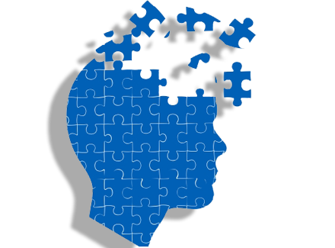
Introduction
To promote the health of the individual it is necessary to understand the health concepts and self care skills.
Learning includes measurable change in behaviour that persists over time, needs practice and reinforcement to be permanent.
The health educator need to know how people learn, based on learning situations one should apply appropriate educational theory either singly or in combination with.

Slide 6
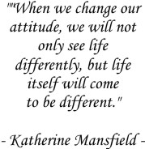
Introduction
Educational theories aid in understanding how individuals learn and how to design and implement education programmes.
More often combination of these theories is required in a wide variety of situations.

Slide 7
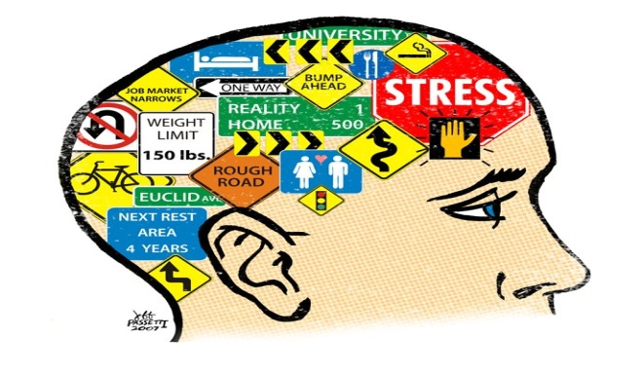
Introduction
Oral diseases continue to bother mankind in spite of great advances made in the field of oral health in the last century.
Although effectiveness of use of fluorides in caries prevention is documented beyond doubt, dental caries still exists.
Similarly periodontal diseases, malocclusion, oral cancer, edentulism are still a major public health problem. These diseases can be prevented or controlled by a positive dental health behavior with stress on individual’s oral health care.

Slide 8
Introduction
In this situation, oral health education can effectively be used to bridge the gap between the community and the dental fraternity for a better oral health.

Slide 9
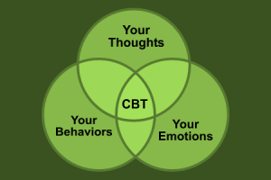
Definition
Cognitive Behavioural Therapy (CBT)
It is a psychotherapeutic approach that addresses dysfunctional emotions, maladaptive behaviors and cognitive processes and contents through a number of goal-oriented, explicit systematic procedures. The name refers to behavior therapy, cognitive therapy, and to therapy based upon a combination of basic behavioral and cognitive principles and research. Most therapists working with patients dealing with anxiety and depression use a blend of cognitive and behavioral therapy.

Slide 10
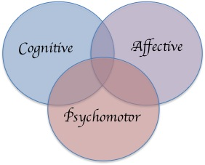
Three Domains of Learning

Slide 11
Definition of Psychology
1. Psychology is defined as “the study of human behaviour-of how people behave and why they behave in just the way they do”
2. Psychology: “is the science dealing with human nature, function, and phenomenon of his soul in the main”
3. Child Psychology is the science that deals with the mental power or an interaction between the conscious and subconscious elements in a child.

Slide 12
HISTORICAL BACKGROUND
The first discrete, intentionally therapeutic approach to CBT to be developed was Rational Emotive Therapy (RET), which was originated by Albert Ellis, Ph.D. in the mid-1950's.
Ellis developed his approach in reaction to his disliking of the in-efficient and in-directive nature of Psychoanalysis.
The philosophic origins of RET go back to the Stoic philosophers, including Epictetus and Marcus Aurelius.
Epictetus wrote in The Enchiridion, "Men are disturbed not by things, but by the view which they take of them."

Slide 13
HISTORICAL BACKGROUND
The modern psychotherapist most influential to the development of RET was Alfred Adler (who developed Individual Psychology).
Adler, a neo-Freudian, stated, "I am convinced that a person's behavior springs from his ideas." Ellis was also influenced by behaviorists, such as John Dollard, Neal Miller, and Joseph Wolpe, and George Kelly (psychology of personal constructs).
Ellis developed and popularized the ABC model of emotions, and later modified the model to the A-B-C-D-E approach. In the 1990's Ellis renamed his approach Rational Emotive Behavior Therapy.

Slide 14
HISTORICAL BACKGROUND
In the 1960's, Aaron Beck, M.D. developed his approach called Cognitive Therapy. Beck's approach became known for its effective treatment of depression.
Also in the 1960's Maxie C. Maultsby, Jr., M.D. (a student of Ellis') developed Rational Behavior Therapy. Maultsby's contributions were numerous, including his emphasis on client rational self-counseling skills and therapeutic homework. Maultsby's contributions included his concept of "thought shorthand", to which he refers as "attitudes", Rational Emotive Imagery, and Rational Self-Analysis.

Slide 15
HISTORICAL BACKGROUND
Other influential theorists / practitioners include Michael Mahoney, Ph.D., Donald Meichenbaum, Ph.D. (Stress Inoculation Therapy) and David Burns, M.D.
David Burns, M.D. popularized CBT with his 1980's best-selling book, Feeling Good.
More recently, cognitive-behavioral therapy has been influenced by the work of Aldo Pucci, Psy.D. (Rational Living Therapy), Michael Mahoney, Ph.D., Marsha Linehan, Ph.D., Arthur Freeman, Ed.D.

Slide 16
HISTORICAL BACKGROUND
People who are working with a cognitive therapist often practice the use of more flexible ways to think and respond, learning to ask themselves whether their thoughts are completely true, and whether those thoughts are helping them to meet their goals.
Source : http://nacbt.org/historyofcbt.htm

Slide 17
Types of CBT
According to the British Association of Behavioural and Cognitive Psychotherapies, "Cognitive and behavioural psychotherapies are a range of therapies based on concepts and principles derived from psychological models of human emotion and behaviour.
There are a number of different approaches to CBT that are regularly used by mental health professionals. These types include:
Rational Emotive Behavior Therapy (REBT)
Cognitive Therapy
Multimodal Therapy

Slide 18
Types of CBT
Rational Emotive Therapy- based on the belief that most problems originate in irrational thought. For example, if a perfectionist encounters a small failure, he or she might perceive it as a much bigger failure. It is better to establish a reasonable standard emotionally, so the individual can live a balanced life. This form of cognitive therapy is an opportunity for the patient to learn of his current distortions and successfully eliminate them.
Cognitive therapy- based on the cognitive model, stating that thoughts, feelings and behavior are mutually influenced by each other. Shifting cognition is seen as the main mechanism by which lasting emotional and behavioral changes take place. Treatment is very collaborative, tailored, skill-focused, and based on a case conceptualization.

Slide 19
Types of CBT
Multimodal therapy is the approach to psychotherapy founded by Arnold Lazarus. It is based on the idea that humans are biological beings that think, feel, act, sense, imagine and interact and that each of these "modalities" should be addressed in psychological treatment.
Multimodal assessment and treatment which follows BASIC I.D. seven interactive and reciprocally influential dimensions of personality/psychology or "modalities" which are Behavior, Affect, Sensation, Imagery, Cognition, Interpersonal relationships, and Drugs/biology, respectively.

Slide 20
Uses of Cognitive Behavior Therapy
CBT is used to treat a range of psychological problems including:
• Anxiety
• Anxiety disorders such as social phobia, obsessive-compulsive disorder or post-traumatic stress disorder
• Depression and Bipolar disorders
• Low self-esteem
• Uncontrollable anger
• Irrational fears

Slide 21
Uses of Cognitive Behavior Therapy
• Hypochondria
• Substance abuse, like smoking, drinking or other drug use
• Weight loss
• Eating disorders
• Insomnia
• Marriage or relationship problems
• Certain emotional or behavioural problems in children or teenagers (Suicidal ideation)

Slide 22
CLINICAL APPLICATIONS
1. Depression :
Treatment is based on a two pronged attack: first, using cognitive techniques to alter maladaptive assumptions containing negative information about the self in rela­tion to the world and the future; and, second, ameliorating reduced levels of behavioural activity, exercise, and positive experience.
The dominance of negative thought patterns leads to a systematic negative bias in the perception and interpretation of information, which in turn underpins the motivational, behavioural, and physical symptoms of depression.

Slide 23
CLINICAL APPLICATIONS
Cognitive techniques train patients to identify, evaluate, and alter the faulty thinking that distorts reality. Behav­ioural methods are complementary and activate patients to test out alternative assumptions in reality.
The efficacy of cognitive therapy in treating depres­sion is well documented. Research has primarily been conducted with outpatients with unipolar, non­ psychotic depression.

Slide 24
CLINICAL APPLICATIONS
A recent review of 15 studies concluded that cognitive behaviour therapy was at least as effective as medication in treating depressed outpa­tients, the combination of the two treatments was more effective than either one alone, and most of the studies found that cognitive behaviour therapy was equally applicable to more severe and more endogenous types of depression.
In comparison with other psychological treatments for depression, cognitive behaviour therapy also fares well.

Slide 25
CLINICAL APPLICATIONS
2. Panic disorder and agoraphobia :
Cognitive behaviour therapy for patients who experience panic attacks is based on identifying and modifying catastrophic misinterpretations of the initial physical symptoms of the anxiety.
Specific exercises that enable exposure to feared bodily sensations and actual exposure to fear cues are central to the treatment.
Controlled studies attest to the efficacy of cognitive behaviour therapy in treating panic and agoraphobia and its superiority over supportive therapy, relaxation , and drugs.
The long term effects of cognitive behavior therapy seem to be superior to other techniques.

Slide 26
CLINICAL APPLICATIONS
3. Post­ traumatic stress disorder :
Perceived unpredictability and uncontrollability have a pivotal role in the development of post­traumatic stress disorder.
In addition, cognitive behaviour therapy focuses on active exposure to the experience of the trauma through repeated activation of the fear memo­ries and eliminating imaginal and behavioural avoidance.
Behaviour therapy and cognitive behavior therapy have been reviewed by Hacker- ­Hughes and Thompson in treating post­traumatic stress disorder. They report encouraging results but highlight the need for more empirical support for the specific cognitive components of the treatment.

Slide 27
CLINICAL APPLICATIONS
4. Generalised anxiety disorder :
Worry lies at the core of generalised anxiety disorder. Sufferers overestimate the likelihood and severity of things going wrong and underestimate both their internal and external coping resources.
A review of 11 studies using cognitive behavior therapy to treat generalised anxiety disorder indicated that these methods were at least as effective as anxiolytic drugs and superior to placebo or to no treat­ment. The results of the treatment in studies of long term follow up are also encouraging.

Slide 28
CLINICAL APPLICATIONS
5. Social phobia :
Social phobics interpret social situations as threaten­ing; their attention is self focused, leading to a belief that others are evaluating them negatively; and they exhibit a greater awareness of their own bodily symptoms.
Despite having poorer memories of recent social interactions than control subjects, social phobics tend to conduct long post mortems after social encounters typified by negative self evaluation.

Slide 29
CLINICAL APPLICATIONS
This process leads ultimately to behavioural avoidance. Combined exposure and cognitive restructuring has proved beneficial. However, cognitive behavior therapy has been shown to bring greater benefit to patients with circumscribed social phobia rather than those with generalized social phobia.

Slide 30
CLINICAL APPLICATIONS
6. Obsessive ­compulsive disorder :
Behavioural treatments involving exposure of patients to their fears while preventing obsessive ritualizing have proved highly successful in treating many obsessive ­compulsive disorders. However, those who fail to respond to behaviour therapy tend to have “overvalued ideas” concerned with exaggerated personal responsibility, perfectionism, and fear of punish­ment or catastrophic outcomes.
These beliefs are the focus for cognitive interventions with obsessive­ compulsive patients.

Slide 31
CLINICAL APPLICATIONS
7. Eating disorders :
In anorexia the central dysfunctional assumption is the statement “I must be thin.” The developmental distresses of adolescence are allayed through the pursuit of thinness, and feelings of self doubt and defi­ciency are overridden by maintaining a figure perceived to be the envy of all others.
Despite the central role ascribed to cognition in the aetiology of this disorder, anorexia has remained remarkably resistant to cognitive behaviour therapy. Outcome studies are limited and offer only marginal support of cognitive behaviour therapy compared with other types of intervention.

Slide 32
CLINICAL APPLICATIONS
Fairburn and Cooper are credited with the most comprehensive model of bulimia nervosa with regard to cognitive behaviour therapy.
The specificity of cognitive behaviour therapy in treating bulimia is still a matter for debate. In most out­ come studies, important therapeutic effects are reported in about half of those treated by cognitive behaviour therapy.

Slide 33
CLINICAL APPLICATIONS
8. Hypochondriasis :
Cognitive behaviour therapy focuses on patients‘ enduring tendency to misinterpret innocuous physical symptoms as evidence of serious illness.
The ensuing anxiety leads to repeated reassurance seeking, hyper­ vigilance to information about illness, increased bodily focus, and avoidance.
The only published controlled trial compared 16 sessions of cognitive behaviour therapy with a control group awaiting treatment. Despite limitations in design and methodology, this study reported a positive outcome for the treated group.

Slide 34
CLINICAL APPLICATIONS
9. Psychosis and schizophrenia :
Cognitive behaviour therapy for patients with psycho­ses is based on the idea that first rank symptoms occur as a result of normal attempts to make sense of abnor­mal perceptual experiences.
Treatment helps patients distract themselves from their symptoms and alter their beliefs about the nature of their experiences.

Slide 35
CLINICAL APPLICATIONS
Studies have reported the beneficial effects of cognitive behaviour therapy in improving compliance, insight, and functioning in a mixed group of patients with psychotic disorders.
Research has also focused on using cognitive behaviour therapy in family interventions, which have been shown to improve families problem solving skills and to reduce clinical, social, and family morbidity.

Slide 36
CLINICAL APPLICATIONS
10. Personality disorders :
Beck and colleagues have suggested that each of the subcategories of personality disorder reflect specific dysfunctional beliefs and an associated maladaptive behavioural strategy that is harmful to the individual or to society.
Other work highlights early dysfunctional beliefs that reflect four areas of vulnerability: autonomy, connectedness, worthiness, and limits and standards.

Slide 37
CLINICAL APPLICATIONS
As yet there are few controlled trials to validate treatment of personality disorder with cognitive behav­iour therapy. Treatment can last for more than two years, and most research is based on single case studies. Much more evidence of efficacy is needed.

Slide 38
CLINICAL APPLICATIONS
11. Offenders :
Numerous studies attest to the efficacy of cognitive behaviour therapy in modifying behaviour and reduc­ing recidivism. The main areas of study relate to sex offenders, violence, juvenile crime, and mentally disor­dered offenders.

Slide 39
CLINICAL APPLICATIONS
12. Couples and sex therapy :
Cognitive behaviour approaches focus on behavioural interactions, problem solving, and cognitions related to roles, standards, and specific experiences. In sex therapy cognitive behaviour therapy aims to address sexual anxiety, attitudes, and behavioural skills.
Evidence is slowly emerging that behavioural tech­niques can be enhanced by understanding and modifying partners' cognitions. However, there is little consensus as to which cognitive variables are the most important in sustaining healthy relationships.

Slide 40
CLINICAL APPLICATIONS
13. Other Medical Conditions :
Diabetes
Cancer
Coronary proneness
Asthma
Epilepsy
Obesity
Irritable bowel
Hypertension
Atopic dermatitis
Insomnia
HIV infection and AIDS

Slide 41
CLINICAL APPLICATIONS IN DENTISTRY
14. Child psychology
The children are usually scared of the sound of the bur and the dentist is also usually present at that time. Therefore the child associates the fear of the bur with the dentist. Whenever a dentist tries to come near to him to perform a treatment, the child starts crying due to fear and will remain scared.
When the child actions are reinforced or rewarded. It is contended that rewarded behavior is behavior that is likely to be repeated.

Slide 42
Various theories in Psychology
Psychodynamic theories
Psychoanalytical theory – Sigmund Freud
Psychosocial theory – Eric Erickson
Cognitive theory – Jean Piaget
Behavioural theories
Hierarchy of needs – Maslow
Social learning theory – Bandura
Classical Conditioning theory – Pavlov
Operant conditioning theory - Skinner

Slide 43
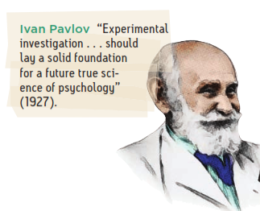
Classical conditioning a type of learning in which one learns to link two or more stimuli and anticipate events.

Slide 44
Pavlov’s classic experiment :
Pavlov presented a neutral stimulus (a tone) just before an unconditioned stimulus (food in mouth). The neutral stimulus then became a conditioned stimulus, producing a conditioned response.

Slide 45
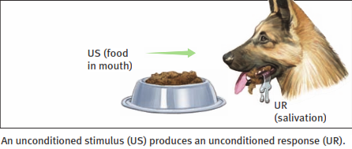
A dog doesn’t learn to salivate in response to food in its mouth. Food in the mouth automatically, unconditionally, triggers a dog’s salivary reflex

Slide 46
US : a stimulus that unconditionally—naturally and automatically—triggers a response (UR)
UR : an unlearned, naturally occurring response (such as salivation) to an unconditioned stimulus (US) (such as food in the mouth).

Slide 47
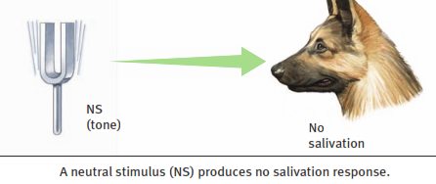
Stimulus that elicits no response before conditioning.

Slide 48
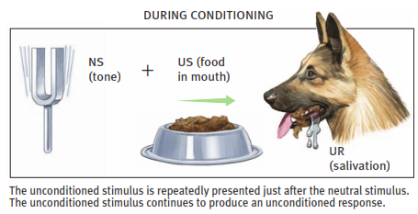

Slide 49
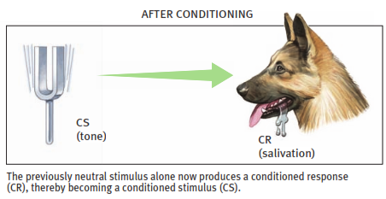
CS : an originally irrelevant stimulus that, after association with an unconditioned stimulus (US), comes to trigger a conditioned response (CR).
CR : a learned response to a previously neutral (but now conditioned) stimulus (CS).

Slide 50
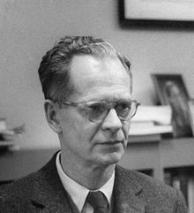
OPERANT CONDITIONING 1938
B. F. Skinner
American psychologist, behaviorist, author, inventor, and social philosopher.

Slide 51
Classical conditioning and operant conditioning are both forms of associative learning, yet their difference is straightforward
Classical conditioning forms associations between stimuli (a CS and the US it signals). It also involves respondent behavior—actions that are automatic responses to a stimulus (such as salivating in response to meat powder and later in response to a tone).

Slide 52
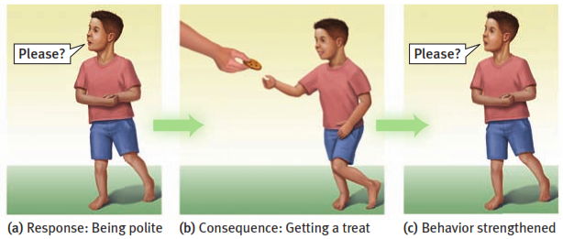
In operant conditioning, organisms associate their own actions with consequences. Actions followed by reinforcers increase; those followed by punishers often decrease. Behavior that operates on the environment to produce rewarding or punishing stimuli is called Operant Behavior.

Slide 53
Theoretical model of cognitive-behavioural approaches
Environmental influences on behaviour
Self-regulation and the role of language
Inter-relationships of thoughts, feelings and behaviour
Access to private events
Attributions and the self
Neural bases
Interactionism
Developments in cognitive-behavioural theory

Slide 54
Theoretical model of cognitive-behavioural approaches
Environmental influences on behaviour
The starting-point of behaviour analysis is the finding that an environmental event or stimulus (S) elicits a response (R).
In behaviourist terminology this is represented by the simple notationS-R. The form of classical conditioning discovered by Pavlov fits this paradigm. The response is dependent upon the stimulus event which preceded it.
In the form of learning discovered by Skinner, operant conditioning, responses (here called operants) are influenced more by what happens afterwards than by what happens before.
Behaviour is under the control of its consequences (C). In the same notation, this sequence is therefore usually symbolised S-R-C.

Slide 55
Theoretical model of cognitive-behavioural approaches
S - O - R – C - Stimulus Organism Response Consequences
The S-O-R-C model is the basic foundation of social learning and of cognitive-behavioural theories.
The cognitive mediating events represented by the symbol O add a totally new dimension to the behaviourist learning approach.

Slide 56
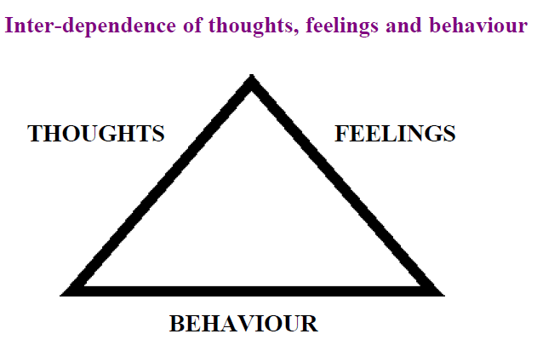
Theoretical model of cognitive-behavioural approaches
Inter-relationships of thoughts, feelings and behavior
The second principle is the assertion that an organism’s, or person’s, activity has three modalities. These are respectively behaviour, emotion, and cognition.

Slide 57
Theoretical model of cognitive-behavioural approaches
Each of the three modalities forming the triangle can be described as having three dimensions as follows:
Intensity: its experienced strength.
Frequency: how often a type of event occurs.
Duration: the time lapsed since its first occurrence.
In clinical assessment of any problem, collection of information about these dimensions is an essential first step.

Slide 58
Theoretical model of cognitive-behavioural approaches
Self-regulation and the role of language
Although our capacity to store automatic programmes is large, there are much more limited capacities for making use of the information in controlled processes.
Language facilitates this to some extent. The developing infant learns to self-regulate with the assistance of language, first overtly, then covertly. This self-regulation may take the form of explicit internalised instructions concerning some piece of behaviour.
This is the foundation of the important part played by cognitions in the self-management of feelings and behaviour.

Slide 59
Theoretical model of cognitive-behavioural approaches
Self-regulation and the role of language
Kanfer and Schefft (1988) for example view it as a three-stage process, involving self-monitoring (or self-observation), self-evaluation, followed by self-reinforcement.
Once self-regulatory processes have been established, the individual becomes much less dependent upon the environment and on external sources of stimulation for the guidance of behaviour.

Slide 60
Theoretical model of cognitive-behavioural approaches
Access to private events
A more fruitful position to adopt is the view that whether individuals can reliably describe private events or not varies according to the nature and content of different cognitive processes (Ericsson and Simon, 1980).
Cognitive-behavioural methods cannot be used methodically with those who are unable to self observe and self-monitor to some extent.

Slide 61
Theoretical model of cognitive-behavioural approaches
Within the developing person, a specific sub-set of self-referent statements develops which in itself constitutes a form of theory, or meta-cognitive appraisal, concerning the other activities of the system. This is the cognitive-behavioural view of the evolution of the self-concept.
Knowledge of what is labelled the ‘objective’ or phenomenal self is viewed as a batch of information stored in memory just like any other.
Higgins (1987) formulated cognitive behavioural model of the functioning of the self which depicts it as a series of self-state representations.

Slide 62
Theoretical model of cognitive-behavioural approaches
In most cases, there are discrepancies between three domains of the self (actual; ideal; and ought self). Higgins sees the pattern of these discrepancies as linked to specific forms of dysfunction and illness.
Within these self-referent constructs there is another set of propositions which provide an account of cause-and-effect relationships in the world around us, including perceptions of ourselves.
These propositions are called attributions and they are described as having three dimensions:

Slide 63
Theoretical model of cognitive-behavioural approaches
1. Internality-externality: the extent to which causes are ascribed to individuals themselves or to environmental events such as the actions of others.
2. Stability-instability: the extent to which they remain static, or change over time.
3. Specificity-globality: the extent to which they apply to one event or sphere of experience, or are thought to extend to cover a whole class of events.

Slide 64
Theoretical model of cognitive-behavioural approaches
A further specific sub-set of these attributions applies to our general sense of our ability to influence our own behaviour. This feature is called self-efficacy (Bandura, 1978).
Interconnected sets of propositions and attributions which individuals use for organising information about the world around them are called schemata.

Slide 65
Theoretical model of cognitive-behavioural approaches
Neural bases
In recent years a series of both philosophers (e.g. Churchland, 1988; Dennett, 1993) and biological scientists (e.g. Crick, 1994; Damasio, 1999) have forwarded proposals concerning how mental events and processes are created by complex events on a neurological level.
Robertson (1999) has described recent knowledge concerning learning processes in the brain, and how these might provide an account of the kinds of changes that are more familiar on an everyday, psychological level.

Slide 66
Theoretical model of cognitive-behavioural approaches
We have heard about thoughts, feelings and behaviour, self-regulation, automatic and controlled processes, attributions, self-perceptions and the proposed neural basis of them all.
It must not be forgotten however that though we have placed the ‘organism’ in a central place in the cognitive-behavioural framework, a key role still remains, as in all accounts of behavior based on learning theory, for events in the environment.
Thus in cognitive-behavioural approaches both personal, intra-psychic variables, and situational, environmental variables, are viewed as important.

Slide 67
Theoretical model of cognitive-behavioural approaches
Interactionism
It is assumed that the best explanation of human behaviour will come from an analysis of the interaction between the two.
In fact, research studies have repeatedly shown that the best prediction of behaviour comes, not from information concerning either personal or situational factors, but from the interaction effect of the two.
This stance is therefore known simply as interactionism. Behaviour is a product of a complex interplay between personal and situational factors

Slide 69
Developments in cognitive-behavioural theory
The theoretical framework of cognitive-behavioural psychology continues to undergo development and recently Donald Meichenbaum (1995), one of the originators of the approach in his 1977 book Cognitive-Behavior Modification, has offered a re-formulation of its history and the basic concepts underlying it.
According to Meichenbaum, cognitive-behavioural therapy (CBT) can be described as having had three principal stages in its evolution. To some extent they reflect wider developments in psychology itself.
Each is characterised by reliance on a different fundamental metaphor for the understanding of change processes in individuals.
These three stages and underpinning metaphors are:

Slide 70
Developments in cognitive-behavioural theory
Conditioning:
Given the prevailing notions of learning theory as a basic foundation of cognitive-behavioural approaches, change was initially conceptualised in terms of alterations in learning process in the nervous system.
Even cognitive events were originally viewed by behaviourists as covert forms of conditioning. While this gave rise to some invaluable therapeutic tools which still form part of the CBT repertoire, the concepts appeared too rigid to encompass the range of individual differences seen and the complexity of the factors that were operating. As these inadequacies became more apparent, simultaneously the view of cognitive events as ‘computational’ was increasing in influence.

Slide 71
Developments in cognitive-behavioural theory
2. Information processing:
The first phase of artificial intelligence (AI) research failed to make a great deal of headway with the problems it addressed. But despite this failure the focus on cognitive events as prime factors influencing individuals and their difficulties took a strong hold in work with mental health problems and the key notions of cognitive therapies were spelt out by Beck, Ellis and others.
This was followed by large quantities of research on how cognitive patterns support dysfunctional feelings and behaviour, and on the nature and causes of these patterns themselves.

Slide 72
Developments in cognitive-behavioural theory
3. Constructive narrative:
As an understanding of the roles of thoughts and beliefs, or of cognitive events, processes and structures became more clearly grounded. An appreciation also developed of how individuals generate more complex sets of cognitive patterns, which might Person Situation loosely be called ‘stories’, through which they understand, express and create their own lives.
This is the view that we can comprehend individuals, and assist them in personal change, by entering into the sets of meanings they have created in their lives, and by becoming collaborators in the re-arrangement of such narratives to enable them to resolve difficulties and adapt to changes.

Slide 73
Studies on CBT in Dentistry
The pilot study was done to evaluate the effectiveness of cognitive-behavioral therapy (CBT) and use of amitriptyline, a tricyclic antidepressant, in patients with chronic temporomandibular disorders (TMD).
The obtained results suggest that the combination of amitriptyline and CBT may be effective in reducing pain and depression levels as well as in improving the quality of life and sleep in patients with chronic TMD.
Source : Patrícia dos Santos Calderoet al Braz. Dent. J. 2011;22(5)

Slide 74
Studies on CBT in Dentistry
T. Newton conducted a study as a key premise the view that all patients may have some level of anxiety about their treatment. On the basis of this they propose that it is essential to the clinical management of the patient that the dental team assesses the patient's level of anxiety and intervenes proportionately.
Patients with low levels of dental anxiety may require only low level interventions involving enhancing the environment and reducing the degree of uncertainty involved in treatment.
Those patients with moderate levels of dental anxiety may require more intensive interventions, such as the provision of information on coping strategies.
Finally for the phobic dental patient, the complementary use of pharmacological and psychological approaches (most notably cognitive behavioural therapy).
Source : British Dental Journal 213, 271 - 274 (2012)

Slide 76
Studies on CBT in Dentistry
Phidelma Lisowska conducted a study to establish the aetiology of severe needle phobia in a 13- year- old patient, investigate its effect and use a range of anxiety management techniques to overcome this, in order to achieve medical and dental treatment.
The concluded that Cognitive behavioural therapy can be used to support children and adolescents to overcome their fears of needles and injections in order to obtain treatment.
Source : Journal of Disability and Oral Health.2009; 10(3): 135-138.

Slide 79
Studies on CBT in Dentistry
The difficulty with the traditional language of CBT is highly technical and therefore inaccessible to those without specialist training.
It also causes problems for clinicians new to the principles and practices of CBT, who must ‘translate’ concepts such as dysfunctional assumptions and selective abstraction in order to utilize their knowledge clinically.
So the language used not only affects clinical work with patients, but can also affect the take-up of CBT skills across health service settings within both primary and secondary care.
Source :Ben Wright, Chris Williams & Anne Garland. Advances in Psychiatric Treatment. 2002; 8:307-15.

Slide 80
Conclusion
Cognitive Behavioural Therapy (CBT) opened up the possibility of on-going general health care. CBT involved a mixture of psycho-education, information gathering, imagined and in vivo exposure as well as discussions at the dental practice.
A crucial part of CBT is a self-help approach that enables the patient to put into practice in everyday life what he or she has learned during treatment sessions.
Equipping the patient with a set of skills to self-manage current problems is a central aim of CBT.

Slide 81
Public health significance
Cognitive behavior therapy is based on a cognitive theory of psychopathology. The cognitive model describes how people’s perceptions of, or spontaneous thoughts about, situations influence their emotional, behavioral (and often physiological) reactions. As public health personnel we can educate and provide knowledge to the patient.
Health promotion is important to laid emphasis upon these behavioural therapies. This can be done at clinics and also at camp sites. Since behaviour change is a tough task but as public health dentist its our duty to motivate the patient by making them understand the value of prevention from diseases rather treating.

Slide 82
References
James Mcguire. Cognitive – Behavioural Approaches. An Introduction to Theory and Research. Accessed on 6th August 2014 at 7:00 p.m.
Phidelma Lisowska. Cognitive behavioural therapy and severe needle phobia – a case study. Journal of Disability and Oral Health. 2009; 10(3): 135-138.
M Catherine Hollister and Marion G Anema. Health Behavior Models and Oral Health: A Review. Journal of Dental Hygiene, 2004; 78(3): 1-8.

Slide 83
References
Ben Wright, Chris Williams, Anne Garland. Using the Five Areas cognitive–behavioural therapy model with psychiatric patients. Advances in Psychiatric Treatment. 2002; 8:307-15.
http://nacbt.org/historyofcbt.htm. Accessed on 6th August 2014 at 6:00 P.M.
www.babcp.com. Accessed on 6th August 2014 at 8:00 P.M.
American Psychiatric Association Work Group on ASD and PTSD. (2004). Practice guideline for the treatment of patients with acute stress disorder and posttraumatic stress disorder. Washington, DC: American Psychiatric Association. Accessed on 6th August 2014 at 9:00 P.M.

Slide 84
THE MIND IS NOT A VESSEL TO BE FILLED BUT A FIRE TO BE KINDLED.
THANK YOU

