Slide 2
Prostho & perio interrelationship
DR.HEMENDRA PRATAP
M.D.S IIIRD YEAR
(PROMOTED STUDENT)
DEPT.OF PROSTHODONTIC

Slide 3
CONTENT
Introduction
Applied anatomy, physiology and examination
Clinical Relevance to Interdisciplinary Dentistry
Restorative considerations that impact the periodontium.
Current trends in periodontal aspects of restorative dentistry
Periodontal considerations

Slide 4
Perio consideration during tooth preparation
Pontic residual ridge relationship
Overdentures
Summary and conclusion
References
Theories of connectors
Tunneling technique

Slide 5
INTRODUCTION
The relationship between periodontal health and the restoration of teeth is intimate and inseparable.
For restorations to survive long term,the periodontium must remain healthy so that the teeth are maintained.

Slide 6
For the periodontium to remain healthy,restorations must be critically managed in several areas so that they are in harmony with their surrounding periodontal tissues.

Slide 7
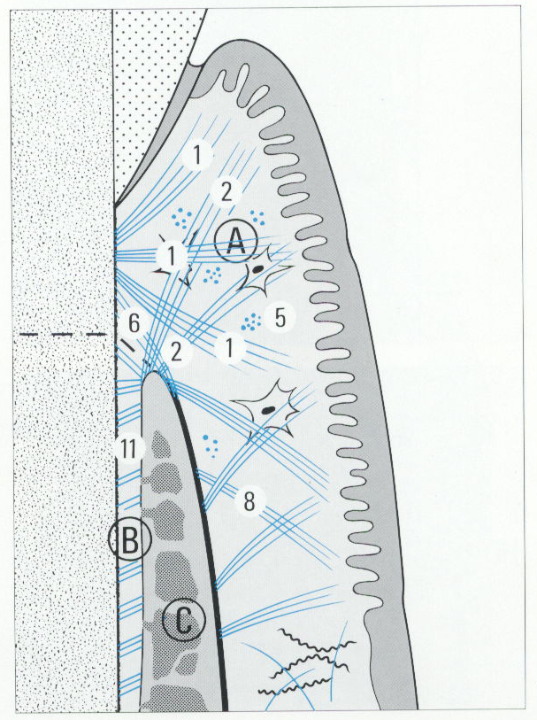
Applied anatomy, physiology and examination
The periodontium is the attachment apparatus of the teeth
Consists –
cementum,
periodontal ligament,
alveolar bone and
gingiva.

Slide 8
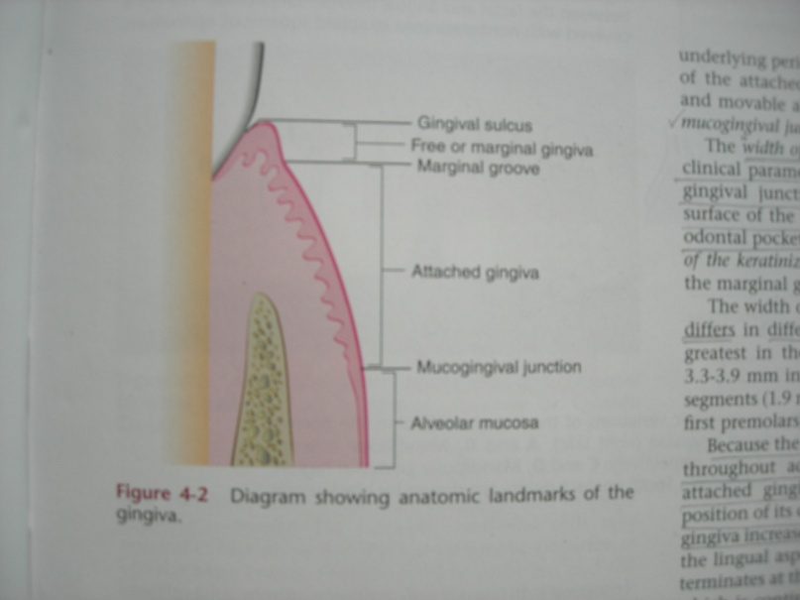
Gingiva : coral or salmon pink
Anatomically 3 parts:
-marginal
-attached
-interdental
Notes:
are common depending upon epithelial thickness and keratinization, vascularity and pigmentation

Slide 9
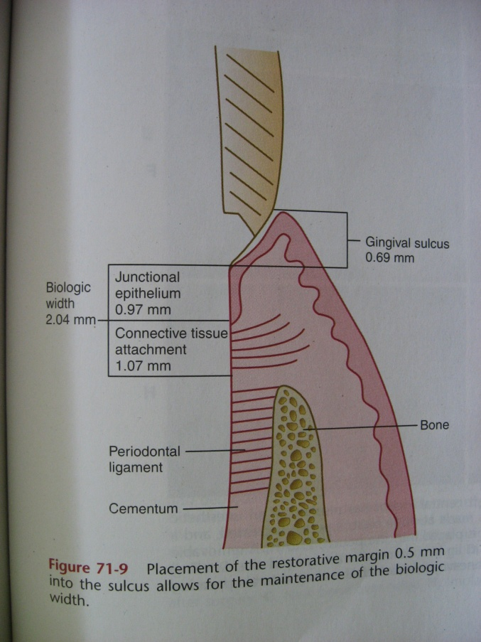
Physiology of gingival sulcus
Most vulnerable part of the periodontium
V shaped shallow crevice or
space around the tooth bounded by the surface of the tooth on one side and the epithelium lining the free margin of the gingiva on the other side.
Normal clinical depth: 2-3mm.
Notes:
between the gingival epithelium and the tooth.

Slide 10
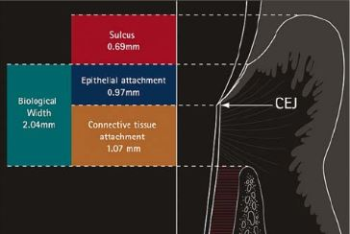
Dentogingival Complex
The dentogingival complex is composed of three entitie.
Supracrestal coonnective
Tissue attachment
Junctional epithelium
Attachment
The sulus- coronal
To the juctional epithelium i.e gingival sulcus

Slide 11
Most often Periodontal disease starts by plaque accumulation and therefore it is utmost important all the restoration should have smooth surfaces that do not hinder plaque removal by physiologic and artificial means.

Slide 12
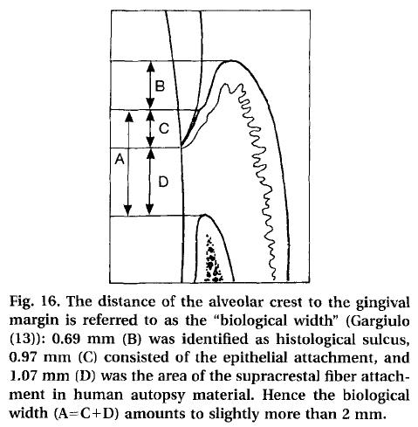
Biologic width:
Garguilo described the dimensions and relations of the dentogingival junction in humans
The combined dimension of the connective tissue and epithelium attachment averages 2.04mm and was described by Walter Cohen as “biologic width”.

Slide 13
Placement of restoration that violate the biologic width will result in chronic progressive inflammation leading to periodontitis and possible tooth loss.

Slide 14
Current standers of care dictate that the gingiva should return to health before any restorative procedure is initiated.
Rule is to place margin 0.5 mm beneath gingival margin.

Slide 15
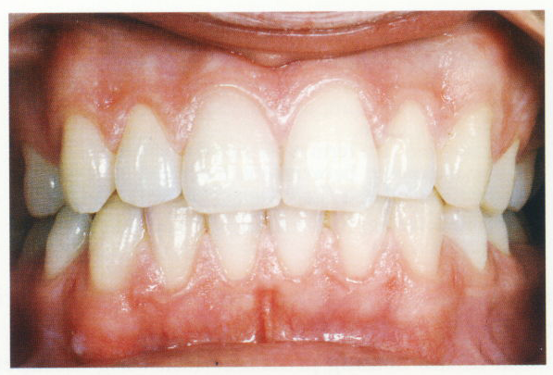
Examination
Visual examination:
Examine hard and soft tissue present
No of teeth present
Amount of stains
Calculus
Malocclusion
Amount of bone
resorbed
Color
Pigmentation
Size
Contour
Consistency
Texture
Shape
position

Slide 16
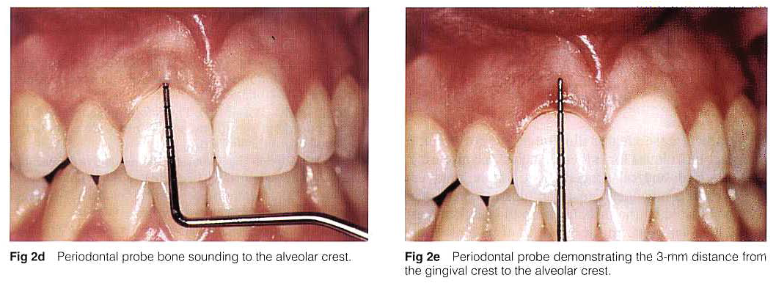
Probing:
- Technique – insert the probe parallel to the vertical axis of the tooth and walked circumferentially around each surface of each tooth to detect the areas of deepest penetration with 0.75N force.
Notes:
Check for bleeding and exudation
Bleeding is the result of ulceration of sulcular ulceration
Local anesthesia is recommended when the bony contours are probed to establish whether surgery is necessary. This procedure is called Bone Sounding.

Slide 17
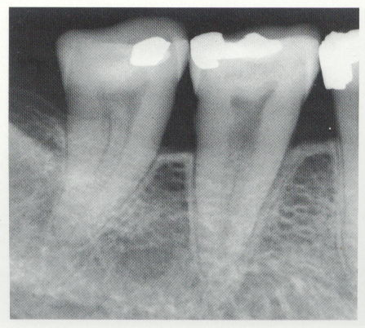
Radiographs:
valuable aid in the diagnosis, prognosis and evaluation of the treatment outcome of periodontal disease.

Slide 18
The areas to be reviewed on the radiographs are:
-Alveolar crest resorption.
-Integrity and thickness of lamina dura.
-Evidence of generalized horizontal bone loss.
-Evidence of vertical bone loss.
-Widened periodontal ligament space.
-Density of the trabecullae of both the arches.
-Size and shape of the roots compared to crown, to determine crown root ratio.

Slide 19
Habits
Bruxism : wear facets on visual examination and x-ray shows thickened lamina dura and widened periodontal ligament

Slide 20
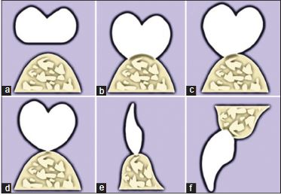
Clinical Relevance to Interdisciplinary Dentistry
To promote restoration and pontic designs that promote favorable tissue response.
To stress the importance of preserving biologic width to all dental practitioners
perio-restorative interrelationship-expanding the horizons in esthetic dentistry
Jid:Year : 2015 | Volume : 5 | Issue : 1 | Page : 46-53
Notes:
The requirements of
the pontic design include esthetics, biocompatibility,
function, phonetics, patient comfort, and maintenance
of healthy tissue on the edentulous ridg

Slide 21
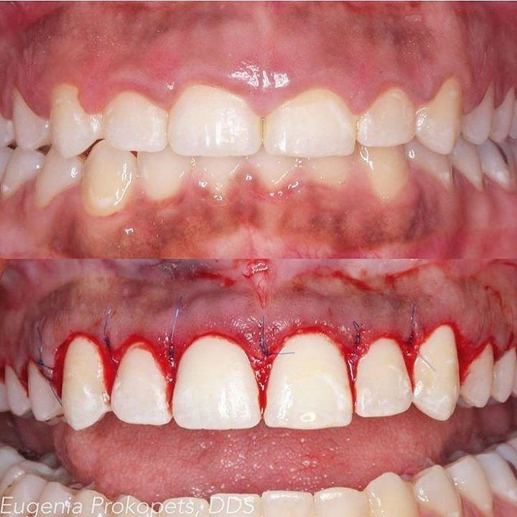
To shed light on iatrogenic damage to the periodontium from certain materials and procedures.
To unveil the potential of periodontal plastic surgery techniques.
Notes:
like augmenting attached gingiva and esthetic crown lengthening prior to restorative procedures when indicated.

Slide 22
To emphasize the need for recall and maintenance therapy

Slide 23
Restorative considerations that impact the periodontium
Restoration contour and contact areas
Margin adaptation and defects
Location of margin
Role of provisional restorations
Design of fixed and removable partial dentures (RPDs)
Occlusal function
Prosthetic and restorative materials and alloy hypersensitivity
Iatrogenic damage from restorative procedures.

Slide 24
Restoration contour and contact areas:
Clinical longevity of any prosthesis is directly related to achieving proper restorative contours.
It is the function of the axial form of teeth to afford protection and stimulation to the marginal periodontium

Slide 25
Physiologic tooth contouring
Allows for self-cleansing mechanisms of cheek, tongue, etc
Cervically -create the correct contour that facilitates plaque removal,
occlusally -allow the restoration of a proper occlusion,
and axially to provide a proper thickness of veneering material to achieve an esthetically acceptable prosthesis.

Slide 26
Problems with over contouring:
Food traps" from open contacts, overhangs, or plunger cusps may occur
Poor occlusal design, and poor esthetics
Plaque accumulation, inflammation, bleeding, and potential bone loss. Plaque is the primary factor in gingivitis
An unesthetic emergence profile of a restoration is created.
Notes:
The emergence profile is the shape of the restoration in relation to the gingival tissues. Stein and Kuwata described the part of the axial contour that extends from the base of the gingival sulcus past the free margin of the gingiva as the emergence profile that was straight in the gingival third.

Slide 27
Contact areas:
Should be in the coronal third of the crown and buccal in relation to the central fossa
Proximal contact points are buccal to the central fossa line, except for maxillary molars founds at the middle third. This creates a large lingual embrasure for optimum health of the lingual papilla.

Slide 28
Problems with misplaced contacts
Horizontal food impaction is produced by the action of the tongue, lips, cheeks and results from poorly contoured interproximal surfaces.
Lifting and rotating forces on dentures
Deflective occlusal contacts
Notes:
Lower fixed partial dentures usually collect more food than upper dentures, particularly in the molar region

Slide 29
Marginal adaptation and defects
Average opening is about 100 nm, which tends to harbor bacterial plaque even around the best fitting margins of a restoration causing inflammation
Inadequate marginal fit of the restoration, dissolution and disintegration of the luting material causing crater formation between the preparation and the restoration and inflammation of gingiva
Notes:
Sharp edges or corners in the preparation not reproduced accurately on the stone die can create marginal discrepancies. Dentists must ensure that the crowns completely seat on the tooth.

Slide 30
Preparation margin designs for metal ceramic crowns
The chamfer: The thin metal collar may distort during the firing of porcelain, thus producing inaccurate margins
Feather-edge margin: Used for cast crowns and veneers. But finish line is hard to read and not amenable to thorough finishing and polishing

Slide 31
A shoulder with bevel is more conservative than a full shoulder preparation, but the presence of the metal collar necessitates an intra-crevicular preparation in esthetic areas
A shoulder preparation allows for sufficient bulk for porcelain to produce esthetically pleasing restorations.

Slide 32
Location of margin: The clinical significance of margin placement
Eissman et al.'s design criteria for fixed partial dentures state that crown margins should be placed on tooth surfaces that are fully exposed to cleansing action, preferably supragingival or slightly into the sulcus.
Vigorous tooth brushing was effective up to 0.7 mm below the gingival margin, suggesting that the submarginal extension of restorations should be limited to no more than this distance

Slide 33
Restorative requirements frequently necessitate subgingival margin placement in order to
gain resistance or retention form to alter tooth contour,
for caries for subgingival tooth fracture removal, in furcation involvement and to hide the tooth-restorative interface

Slide 34
In such cases, subgingival margin placement is necessary, marginal fit should be optimal because rough restorations or grossly open margins lead to an accumulation of bacterial plaque

Slide 35
Advantages of supragingival margins over subgingival margins
Supragingival margins improved periodontal health
Subgingival margins demonstrated increased plaque, gingival index score, and probing depths
Furthermore, more spirochetes, fusiforms, rods and filamentous bacteria were found to be associated with subgingival margins

Slide 36
Violation of the connective tissue attachment; and greater pathogenicity of the subgingival plaque are documented with subgingival margins
Supragingival margins stay away from the periodontal tissues, and thus, they are easier to prepare, record and maintain.

Slide 37
Current trends favor equigingival margins over older concepts of subgingival margins for crowns.
Furthermore, advances with emerging translucent restorative materials adhesive dentistry, and resin cements, promote polished margins that esthetically blend with the tooth for a healthy tooth-restorative interface even when placed equigingival
Notes:
2-3-mm distance remains constant in health and disease biologic width

Slide 38
Assessment of biologic width
Kois suggested that the restorative dentist must determine the total distance from the gingival crest to the alveolar crest.
Procedure is termed bone sounding.
The tissues are anesthetized, and the periodontal probe is placed in the sulcus and pushed through the attachment apparatus until the tip of the probe engages alveolar bone.
Notes:
Kois suggested that the restorative dentist must determine the total distance from the gingival crest to the alveolar crest. ^{[4]} This procedure is termed bone sounding

Slide 39
Based on this measurement, the three categories of biologic width described are:
Normal crest A biologic width of 3 mm allows for a crown margin that is placed 0.5 mm subgingivally
High crest Measurement lesser than 3 mm does not allow for subgingival margins
Low crest Measurement of more than 3.0 mm
most susceptible to recession
Notes:
A biologic width of 3 mm on the labial aspect allows for a crown margin that is placed 0.5 mm subgingivally

Slide 40
Correction of violation of biologic width
To restore gingival health, it is necessary to reestablish the space clinically between alveolar bone and the gingival margin.
For this purpose, either surgery to alter bone level or orthodontic extrusion of the tooth to move the restoration margin away from the bone level

Slide 41
Margin placement guidelines
Rule I: If the sulcus probes 1.5 mm or less, place the restoration margin 0.5 mm below the gingival tissue crest
Rule II: If the sulcus probes more than 1.5 mm, place the margin one-half the depth of the sulcus below the tissue crest.
Melnick PR. Preparation of the periodontium for restorative dentistry. In: Carranza's Clinical Periodontology. 10 ^{th} ed. Philadelphia: WB Saunders Co.; 2006. p. 1039-48.
Notes:
This places the margin enough below tissue so that it is still covered if the patient is at higher risk of recession

Slide 42
Rule III: If the sulcus >2 mm is found, especially on the facial aspect of the tooth, then evaluate to see whether a gingivectomy could be performed to lengthen the teeth and create a 1.5 mm sulcus.
Then the patient can be treated as mentioned in rule I

Slide 43
Gingival retraction
It can be achieved mechanically using retraction cords, copper bands or cords.
A single-cord technique is the least traumatic option than two cord technique
Chemicals used for the treatment help to control seepage of blood or gingival fluid
Notes:
is normally employed when the sulcus, is shallow, and the margin is placed only minimally in the crevice in areas of root proximity.

Slide 44
Newer and safer materials like biocompatible polymer-
hydroxylate polyvinyl acetate (Merocel) absorbs intraoral fluids
Expasyl is a paste that not only opens the sulcus but also leaves the field dry.
Notes:
It is mainly composed of micronized kaolin, aluminum chloride and water.

Slide 45
Role of provisional restorations
Provisional restorations are needed to protect the prepared teeth, to reduce the sensitivity of the vital abutments, and to prevent tooth migration
Provisionals should have good marginal fit and polish
This prevents plaque accumulation and related inflammatory gingival overgrowth or recession.

Slide 46
Occlusion
Occlusal discrepancies in a restoration appear to be a significant risk factor that contributes to more rapid periodontal destruction
Cantilever designs often result in fractures of casting and roots and periodontal inflammation around abutment tooth.

Slide 47
Restorative materials and alloy sensitivity
Self-curing acrylics are less tissue friendly.
Improperly finished composites may become rough.
Phosphate cements and silicates are irritant.
Lab cast and high polish of restorations is important in preventing plaque accumulation
The fine marginal fit of glass ceramics and porcelain veneers have least gingival irritation.

Slide 48
Iatrogenic damage from procedures
The residual material of retraction cords left in the crevice can lead to periodontal abscess later
Injury from rubber dam clamp and disks can lead to gingival inflammation.
Injudicious use of electrosurgery, cryosurgery and laser can cause excessive necrosis of the gingiva

Slide 49
CURRENT TRENDS IN PERIODONTAL ASPECTS OF RESTORATIVE DENTISTRY
Supragingival placement of margins of restorations
Avoidance of over contoured restoration, and minimal concern with lack of contour
Occlusal stability through precise occlusal adjustment and accurate reconstruction of occlusal anatomy in single restorations

Slide 50
Restricted indications for splinting of mobile teeth
Hemisection with fixed bridges in cases of extensive bifurcation involvement.

Slide 51
Periodontal considerations
Periodontal therapy to resolve inflammation must be completed before prosthetic treatment.
Importance of a healthy periodontium:
Healthy gingival margins do not shrink after tooth preparation and enable accurate impressions
There are less chances of bleeding after preparation, which aids visibility and making impressions

Slide 52
Stable tissues, free of inflammation ensures predictable restorations
Trauma from occlusion on teeth with untreated periodontitis may increase tooth mobility and rate of attachment loss

Slide 53
Quality and topography of the periodontium should be improved to prevent negative changes once the restorations have been placed.
Wider zone of attached gingiva is needed around abutment teeth and in those with subgingival restorations as less inflammation is reported than in teeth with narrow zones

Slide 54
Periodontal therapy
A thorough periodontal evaluation is indicated in the planning stages prior to fabrication of the prosthesis.
Selection of abutment teeth is based on prosthodontic and periodontal considerations, including bone support and architecture, width of attached gingiva, tooth mobility, root anatomy, and tooth position

Slide 55
Correction of the gingival architecture that may favor disease, impair esthetics, or impede placement of prosthesis with preprosthetic surgery
Periodontal maintenance and motivation for oral hygiene should be given during treatment and interim periods.

Slide 56
Cause-related therapy
Plaque control
Calculus removal
and the removal of any inadequate dental restorations in the gingival environment, treatment of food impaction
Correction of trauma from occlusion, and orthodontic tooth movement
Motivation for oral hygiene, as well as extraction of hopeless teeth can be done.

Slide 57
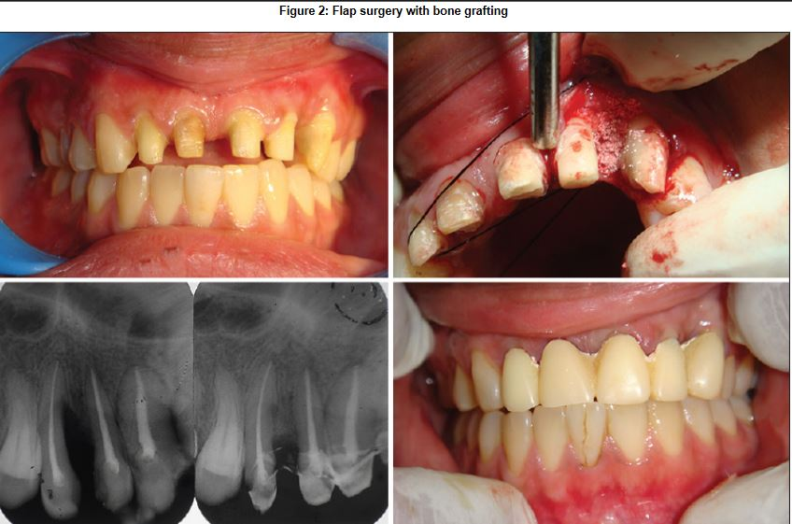
Surgical therapy
Periodontal flap surgery
Gain access for debridement, to reduce pockets and for periodontal regenerative therapy with bone grafts.

Slide 58
Preprosthetic surgery: Gingival augmentation
Vestibuloplasty may be required in areas where a shallow vestibule complicates oral hygiene.

Slide 60
Crown lengthening:
Removal of gingival excess and maintaining biologic width
In situations in which a tooth has a short clinical crown deemed inadequate for retention of a required cast restoration
Esthetic crown lengthening can be done using flap surgery with bone removal using a surgical guide

Slide 62
Supportive periodontal therapy
Maintenance recalls are essential to the long-term success of fixed and removable prosthesis especially overdenture abutments.

Slide 63
Pre-prosthetic consideration
Tooth mobility and pain interfere with mastication and function of restored teeth.
2. Restorations constructed to provide beneficial functional stimulation to a healthy periodontium become a destructive influence when superimposed on existing periodontal disease, shortening the life of the teeth and the restoration.

Slide 64
3. The position of teeth is frequently altered in periodontal disease.
4. Partial prostheses constructed on casts made from impressions of diseased gingiva and edentulous mucosa do not fit properly when periodontal health is restored.
5. Margins of restorations hidden behind diseased gingiva are exposed when the inflamed gingiva shrinks following periodontal treatment.

Slide 65
Furthermore, the aims of periodontal treatment are not limited to the elimination of periodontal pockets and the restoration of gingival health.
Treatment should also create the gingivomucosal environment and the osseous topography necessary for the proper function of single-tooth restorations and fixed and removable partial prostheses

Slide 67
Treatment planning in periodontally compromised tooth

Slide 69
Preliminary phase (emergency treatment) | Etiotropic phase (Phase I)
Dental and periapical Periodontal Extraction of hopeless teeth Provisional replacement if needed | Scaling and root planning Correction of Prostho and restorative irritational factor Excavation of caries and restoration Antimicrobial therapy Occlusal therapy Minor Ortho correction Provisional splinting

Slide 70
Evaluation of response of phase I therapy | Surgical phase ( Phase II therapy)
Pocket depth and gingival inflammation Plaque and calculus Caries | Periodontal surgery RCT
Restorative phase ( Phase III therapy) | Maintenance phase ( Phase IV therapy)
Final restoration FPD or RPD | - periodical recall visit - checking plaque and calculus - gingival condition - occlusion and tooth mobility

Slide 71
Prostho management should provide:
Stable occlusion
Favorable occlusal plane
Incisal path, esthetic and phonetics
Physiologic contour retainers
Establishing splinting of mobile teeth

Slide 72
Periodontal consideration for designing RPD
There are situations, however, when financial, systemic, or local conditions preclude the use of dental implants.
A well-constructed removable partial denture (RPD) can be an excellent treatment alternative.
Int J Prosthodont 2001;14:164–172. Periodontal Considerations in Removable Partial Denture Treatment: A Review of the Literature

Slide 73
Strategic extractions of severely weakened teeth should be performed, especially in cases when the treatment plan does not change
For example, a compromised maxillary second premolar could be extracted if the first premolar is healthy. The new RPD will have the same design for retention with an additional denture tooth.

Slide 74
The use of RPDs leads to detrimental changes in the quality and quantity of plaque. Implementing meticulous hygiene of both the oral cavity and dentures can offset these changes.
Factors that affect force distribution from the RPD to the abutment teeth and edentulous ridge include denture design, denture base adaptation, and residual ridge inclination

Slide 75
The wearing of a new RPD is followed by a "settling" period that lasts about 1 to 1.5 months and leads to a reduction of the initial torque exerted on the abutment teeth.
Splinting of abutment teeth is indicated when the periodontal support has been reduced or when increased stresses are expected, as in the use of intracoronal attachments

Slide 76
Properly designed and maintained RPDs can provide long-term clinical service without any detrimental effects on the periodontal condition of the remaining dentition.

Slide 77
Perio consideration during tooth preparation
Presence of sufficient tooth structure coronal to bone crest is essential to satisfy the following criteria
Placement of margin on sound tooth structure
Preservation of the biologic width
Ability to make an impression of prepared
Esthetic

Slide 78
Margins are the most important and weakest link in success of cast restoration.
Margins are the component of restoration which are most susceptible to failure both biologically and mechanically

Slide 79
Four fundamental criteria for successful margins:
Acceptable margin adaptation
Tissue tolerant surface
Adequate contour
Sufficient strength

Slide 80
Requirements for the successful restorative margins:
Margins must fit as closely as possible against the finish line of the preparation to minimize the width of exposed cement.
They must have sufficient strength to withstand the forces of mastication.

Slide 81
Whenever possible they should be located in the areas where the dentist can finish and inspect them and the patient can clean them.
“The key to successful margin placement is to minimize the plaque retention.”

Slide 82
Perio consideration during cementation
Excess of cements used for provisional/final cementation should be removed carefully
Failure to do so will result in gingival irritation
May lead to periodontal inflammation with possible bone loss
Sulcus must be carefully checked and irrigated with air-water syringe

Slide 83
ZINC PHOSPHATE:
Even tiny spicule will cause gingival irritation and harbor debris and plaque.
Every speck must be removed without scratching the restoration.
ALUMINA EBA:
Does not require meticulous removal because films or smears of this cement
if left alone will be self destructed in a day or 2 through food abrasion thermal changes and possible enzymatic changes or microleakage activity

Slide 84
POLYCARBOXYLATE/ RESIN CEMENT:
Require special consideration.
Excess should be removed when cement reaches rubbery stage of partial polymerization.
After complete polymerization cement have to be ground away this is difficult especially interproximal area.
Pressure should be maintained for 3-4 min and after 15 sec excess cement should be wiped away.
Dental floss should be passed through interproximal area before 30 sec has elapsed.

Slide 85
Silicone grease, petroleum jelly, carding wax and other agents can be used to facilitate cement removal.
Problems due to improper cementation:
Premature occlusion
Pulpitis
Loosing of restoration
Recurrent caries
Incomplete seating.

Slide 86
Multiple abutments
Multiple abutments reduce the lateral and torsional stresses on the abutment teeth and should be standard procedure in patients with reduced periodontal support.
This objective can be achieved by:
connecting inlays or crowns
clasping abutment teeth in a sequence

Slide 87
Overdentures
SYNONYMS:
Biologic denture
Hybrid denture
Telescopic denture
Overlay denture
Onlay denture
Tooth supported dentures
Superimposed denture
ADVANTAGES
Preservation of alveolar bone
Improved denture retention, stability and support
Provides a vertical definite stop
Psychological acceptance hence better patient cooperation.
Preservation of masticatory proprioception
Fewer post insertion problems

Slide 88
Factors to be consider while planning for overdenture
Periodontal considerations
Endodontic treatment
Caries Management
Location and Distribution of forces
Economics
Notes:
Condition of remaining teeth
Pocket depth
Radiographs
Attached gingival tissue
Tooth mobility and crown root ratio
Periodontal defect

Slide 89
CONCLUSION
An interdisciplinary approach requiring coordinated efforts by the restorative dentist and periodontist is the need of the hour.
Close attention paid to both soft and hard tissues around teeth and implants before, during, and after restorative produces a successful outcome.

Slide 90
It also gives the patient the benefit of comprehensive treatment with precise and lasting and restorations.

Slide 91
REFRENCES
References:
1.Tylman’s theory and practice of fixed prosthodontics: W.F.P Malone, D.L. Koth, E. Cavazos, Jr, D.A Kaiser, S.M Morgano, 8th edition.
2.Contemporary fixed prosthodontics: Rosenstiel, Land, Fujimoto, 3rd edition.
3. Fundamentals of fixed prosthodontics: Herbert T. Shilingberg, Sumiya Hobo, Lowell D. Whitsett, Richard Joacobi, Susan E. Brackett, 3rd edition.
4.Clinical periodontology: Carranza, Newman, 8th edition.
5.Textbook of clinical periodontology: Jan Lindhe, 2nd edition.

Slide 92
CURRENT THEORIES OF CROWN CONTOUR
One of the prime goals of restorative therapy is to establish a physiologic periodontal climate and facilitate the maintenance of periodontal health
Crown contour, margin placement, and pontic design all affect periodontal health.
J Prosthet Dent 1981;45:268-77. J Prosthet Dent 2005;93:107-15. CURRENT THEORIES OF CROWN CONTOUR, MARGIN PLACEMENT, AND PONTIC DESIGN

Slide 93
CROWN CONTOUR
The contours for full and partial coverage restorations play a supportive role in establishing a favorable periodontal climate.
Three prominent theories of crown contour have evolved:
(1) Ginvial protection
(2) Muscle actions
(3) Access for oral hygiene

Slide 94
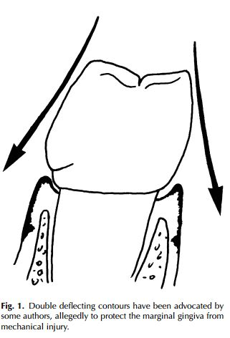
Gingival protection theory
The gingival protection theory advocates that contours of cast restorations be designed to protect the marginal gingiva from mechanical injury

Slide 95
The gingival protection theory has been defended primarily on the basis of three elements:
Protection of gingival margins,
Gingival stimulation and
Self-cleansing contours.

Slide 96
Protection of gingival margins
This concept implies that undercontouring of the clinical crown will cause deflection of masticated food onto the gingival margin, forcing it into the sulcus, thus initiating gingivitis.
Koivumaa and Wennstrom19 studied the histologic effects of crown contour on human gingiva.

Slide 97
They found that there was an increase in inflammation adjacent to bulbous artificial crowns but that properly contoured artificial crowns exhibited no such increase at the adjacent gingiva.

Slide 98
Gingival stimulation:
This concept reasons that, as food is masticated, it will pass over the gingiva, stimulating it and causing increased keratinization of the epithelium.
Resistant to periodontal breakdown.

Slide 99
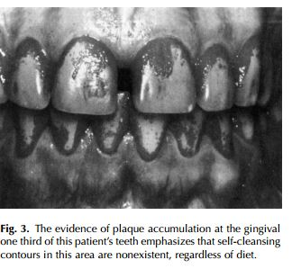
Self-cleansing contours
This concept asserts that, as food passes over the tooth during mastication, the tooth will be cleansed.
Numerous authors have shown that mastication does not remove plaque at the gingival margins of teeth.

Slide 100
Neither does mastication have any effect on the progress of gingivitis.
Thus, self-cleansing crown contours apparently are nonexistent at the gingival margins of the teeth

Slide 101
Muscle action theory
Morris,was one of the first to question the rationale of the gingival protection theory
He and suggested that overcontouring prevents the normal cleansing action of the musculature and allows food to stagnate in the overprotected sulcus.

Slide 102
Some authors stated that evenif there were some cleansing of the buccal and lingual surfaces from muscle action, interpoximal cleansing still would be impossible.

Slide 103
Theory of access for oral hygiene
This theory is based on the concept that plaque is the prime etiologic factor in caries and gingivitis.
Thus crown contour should facilitate plaque removal, not hinder it.
When crowns were overcontoured experimentally, 64.3% of the test sites demonstrated an increase in periodontal inflammation.

Slide 104
This was attributed to decreased access for oral hygiene.
4 guidelines to contouring crowns that emphasis access for oral hygiene was described
Buccal and lingual contours–flat, not fat!
Open embrasures
Location of contact areas
Furcations involvement.

Slide 105
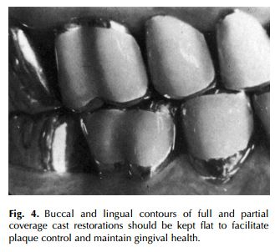
Buccal and lingual contours:
Plaque retention on the buccal and lingual surfaces occurs primarily at the infrabulge of the tooth
Reduction or elimination of the infrabulge would reduce plaque retention

Slide 106
Thus, a normal tooth at the buccocervical bulge is usually <0.5 mm wider than the CEJ.

Slide 107
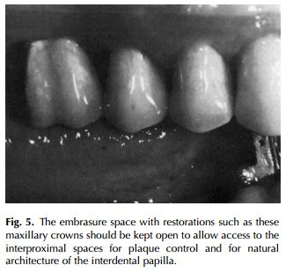
Open embrasure:
If plaque is a primary etiologic factor in gingivitis,then every effort should be made to allow easy access to the interproximal area for plaque control.
Open embrasure spaces will allow for this easy access

Slide 108
An overcontoured embrasure will reduce the space intended for the gingival papilla.
Result is a broadening of the col area, causing pressure and irritation on the papilla.
Also inhibits effective oral hygiene

Slide 109
Several authors have suggested that an interproximal space that is slightly larger than normal may be desirable since it provides adequate room for the gingival papilla and is a more accessible area to clean
Some authors have reported the fear of creating an environment which promotes ‘‘lateral food impaction’’ when open embrasures are employed.

Slide 110
Townsend has observed that, even with grossly undercontoured, open embrasure spaces, lateral food impaction rarely occurs as long as interproximal tooth contacts are properly maintained.
The interproximal brush is used, the space between two adjacent proximal surfaces must be wide enough to allow it to pass through

Slide 111
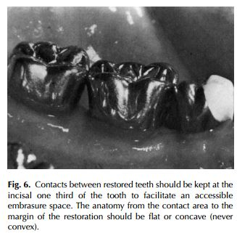
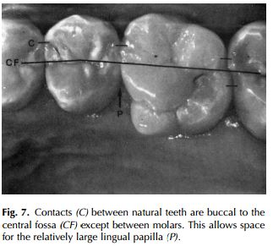
Location of contact areas.
Contacts should be high (directed incisally) and buccal in relation to the central fossa.

Slide 112
contact area of all teeth, except between the maxillary first and second molars, should be buccal to the central fossa
This creates a large lingual embrasure for optimum health of the lingual papilla
Placement of contact areas as far occlusally as possible to facilitate access for interproximal plaque control.

Slide 113
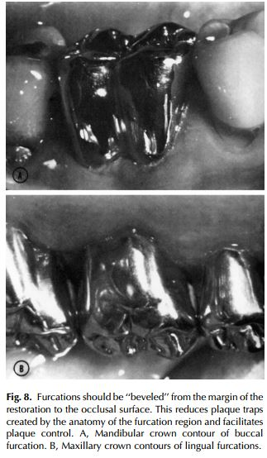
Furcations involvement
Furcations that have been exposed owing to loss of periodontal attachment should be ‘‘fluted’’ or ‘‘barreled out’’

Slide 114
The concept of fluting into molar furcations is based on the desire to eliminate ‘‘plaque traps’’ and facilitate plaque control
Yuodelis et al, stated molar furcations, warn that the final restoration should not follow the anatomy of the original clinical crown but should be an extension of the contours of the periodontally exposed roots.

Slide 115
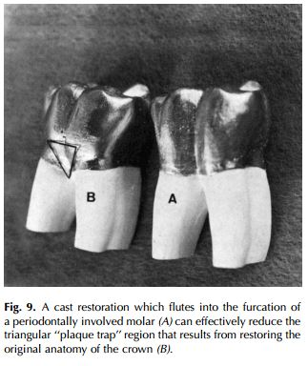
When this approach is properly executed, the triangular region that is created by the roots and the cervicular bulge is eliminated .

Slide 116
This triangular region is the most difficult area to maintain in a plaque-free condition with conventional brushing techniques.
Recontouring the furcation to eliminate the triangle, plaque control with normal brushing is greatly facilitated

Slide 117
SUMMARY
Crown contours which promote favorable tissue response follow these guidelines:
(1) Buccal and lingual contours are flat
(2) Embrasure spaces should be open
(3) Contacts should be high (incisal one third) and buccal to the central fossa (except between first and second molars)
(4) Furcations should be ‘‘fluted’’ or ‘‘barreled out.’’

