Slide 1
CULTURE AND ORAL HEALTH
PRESENTED BY:
DR SMRITI SAXENA
Notes:
1

Slide 2
Contents
Introduction
Terminologies related to culture
Cultural practices in India
Family
Food habits
Oral hygiene practices
Other habits
Caste
Sex and marriage

Slide 3
Contents
Cultural practices across the world
Tooth avulsion/ Ablation/ Extraction
Traditional tooth bud gouging/removal
Mutilation of tooth crown
Decorative dental inlays and crowns
Piercing Of Oro-facial Soft Tissue
Attitudes Towards Oral Health
Conclusions
References

Slide 4
AS THE SOIL, HOWEVER RICH IT MAY BE, CANNOT BE PRODUCTIVE WITHOUT CULTIVATION, SO THE MIND WITHOUT CULTURE CAN NEVER PRODUCE GOOD FRUIT

Slide 5
Introduction
For an individual to survive successfully in a society, he or she should develop the essential qualities necessary to fit effectively in the society.
These essential qualities are the acquirement of customs, beliefs, laws, moral percept, art, skills and religion.

Slide 6
Introduction
These qualities may have beneficiary effect or sometimes have a detrimental effect on the general health as well as on the oral health.
In a large and popular nation like India, there are many "subcultures" each differing from other in some of the characteristics and have an impact on oral health.

Slide 7
Terminologies
Society: defined as an organization of member agents. In other words society is made up of group or groups of individuals.
Community: defined as a group of individuals and families living together in a defined geographic area, usually comprising a village, town or city. These communities are a network of human relationships and form the major functioning unit of the society.

Slide 8
Terminologies
Culture is defined as "Learned behavior which has been socially acquired".
The process by which an individual gradually acquire culture and becomes a part of the society is called socialization.

Slide 9
Cultural practices in India

Slide 10
FAMILY

Slide 11
FAMILY
The family is a primary unit in all societies.
It is a group of biologically related individuals living together and eating from a common kitchen.
as a biological unit, the family members share a pool of genes;
as a social unit, they share common physical and social environment;
as a cultural unit, the family reflects the culture of wider society of which it forms a part and determines the behavior and attitude of its members.

Slide 12
FAMILY
.
In India the common beliefs are:
Children are gifts of God
Children are poor man’s wealth
Hindus and Muslims should have a son
Close birth
intervals

Slide 13
Rural India (Gwalior region), child is not put to breast feeding during the first 3 days due to misbelief that colostrum is harmful- prevents passive transport of immunity – susceptible to oral infections.
Diarrhea in children during teething is a normal phenomenon - malnutrition – affects oral tissues.

Slide 14
FOOD HABITS

Slide 15
Food habits
Rice is a staple diet in eastern and southern states of India – riboflavin deficiency- gingivitis, angular stomatitis, dry and fissured lips, acute glossitis (mild).
Maize eating population – niacin deficiency- gingivitis, cheilitis, pellagra, atrophic glossitis with magenta color (common), with black color (rare) seen in areas of Telangana (A.P).
Dental fluorosis is high among the jowar eating population. (Krishnamachari et al (1978)

Slide 16
Food habits
Gopalan et al described:
Amino acid imbalance caused by an excess of leucine is the cause of pellagra in both jowar and maize eaters.
Vegetarianism – nutritional anemia especially B12 - MOELLER’S GLOSSITIS ( erythematous, edematous and painful tongue that appears smooth because of lose of filliform papillae and fungiform papillae (rare).
Notes:
L-leucine was found to interfere with tryptophan and nicotinic-acid metabolism, and leucine supplements induced " black tongue "

Slide 17
Food habits
Men eat first and the women eat last and poorly served – poor nourishment.
In parts of Andhra Pradesh and Northern Karnataka, the habits of taking spicy food and high consumption of green chilies is prevalent – oral cancer and peptic ulcer.

Slide 18
Food habits
Fasting - acidity, peptic ulcer, nutritional anemia, loss of weight - dental erosion, dry mouth.
Hindus – prohibits eating beef – prevents the occurrence of the disease Taeniasis caused by adult form of Taenia Saginata (Beef tape worm) which manifests orally as oedematous mucosal ulcers, gingival bleeding apart from the general manifestation.

Slide 19
Food habits
Muslims – pork is forbidden – prevents the occurrence of Taeniasis and Cysticercosis, which manifests orally as oedematous mucosal ulcers, gingival bleeding and lesions mimicking mucocles.
Jews do not eat Pork, shell fish and certain other foods. They also follow strict dietary laws regarding the storing, preparation and serving food (avoid alcoholic drinks and meat products).

Slide 20
Food habits
Intake of Western diet - refined carbohydrates including large amount of snack food , confectionery and canned soft drinks (Mayhall 1975) - dental caries, dental erosion

Slide 21
ORAL HYGIENE PRACTICES

Slide 22
Oral hygiene practices
1. RELIGION
Hindus
Brahmins (Priests) clean their teeth with cherry wood for about an hour facing rising sun reciting prayers and involving heavenly blessings on them and their family members.

Slide 23
Oral hygiene practices
Muslims
Muslims as a part of namaaz, clean their teeth five times a day – improves oral health.
Few of them also use miswak tooth sticks, tooth picks and gum massaging as part of oral hygiene aid.

Slide 24
Oral hygiene practices
2. CHEWING TWIGS
Indians – twigs of mango, neem, triphala, coconut fibres as DATUN to clean their teeth which have anti microbial property as well (G M Prashant, 1991).

Slide 25
Oral hygiene practices
3. DENTRIFICES
Rural and urban slum area – common salt, charcoal powder, brick powder, sand, ash and cow dropping as cleaning material – enamel abrasion, dentin hypersensitivity and gingival recession.

Slide 26
OTHER HABITS

Slide 27
Alcohol
Alcoholic drinks are tabooed in Islam and brahmins’ caste of hindus , Jainism– promote oral health.
Western culture – alcohol glamorous and as a status symbol.
Increases the incidence of oral cancer and mental illness

Slide 28
Smoking tobacco
Beedi smoking – lower social class people
Hookah – frequent in places where Mughal culture is still present.
Reverse smoking – fishing communities of Vishakhapatnam and Srikakulam districts
Reasons –
prevent halitosis and tooth ache
Not to expose the lighted end to wind.
Females do it to prevent husband from seeing it.
Prevent ashes from falling over the suckling child.
CANCERS OF HARD PALATE AND BASE OF THE TONGUE.

Slide 29
Smoking tobacco
Western Societies – STATUS SYMBOL
Smoking among pregnant women – increases incidence of cleft lip and cleft palate in the child and also low birth weight child.

Slide 30
Chewing pan
India – offering pan is a way of welcoming the guest in
West Bengal, eastern U.P , Rajasthan, Maharashtra.
Oral cancer and staining of teeth

Slide 31
Fomentation
Belief – fomentation reduces pain in decayed teeth.
Fomentation increases the spread of inflammation along the facial planes causing cellulitis.

Slide 32
Kola chewing
The chewing of kola nut is common in West and Central Africa.
The chewing of kola nut plays an important role in religious functions.
It contains alkaloids like caffeine, theobromine and tannin.
The high tannin level in the nut is reported to exert a beneficial effect on healing of oral mucosal lesions and to exert a possible cariostatic effect.

Slide 33
Alum rinsing
There is a wide belief that rinsing the mouth with alum solution would make the gums stronger.
The antibacterial characteristics helps in curing the oral ulcers.
It may have adverse effect on health as well .

Slide 34
Caste
Indian society is based on caste system. Caste system is less rigid in urban areas.
In rural India, caste is an important basis of social differentiation.
Children of lower caste people are forbidden to attend the schools.
There is a notion that they will be ill treated in all aspects, including discriminations in providing health facilities.

Slide 35
Caste
These lower caste people work in agricultural fields of land lords and they in turn get their daily wages which is usually insufficient.
These practices have direct and indirect effect on oral health of the lower caste people.

Slide 36
Sex and marriage
Sexual customs vary among different religious and ethnic groups.
The practices of :
polygamy (marrying of one man to several women)
polyandry (marrying of one woman to several men) seen in many tribal communities of the country (Todas of Nilgiri hills, Nayars of Malabar coast, the inhabitants of Jaunsar Bhawar in Uttar Pradesh)
These practices attribute to the high rate of venereal diseases and affect the oral health.

Slide 37
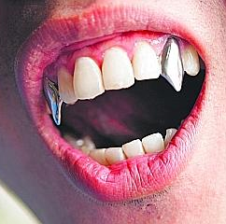
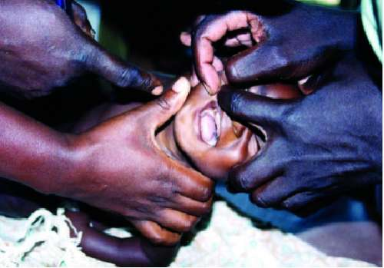
Cultural practices across the world

Slide 38
Cultural practices directly affecting oral health
The practice of deliberate mutilation of the human dentition is known to have existed since prehistoric times in an ethnically and geographically diverse range of people. These practices include:
1. MUTILATION OF TOOTH CROWN
Tooth avulsion
Tooth Bud gouging
Chipping and filling of teeth
Lacquering of teeth
Decorative dental inlays and crowns
2. MUTILATION OF SOFT TISSUE

Slide 39
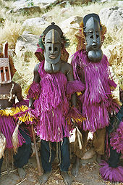
MUTILATION OF TOOTH CROWN
It is common in:
Dogon people of Mali
The kirdi of cameroun
The Tbo, Munchi, and Yoruba of Nigeria
The Bahigh tribe of Uganda
Tribes of Southwest Africa (Narrubia), Angola and Botswana
Various Kavango tribes of South West Africa
Various Lokwe, Wanyembo and Ovambo tribes in South West Africa and Angola

Slide 40
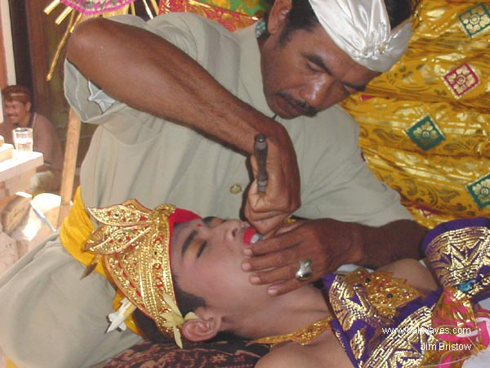
Reasons for altering the shape of teeth-
Aesthetics
Tribal identity
Initiation of rituals
Religious motives

Slide 41
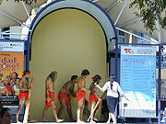
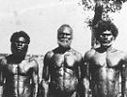
Tooth avulsion/Ablation/ Extraction
Van Ripen (1918) and Campbell (1923) described the practice of tooth avulsion among Australian Aboriginal tribes.
The practice of tooth avulsion is one which dates from early Mesolithic period to late Paleolithic times.
The practice has a wide geographic distribution and has been described in Africa, central and South America, parts of South East Asia, the Philippines, Indonesia, Melanesia, Polynesia and Australia.
Notes:
The term "Aboriginal" has traditionally been applied to indigenous inhabitants of mainland Australia, Tasmania, and some of the other adjacent islands.

Slide 42
Reasons
Tribal identification (Handler1994; Van Rippen 1978)
Initiation ritual
Sign of manhood/ bravery
Differentiation of sexes
Sign of marriageable age for women
Therapeutic purpose
Cultural mimicry
Local superstition - that during sleep the soul departs and re-enters the body via mouth- hence the need to remove anterior teeth.

Slide 43
Social status (Fastlicht 1948, 1976)
Sign of ceremonial sacrifice
To ensure life after death
Aesthetics and fashion( Fastlicht, Romero 1958; Rubin de la Borbolla 1940)
To allow room intra orally for the placement of lip plugs and labrets

Slide 44
Complications
Dento alveolar complications include alveolar fractures, damage to mucosal tissue and fracture of tooth crown leaving the tooth roots in situ.
Gross wound sepsis
periapical granuloma, abscess formation consequent to trauma, pulp necrosis, and bacterial infestation of the root canal.

Slide 45
TRADITIONAL TOOTH BUD GOUGING/REMOVAL
Terms used for tooth gouging
Baba and Kay (1989) referred to the traditional practice in Southern Sudan, named ‘LUGBARA’ that involves the removal of unerupted canines as a treatment for childhood illnesses.
Rasmussen et al (1992) in Khartoum proposed, the lancing of the swollen alveolar process over the unerupted canine with a heated instrument is known as ‘HAIFAT’.

Slide 46
The procedure is done as early as in one month till up to three years of age. Most studies report a peak age of 4-18 months (Kikwilu E.N 1997); (S.N.Dewhurst 2001).
The places include Tanzania, Uganda and Somalia, Acholi and Lango tribes in Northern Uganda, near the border of Sudan.

Slide 47
COMPLICATIONS
Any attempt at enucleation of the developing primary canine tooth bud will cause major disruption of the underlying successional tooth bud; with damage ranging from hypoplasia to total atrophy.
Tooth bud gouging also has the risk to life of the child. Severe hemorrhage, septicemia and tetanus have caused fatalities.

Slide 48
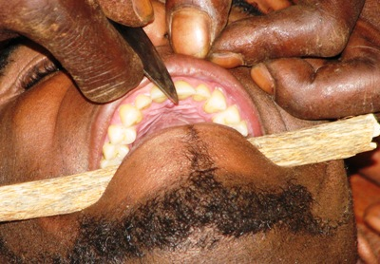
PATTERNS OF CHIPPING & FILLING
The simplest form of tooth mutilation is the filling of the teeth.
In general various forms of chipping, filling of the tooth crown primarily involve mutilation of:
Incisal edges
Mesial/Distal incisal angles
Mesial/Distal incisal surfaces
Labial surface
Whole tooth crown

Slide 49
LACQUERING & DYEING OF TEETH
Blackening of teeth was seen in ancient Japan, Vietnam and Philippines.
In French colonial Annam (now Vietnam), every Annamese of either sex was expected to have his/her teeth blackened by a process said to be very painful.
The custom is still practiced by some people in Vietnam, Laos and Thailand, some areas of Indonesia and the Philippines and in parts of Columbia and Peru of South America.

Slide 50
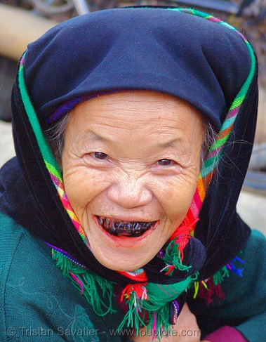
Reasons
Concepts of beauty or maturity.
In Vietnam also, tooth lacquering is used for cosmetic purposes.
Some people reportedly blacken their teeth to help prevent tooth decay.
The custom of ‘Ohaguro’ tooth blackening among the Japanese was primarily used to signify marriage and fidelity in marriage.

Slide 51
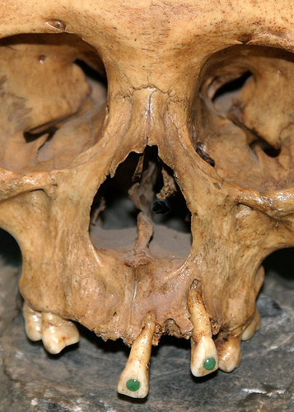
DECORATIVE DENTAL INLAYS AND CROWNS
The use of dental inlays and crowns for adornment purposes is a form of non- therapeutic tooth mutilation occasionally encountered among contemporary people within and outside the tropics.
Purposes - beautification, to signify wealth or signify some event.

Slide 52
The practice of placing decorative inlays in front teeth was also carried out in India in previous times.
In India the teeth of important people such as Kings of various Kingdoms were reportedly decorated with glass, pearl and diamond.

Slide 53
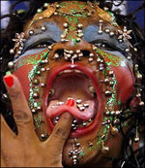
MUTILATION OF SOFT TISSUE (PIERCING)

Slide 54
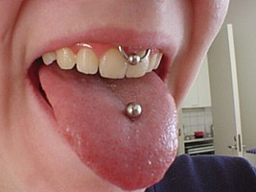
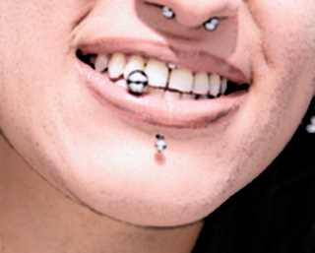
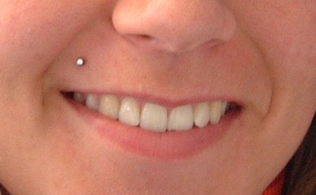
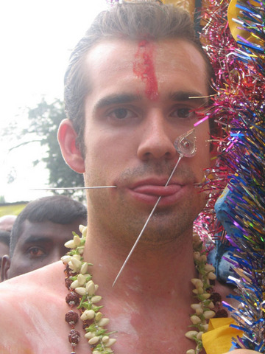
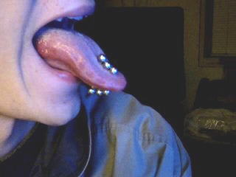
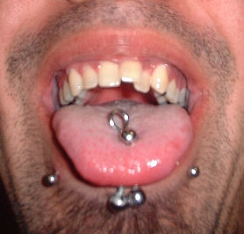

Slide 55
Complications of Piercing
LOCAL COMPLICATIONS
The jewellery at the location can contribute to gingival recession at the anterior facial surface of the mandibular region, due to physical trauma to the tissues.
Functional issues involving the gag reflex, throat irritation and deglutition occurs with piercing done on the uvula.
For individual with several oral piercing, the effects on speech, mastication and deglutition are compounded.

Slide 56
COMPLICATION DURING PIERCING
Hemorrhage – the highly vascularized tongue served by the deep lingual artery and vein will bleed during the procedure.
Nerve damage – the tongue being highly innervated by the trigeminal( mandibular division), facial, hypoglossal and glosso-pharyngeal nerves, it is possible to puncture a nerve during the procedure.
If nerve damage occurs, there can be alteration in sensory (taste) or motor effects depending on the nerve affected.

Slide 57
COMPLICATION DURING PIERCING
HIV, Hepatitis, Tetanus and other communicable diseases –any of these conditions can result from improper sterilization / disinfection of equipments or supplies.

Slide 58
COMPLICATIONS IMMEDIATELY FOLLOWING PIERCING
Local inflammation of tongue
Localized infection
Trauma to gingiva
Bacteremia
Ludwig’s angina.

Slide 59
LONG TERM COMPLICATIONS
Tissue hyperplasia – at the site and may be accompanied by pain and edema
Dehiscence – the ball of the laberette or lip barbell rubbing against the gingival region of facial aspect of mandibular anteriors can create a dehiscence over time.
Cracked or fissured teeth – this can result from para functional oral habits related to biting the barbell, careless jewellery insertion or during eating.

Slide 60
PRACTICES OF FLUORIDE INTAKE
Tribal population and Aborigines population like eskimos, Newzealand Maoris, Ghanacians, Australian aborigines, Atayal aborigines have diet pattern free from refined carbohydrates (the staple food – cassava, maize, millet, yam, Tapioca, potatoes) – good source of fluorides.
Central African countries ( tribal areas of Tanzania) Trona [a mixture of salts] is used as a Tenderizer, flavouring agent and preservatives, which is rich source of fluorides. (Mebelya 1992).

Slide 61
ATTITUDES TOWARDS ORAL HEALTH
Evans cites four dental "myths" or beliefs embraced by older people that are detrimental to their oral health.
These include the belief (myths) that
aging is naturally associated with tooth loss
dental care is expensive
dental treatment require lengthy visits
dentists and dental delivery systems do not vary from each other.
Such attitudes can create barriers to seeking appropriate dental care.

Slide 62
CONCLUSIONS
It is clear now that not all customs beliefs and practices are harmful to oral health.
There are certain beliefs and practices which are beneficial to oral health, those should be followed and encourage others to follow it and vice versa without hurting the sentiments of people.
The mass media in the form of radio, television, newspapers, health exhibitions, can also change the attitude and behavior of the people.

Slide 63
CONCLUSIONS
The primary health workers and school teachers can a play a vital role in creating the awareness on the adverse effects of deleterious cultural practices among the general population and students.
This demands more patience as well as persistence from the health care workers, as the cultural practices are deep rooted and requires a very long time to change or modify.

Slide 64
REFERENCES
Cultural modification of teeth.www.uic.edu/classes/osci/osci590/6 Accessed on 03.10.16 at 4:20 p.m.
Van Reenan J F. Tooth mutilation amongst the people of Kavango and Bushmanland South West Africa (Namibia). Journal of Dental Association of South Africa.1978;33:205-218
Tayanin GL, Bratthall D. Black teeth- beauty or caries prevention? Practice and beliefs of the Kammu people. Community dentistry and oral epidemiology .2006;34:81-86
Shelia S Price & Maurice W Lewis. Body piercing involving oral sites. JADA. 1997;128:1017-1020

Slide 65
REFERENCES
Dentistry – an illustrated history by Malvin E Ring.
Gopalan V. Possible role for dietary leucine in the pathogenesis of pellagra. The Lancet. January 1969;293(7587):197-199
Amrita Jay. Oral cysticercosis .British journal of oral and maxillofacial surgery. June 2007; 45(4):331-334
http://www.who.int/zoonoses/diseases/taeniasis/en/. Accessed on 05.10.16 at 09:20 p.m.

Slide 66
REFERENCES
Text Book of Preventive and Social Medicine by K. Park, 22ND Edition, Bhanarsidas Bhanot Publishers.
Essentials of Preventive and community dentistry by Soben Peter, 5th Edition, Arya Publishing House.

