Slide 1


Slide 2
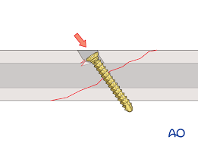
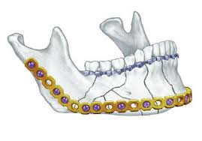
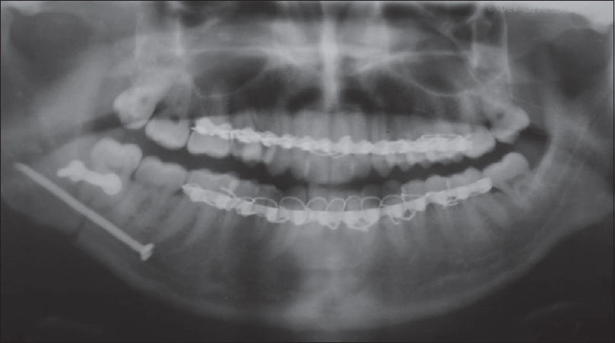
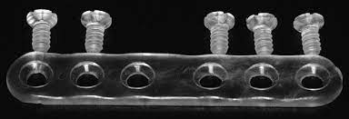
PRINCIPLE OF OSTEOSYNTHESIS PART II
LAG SCREW OSTEOSYNTHESIS AND RESORBABLE PLATING SYSTEMS
DR.ARCHANA CHAURASIA

Slide 3
CONTENTS
HISTORY
FIXATION
GOALS OF FIXATION
CLASSIFICATION OF FIXATION
LAGSCREW FIXATION AND ITS PRINCIPLE
RECONSTRUCTION PLATES
BIO-RESORBABLE PLATES
COMPLICATIONS OF FIXATION OF FRACTURES
CONCLUSION
REFERNCES

Slide 4
HISTORY OF MAXILLOFACIAL FRACTURE
FIXATION
In the preantibiotic era closed reduction of fractures was the rule for most fractures.
Gilmer reintroduced intermaxillary fixation by wiring in US in 1887.
Most of the nondental fixation techniques used during that time took the form of pins inserted transcutaneously into the mandible and connected externally by a variety of devices.

Slide 5
Following the development of antibiotics, the open treatment of fractures began to be used on a more frequent basis:
Buck -first to place an intraosseous wire in a mandibular fracture in 1847.
Adams in 1942 popularised the use of internal wire fixation.
To overcome the lack of stability at the fracture site provided by intraosseous wiring, more rigid hardware was applied to mandibular fractures.
Intramedullary pinning, first advocated by Major in 1938 was extensively used by McDowell et al for maxillofacial fractures.
Ref : Ellis E. Rigid skeletal fixation of fractures. Journal of Oral and Maxillofacial Surgery. 1993;51(2):163-173.

Slide 6
The surgeon Hansmann (1886) was the first to develop and present a procedure for subcutaneous fixation of bone fragments with a plate screw system.
Up to 1886, Hansmann had treated 21 bone fractures and pseudarthroses with this method.
Two of these were mandibular fractures making him the first to perform a plate osteosynthesis on the mandible.
Lambotte (1907)-established the term osteosynthesis.
. Ref : Sauerbier S, Schön R, Otten J, Schmelzeisen R, Gutwald R. The development of plate osteosynthesis for the treatment of Fractures of the mandibular body – A literature review. Journal of Cranio-Maxillofacial Surgery. 2008;

Slide 7
HISTORY OF BONE PLATING
Compression plating:
Luhr introduced ‘‘compression osteosynthesis’’ of the mandible.
In 1969, the AO/ASIF introduced a Dynamic Compression Plate (DCP) for limb surgery.

Slide 8
Spiessl modified these plates to match the dimensions of the mandible and applied them clinically.
The plates modified by Niederdellmann and Schilli (1972, 1973) possessed two holes located close to the fracture gap for screws to build up axial pressure – Eccentric Dynamic Compression Plates.

Slide 9
LAG SCREWS:
First introduced to maxillofacial surgery by Brons and Boering in 1970, who cautioned that at least two screws are necessary to prevent rotational movement of the fragments in oblique fractures of the mandible.

Slide 10
RECONSTRUCTION PLATES:
Raveh et al. (1987) introduced a reconstruction plate system made of titanium which enabled the heads of the screws to lock into the holes of the plate-THORP( Titanium-coated Hollow Screw and Reconstruction Plate System).
A similar, but smaller reconstruction plate was developed in the mid 1990s by the AO/ASIF, the UniLOCK 2.4 (Universal Locking Plate).

Slide 11
MINIPLATE OSTEOSYNTHESIS:
Small finger plates, originally utilized in hand surgery, were inserted for mandibular fractures by Brons and Boering (1970).
Michelet et al. (1973) applied vitalliumminiplates in more than 300 mandibular fractures. He placed the material along the tensile trajectories and inserted monocortical screws to avoid injury to the tooth roots.
Postoperatively, mandibulo-maxillary immobilization was not necessary in most cases.
Champy et al. (1975, 1976, 1977, 1978) modified this method to make it clinically more applicable-outlined the zones of Ideal osteosynthesis.

Slide 12
FIXATION
Reduced fracture fragment in their normal anatomical relationship to prevent displacement and achieve proper approximation.
GOALS OF FIXATION
Reduction of bone fragments
Stable fixation
Preservation of blood supply
Early And Safe functional mobilization

Slide 13
Implications for biomechanics of internal fixation
Fixation of fractures done for:
Restoration of tension and pressure trajectories
Neutralization of functional stresses developing in the bone
CONCEPTS IN FRACTURE FIXATION:
Direct vs Indirect fixation
Rigid vs Non-Rigid fixation vs semi-rigid fixation
Compression vs non-compression osteosynthesis
Load bearing vs load sharing osteosynthesis

Slide 14
Direct vs indirect fixation
Direct fixation- fracture fixation implant placed directly across the fractured segments after surgical exposure of the fracture site.
Examples –interosseous wiring, bone plating, lag screws
Indirect fixation- adjacent structures used as anchorage to immobilise the fractures fragments in anatomical position
Examples – dental wiring for maxillomandibular fixation, internal skeletal suspension, cap splints, gunning splints

Slide 15
Rigid versus Non-rigid fixation
RIGID FIXATION
INDICATIONS:
Any form of fixation applied directly to the bones which is strong enough to prevent interfragmentary motion across the fracture when actively using the skeletal structure.
To rigidly stabilize fractures, an operative procedure is necessary
Fractures undergo healing by primary or direct union.
Fracture in atrophic edentulous mandible
Concomitant fractures of the body and condyle when early mobilization is required
Continuity defects
Non-union or malunion

Slide 16
Rigid versus Non-rigid fixation
RIGID FIXATION
Examples:
Large compression plate in combination with arch bar
Two bone plates for mandibular fractures
Two lag screws inserted across a symphysial fractures

Slide 17
NON-RIGID FIXATION:
There is mobility of the osseous fragments during active use of the skeletal structure following application of internal fixation devices.
Only partial stabilization of bone fragments, torsional or shear stress not neutralized.
Additional form of fixation like IMF is usually required.
Examples – inter-osseous wiring

Slide 18
Semi-rigid or Functionally stable fixation
Form of non-rigid fixation that are strong enough to allow active use of the skeleton during the healing phase but not of sufficient strength to prevent inter-fragmentary mobility.
Adequate stability to allow function.

Slide 19
Load bearing vs Load sharing osteosynthesis
LOAD BEARING FIXATION:
Load-bearing fixation is a device that is of sufficient strength and rigidity that it can bear the entire load applied to the mandible during functional activities.
Indications:
Comminuted fractures of the mandible,
Those fractures where there is very little bony interface because of atrophy
Those injuries that have resulted in a loss of a portion of the mandible (defect fractures)

Slide 20
The most commonly used load-bearing device is a mandibular reconstruction bone plate (relatively large, thick, and stiff)
When secured to the fragments on each side of the injured area by a minimum of three bone screws, reconstruction bone plates can provide temporary stability to the bone fragments.

Slide 21
Load sharing osteosynthesis
Insufficient stability to bear all of the functional loads applied across the fracture by the masticatory system.
Requires solid bony fragments on each side of the fracture that can bear some of the functional loads.
Indicated for simple linear fractures without any bony defect:
2mm miniplate systems,
Lag screw techniques

Slide 22
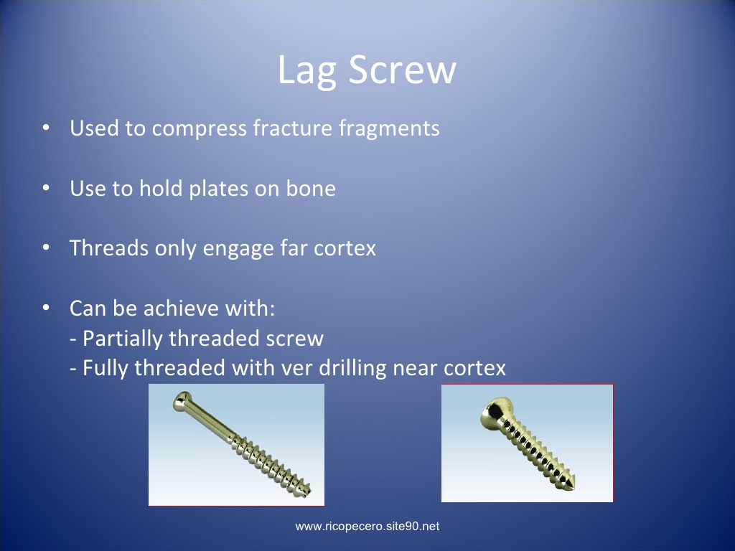
LAG SCREW
Defined as the stable union of two bone fragments under pressure with the help of screws inserted in lag fashion.
Compress fracture fragments without the use of bone plate
Two sound bony cortices are required -- Shares the loads with the bone
Oblique fracture
Symphyseal fractures
Fixation of bone grafts
Sagittal split osteotomies

Slide 24
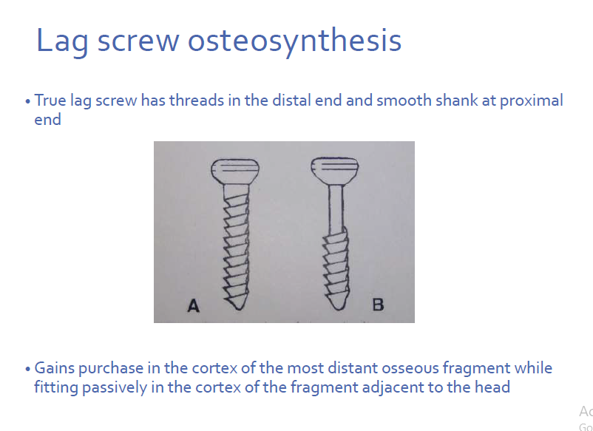

Slide 25
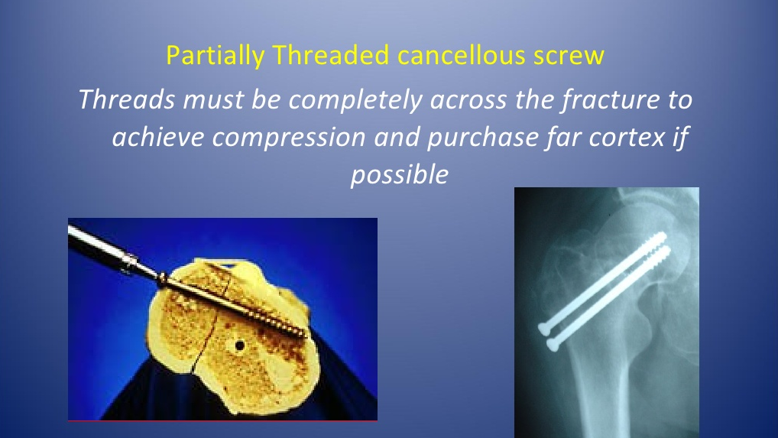

Slide 26
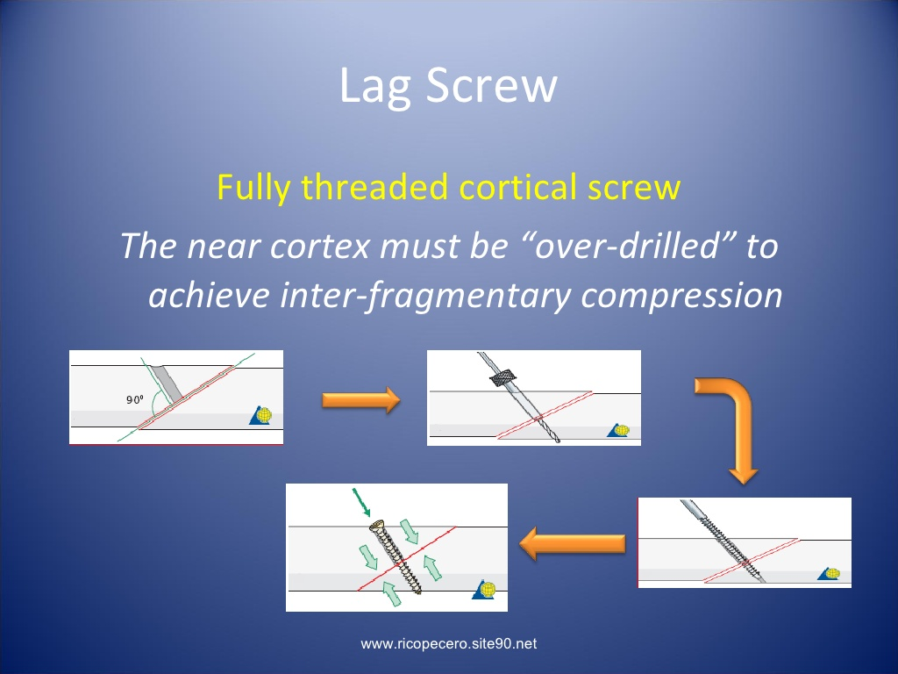

Slide 27
PRINCIPLE
A screw that glides through the cortex of one fragment and engages the cortex of the opposite fragment with its thread, draws the fragments together and compresses them when tightened.
Gliding hole in one segment, thread hole in other.

Slide 28
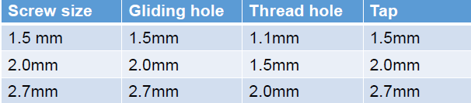
Cortical screw
Head & shank
Screw head-Cruciform or hexagonal slot
The diameter of the gliding hole must correspond to the thread diameter & thread hole must correspond to the core diameter of the screw used.
Contact between screw head & bone produce a pressure point
Should be inserted in lag fashion whenever possible

Slide 29
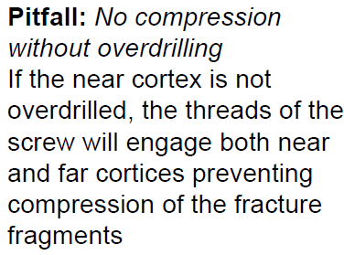

Slide 30
Avoid shearing of the fragments
The screw holes for lag screws should be drilled perpendicular to the fracture line & perpendicular to the bone surface.
Contraindication – comminuted fractures
Notes:
To prevent overriding and displacement during tightening of screws
To avoid secondary dislocation

Slide 31
Lag Screw Technique
Drill the near cortex to the external diameter of screw.
Oblique surfaces:
1. orient the drill perpendicular to the near cortex to create an initial hole
2. drilling obliquely to the surface of the bone

Slide 32
Lag Screw Technique
Countersink near cortex (preparation of bed for screw head)
The hole created by the countersinking tool provides a platform into which the undersurface of the head of the screw will intimately contact when the screw is tightened.
Should be done by hand instrumentation.
Notes:
It allows full contact between screw head and bone thus minimizing the risk of microfractures of cortex

Slide 33
Lag Screw Technique
No countersinking:
Displace the fracture fragments upon tightening the screws
Too much countersinking:
Head will enter the medullary space and provide no compression of the fracture fragments.

Slide 34
Lag Screw Technique
Drill the far cortex to the inner diameter of the screw using “centering” drill guide.
This drill guide has an extension on its tip that is the same diameter as the external diameter of the screw.
It is imperative that the fracture fragments be properly reduced prior to drilling through the far cortex.

Slide 35
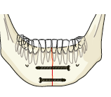
LAG SCREW OSTEOSYNTHESIS
It is another type of compression osteosynthesis. Typically two 2.4 mm lag screws are used to avoid torsion and for better stability, but one 2.4 mm lag screw in combination with a tension band splint can be sufficiently rigid.
If two lag screws are used, one screw is placed at the inferior border while the second screw is placed a few millimeters superior to the first screw at a safe distance from the tooth roots

Slide 36
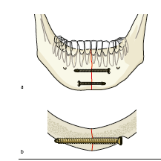
LAG SCREW OSTEOSYNTHESIS
First the fragments are reduced. The gliding hole for the first screw is drilled using a 2.4 mm drill bit and a 2.4 mm drill guide for soft-tissue protection
Gliding hole only penetrates the proximal fragment. It ends at the fracture surface, creating a canal in which the screw glides.
After completion of the gliding canal, a second canal in the opposite fragment is drilled using a 1.8 mm drill bit and a 1.8 mm drill guide.

Slide 37
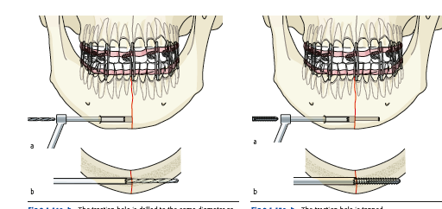
LAG SCREW OSTEOSYNTHESIS
A 1.8 mm drill guide is inserted into the gliding hole to determine the correct direction for drilling.
The depth is measured with a depth gauge, then the 1.8 mm canal is tapped
The cortical bone on which the screw head is going to engage is countersunk to allow the screw head to snuggly fit onto the bone, thus avoiding microfractures within the cortical layer during tightening and reducing palpability.

Slide 38
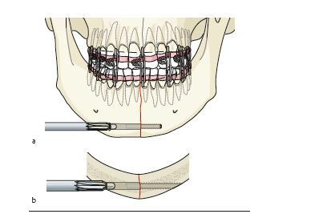
LAG SCREW OSTEOSYNTHESIS
Finally, the first screw is inserted and fully tightened.
Second screw is inserted using the same technique.
It can be placed in the same direction or from the opposite side. It does not matter which screw is inserted first but the second hole must be drilled only after the first screw is tightened.

Slide 39
Lag Screw Technique
The drill guide centers the drill the far cortex with the hole through the near cortex.
This drill diameter that is similar to the inner diameter of the screw.
For eg- 2.4 mm screw, a 1.8 mm drill is used to drill the far cortex.
Notes:
repeatedly withdrawn the drill so that the irrigant effectively cools the tip of the drill and washes away bony debris

Slide 40
Lag Screw Technique
Determine the screw length:
A tip of the screw completely engages the far cortex.
It is always better to select a screw that is slightly longer than the measurement recorded with the depth gauge.

Slide 41
Lag Screw Technique
Screw insertion
Properly applied lag screw resulting
in inter-fragmentary compression.

Slide 42
ADVANTAGES
DISADVANTAGES
Absolute rigid fixation
Less hardware
More cost effective
Rigid method of internal fixation
Insertion -quicker and easier
Reduction more accurate
Loosening of screw
Damage to bone
Mobility of fragments
Incidence of pain
Infection

Slide 43
RECOSTRUCTION PLATES
Load bearing
They are thickest plate can be used without tension band
Plate can be bended by 15˚without distortion of plate holes 8mm in width 2.7 mm and 3.2mm thick.
Straight plate with 6-24 holes mandible angle plate 4,6,8 holes
Reconstruction plate is strong enough to overcome the functional load as well as to counteract the masticatory forces & provide primary stability

Slide 44
The plate must be long enough so that there can be a minimum of three or preferably four screws on each side of the fracture.
The screws adjacent to the fracture should be at least 7 mm away from the fracture line.
2.0 mm plate with bicortical screw used in conjunction with lag screws or miniplates.
Defect fractures can be treated(comminuted, mandibular angle)
Provides stability and support to fracture segments as the fracture heals.

Slide 45
Screws:
2.7mm cortex screw is used
Full threaded screw as the same diameter from head to tip
Thread has saw tooth profile wth flat bearing surface at the right angle to screw axis.
Hemispherical screw head with hexagonal recess
Angle ± 25˚ axially and ±7˚transversely
Length 6-40mm
Emergency screw

Slide 46
DISADVANTAGES
Screws in these large plates may cause another fracture upon
Screws can fail by stripping the bone
Inflammation
Bony necrosis
Injury to the inferior alveolar nerve

Slide 47
THORP (Titanium hollow osseointegrated reconstruction plate)
Developed to fulfill the requirement of total ooseointegration and long term functional stability
Types of plate
1. Pre-bent
2. Straight
3. Attachment with TMJ prosthesis

Slide 48
Plate thickness 3 mm
Reconstruction plate is notched between the 4.0 mm- diameter holes
To prevent deformation of the plate holes when the plate is bent
Plastic insert in the bolts for retention
Expansion bolt is applied to the head screw
Plates can be easily bent in any direction without deformation of the holes
Spread the strain over a greater length on bending and reduced possibility of plate failure
To prevent any deformation of plate holes, metal bolts are inserted before the plate bent.

Slide 49
Screws ( two types)
1. Titanium plasma-coated, perforated hollow screw
2. Titanium full-body screw
Cylindrical screw head
Screw diameter
4.5mm for hollow screw
3.5 to 4mm for full body screw
Thread depth 0.5mm
Implant volume low for osseointegration
Screw surface coated with 0.04mm with argon titanium plasma spray
Pitch- 1.25- 1.50 mm

Slide 50
ADVANTAGES
DISADVANTAGES
Plate removal is difficult
Plate fracture
Skin perforation
Mucosal dehiscence
Rigid fixation of screw to the plate
Stability to fractured bone segments without applying pressure to underlying bone
Prevents focal ischemia, bone necrosis,
screw loosening and plate mobility
Promotes osseointegration
Reducing the of infection & malunion

Slide 51
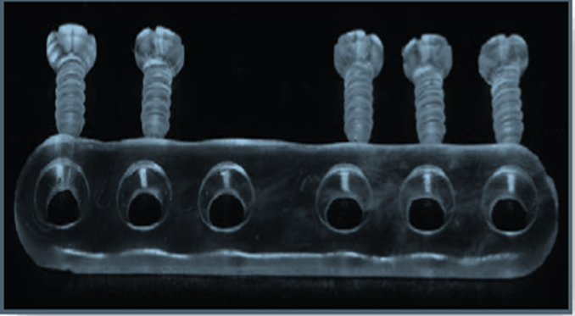
BIORESORBABLE PLATES
Metallic plates- growth restriction and plate translocation
Bio resorbable materials used for rigid fixation
Polydioxanone
Polyglycolic acid
Polylactic acid
The plates used will resorb over a period ranging from 2 to 4 years

Slide 52

ADVANTAGES
Degradation of the material by citric acid cycle into CO2 and H2O
No interference with imaging (CT, MRI, standard radiographs)
No effect on postoperative radiation treatment
The possibility of integrating substances such as antibiotics within the fixation material
Reduce the total treatment & rehabilitation time of the patient.
Adequate stability to achieve bone union
Small
No need for an additional removal operation.

Slide 53
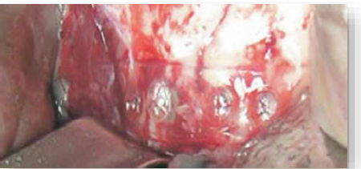
DISADVANTAGES:
Less mechanical strength when compared with titanium alloys of similar sizes
“Memory” of the material, which may distort reduction of fracture
Increased reactivity & inflammatory response during the degradation phase
Increased operative working time
Greater diameter
Screw breakage
High cost
Long resorption time
Less stable than conventional systems
No radiopacity

Slide 54
Complications of fracture fixation
Infections
Nerve injuries
Malunion
Restriction of craniofacial growth
Hypertrophic scar formation
Injury to tooth roots

Slide 55
CONCLUSION
It has been demonstrated that absolute rigid fixation is not necessary for successful healing.
In fact it has been shown that the additional plates necessary to establish absolute rigidity may actually increase the complication rate.
The rapid increase in bioresorbable technology has led to the introduction of many successful resorbable plating systems that do not meet the criteria for rigid fixation, and some of the plating manufacturers are even introducing semi rigid fixation that is intentionally designed to allow minor post fixation manipulation.

Slide 56
Current clinical techniques using titanium or resorbable plating systems may not meet the definition of rigid fixation yet are capable of providing clinically adequate fracture stability. Ellis has used the term "functionally stable fixation"

Slide 57
REFERENCES:
Oral and maxillofacial trauma – Fonseca (third edition) Maxillofacial injuries – Rowe and Williams
Peterson’s principals of oral and maxillofacial surgery-2nd edition
Oral and Maxillofacial traumatology-Kruger,Schilli
Principles of internal fixation of craniomaxillofacial skeleton and orthognathic surgery-AOCMF

Slide 58


