Slide 2
ORBIT AND ITS CONTENTS
Dr. Archana Chaurasia

Slide 3
CONTENTS
Anatomy of Orbit
Size, Shape and Relations of the Bony Orbit
Walls of Orbit
Bones of Orbit
PeriOrbita and Orbital Fascia
Orbital Fat
Contents Of Orbit
Nervous and Vascular Supply of orbit
Eyeball and its parts
Muscles of eye

Slide 4
ORBIT ANATOMY
Quadrangular truncated pyramids
Situated between the anterior cranial fossa above and the maxillary sinus below.

Slide 5
Each orbit is formed by seven bones : frontal, ethmoid, lacrimal, palatine, maxilla, zygomatic and sphenoid.

Slide 6
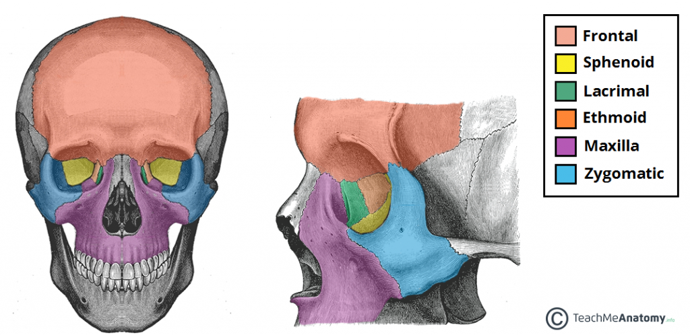
BONES OF ORBIT

Slide 7
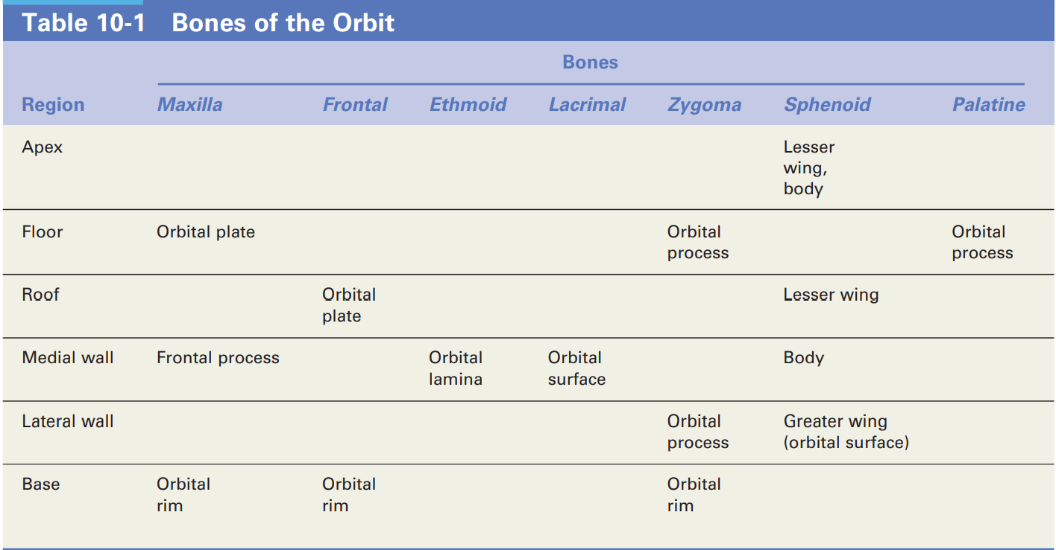

Slide 8
WALLS OF THE ORBIT
Notes:
Alongwith base and apex

Slide 9
ROOF
It is concave from side-to-side.
Formed by the frontal bone and the lesser wing of the sphenoid. The frontal bone separates the orbit from the anterior cranial fossa.
Relations:
1. It separates the orbit from the anterior cranial fossa.
2. The frontal air sinus may extend into its anteromedial part.
Notes:
(superior wall)

Slide 10
APPLIED ANATOMY
Thin and periorbita peels away easily
Objects piercing upper eyelid penetrate roof and damage frontal lobe
In old age roof may be absorbed so that periorbita and duramater comes into contact
Any trauma of dura mater and CSF escapes into orbit/nose/both

Slide 11
LATERAL WALL
This is the thickest and strongest of all the walls of the orbit.
Formed By:
1. the anterior surface of the greater wing of the sphenoid bone, posteriorly
2. By the orbital surface of the frontal process of the zygomatic bone, anteriorly.
Relations:
The greater wing of the sphenoid separates the orbit from the middle cranial fossa.
The zygomatic bone separates it from the temporal fossa.

Slide 12
More anteriorly, the wall is marked by the zygomatic groove and foramina (which are traversed by the zygomatic nerve and vessels)
On the anterior part of the wall there is a projection, the lateral orbital tubercle of Whitnall.
WHITNALL’S TUBERCLE: It gives attachment to the check ligament of the lateral rectus muscle, Levator palpebral superioris,Lateral palpebral ligament and to the suspensory ligament of the eyeball. The lateral wall posteriorly is separated from the roof by the superior orbital fissure and from the floor by the inferior orbital fissure

Slide 13
Clinical applications of lateral wall-
The lateral wall of the orbit protects only the posterior half of the eyeball.
The anterior half of globe is not covered by bone on the lateral side.
Hence palpation of retrobulbar tumours is easier from the lateral rather than from the nasal side of the eyeball.

Slide 14
MEDIAL WALL
It is very thin.
From before backwards, it is formed by:
The frontal process of the maxilla
The lacrimal bone
The orbital plate of the ethmoid
The body of the sphenoid bone
Relations:
1. The lacrimal groove, formed by the maxilla and the lacrimal bone, separates the orbit from the nasal cavity.
2. The orbital plate of the ethmoid separates the orbit from the ethmoidal air sinuses.
3. The sphenoidal sinuses are separated from the orbit only by a thin layer of bone.

Slide 15
APPLIED ANATOMY
Since it is thinnest, ethmoiditis is the commonest cause of orbital cellulitis, especially in children
Frequently eroded by chronic inflammatory lesions, neoplasms, cysts
It is easily fractured during trauma and during orbitotomy operations

Slide 16
FLOOR
It slopes upwards and medially to join the medial wall.
It Is formed:
Mainly by the orbital surface of the maxilla .
By the lower part of the orbital surface of the zygomatic bone, anterolaterally.
The orbital process of the palatine bone, at the posterior angle.
Relation:
It separates the orbit from the maxillary sinus.

Slide 17
Clinical applications of the floor-
The orbital floor being quite thin is commonly involved in 'blow-out fractures' and is easily invaded by tumours of the maxillary antrum.
The floor of the orbit is best visualised with standard postero anterior radiographs

Slide 18
BASE OF ORBIT
The anterior open end of the orbit is referred to as base.
It is bounded by the orbital margins
The margins are formed by a ring of compact bone.
It gives attachment to the septum orbitale
The orbital margin can be described under four parts:-
Superior orbital margin
Inferior orbital margin.
Medial orbital margin.
Lateral orbital margin.

Slide 19
APEX OF ORBIT
Orbital apex is the posterior end of the orbit.
Here the four orbital walls converge.
The apex has two orifices: the optic canal and the superior orbital fissure which are situated in the sphenoid bone (where the body, greater wing and lesser wing meet each other)

Slide 20
Notes:
Optic canal: It connects the orbit to the middle cranial fossa. transmits the Optic nerve( surrounded by meninges) and the ophthalmic artery. Its average length is 6- 11 mm (lateral wall is shortest and medial wall is longest)
Superior orbital fissure- ▪ It is a comma shaped aperture in the orbital cavity. ▪ It is bounded by lesser and greater wing of the sphenoid. ▪ It is situated lateral to the optic foramen at the orbital apex. ▪

Slide 21
SUPERIOR ORBITAL FISSURE
Divided into upper, middle and lower parts by the common tendinous ring (for origin of the recti).
The structures passing through the upper and lateral part are the lacrimal and frontal nerves (branches of ophthalmic division of Vth nerve),trochlear nerve, superior ophthalmic vein and recurrent branch of the ophthalmic artery.
The middle part of the fissure (within tendinous ring) transmits the superior and inferior divisions of the oculomotor nerve, the nasociliary branch of the ophthalmic division of the trigeminal nerve and the abducent nerve.
The lower and medial part of the fissure transmit the inferior ophthalmic vein

Slide 22
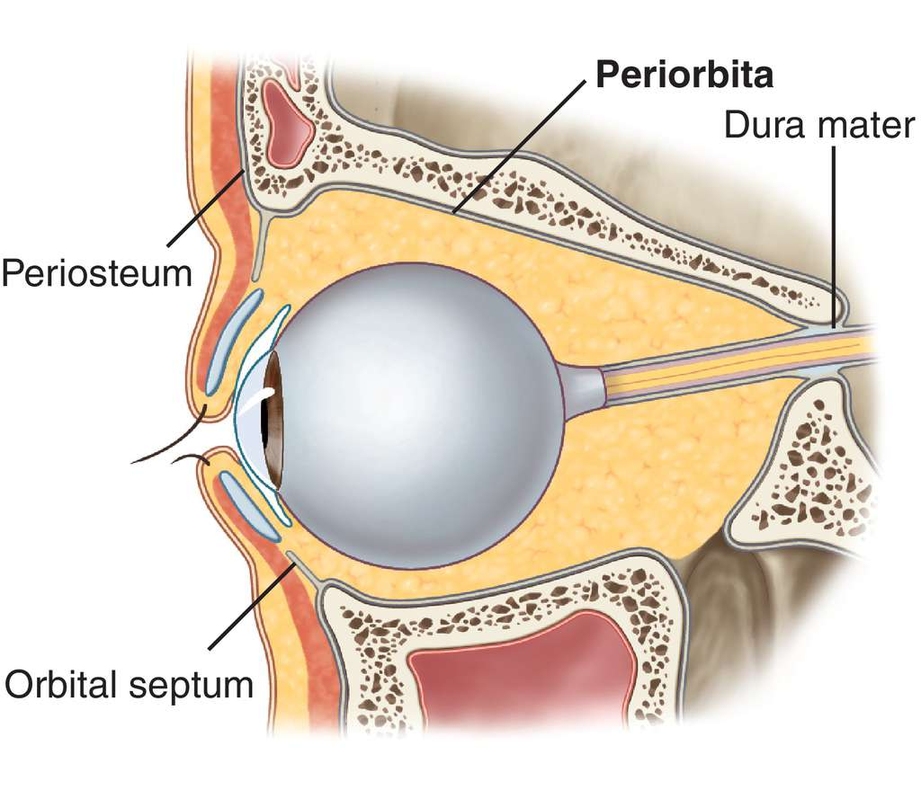
PERIORBITA
The periosteum lining the surface of the orbital bones is called the periorbita.
Generally it is loosely adherent to bone.
However, it is firmly adherent at the orbital margin, superior and inferior orbital fissures, the optic canal, the lacrimal fossa and at the sutures.
Notes:
Posteriorly, it is continuous with the dura mater and with the sheath of the optic nerve. Anteriorly, it is continuous with the periosteum lining the bones around the orbital margin

Slide 23
ORBITAL FASCIA
It is a complex interwoven thin connective tissue membrane joining the various intra-orbital content.
Fascia bulbi
Membranous expansions of the extraocular muscles
Ligament of Lockwood.

Slide 24
Fascia bulbi, or Tenon's capsule is a loose membranous sheath envelops the eye ball from the optic nerve to the sclero-corneal junction.
It is separated from the sclera by the episcleral space which is traversed by delicate fibrous bands. The eyeball can freely move within this sheath.
It is separated from the sclera by the epi-scleral space.
The lower part of the fascia bulbi is thickened and takes part in the formation of a sling or hammock on which the globe rests (suspensory ligament of Lockwood)
Notes:
Fascia bulbi is pierced posteriorly ▪ The optic nerve, ▪ Ciliary nerves and vessels, just behind the equator by venae vorticosae, ▪ Anteriorly by six extraocular muscles; where it becomes continuous with the fascial sheaths of these muscles.

Slide 25
Suspensory ligament of Lockwood-
It is a thickened sling or hammock of fascial sheath It extends from the posterior lacrimal crest to the lateral orbital tubercle, on which rests the eyebal.
It is formed by fusion of expansions from the muscular sheaths of the medial rectus, inferior oblique, inferior rectus and lateral rectus muscle joined with the thickened inferior part of Tenon's capsule.

Slide 26
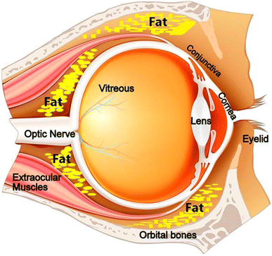
ORBITAL FAT
Most of the orbital cavity is occupied by orbital fat which extends from the optic nerve to the orbital wall and from the apex of the orbit to the septum orbitale.

Slide 27
CONTENTS OF THE ORBIT
1 Eyeball: Eyeball occupies anterior one-third of orbit
2 Fascia: Orbital and bulbar.
3 Muscles: Extraocular and intraocular.
4 Vessels: Ophthalmic artery, superior and inferior ophthalmic veins, and lymphatics.
5 Nerves: Optic, oculomotor, trochlear and abducent; branches of ophthalmic and maxillary nerves, and sympathetic nerves.
6 Lacrimal gland.
7 Orbital fat.

Slide 28
VASCULAR AND NERVE SUPPLY OF ORBIT
ARTERY - ophthalmic artery
VEINS – ophthalmic veins
NERVES
MOTOR NERVES - IIIrd C.N., IVth C.N. VIth C.N.
SENSORY NERVES- 1st and 2nd branches of the Vth .C.N.
Gannglion- Cilliary ganglion.
Notes:
NO LYMPHATIC DRAINAGE

Slide 29
Ophthalmic artery
Branch of internal carotid
Arises when that vessel emerges through the roof of cavernous sinus
Enters orbit through optic canal infero-lateral to Optic nerve.
CENTRAL ARTERY OF RETINA: The first and most important branch, First lie below the optic nerve, Pierces the dural sheath and enters the substance of the nerve. Reach the optic disc divide into branches. It is an end artery
Notes:
-Relations to optic nerve ▪ First infero lateral to optic nerve in a common sinovial sheath of dura mater ▪ In the orbit it pierces dura, winds around and lies on the lateral side of optic nerve ▪ Then Runs Forwards And medially above the optic nerve between the superior ophthalmic vein in front and nasociliary behind
-In the medial wall of the orbit it lies between medial rectus and superior oblique muscles ▪ At the medial end of upper eyelid the artery divides into its two terminal branches: 1. supra trochlear 2. dorsal nasal

Slide 30
Branches to eye ball: central artery of retina & posterior ciliary artery-long and short
Branches to orbital muscles: anterior ciliary arteries
Branches along the lateral wall: Glandular branches, lacrymal artery-two lateral palpabebral arteries, Two zygomatic and recurrent meningial artery
Branches along the medial wall: Posterior ethmoidal artery, anterior ethmoidal artery, medial palpebral arteries, Supra orbital and supra trochlear arteries, & dorsal nasal artery anastamoses with terminal branch of facial artery

Slide 31
OPHTHALMIC VEINS
Superior ophthalmic vein:
Lies in medial part of upper eye lid.
Crosses above optic nerve in company with ophthalmic artery and receives its tributaries
Passes through supraorbital fissure and ends in cavernous sinus
Devoid of valves
At its commencement it communicates with facial vein through angular vein
Inferior ophthalmic vein:
Begins in the floor of the orbit and drains in the cavernous sinus either directly or after joining with superior ophthalmic vein
Communicates with the pterygoid venous plexus through inferior orbital fissure

Slide 33
The optic nerve is the nerve of sight.
It is made up of the axons of cells in the ganglionic layer of the retina.
It emerges from the eyeball 3 or 4 mm nasal to its posterior pole.
It runs backwards and medially, and passes through the optic canal to enter the middle cranial fossa where it joins the optic chiasma

Slide 34
OCCULOMOTOR NERVE

Slide 35
TROCHLEAR NERVE

Slide 36
ABDUCENT NERVE

Slide 37
BRANCHES OF OPHTHALMIC DIVISION OF TRIGEMINAL NERVE

Slide 38
Volume: 30 ml
Ratio of vol. of orbit: volume of globe : 4.5:1

Slide 40
The iris is the most anteriorly placed portion of the intermediate tunic. This circular disc, imparted with color from a deep pigmented layer, possesses two separately arranged layers of smooth muscle whose contractions, when stimulated by autonomic nerves, alter the diameter of the hole in the center of the iris, known as the pupil.

Slide 42
The iris is continuous with the ciliary body and is connected to the cornea at its periphery. Its location, between the lens and the cornea, separates this space into an anterior chamber in front of it and a posterior chamber behind it
A watery fluid, the aqueous humor, is secreted into the posterior chamber the eye by the ciliary body. The fluid passes from this chamber into the anterior chamber through the pupil lying on the anterior surface of the lens. It exits the anterior chamber by draining into the canal of Schlemm, a venous channel located at the junction of the iris and cornea

Slide 44
The choroid, the posteriorly located portion of the intermediate tunic, is a vascular, darkly pigmented layer closely adhering to the sclera and the retina. It is pierced by the optic nerve posteriorly.
The ciliary body is a structure located in an intermediate zone between the choroid and the iris portions of the vascular tunic and extends between the most anteriorly located parts of the retina and the iris

Slide 47
MUSCLES OF THE EYE

